Slide 1
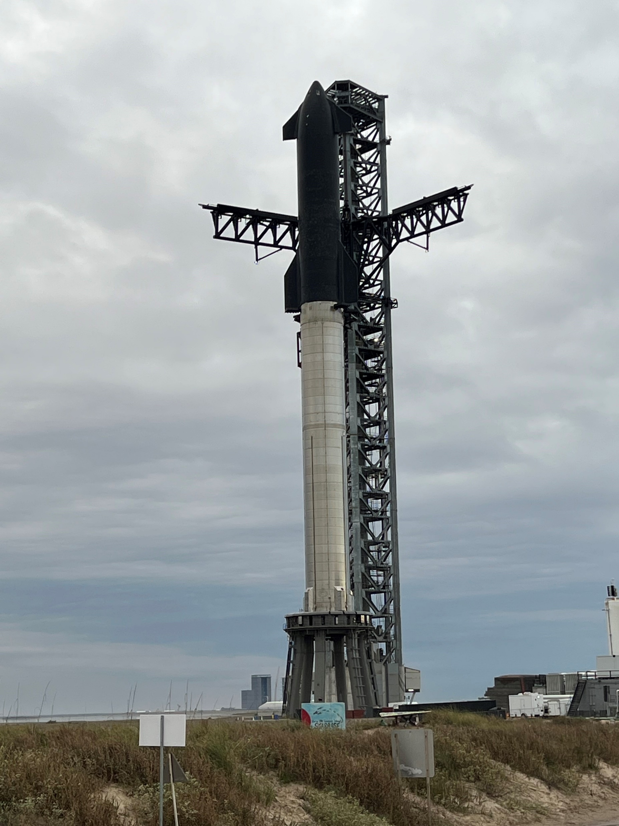
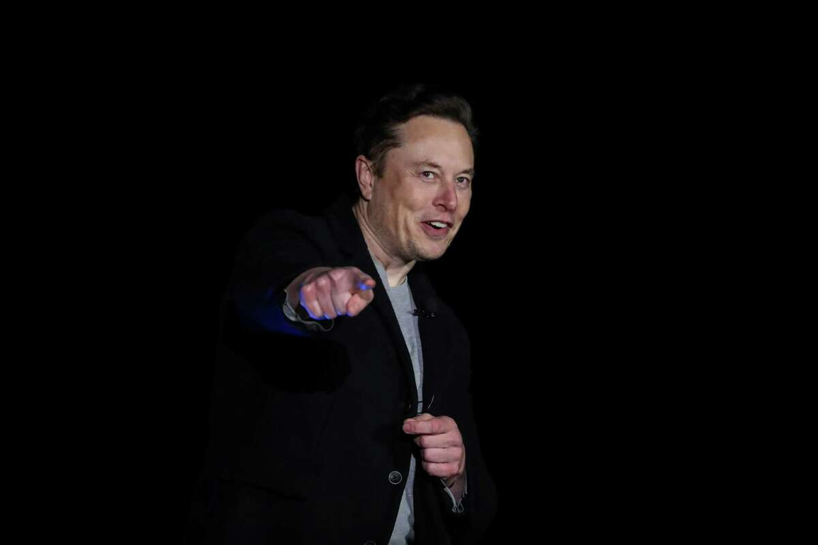
Covering space in 2022

Slide 2
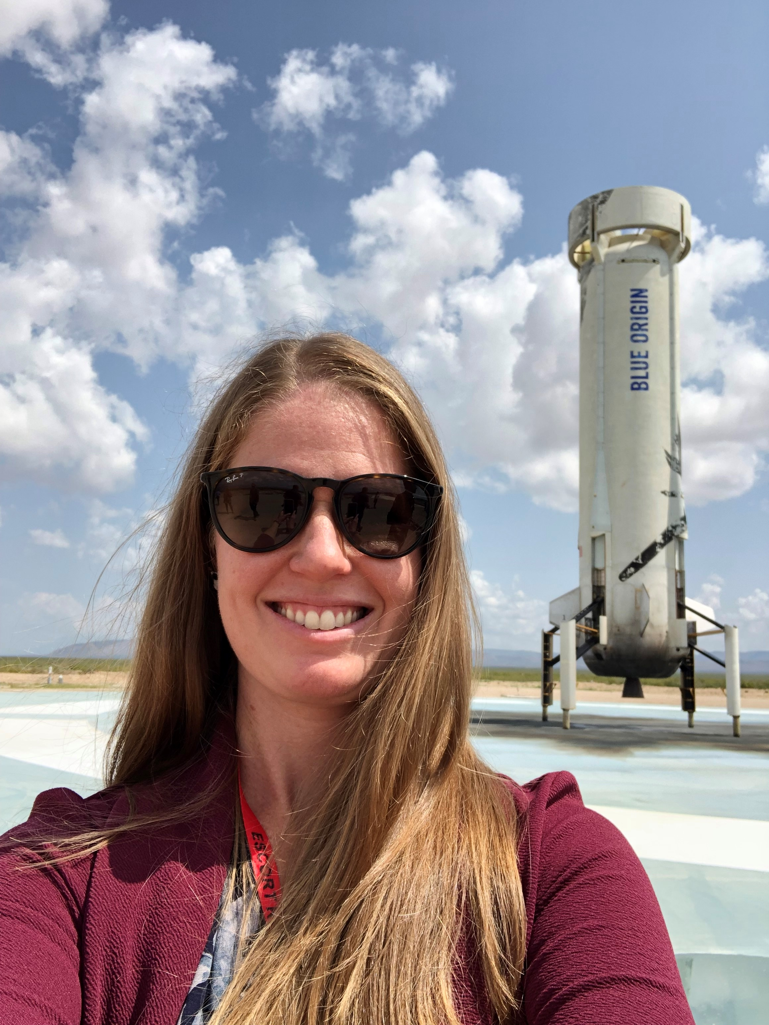
About me

Slide 3
Space is getting busy

Slide 4
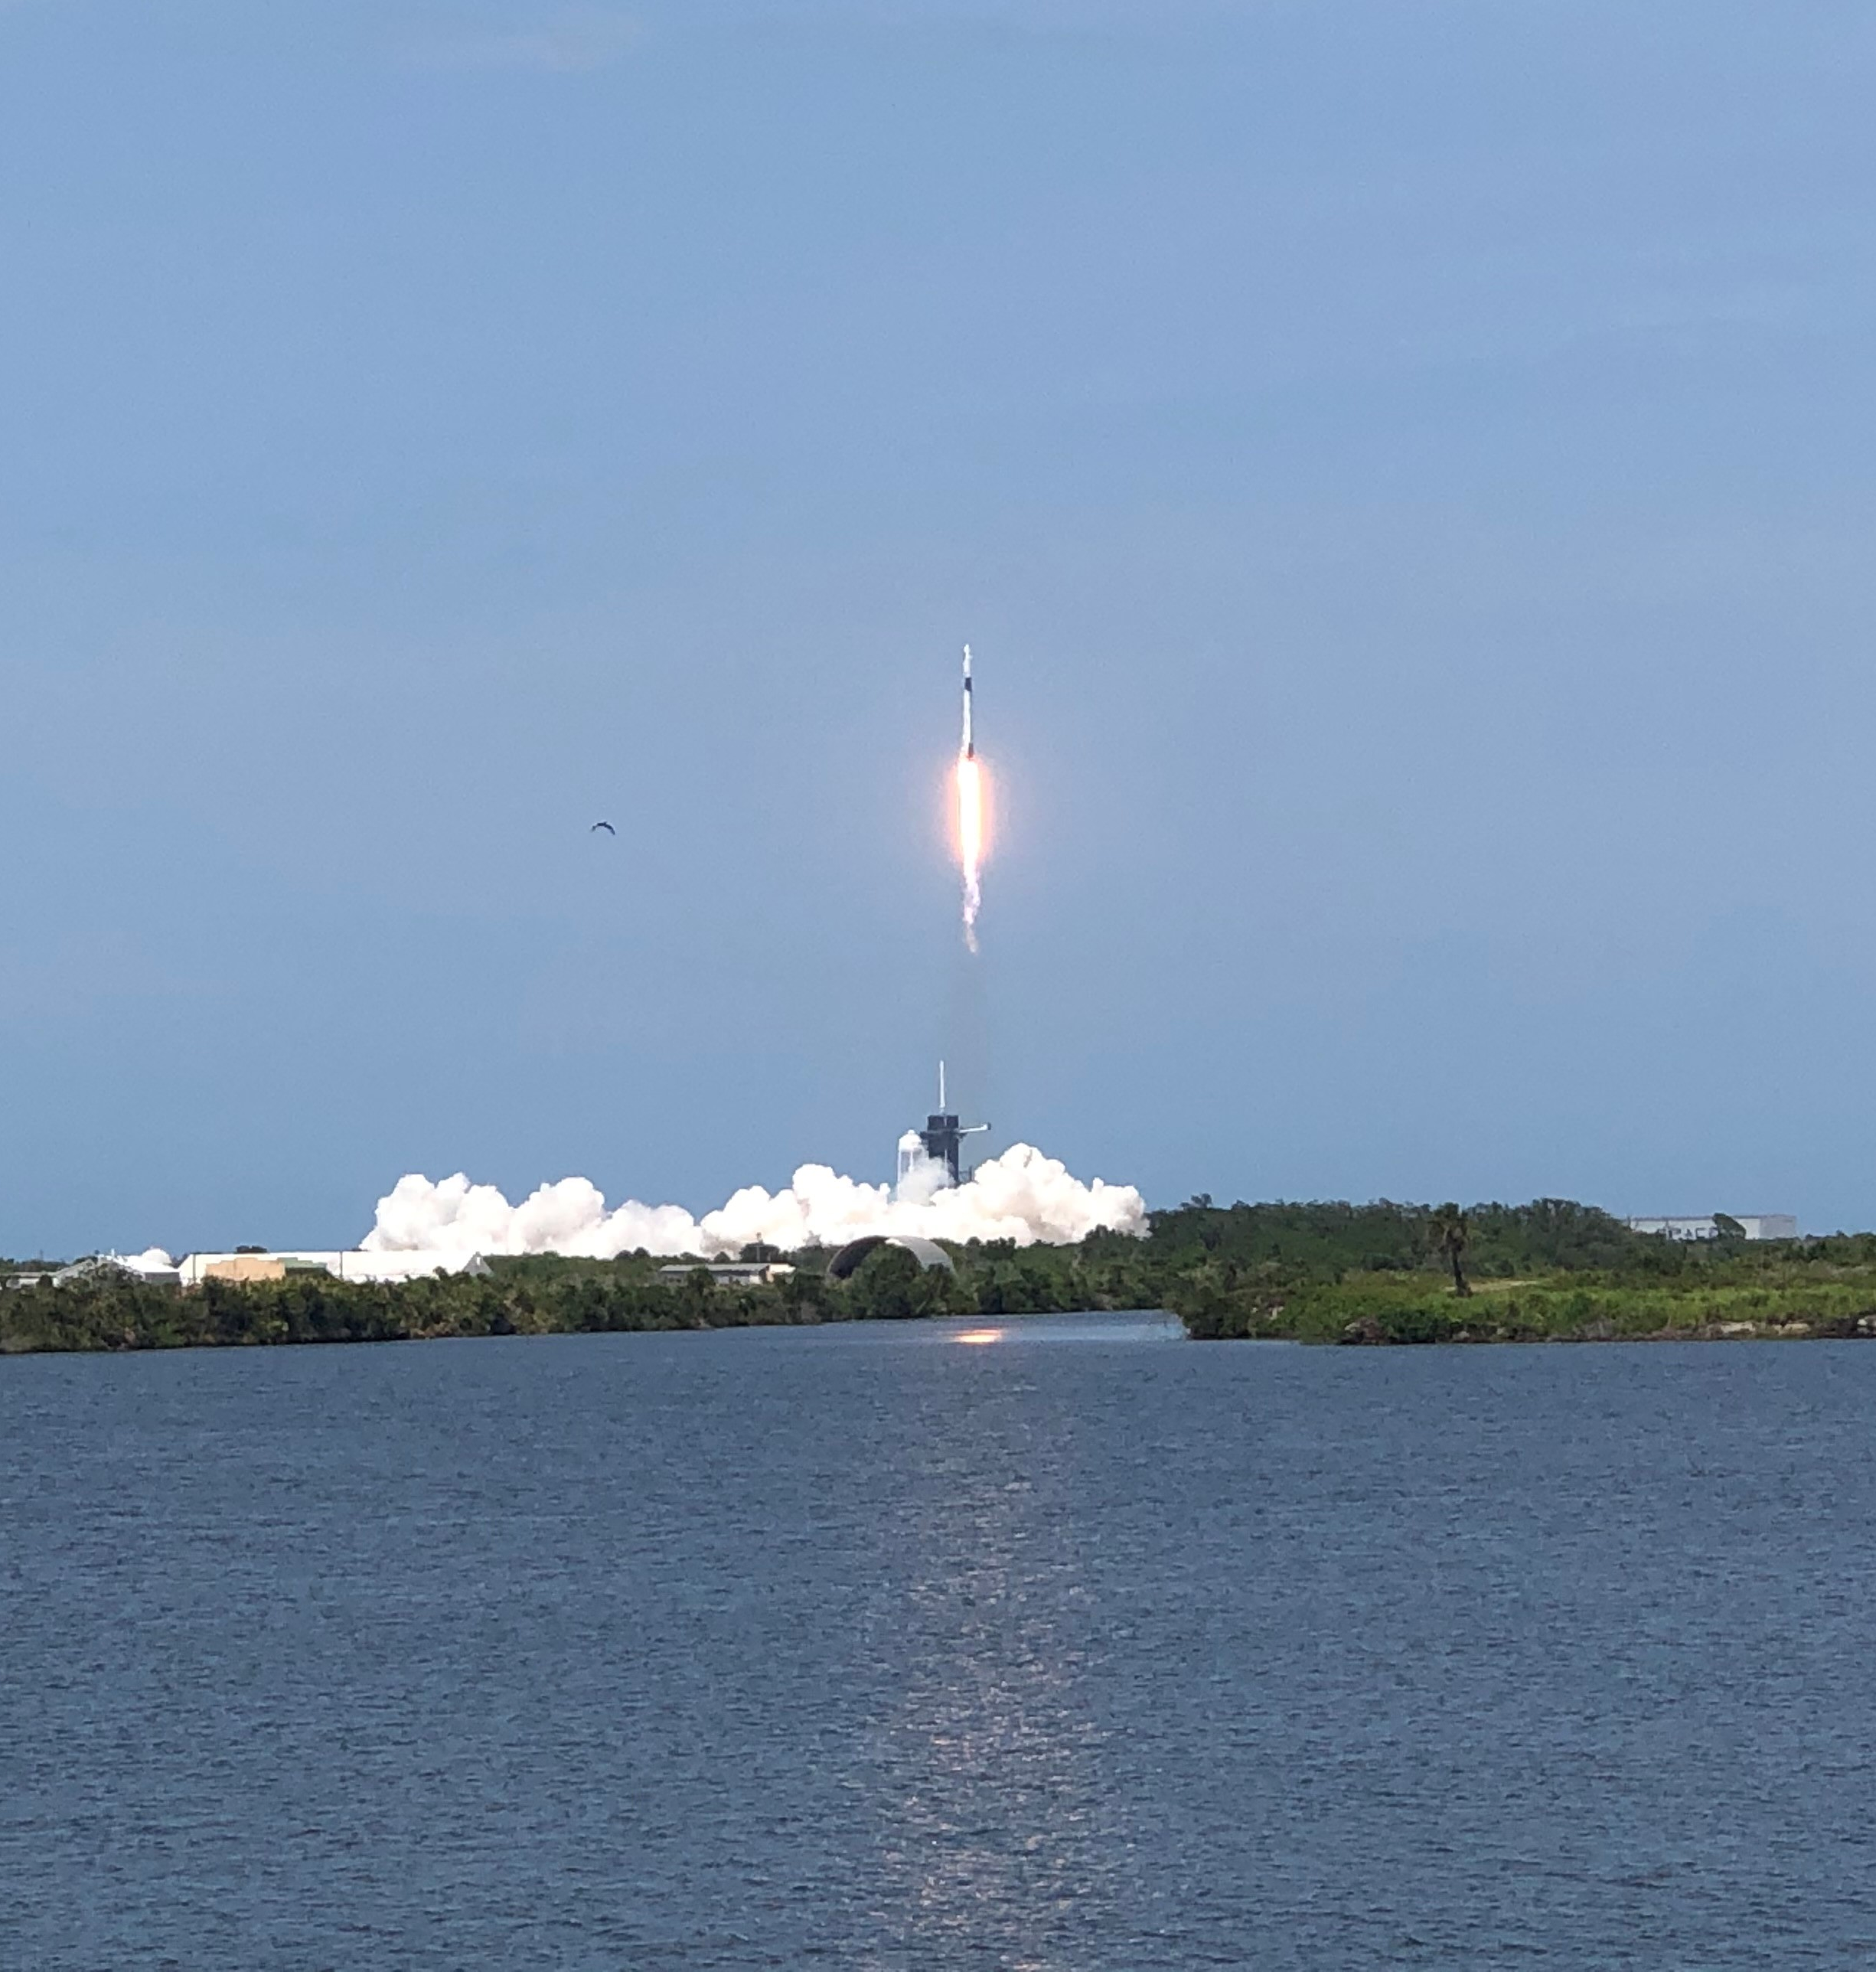
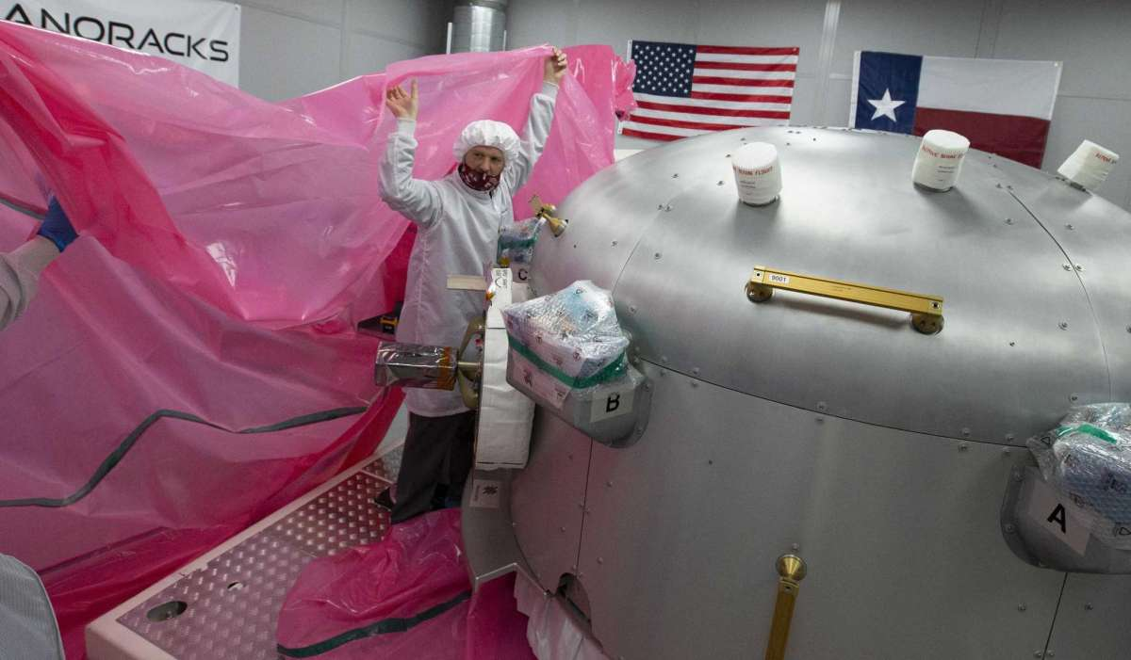
Space is getting busy

Slide 5
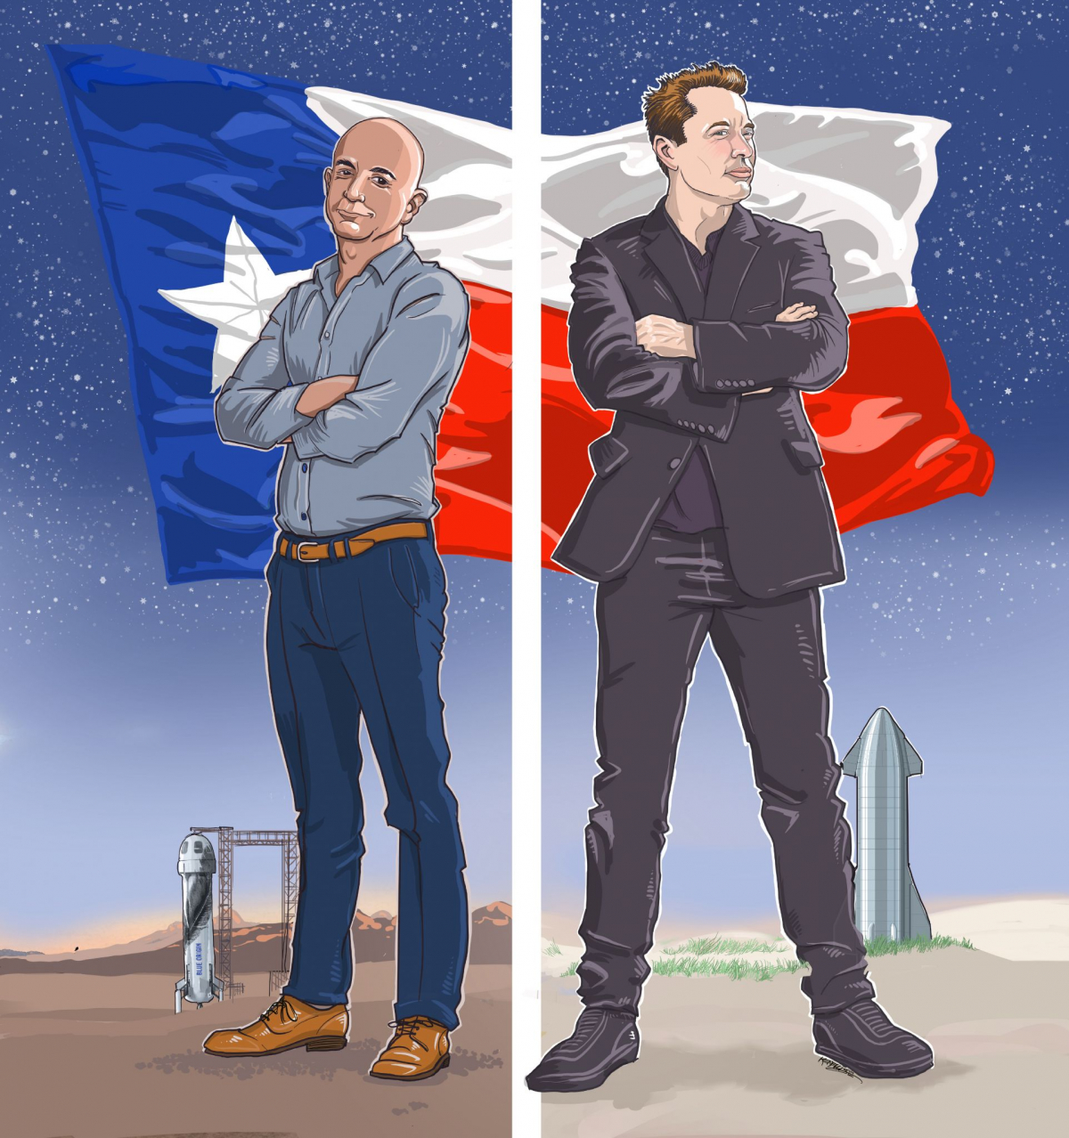
Bigger in Texas

Slide 6
Boca Chica

Slide 7
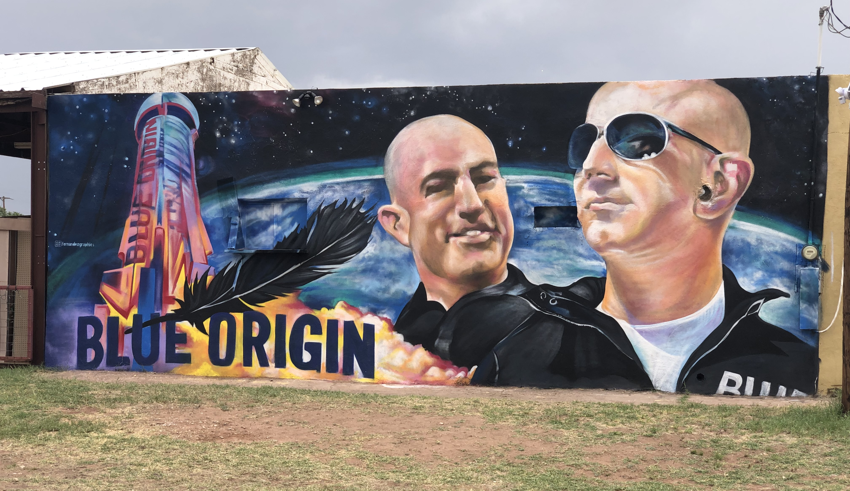
Van Horn

Slide 8
Starship update

Slide 9
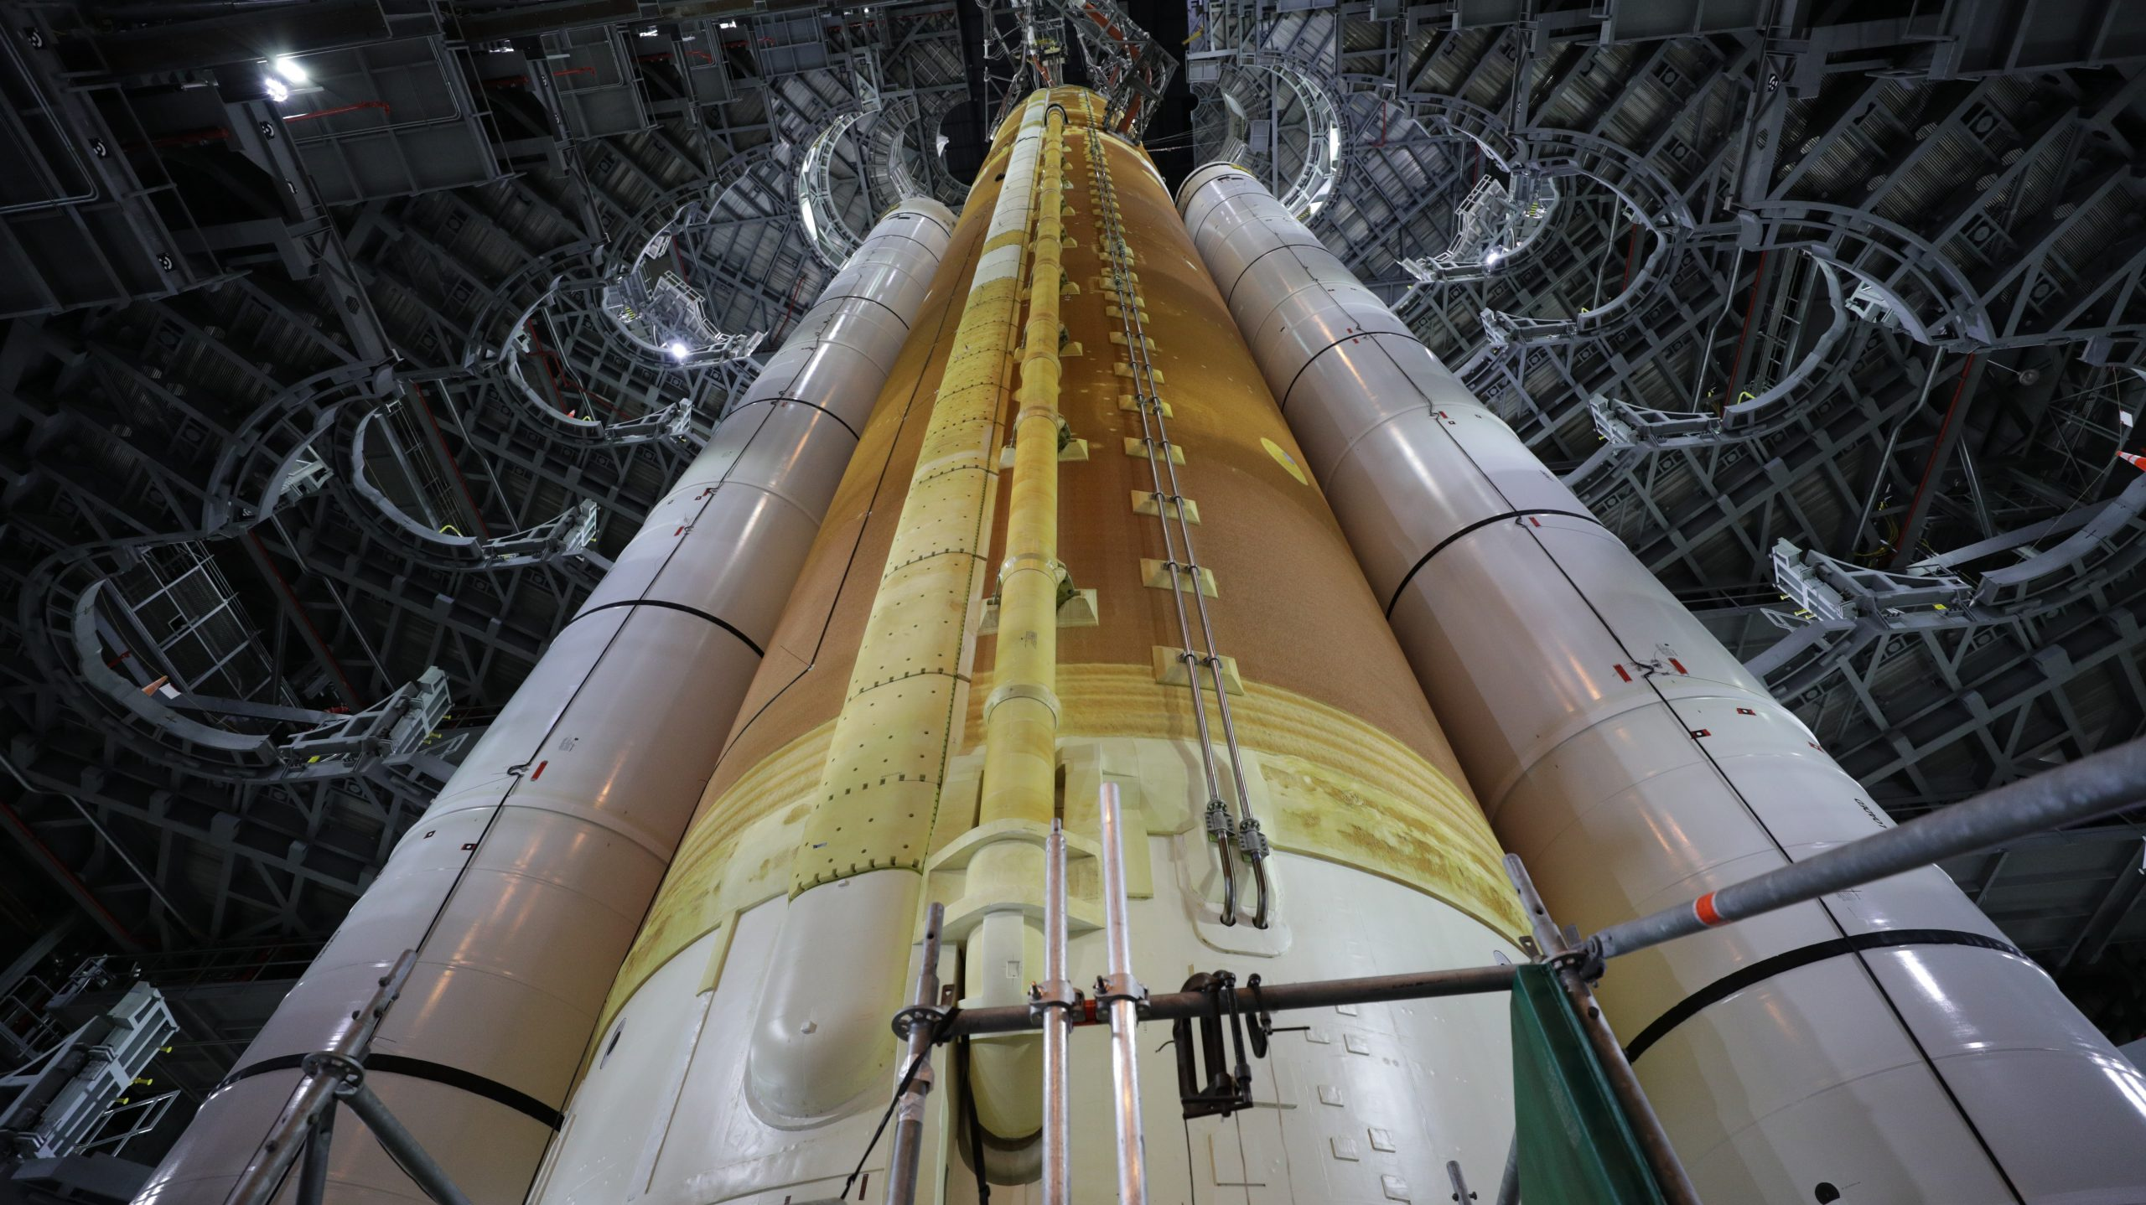
Upcoming missions
Photo credit: NASA/Frank Michaux

Slide 10
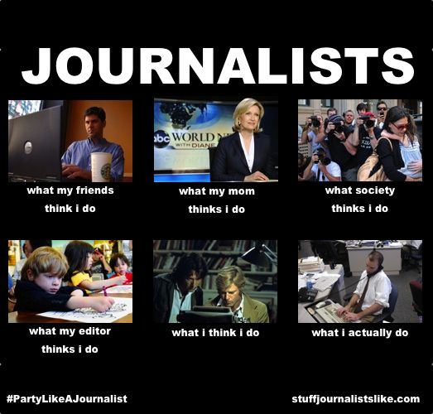
The state of journalism

