Slide 1
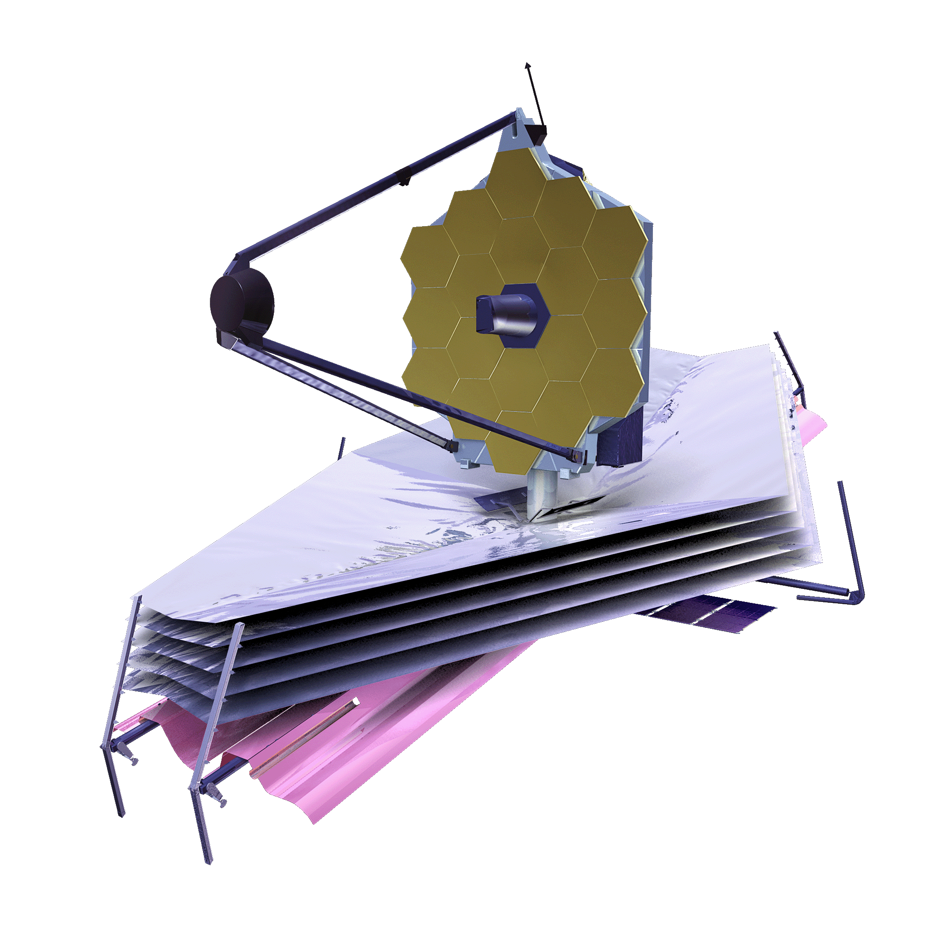
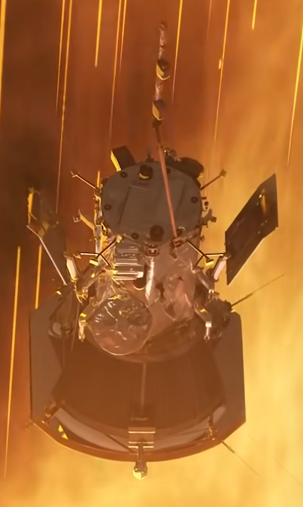
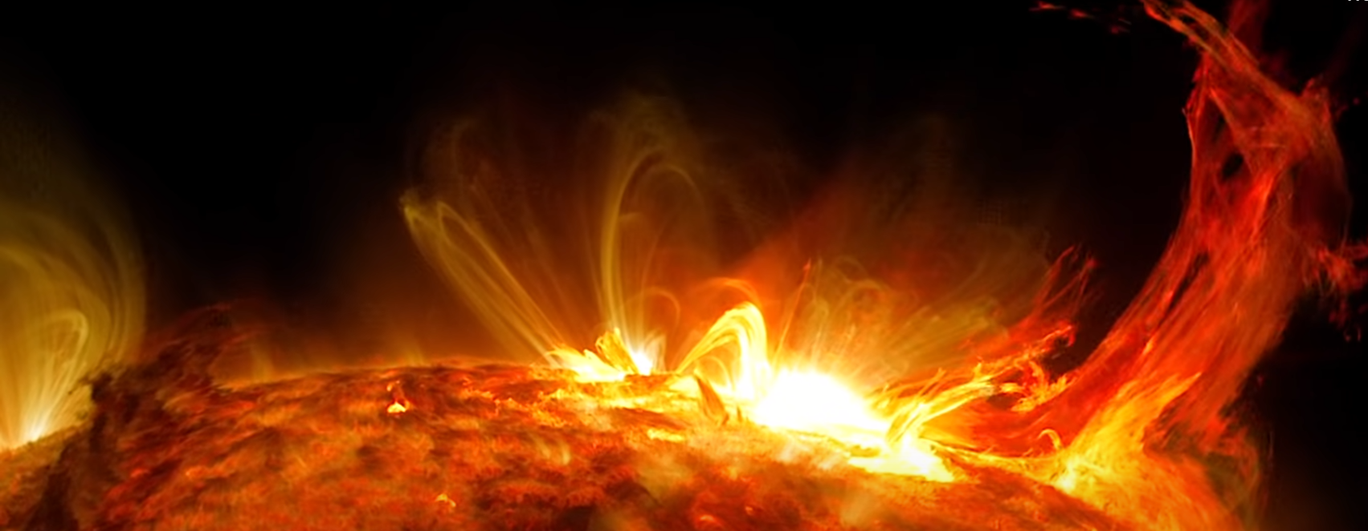
Monthly Space News -- and year end summary
Greg Stanley
Jan. 8, 2022

Slide 2
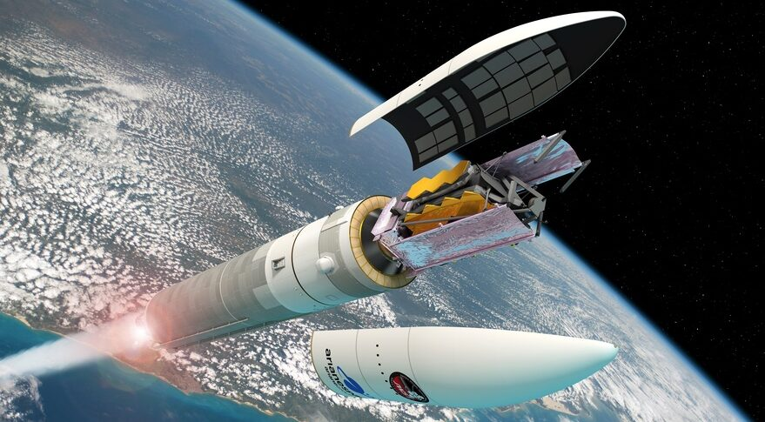
James Webb Space Telescope (JWST) launched
Launched Dec 25 from French Guiana on an Ariane 5 rocket as successor to Hubble Space Telescope
Details covered extensively last month in Doug Hall’s presentation
100x more powerful than the Hubble space telescope
Most risk: complex unfolding and calibration of all its parts, not launch
So far, so good…
Image credit: NASA
Image credit: ESA – D. Ducros

Slide 3
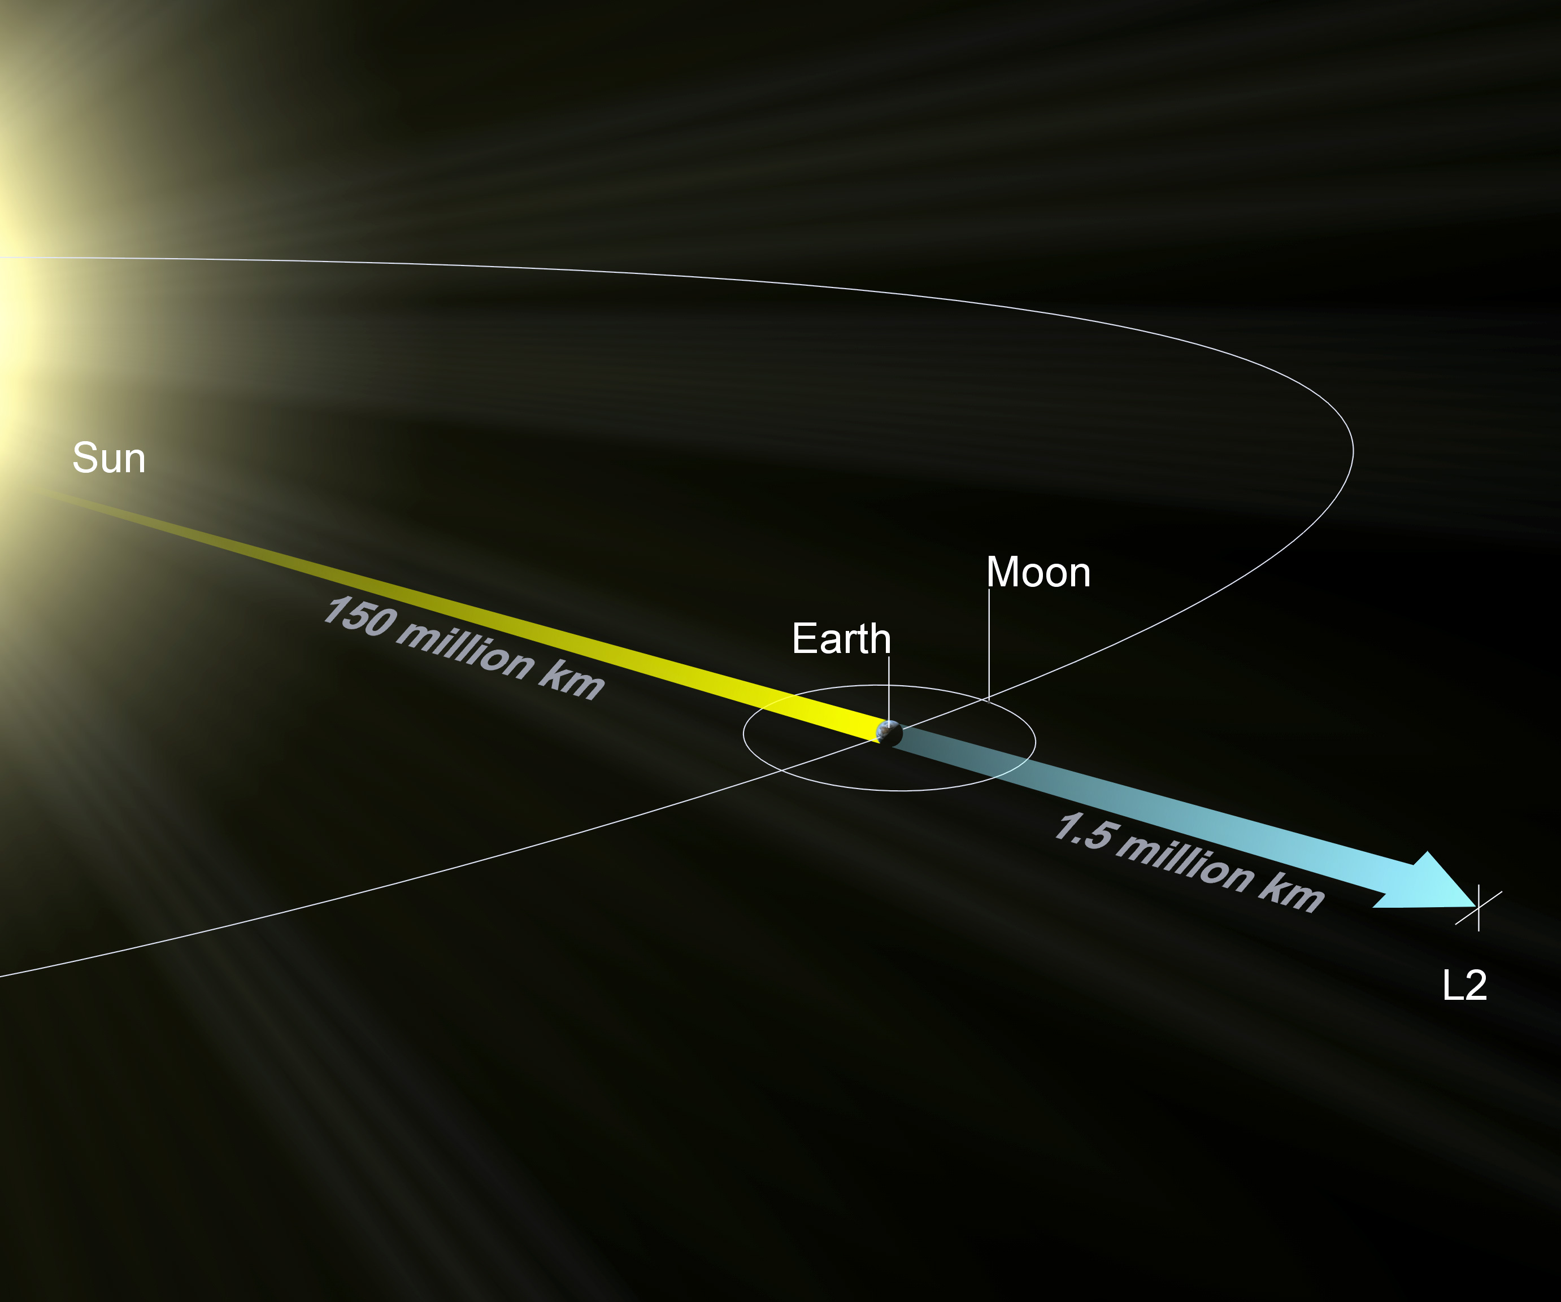
James Webb Space Telescope (JWST)
hot side
cold side
Sunshield
Will orbit around Sun-Earth Lagrange point L2
L2 is position always in the shadow of Earth as Earth orbits the Sun
Halo orbit around L2 (out of Sun-Earth-Moon plane) so the Moon never blocks signals
1 million miles further out than Hubble Space Telescope in Low Earth Orbit
Images credit:NASA

Slide 4
James Webb Space Telescope (JWST) schedule
29 days to L2 point
* L2
Image credit: European Space Agency (ESA)

Slide 5
James Webb Space Telescope (JWST) status
Solar power arrays deployed
Main antenna deployed
Tower for primary mirror extended
Sunshields deployed, opened, tensioned
0.002 inches thick
Size of a tennis court
Biggest risk in the project
70-75% of 344 single-point failures completed with this
139 release mechanisms, 70 hinges, 8 motors
400 pulleys, 90 cables with total length ¼ mile
Secondary mirror deployed
Left 3 segments of primary mirror unfolded
Accurate launch left more fuel for maintaining orbit: should last 10 years, not just 5
Secondary mirror
Sensors
Primary mirror
5-layer Sunshields
Image credit:NASA

Slide 6
Parker Solar Probe “touched the Sun”
Launched in August, 2018
Will travel at 430,000 mph at closest to Sun (fastest human object)
Entered Sun’s corona (where magnetic fields dominate particle movement) several times, closest 4.9m miles from Sun’s surface
Boundary is irregular and always in flux
Spiraling ever closer in elliptical orbit, goal of 3.8m miles in 2025
24 orbits over 7 years, with 7 Venus gravity assist flybys to slow it down
Measuring temperature, particle flow & angle, density, magnetic fields
Will lead to better forecasting extreme space weather (solar wind) events that endanger communications, satellites, and astronauts
Image credit:NASA

Slide 7
Why doesn’t the Parker Solar Probe melt?
Solar
panel
Solar
panel
Temperatures of corona particles are 1-2 million °F
BUT, low density: very few particles to carry & transfer heat
Radiation much more significant: 475 times higher than at Earth orbit
Heat shield
4.5” thick carbon & carbon composite foam, white ceramic paint
Surface gets heated to 2,500 °F, but spacecraft is at 85 °F
Solar panels retract during close approach in the elliptical orbit
Autonomous orientation correction (4 light sensors kept in shadow)
Radiator cooling with pressurized water coolant
2 instruments not protected by heat shield
“Solar cup” measures ion & electron fluxes & angles, made from Titanium-Zirconium-Molybdenum alloy (melting point 4,260 °F), grids of tungsten (melting point 6,192 °F)
Wires made of niobium, suspended in sapphire crystal tubes
Heat shield
Images credit:NASA

Slide 8
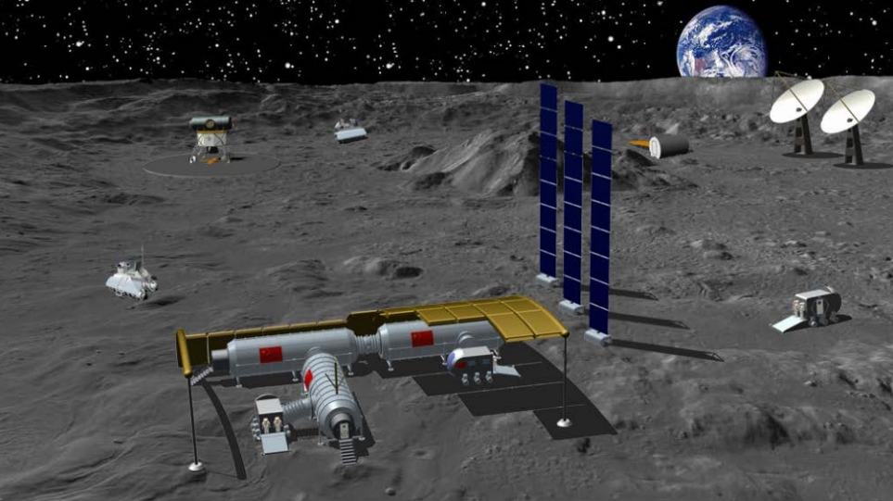
China advances lunar base mission by 8 years
Joint Chinese/Russian lunar base goal now 2027, not 2035
Competing with US-led Artemis program
Direct: no diversion for lunar orbit space station (Gateway)
Nuclear powered station, initially unmanned
Automated mobile station to travel 1000 km to challenge expected US “safety zones” under Artemis accords
Emphasis on cave exploration for permanent habitation
Before that, 3 missions target the South Pole
Image credit:China Academy of Space Technology

Slide 9
Some 2021 Highlights
Record numbers of space missions and new satellites
3 Mars missions arrived, including 2 rovers and 1 helicopter
Other major NASA achievements (besides Mars rover & helicopter)
OSIRIS-REX took samples from asteroid Bennu and started return flight
Parker Solar Probe “touched the Sun” (entered the corona)
Launched Lucy (asteroid explorer), DART (planetary defense test), IXPE (X-ray explorer), James Webb Space Telescope
Contracted for Human Landing System (for Moon), commercial space stations
Chinese space station launched, module was added
Russia added Nauka science module to ISS
Suborbital tourism started with both Blue Origin and Virgin Galactic
New companies reached orbit (Astra, Virgin Orbit)
SpaceX Starship (upper stage) test landed successfully after many explosions

Slide 10
Some 2021 Lowlights
More delays in SLS, Boeing Starliner, Blue Origin rocket engines, Artemis Moon missions (partly due to Blue Origin legal maneuvers)
Russian ASAT test spread debris, requiring ISS to maneuver
Chinese space station maneuvered to avoid de-orbiting Starlink satellites
Aging Russian modules at ISS threaten reliability with cracks and leaks
Accidental Russian thruster firing destabilized ISS – twice!

Slide 11
Trends in space missions
Rapid ascent of Chinese space program
Including number of launches and variety of rockets and programs
Market lead of SpaceX Falcon 9 due to reliability and low cost
31 of 51 US missions were on Falcon 9, all successful
Proof of re-usability: only 2 new first stages were needed!
Rise of new launch companies like Rocket Lab (with 6 launches)
Rise of new companies providing services in space, just assuming launch costs will get cheaper (e.g., satellite constellations)
Profusion of satellites
Especially in Low Earth Orbit (LEO)
Small satellites (down to the size of a sandwich – ¼ of a cubesat)

Slide 12
Expectations for 2022, part 1
More launches: estimates are for 150
More competition in rockets if they stay on schedule
SpaceX Starship should achieve orbit, promising reduced cost for space access
Chinese and European progress on reusable craft to challenge Falcon 9 and Starship
New rockets (Starship/Super Heavy, SLS, Vega-C, Ariane 6, H3, Terran 1, Vulcan, … )
Up to 9 Moon missions, including robotic landers

Slide 13
Expectations for 2022, part 2
Increasing growth in commercialization and space-based services
Especially in LEO (Low Earth Orbit)
Internet service (Starlink, OneWeb, … )
Monitoring: e.g., “how many cars park in Walmart parking lots each day”
Companies like Planet Labs, Black Sky, Maxar have satellites and analytics to answer that
“In-orbit services” growth
Moving existing satellites, e.g., GEO satellites out of propulsion fuel
Capturing and moving or de-orbiting space junk
Space tugs to deploy satellites to multiple orbits from one large (low cost) launch
Increasing conflict over utilization of space
More obvious space race between China and the US, both in orbit and to the Moon
Increased concern over space junk, avoiding collisions, hardening satellite systems
Increased military reliance on commercial services

Slide 14
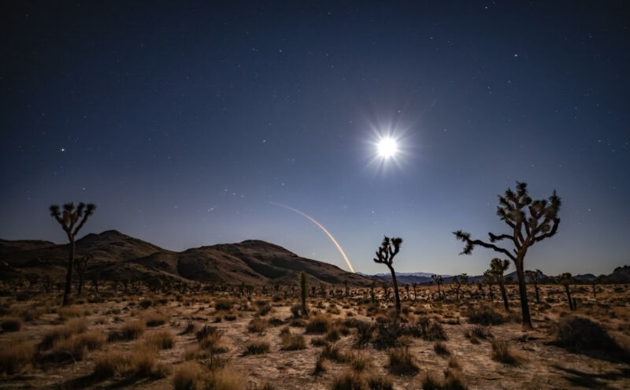
How many launches since the last meeting (Dec 11)?
This includes failed launches if they lift off the launch pad
Only includes launches attempting going into orbit or beyond
December, 2021 SpaceX Falcon 9 launch from Vandenberg Space Force Base. Credit: SpaceX

Slide 15
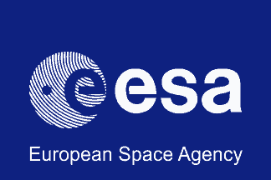
Launches since last meeting
Dec 13 – Proton – 2 communications satellites (TV, radio, internet relay)
Dec 13 – Long March 3B – communications satellite
Dec 14 – Kuaizhou-1A (China) – 2 Geely satellites supporting autonomous driving (FAIL)
Dec 18 – Falcon 9 – 52 Starlink (internet) satellites
Dec 18 – Falcon 9 – Turkish communications satellite
Dec 21 – Falcon 9 – Cargo resupply to the International Space Station (ISS)
Dec 22 – H-2A (Mitsubishi) – Inmarsat communications satellite
Dec 23– Long March 7A– 2 classified satellites
Dec 25 – Ariane 5 – James Webb Space Telescope
Dec 27 – Soyuz– 36 OneWeb (internet) satellites
Dec 27 – Angara-A5 (Russia) – test flight (FAIL in upper stage)
Jan 06 – Falcon 9 – 49 Starlink (internet) satellites

Slide 16
Summary of launches (orbit or beyond) in 2021*
US: 51 launches, with 48 successes (includes Rocket Lab)
China: 48 launches, with 45 successes (another count: 56 launches/53 successes)
Russia: 24 launches, 23 successes
Europe (ESA): 6 launches, 6 successes
India: 2 launches, 1 success
Iran: 0 launches (not counting 2 unannounced failures)
Israel: 0 launches
Japan: 2 launches, 2 successes
South Korea: 1 launch, 0 successes
UAE: 0 launches
Total: 134 launches: 125 successes, 9 fails
2020: 114 launches: 104 successes, 10 fails
2019: 102 launches: 97 successes, 5 fails
Close to or exceeded records set in 1967 (139 launches) and 1976 (125 successes)
* Based on Monthly Space News reports. Other counts vary, mainly for Chinese launches

Slide 17
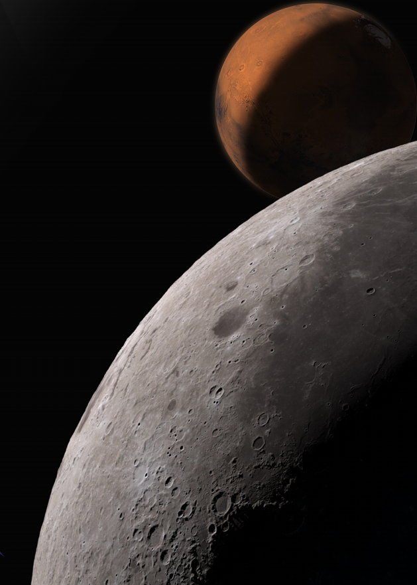
Discussion & questions?
Image: NASA

Slide 18
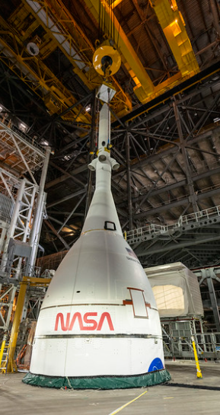
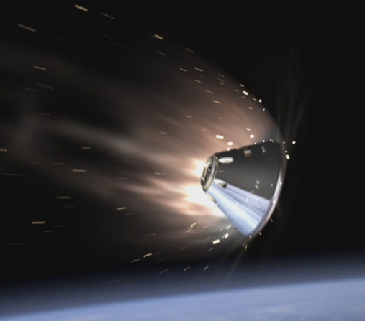
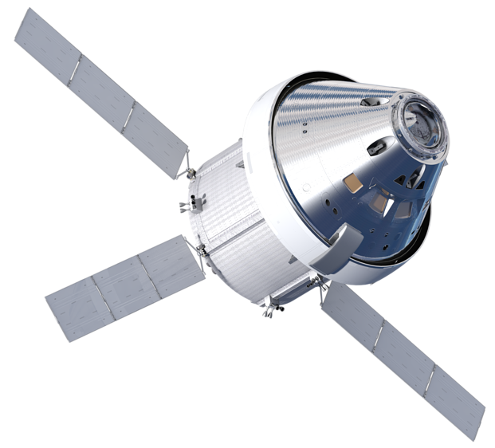
Featured speaker (Q&A) : Jeff Perkins
Systems Engineer Principle at Lockheed Martin Space Systems, Houston
Responsible for technical integrity of the Orion spacecraft
Previously at Lockheed Martin Aeronautics, responsible for F-35 systems engineering
BS in Electrical Engineering from Texas A&M
MBA from University of Dallas
In Launch Abort System ready for SLS stacking
TOPIC: Orion spacecraft
Crew Module descent into atmosphere
European-built Service Module (ESM)
Crew Module
Images credit: NASA

