Slide 1
NSS North Houston Space Society
January 8, 2021

Slide 2
Agenda
2:00 PM – Opening Remarks
2:10 PM – Recent Space News – Greg Stanley
2:40 PM – Orion Q&A with Jeff Perkins – Systems Engineer Principle at Lockheed Martin
3:45 PM – Socializing
4:00 PM – End of Meeting

Slide 3
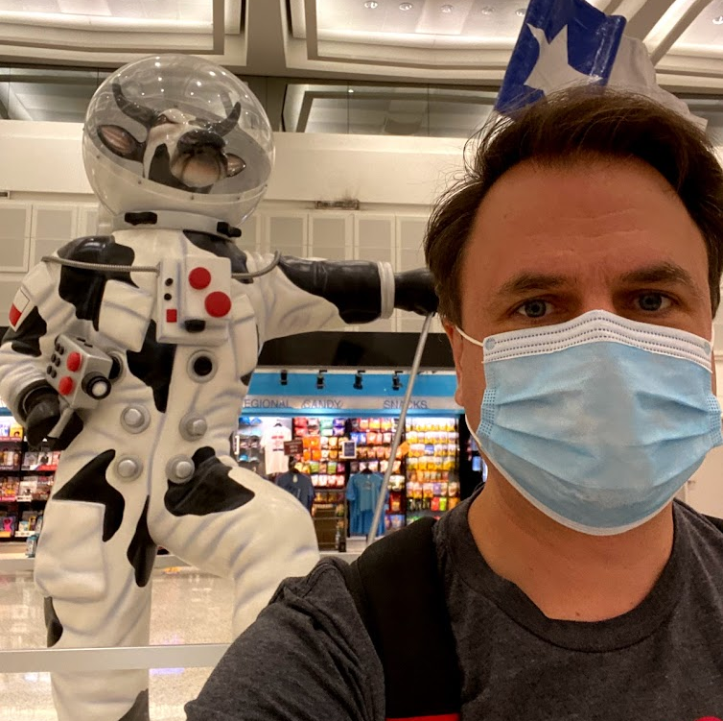
Nathan Price
832-620-6385
Nathan.Price
@NorthHoustonSpace.org
NSS North Houston Space Society President and Founder. Nathan works for a software company but has a lifelong passion for space exploration.
Nathan will start training in February as a SPARTAN Flight Controller at Johnson Space Center to eventually work in Mission Control supporting the International Space Station (ISS).

Slide 4
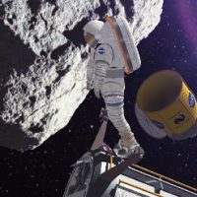
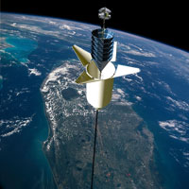
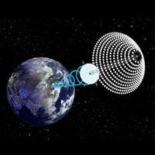
National Space Society Vision
People living and working in thriving communities beyond the Earth, and the use of the vast resources of space for the dramatic betterment of humanity.

Slide 5
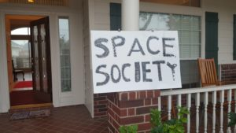
NSS North Houston Space Society – starting 5th year First meeting January 6, 2018

Slide 6
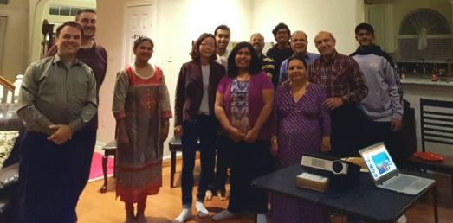
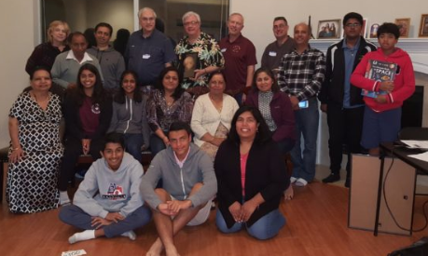
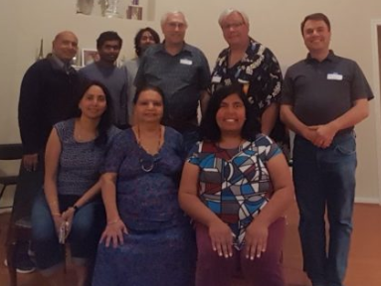
2018 – 11 Meetings at Nathan’s House
Jan 2018
Feb 2018
March 2018
April 2018
Topics included: overview of 2016/2017; Space Tourism; ZERO-G Experience; Humans 2 Mars Summit; Biosphere 2 and Closed Ecological Systems; Yuri Gagarin; Skylon; Orion Span; Spaceports; Lunar Exploration; Space Law; SpaceX’s BFR; Space Architecture
June 2018

Slide 7
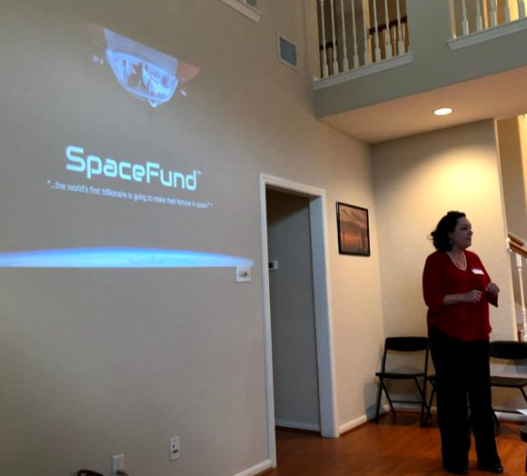
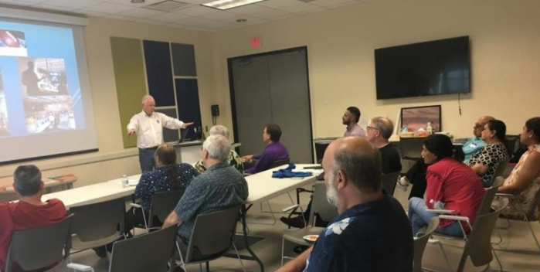
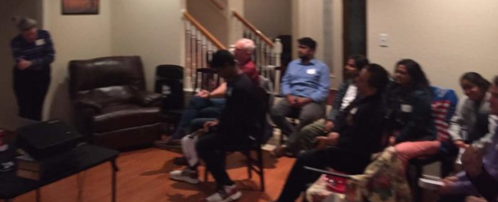
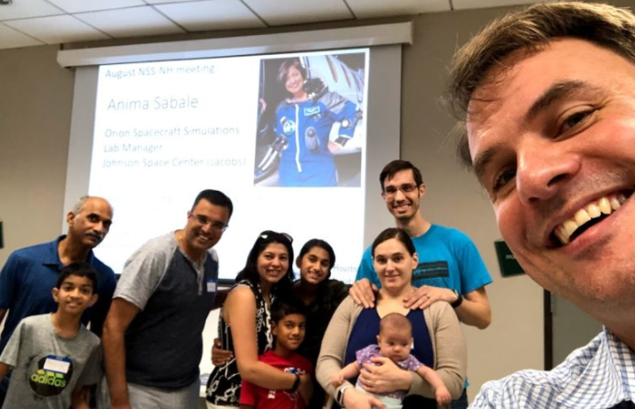
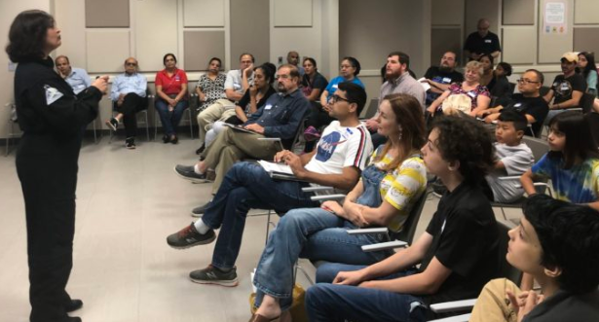
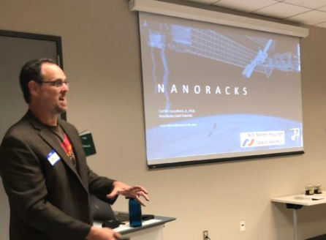
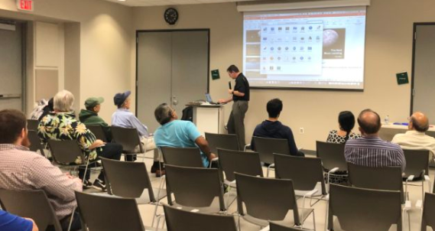
12 meetings in 2019 – Moved to Library in May
Jan 2019
April 2019
May 2019
Feb 2019
August 2019
September 2019
June 2019
December 2019

Slide 8
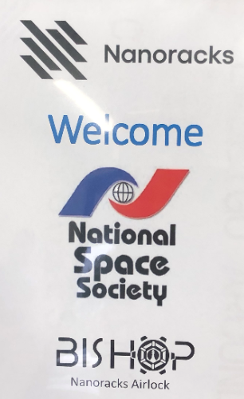
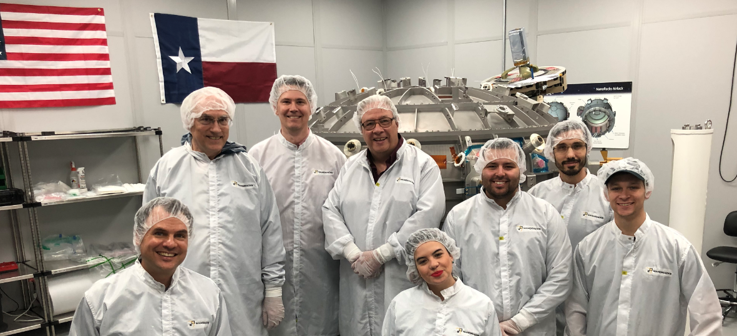
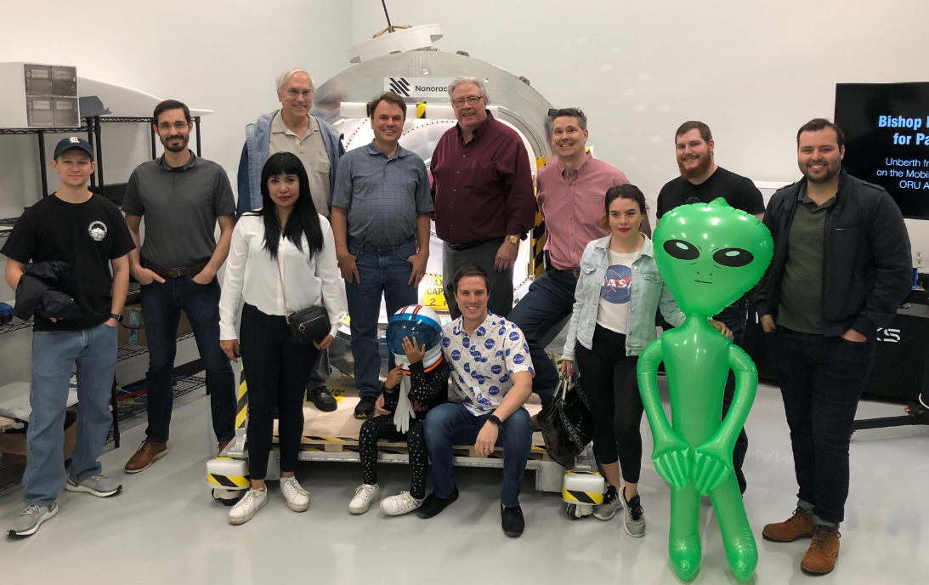
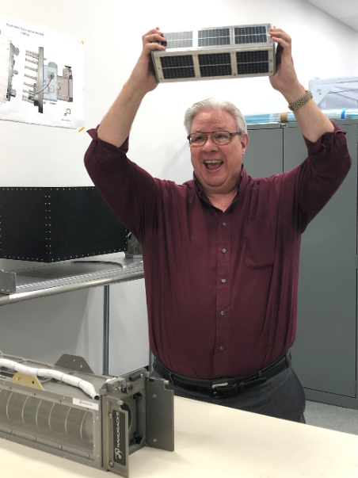
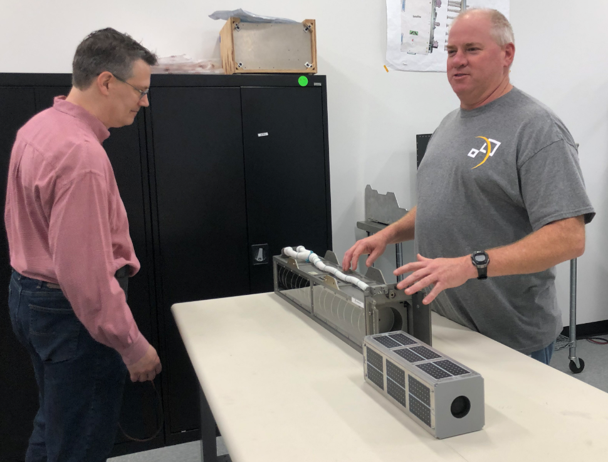

Slide 9
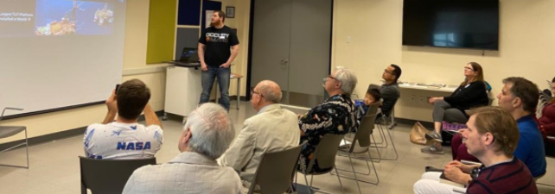
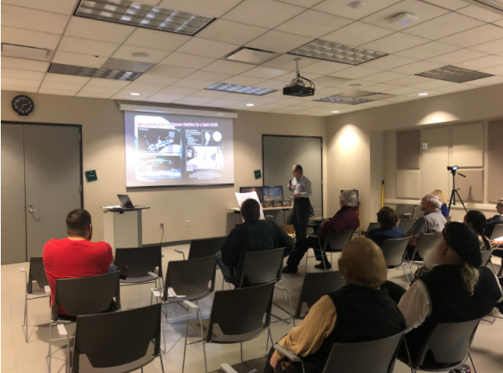
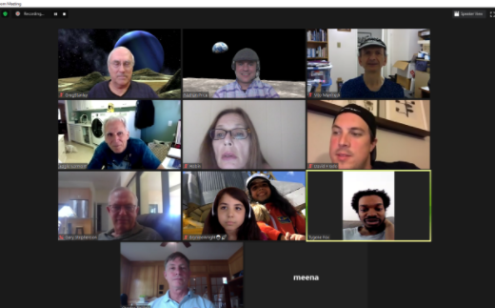
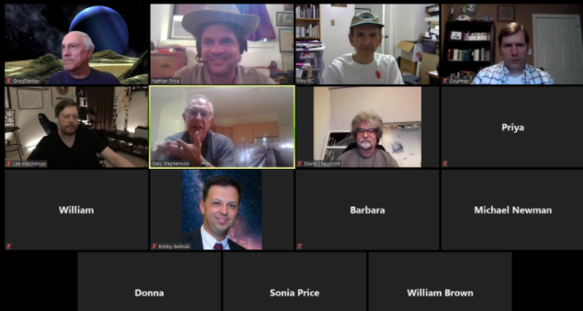
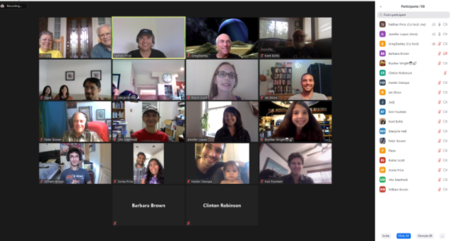
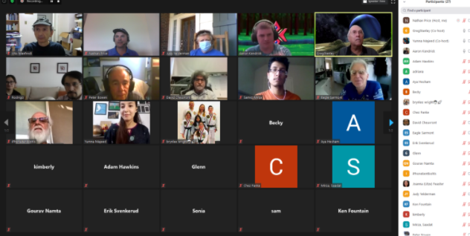
12 meetings in 2020

Slide 10
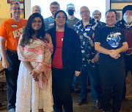
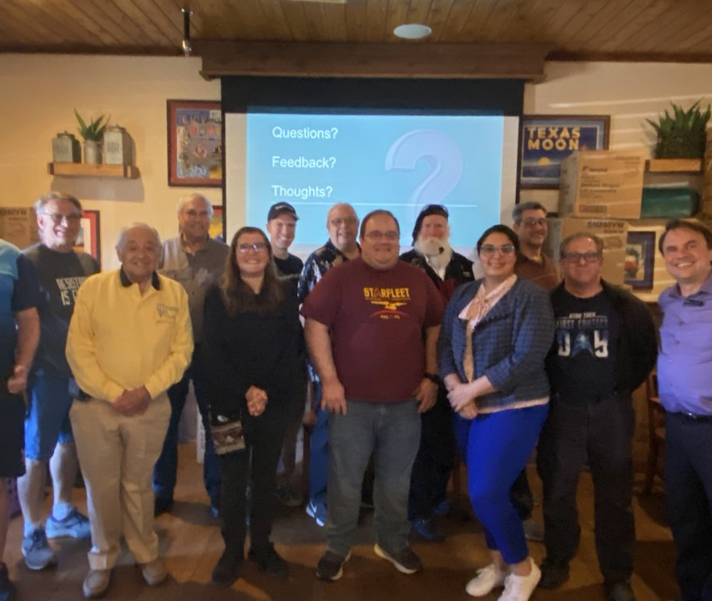
12 Meetings in 2021

Slide 11
This is our 48th Meeting

Slide 12
Agenda
2:00 PM – Opening Remarks
2:10 PM – Recent Space News – Greg Stanley
2:40 PM – Orion Q&A with Jeff Perkins – Systems Engineer Principle at Lockheed Martin
3:45 PM – Socializing
4:00 PM – End of Meeting

Slide 13
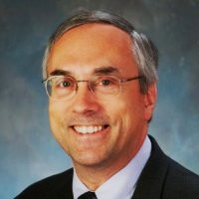
Dr. Greg Stanley
Dr. Greg Stanley, mostly retired, creates, develops, and manages innovative technology, especially based on artificial intelligence.
Greg has a PhD in Chemical Engineering from Northwestern University, and a BS in Chemical Engineering from Purdue University. He has published over 25 peer-reviewed technical papers.
He worked at and on projects for a variety of companies including Exxon, Gensym, AT&T,Intelsat, Biosphere 2, a Japanese nuclear industry/government consortium, Integration Objects, and BMC.
North Houston Space Society Vice President.

