Slide 1
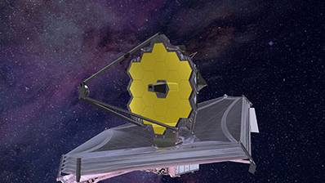
James Webb Space Telescope
It’s finally here!
Launch Date December 22, 2021

Slide 2
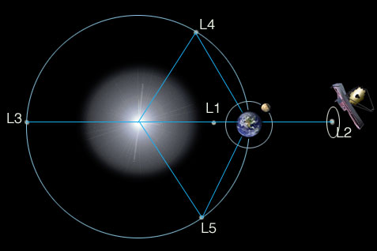
Notes:
JWST will take 29 days to travel from LEO to its destination, the Sun-Earth L2 LaGrange Point. At these points gravity from the Sun and the Earth are balanced.
This L2 point is located almost 1 million miles from Earth, well beyond the Moon’s orbit of 240, 000 miles. (A million miles above midnight!)
JWST will establish a “halo” orbit around L2. This is so JWST will never end up in the shadow of either the Moon or Earth, thus cutting off power to the solar panels, yet it will always be visible from Earth for communication purposes.
During the 29 day trip JWST will undergo 52 major deployments, including 300+ single-point-failure procedural steps. The “must-not-fail” nature of these 300 steps added considerably to the program’s cost and schedule.

Slide 3
In development for 25 years (1996)
Must fit a mirror 7X area of Hubble into a 56-ft tall x 18-ft dia payload shroud
Employs a segmented foldable mirror
Uses a 5-layer sunshield that unfolds to the size of a tennis court
Had to create 10 new technologies
Original cost estimate: $580M
Current cost: $9.6B

Slide 4
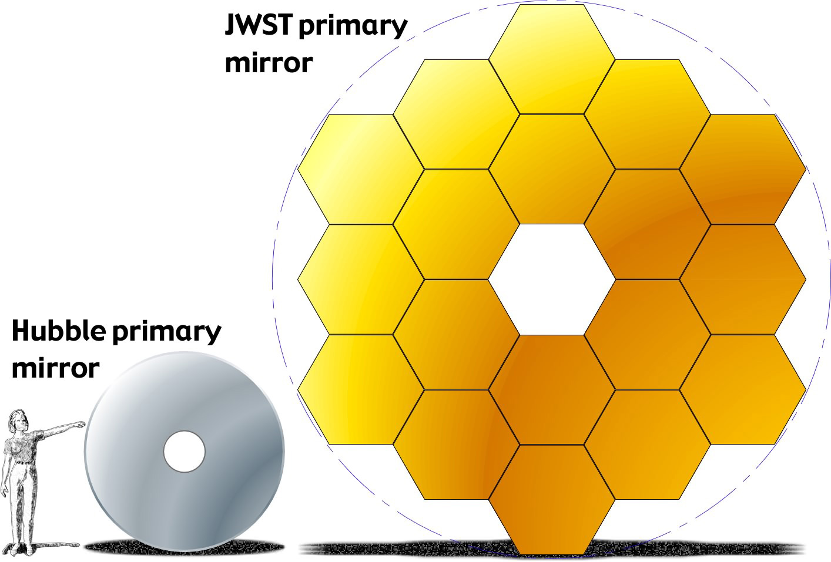

Slide 5
Primary mirror facts
JWST is 400X more sensitive than ground based telescopes
JWST is 100X more sensitive than Hubble space telescope (21.3 ft dia vs. 7.9 ft)
Glass mirror like Hubble too heavy, so 18 hexagonal mirror segments made of beryllium used; a lightweight strong metal good at cryogenic temperatures. Each 4.3 ft dia segment weighs 46 lbs. Segments are coated in gold, which reflects infrared better.
To act like one mirror, segments must be aligned to 1/10,000 the thickness of a human hair (32 nm), and maintain that alignment during operations. [New technology]
Hot side of telescope is at +200F, cold side is at -364F

Slide 6
Wavefront sensing and control
Need to focus each of 18 segments to within 30-50 nanometers
Focus on a test star, then wiggle each segment one-by-one to identify which image “spot” is being controlled, analyze how far spot is away from ideal location, adjust segment shape to shift spot to ideal focus. Repeat 18X. Three iterations: coarse , medium, then fine focus. This is one reason why it will take so long (6 months) for telescope to come online.
This technology was spun off into a technique to diagnose eye conditions, map eye movements, and improve LASIK procedures.

Slide 7
Notes:
Sunshield
To observe infrared (heat) wavelengths, telescope must be kept very cold , -360F
JWST must be shielded from Sun, Earth, and Moon heat and light sources, as well as to dissipate heat generated by JWST itself during operation.
JWST uses 5-layer kite-shaped sunshield the size of a tennis court to partition the scope into a hot side (+200F) and a cold side (-360F). The mirror and cameras are on the cold side, the spacecraft power, communications, and engines are on the hot side.
Each layer is less than half the thickness of a sheet of paper (.002”/2), made of Kapton, a commercial polyimide film coated with aluminum.
Each layer of the sunshield is cooler than the one below. Heat radiates out from between the layers, with the vacuum between the layers providing insulation. The sunshield is a passive system, with no consumables for cooling.
The membranes are folded 12X in order to fit in the payload shroud of the Ariane 5 rocket.
The sunshield support structure contains more than 7,000 parts, including springs, bearings, pulleys, and magnets, and hundreds of custom-fabricated parts. Unfurling the sunshield is among some 40 major deployments.

Slide 8
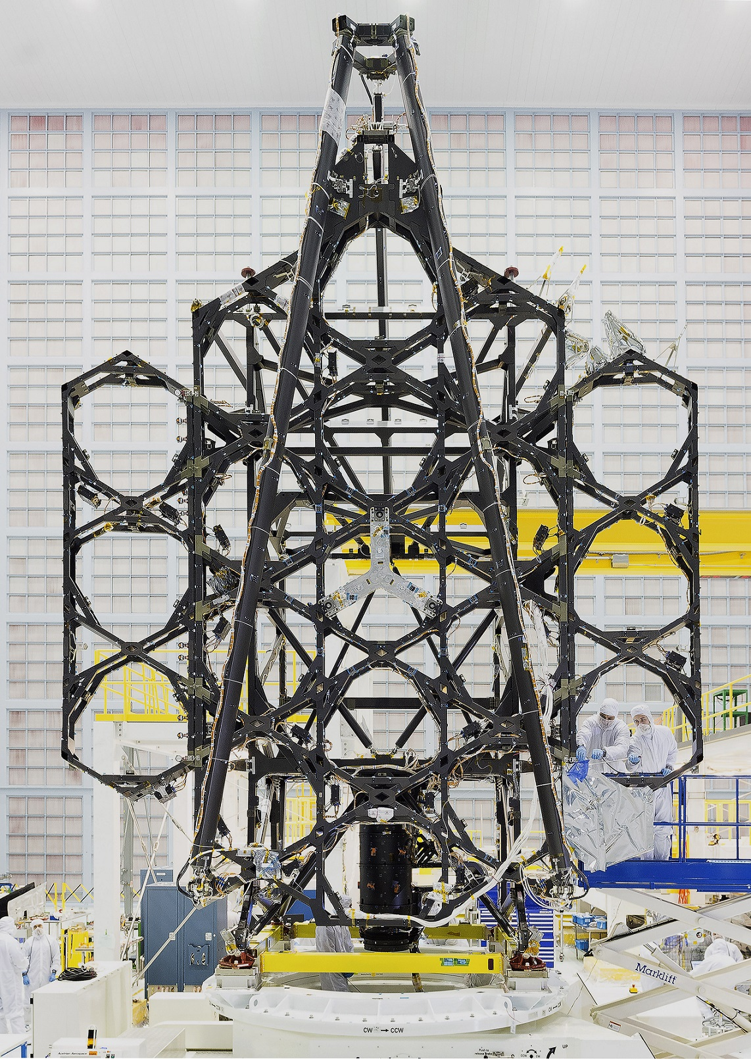
Notes:
The Backplane
Made of a lightweight composite structure, very stiff. Weighs only 2.5 tons.
Must remain motionless so the mirrors and science instruments can operate as intended.
Steady down to 1/10,000 of a human hair during repeated temperature swings from -343F down to -406F.
Holds up the primary mirror and other optics, plus all the science instruments.

Slide 9
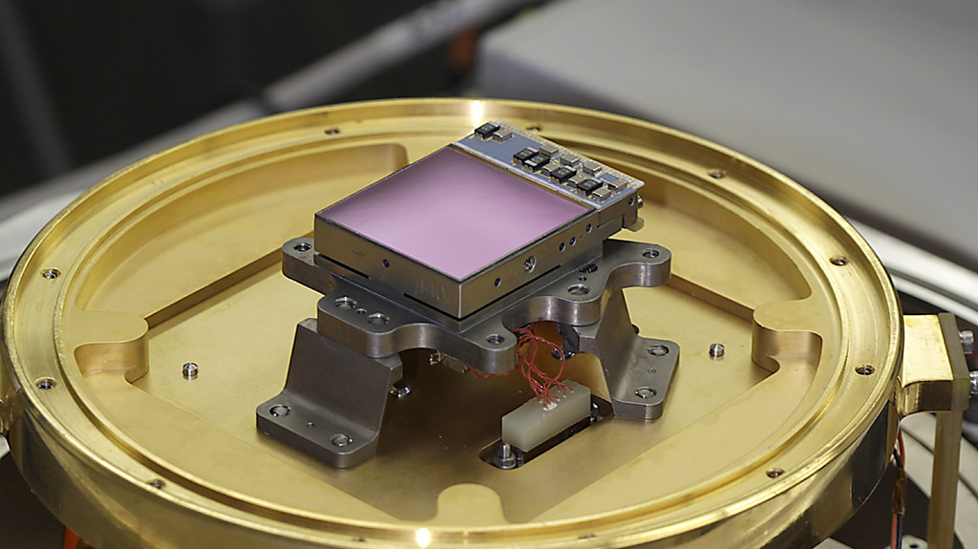
Notes:
Near-Infrared and Mid-Infrared Detectors / Cryogenic Data-Acquisition Integrated Circuit
Detecting faint emissions from distant galaxies, stars, and planets requires large arrays for efficient sky surveys. A special multiyear technology development effort for the JWST yielded arrays that are larger format and much more sensitive.
The Near-IR detector is a 4 megapixel (4 million pixels) mercury-cadmium-telluride chip for wavelengths of 0.6-5 microns (visible orange and red through near IR spectrum)
The Mid-IR detector is a one megapixel silicon-arsenic chip for wavelengths of 5-29 microns
JWST team developed a new technology low-noise, cryogenic application-specific IC microprocessor with extremely low power dissipation and a 16-bit analog-to-digital converter that generates less noise compared to conventional warm electronics.

Slide 10
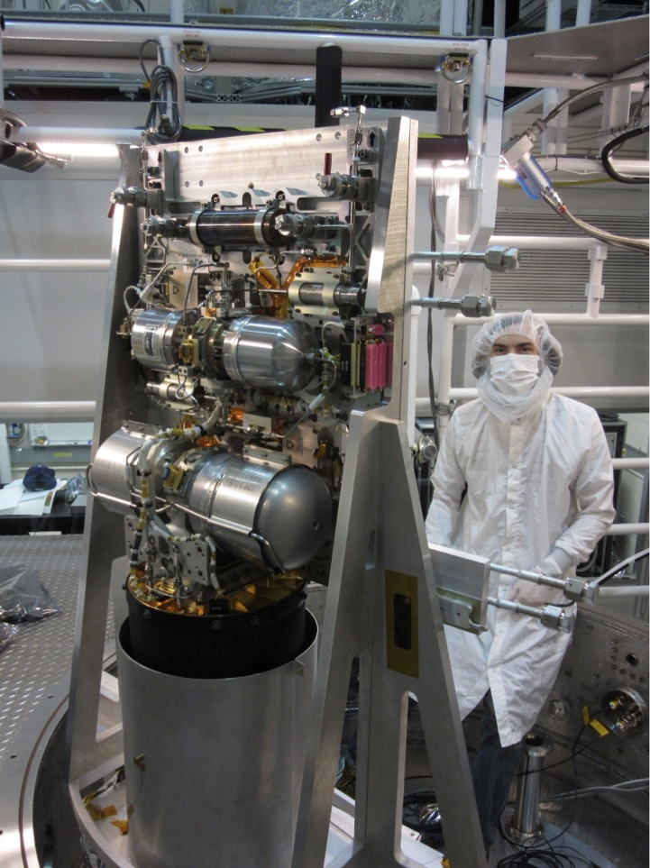
Notes:
Mid-Infrared Instrument Cryocooler
JWST is outfitted with four science instruments: the Near-IR Spectrograph (NIRSpec) which can determine temperature, mass, and chemical composition of 200 objects simultaneously; the NEAR-IR Camera (NIRCam) designed to image the most distant objects in near IR; the Near-IR Imager and Slitless Spectrograph (Niriss); and the Mid-IR Instrument (MIRI) to observe cold, distant objects and provides spectroscopy mapping.
MIRI has its own cooler to reduce its operating temperature to -448F, just above absolute zero. Manufacturing and development problems with this device caused major program delays.
The Cryocooler Compressor Assembly is a heat pump consisting of a precooler that generates 0.25 watts of cooling power at 14K (-434F) using helium gas as a working fluid, and a high-efficiency pump that circulates refrigerant (also helium gas) cooled by conduction with the precooler to MIRI.
The only moving parts in the cryocooler are the pair of two-cylinder piston pumps in the CCA that are horizontally opposed, which cancels out most vibration. As a closed system, the cryocooler does not use liquid helium or any other coolant. Its operational life is limited only by wear to its moving parts (the pumps) and the longevity of its electronics.

Slide 11
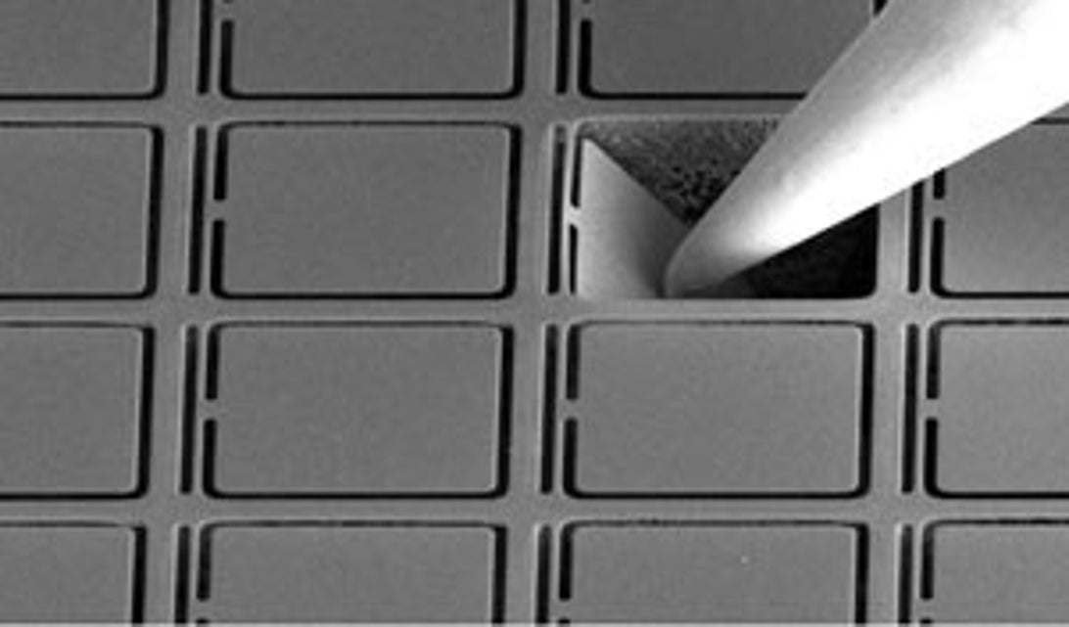
Notes:
Microshutters
Major technology effort focused on microshutters, tiny windows the width of a few hairs that allow scientists to block out unwanted light so only the most distant stars and galaxies can be detected by NIRSpec.
Beginning at Technology Readiness Level 0 (TRL-0) work on the microshutters stalled for a decade due to an acoustic damage issue.
The Microshutter Assembly consists of tiny cells measuring 100 x 200 microns (about the width of 3-6 human hairs) that are arranged in four waffle-like grids. Each grid, the size of a postage stamp, contains more than 62,000 shutters designed to be individually opened or closed to view or block a portion of the sky.
With microshutters, NIRSpec will become first spectroscope that can make high-resolution observations of 100 objects simultaneously.
Operating in extreme cold, the microshutters, made of silicon nitride (think ceramics) had to demonstrate reliable operation without fatigue. Six years of effort led to tiny shutters that could open and close 200,000+ cycles, double their design life.
JWST loaded with propellants on December 3 , 80 liters hydrazine, 160 liters dinitrogen tetroxide for station-keeping for a design life of 5 years, hopefully stretching out to 10 years.

Slide 12
?
Questions?

Slide 13
Sun-Earth L2 Orbit
JWST will take 29 days to travel from LEO to its destination, the Sun-Earth L2 LaGrange Point. At these points gravity from the Sun and the Earth are balanced.
This L2 point is located almost 1 million miles from Earth, well beyond the Moon’s orbit of 240, 000 miles. (A million miles above midnight!)
JWST will establish a “halo” orbit around L2. This is so JWST will never end up in the shadow of either the Moon or Earth, thus cutting off power to the solar panels, yet it will always be visible from Earth for communication purposes.
During the 29 day trip JWST will undergo 52 major deployments, including 300+ single-point-failure procedural steps. The “must-not-fail” nature of these 300 steps added considerably to the program’s cost and schedule.

Slide 14
Sunshield
To observe infrared (heat) wavelengths, telescope must be kept very cold , -360F
JWST must be shielded from Sun, Earth, and Moon heat and light sources, as well as to dissipate heat generated by JWST itself during operation.
JWST uses 5-layer kite-shaped sunshield the size of a tennis court to partition the scope into a hot side (+200F) and a cold side (-360F). The mirror and cameras are on the cold side, the spacecraft power, communications, and engines are on the hot side.
Each layer is less than half the thickness of a sheet of paper (.002”/2), made of Kapton, a commercial polyimide film coated with aluminum.
Each layer of the sunshield is cooler than the one below. Heat radiates out from between the layers, with the vacuum between the layers providing insulation. The sunshield is a passive system, with no consumables for cooling.
The membranes are folded 12X in order to fit in the payload shroud of the Ariane 5 rocket.
The sunshield support structure contains more than 7,000 parts, including springs, bearings, pulleys, and magnets, and hundreds of custom-fabricated parts. Unfurling the sunshield is among some 40 major deployments.
Notes:
Sunshield

Slide 15
The Backplane
Made of a lightweight composite structure, very stiff. Weighs only 2.5 tons.
Must remain motionless so the mirrors and science instruments can operate as intended.
Steady down to 1/10,000 of a human hair during repeated temperature swings from -343F down to -406F.
Holds up the primary mirror and other optics, plus all the science instruments.
Notes:
The Backplane
Made of a lightweight composite structure, very stiff. Weighs only 2.5 tons.
Must remain motionless so the mirrors and science instruments can operate as intended.
Steady down to 1/10,000 of a human hair during repeated temperature swings from -343F down to -406F.
Holds up the primary mirror and other optics, plus all the science instruments.

Slide 16
Near-Infrared and Mid-Infrared Detectors / Cryogenic Data-Acquisition Integrated Circuit
Detecting faint emissions from distant galaxies, stars, and planets requires large arrays for efficient sky surveys. A special multiyear technology development effort for the JWST yielded arrays that are larger format and much more sensitive.
The Near-IR detector is a 4 megapixel (4 million pixels) mercury-cadmium-telluride chip for wavelengths of 0.6-5 microns (visible orange and red through near IR spectrum)
The Mid-IR detector is a one megapixel silicon-arsenic chip for wavelengths of 5-29 microns
JWST team developed a new technology low-noise, cryogenic application-specific IC microprocessor with extremely low power dissipation and a 16-bit analog-to-digital converter that generates less noise compared to conventional warm electronics.

Slide 17
Mid-Infrared Instrument Cryocooler
JWST is outfitted with four science instruments: the Near-IR Spectrograph (NIRSpec) which can determine temperature, mass, and chemical composition of 200 objects simultaneously; the NEAR-IR Camera (NIRCam) designed to image the most distant objects in near IR; the Near-IR Imager and Slitless Spectrograph (Niriss); and the Mid-IR Instrument (MIRI) to observe cold, distant objects and provides spectroscopy mapping.
MIRI has its own cooler to reduce its operating temperature to -448F, just above absolute zero. Manufacturing and development problems with this device caused major program delays.
The Cryocooler Compressor Assembly is a heat pump consisting of a precooler that generates 0.25 watts of cooling power at 14K (-434F) using helium gas as a working fluid, and a high-efficiency pump that circulates refrigerant (also helium gas) cooled by conduction with the precooler to MIRI.
The only moving parts in the cryocooler are the pair of two-cylinder piston pumps in the CCA that are horizontally opposed, which cancels out most vibration. As a closed system, the cryocooler does not use liquid helium or any other coolant. Its operational life is limited only by wear to its moving parts (the pumps) and the longevity of its electronics.

Slide 18
Microshutters
Major technology effort focused on microshutters, tiny windows the width of a few hairs that allow scientists to block out unwanted light so only the most distant stars and galaxies can be detected by NIRSpec.
Beginning at Technology Readiness Level 0 (TRL-0) work on the microshutters stalled for a decade due to an acoustic damage issue.
The Microshutter Assembly consists of tiny cells measuring 100 x 200 microns (about the width of 3-6 human hairs) that are arranged in four waffle-like grids. Each grid, the size of a postage stamp, contains more than 62,000 shutters designed to be individually opened or closed to view or block a portion of the sky.
With microshutters, NIRSpec will become first spectroscope that can make high-resolution observations of 100 objects simultaneously.
Operating in extreme cold, the microshutters, made of silicon nitride (think ceramics) had to demonstrate reliable operation without fatigue. Six years of effort led to tiny shutters that could open and close 200,000+ cycles, double their design life.
JWST loaded with propellants on December 3 , 80 liters hydrazine, 160 liters dinitrogen tetroxide for station-keeping for a design life of 5 years, hopefully stretching out to 10 years.

