Slide 1
NSS North Houston Space Society
December 11, 2021

Slide 2
Agenda
2:00 PM – Opening Remarks
2:10 PM – Recent Space News – Greg Stanley
2:40 PM – James Webb Telescope – Doug Hall
3:15 PM – Q&A
3:30 PM – Officer and Board Elections
3:45 PM – Socializing
4:00 PM – End of Meeting

Slide 3
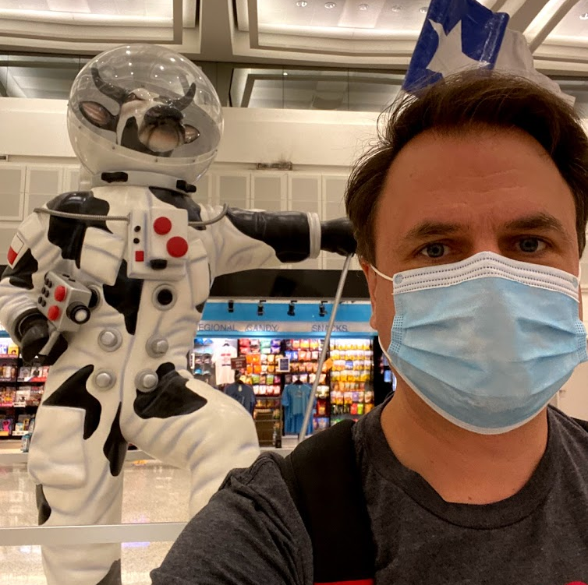
Nathan Price
832-620-6385
Nathan.Price
@NorthHoustonSpace.org
NSS North Houston Space Society President and Founder. Nathan works for a software company but has a lifelong passion for space exploration. He has attended space conferences including the International Astronautical Congress (IAC), New Worlds Conference (in Austin, TX), and International Space Development Conference (ISDC). He has experienced weightlessness on a ZERO-G flight. He dreams of the day that humanity branches out into the stars.

Slide 4
Choices and Perspectives

Slide 5
Imagine

Slide 8
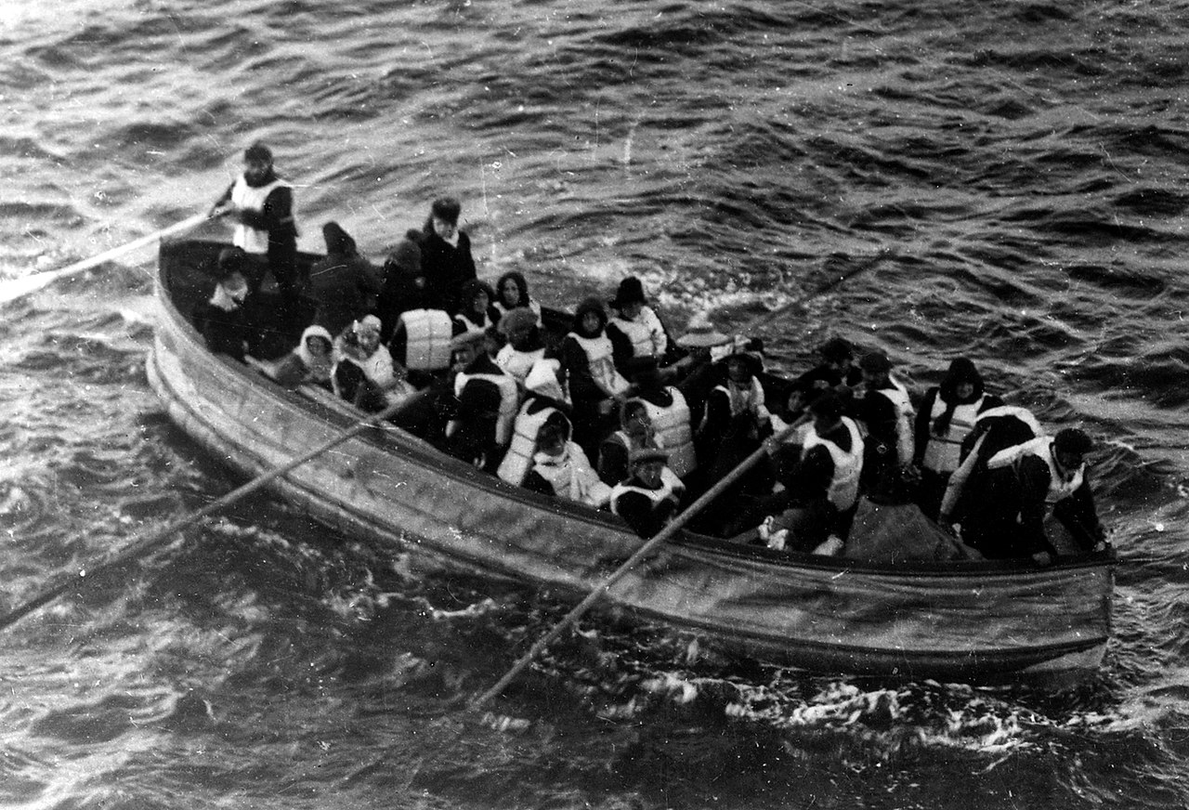

Slide 9
Limited food & Limited Water.
Unlimited needs.
Rescue unknown. What do you do?

Slide 10
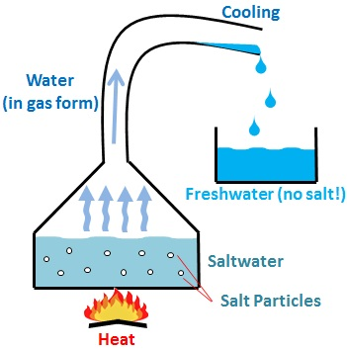

Slide 11
How is this different from our current life? Are we not just on a bigger lifeboat?

Slide 12
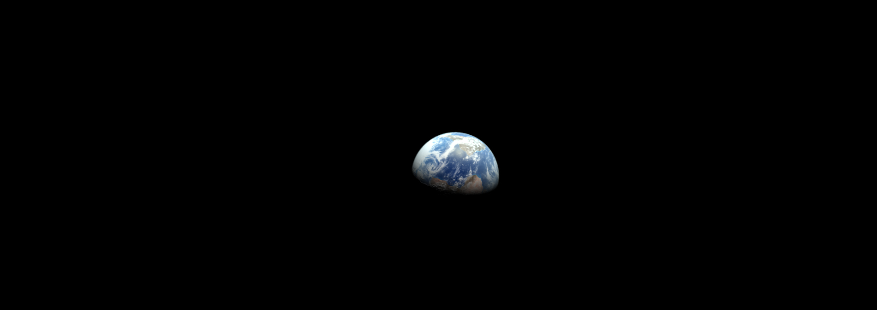

Slide 13
Unlimited
Power

Slide 14
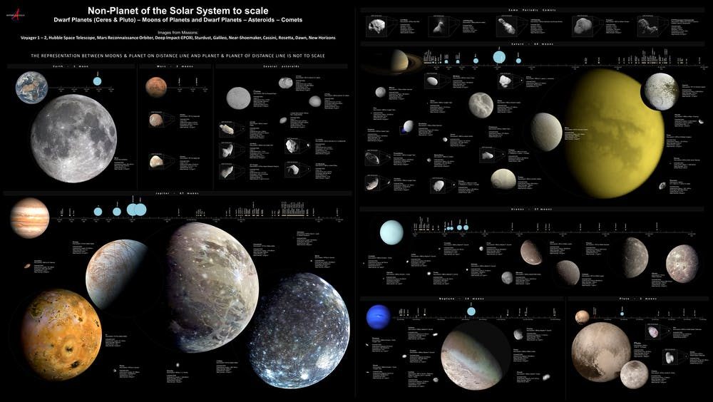

Slide 15
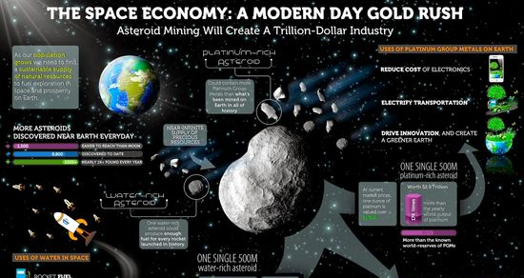

Slide 16
Would the world be a better place if we realized we are surrounded by a sea of resources and scarcity is only a lack of vision and knowledge?

Slide 17
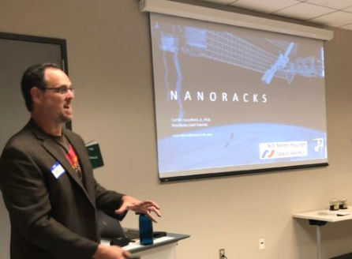
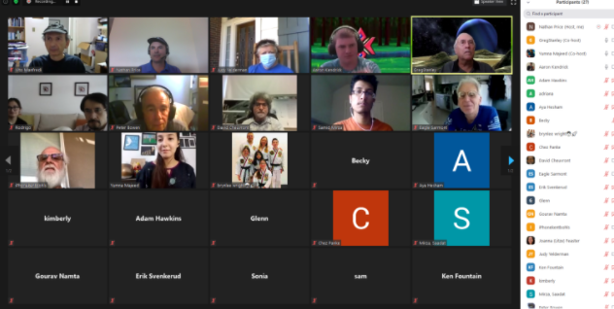
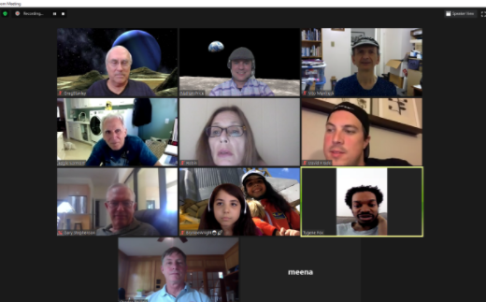
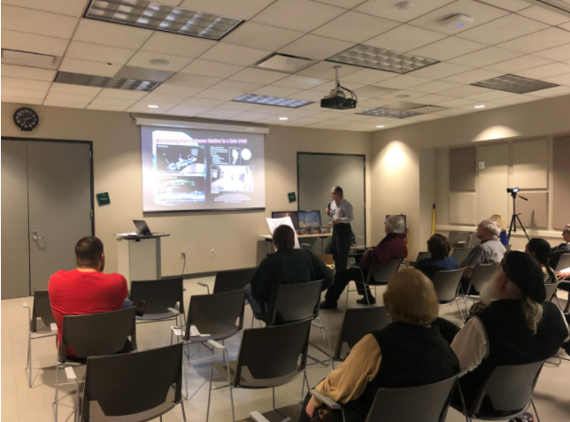
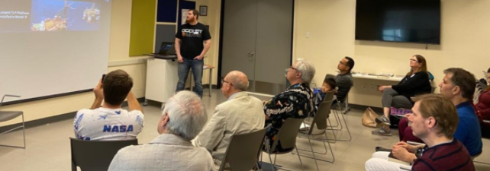
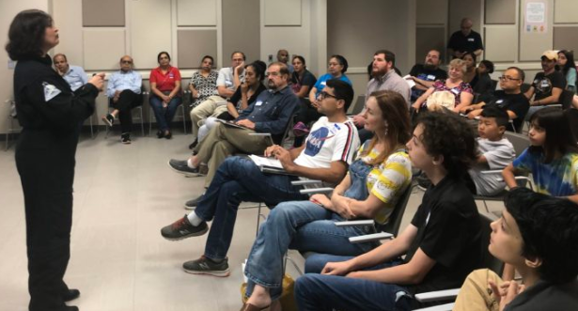
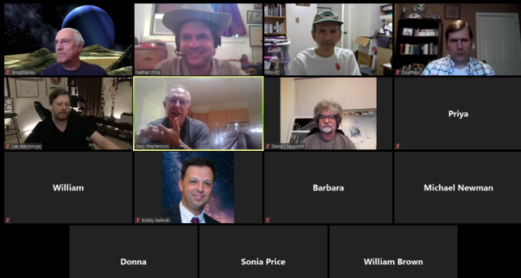
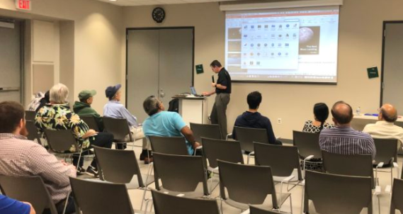
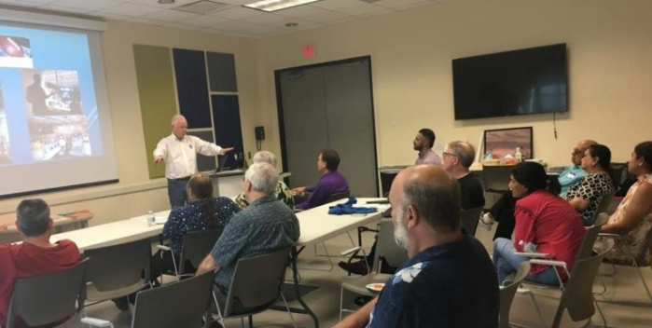
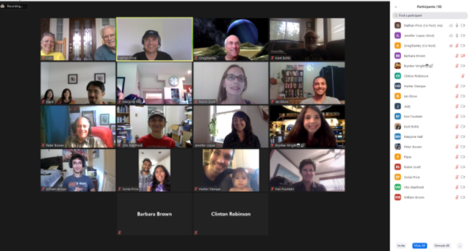
Monthly Meetings

Slide 18
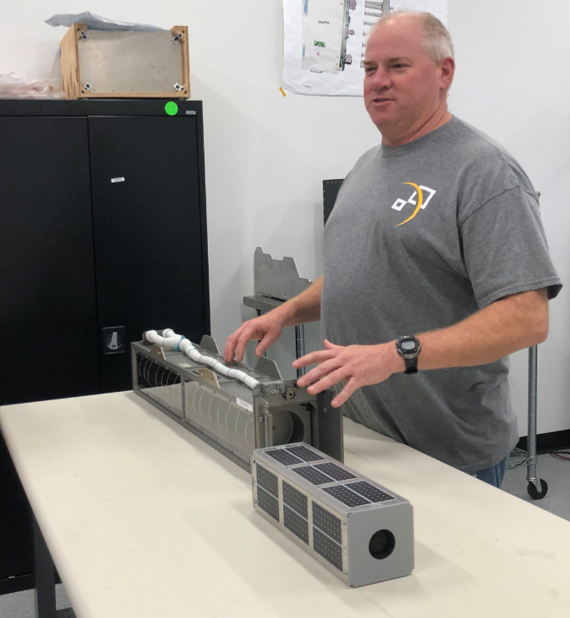
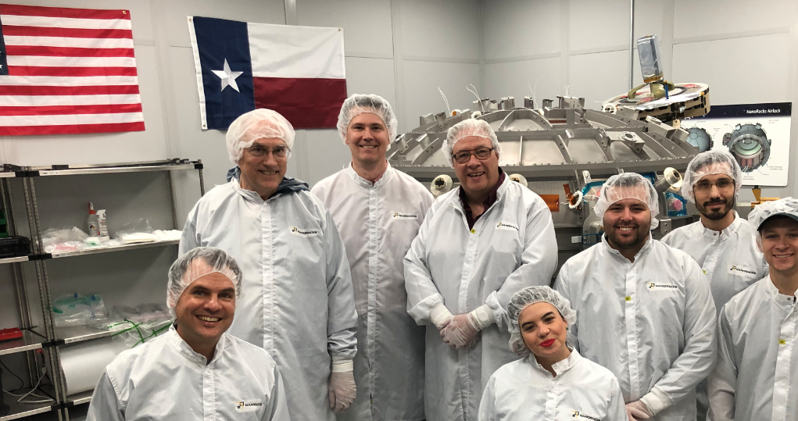
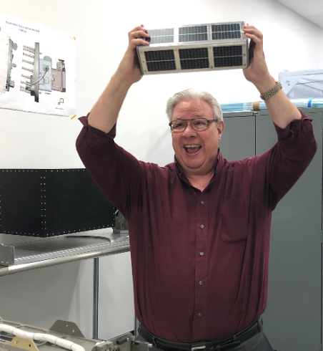
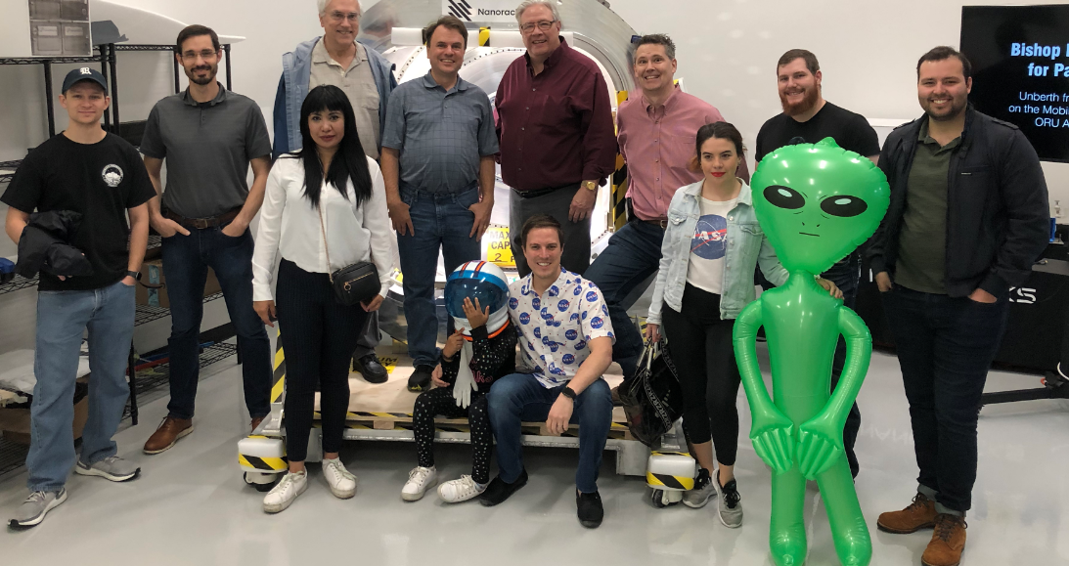
Tours

Slide 19
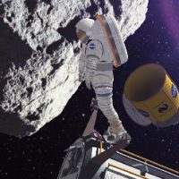
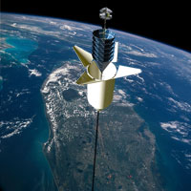
National Space Society Vision
People living and working in thriving communities beyond the Earth, and the use of the vast resources of space for the dramatic betterment of humanity.

Slide 20
Join us:
http://NorthHoustonSpace.org
Sign up for our email list
Join the National Space Society
Connect with others that share the vision of humanity branching out into space
Educate and inspire our communities about the benefits to humanity!

Slide 21
Meeting IS being RECORDED
This meeting is being recorded and will be posted on YouTube, NorthHoustonSpace.org, Facebook, etc.

Slide 22
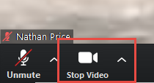
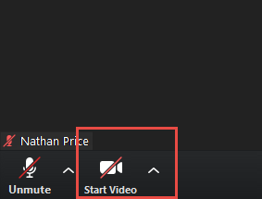
How to use ZOOM - Video
Video is turned off by default. Turn it on when you are ready:

Slide 23
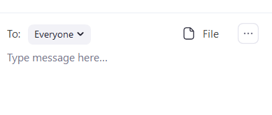
How to use ZOOM - Video
Video is turned off by default. Turn it on when you are ready:
Chat
Audio
How to raise your hand

Slide 24
Agenda
2:00 PM – Opening Remarks
2:10 PM – Recent Space News – Greg Stanley
2:40 PM – James Webb Telescope – Doug Hall
3:15 PM – Q&A
3:30 PM – Officer and Board Elections
3:45 PM – Socializing
4:00 PM – End of Meeting

Slide 25
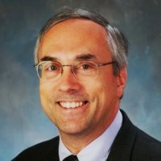
Dr. Greg Stanley
Dr. Greg Stanley, mostly retired, creates, develops, and manages innovative technology, especially based on artificial intelligence.
Greg has a PhD in Chemical Engineering from Northwestern University, and a BS in Chemical Engineering from Purdue University. He has published over 25 peer-reviewed technical papers.
He worked at and on projects for a variety of companies including Exxon, Gensym, AT&T,Intelsat, Biosphere 2, a Japanese nuclear industry/government consortium, Integration Objects, and BMC.
North Houston Space Society Vice President.

Slide 27
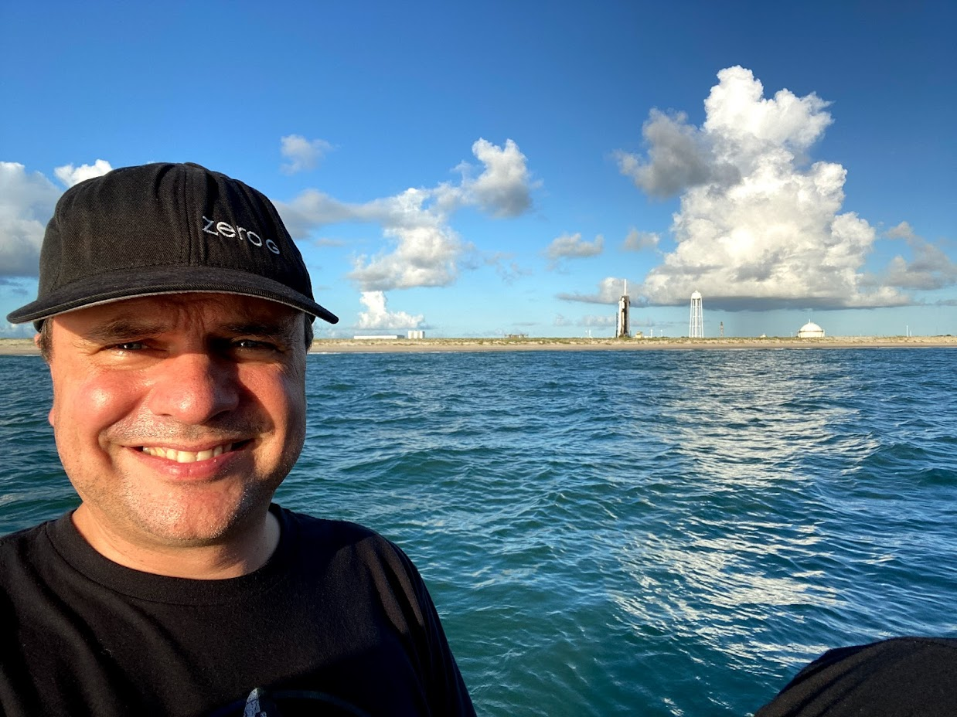
Inspiration 4 Launch

Slide 28
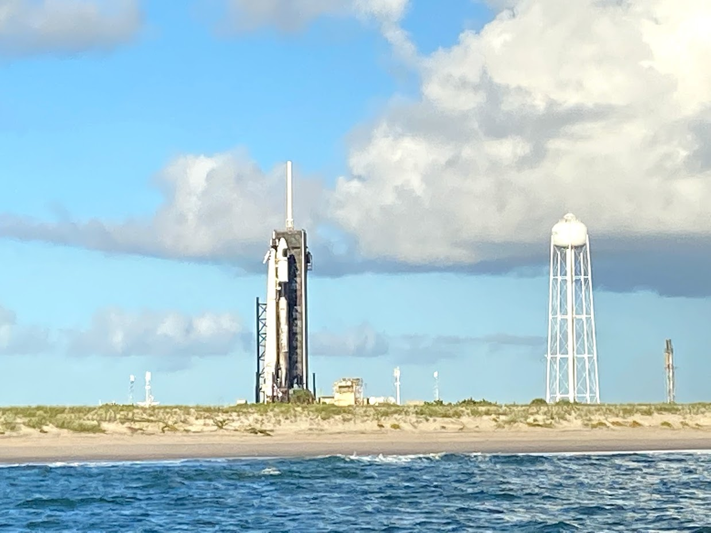
Share
Edit
Zoom
Info
Favorite
Delete
Turn on motion
Press question mark to see available shortcut keys

Slide 29
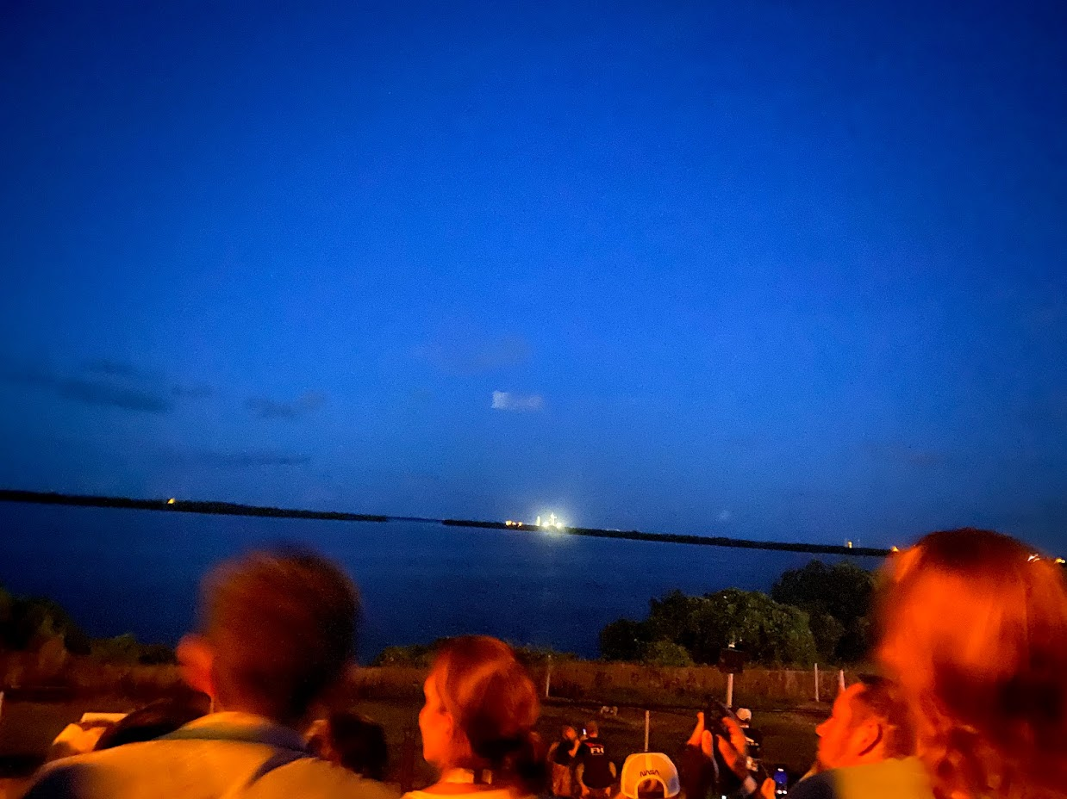
Edit
Zoom
Info
Favorite
Delete
Share
Press question mark to see available shortcut keys

Slide 31
Nathan.Price@NorthHoustonSpace.org

Slide 32
Thursday October 21: Professor Kris Lehnhardt, MD Baylor College of Medicine "Please state the nature of the medical emergency: preparing for medicine on Mars" Thursday November 11: Stephen Altemus, CEO Intuitive Machines "How to Land on the Moon in 30 Months for Less than $100M“
https://rsi.rice.edu/

Slide 33
Next North Houston Space Society Meeting
November 6, 2021
Spring Creek Barbecue on SH249
Nathan Price will give an overview of the Interstellar Symposium covering topics such as:
Finding Exoplanets
The nearest stars
Future imaging techniques
Breakthrough Starship project
Plasma Fusion Drive
https://irg.space/

Slide 34
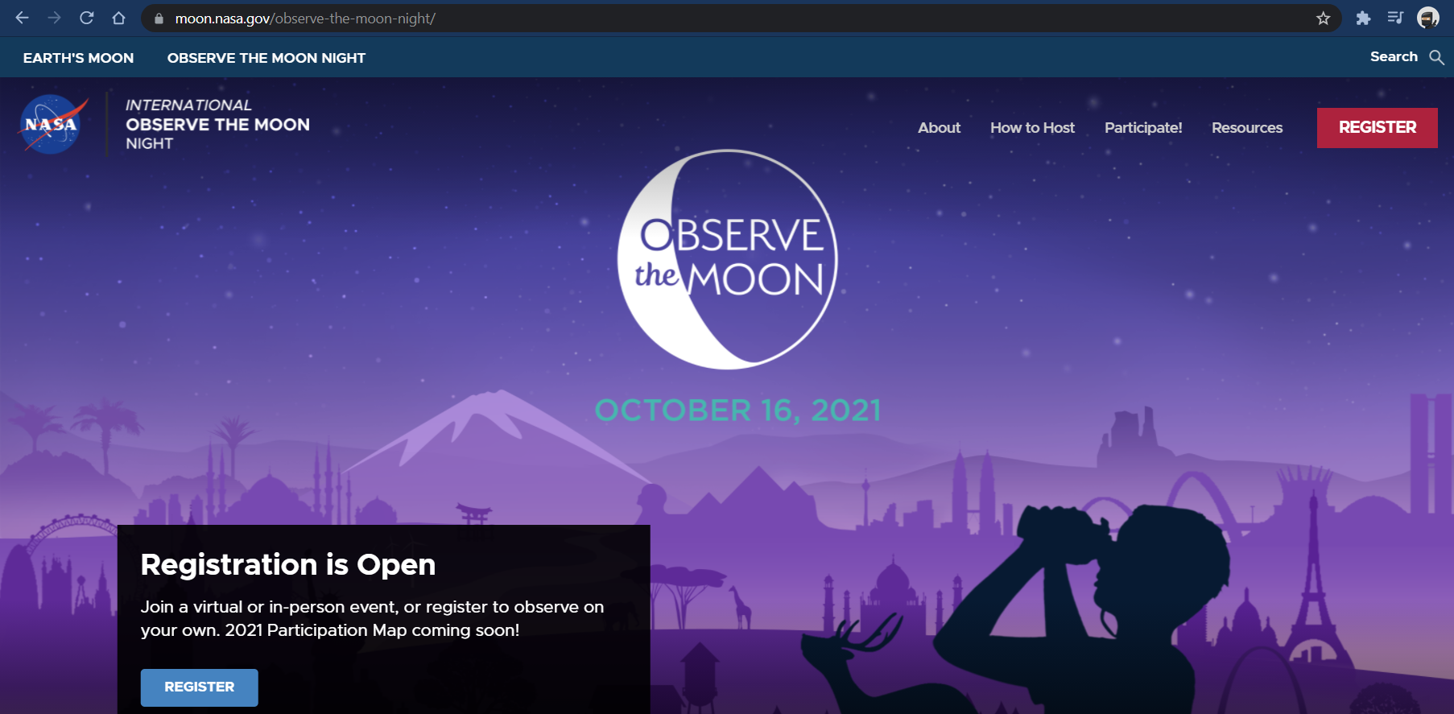

Slide 35
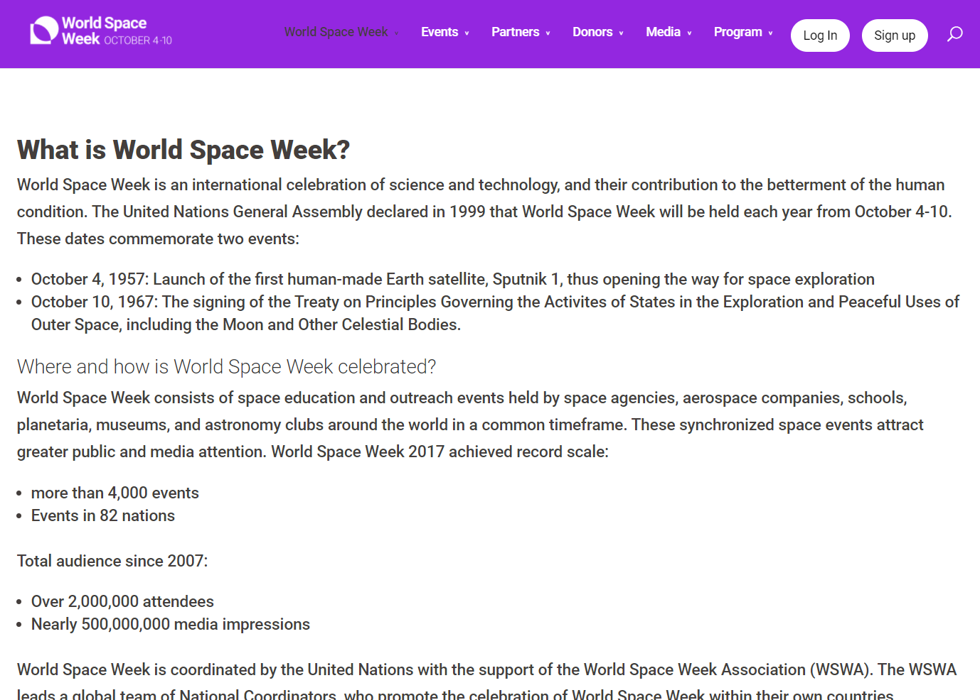

Slide 36
“Into the Unknown” Human Exploration
in the True Space Age Ellena Hyeji Joo
Saturday, Oct. 2, 2021
2-4PM (Hybrid)
http://NorthHoustonSpace.org

