Slide 1
Going Interstellar
Nathan Price
November 6, 2021

Slide 2
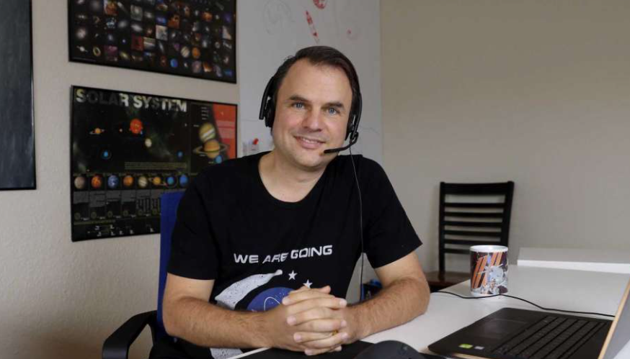
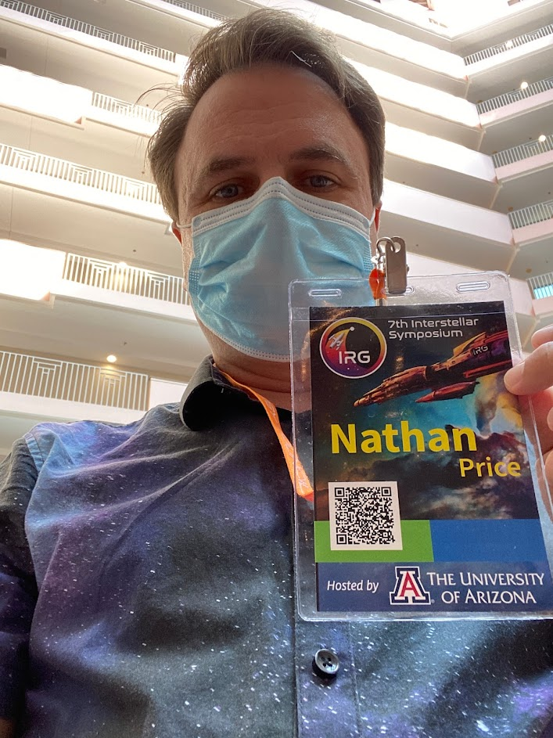
Nathan Price
Work for a software company
Passionate about space exploration and development
Founder of the North Houston Space Society (http://NorthHoustonSpace.org)
On a quest to interview a person a day till the end of 2024 as we Countdown to the Moon (http://CountdownToTheMoon.org)

Slide 3
Notes:
The Interstellar Research Group is a non-profit educational organization dedicated to bringing together solid, passionate individuals in order to discuss topics relevant to (eventually) turning humanity into an interstellar species. It is a forum of multidisciplinary individuals working together to facilitate solving interesting technical, economic, and social problems in our way.
The Interstellar Research Group is about taking humanity to the stars. This is a dream that may not become a reality for another millennium. Why, then, should some of the most visionary and intelligent people in the world (!!) gather at a hotel once every two years to discuss the challenges and opportunities of interstellar travel? Because we must. We are compelled by our nature to think positively about the future of humanity in a beautiful yet extremely hostile universe. Life on Earth is wonderful and we should do what we can to protect and preserve it here, and yet…
…there is more. Among the billions of galaxies, with their billions of stars and billions of planets, we sense a call to explore. A call to disperse ourselves and settle a multitude of worlds in order to preserve and protect what must be very rare indeed: a bipedal species of intelligent tool users who dare to dream, to love, to create and to aspire for more than mere survival. To survive and thrive we must push the boundaries and, well, we must go. And it isn’t too soon to prepare. There are many challenges and some of them will take generations to overcome.
Here, in various locations within a great nation, gather visionaries from many great nations to take up the challenge. Join us. Find a project that you can start and work on together. Meet that person you’ve never met and help them solve a technical or social challenge related to interstellar flight with which they’ve been wrestling. Let’s make these precious few days count. Be an active participant.

Slide 4
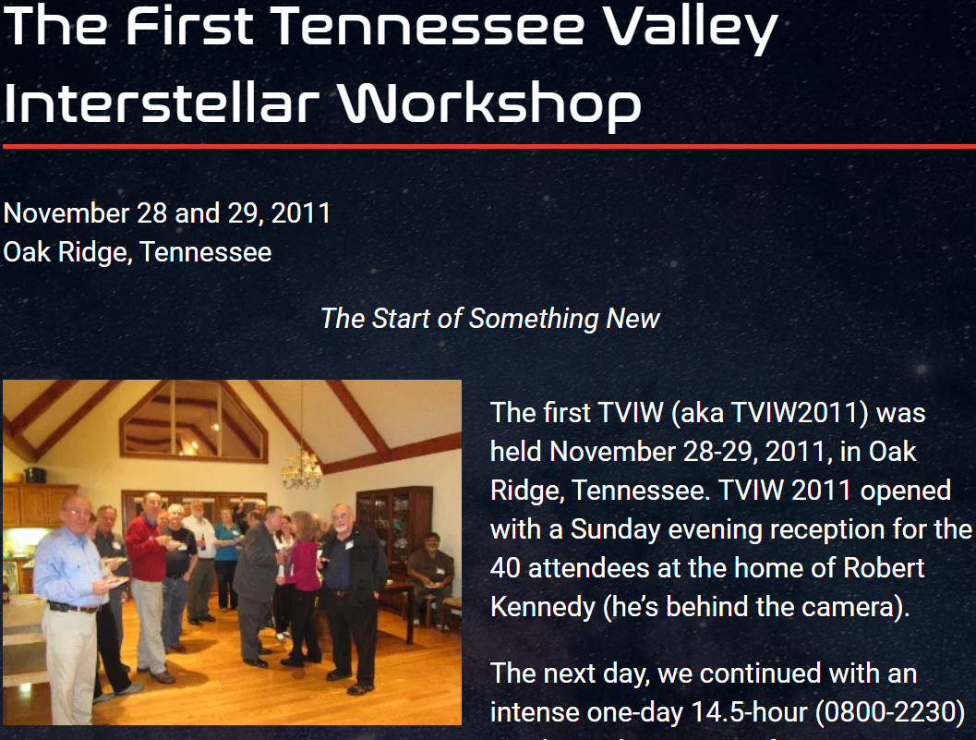
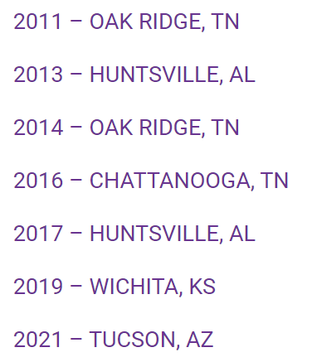
Semi-Annual Interstellar Symposium

Slide 5
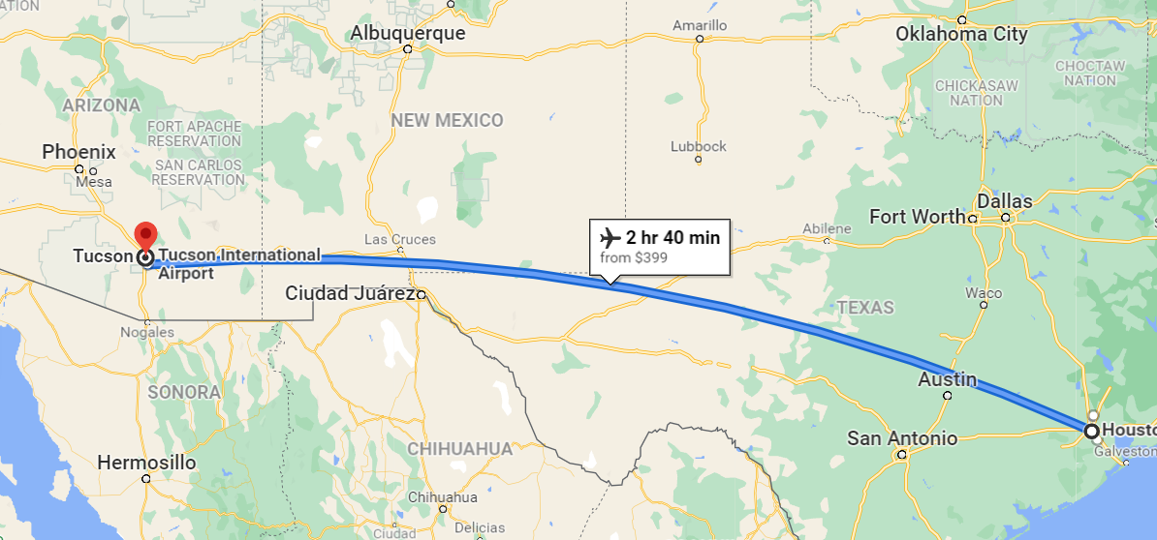

Slide 6
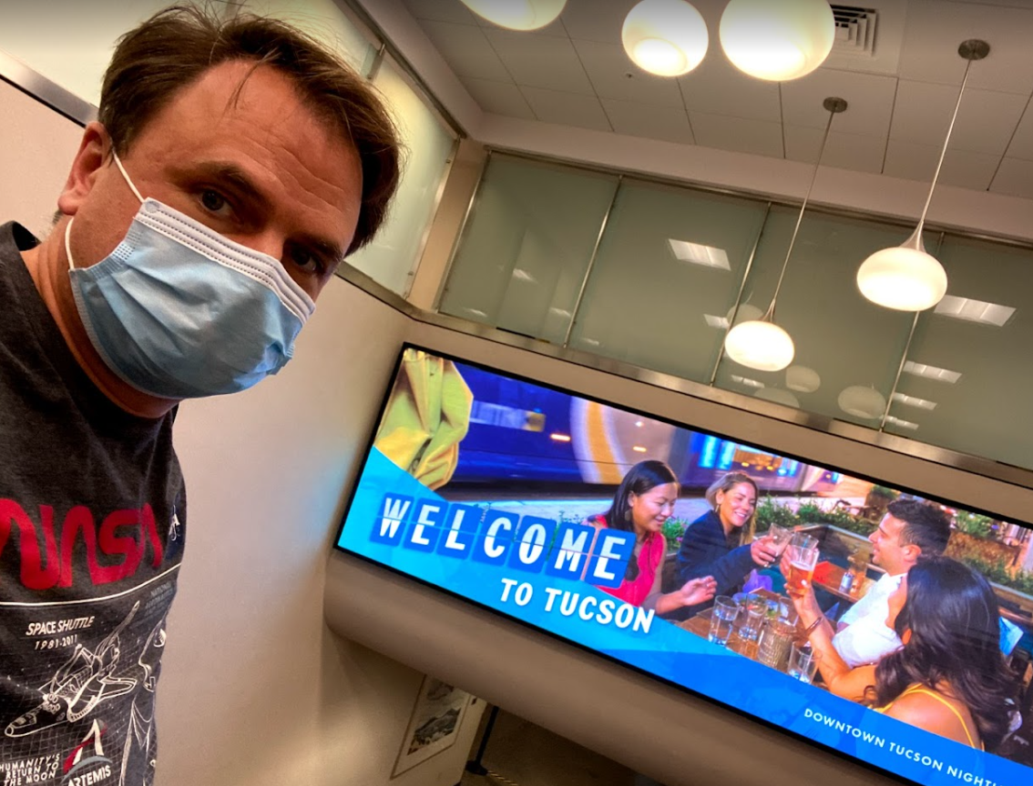

Slide 11
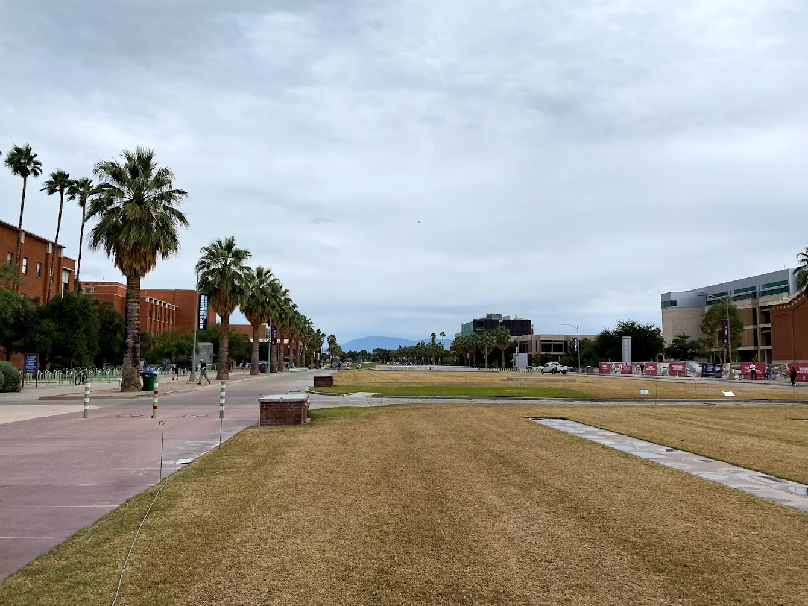

Slide 12
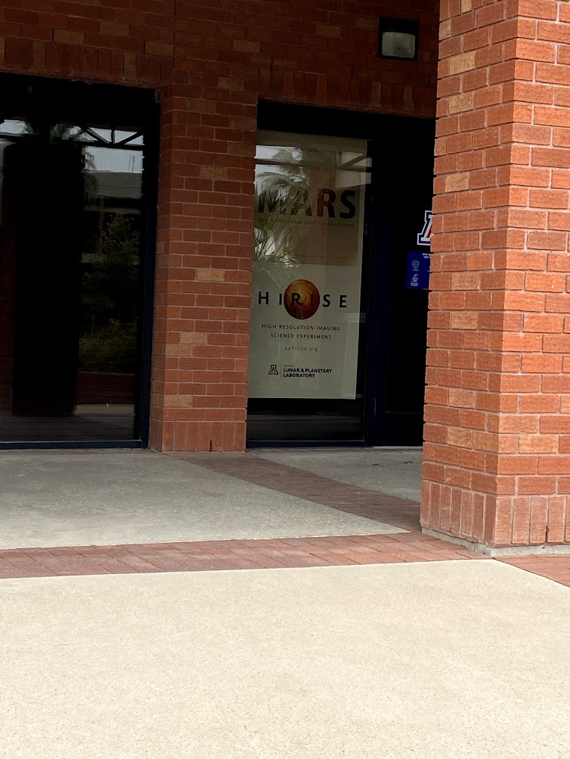
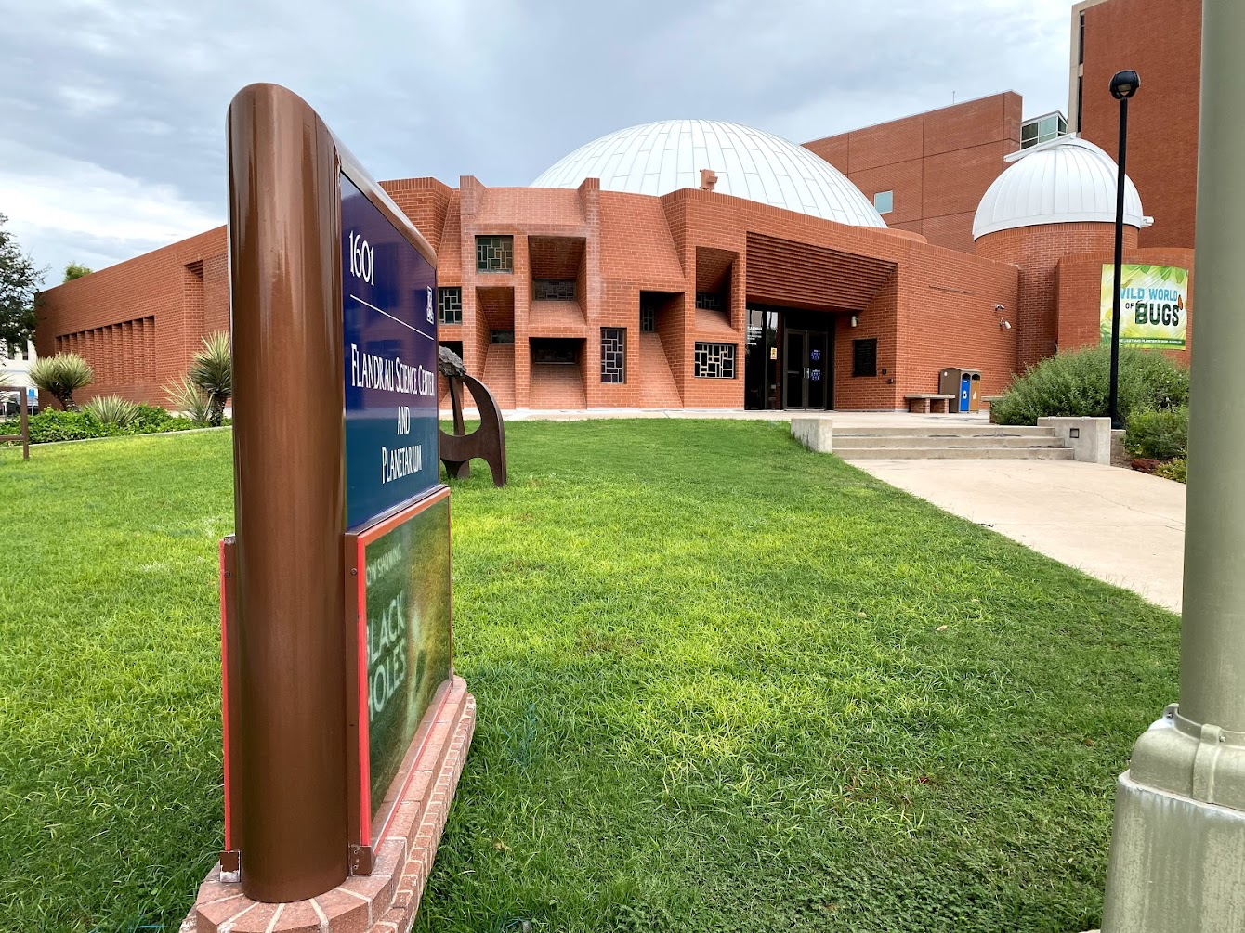
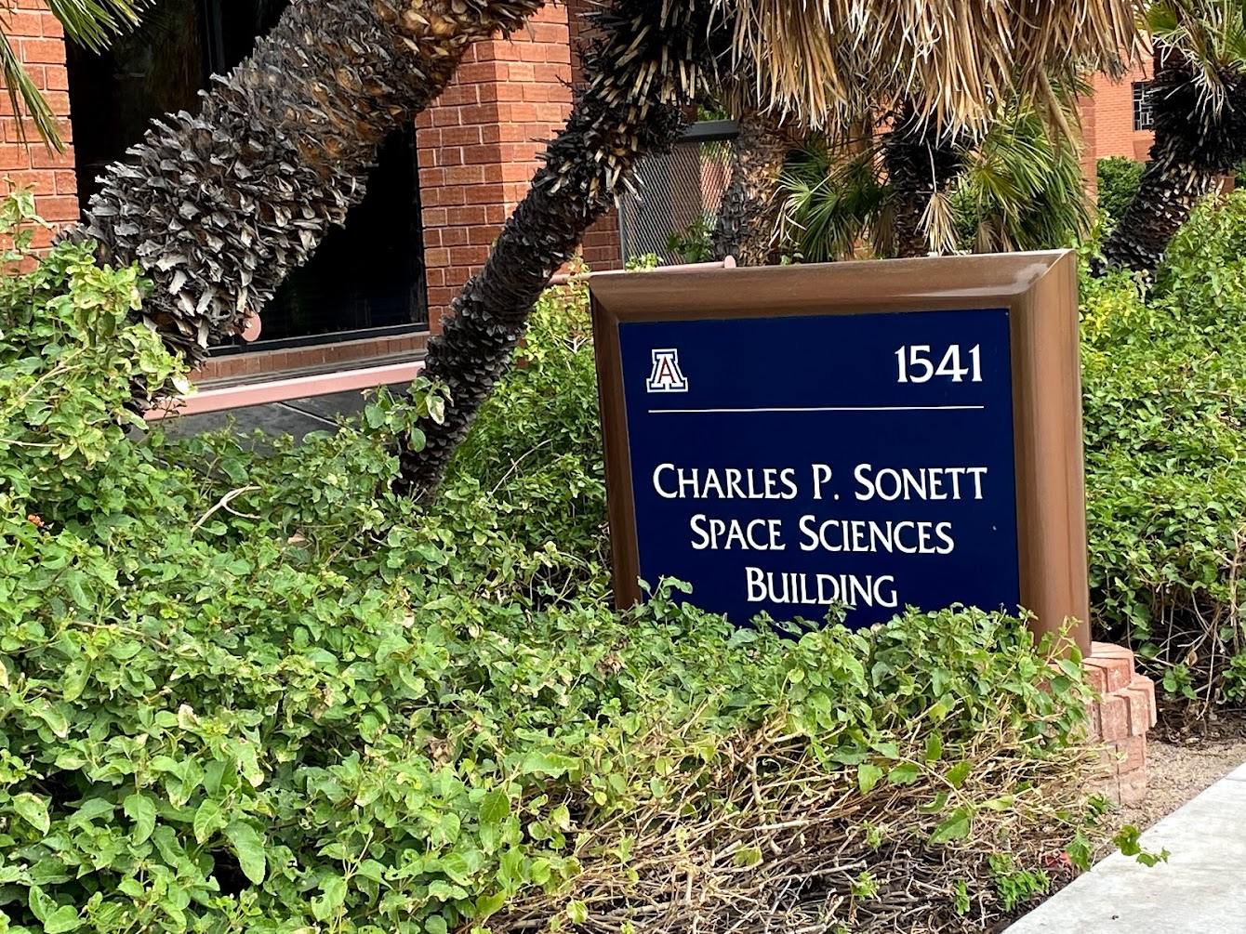
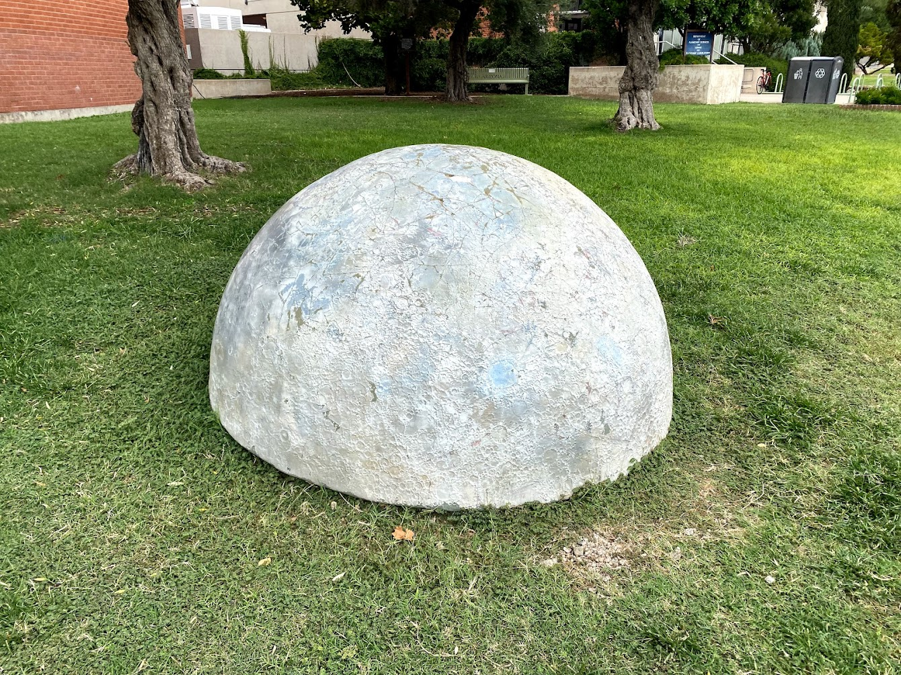
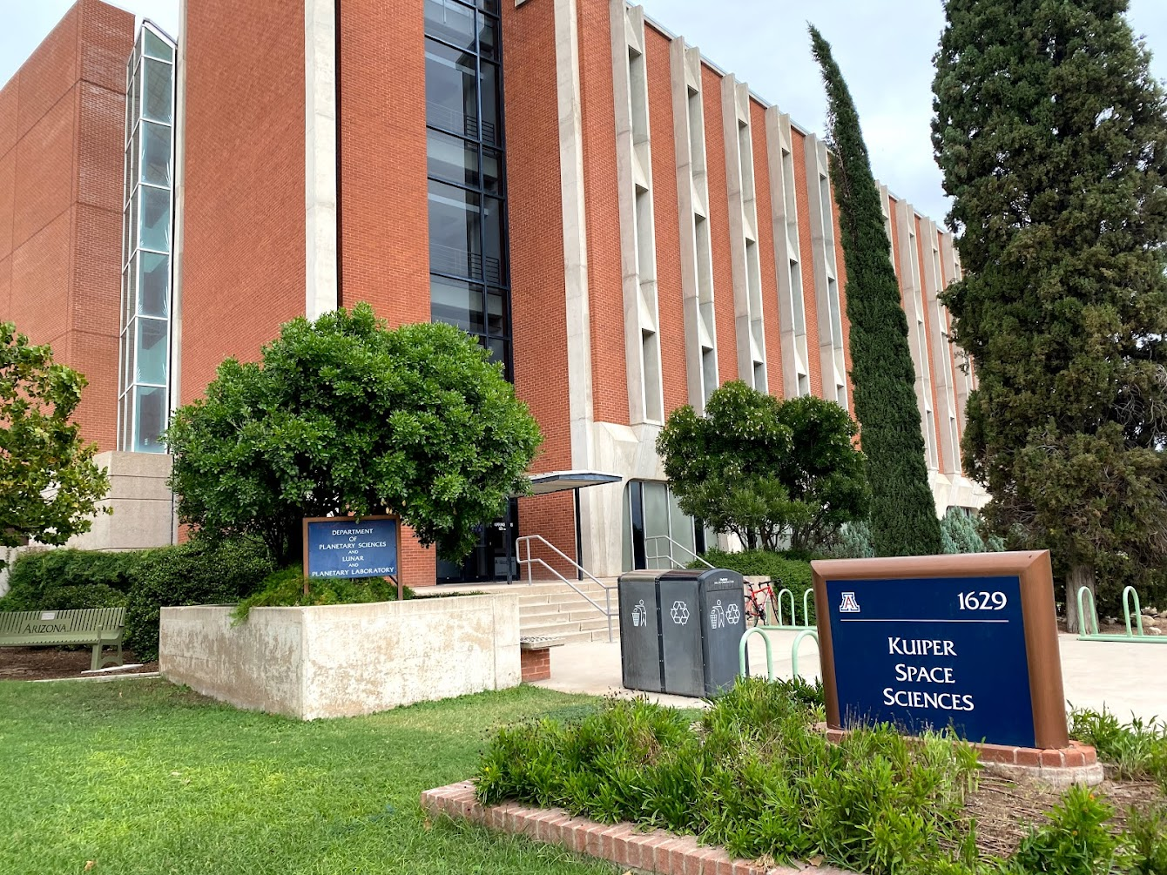

Slide 13
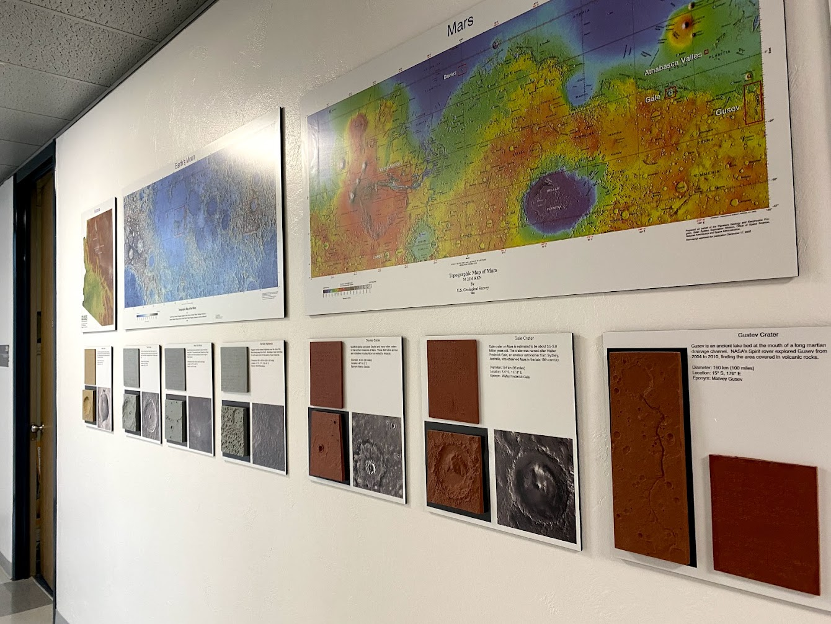

Slide 14
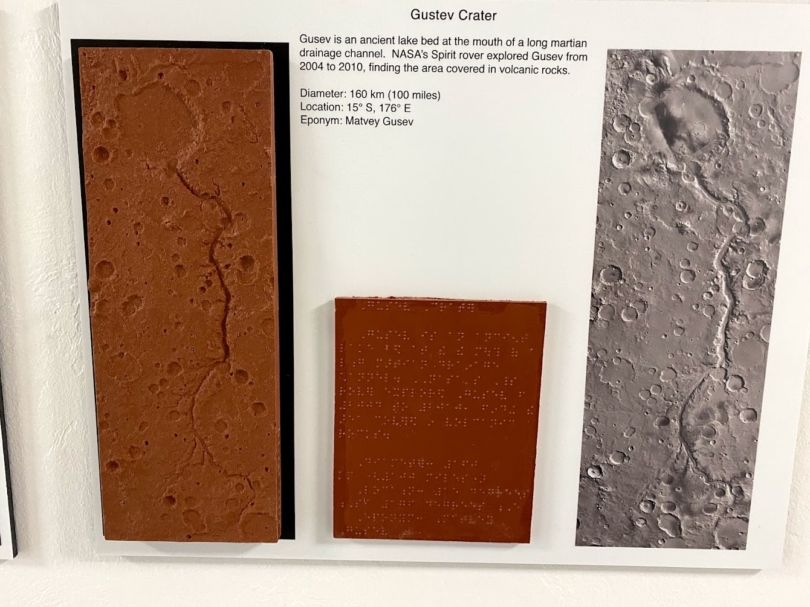

Slide 15
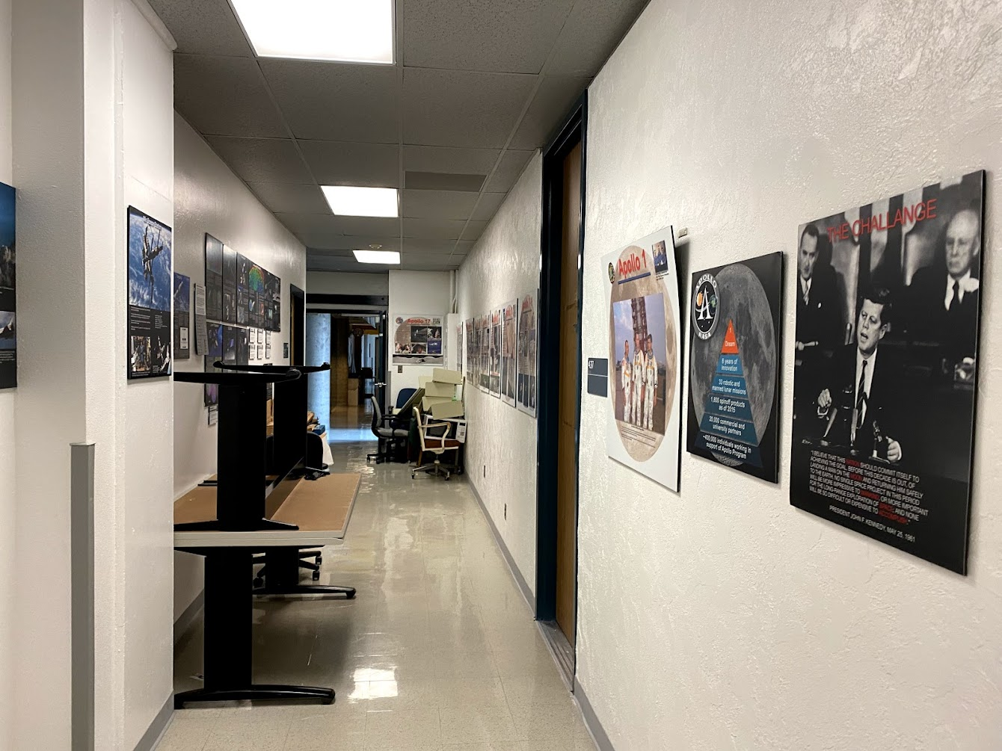

Slide 16
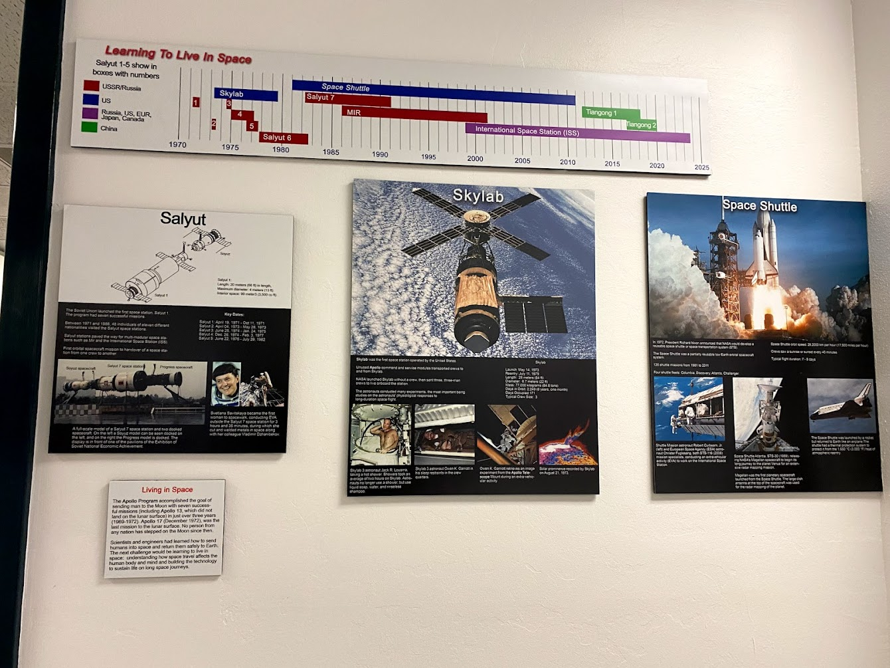

Slide 17
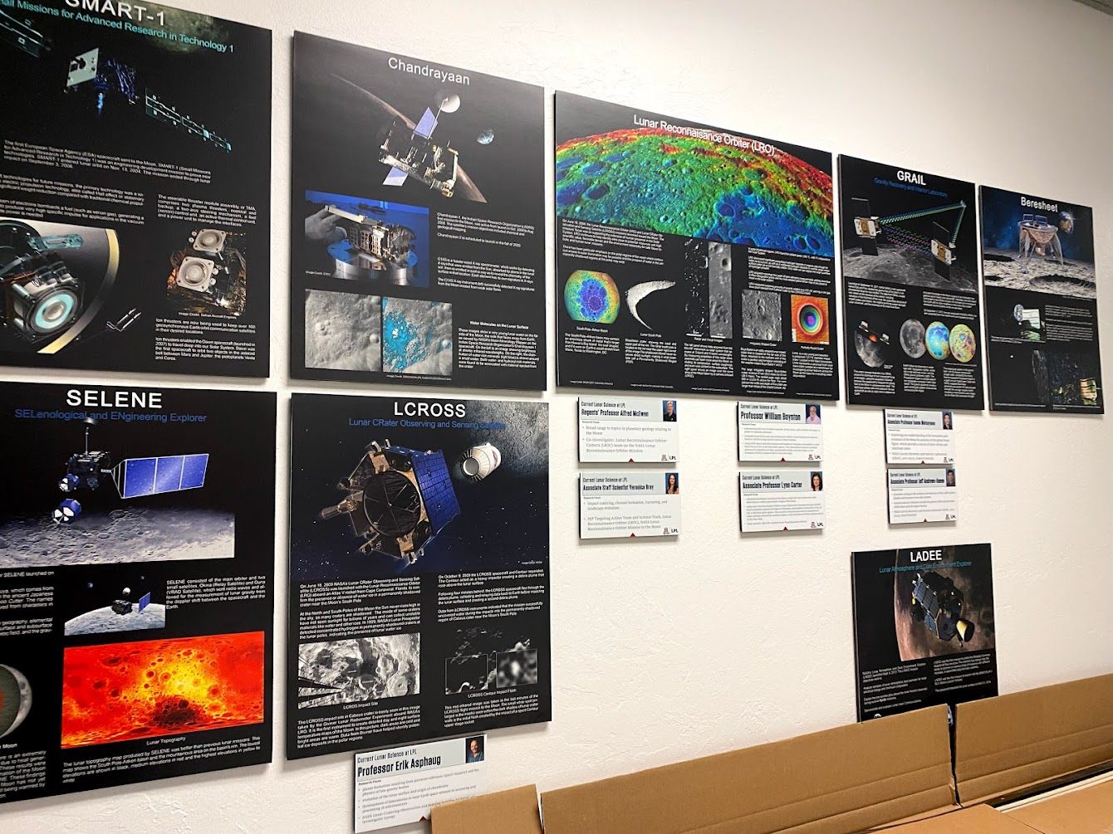

Slide 18
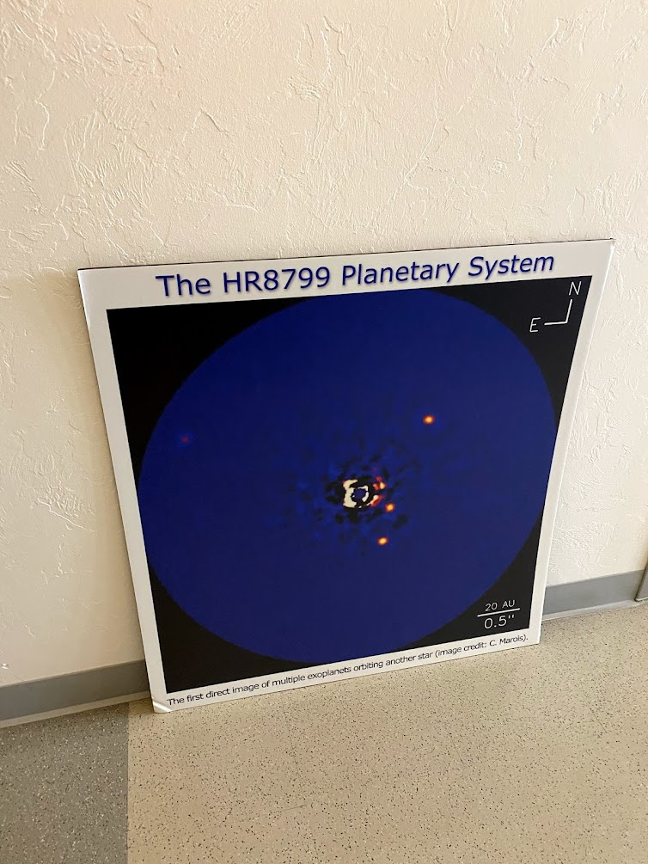

Slide 19
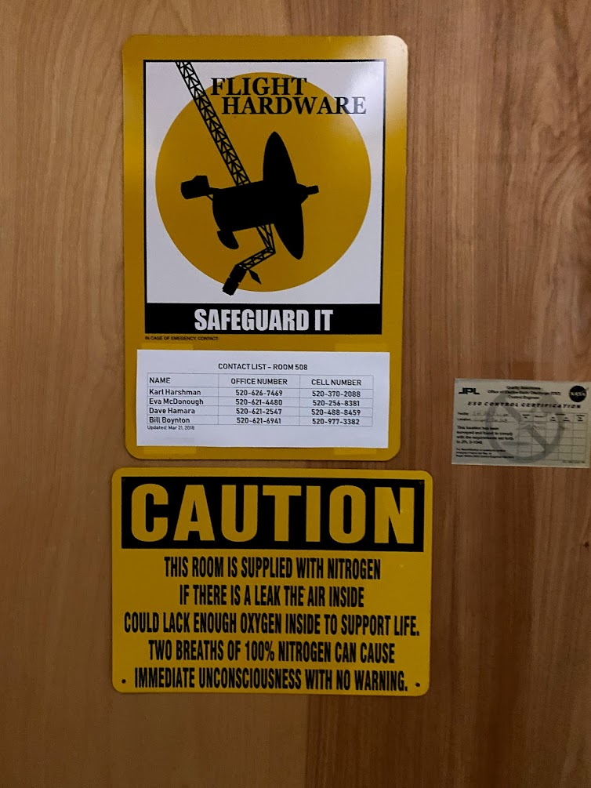

Slide 20
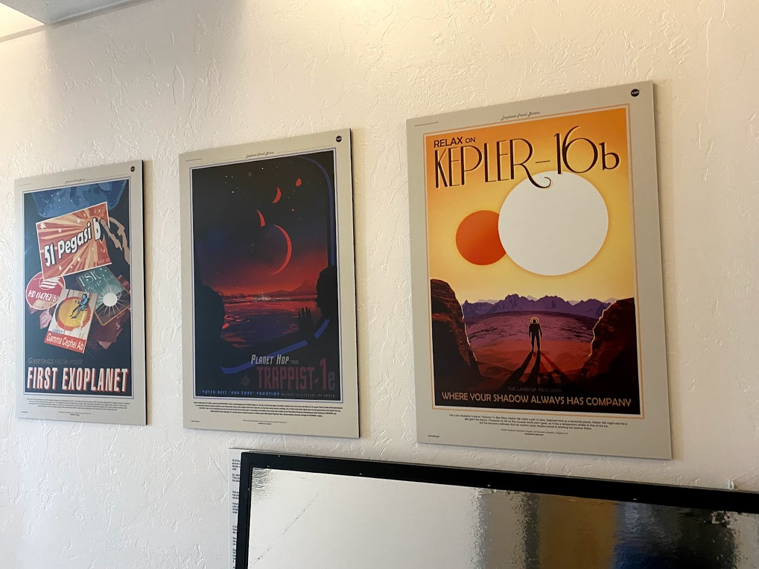

Slide 21
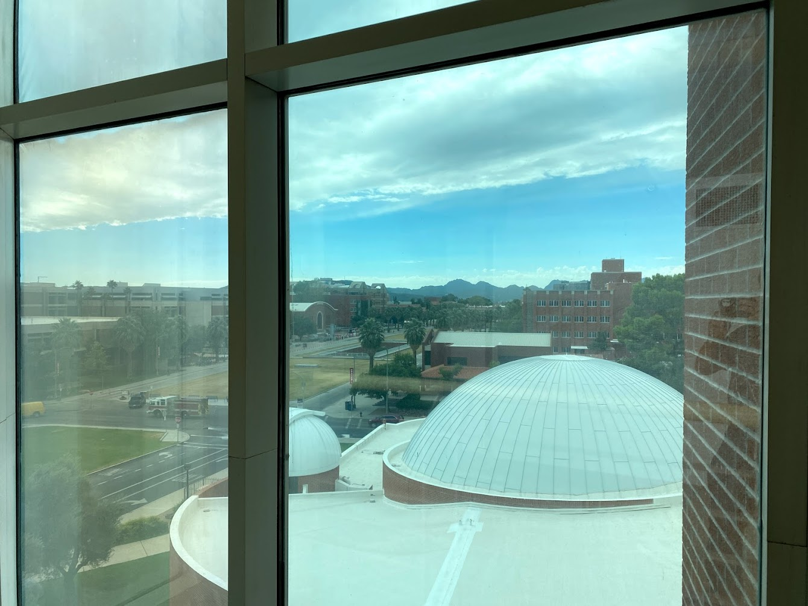

Slide 22
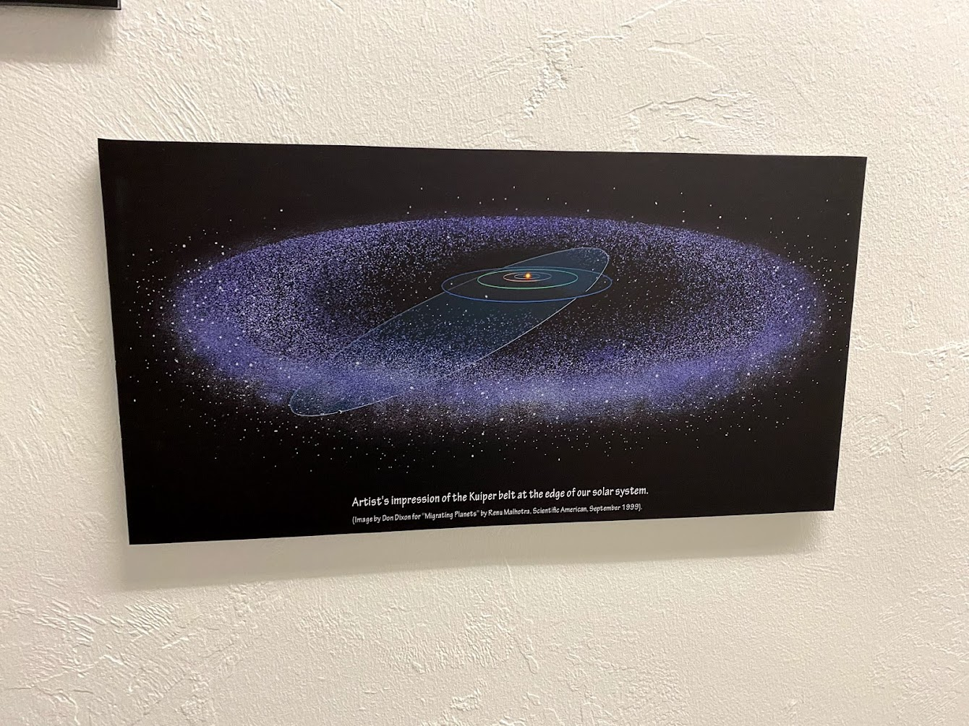

Slide 23
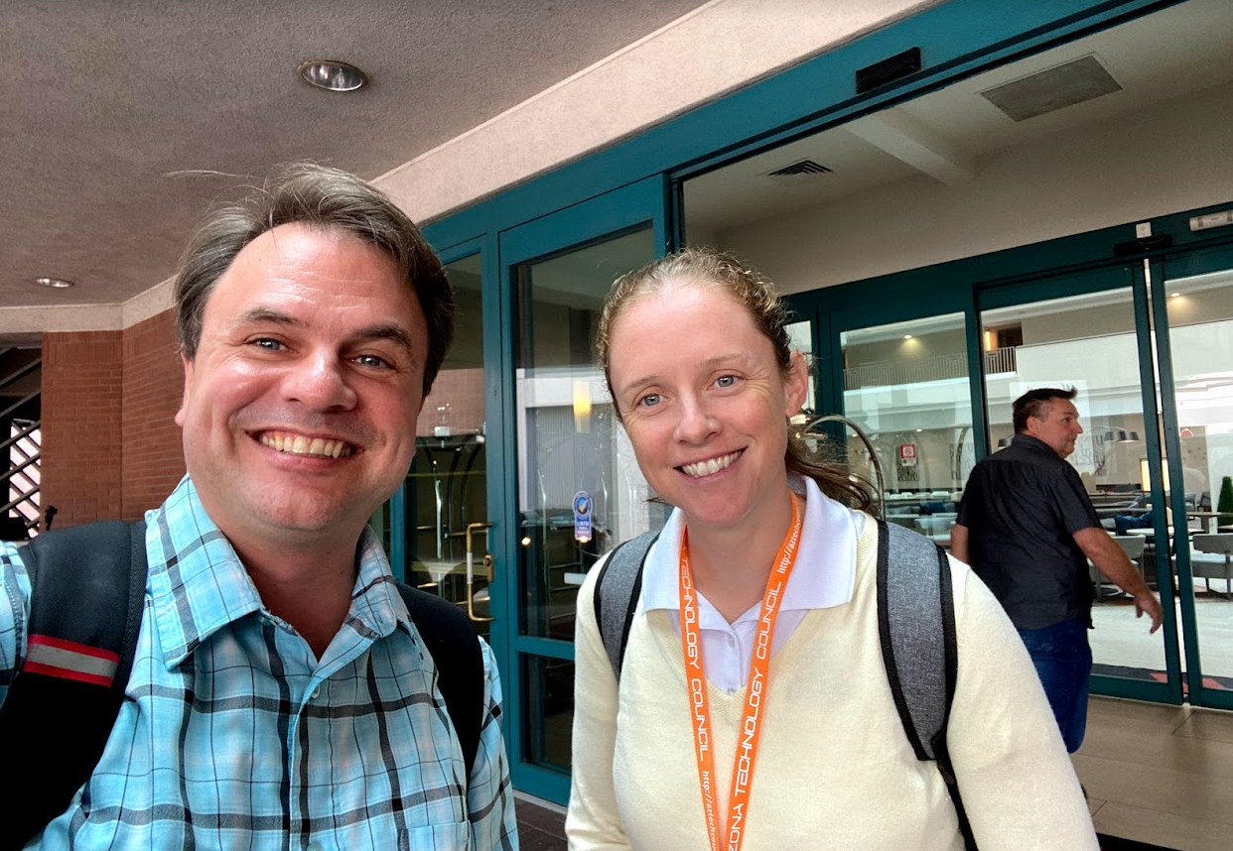

Slide 24
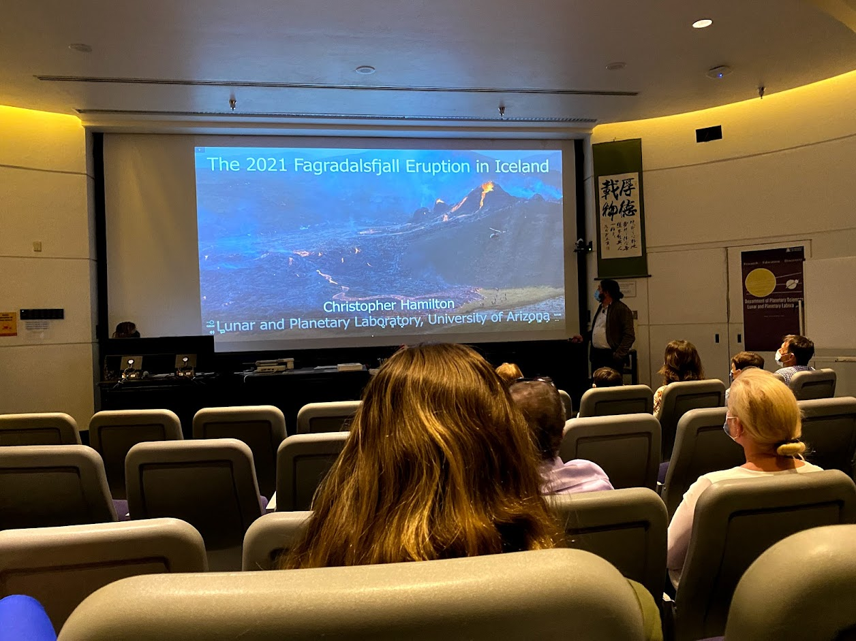

Slide 25
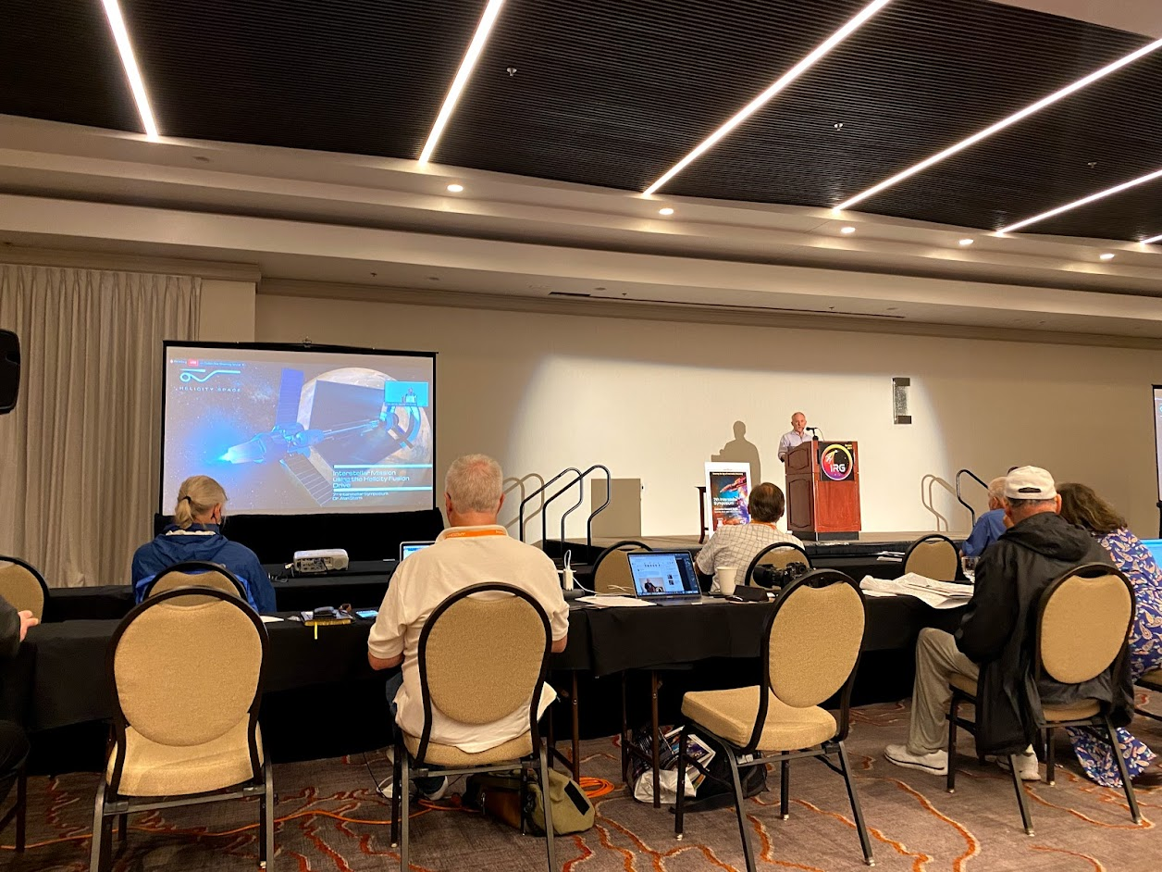

Slide 26
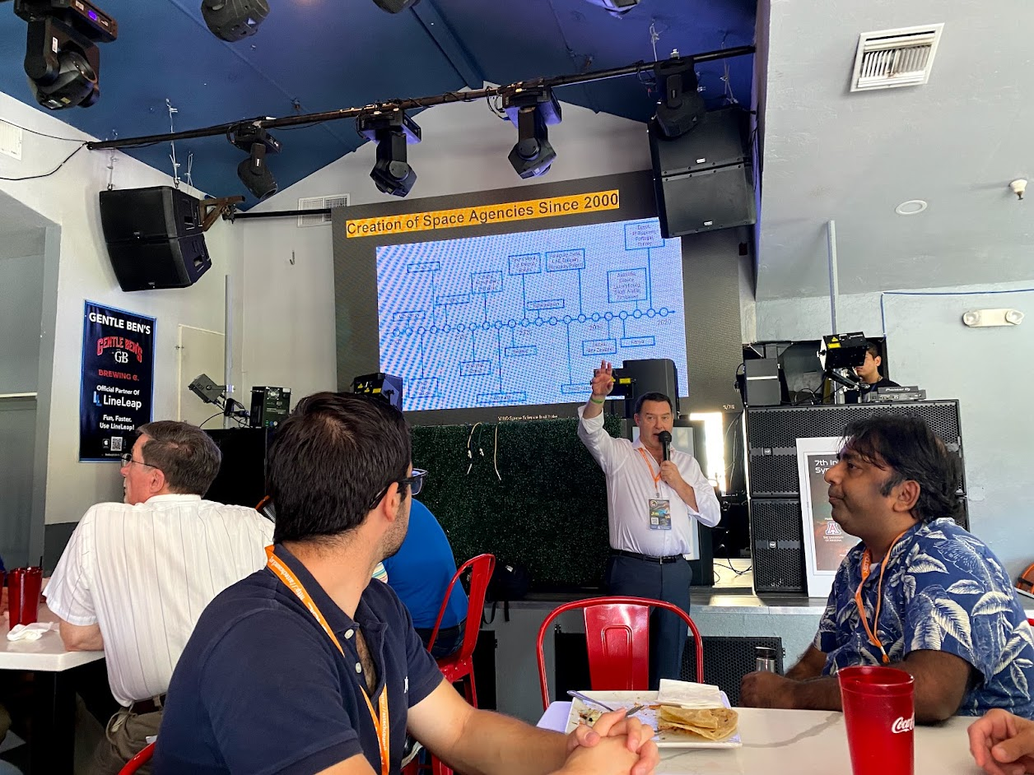

Slide 27
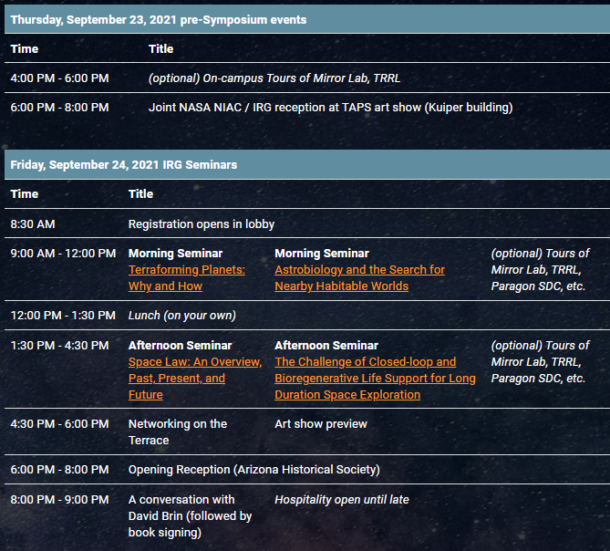
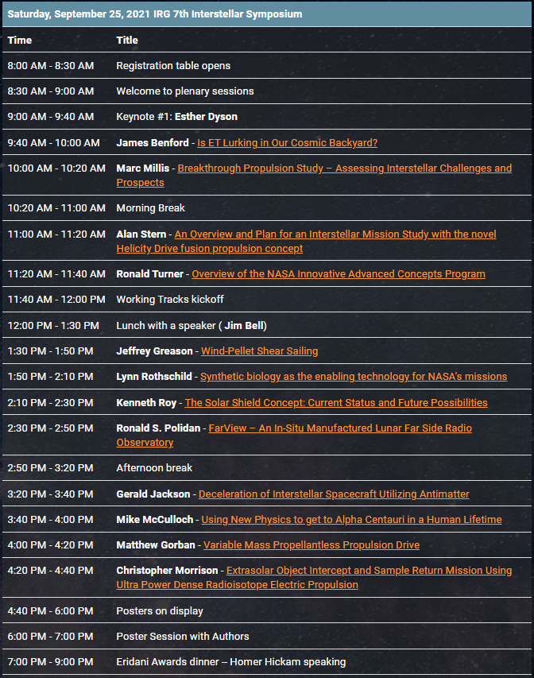
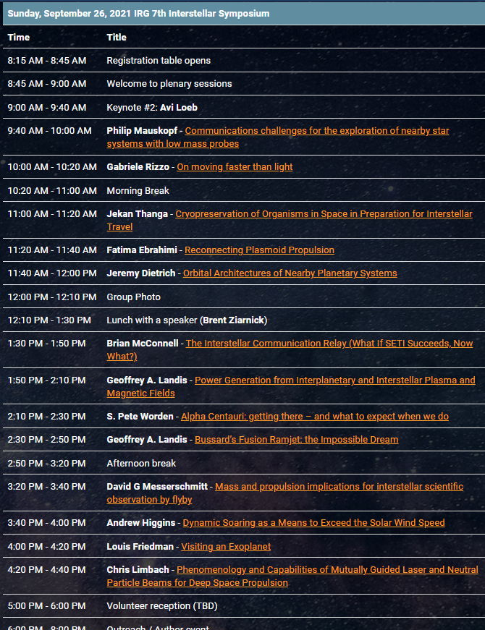

Slide 29
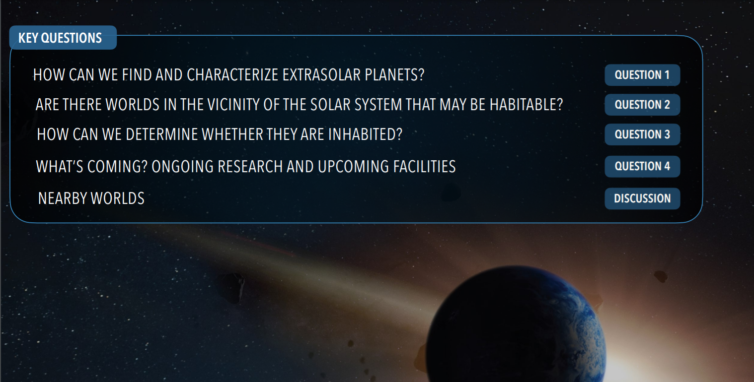

Slide 34
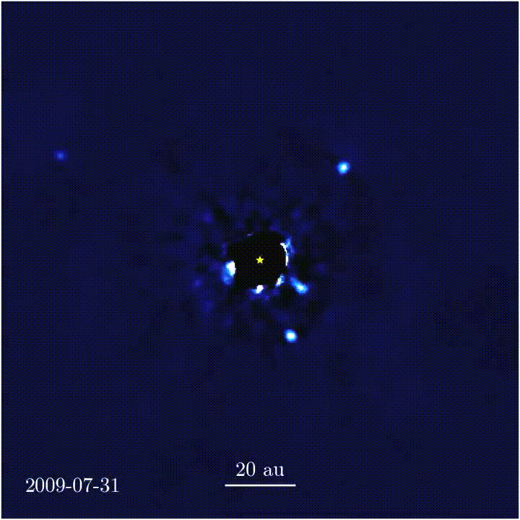

Slide 35
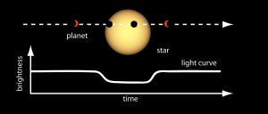
Transit Method

Slide 36
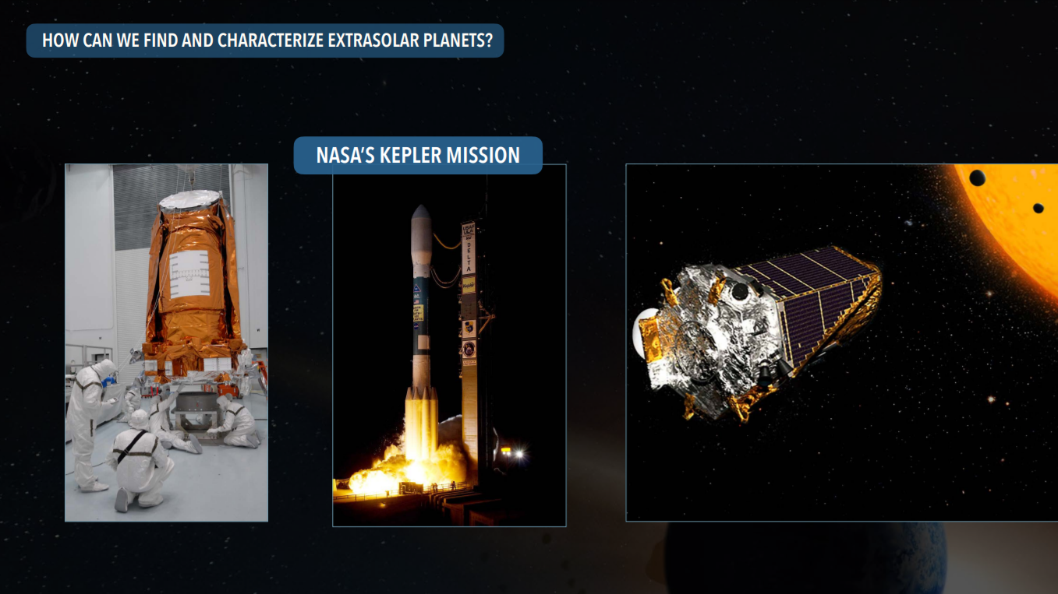

Slide 37
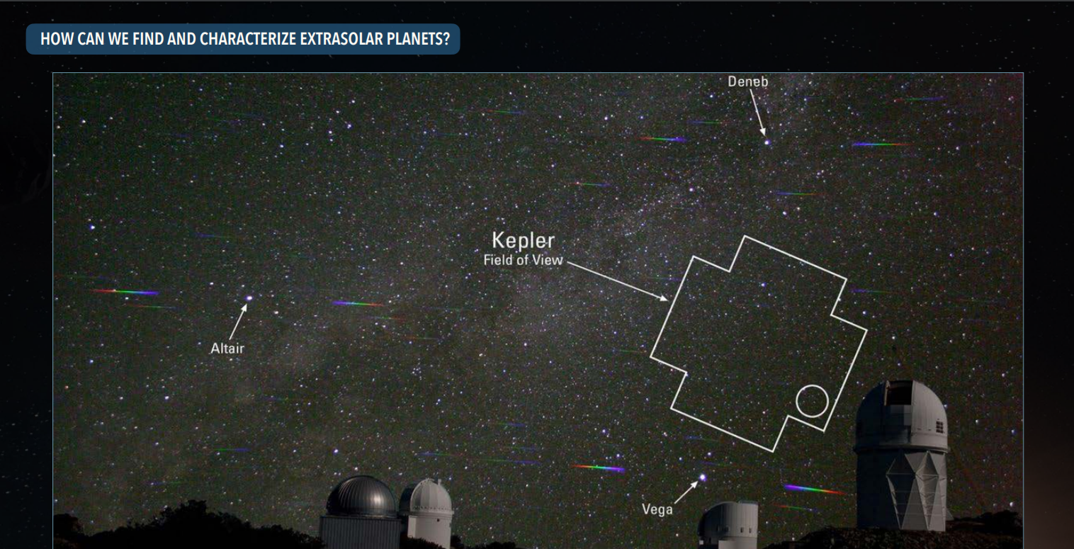

Slide 39
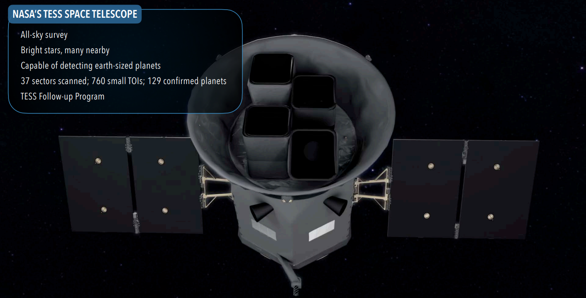

Slide 40
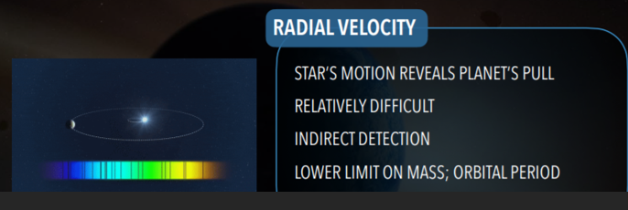

Slide 41
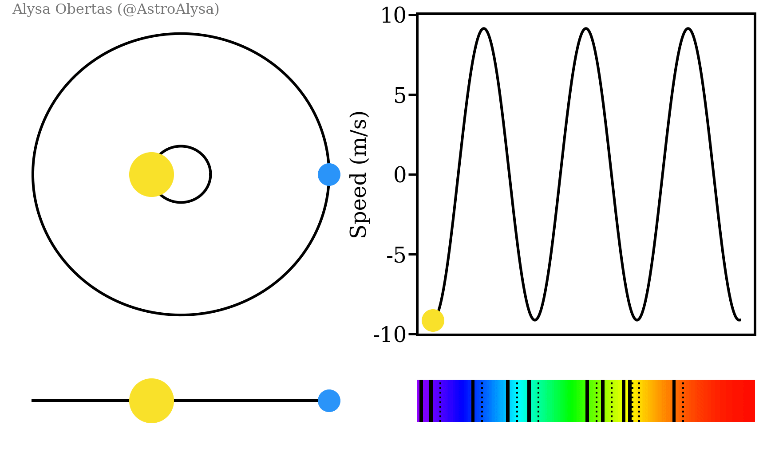
Notes:
https://upload.wikimedia.org/wikipedia/commons/c/cd/Radial_velocity_doppler_spectroscopy.gif

Slide 42
To see more
you need better Eyes

Slide 43
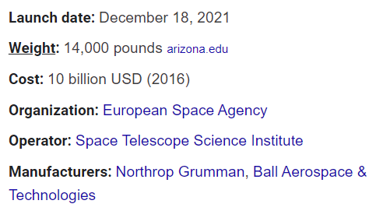
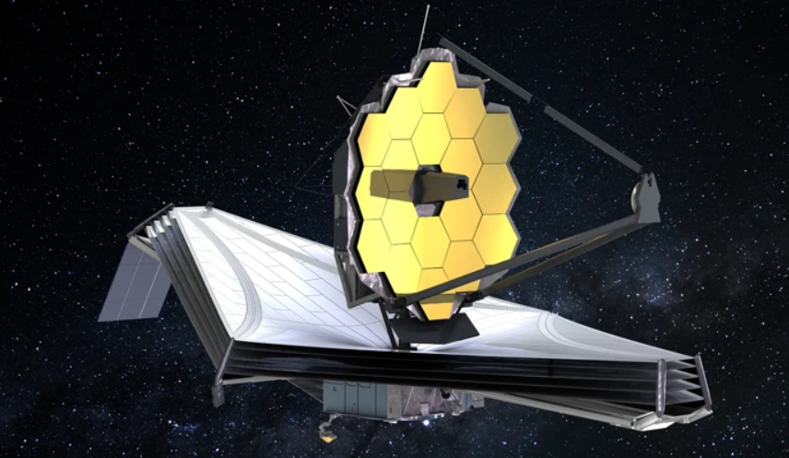

Slide 44
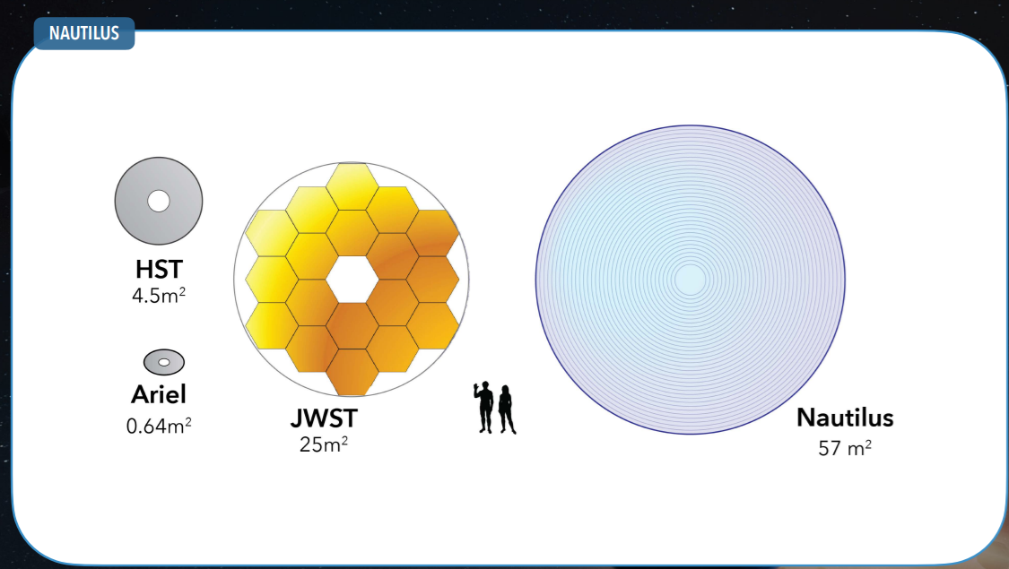

Slide 46
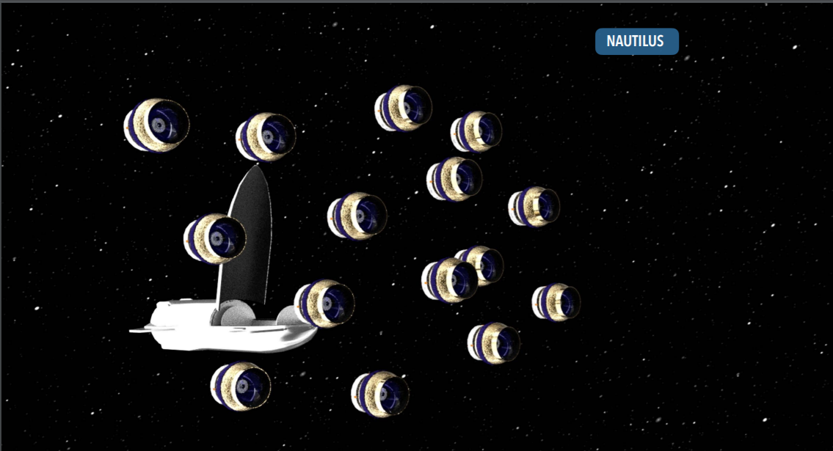

Slide 48
A Few More Topics to Breeze Through

Slide 49
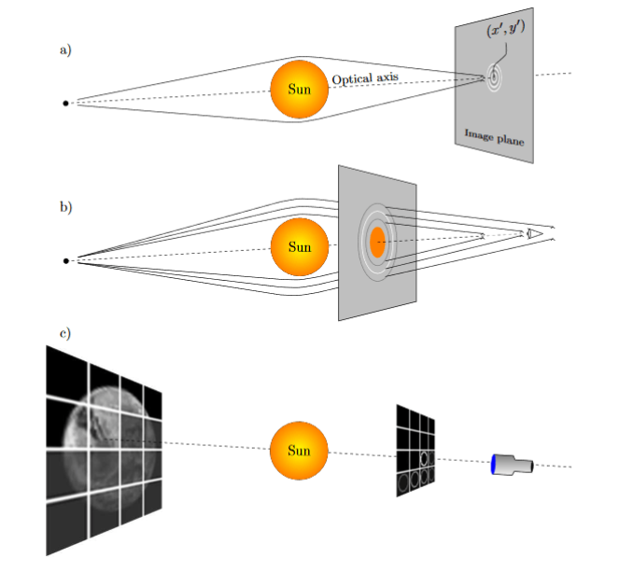
Gravitational Lensing

Slide 50
Break Through Starshot
Developing technology in the next 30 years that would allow for us to send a probe to the nearest star in the next 50 years

Slide 51
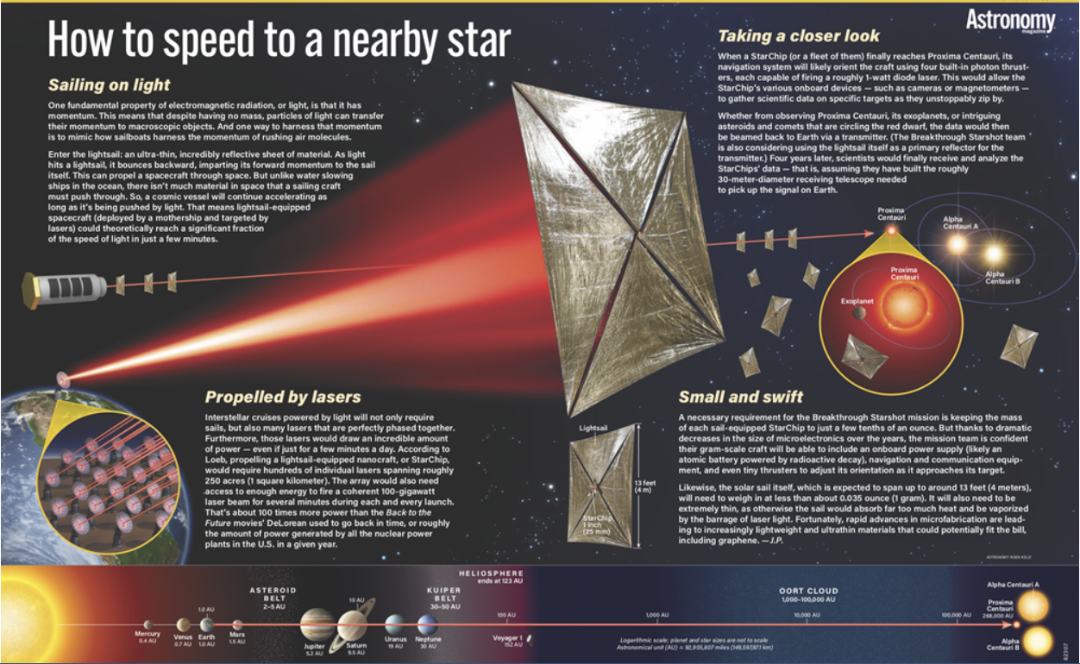

Slide 52
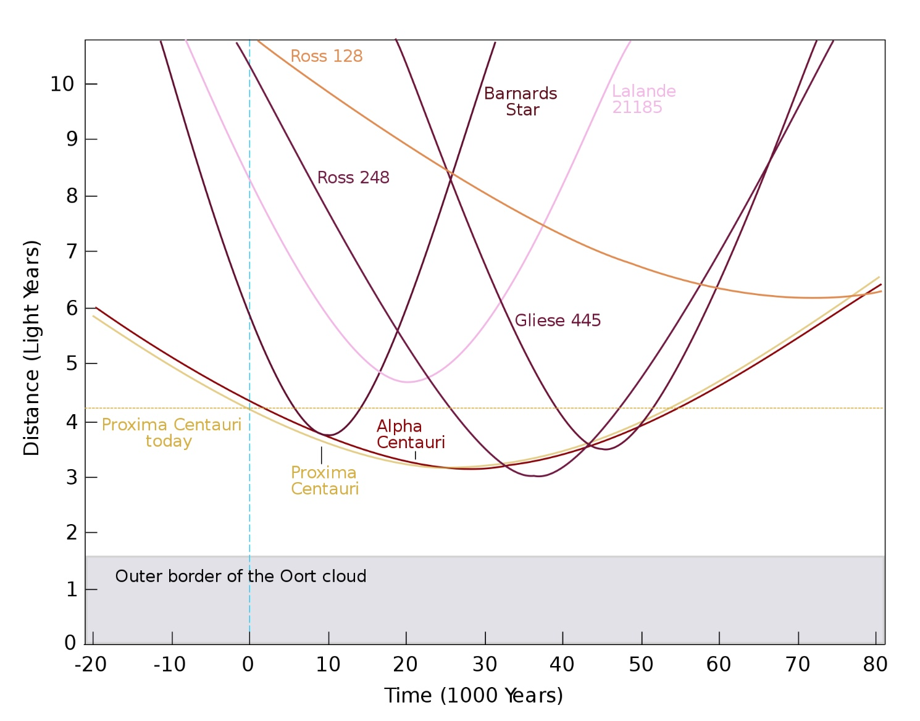
Stars move relative to the Sun. Stars come close to Earth frequently, ~2/Myr within 1 light year
Data provided by James Benford

Slide 53
by James Benford

Slide 57
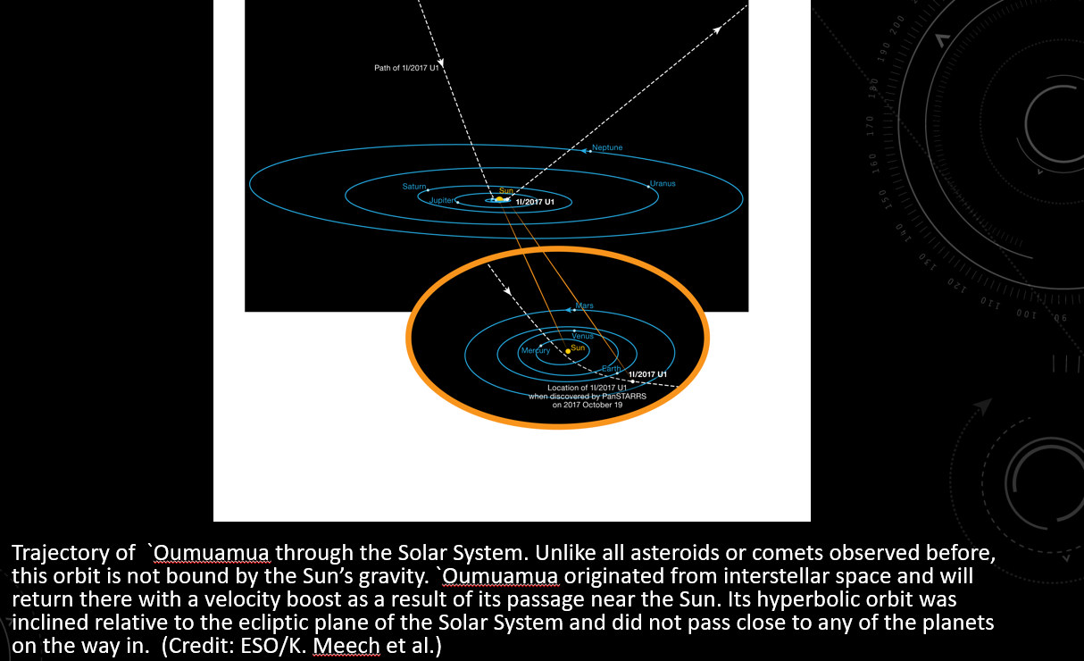

Slide 62
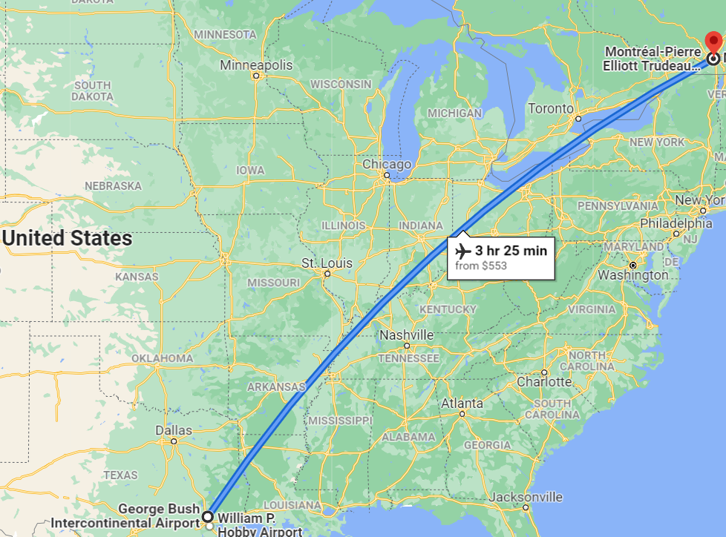
Next Interstellar Symposium
2023
McGill University
Montreal, Quebec
Canada
https://irg.space/

Slide 63
Questions? Feedback? Thoughts?

Slide 69
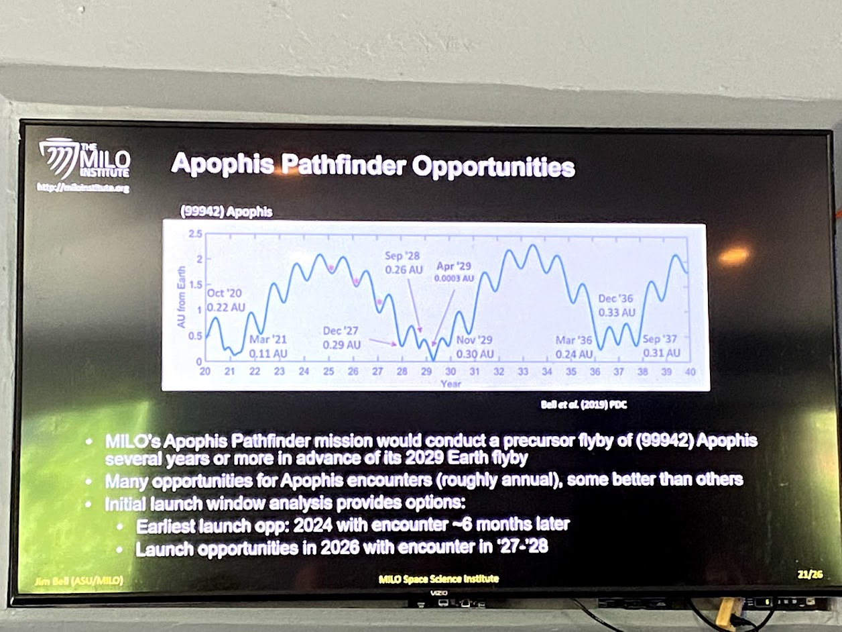

Slide 71
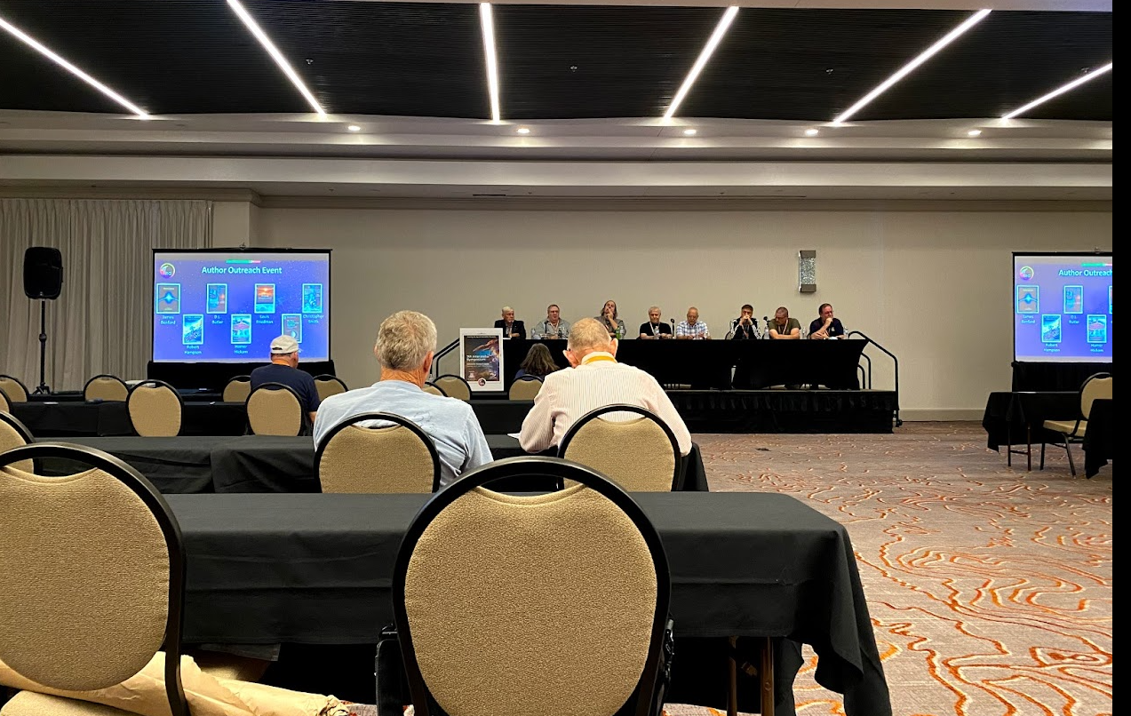

Slide 73
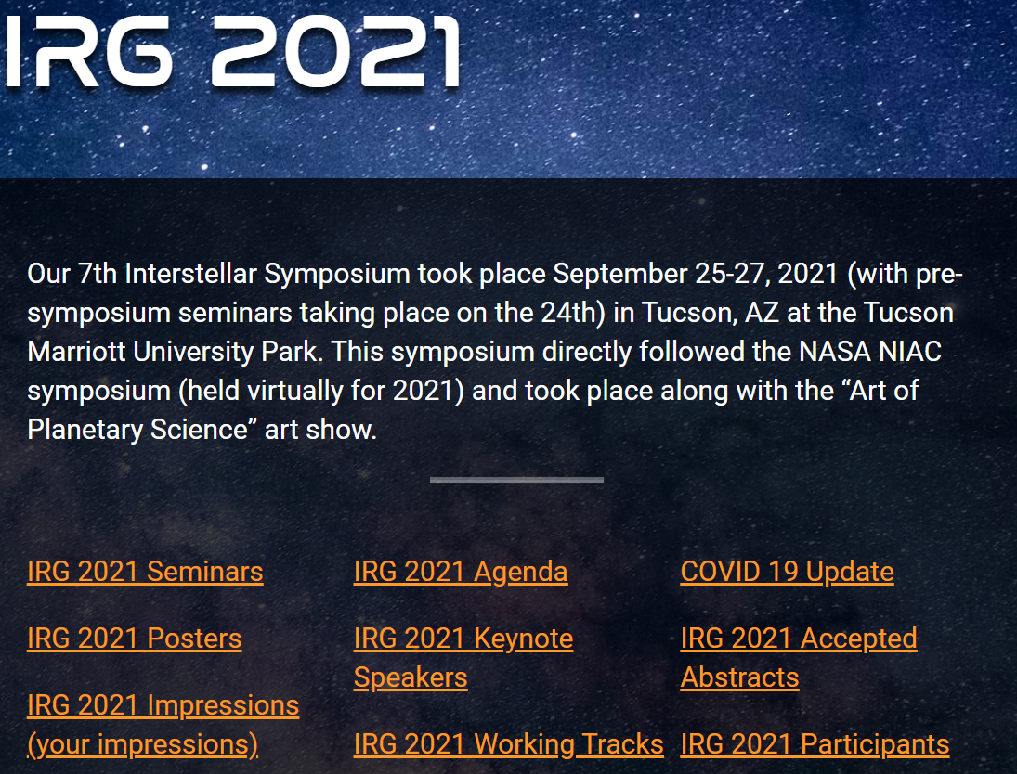

Slide 74
