Slide 1
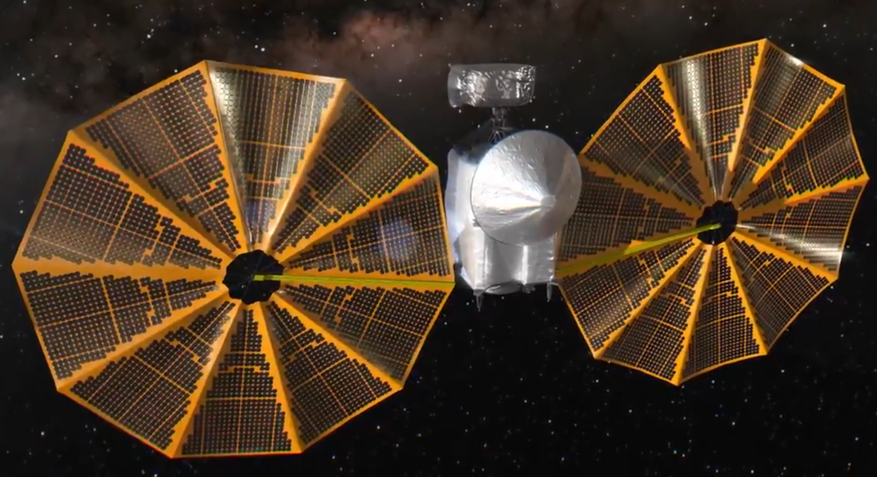
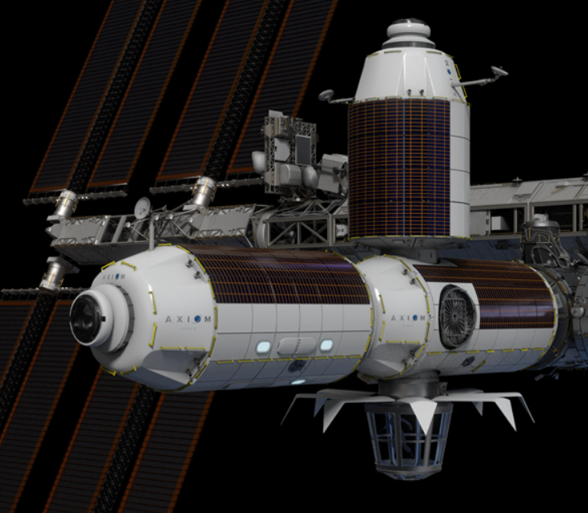
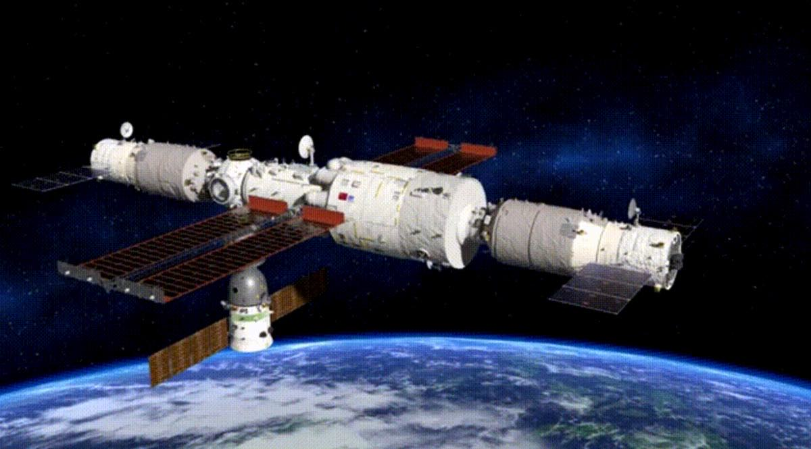
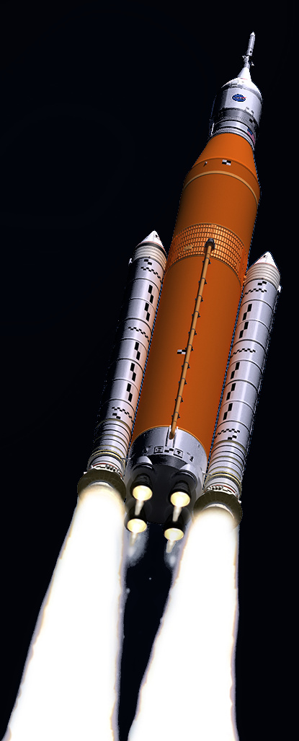
Monthly Space News
Greg Stanley
Nov. 6, 2021

Slide 2
Low Earth Orbit (LEO) news: Chinese space station
Chinese sent a second crew of 3 to their space station for 6 month tour
Under construction with initial target configuration of 3 modules in 2022
Cargo craft
Tianhe core module
Cargo craft
Diameter: 14 feet
Length: 120 feet
Shenzhou 13 crew spacecraft
Chinese space station configuration Oct, 2021 (artist illustration). Credit: CMSA

Slide 3
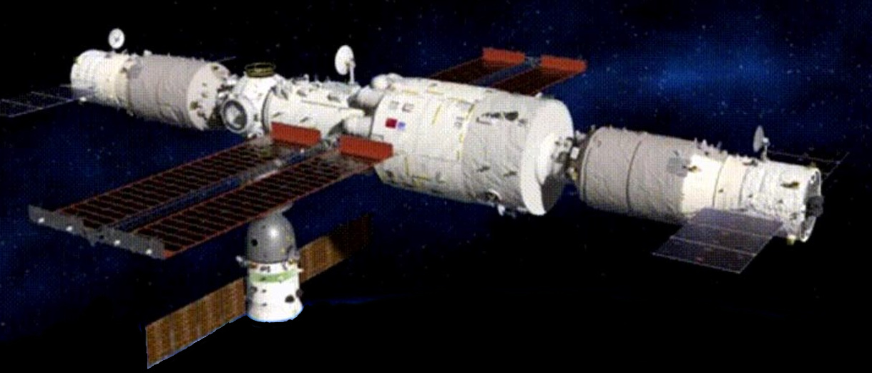
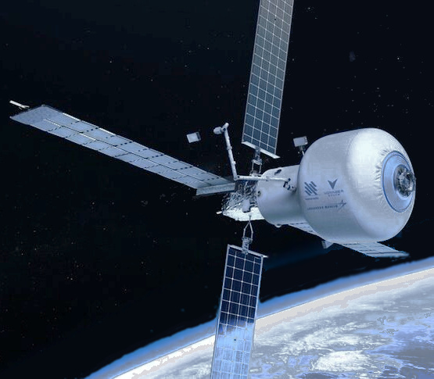
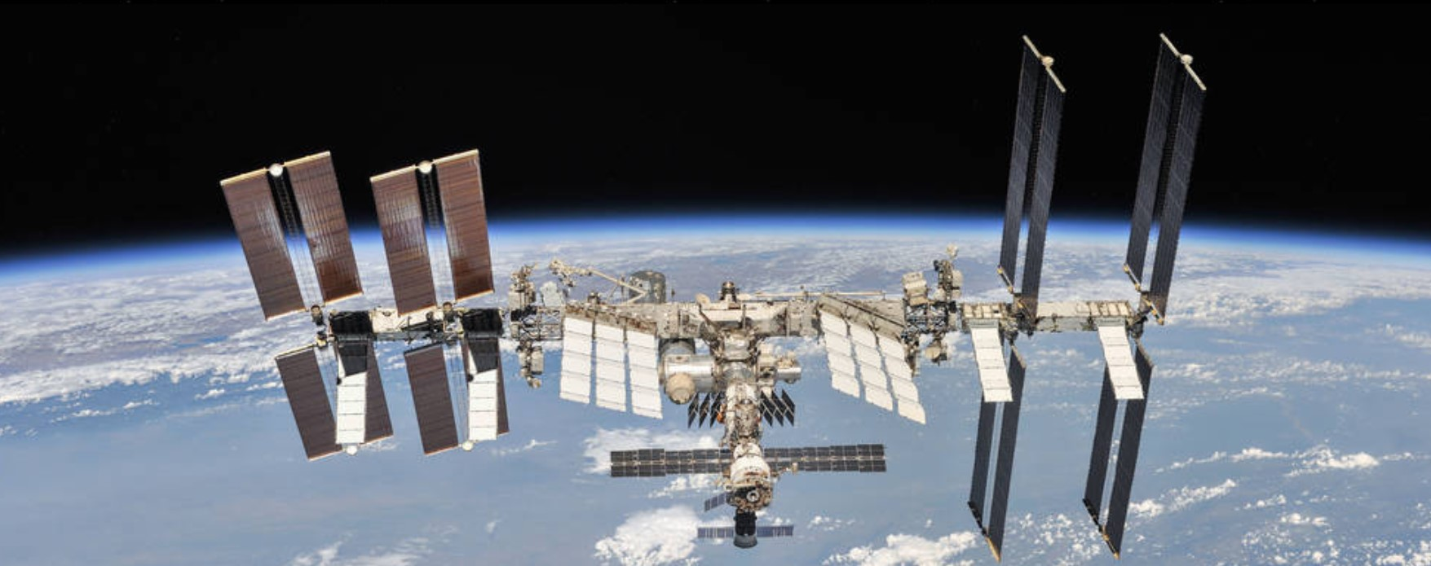
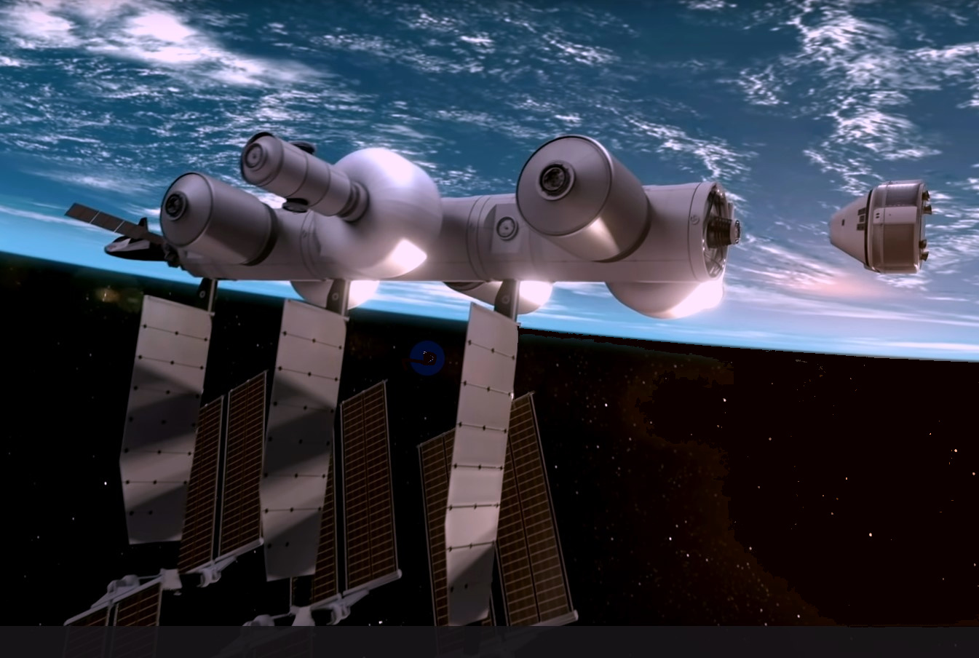
Space stations galore (potentially)
ISS life may be extended to 2028-2030, but the end is coming
Concern over stress cracks, air leaks in Russian Zarya module (the oldest - 1998)
Cost $150 billion to build, $4 billion/year to operate
Chinese space station
Axiom building detachable ISS modules, launching in 2024 ($140m NASA funding)
Axiom says it has lost some business to the Chinese station
NASA Commercial LEO Destinations Project (CLD) program analogous to Commercial Crew has proposals already, funding up to 4 at $400 million initially
Orbital Reef: Blue Origin/Sierra Space/Boeing/others
Starlab: Nanoracks/Lockheed Martin (2027)
Previous business failures: Bigelow Aerospace, Orion Span
Image credit:Axiom
Image credit:Nanoracks
Image credit:CMSA
Image credit:NASA
Image credit:Blue Origin

Slide 4
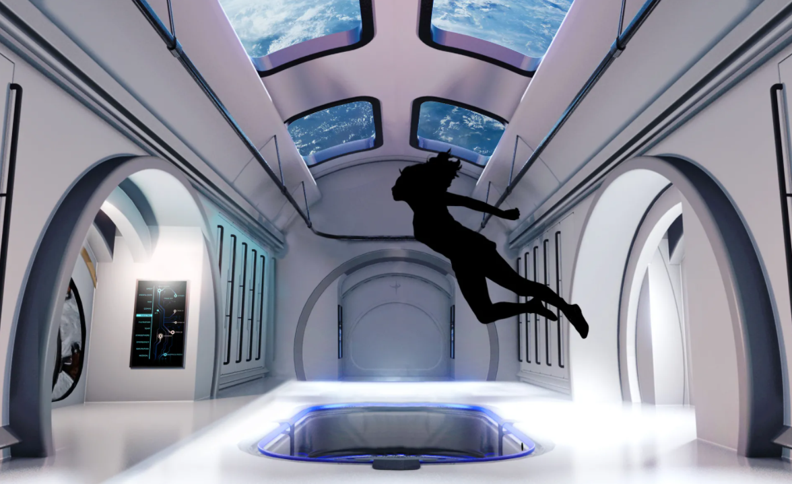
Orbital Reef: “Mixed use business park”, open spaces…
text
Image credit:Blue Origin

Slide 5
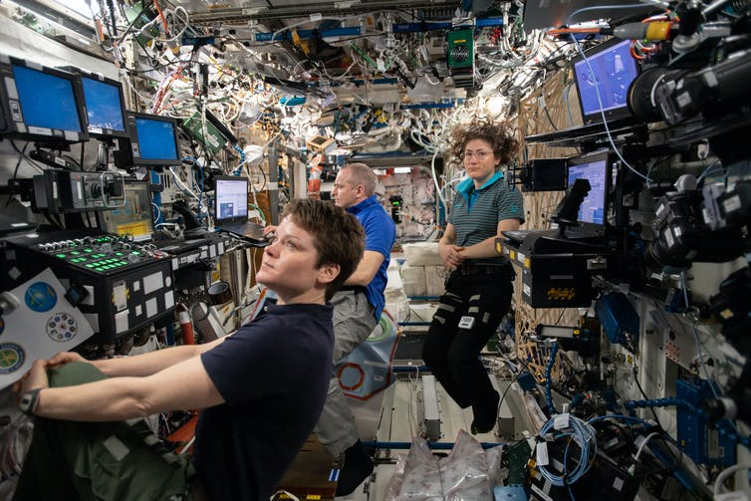
… compared to ISS (International Space Station)
text
Image credit:NASA

Slide 6
Movie making at the ISS (International Space Station)
Russian Soyuz took director, actress to the ISS to film “The Challenge”
Actress Yulia Peresild plays a surgeon making an emergency house call to ISS
After 12 days of filming, the director and actress returned to Earth
Real-life minor drama: Automated docking failed, Soyuz docked manually
Russians accidentally fired a thruster again, tilting ISS 57 degrees, destabilizing ISS for 30 minutes
Image credit:NASA

Slide 7
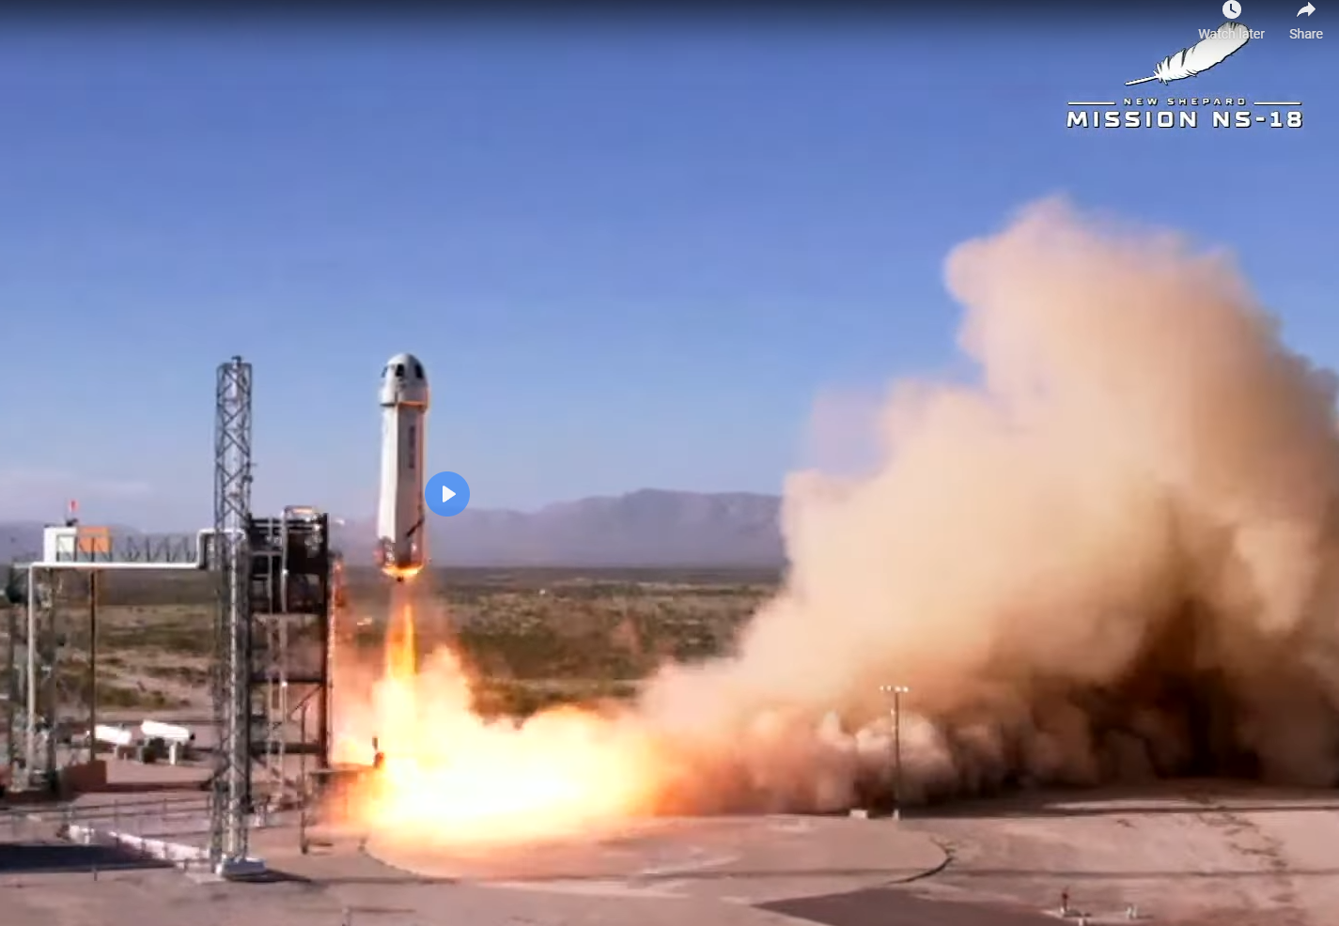
Suborbital space tourism starts a controversy
Captain Kirk (William Shatner) finally made it to the edge of space (66 miles/10 minutes)
Free ride on Blue Origin New Shepard suborbital flight
Now the oldest person to get to space (age 90)
But Prince William (British royal family) wasn’t happy about it…
Credit: https://flickr.com/photos/10246637@N04/38060065682
Credit: Blue Origin
Credit: NBC

Slide 8
Prince William is unhappy
“We need some of the world’s greatest brains and minds fixed on trying to repair this planet, not trying to find the next place to go and live”
Space vs. environment is a false dichotomy!
Space development and environmental stewardship are not mutually exclusive – each helps the other
Space programs are a major factor in providing data to enable climate modeling and understanding, and improving earth life
GPS, temperatures, cloud cover, ice extent, atmospheric composition, deforestation, land use, solar input, …
Modeling the environment is essential for settling space, and includes studies with much shorter time scales to see the effects faster than on earth
Even joyrides by a privileged few lead to an appreciation of earth
Environmentalism got a big jolt with the “Blue Marble” view of Earth from space
The vast resources of space will enrich humankind (material, energy, places to go, …)
Environmentally-friendly space solar power, specialized industry, new technology, diverse governments, new hopes and challenges for the human spirit, surviving cataclysms, …
Credit: Blue Origin

Slide 9
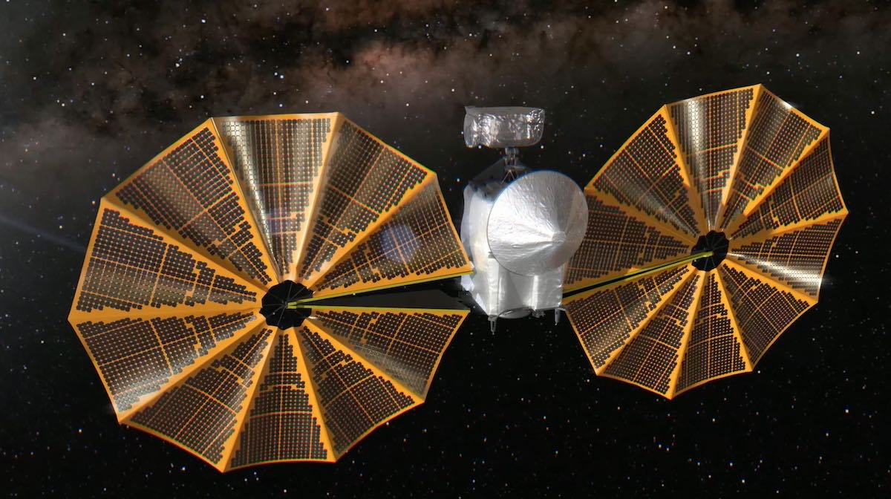
Lucy launched to explore 8 asteroids in 12 years
NASA’s Lucy will fly by Jupiter’s “trojan” asteroids
Asteroids trapped by Jupiter’s gravity near Lagrange points L4 and L5
Expected to be about the same as 4 billion years ago - window to the distant past
Will obtain detailed images, analysis with imaging spectrometers, temperatures, mass estimates by velocity changes through doppler effect
Solar powered. But one solar array didn’t fully open and latch. No action yet
Wingspan: 52 feet
Weight: 3,300 lbs (half propellant)
Artist’s visualization of modified Crew Dragon with glass dome observation window. Credit: SpaceX
Illustration of final phase of deploying solar arrays on NASA’s Lucy spacecraft. Credit: NASA

Slide 10
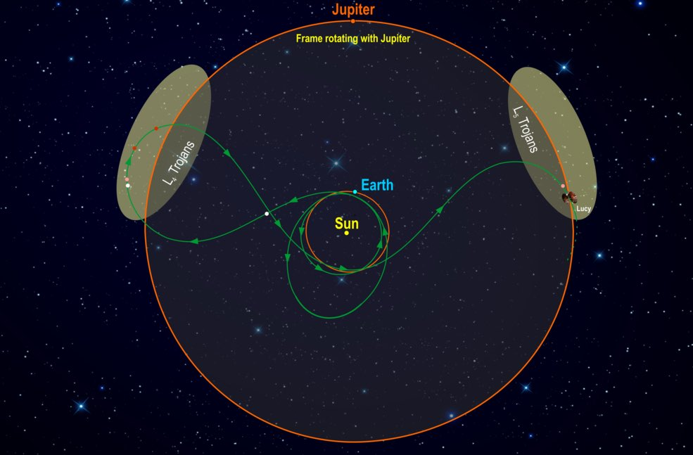
Lucy has a complex trajectory to save 80% of fuel
Lucy will fly by Earth 3 times for gravity assist!
Most distant use of solar power (usually nuclear power for deep space)
18,000 watts of solar power near earth, but only 500 watts near Jupiter!
Credit: NASA/SWRI (Southwest Research Institute)

Slide 11
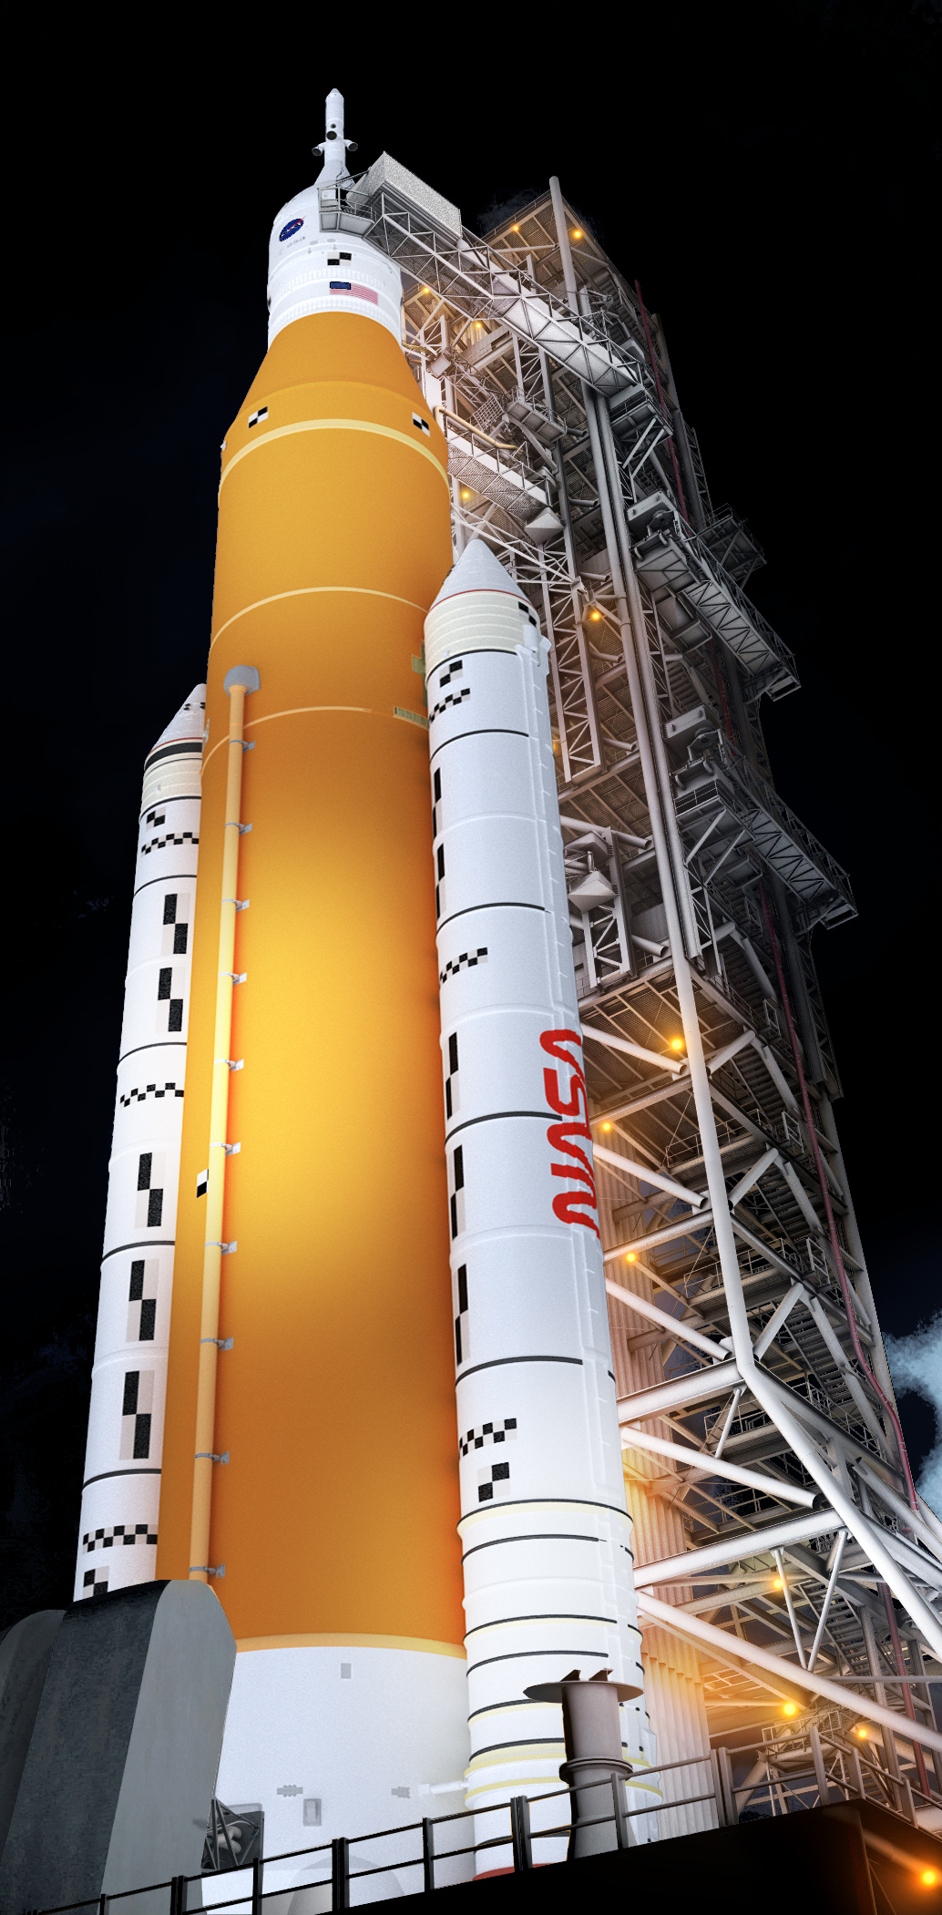
New NASA SLS (Space Launch System) controversy
Background on the SLS heavy launch rocket program
Started in 2011 by Boeing (prime contractor)
Original estimate: $10 billion cost, for launch in 2016
Now expected to first launch in 2022, after $21+ billion for the rocket & ground systems
Will use up 16 old Space Shuttle engines for first 4 flights (Congressional mandate), then use Aerojet updated copies
A key part of Artemis back-to-the-moon program
Dropped from NASA 2024 Europa Clipper due to delays, cost
Then-Florida Senator Bill Nelson was a political architect, steering billions to Florida for ground systems, etc.
“If we can’t do a rocket for $11.5 billion, we ought to close up shop” (Bill Nelson, 2011)
New NASA RFI (Request For Information), under NASA administrator Bill Nelson
Wants proposal by January 27, 2022 to fly SLS rocket for 30 years, with one crewed flight per year for the next decade
A “sustainable and affordable system” by saving 50% off “baseline per flight cost” (not stated)
(Cost of one launch was estimated by OMB at over $2 billion in 2019), vs. Starship where estimates are in units of millions
Image credit:NASA

Slide 12
SLS controversy
SLS detractors say competition offers much lower costs
Technology changes faster now: we shouldn’t have 30-year time horizons
This is just old-school NASA/defense-style “pork”, appeasing Congress
Reusability, pioneered by SpaceX, is now proven to lower costs
Entire industry is planning to shift to reusability
SLS is disposable, although the old Shuttle engines could be reused
In orbit refueling with reusable craft (Falcon Heavy) would be cheaper
Entire Starship development expected to be $5 billion, largely self-funded
One flight per year is too low to achieve cost savings, and no one but NASA would pay the high SLS price
Some think this RFI is a maneuver by Nelson to force Boeing and Congress to give up after the initial few SLS launches , since they couldn’t really make SLS “sustainable and affordable”
Image credit:NASA

Slide 13
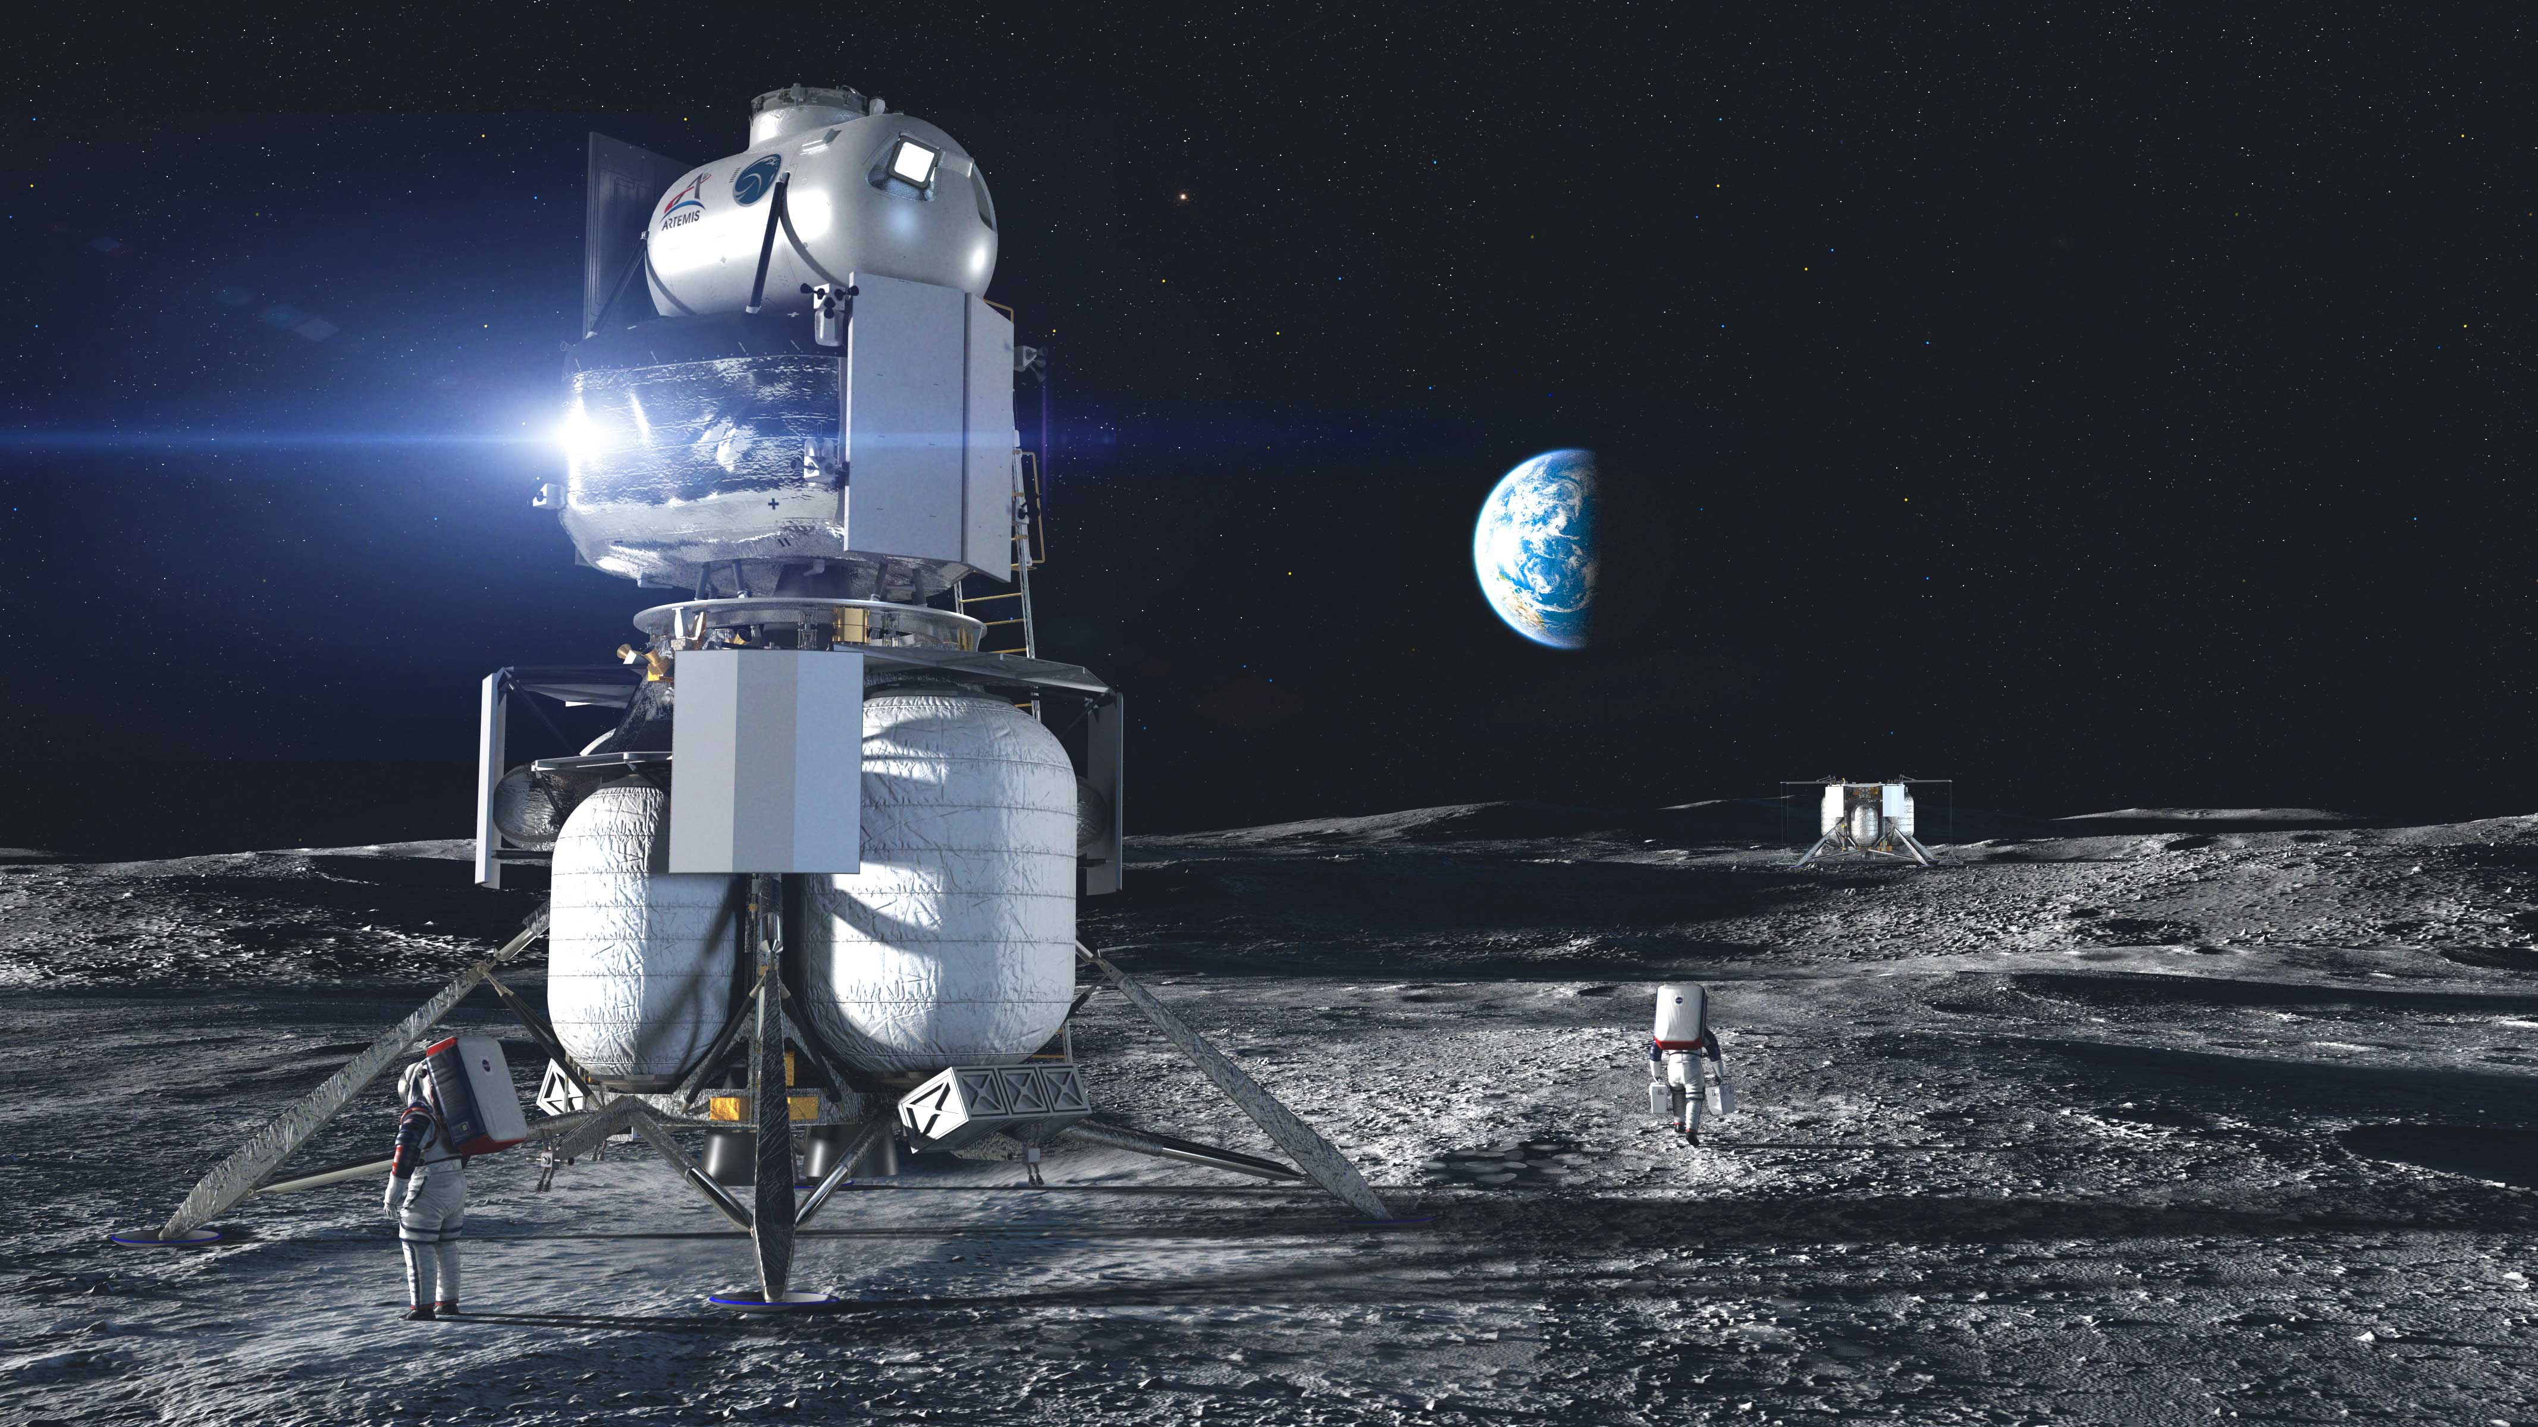
The first Artemis HLS contract dispute may be over
A federal judge dismissed the Blue Origin lawsuit over NASA’s awarding the first Human Landing System contract to SpaceX for a manned lunar landing
Jeff Bezos conceded gracefully in a tweet. But…
Elon Musk tweet (quoting 1995 movie Judge Dredd:
Credit: Blue Origin

Slide 14
X-37B Space plane lands after record 780 days in orbit
What are they? (At least 2, also known as OTV = Orbital Test Vehicle)
Reusable, autonomous mini-shuttle (robotic space plane) built by Boeing
¼ size of the Space Shuttle (29 feet long, 15 feet wingspan, 11,000 lbs)
Miniature payload bay for satellites or experiments
Launched on Atlas V or Falcon 9 rocket, Mach 25 deorbit, glide to land on a runway
History
Started by NASA (1999), transferred to military classified project since 2004
First orbited by USAF (2010), now U.S. Space Force
What do they do? It’s classified, but officially…
“Demonstrate technologies for a reliable, reusable, uncrewed space test platform” for the U.S. Space Force
Focus on reusable spacecraft, operating experiments which can be returned to Earth
Photo credit: US Air Force

Slide 15
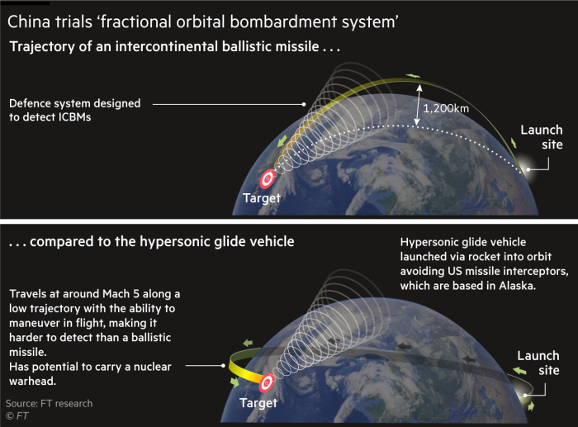
August Chinese hypersonic missile tests? Space plane?
China denies testing a nuclear-capable hypersonic missile twice
China didn’t announce launches, but now says they tested a reusable space vehicle
If true, indicates Chinese program is more advanced than we thought
China, U.S., Russia, maybe N. Korea, lead work on hypersonic weapons
General John Hyten says U.S. is falling behind due to risk-averse culture
Claim: in last 5 years the U.S. did 9 hypersonic missile tests, China did hundreds
Rocket launched and flies partly through a Very Low Earth Orbit (e.g., 150 km)
Circling earth in this test -- could stay in orbit for a while, attack from space
De-orbit burn & release glider
Hypersonic glide down to target
5x the speed of sound: slower than a ballistic missile
Maneuverable, lower trajectories, does not follow a fixed parabolic trajectory
Hard to track, impossible to intercept with current defense
Could fly over South pole: challenge since U.S. defenses are focused on Northern polar route
Image credit: Financial Times

Slide 16
Hypersonic gliders aren’t a new concept
Explored since the 1960s by Russia, US, …
Any craft returning from Low Earth Orbit is hypersonic: 17,000 mph/Mach 25
Space Shuttle was a controllable hypersonic glider, like other space planes
Difference? Space planes are less aerodynamic, landing gear, no explosive payload
China fielded the mobile Donfeng DF-17 medium range ballistic missile in 2019, equipped with a DF-ZF hypersonic glide vehicle
Conventional (or nuclear?) warhead
Range 1,100 – 1600 miles
No defense against these
Dongfeng-17 hypersonic glider in military parade, 2019. Image credit: Zoya Rusinova/ Getty Images

Slide 17
Clearing space junk/preparing for space war
Chinese launched a classified military satellite to “test space debris mitigation technology”
Dual use (civilian/military): Approach a satellite and capture, disable, or move it
Details have not been provided on this satellite which went into geosynchronous orbit
Geosynchronous orbits (22,000 miles) are where the large, highest-value targets are
The military (especially the US) depends heavily on space
Communications
GPS for guiding weapons: smart bombs, missiles, drones, …
Identifying targets, and tracking moving targets (ship/submarine/troops/planes)
Detecting missile launches and calculating trajectories for anti-missile defense
General intelligence on economic and military capability, agriculture
Brute force weapons kill satellites by crashing into them or exploding
Kinetic weapons tested by U.S., China, Russia, others
Launched from ground, sea, planes, or satellites
Problem: dangerous debris for all, some left over from previous tests, even without Kessler cascade
Large EMP (Electromagnetic pulse). Problem: kills enemy & friendly assets.
Developed and retained “just in case” as a strategic deterrent
Might be used by minor space powers with little to lose (N. Korea)

Slide 18
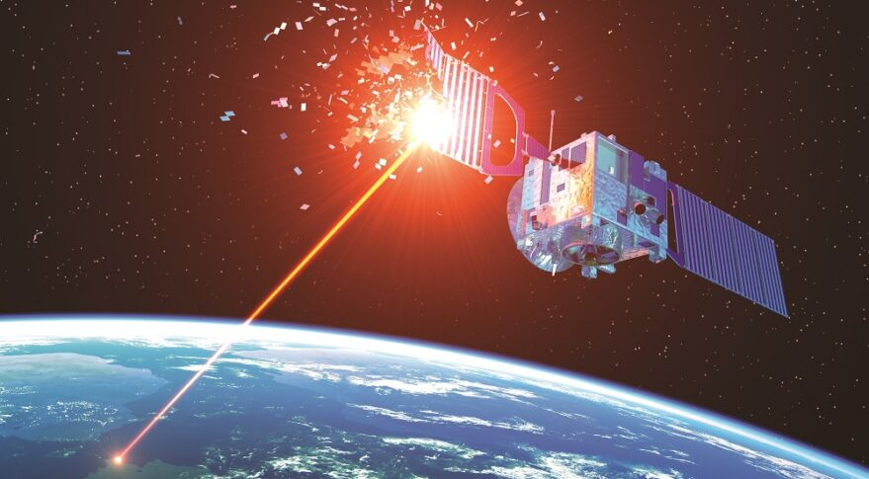
Ongoing preparation for space war/deterrence
Pentagon officially declared space is a warfighting domain
Emphasis now is in disabling satellites in place, ideally with deniability
Chinese Shijian 17 satellite (2016) can approach & capture satellites in geo orbit, and has a robot arm for grappling or damaging it (e.g., destroying solar panels)
Chinese working on grabbing a satellite, putting small explosive up into the thruster, which could look just like a simple failure, according to Chinese press (SCMP)
MEV satellites by Northrop Grumman grab a satellite and change its orbit, and newer versions will have a robotic arm for capability
Other examples for offense
Lasers to blind or disable satellites from ground, sea, air, maybe other satellites
L3Harris: $121 million upgrading U.S. ground-based communications jamming
Cyberattacks on satellites
Problem: how to respond to
A laser blinding a satellite
Tailgating by a satellite
Credit: Adobe stock/spacenews.com

Slide 19
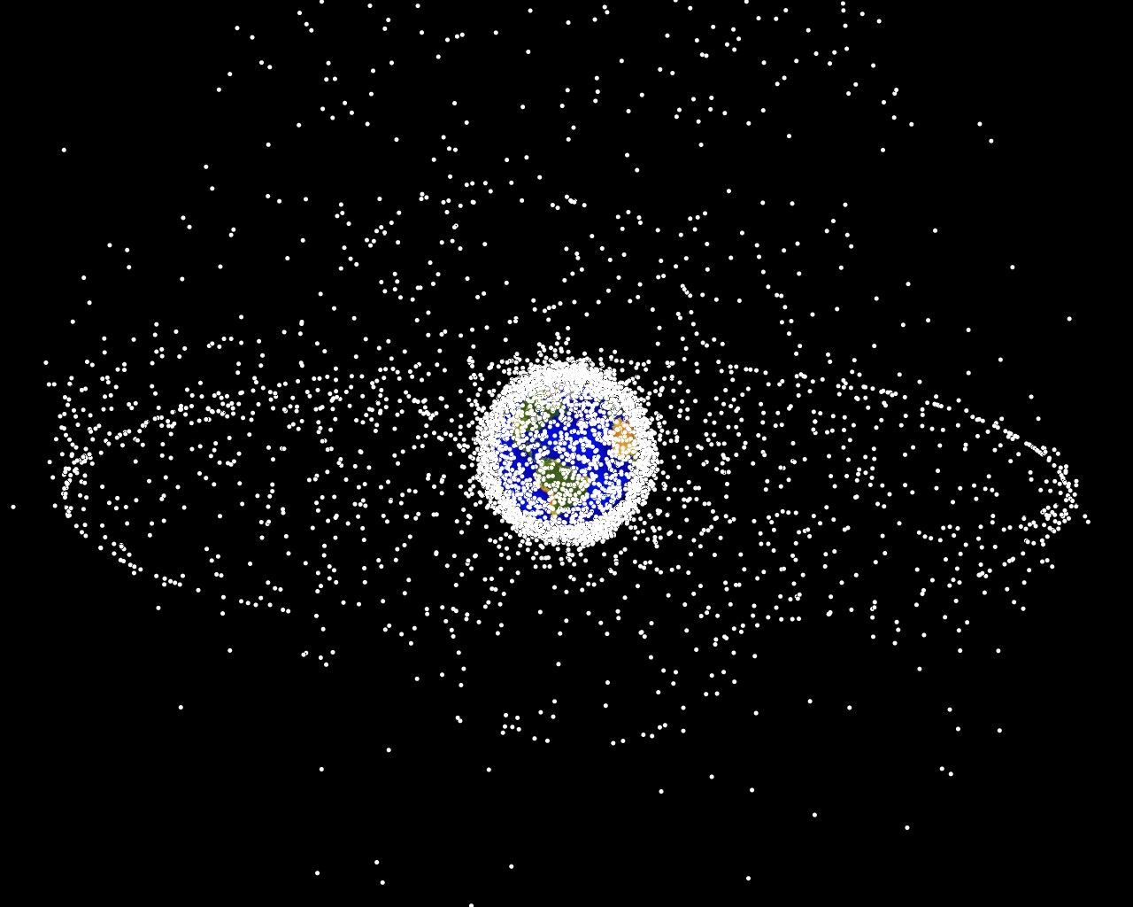
Defensive strategies for space war
French military satellite just launched has cameras to identify & monitor attackers, extreme anti-jamming, EMP resistance, moves to avoid attack
School of fish strategy
Shift to from current large geo satellites (“juicy targets”) to constellations of smaller LEO satellites: easier to launch and replace, too many to easily destroy.
Backup redundancy
US wants backup communications, GPS, intelligence gathering, in constellations of smaller commercial satellites, including Starlink
Objects in Earth orbit (5% satellites and 95% debris), density correlating with live satellites. Credit: NASA

Slide 20
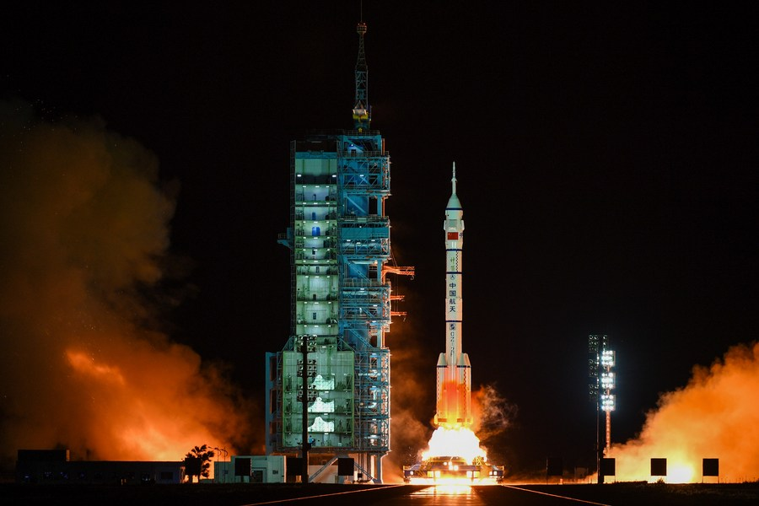
How many launches since the last meeting (Oct 2)?
This includes failed launches only if they lift off the launch pad and only includes launches that attempt going into orbit
Does NOT include the Chinese hypersonic missile test
Long March 2F rocket carrying 3 astronauts to Chinese space station. Credit: Xinhua

Slide 21
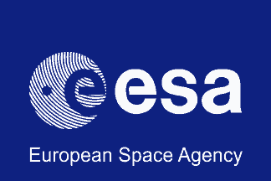
Launches since last meeting (Oct 2, 2021)
Oct 5 – Soyuz – International Space Station – crew, actress, movie director
Oct 14 – Soyuz – 36 more OneWeb satellites for internet service
Oct 14 – Long March 2D – Solar observatory, 10 small secondary payloads
Oct 15 – Long March 2F – 3 astronauts to Chinese space station
Oct 16 – Atlas 5 – NASA’s Lucy spacecraft flying to 8 asteroids in 12 years
Oct 21 – Nuri (S. Korea) – first test flight to orbit (FAIL)
Oct 23 – Long March 3B – Classified satellite military/space debris mitigation
Oct 23 – Ariane 5 – 2 Telecom satellites: 1 commercial, 1 French military
Oct 25 – H-2A (Japan) – Navigation service satellite
Oct 27 – Kuaizhou 1A – Small earth observation sat. for Jilin 1 constellation
Oct 27 – Soyuz – 79th Progress cargo ship – 5,000 lbs to the ISS
Nov 3 – Long March 2C – 2 classified military satellites

Slide 22
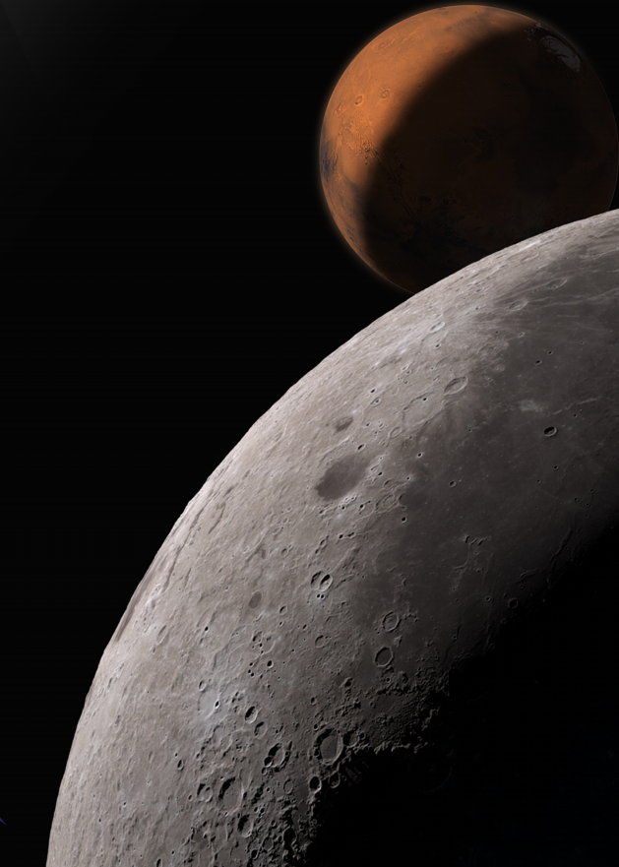
Discussion & questions?
Image: NASA

Slide 23
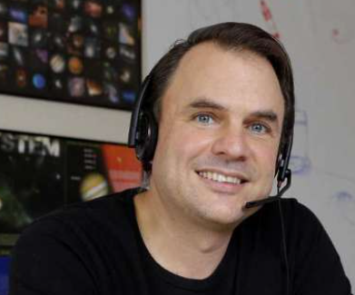
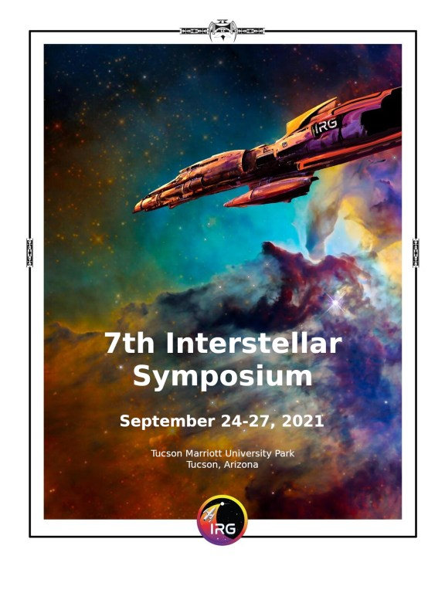
Featured speaker: Nathan Price
Lifelong passion for space exploration/development
Countdown to the Moon program interviewing a person a day https://CountdownToTheMoon.org
Volunteer at Space Center Houston
Started NSS North Houston chapter meetings in Jan, 2018
President, and the person who does the most to make this chapter successful !
Manager and Solutions Architect at Anaplan, previously Development Lead at HP
BS in Mathematics, minor in Economics, University of Houston
TOPIC: Going Interstellar: What I learned at the 7th Interstellar Symposium
Interstellar Symposia every 2 years provide an exciting vision for our long range future in space

