Slide 1
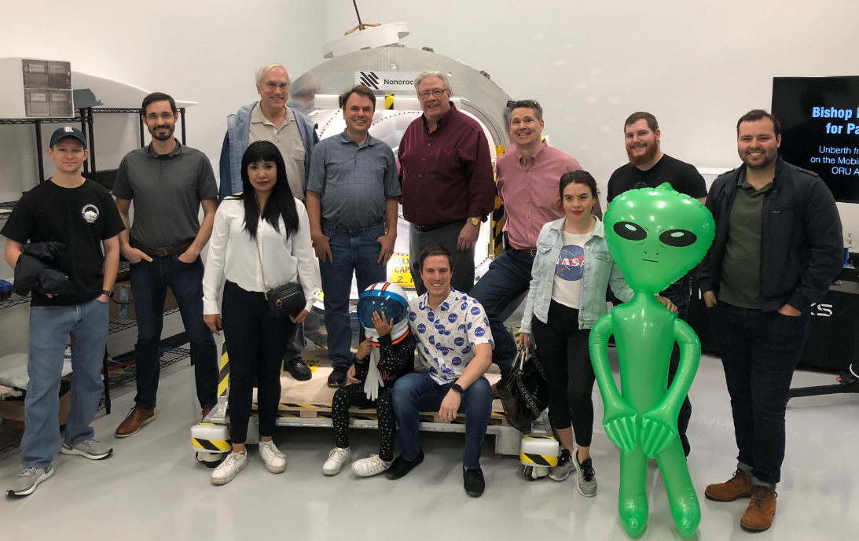
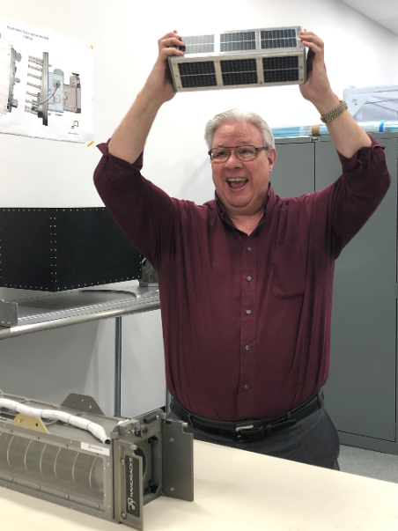
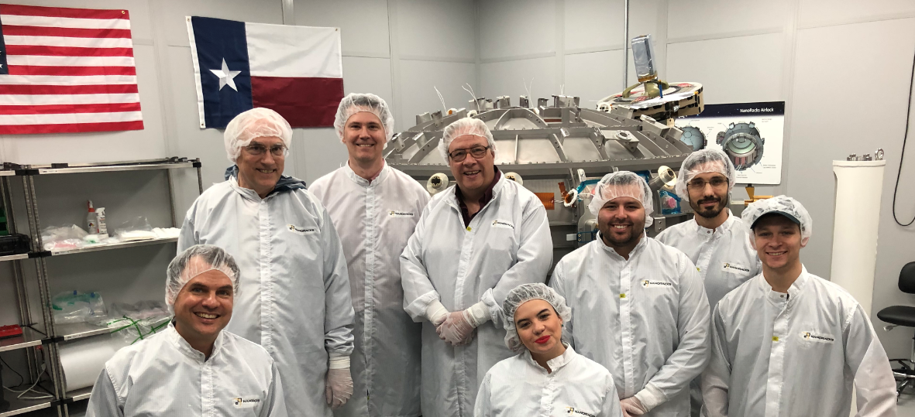
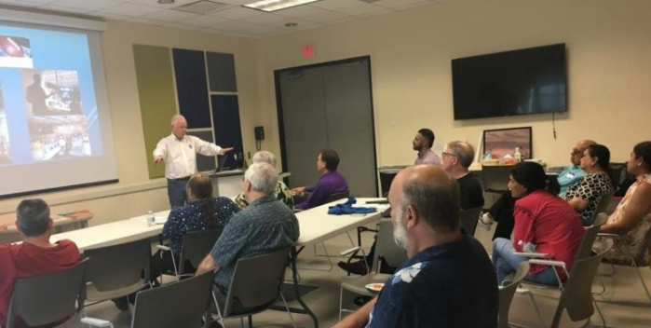
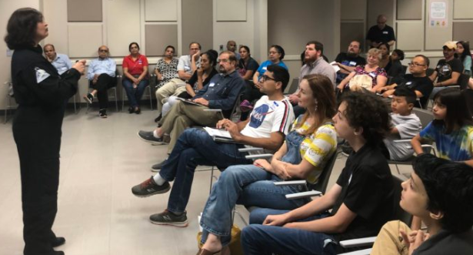
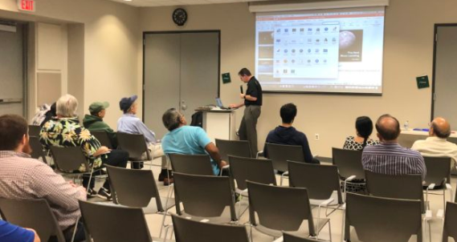
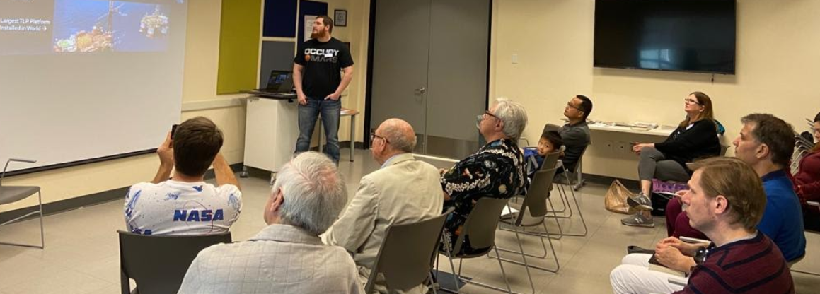
Notes:
Nathan: Welcome to the North Houston Space Society meeting for the month of May. Before we get started, let me introduce myself.

Slide 2
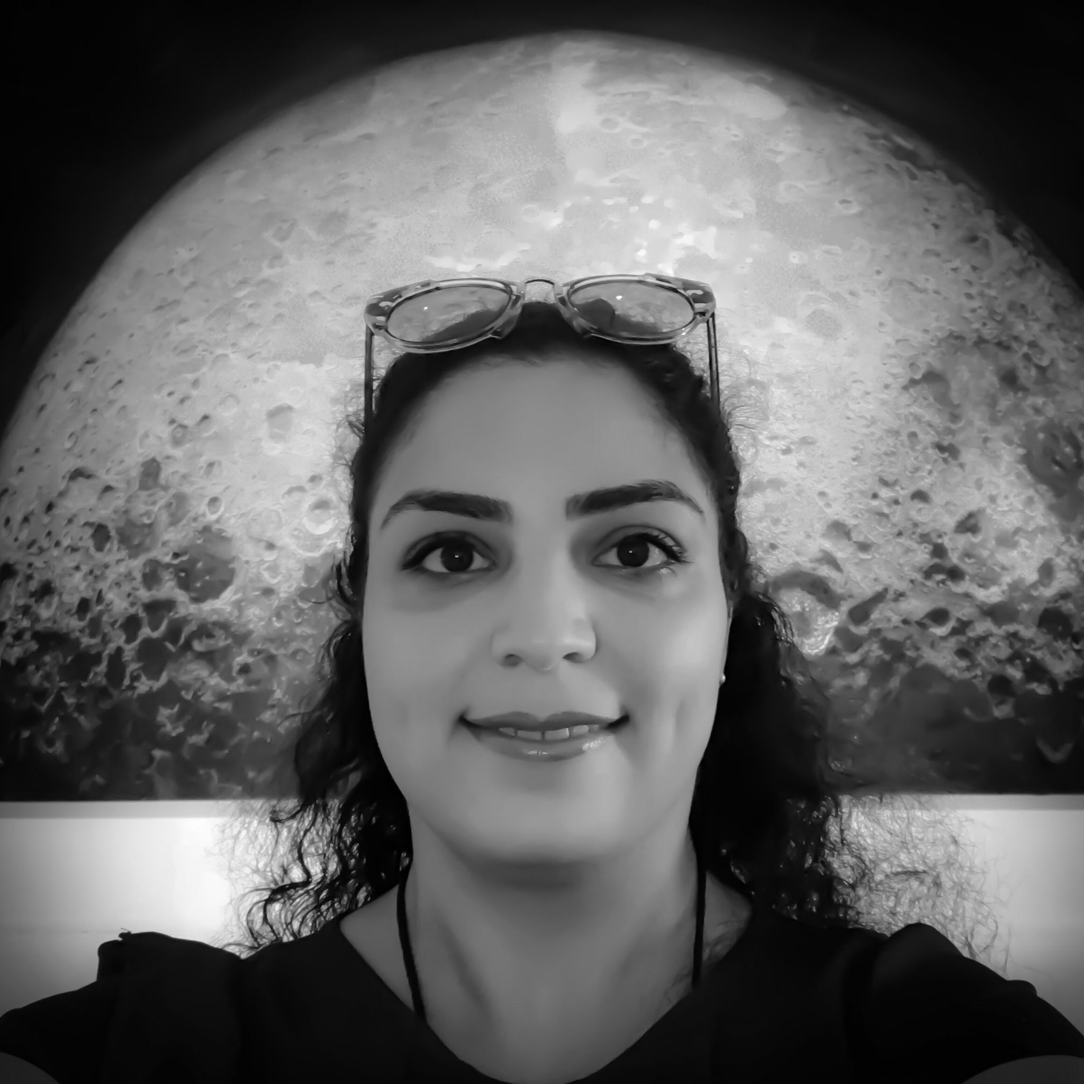
Mahsa.Esfand
@NorthHoustonSpace.org
Designs habitats and greenhouses for Mars, Moon, and the zero-gravity through consultations with several companies.
Member of Space Architecture Technical Committee (SATC-AIAA), Judge for NASA's Deep Space Food Challenge.
Notes:
Nathan: I’m Nathan Price, founder and president of the North Houston Space Society. During the day I work for a software company, but all other times I’m working on space exploration. I am a Space Hero insider and a volunteer at Space Center Houston. Mahsa will be co-hosting, I’ll have her introduce herself Mahsa: Thank you Nathan! Hello everyone and welcome to this month's meeting. i am Mahsa Esfandabadi, architect and aerospace architect and i am a member of space architecture technical committee at AIAA. . I work as a consultant for several space design companies and i do volunteer work for space education events

Slide 3
Agenda
2:00 PM – Opening Remarks – Nathan Price & Mahsa Esfand
2:10 PM – Recent Space News – Greg Stanley
2:30 PM – Going Interstellar – Nathan Price
3:30 PM – Q&A
3:45 PM – Share your personal space experiences since the last meeting. Rocket Launches, Other Meetings, Research, etc.
4:00 PM – End of Meeting
Notes:
Nathan: We have a full agenda lined up
Mahsa: (overview of agenda) Nathan: But before we get into that, let’s talk a little bit about why we are here.

Slide 4
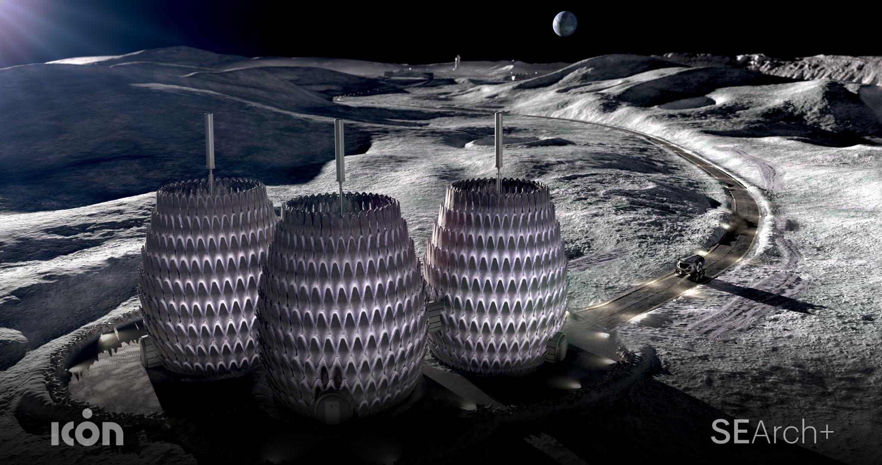
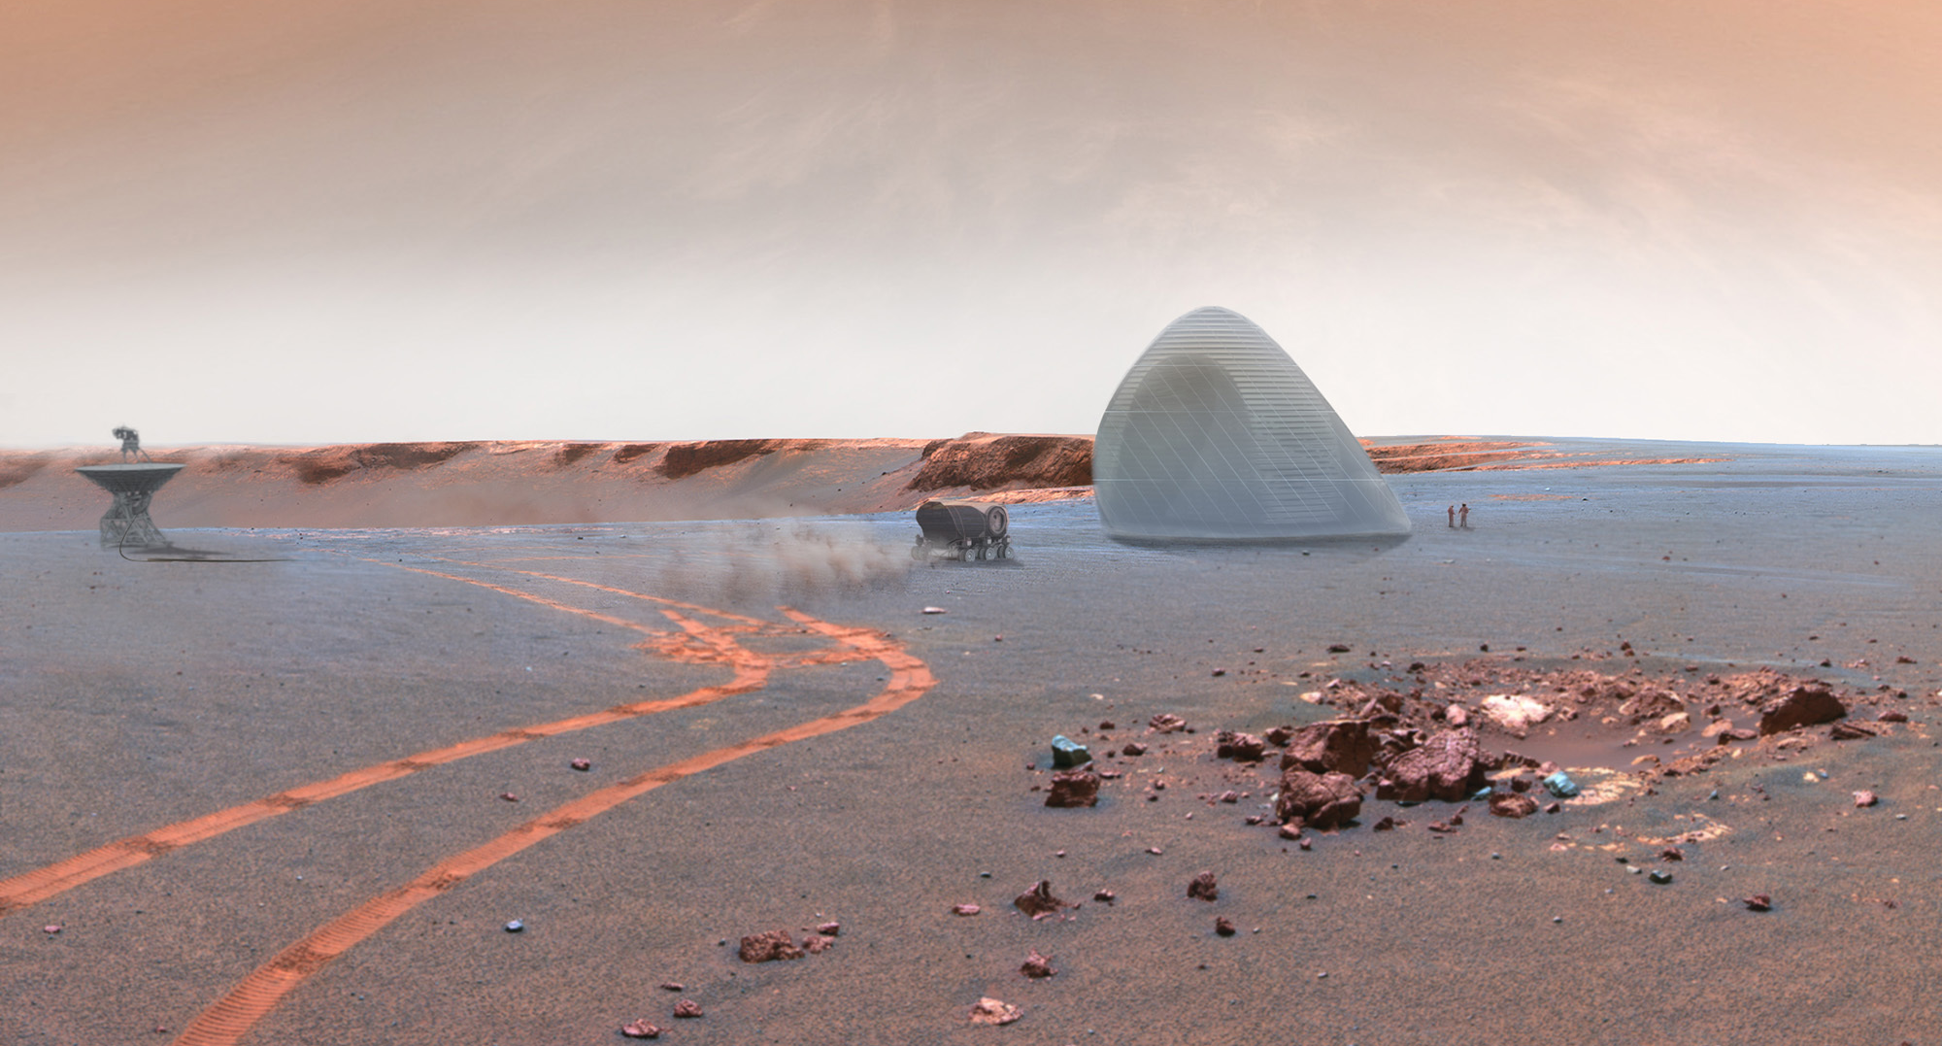
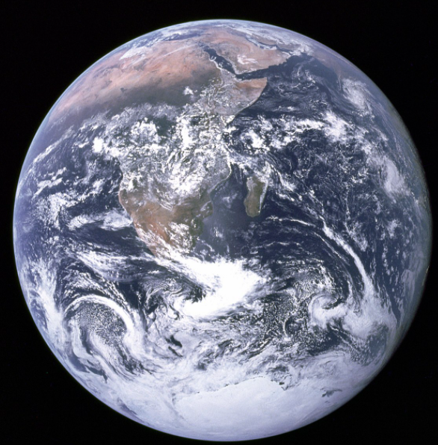
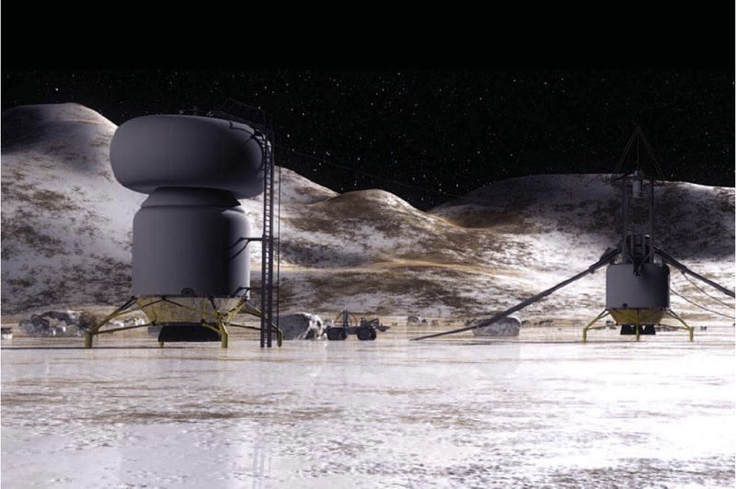
Where is the Future of Humanity?
Moon
Mars
EARTH
Orbit
Titan
Notes:
Mahsa: lots of people ask why should we expand the humanity into the galaxy and go to moon and mars while we can save the earth with that money. well, there is no right or wrong answer to that question. we believe that one cannot move forward without the other one. the technology that has been and will be invented for the space missions, will be useful for human sustainability on earth

Slide 5
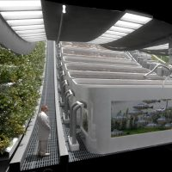
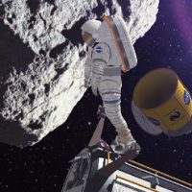
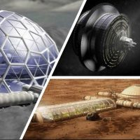
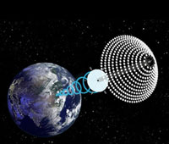
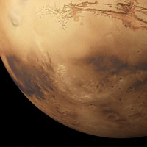
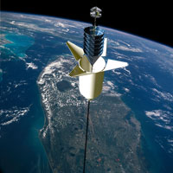
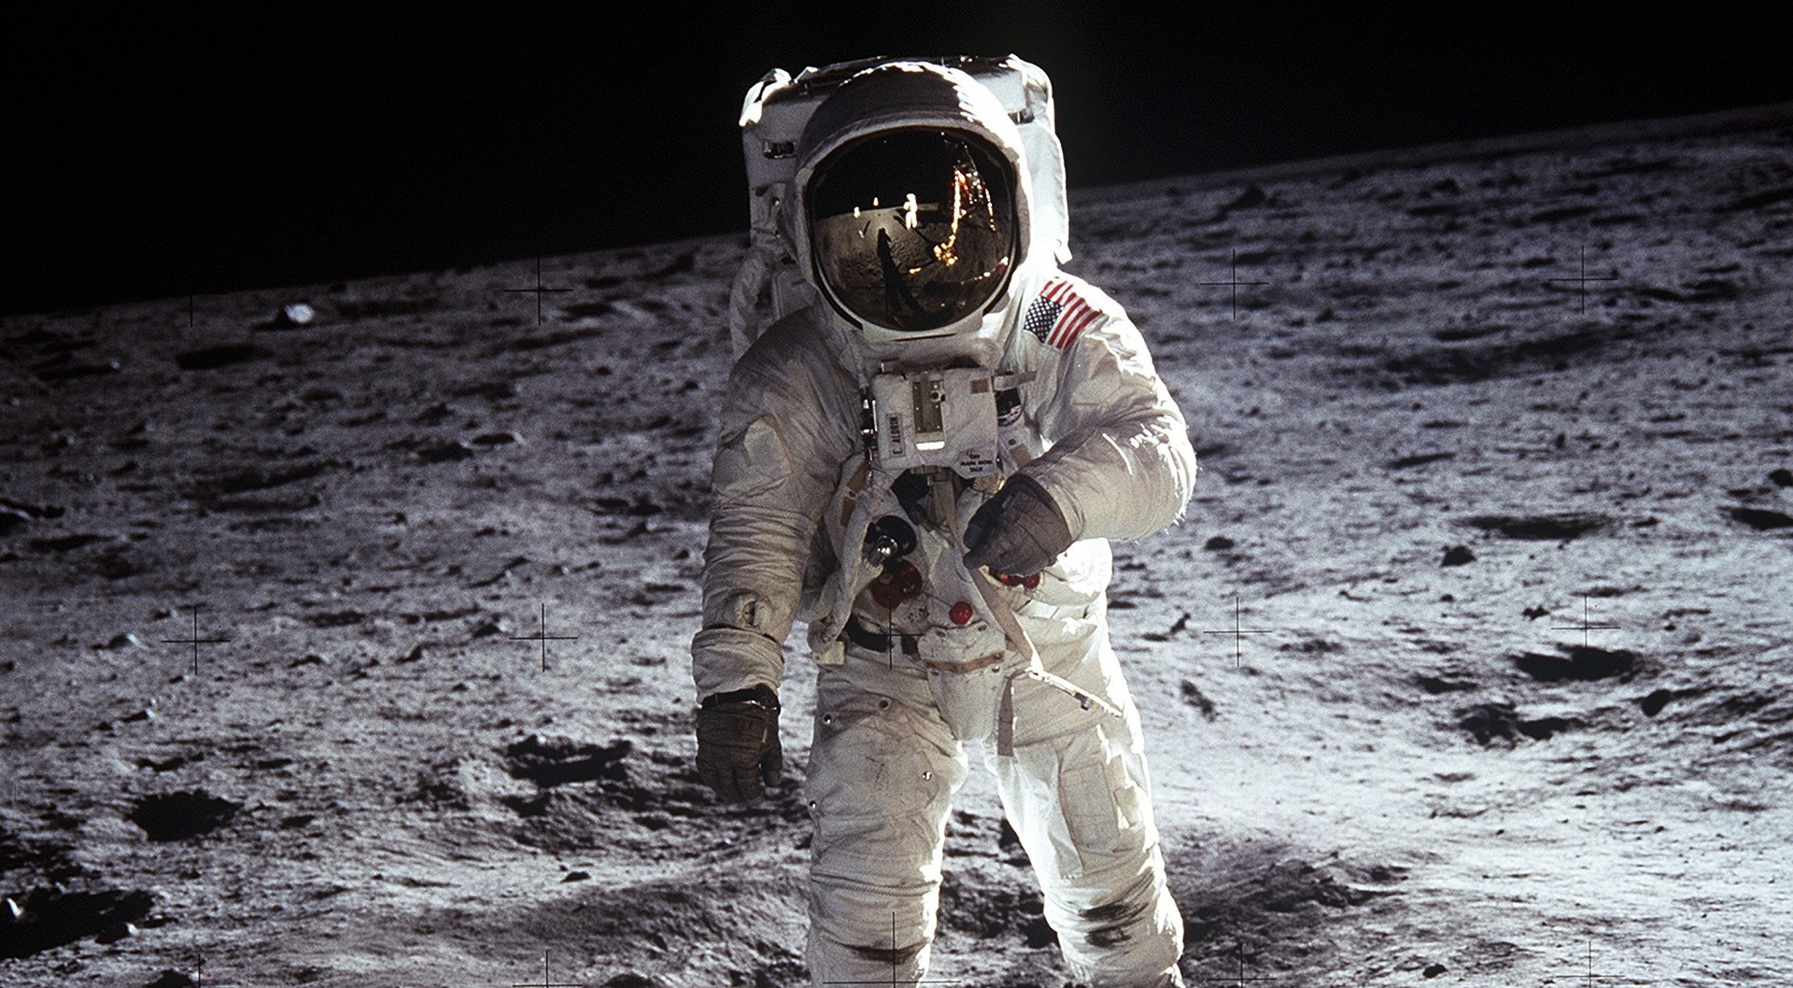
National Space Society
Vision
People living and working in thriving communities beyond the Earth, and the use of the vast resources of space for the dramatic betterment of humanity.
Notes:
Nathan: The National Space Society (NSS) is an international organization that exists to promote humanity’s exploration into space. The NSS Vision is People living and working in thriving communities beyond the Earth, and the use of the vast resources of space for the dramatic betterment of humanity.

Slide 6
How does the North Houston Space Society help?
We
Educate citizens in North Houston about what is going on in Space Exploration and Development and Inspire them about the abundant future we could have.
Encourage students to explore their space dreams and careers in space exploration
Help parents and teachers to see that our future in space will ultimately be bigger than our history here on earth
Open the eyes of investors to potential space businesses
Connect space exploration enthusiasts together for fun and community.
Notes:
Mahsa

Slide 7
http://NorthHoustonSpace.org
Sign up for our email list
Join the National Space Society
Connect with others that share the vision of humanity branching out into space
Educate and inspire our communities about the benefits to humanity!
Notes:
Nathan: The North Houston Space society can keep you informed and help you get engaged. Everyone is welcome to our meetings. And we will be planning more events and activities in the future. To ensure that you don’t miss out, be sure and bookmark our website North Houston Space dot Org. There you can find our pages on Facebook, Linked In, Meetup, and other social platform. Also, I would encourage you to sign up for our email list. Join the National Space Society This is a key step to connect with others that share the vision of humanity taking steps into space. You can be plan an important role in educating and inspiring our communities about the benefits to humanity of branching out into space.

Slide 8
This meeting is being recorded and will be posted on YouTube, NorthHoustonSpace.org, Facebook, etc.
Notes:
Mahsa: this meeting is being recorded and you can access it later on youtube, our main page, north houston space society, facebook

Slide 9
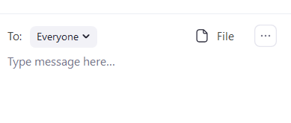
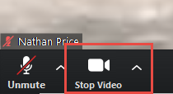
How to use
Video is turned off by default. Turn it on when you are ready:
Audio
How to raise your hand
Chat
Notes:
Nathan: Let me review some of the basics of the zoom. in the bottom left there are icons to turn on/off your video. Also, you can mute and unmute yourself. We will be disabling this feature during parts of the meeting to ensure that there are few disruptions, but would like to have you ask questions and participate in discussions at key points. Also, you can chat with the hosts of the meeting using the Chat button
And when it comes to asking questions, it would be best if you use the built in functionality to “raise your hand” so that everyone gets a chance to ask a question.

Slide 10
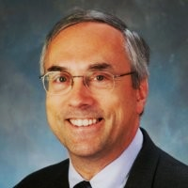
Dr. Greg Stanley
Dr. Greg Stanley, mostly retired, creates, develops, and manages innovative technology, especially based on artificial intelligence.
Greg has a PhD in Chemical Engineering from Northwestern University, and a BS in Chemical Engineering from Purdue University. He has published over 25 peer-reviewed technical papers.
He worked at and on projects for a variety of companies including Exxon, Gensym, AT&T,Intelsat, Biosphere 2, a Japanese nuclear industry/government consortium, Integration Objects, and BMC.
North Houston Space Society Vice President.
Notes:
Mahsa: Now let me introduce Dr. Greg Stanley who will give us an update on the Space News since our last meeting.

