Slide 1
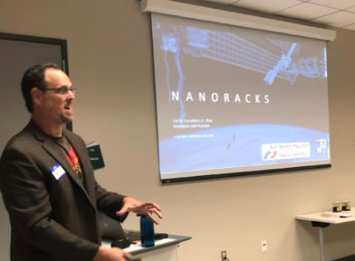
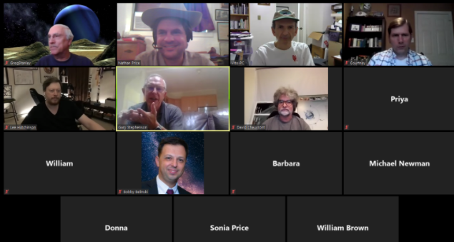
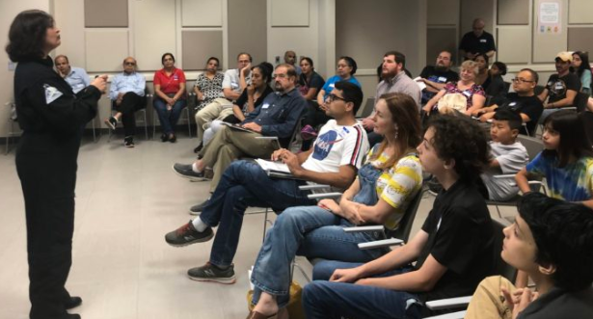
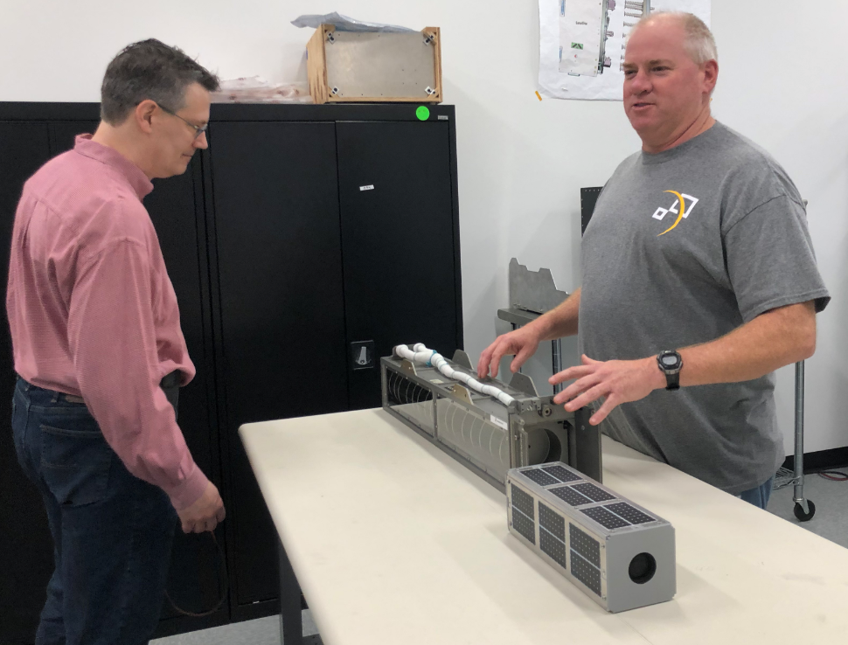
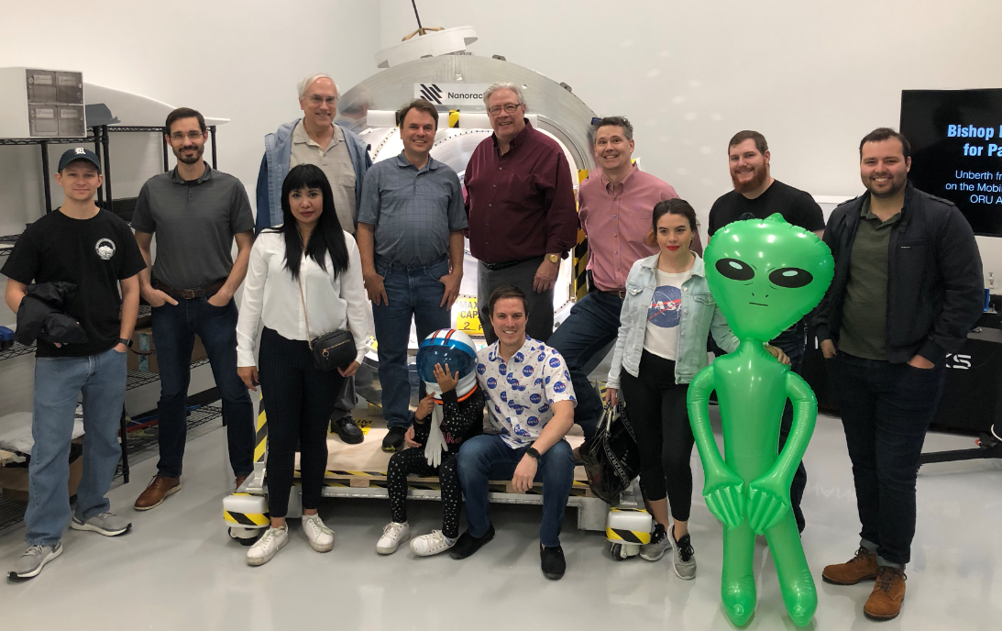
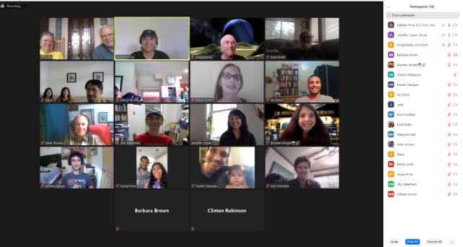
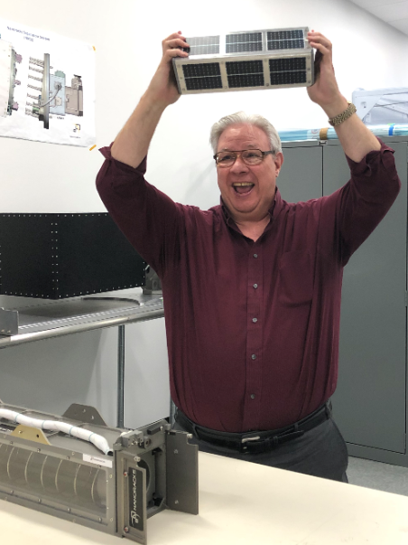
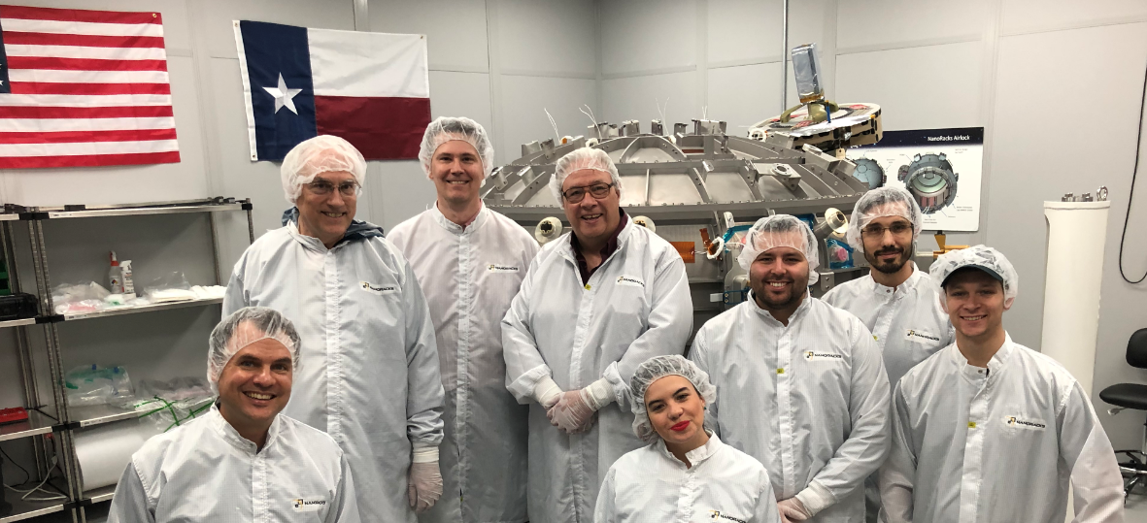
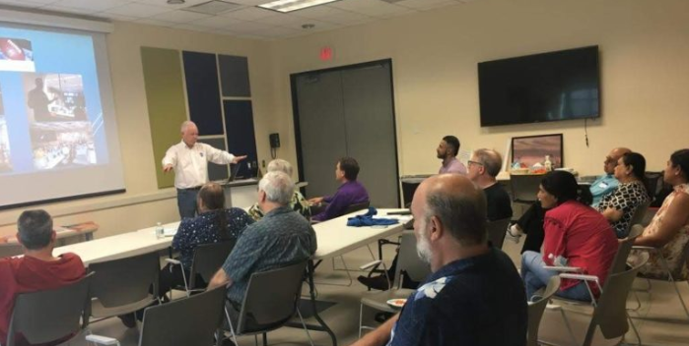
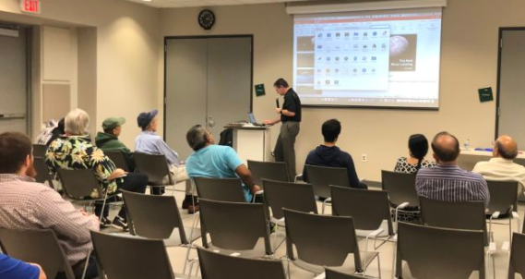
NSS North Houston Space Society
March 6, 2021

Slide 2
Agenda
2:00 PM – Opening Remarks – Nathan Price
2:10 PM – Recent Space News – Greg Stanley
2:30 PM – “Left Brains for the Right Stuff: Computers, Space, and History” – Hugh Blair-Smith
3:30 PM – Q&A
3:45 PM -Share your personal space experiences since the last meeting. Rocket Launches, Other Meetings, Research, etc.
4:00 PM – End of Meeting

Slide 3





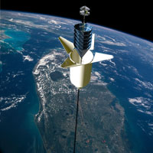

National Space Society Vision
People living and working in thriving communities beyond the Earth, and the use of the vast resources of space for the dramatic betterment of humanity.

Slide 4
Join us:
http://NorthHoustonSpace.org
Sign up for our email list
Join the National Space Society
Connect with others that share the vision of humanity branching out into space
Educate and inspire our communities about the benefits to humanity!

Slide 5
Meeting IS being RECORDED
This meeting is being recorded and will be posted on YouTube, NorthHoustonSpace.org, Facebook, etc.

Slide 6
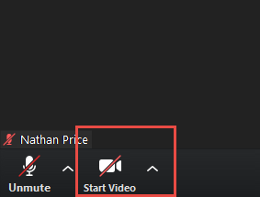
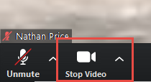
How to use ZOOM - Video
Video is turned off by default. Turn it on when you are ready:

Slide 7
Agenda
2:00 PM – Opening Remarks – Nathan Price
2:10 PM – Recent Space News – Greg Stanley
2:30 PM – “Left Brains for the Right Stuff: Computers, Space, and History” – Hugh Blair-Smith
3:30 PM – Q&A
3:45 PM -Share your personal space experiences since the last meeting. Rocket Launches, Other Meetings, Research, etc.
4:00 PM – End of Meeting

Slide 8
Nathan.price@NorthHoustonSpace.org

