Slide 1
NSS North Houston Space Society
February 6, 2021

Slide 2
Agenda
2:00 PM – Opening Remarks – Nathan Price
2:10 PM – Recent Space News – Greg Stanley
2:30 PM – Creating a better space exploration future through children’s books – Brett Hoffstadt
3:30 PM – Q&A
3:45 PM -Share your personal space experiences since the last meeting. Rocket Launches, Other Meetings, Research, etc.
4:00 PM – End of Meeting

Slide 3
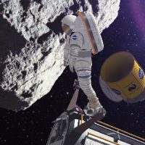
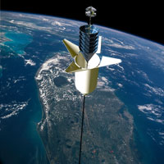
National Space Society Vision
People living and working in thriving communities beyond the Earth, and the use of the vast resources of space for the dramatic betterment of humanity.

Slide 4
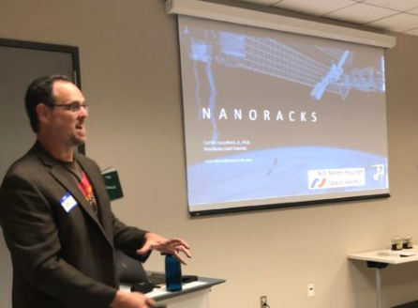
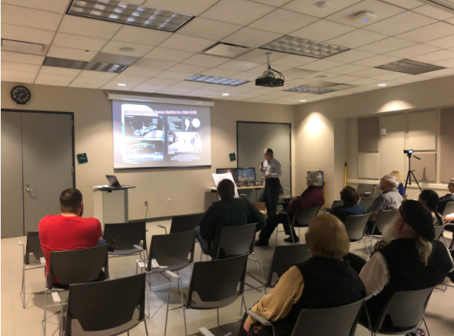
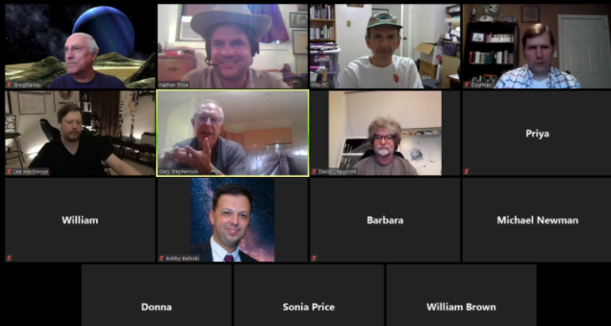
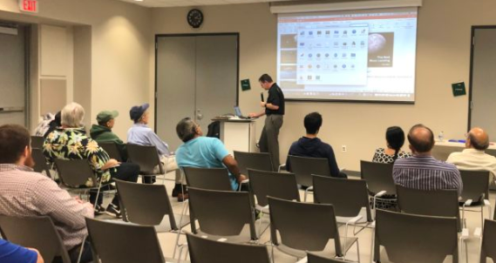
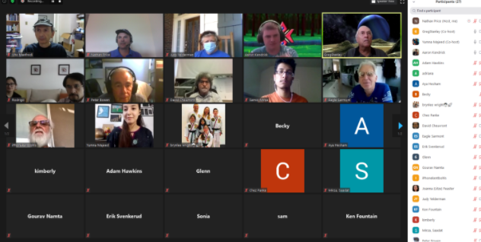
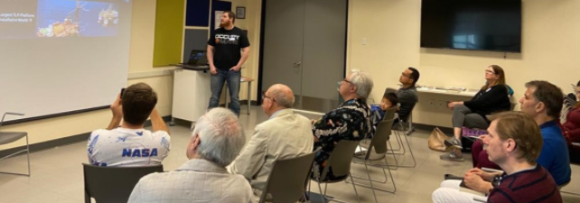
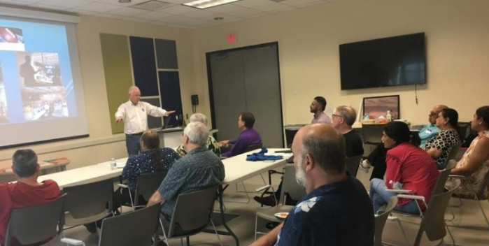
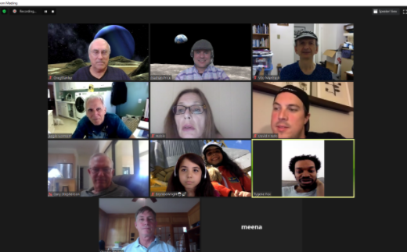
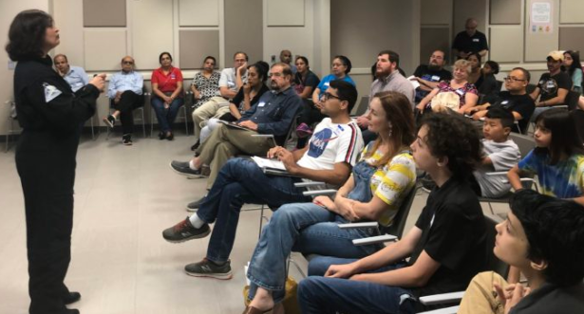
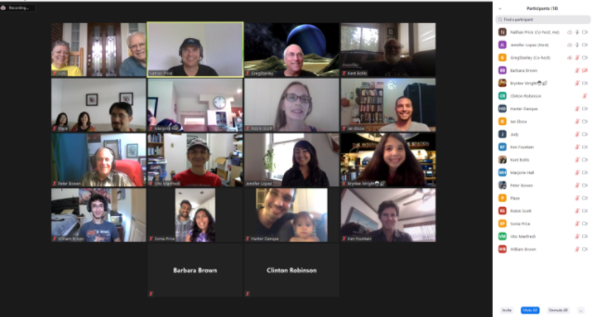
Monthly Meetings

Slide 5
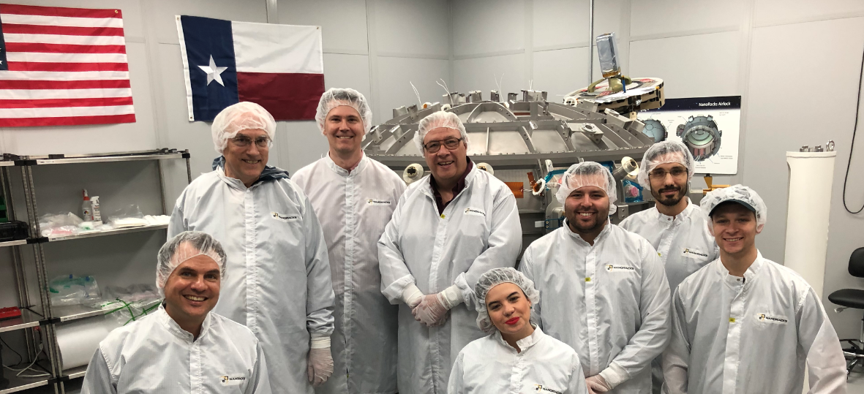
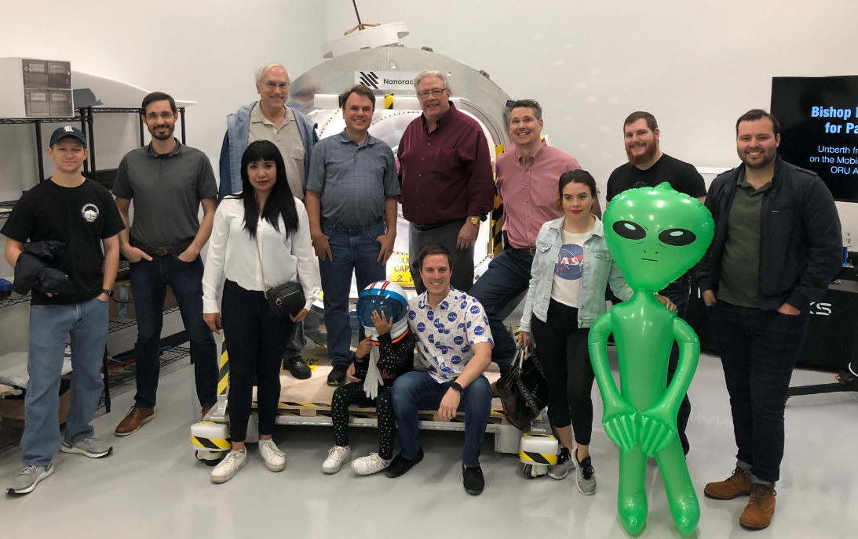
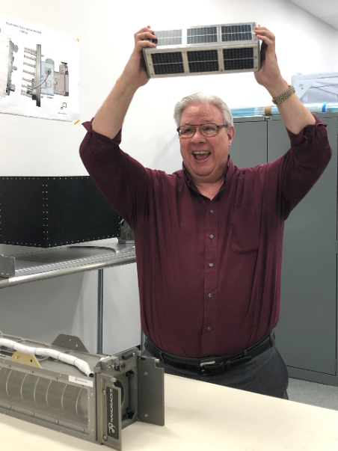
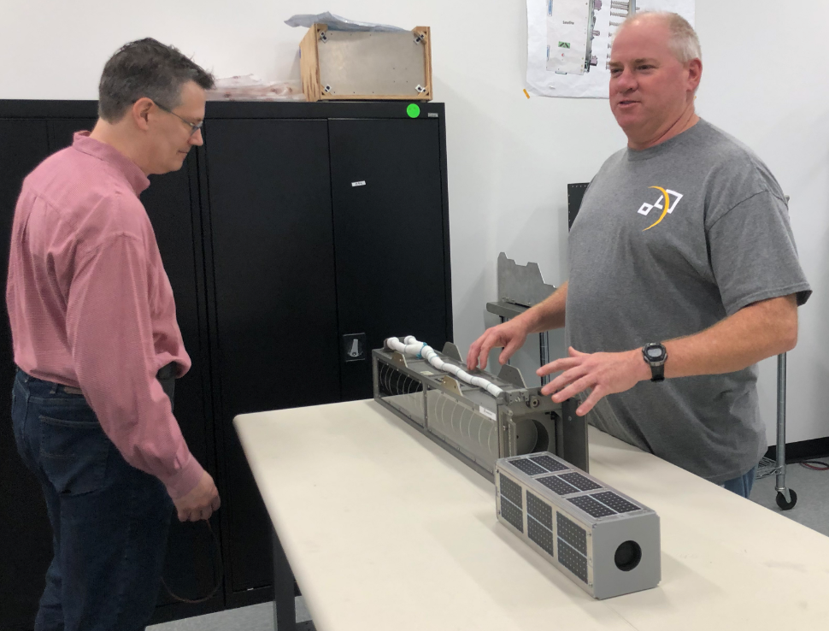
Tours

Slide 6
Join us:
http://NorthHoustonSpace.org
Sign up for our email list
Join the National Space Society
Connect with others that share the vision of humanity branching out into space
Educate and inspire our communities about the benefits to humanity!

Slide 7
Meeting IS being RECORDED
This meeting is being recorded and will be posted on YouTube, NorthHoustonSpace.org, Facebook, etc.

Slide 8
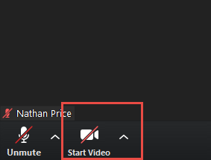
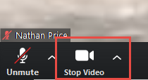
How to use ZOOM - Video
Video is turned off by default. Turn it on when you are ready:

Slide 9
Agenda
2:00 PM – Opening Remarks – Nathan Price
2:10 PM – Recent Space News – Greg Stanley
2:30 PM – Creating a better space exploration future through children’s books – Brett Hoffstadt
3:30 PM – Q&A
3:45 PM -Share your personal space experiences since the last meeting. Rocket Launches, Other Meetings, Research, etc.
4:00 PM – End of Meeting

Slide 10
Nathan.price@NorthHoustonSpace.org

