Slide 1
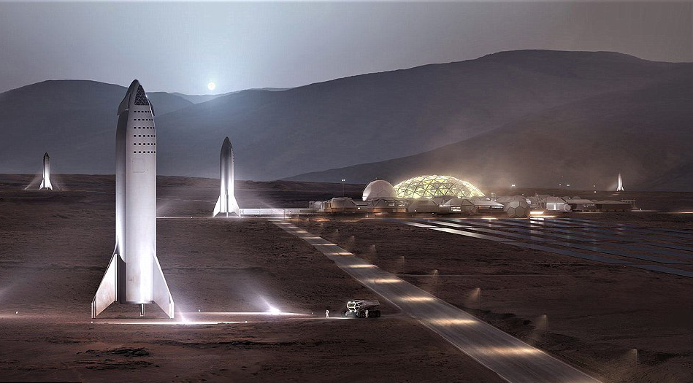
NSS North Houston Space Society Space News
November 7, 2020
Greg Stanley

Slide 2
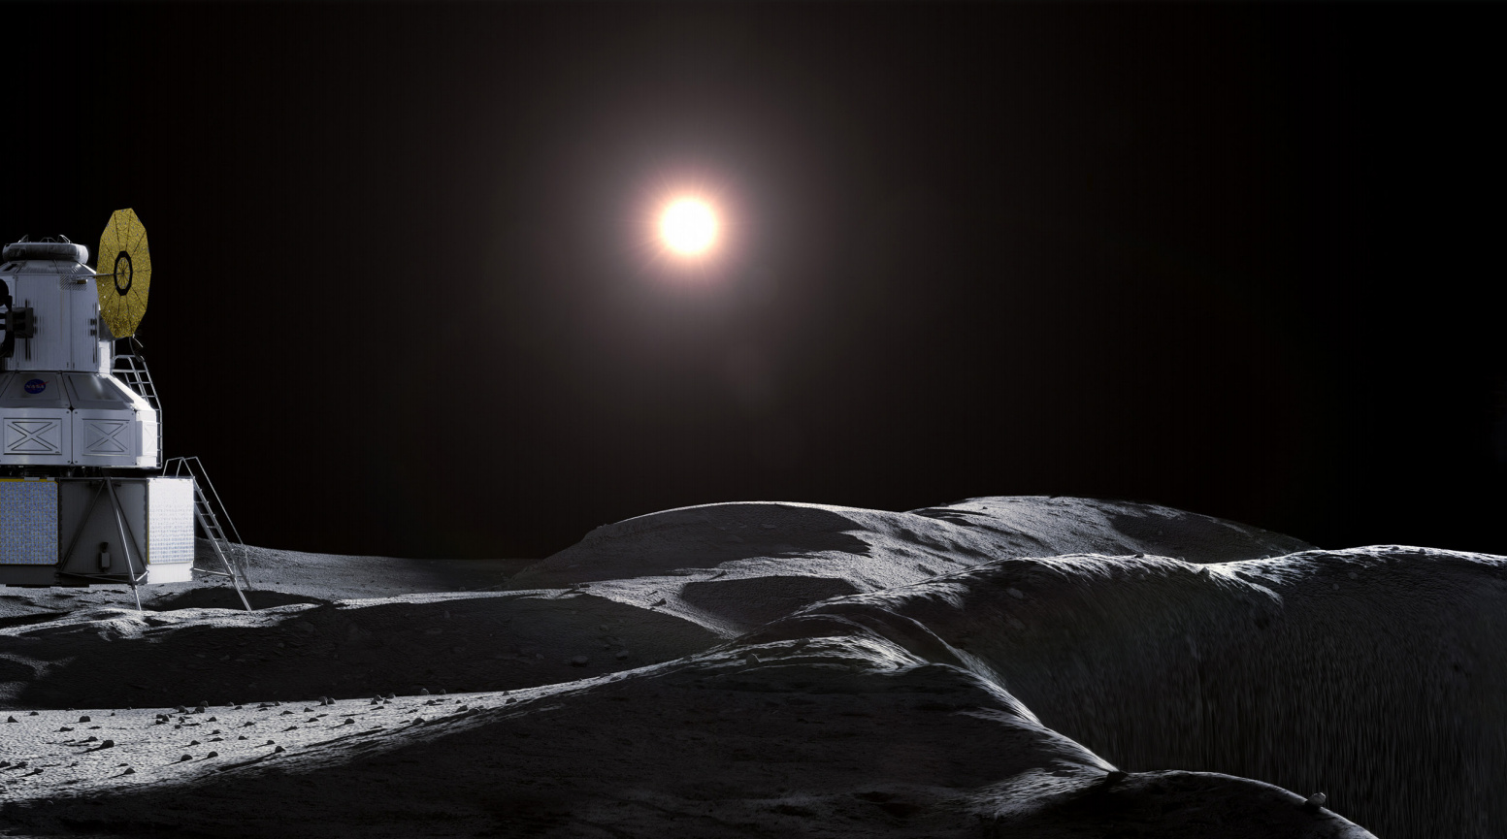
Lunar news
Lunar news
Credit: NASA Artemis document

Slide 3
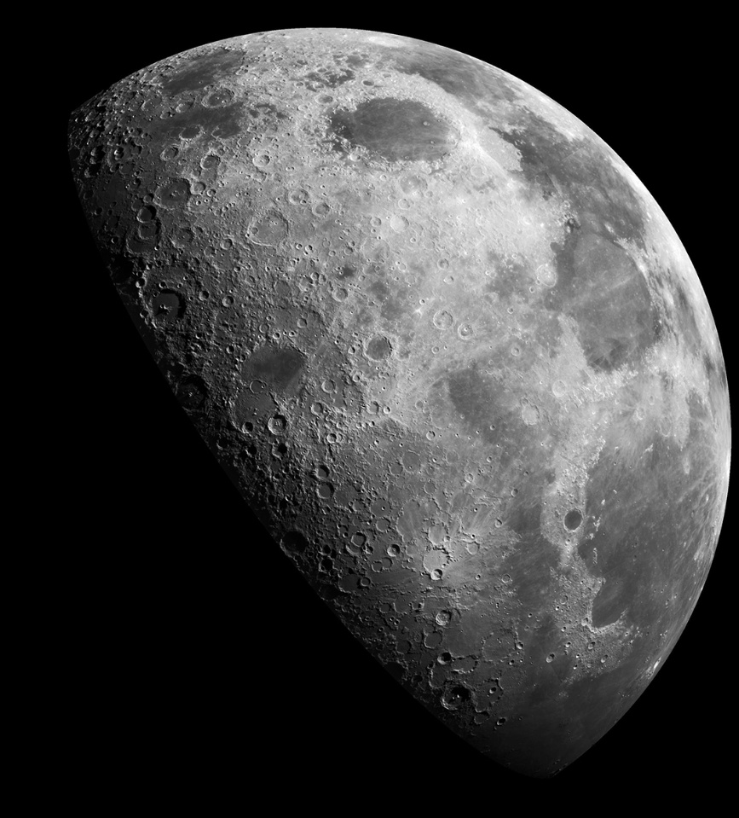
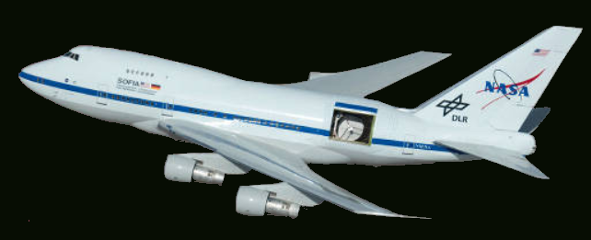
NASA found water in sunlit areas of the Moon
Found 100 – 412 ppm ice over large areas
Small 1cm “cold traps”, not just large shaded craters
Maybe in a glass formed after comet material impact
15,000 sq. miles have this
12 ounces water in a cubic meter of regolith
Sahara desert has 100x this amount of water
May improve chances of living off the land
As water, if we determine how to free it
Broken down by electrolysis into O₂ and H₂ for breathing and rocket fuel
Found by SOFIA flying infrared observatory
Stratospheric Observatory For Infrared Astronomy
Stratosphere above clouds, most water in atmosphere
Will this save SOFIA from termination?
Credit: SpaceX
Credit: NASA

Slide 4
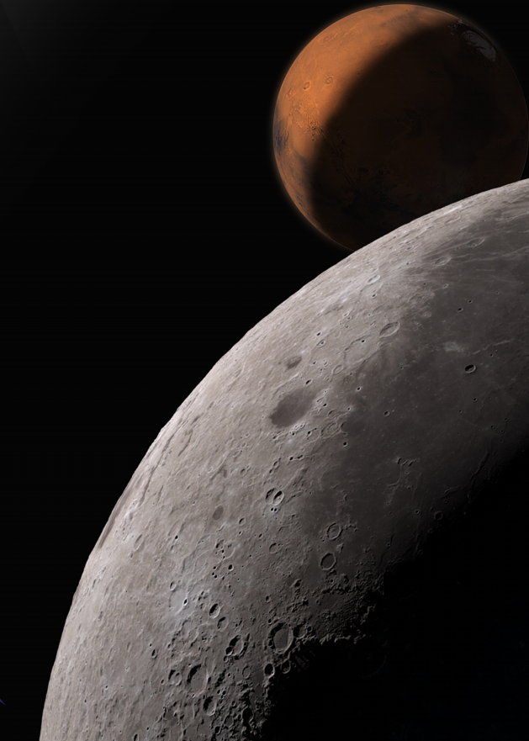
$370 million for 14 New NASA “Tipping Point” contracts
$256 million focused on in-space refueling, propellant depots
Cryogenic fluid management transferring liquid H₂, methane, O₂
Mostly to ULA, SpaceX, Lockheed Martin, Eta Space
A shift, undermining need for largest, expensive rockets like Space Launch System (SLS)
Rest for power, precision landing, communications
“Tipping point” refers to accelerating technology and commercialization through public/private partnerships
Credit: NASA

Slide 5
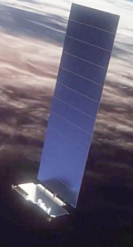
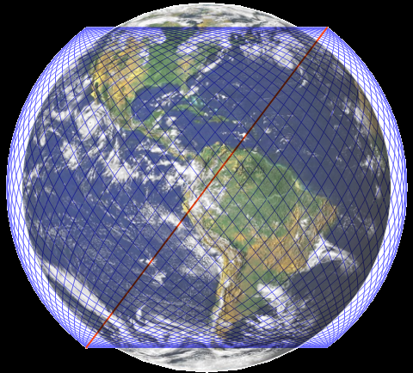
SpaceX Starlink update
Credit: SpaceX
Credit: Lamid58, https://commons.wikimedia.org/w/index.php?curid=83888262
Near-global satellite based internet service
Pays for ambitious Mars plans – launch market is too small for that
Constellation of LEO satellites
Plan
Phase 1: 1440 satellites in 72 orbital planes of 20 satellites each, in 340 mile orbits, 53 ◦ inclination
FCC approved: 12,000+ satellites
Applied for: another 30,000 satellites
Satellite status (10/24/2020)
895 launched, 51 deorbited, 844 orbiting
Credit: SpaceX
Image: https://www.bcsatellite.net/blog/leo-update-the-big-three-which-is-best/

Slide 6
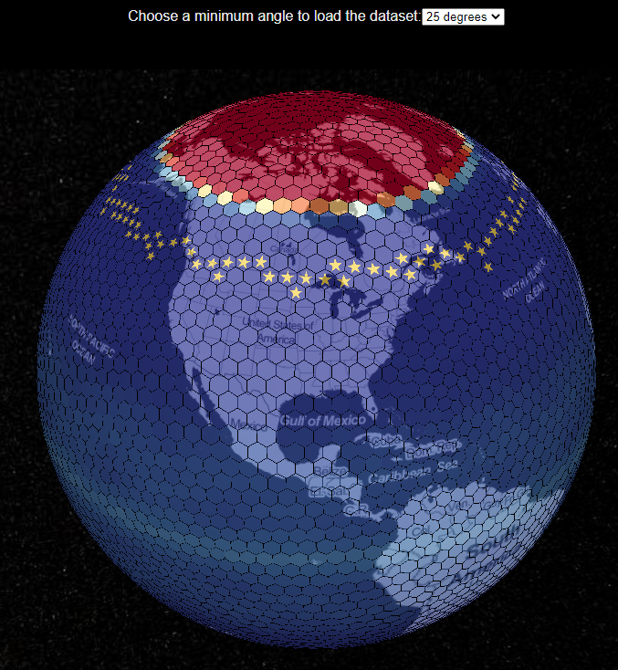
Starlink satellite coverage Nov 5, 2020
Credit: SpaceX
Antenna angle from horizon matters
25 degrees: blockage more likely
35 deg: target as more satellites come online
Red: no coverage
Blue: daily coverage
Star: 100% coverage
https://sebsebmc.github.io/starlink-coverage/index.html

Slide 7
Starlink beta test
Credit: SpaceX
“Better Than Nothing Beta” test
Estimated speeds 50Mbps – 150 Mbps
Estimated latency 20 ms to 40 ms
Expecting 16 ms to 19 ms by summer 2021
Some interruptions in connectivity to be expected
$499 for phased array antenna and Wi-Fi router
$99/month subscription
Offered at higher latitudes (44◦ – 52◦ N), e.g., Montana, Washington state, Canada
Washington state emergency services has been happily using it (for free)
Credit: SpaceX
Credit: Lamid58, https://commons.wikimedia.org/w/index.php?curid=83888262

Slide 8
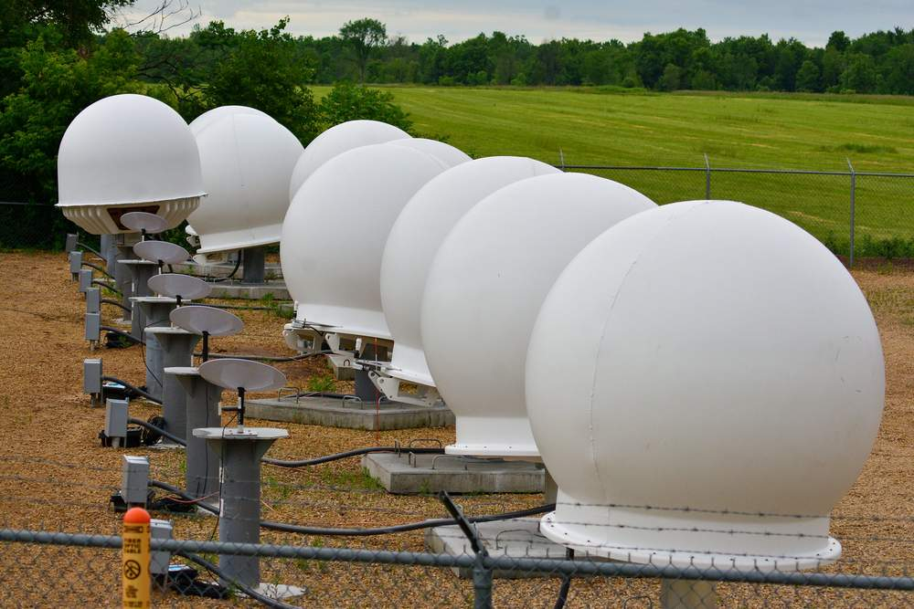
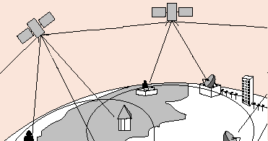
Starlink Ground station problem
Image: Wisconsin resident r/darkpenguin22 via Reddit
User terminals connect user to satellite
“Gateway” ground stations are also needed
Tie to existing fiber optic infrastructure
Original FCC registration had 26 locations
Gateway
Terminal
Crosslink
Gateway – satellite – user link could reach 500 miles (“bent pipe” architecture)
Beyond 500 miles, need satellite crosslinks
Internet/
Servers
User
Gateway
User
User
But planned laser based crosslinks are not in place yet
Limits coverage to presence of gateways
Higher costs to cover land areas with many more gateways
Rules out coverage of vast areas of seas, some deserts, unfriendly countries that don’t want citizens or foreigners with uncensored access, much military use

Slide 9
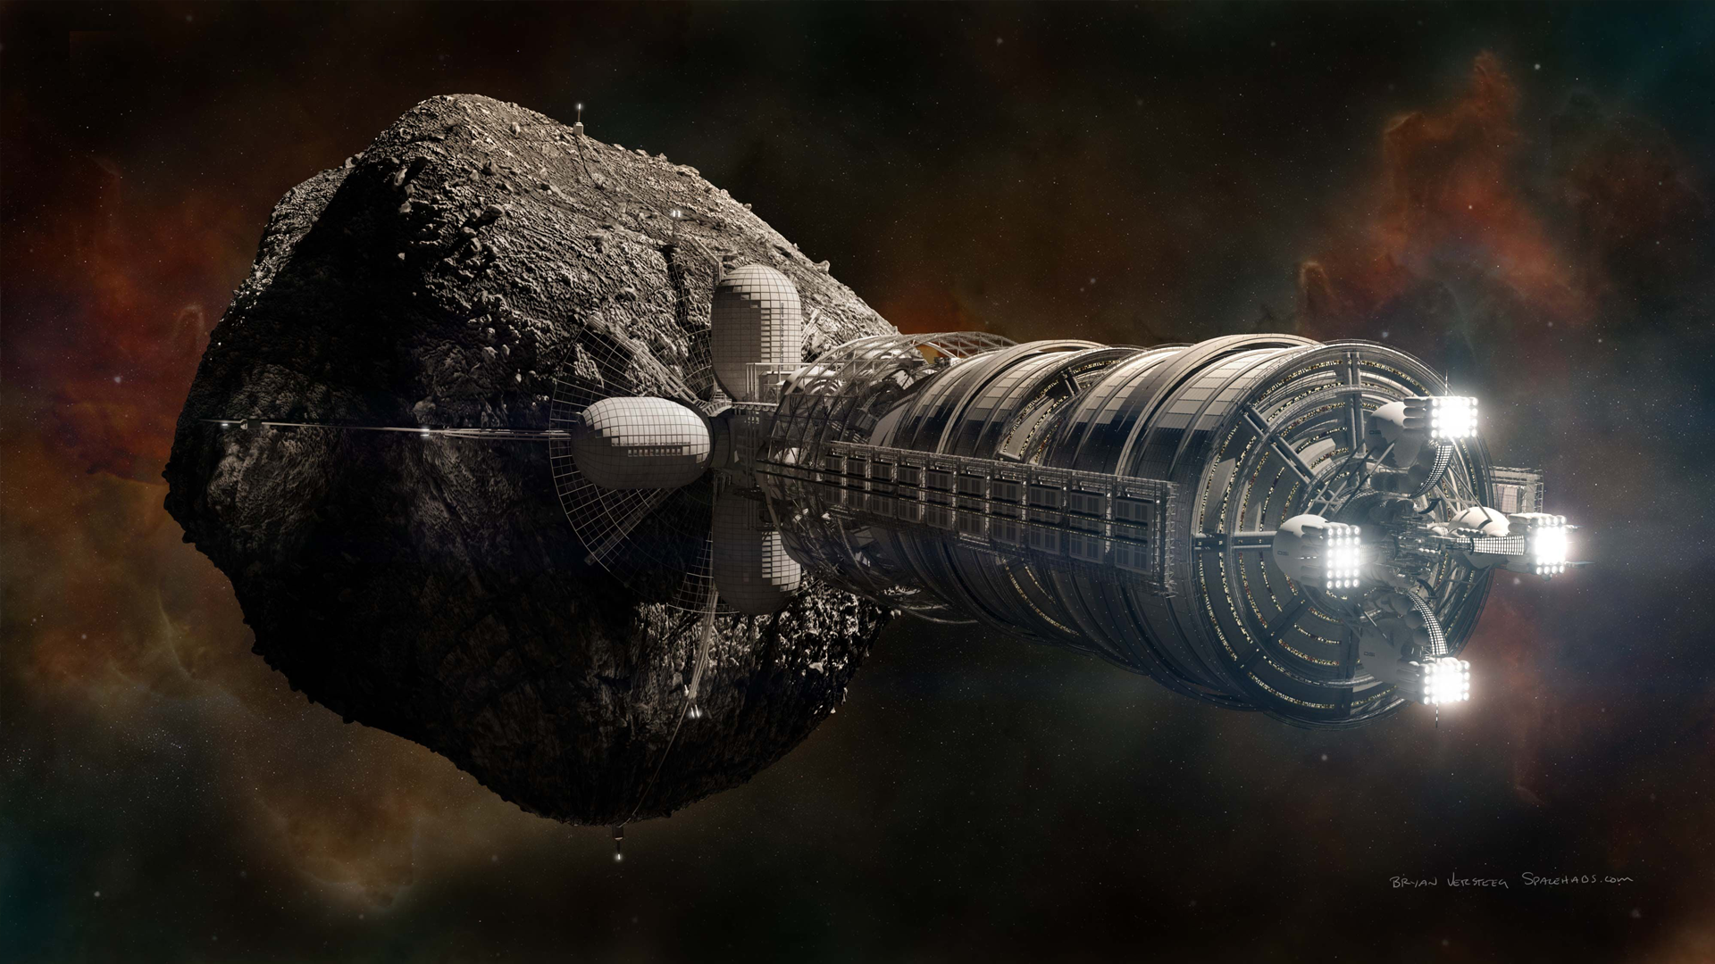
Asteroids!
Can we mine them, and live amongst them?
How do we prevent some of them from hitting Earth?
Do they give hints to origins of solar system and life?
We need visits and samples to answer those questions
Credit: NSS - Space Settlement Summit 2020

Slide 10
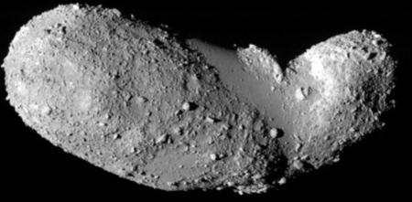
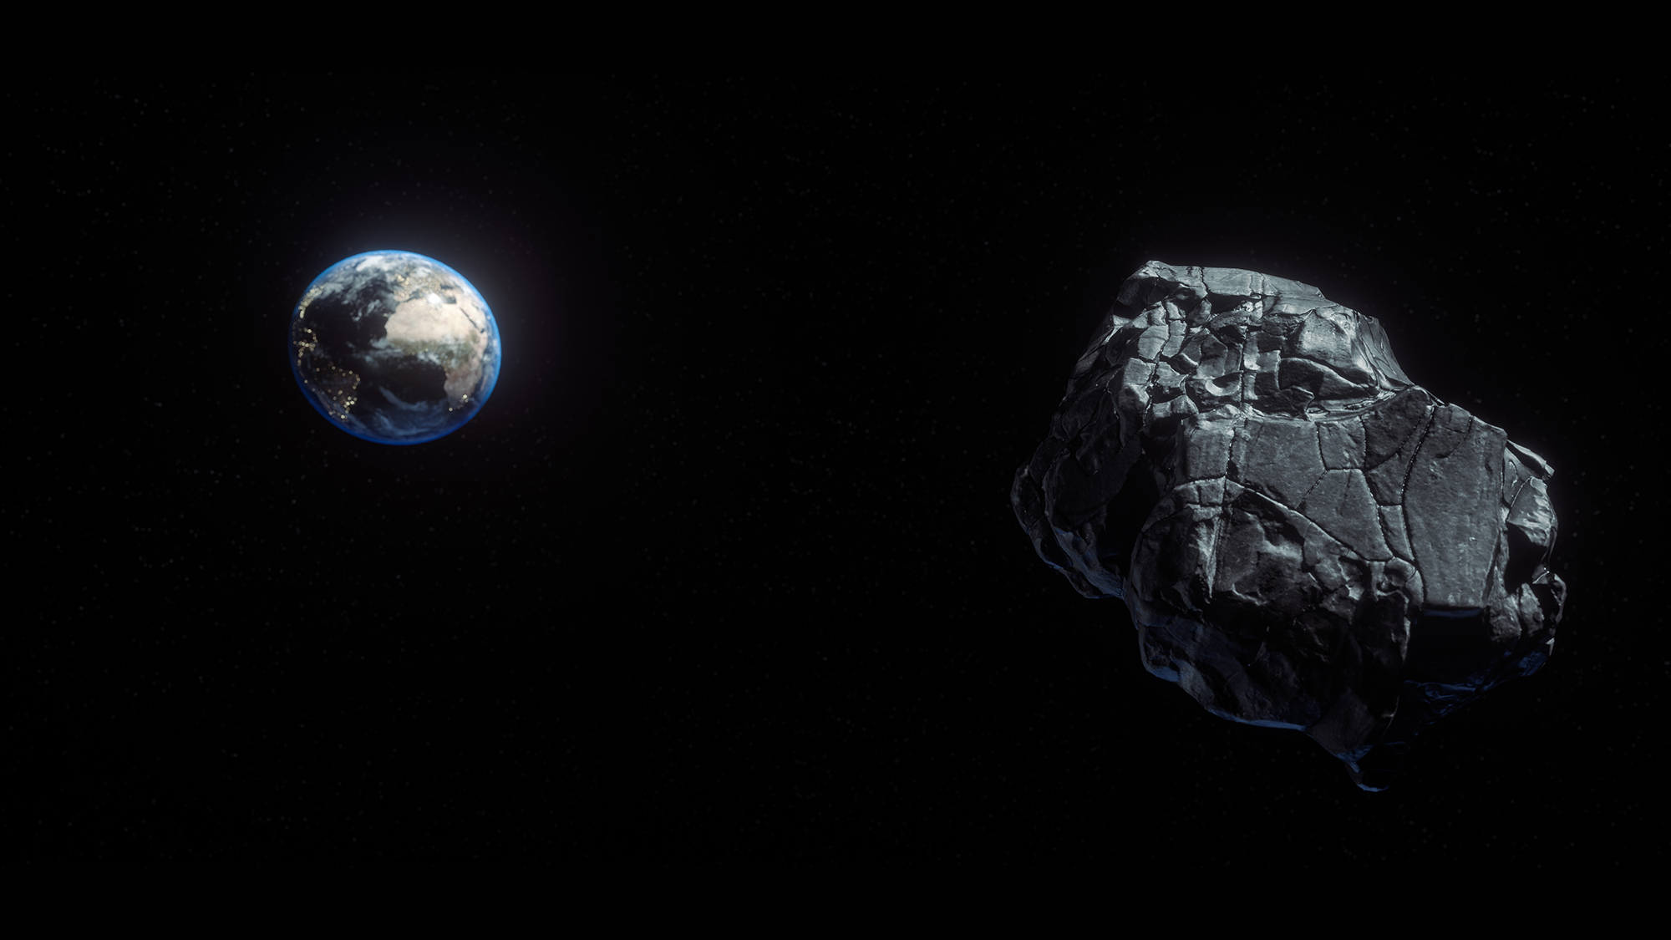
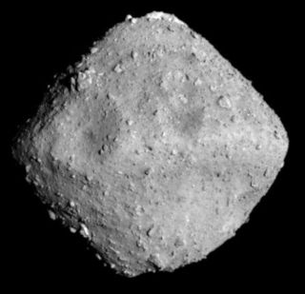
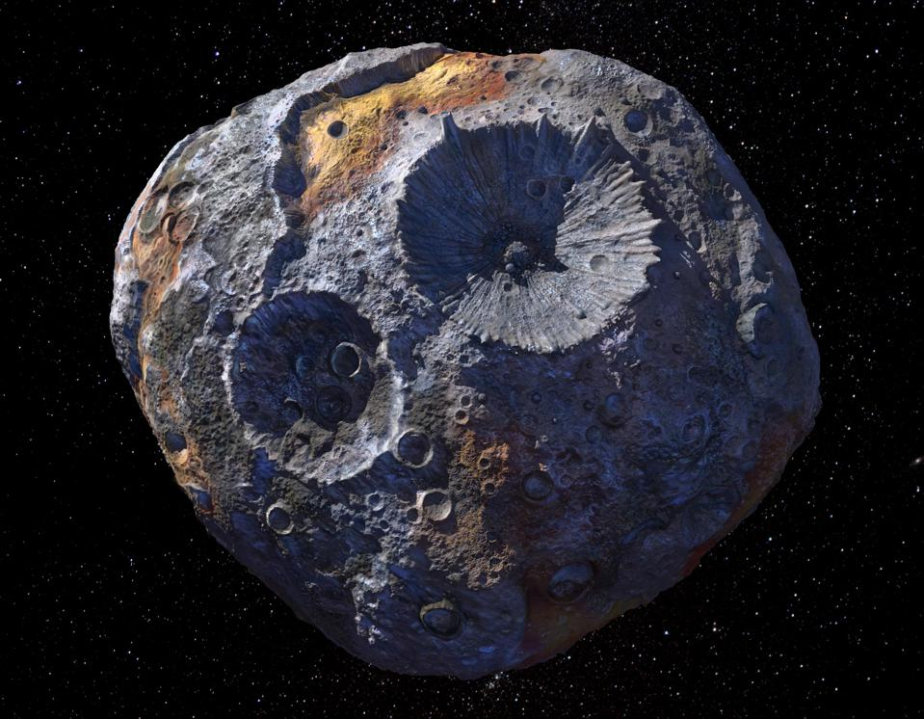
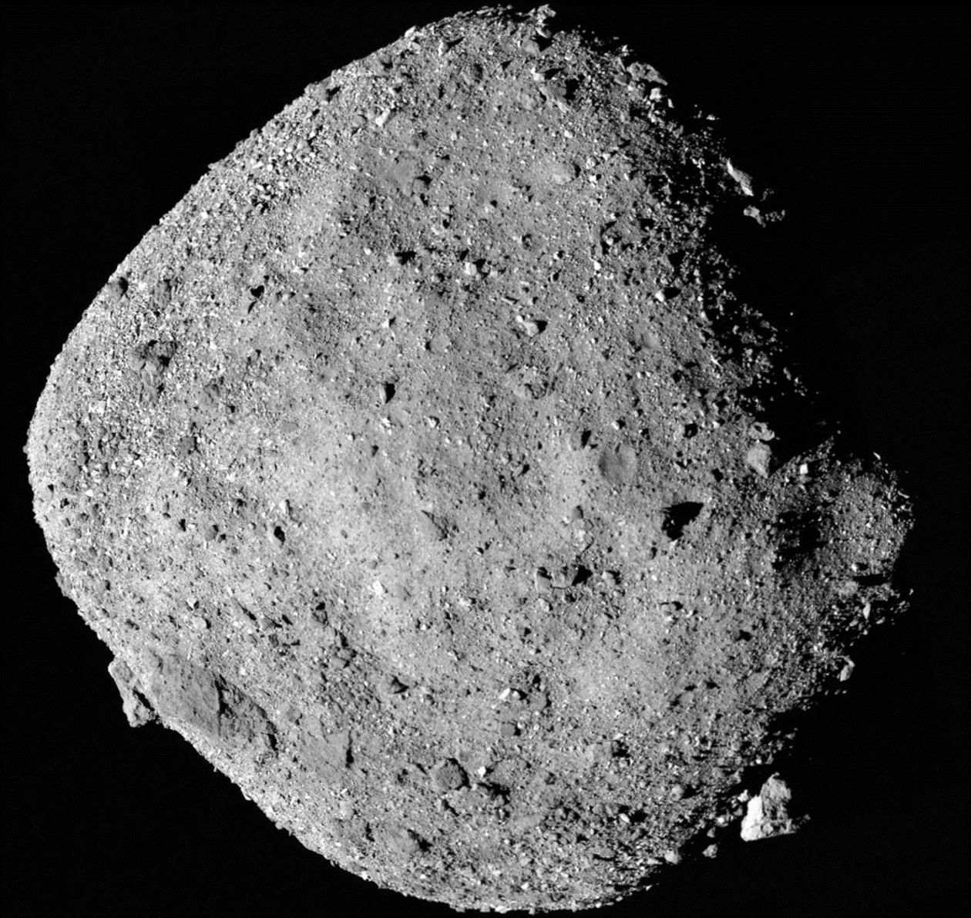
Missions to land on asteroids and get samples
Japanese probe Hayabusa returned 1 mg sample from 25143 Itokawa in 2010 (launched in 2003)
Japanese probe Hayabusa 2 will return 100 mg sample from half-mile wide 162173 Ryugu in Dec., 2020 (launched Dec., 2014)
Had dropped robotic explorers, used explosives to blast a 60 foot crater
Now, NASA missions …
Itokawa
Ryugu
Bennu
Psyche
Credit: NASA JPL/Caltech/ASU
Credits: Shutterstock via Space.com, JAXA

Slide 11
Asteroid Bennu
1/3 mile diameter
200 million miles away
1 in 2700 chance of hitting earth in late 2100’s
A “time capsule” little changed from birth of the solar system
A lot of carbonaceous material (organic molecules)
Credit: NASA/Goddard/University of Arizona

Slide 12
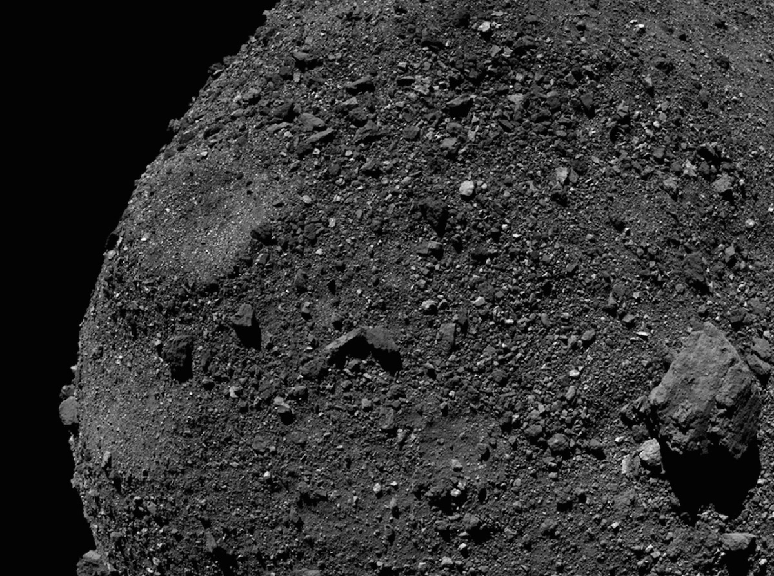
OSIRIS-REx mission to Bennu
Origins, Spectral Interpretation, Resource Identification, Security, Regolith Explorer
Van-sized craft, 4650 lbs
Launched Sept. 2016
3 billion km trip, with Earth gravity assist in Sept. 2017
Arrived Dec 2018
Orbited Bennu for 2 years, searching for ideal landing spot
Credit: NASA/Goddard/University of Arizona/Lockheed Martin

Slide 13
OSIRIS-REx “smash and grab” at Bennu
6 second touchdown of robot arm at 0.2 mph on Oct. 20
Robot arm sunk 19” into soft surface
Blast of N₂ to stir up particles
Collected 2 lb sample, reversed thrusters to back away
Autonomous operation
Will leave in March, 2021
Sample return to Earth (Utah): Sept. 2023
Already have some results:
Low density, porous, loose collection of rocks
Outer layers would mostly break up and burn up in Earth’s atmosphere
Returned sample will thus be different than in intact meteorites that fell to earth
Credit: NASA/Goddard/University of Arizona/Lockheed Martin

Slide 14
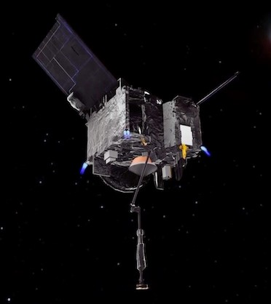
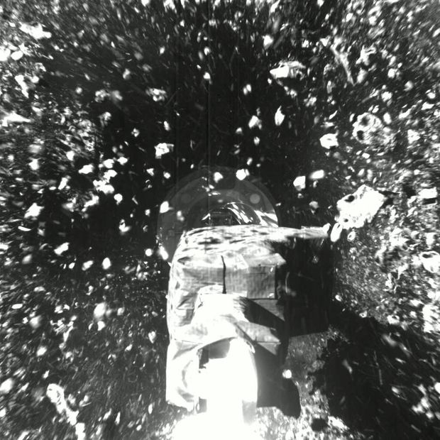
OSIREX-REx
OSIREX-REx craft Impact!
Artist’s Illustration: NASA
Credit: NASA Goddard-University of Arizona

Slide 15
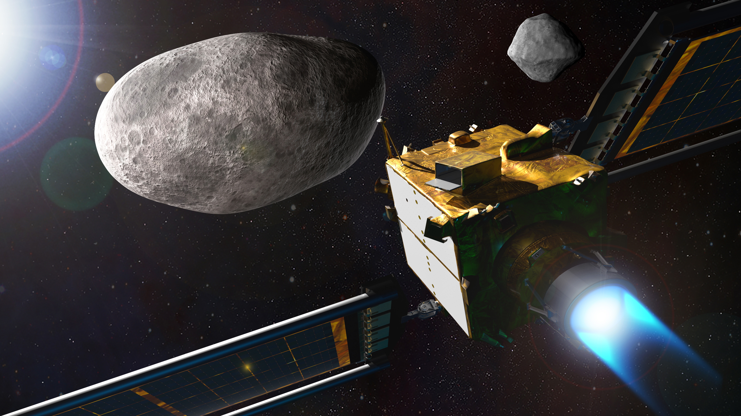
Future NASA asteroid missions - DART
DART (Double Asteroid Redirection Test) launching in July, 2021
Planetary defense test of diverting an asteroid if on collision course with Earth
1100 lb craft will slam into a moonlet orbiting a larger asteroid (Didymos)
“Didymoon: 535 ft. diameter
“Didymos: 2560 ft. diameter
May produce first human-caused meteor shower, ejecting between 22,000 and 220,000 lbs of centimeter-sized debris
Small amount of debris may reach Earth
Will measure orbit change orbit of the moonlet
Intercepting Didymos in Sept. 2022
Artist impression. Credit: NASA/Johns Hopkins APL

Slide 16
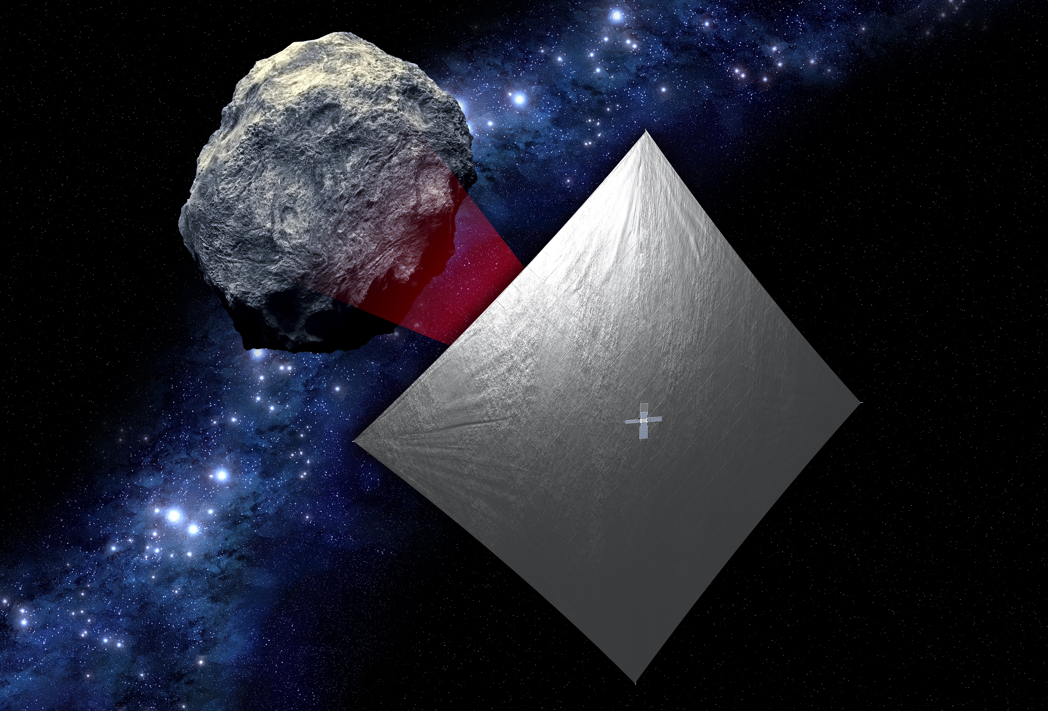
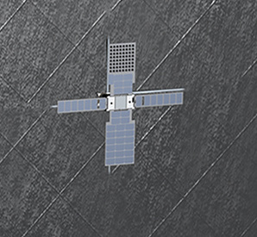
Future NASA asteroid missions: NEA Scout
NEA (Near Earth Asteroid) Scout, mapping a small asteroid (< 300 ft diameter)
Launching in 2021 as secondary payload of Artemis 1 moon launch
First CubeSat to reach an asteroid (large shoebox size)
Propelled by 282 sq. ft. solar sail (aluminized polymer)
Enlargement of Cubesat in picture to the right →
Credit: NASA/JPL/California Institute Of Technology

Slide 17
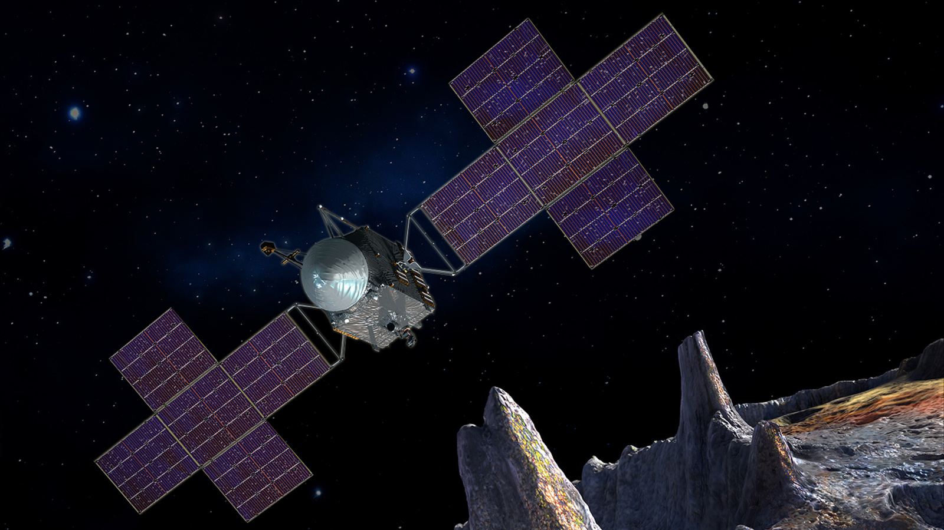
Future NASA asteroid missions, continued
Lucy launching in 2021
Will pass “Trojan asteroids” trapped in Jupiter’s orbit (near Jupiter L4 & L5 points)
Psyche mission launching in 2022
Unique metal asteroid, maybe the nickel-iron core of an early Earth-like planet
1 percent of the mass of the entire asteroid belt
140 mile wide, surface area of Texas
Worth $10 quintillion at current prices
Reminder of vast resources of space!
Mars flyby/gravity assist in 2023
Arrives at Psyche in 2026
Credit: NASA/JPL/California Institute Of Technology

Slide 18
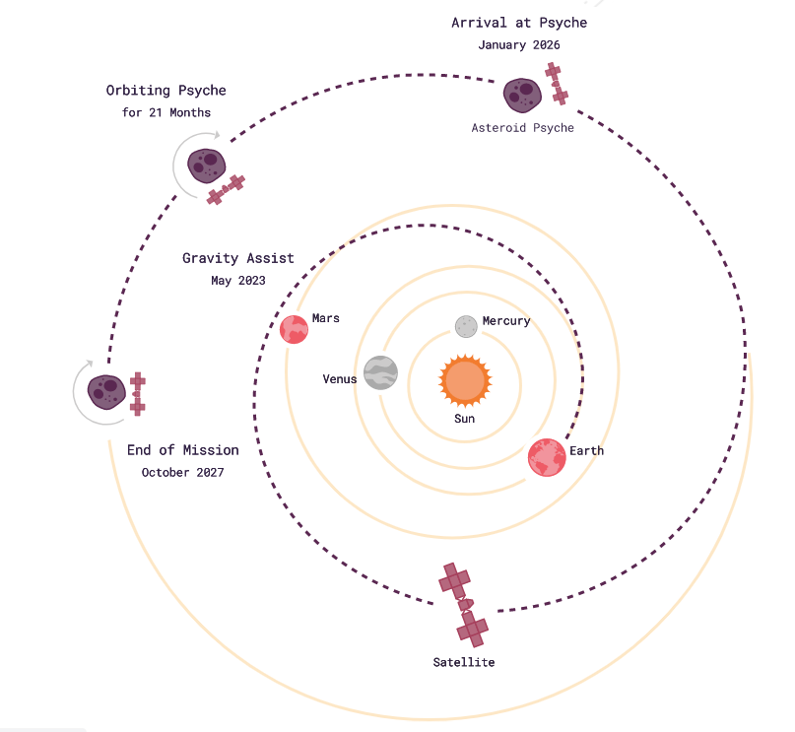
Psyche, continued
Lucy
Credit: Arizona State University

Slide 19
Miscellaneous news
International Space Station has now been inhabited continuously for two decades
Orbited 117,000 times with humans on board
Hosted 240+ astronauts from 19 countries
More active than ever doing research projects
Phosphine gas detection on Venus (hinting at possible life) may just have been noise with flawed data analysis
Voyager 2, after 43 years, responded to NASA call
125 AU (Astronomical Units = Earth/Sun distance)
17 hour time delay
7 Nations joined the US in the Artemis accords
(Australia, Canada, Italy, Japan, Luxembourg, UAE, UK)

Slide 20
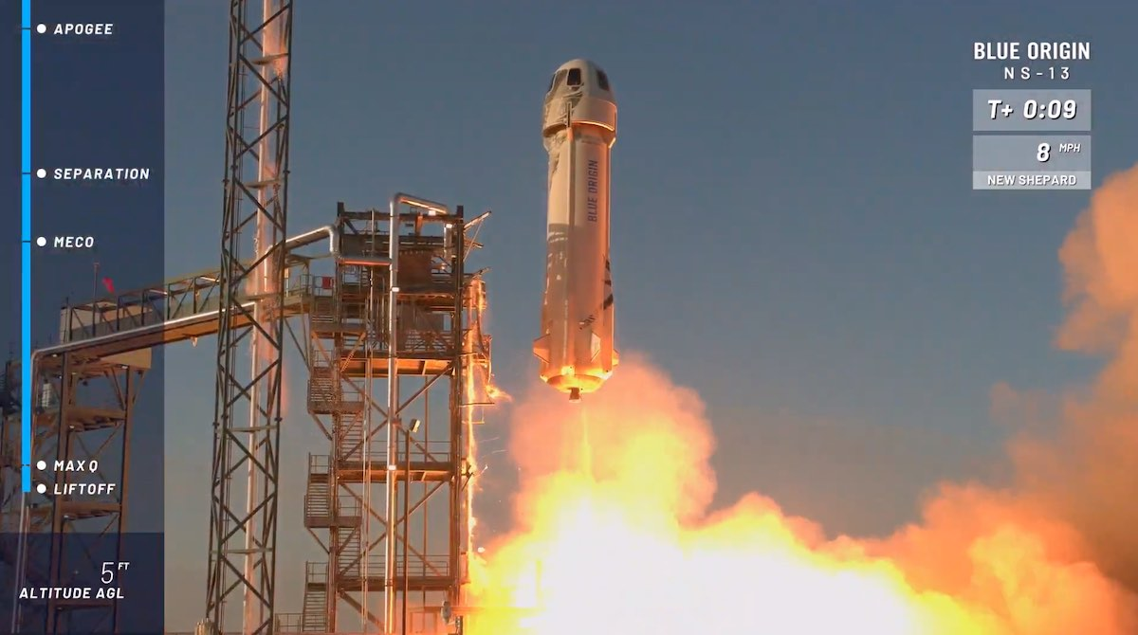
How many launches since the last meeting (Oct 3)?
This includes failed launches only if they lift off the launch pad
and only includes launches that attempt going into orbit
This Blue Origin New Shepard test in West Texas didn’t count
Suborbital, with 12 research payloads
Testing rocket, 6 person crew capsule, and precision landing for lunar missions
Credit: Blue Origin

Slide 21
Launches since last meeting (Oct 3, 2020)
Oct 6 – Falcon 9 – 13th Starlink launch - 60 satellites - internet service
Oct 11 – Long March 3B – 13 geosynch. earth observation satellites
Oct 14 – Soyuz – Crew to ISS – END OF AN ERA
Last seat NASA contracted to Russia
Fastest trip to ISS (3 h)
Oct 18 – Falcon 9 – 14th Starlink launch - 60 satellites - internet service
Oct 24 – Falcon 9 – 15th Starlink launch - 60 satellites - internet service
Oct 25 – Soyuz – navigation satellite
Oct 26 – Long March 2C – 3 military spy satellites, small data relay
Oct 28 – Electron – 10 earth imaging satellites
Nov 5 – Falcon 9 – 5 ton GPS satellite
Nov 5 – Long March 6 – 13 satellites (10 for Argentina)
Nov 7 – Polar Satellite Launch Vehicle (PLSV – India) – 10 satellites

Slide 22
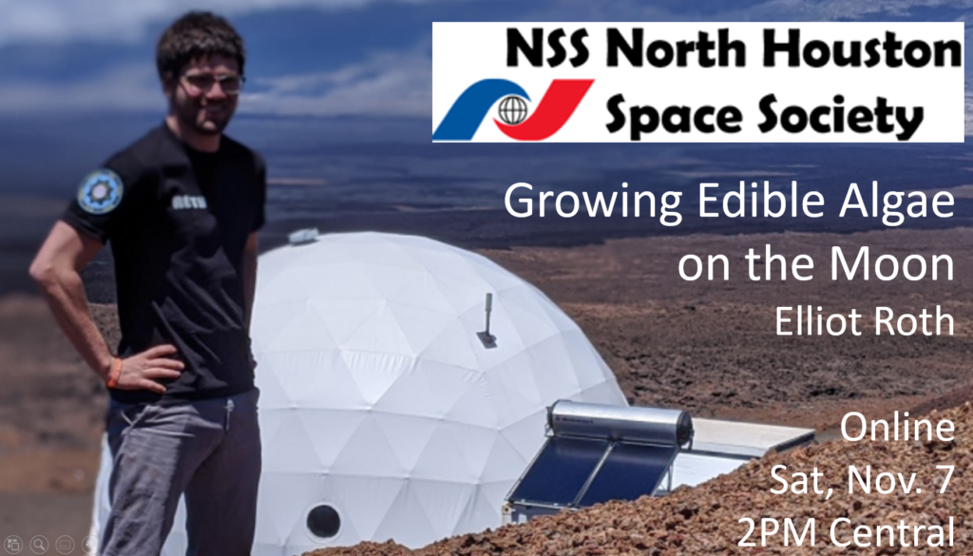
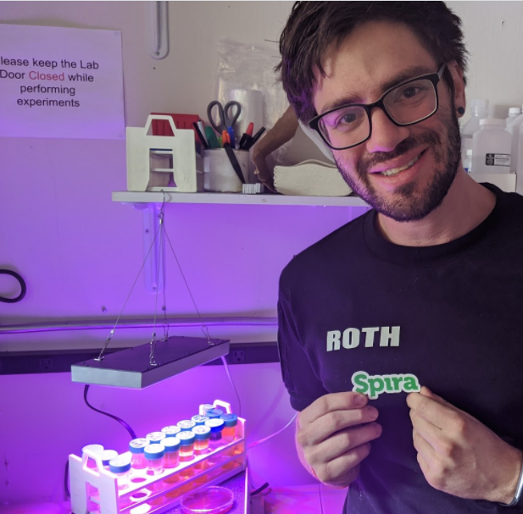
Featured Speaker: Elliot Roth
Founder of Spira (company that creates better-tasting spirulina as an ingredient for food companies)
“DIY astrobiologist and writer” with 10 years of synthetic biology experience
Participant in NASA HI-SEAS program simulating living on the moon (in Hawaii)
Founder of multiple companies and nonprofits
5 years as consultant in product design and business strategy
Future Founders Fellow at Stanford d.school (1 year entrepreneurs program)
Degree in Biomedical Engineering from Virginia Commonwealth University

