Slide 1
Inspiring the Artemis Generation
Brynlee Wright

Slide 2
Dr. Joy Kelly, VP & GM Jacobs
Brynlee & Wyatt
Astronaut Brian Duffy

Slide 3
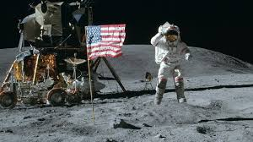
Apollo 11 Mission: Buzz Aldrin and Neil Armstrong
walk on the moon July 20, 1969

Slide 4
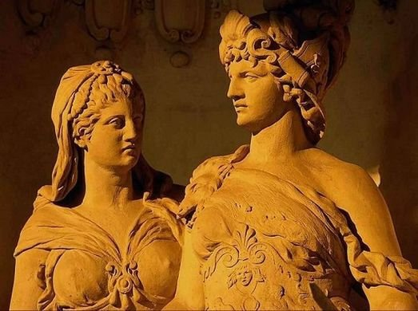

Slide 5
Purpose of Artemis Mission
Search for moon’s water and use it.
Study the moon to discover its mysteries
Learn how to live and work on another celestial body
Test technologies needed for Mars mission

Slide 7
