Slide 1
Artemis Spacesuit
Brynlee Wright
NHSS
Space Communicator

Slide 8
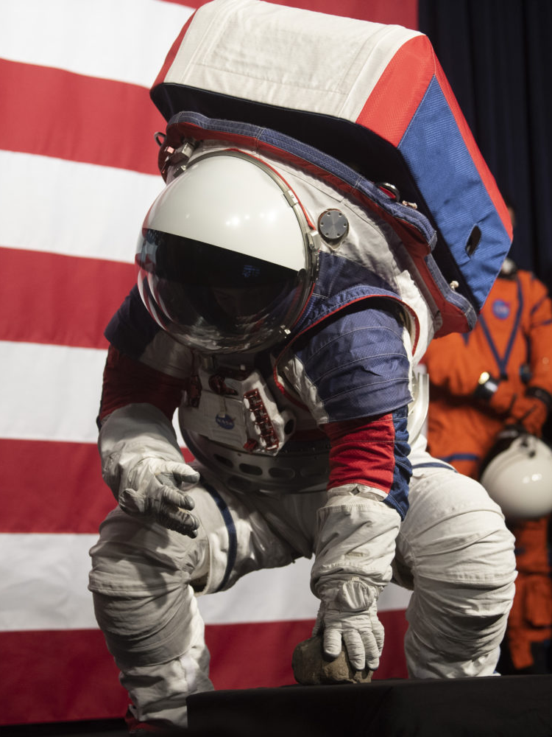

Slide 9
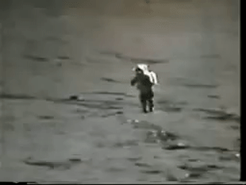

Slide 10
Fun Facts
Work in Progress
Adjustable to fit most people: 5’4-6’3
Each part costs as much as a car! $$$$
You Can Dance in it!

Slide 11
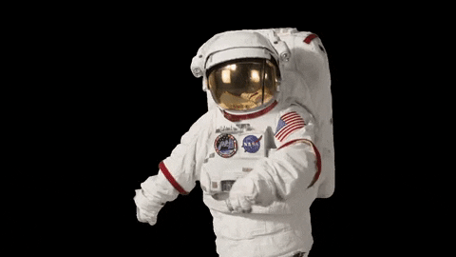

Slide 12
Artemis Spacesuit
Brynlee Wright
NHSS
Space Communicator

