Slide 1
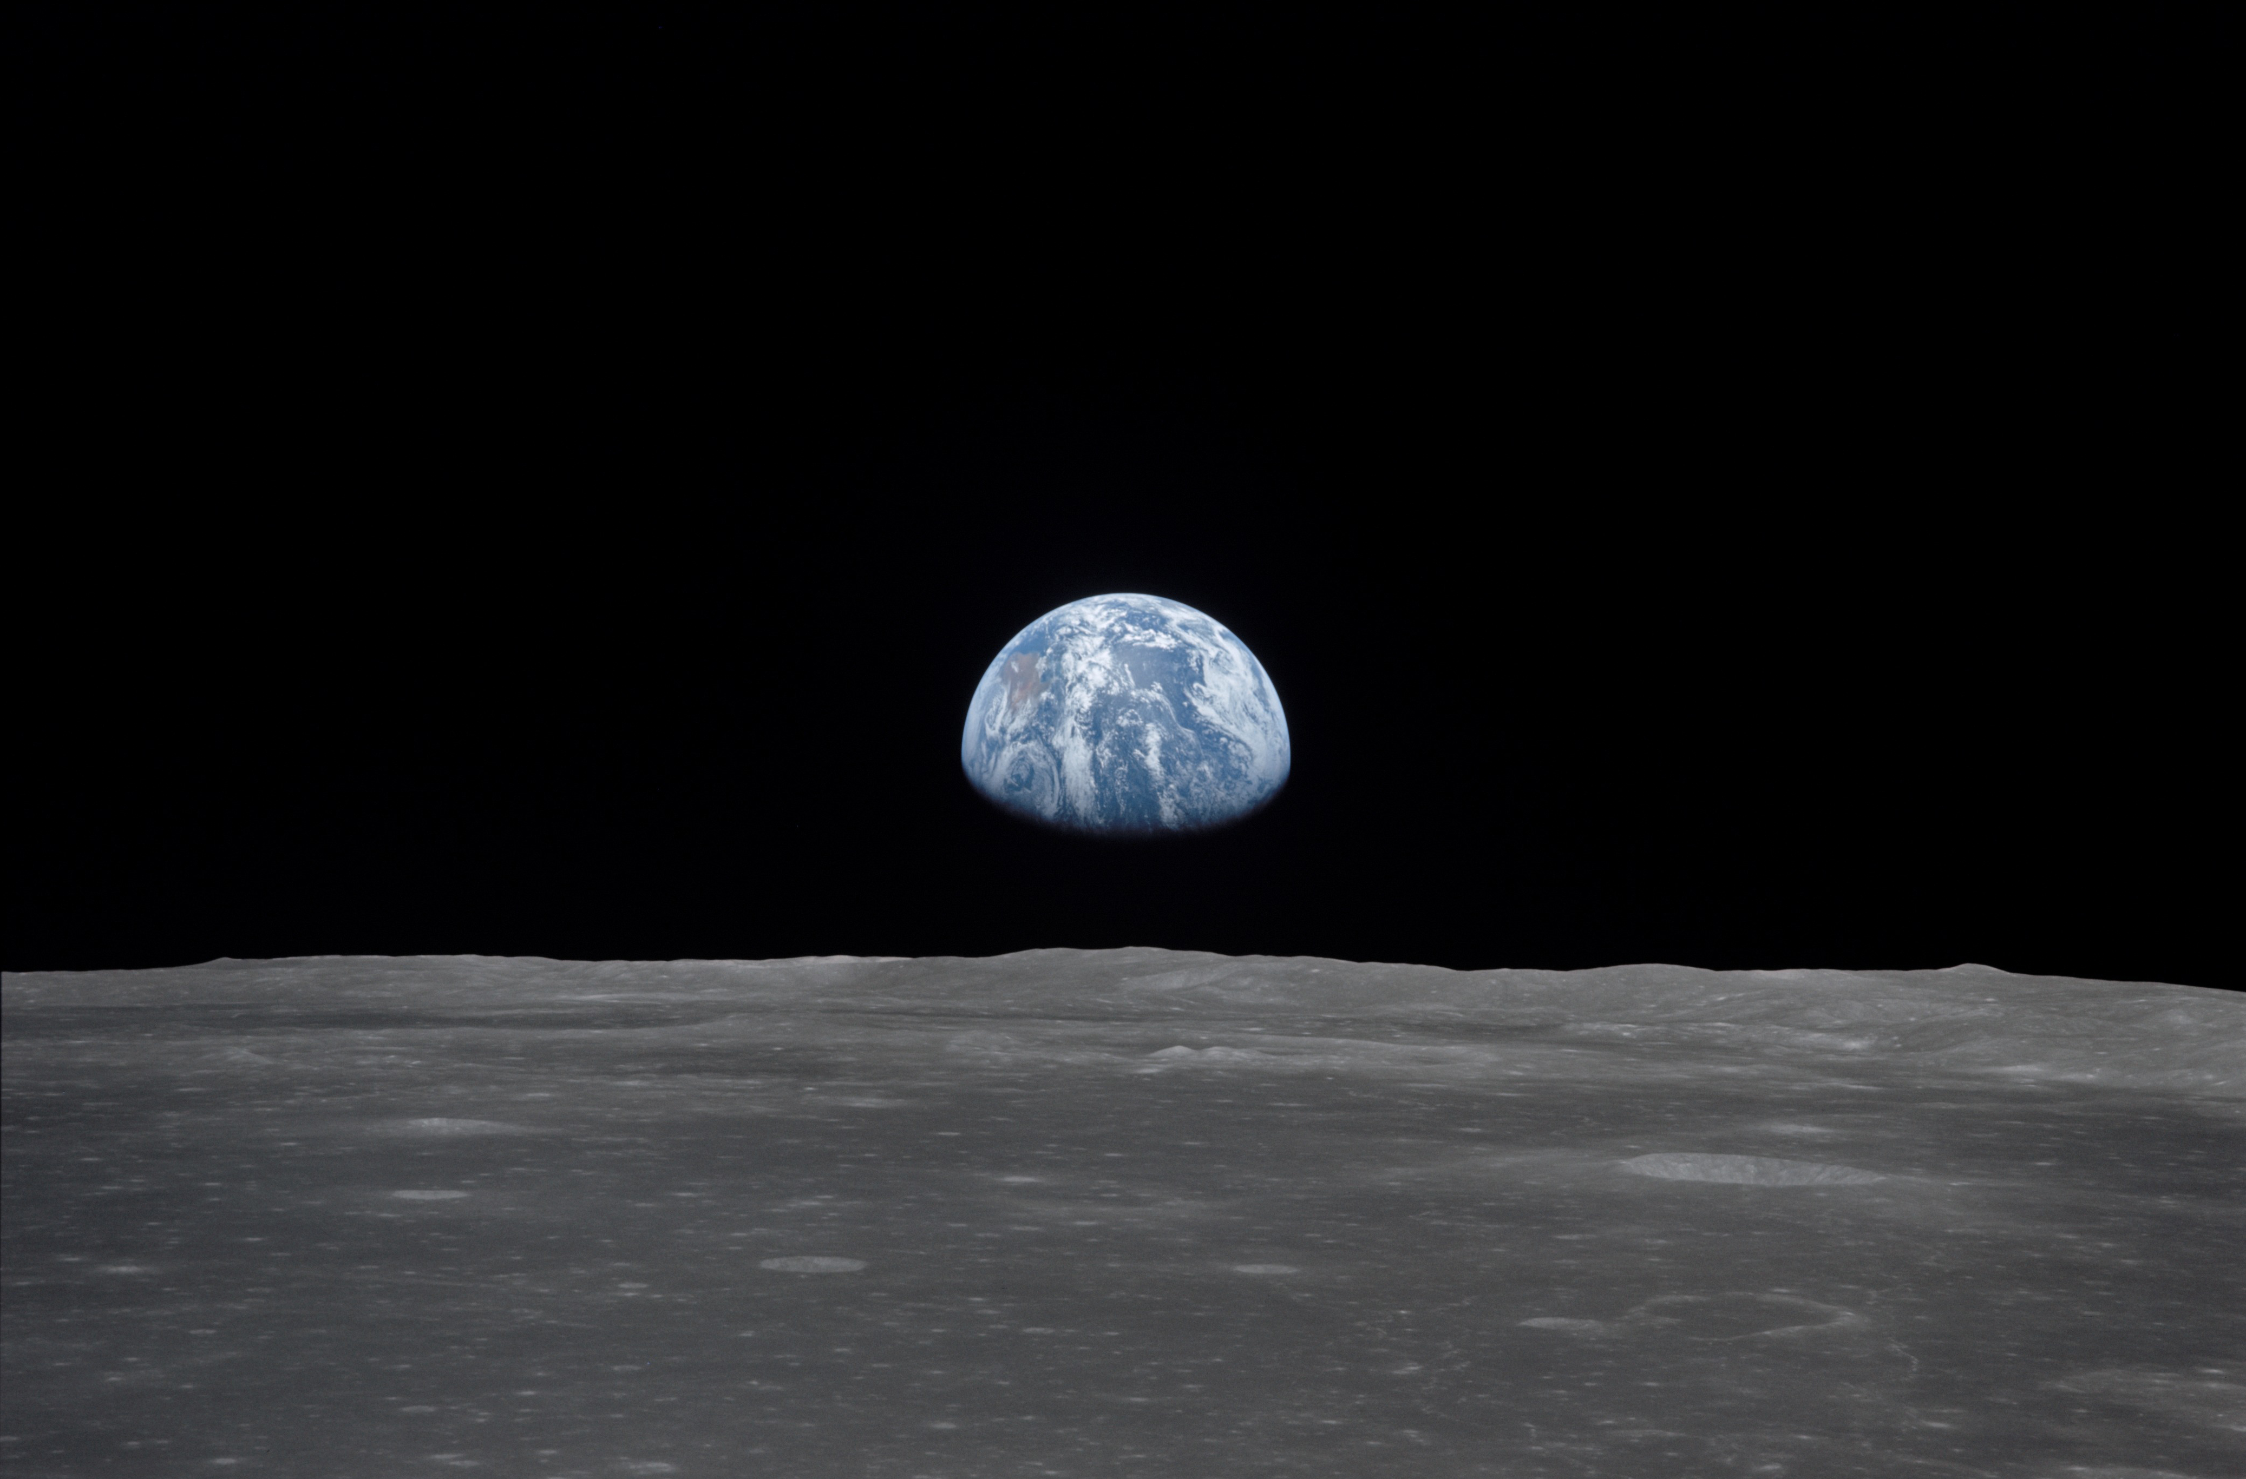
NSS North Houston Space Society Space News
October 3, 2020
Greg Stanley

Slide 2
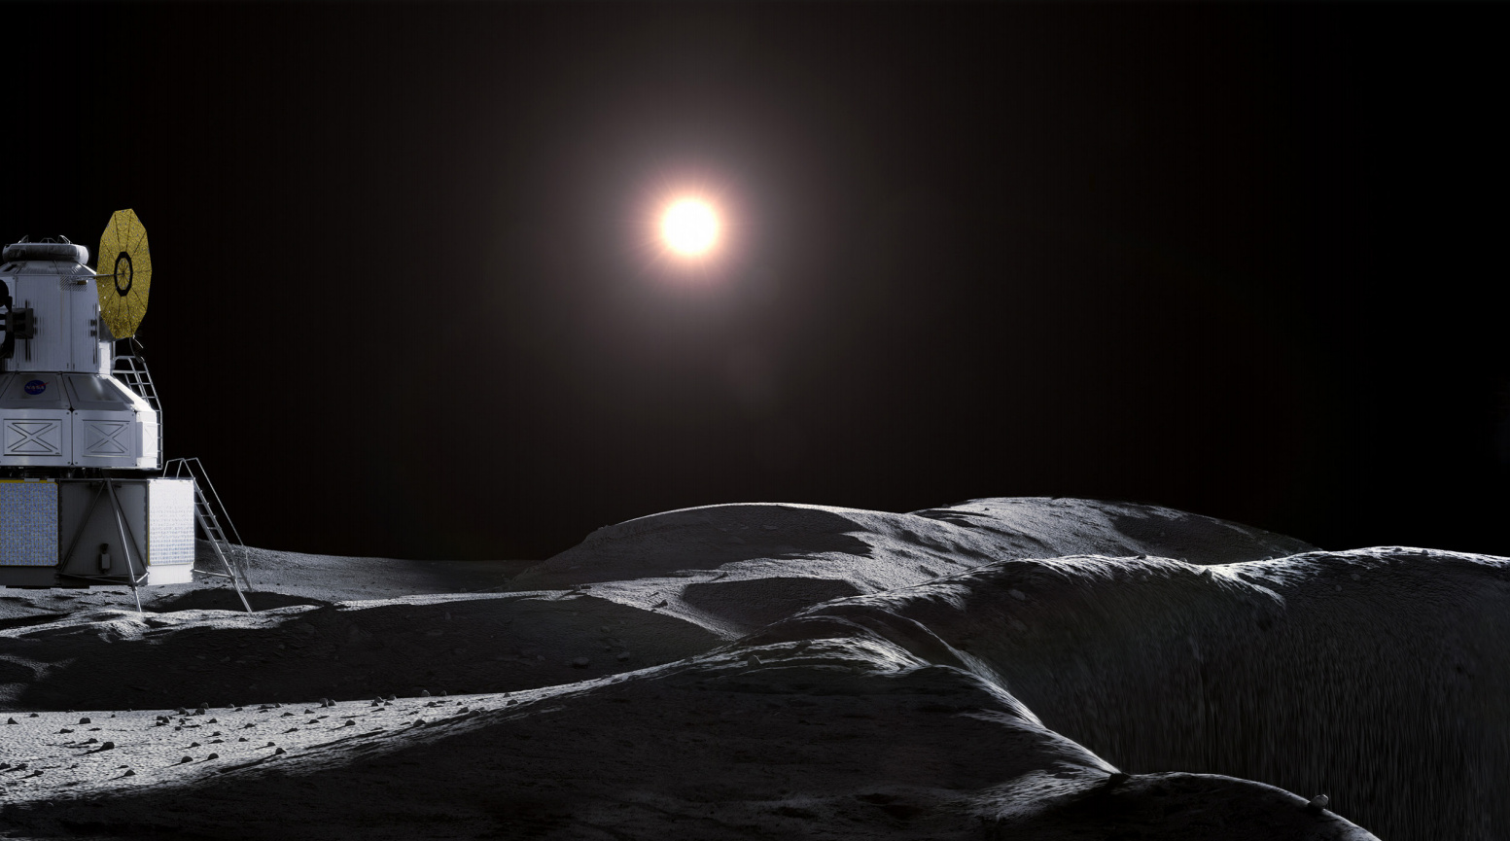
NASA lunar news
Lunar news
Credit: NASA Artemis document

Slide 3
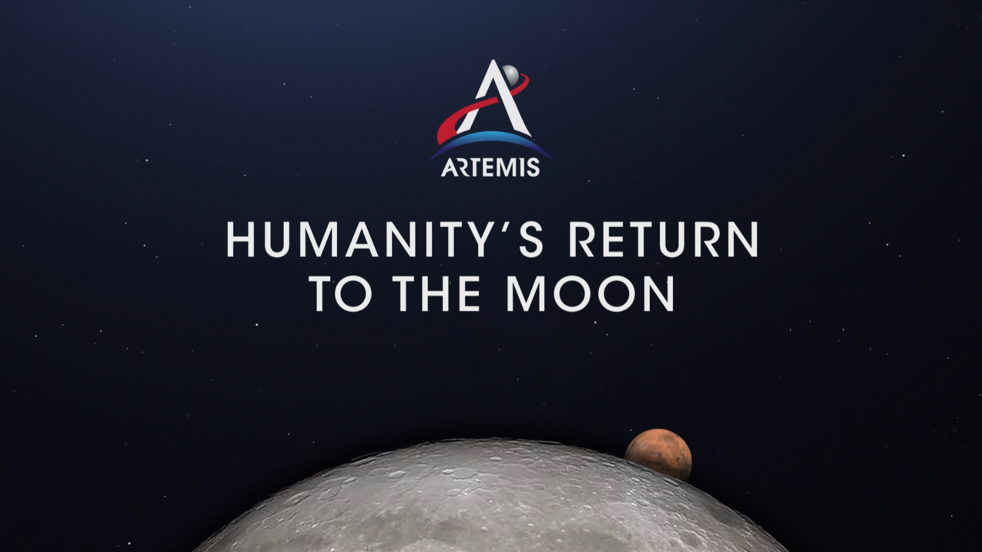
NASA Artemis program
Artemis = twin sister of Apollo, goddess of the Moon
Return astronauts to the moon in 2024
Longer-term: permanent presence, in-situ resource use
“Moon to Mars” emphasizes Moon missions as proving ground
Credit: NASA

Slide 4
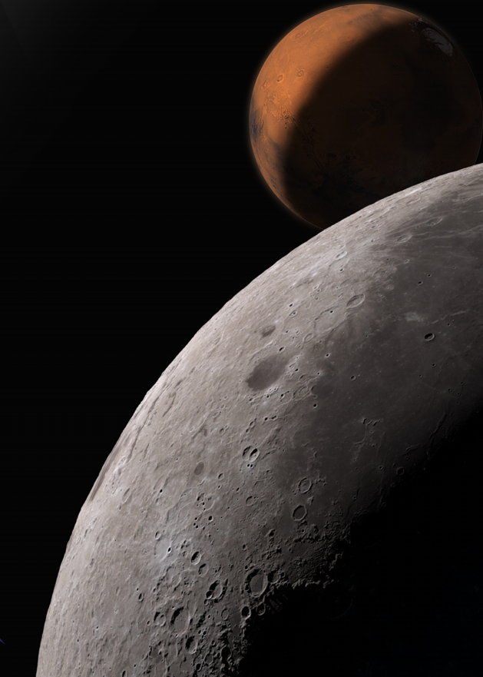
NASA released a new Artemis plan
NASA released 5-year, $28 billion phase 1 plan
Phase 1 returns astronauts to moon by 2024
SLS (Space Launch System) rocket
Orion space capsule
HLS (Human Landing Systems) (to be chosen from 3 service providers)
Phase 2 for long-term presence includes Gateway, base camp
Launch of 2 Gateway modules starting in 2023
NASA warning: timing depends on $3.2 B for HLS this year
NASA now hedging on Artemis landing sites
Astronauts might not go to lunar south pole at first
South pole is strategic: water in crater, etc.
Credit: NASA

Slide 5
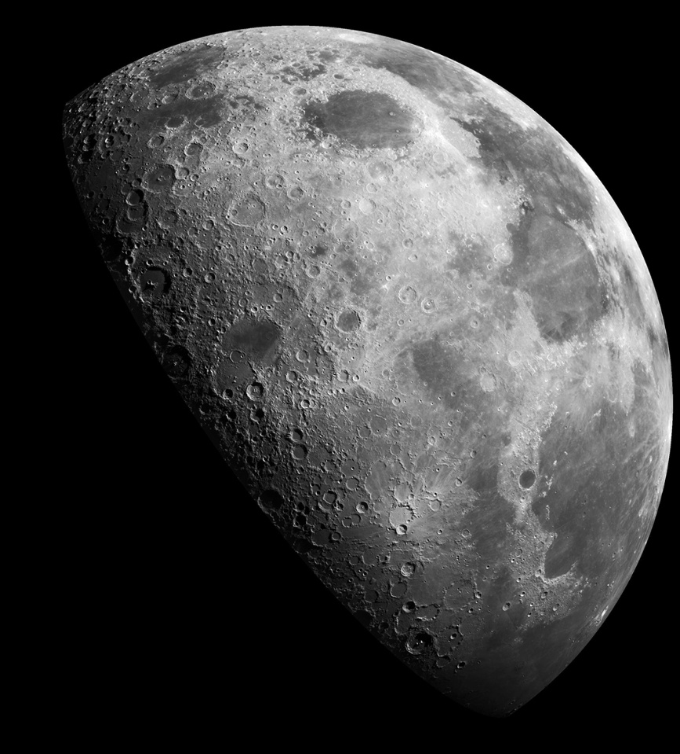
Artemis launches in phase 1
Credit: SpaceX
Artemis 1: SLS/Orion 1-month test (Nov 2021)
Orbit the moon, return to earth (no astronauts)
Deploy 13 6U Cubesats for science, resource analysis, etc.
Artemis 2: SLS/Orion 10-day mission (2023)
Orbit the moon with 4 astronauts (no landing)
Secondary payloads TBD
Artemis 3: SLS/Orion/lander (2024)
4 astronauts fly to lander already positioned by commercial launch
Land, stay 1 week, return
Robotic landers starting in 2021, as CLPS contracts
Commercial Lunar Payload Services, total of $2.6B through 2028
Contracts with commercial service providers, currently at 14
Includes rovers, scientific instruments for resource surveying, etc.
Prepositioning supplies for astronauts
Expect 2 flights/year

Slide 6
NASA plans to buy lunar soil
Credit: SpaceX
NASA issued RFP (Request For Proposals) to purchase lunar soil from commercial companies
Deliveries of 50-500g on moon by 2024
Expecting to pay $15,000 to $25,000 each
Kick start a market for extracting off-earth resources
Establish precedent/regulatory certainty for a predictable investment environment for mining, transferring ownership of extraterrestrial material

Slide 7
NASA lunar soil purchase plan: treaty issues
Credit: SpaceX
Consistent with 1967 Outer Space Treaty
No country can own off-earth land
Signed by 110 countries including the US, UK, China, Russia
Inconsistent with 1979 Moon Treaty treating the moon as a “global commons”
Rejected by US, China, Russia, Japan, most European countries
Signed by only 18 countries including France, India
NASA earlier this year outlined “Artemis Accords”
Peaceful exploration, transparency, interoperability, emergency assistance, registration of space objects, public release of scientific data, resource extraction, space debris mitigation
At a minimum, will be used with Artemis partners

Slide 8
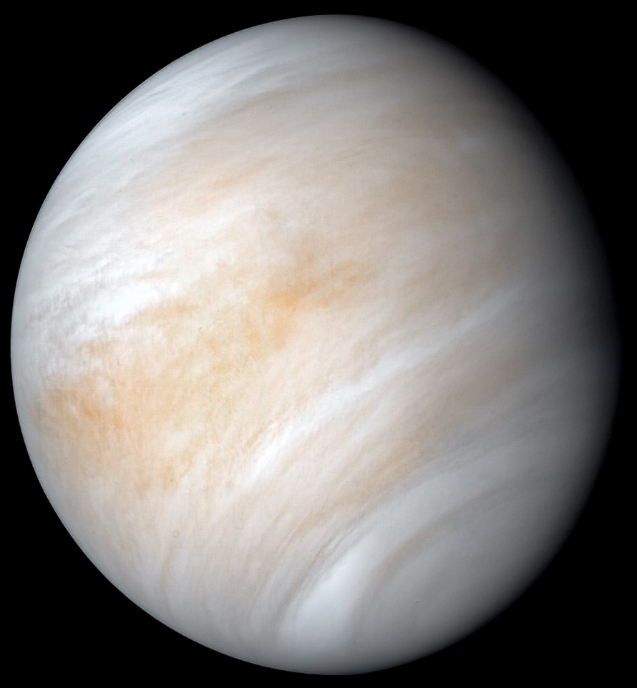
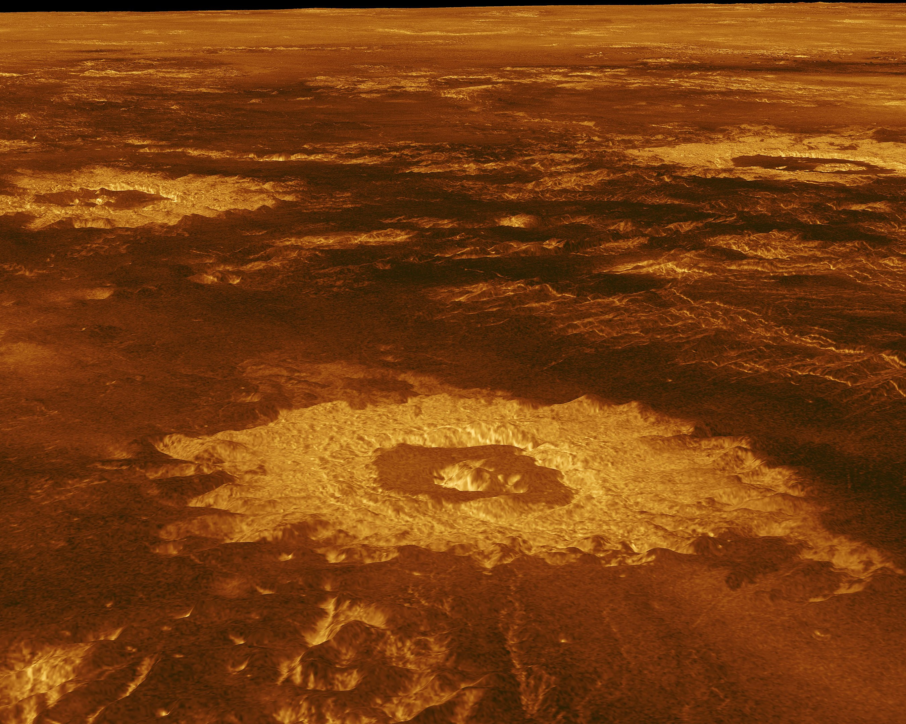
Venus gets renewed interest – a new space race?
Astronomers found phosphine, which might be a product of life, in Venus clouds > 30 miles up (where it’s cool)
Rocket Labs (NZ/US) launching a private Venus mission in 2023
60 lb. payload to the atmosphere
Similar rocket to $10M 2023 lunar orbiter
“Venus is a Russian planet” (Rogozin, head of Roscosmos)
Contrast-enhanced false color image.
Credit: NASA/JPL
Don’t get too excited yet
Link between microbes and phosphine on Earth not clear – is it a valid biosignature?
Phosphine also exists on Jupiter, Saturn
Chemical reaction knowledge limited
Only one spectral line of several was found
Clouds are sulfuric acid
Surface: 90 atmospheres, 750 ◦F
False-color image from radar data Credit: NASA/JPL

Slide 9
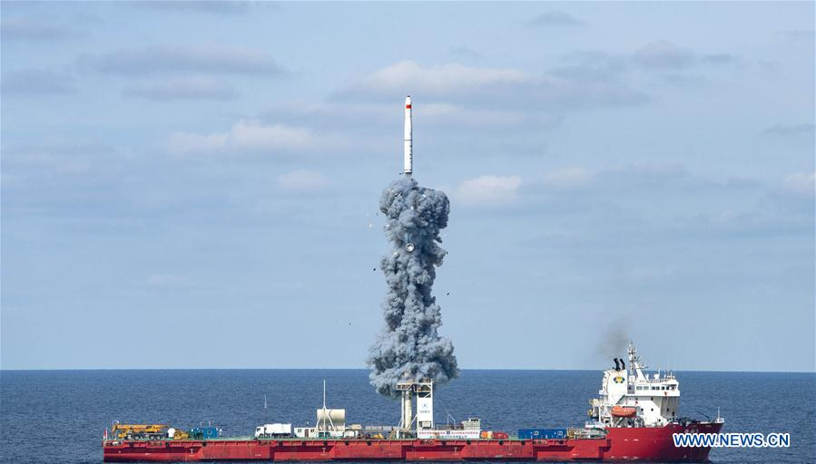
How many launches since the last meeting (Sept 5)?
This includes failed launches only if they lift off the launch pad
and only includes launches that attempt going into orbit
Credit: Xinhua

Slide 10
Launches Since Last Meeting (September 5, 2020)
Oct 2 – Antares/Cygnus (Northrop Grumman) – ISS cargo arriving Oct 5
Sep 28 – Soyuz – 3 communications satellites, 19 smaller rideshares
Sep 26 – Long March 4B – 2 environmental satellites
Sep 21 – Long March 4B – Oceanography satellite
1st stage equipped with fins to guide descent (and not fall on Chinese villages)
Sep 14 – Long March 11H – 9 small (88 lb) earth observation satellites
Launched from a ship
Sep 12 – Kuaizhou 1A – earth observation satellite - FAIL
Small launcher, solid fuel, based on truck-mounted military technology
Sep 11 – Rocket 3.1 (Astra) from Kodiak Island, Alaska – test - FAIL
Sep 7 – Long March 4B – another Earth observation satellite

Slide 11
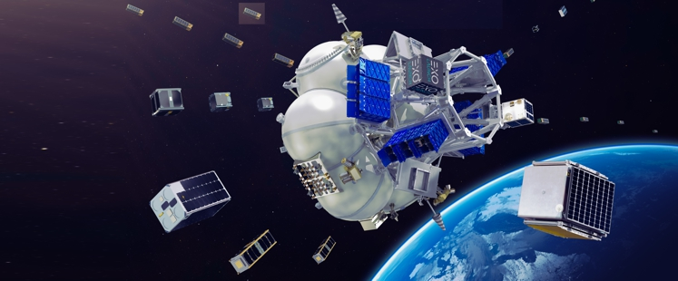
Part of a deployment of small satellites (Soyuz – Russian)
Cubesats can use spring-loaded launchers
Artist’s illustration of small satellites deploying from Soyuz rocket’s upper stage. Credit: Exolaunch

Slide 12
Featured Speaker: Richard D. Easton
Science and technology journalist
Author of book: GPS Declassified: From Smart Bombs to Smartphones
Explores dual paths into space
Military and secret
Scientific and public
A peek behind the scenes at pivotal events in GPS history

