Slide 1
NSS North Houston Space Society
October 2020

Slide 2
Agenda
2:00 PM – Opening Remarks – Nathan Price
2:10 PM – Space Communicator Speech
2:20 PM – Recent Space News – Greg Stanley
2:45 PM – “GPS Declassified” – Richard D. Easton
3:30 PM – Q&A
3:45 PM -Share your personal space experiences since the last meeting. Rocket Launches, Other Meetings, Research, etc.
4:00 PM – End of Meeting

Slide 3
Why Space?

Slide 4
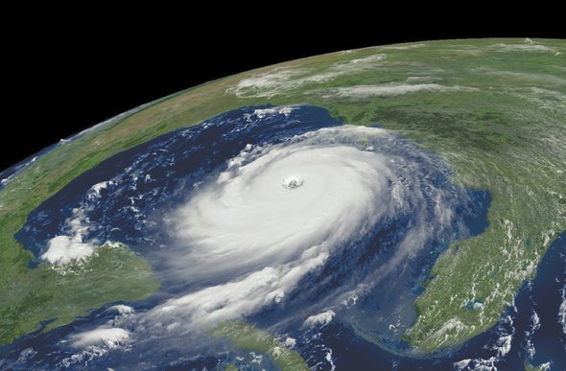
Improve Life on Earth
Weather Prediction
Earth observation
TV & Radio
Communication
GPS
Sun weather
Planetary Protection from Near Earth Objects

Slide 5
Improve Life On Earth
8. Space-based Solar Power
9. Moon and Asteroid Mining
10. Better understanding of the universe and our place within it
11. New challenges leads to new approaches
12. Inspiring stories from the frontier

Slide 6
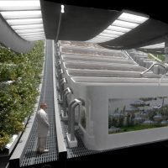
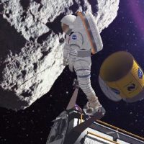
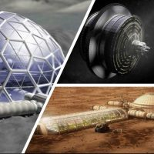


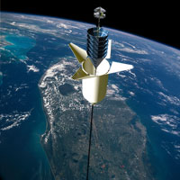

National Space Society Vision
People living and working in thriving communities beyond the Earth, and the use of the vast resources of space for the dramatic betterment of humanity.

Slide 7
Do you share this vision?

Slide 8
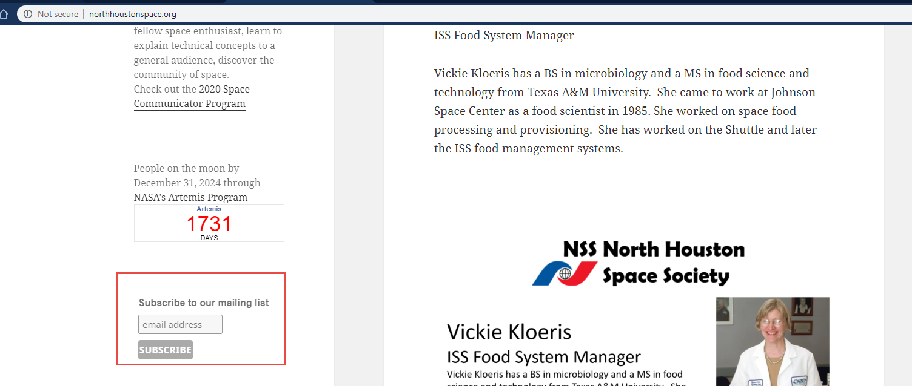
Join the NSS North Houston Space Society Mailing list
Visit http://NorthHoustonSpace.org
Scribe from left side bar

Slide 9
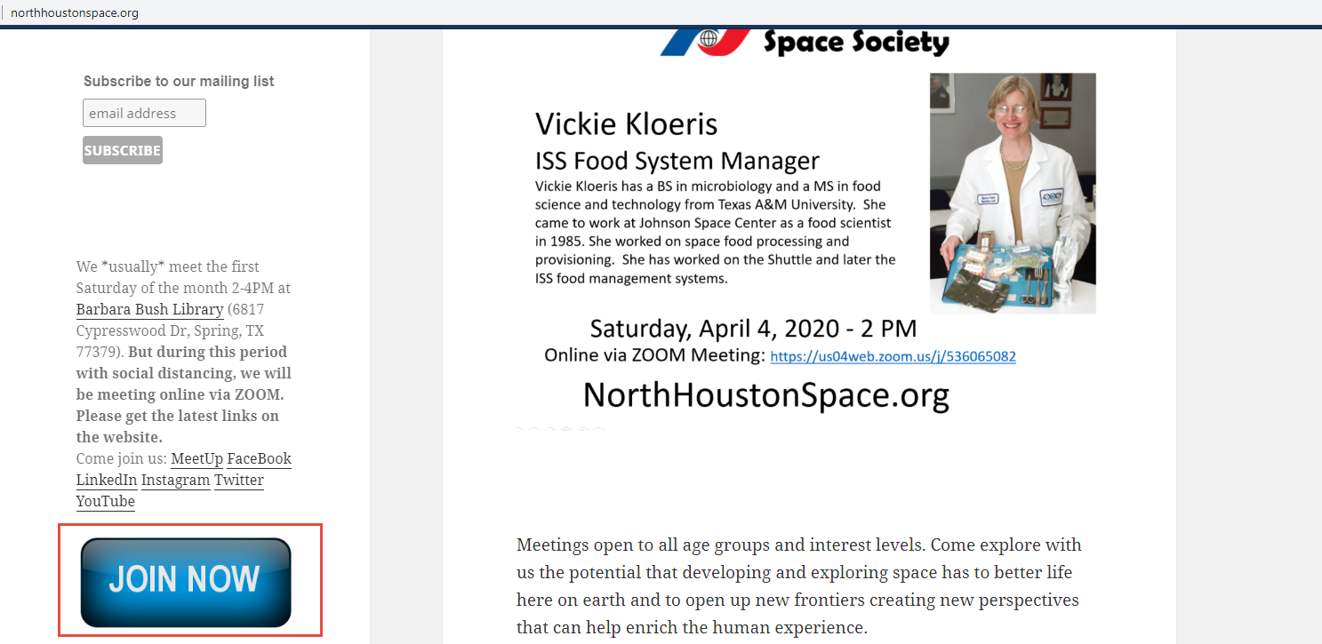
Join the National Space Society
Visit http://NorthHoustonSpace.org
Click on “Join Now” to go to the National Space Society’s website

Slide 10
Meeting IS being RECORDED
This meeting is being recorded and will be posted on YouTube, NorthHoustonSpace.org, Facebook, etc.

Slide 11
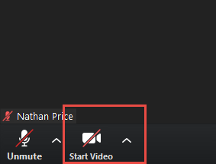
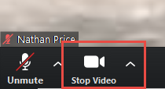
How to use ZOOM - Video
Video is turned off by default. Turn it on when you are ready:

Slide 12
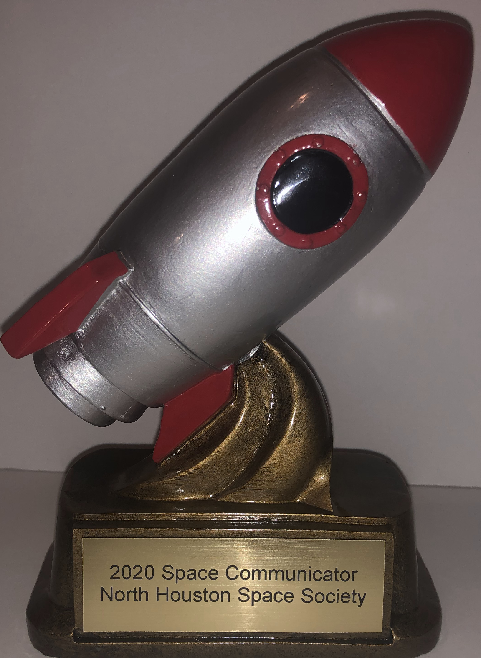
2020 Space Communicator Program
Goal:
Get you talking about space in front of a space friendly audience
Introduce yourself to your fellow space enthusiast
Learn to explain technical concepts to the general public
Discover a little bit about the history, business, and policy related to space.
Requirements:
Give 3 speeches in 2020 (each about 5-10 minutes)
  Personal Space - Why you like space. A personal experience.
  Technical Space - Explain a science concept or an engineering system.
  Community Space – History, Government, Business, Education

