Slide 1
NSS North Houston Space Society
September 5, 2020

Slide 2
Agenda
2:00 PM – Opening Remarks – Nathan Price
2:05 PM – High School Aerospace Scholars Program – Sashreek Bhagavatula
2:25 PM – Recent Space News – Greg Stanley
2:45 PM – “Monitoring, Quantifying, and Assessing the Near-Earth Anthropogenic Space Object Population: The Foundation to Space Traffic Management” – Moriba Jah – Astrodynamicist – UT Austin
3:15 PM – Q&A; Comments & Discussions
3:45 PM -Share your personal space experiences since the last meeting. Rocket Launches, Other Meetings, Research, etc.
4:00 PM – End of Meeting

Slide 3
Why have this meeting?

Slide 4
Confront Wrong Ideas

Slide 5
Wrong Idea: Resources are Limited

Slide 6
Wrong idea “Resources are Limited” Leads to other wrong ideas
Not enough to go around
Better make sure I get mine
War is logical
Win/Lose mentality
Some people are more deserving than others
Make sure your team wins
Make sure you join the winning team

Slide 7
Why is “Resources are limited” a wrong idea?
“Resources” do not exist in nature, raw materials do
“Resources” are created from raw materials with human ingenuity. And we should make use of all the ingenuity of all the humans that we can. Every human brain has the potential of giving us vastly more resources.
Consider:
Crop yields per acre of land
Crop yields per hour of work
Electronics, computers, and communications
Transportation
Even “Raw Materials” are not as limited as we might think. Only a fraction of the raw materials in the solar system exist on the earth.

Slide 8
What is more limited than land?

Slide 9
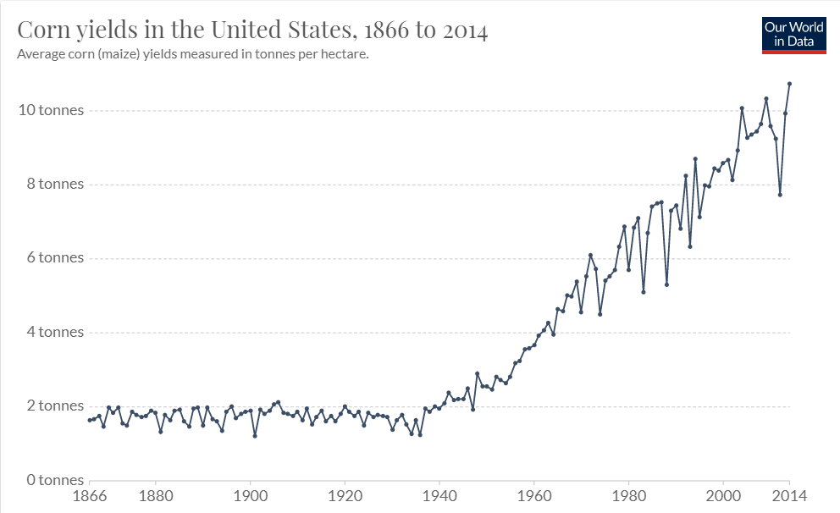
Land is limited, but the crops produced from it are not…

Slide 10
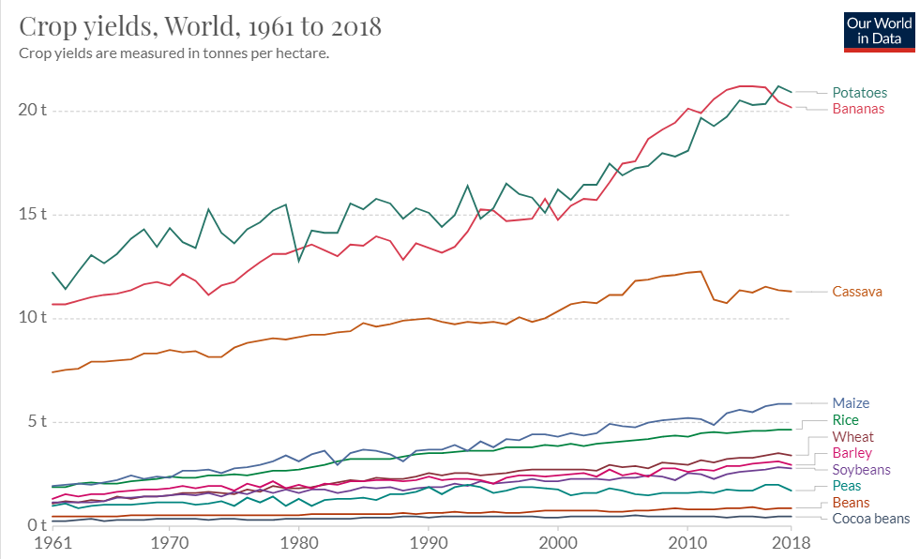
Land is limited, but the crops produced from it are not…

Slide 11
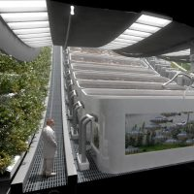
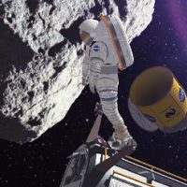
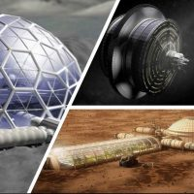
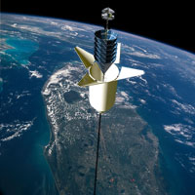
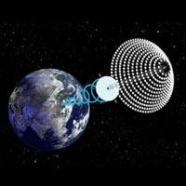
National Space Society Vision
People living and working in thriving communities beyond the Earth, and the use of the vast resources of space for the dramatic betterment of humanity.

Slide 12
Meeting IS being RECORDED
This meeting is being recorded and will be posted on YouTube, NorthHoustonSpace.org, Facebook, etc.

Slide 13
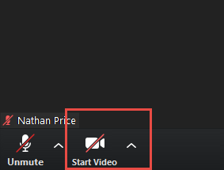
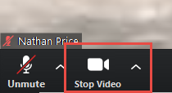
How to use ZOOM - Video
Video is turned off by default. Turn it on when you are ready:

Slide 14
Agenda
2:00 PM – Opening Remarks – Nathan Price
2:05 PM – High School Aerospace Scholars Program – Sashreek Bhagavatula
2:25 PM – Recent Space News – Greg Stanley
2:45 PM – “Monitoring, Quantifying, and Assessing the Near-Earth Anthropogenic Space Object Population: The Foundation to Space Traffic Management” – Moriba Jah – Astrodynamicist – UT Austin
3:15 PM – Q&A; Comments & Discussions
3:45 PM -Share your personal space experiences since the last meeting. Rocket Launches, Other Meetings, Research, etc.
4:00 PM – End of Meeting

Slide 15
NASA High School Aerospace Scholars
Sashreek Bhagavatula

Slide 16
Space News
Greg Stanley

