Slide 1
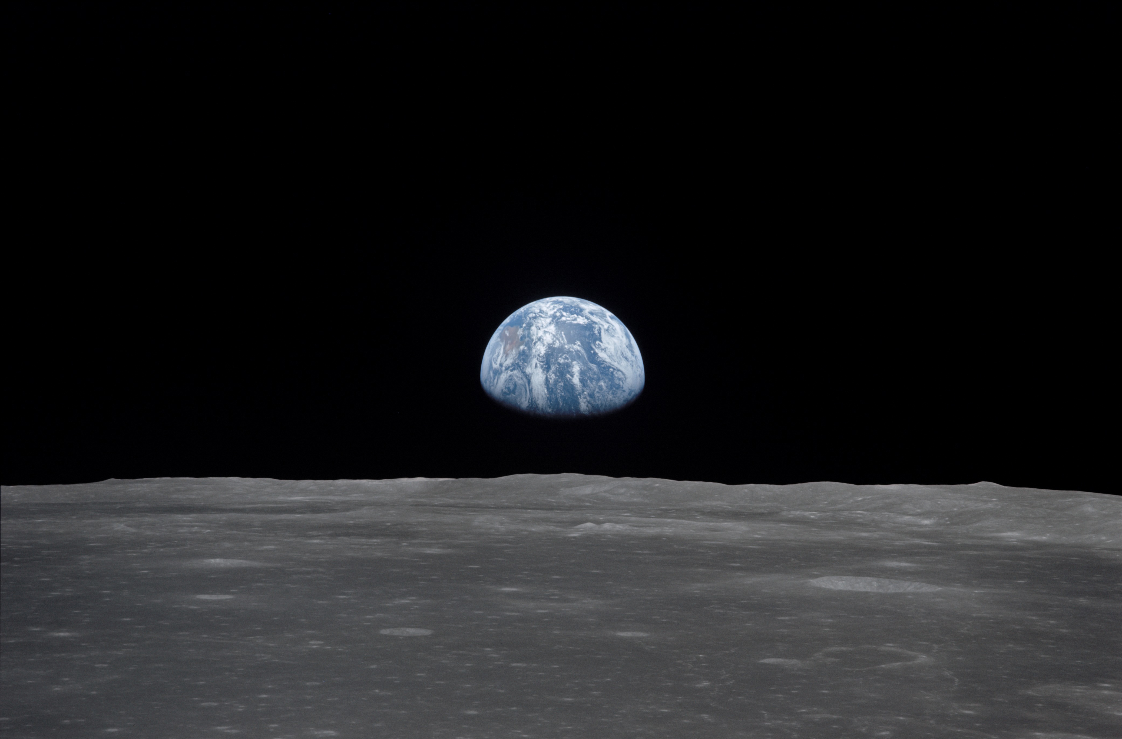
NSS North Houston Space Society Space News
September 5, 2020
Greg Stanley

Slide 2
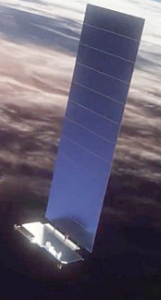
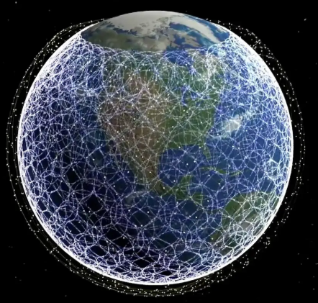
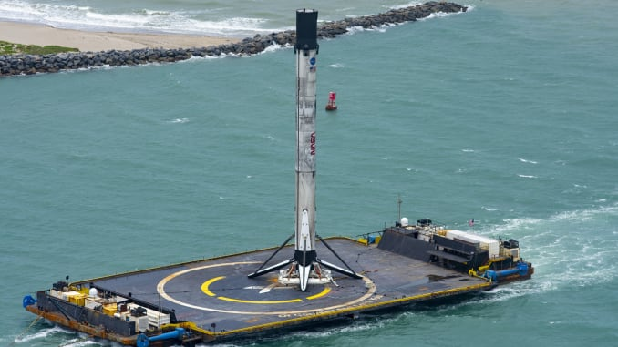
3 SpaceX Starlink launches
175 Starlink satellites + 5 “rideshares”
(Rideshares are as cheap as $1M)
“Constellation”: 713 satellites launched
Want 1440 satellites for global 24/7 coverage
FCC approved: 12,000+ satellites for worldwide internet service
Applied for: another 30,000 satellites
Factory churning out 6 satellites/day
Reusability: first stage now flown record 6 times
2 “drone ships” for recovery
300 ft x 170 ft barges
Towed by tug to landing area
Autonomous!
Octagrabber
Credit: SpaceX

Slide 3
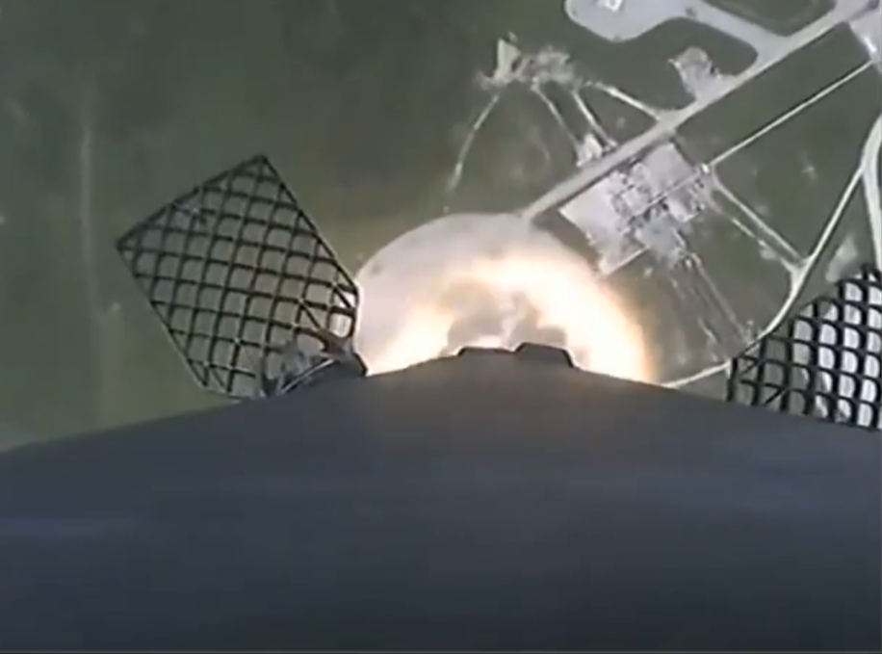
“Barges? We don’t need no stinkin’ barges”
Aug 30 Falcon 9 launch from Florida
Earth observation satellite for Argentina, 2 small “rideshares”, into polar orbit
Last polar orbit launch from Florida: 1969
Booster landed back at Cape Canaveral
Barge only if booster goes too far downrange
Treasure of the Sierra Madre (1948 movie)
Polar orbits launch north or south
Avoid flying over populated areas in case of failure
Normally launched south from west coast (Vandenberg AFB)
US and Cuban land is north or south from Cape Canaveral
East coast launches usually fly easterly (direction of earth’s 914 mph rotation, Atlantic)
We got Cuban approval for this launch because…
Credit: SpaceX

Slide 4
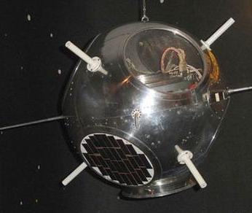
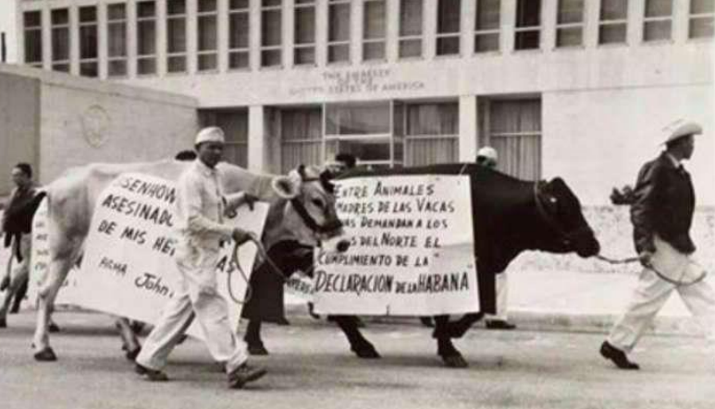
Rufina: the most expensive cow in history (Cuban cows are no longer sacred)
A 1960 launch south failed (second spy satellite)
Debris was strewn over 200 sq. miles of Cuba – an intelligence bonanza
Thor rocket engine sold to Soviets, Chinese were given useful intelligence
Rufina the cow was killed by debris, prompting protests
US awarded Cuba $2 million compensation
Falcon-9 launch got Cuban approval, because of Flight Termination System
(unique autonomous self destruct even during blackouts due to rocket plumes)
“You murdered one of my sisters”
“The Yankees are killing us without mercy”
Rufina was given a state funeral with full honors
We now have insurance for space debris risks
Credit: MAPFRE Global Risks (insurance)

Slide 5
SpaceX Starship development
“Flying grain silo”
Successful 500 foot “hop” test by 5th SpaceX Starship full-sized prototype (“SN5”) at Boca Chica, TX, Aug. 4
30 feet diameter, would be 164 feet high with nose cone
Testing guidance, strength of full-size fuel tanks, basic functions
Single (raptor) engine only, not 6 needed for orbital missions
Fuel: methane/LOX
No nose cone, fins, heat shield, etc
First test of many to increasing heights, more complete versions
SN8 in construction at Boca Chica will have 3 engines, reach 20,000 feet and back
Test repeated Sept 3 with SN6 prototype as well
Eventual starship configuration:
On top of a Falcon Super Heavy first stage which would have >30 raptor engines, total height of 394 feet
Could carry 220,000 pounds to low earth orbit

Slide 6
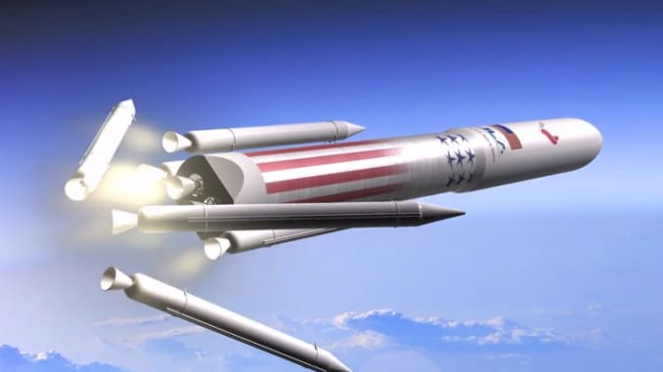
US Dept of Defense selected 2 primary companies for rocket launches for 2022-2027
Worth expected $1B / year, up to 34 launches
60%: ULA (United Launch Alliance = Boeing + Lockheed Martin)
40%: SpaceX
Beat Blue Origin & Northrop Grumman (probably the end of OmegA)
Future ULA Vulcan will replace Atlas V rocket (still using a Centaur 2nd stage)
Losers don’t lose everything
Vulcan replaces Russian main engine with 2 Blue Origin BE-4 engines
Vulcan uses Northrop Grumman solid rocket boosters (as do NASA SLS, USAF ICBMs)
Elon Musk “sore winner” tweets:
“Because their rockets are not reusable, it will become obvious over time that ULA is a complete waste of taxpayer money”
“Nobody would suggest buying airplanes that only fly once & then crash into the ocean. That would be absurd”
ULA’s CEO response:
“I congratulate SpaceX on their USAF NSS Phase 2 award”
(ULA has talked about recovering spent rockets in the air with helicopters)
Vulcan system (artist rendering). Credit: ULA

Slide 7
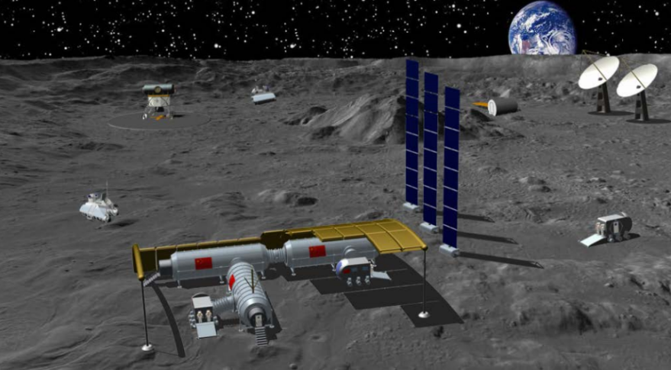
China wants foreign partners for a lunar space station
International Lunar Research Station (ILRS) at lunar south pole region
Will develop through robotic missions in 2020’s and expanded in 2030’s
Long term robotic presence, some short term human presence in 2030’s
Long term human presence 2036-2045
Likely partners include Russia, maybe ESA (European Space Agency)
Shift in policy: little previous cooperation in space
Rendering of a conceptual Chinese lunar base. Credit: CAST

Slide 8
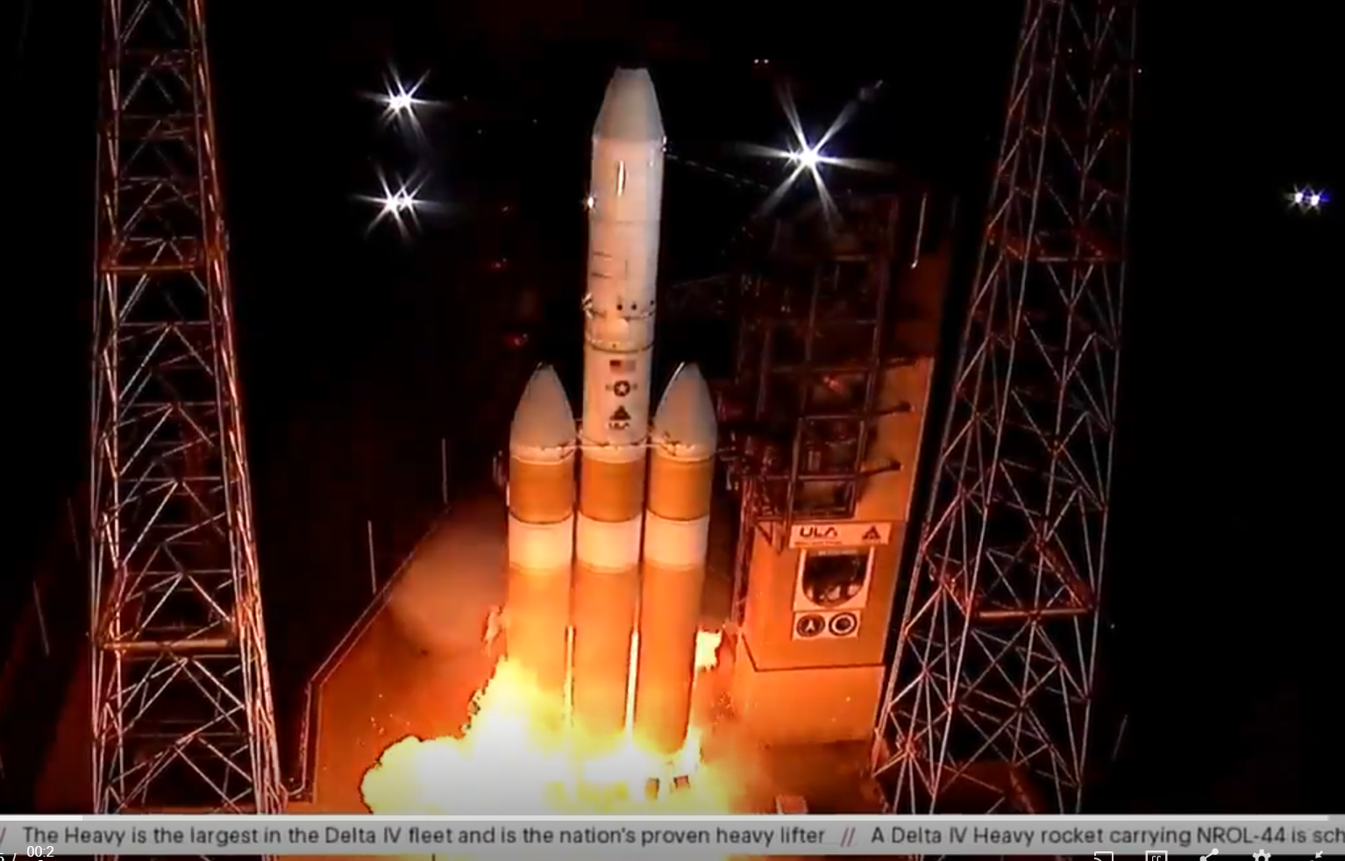
How many launches since the last meeting (Aug 1)?
This includes failed launches only if they lift off the launch pad
and only includes launches that attempt going into orbit
ULA Delta IV Heavy: Aborted 3 seconds before launch
(not counted)
Credit: space.com

Slide 9
Launches Since Last Meeting (August 1, 2020)
Sept 4 – Long March 2F – Experimental reusable spaceplane
Sept 3 – Falcon 9 – 12th Starlink launch (60 satellites)
Sept 2 – Vega (European) – 53 satellites (46 cubesats) for 21 customers
Aug 30 – Electron (Rocket Lab, NZ) – 220 lb remote sensing satellite, and 2nd stage became a satellite – demo for new satellite business
Aug 30 – Falcon 9 – Earth observation satellite in polar orbit for Argentina, 2 small “rideshares”
Aug 22 – Long March 2D – 5th in series of Earth observation satellites
Aug 18 – Falcon 9 – 11th Starlink launch (58 satellites + 3 “rideshares”
Aug 15 – Ariane 5 – 2 Com satellites, 2nd “Mission Extension Vehicle”)
Aug 7 – Falcon 9 – 10th Starlink launch (57 satellites + 2 “rideshares”)
Aug 6 –Long March 2D – 4th in series of Earth observation satellites

Slide 10
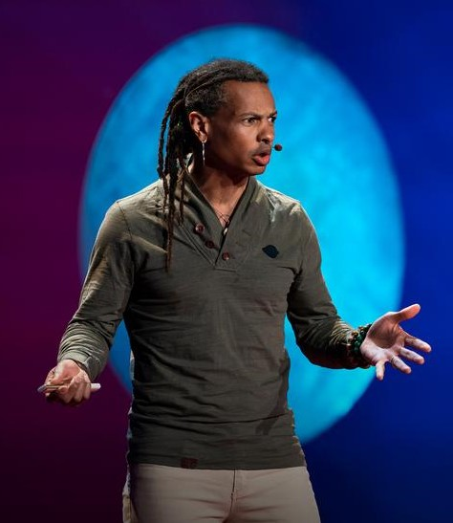
Featured Speaker: Dr. Moriba Jah
Associate Professor, Aerospace Engineering and Engineering Mechanics, Univ. of Texas (Austin)
Specialties include astrodynamics (orbital mechanics), information fusion for space object tracking
Numerous awards and publications
TED fellow – see TED talk on crowdsourced space traffic monitoring system
Author of over 75 peer-reviewed technical papers
Previously
Director, U. of Arizona’s Space Object Behavioral Sciences
Lead at Air Force’s Advance Sciences and Technology Research Institute for Astronautics (ASTRIA)
Spacecraft navigator at JPL for multiple Mars programs
“In the absence of this framework to monitor ... activity in space ... we actually risk losing the ability to use space for humanity's benefit. ”
TOPIC:
Monitoring, Quantifying, and Assessing the Near-Earth Anthropogenic Space Object Population: The Foundation to Space Traffic Management
(“What’s all that stuff in orbit and where is it going?”)

