Slide 1
HIGH SCHOOL AEROSPACE SCHOLARS EXPERIENCE
Sashreek Bhagavatula

Slide 2
AGENDA
1. ABOUT ME
2. WHAT IS HAS?
3. ONLINE EXPERIENCE
4. 1-WEEK EXPERIENCE
5. PROJECTS
6. Q&A

Slide 3
ABOUT ME
Senior at Texas A&M, Computer Engineering
Previously worked at Chevron, State Street
Director of Technology at PEAC (Promoting Education Across the Country)
Interested in machine learning, data science, aeronautics, space travel

Slide 4
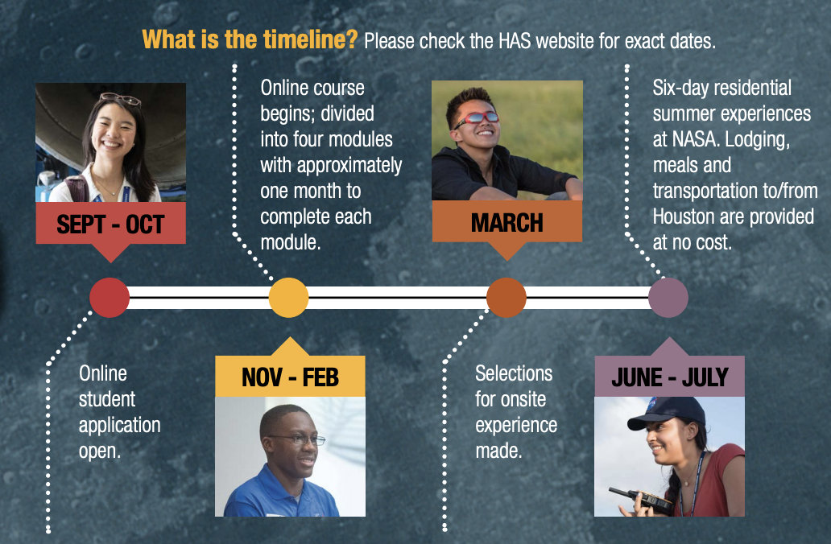
WHAT IS HAS?
STEM focused program for high school juniors
Allows students to explore different avenues of STEM
(Get to stay at hotel and FREE FOOD!)
Requirements
U.S. citizen
Texas high school junior
Committed to a one-year relationship with NASA
Internet access (from home, school or public library)
OPENS SEPTEMBER 8, 2020
https://www.nasa.gov/centers/johnson/stem/High_School_Aerospace_Scholars.html

Slide 5
ONLINE EXPERIENCE
School year long courses in space exploration, earth science, tech, aeronautics
Design challenges
Videos
Posters
3D Drawing
Interesting modules to learn about
Must score a good overall grade to be eligible for 1 week onsite

Slide 6
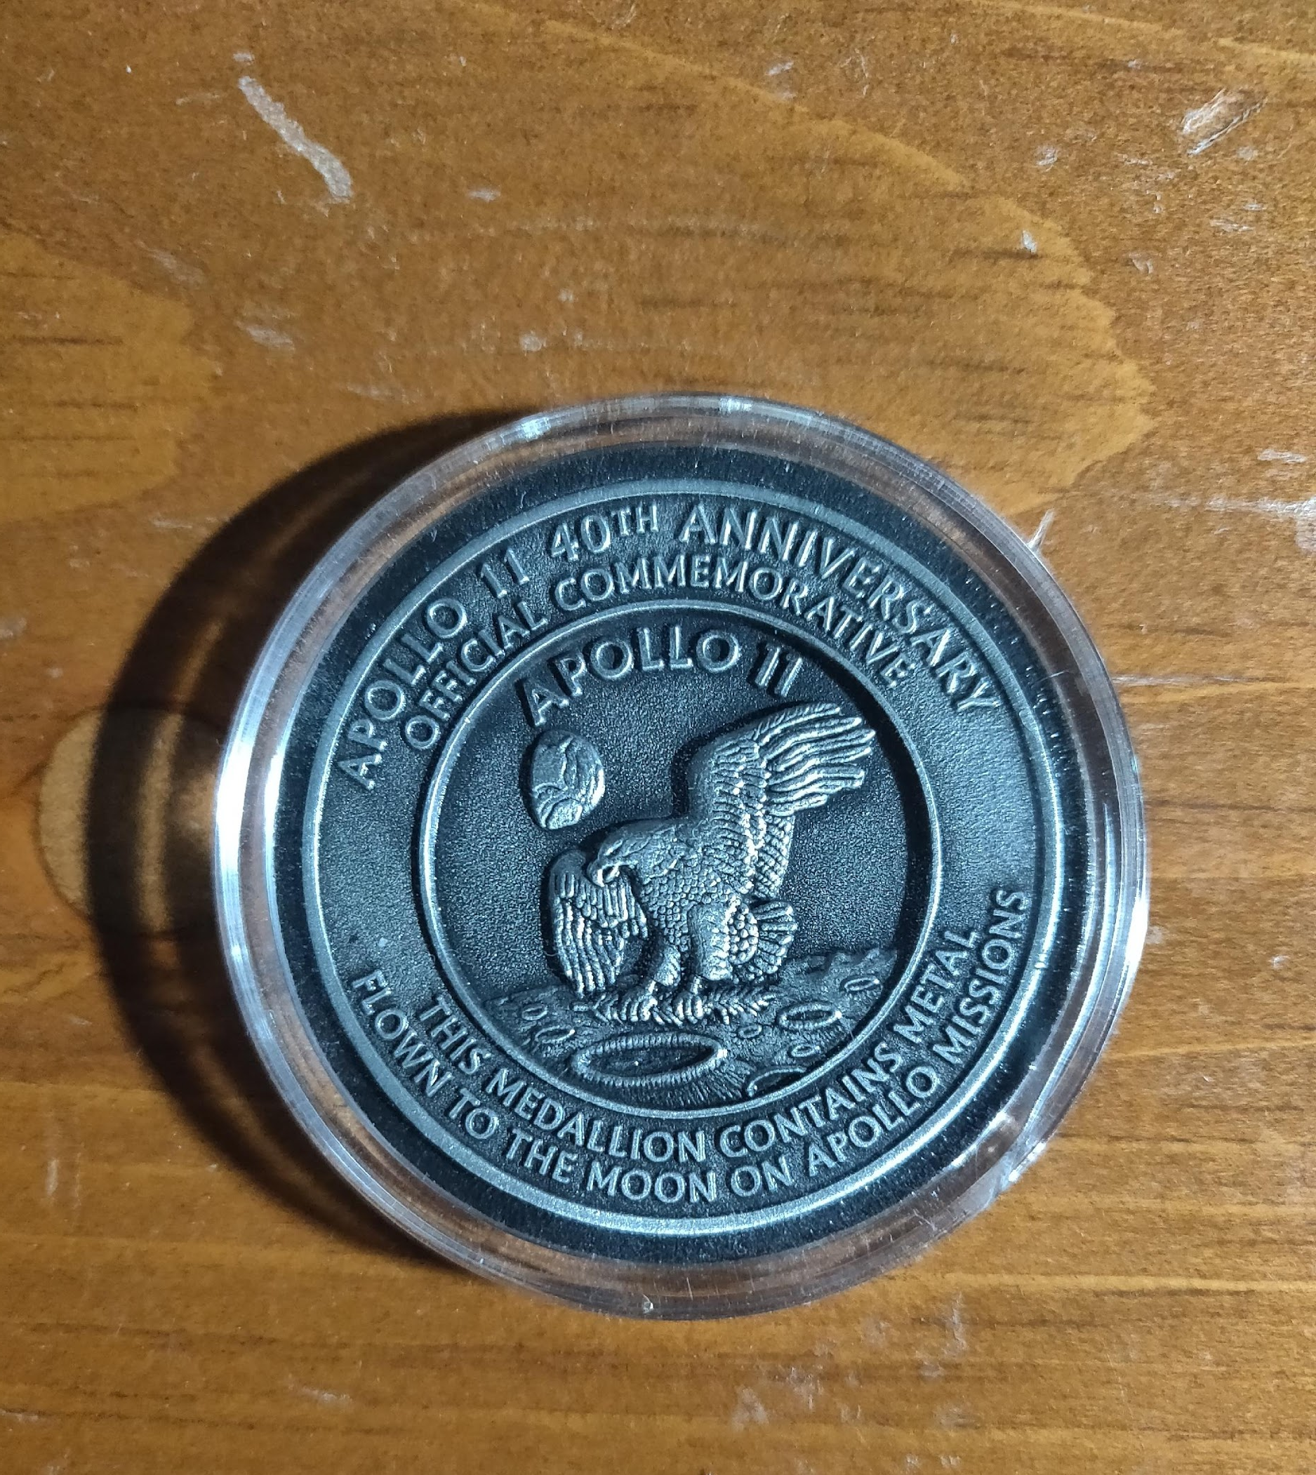
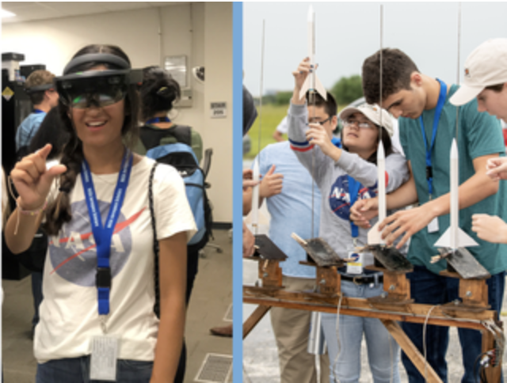
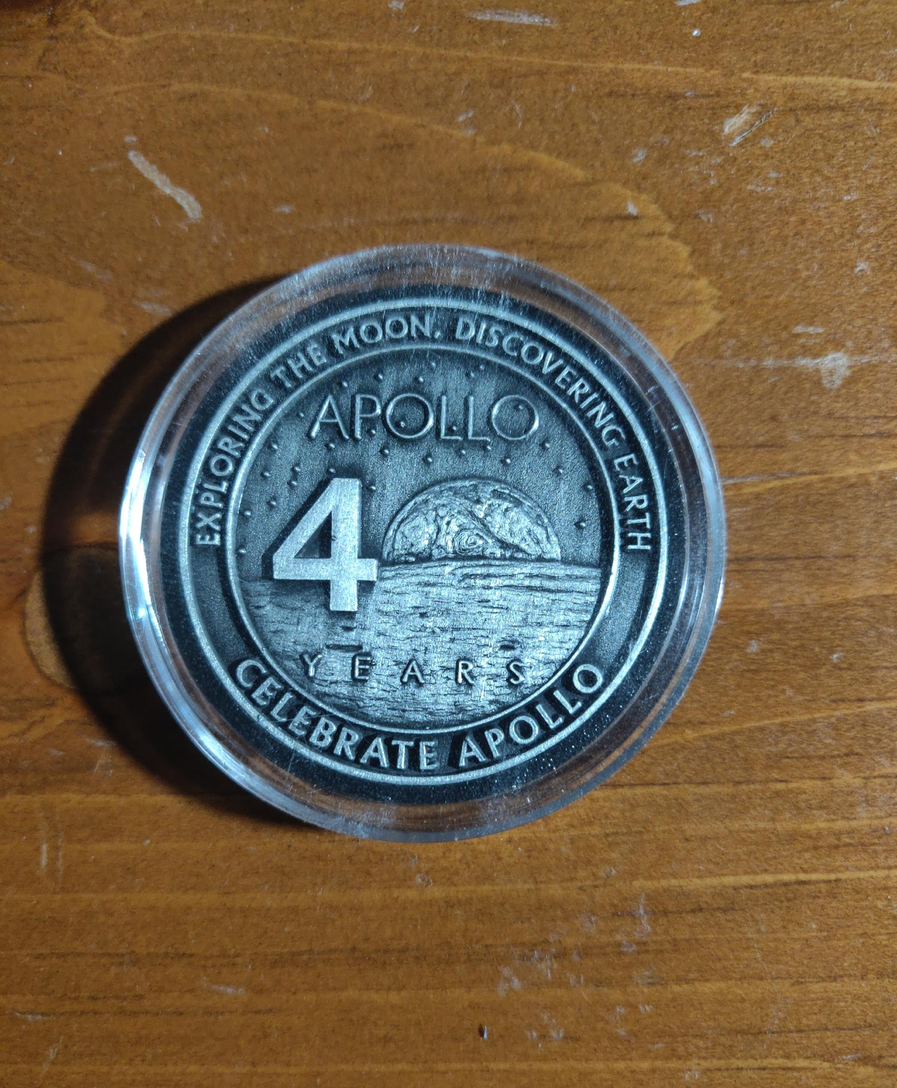
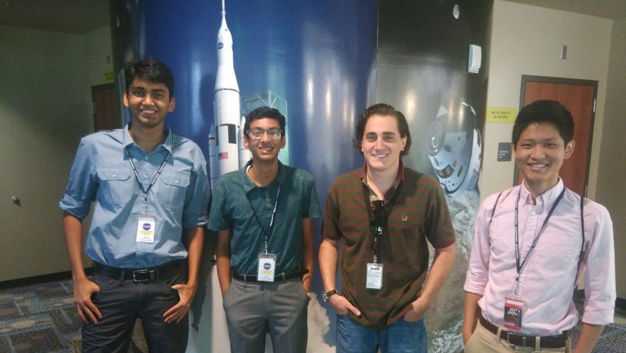
1 WEEK EXPERIENCE
1 week at Johnson Space Center
Met scientists and engineers working on various projects
Tour of Johnson Space Center
Work environments
Saw habitation module used for training
Neutral Buoyancy Laboratory (NBL) for zero gravity Training
Team won for projects competition

Slide 7
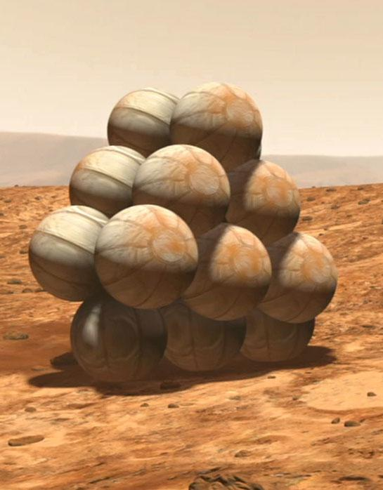
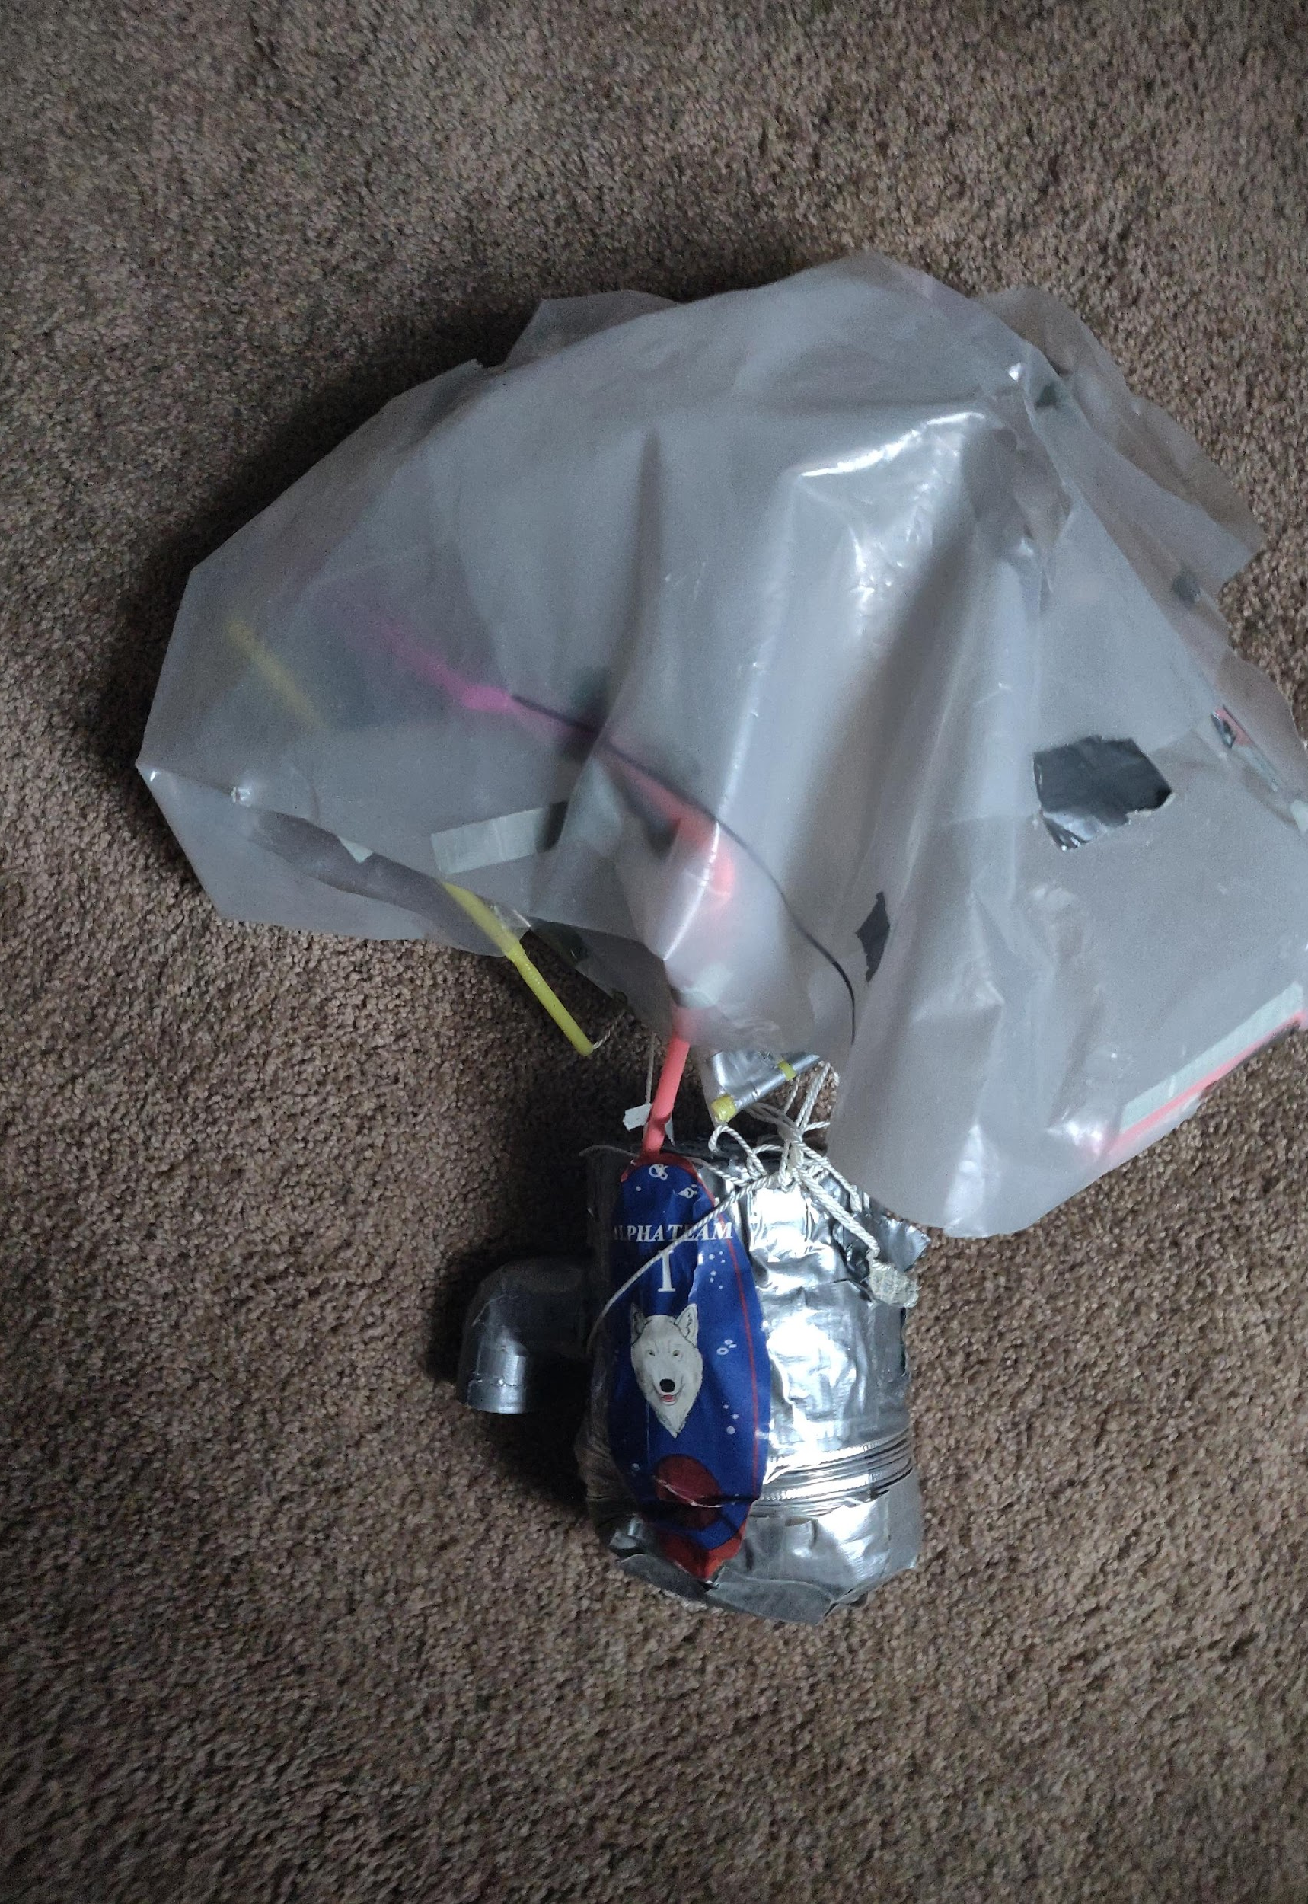
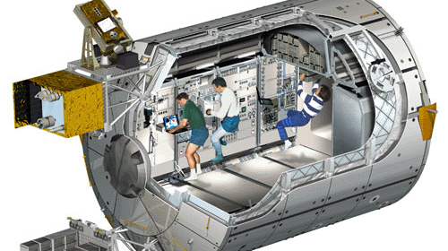
PROJECTS DURING 1 WEEK EXPERIENCE
Work on different side projects
Scaled down habitation module
Capsule landing project
Rocket launch (Highest wins)
Main project
Mission to Mars
Team was responsible for developing a landing plan to Mars
18-24 Month Journey
Use SpaceX rocket to send supplies
Train on Moon for several months to get used to harsh environment

Slide 8
Q&A

