Slide 1
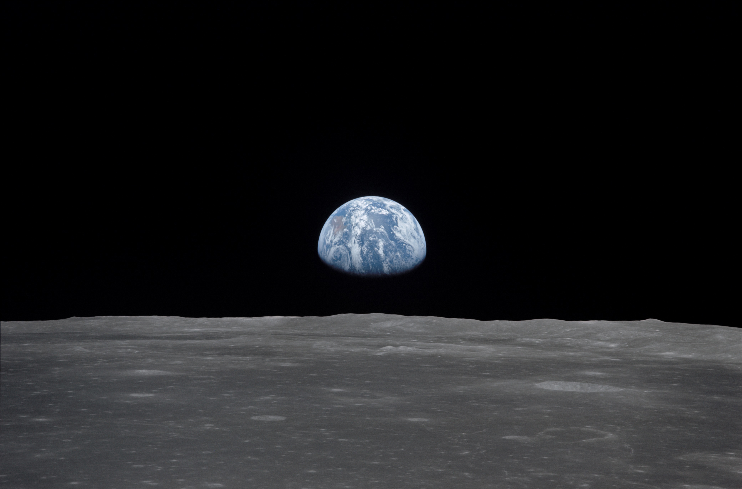
NSS North Houston Space Society Space News
August 1, 2020
Greg Stanley

Slide 2
Mars in the news!
3 missions to Mars launched since last meeting
UAE
China
US

Slide 3
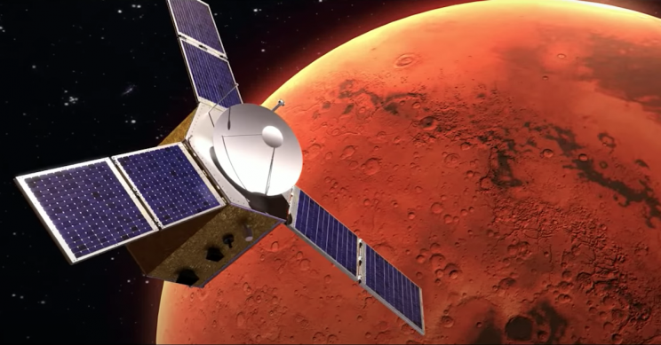
First Emirates Mars mission
UAE launched a Mars orbiter to study Mars weather and atmosphere
Launched July 19 from Japan on Mitsubishi Heavy Industries H-2A rocket
2980 lbs, about the size of a small car
200 day journey, to reach Mars in February 2021
Developed by UAE, collaborating with the University of Colorado, Arizona State University, and UC Berkeley
Step in Mars 2117 program
Developing world-class space sector
Building and operating satellites
Mars Science City Project
Small kingdom!
9.2 M people, only 1.4 M citizens
Image: Mohammed Bin Rashid Space Centre (MBRSC)

Slide 4
First Chinese Mars mission
Launched July 23 from China on Long March 5 rocket
11,000 lb Mars orbiter/lander with a rover
200 day journey, to reach Mars in February 2021
Gradually settle into elliptical polar orbit 165 miles – 7,500 miles
2-3 months later, release lander, with 529 lb rover
Parachute, braking rocket to slow down for landing
Artist illustration: CNSA (Chinese Academy of Sciences/Nature/Astronomy)

Slide 5
Chinese Mars lander
Targeting Utopia Planitia, where radar indicates large ice reservoir
Analyze soil & rock, look for buried water ice with subsurface radar, study atmosphere, analyze Mar’s internal structure
If successful, third country to perform soft landing on Mars, second to drive a rover
Artist illustration: CNSA (Chinese Academy of Sciences/Nature/Astronomy)

Slide 6
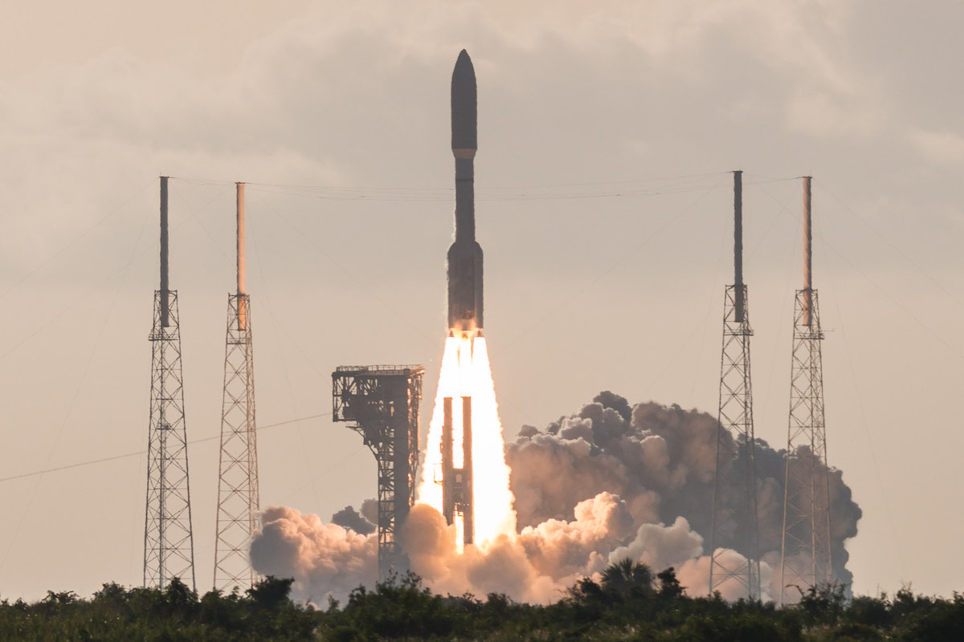
NASA Mars 2020 Perseverance rover
Launched July 30
314 million mile journey, directly to the surface within 200 feet of target
9000 lb. payload on ULA Atlas 5 rocket with Centaur upper stage
541 model: 5 meter fairing, 4 solid rocket 1st stage boosters, 1 RL10 upper stage engine
(In addition to the Russian-built RD-180 main engine)
RL10 models used since 1963!
Most advanced robotic explorer yet – updated Curiosity Rover (2012)
(Curiosity is still operating!)
$2.7 Billion over 10 years
Image: Alex Polimeni/Spaceflight Now

Slide 7
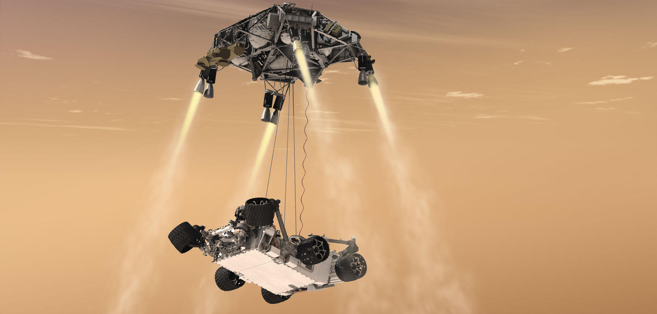
Perseverance Mars rover landing Feb 18, 2021
70 foot parachute at altitude of 7 miles, discarded at 1.3 miles altitude, 200mph
Parachute deployment time based on position
Thrusters on, search for exact landing site, hover at 66 feet, lower rover
Landing spot error reduced from 2 miles to 200 feet
All automated – 20 minute transmission delay each way is too long
After rover landing, “Sky crane” flies to crash a safe distance away
Image: NASA

Slide 8
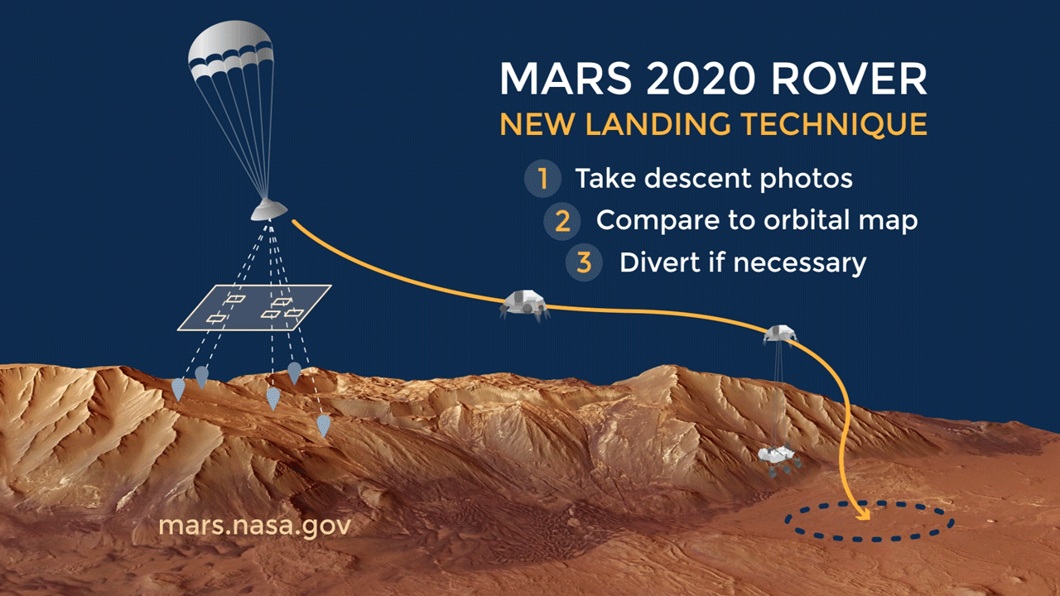
Perseverance: new landing technique
70 foot
After rover landing, “Sky crane” flies to crash a safe distance away
Animated image: NASA. Click if needed to start, or use slide show mode

Slide 9
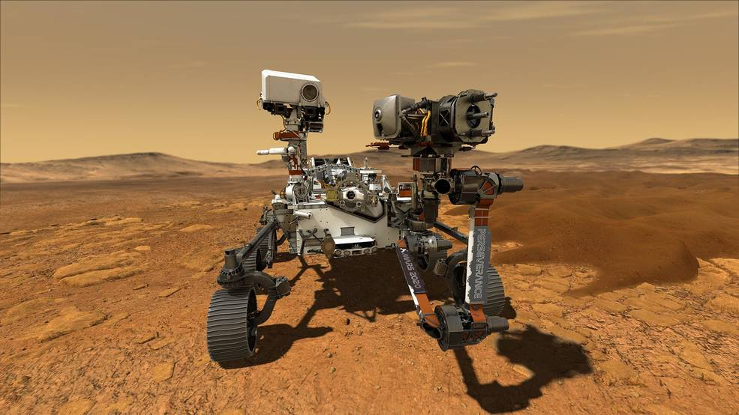
Perseverance Mars rover
2260 lbs., 10 feet long, 9 feet wide, 7 feet high
Nuclear powered like Curiosity (110 Watt plutonium heat source, decays 2%/year)
Prime mission: 3 years in Jezero crater, which was once flooded with water
Focus on ancient life search, with multiple instruments
Example: laser zapping for remote spectroscopy, from robot arm
Drilling & storing samples for possible return in 2031
Weather, monitoring
Subsurface radar (30 ft.)
Test O₂ generation
2CO₂ → 2CO + O₂
Propellant
Future human breathing
First in-situ resource use
Test spacesuit samples
23 cameras
2 microphones
After power-up, first task: place Ingenuity Mars helicopter, drive 330 feet away…
Image: NASA

Slide 10
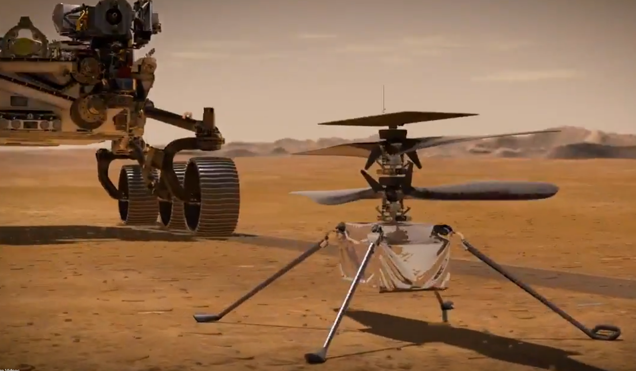
Helicopter on Mars: Ingenuity
4 lbs, 1.6 feet tall, 4 foot diameter blades
Solar cell powered, recharging Lithium-ion batteries
30 day design life, 5 3-minute autonomous flights
Perseverance Rover
Blades spin 2400-2900 rpm
(10x faster than earth helicopters, because atmosphere density is 1% of earth’s)
Ingenuity helicopter
Image: Space.com

Slide 11
Launch windows to get to Mars: Maximum efficiency coasting: Hohmann transfer orbit
Think “orbits”, not straight lines for space travel
Think “mostly coasting” (not for ion engines)
Assumes circular orbits in same orbital plane
Walter Hohmann (1925), inspired by 1897 SciFi
Earth orbit
Sun
Mars orbit
Transfer orbit
Trajectory is half of an elliptical orbit around the Sun: Hohmann transfer orbit (the dashed line)
One focus of ellipse is the Sun
Orbit intersects orbit of each planet
Launch when earth closest to Sun in this orbit, same direction as Earth orbit
Arrives when farthest from Sun in the orbit
Planets must be at “right” relative position. If not: →→→→
Happens every 26 months for Earth/Mars
Click or use slide show for animation from NASA JPL

Slide 12
Other space news
Russia apparently tested a new anti-satellite weapon (projectile launched at high speed from an “inspector” satellite)
For a Korean military satellite launch, SpaceX caught both Falcon 9 fairings (nose cone halves) in a net for re-use (a first)
Fairings are 43 feet high, 17 feet diameter, cost $6M
Steerable parachute descent, fast recovery boats
As is now usual, first stage had landed on a drone ship as well, already re-used from delivering NASA astronauts to the ISS
Current House budget bill freezes NASA budget, endangering sending astronauts back to the Moon by 2024
Minotaur 4 (Northrop Grumman) launched 4 classified payloads for US National Reconnaissance Office – using 30 year old rocket motors/solid fuel from decommissioned Peacekeeper missiles!
Successful static firing test of SpaceX 5th Starship full-sized prototype
500 foot “hop” test should happen soon

Slide 13
How many launches since the last meeting?
Yes, this includes failed launches

Slide 14
Launches Since Last Meeting (July 11, 2020)
July 30 – Proton – Two Russian communications satellites
July 30– Atlas 5/Centaur – NASA Mars 2020 (Perseverance rover)
July 24– Long March 4B– 3rd of land survey satellites, 2 others
July 23 – Soyuz– Cargo delivery to ISS
July 23 – Long March 5 – Chinese Mars mission – orbiter/rover
July 20 – Falcon 9 –South Korean military communications satellite built by Airbus (France)/Lockheed Martin
July 19 – H-2A (Japan) – Mars orbiter for United Arab Emirates
July 15 –Minotaur 4 (Northrop Grumman) – 4 classified payloads for US National Reconnaissance Office

Slide 15
Featured Speaker: Jennifer W. Lopez
Currently
Director, business development, Astrobotic Technology, Inc. (Pittsburgh)
Supports lunar payload development for NASA Artemis Human Landing System for prime contractor Dynetics
On Advisory Council of Physics & Astronomy Dept. at Johns Hopkins University
Previously
Technology lead in commercial innovation & sponsored programs for ISS, including in-space manufacturing, AI, other emerging technologies
Founding member, NASA Datanaut Corps
“I’m always striving to make space accessible to ALL. And we still have a lot of work to do. ﻿”
TOPICS:
Astrobotics overview, lunar partnerships, commercial lunar landscape

