Slide 1
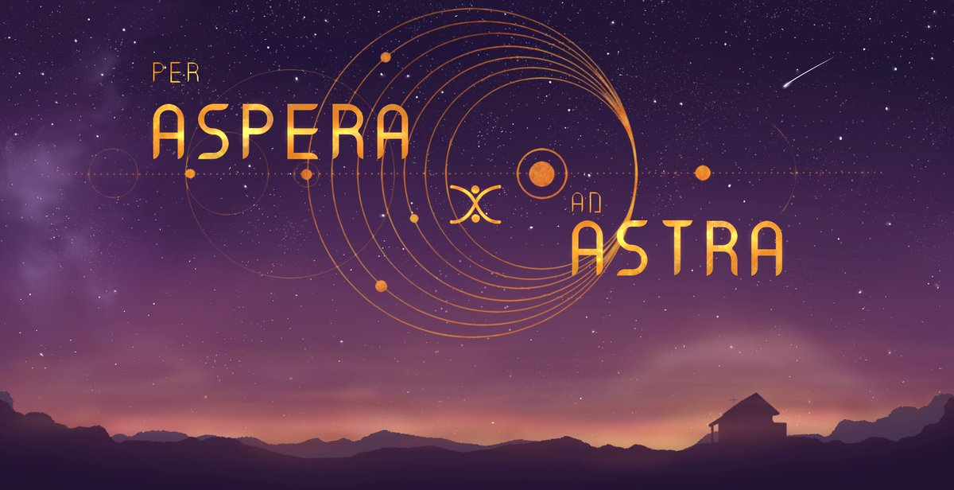
‘’through hardships to the stars’’

Slide 2
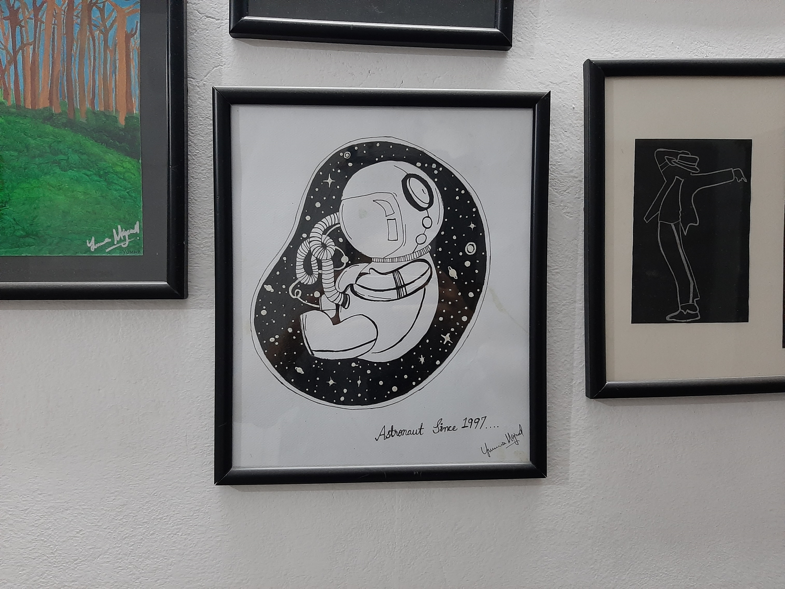

Slide 3
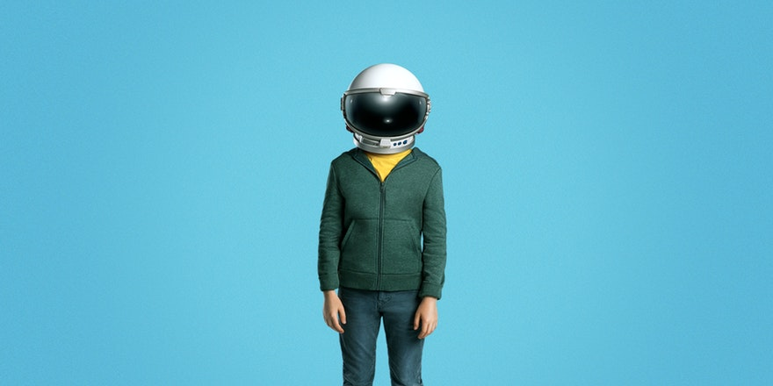
Mocked by my teacher and friends.
Ambition to become an astronaut during the time when ‘astrology’ segment was part of every morning show.
SUPARCO and the guards!
Could not participate in water rocket competition.

Slide 4
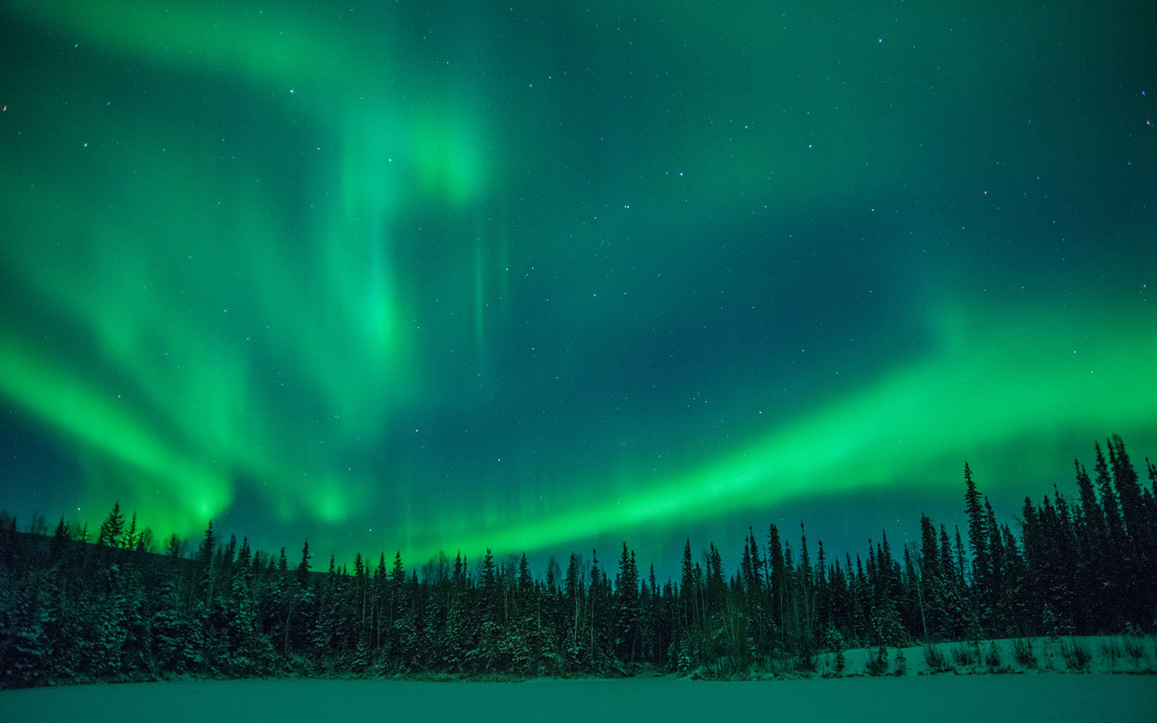
Before knowing LAST, amateur Astronomy.
Newspapers, TV
Internet
Northern Lights
Astro-photography
FACEBOOK!!!

Slide 5
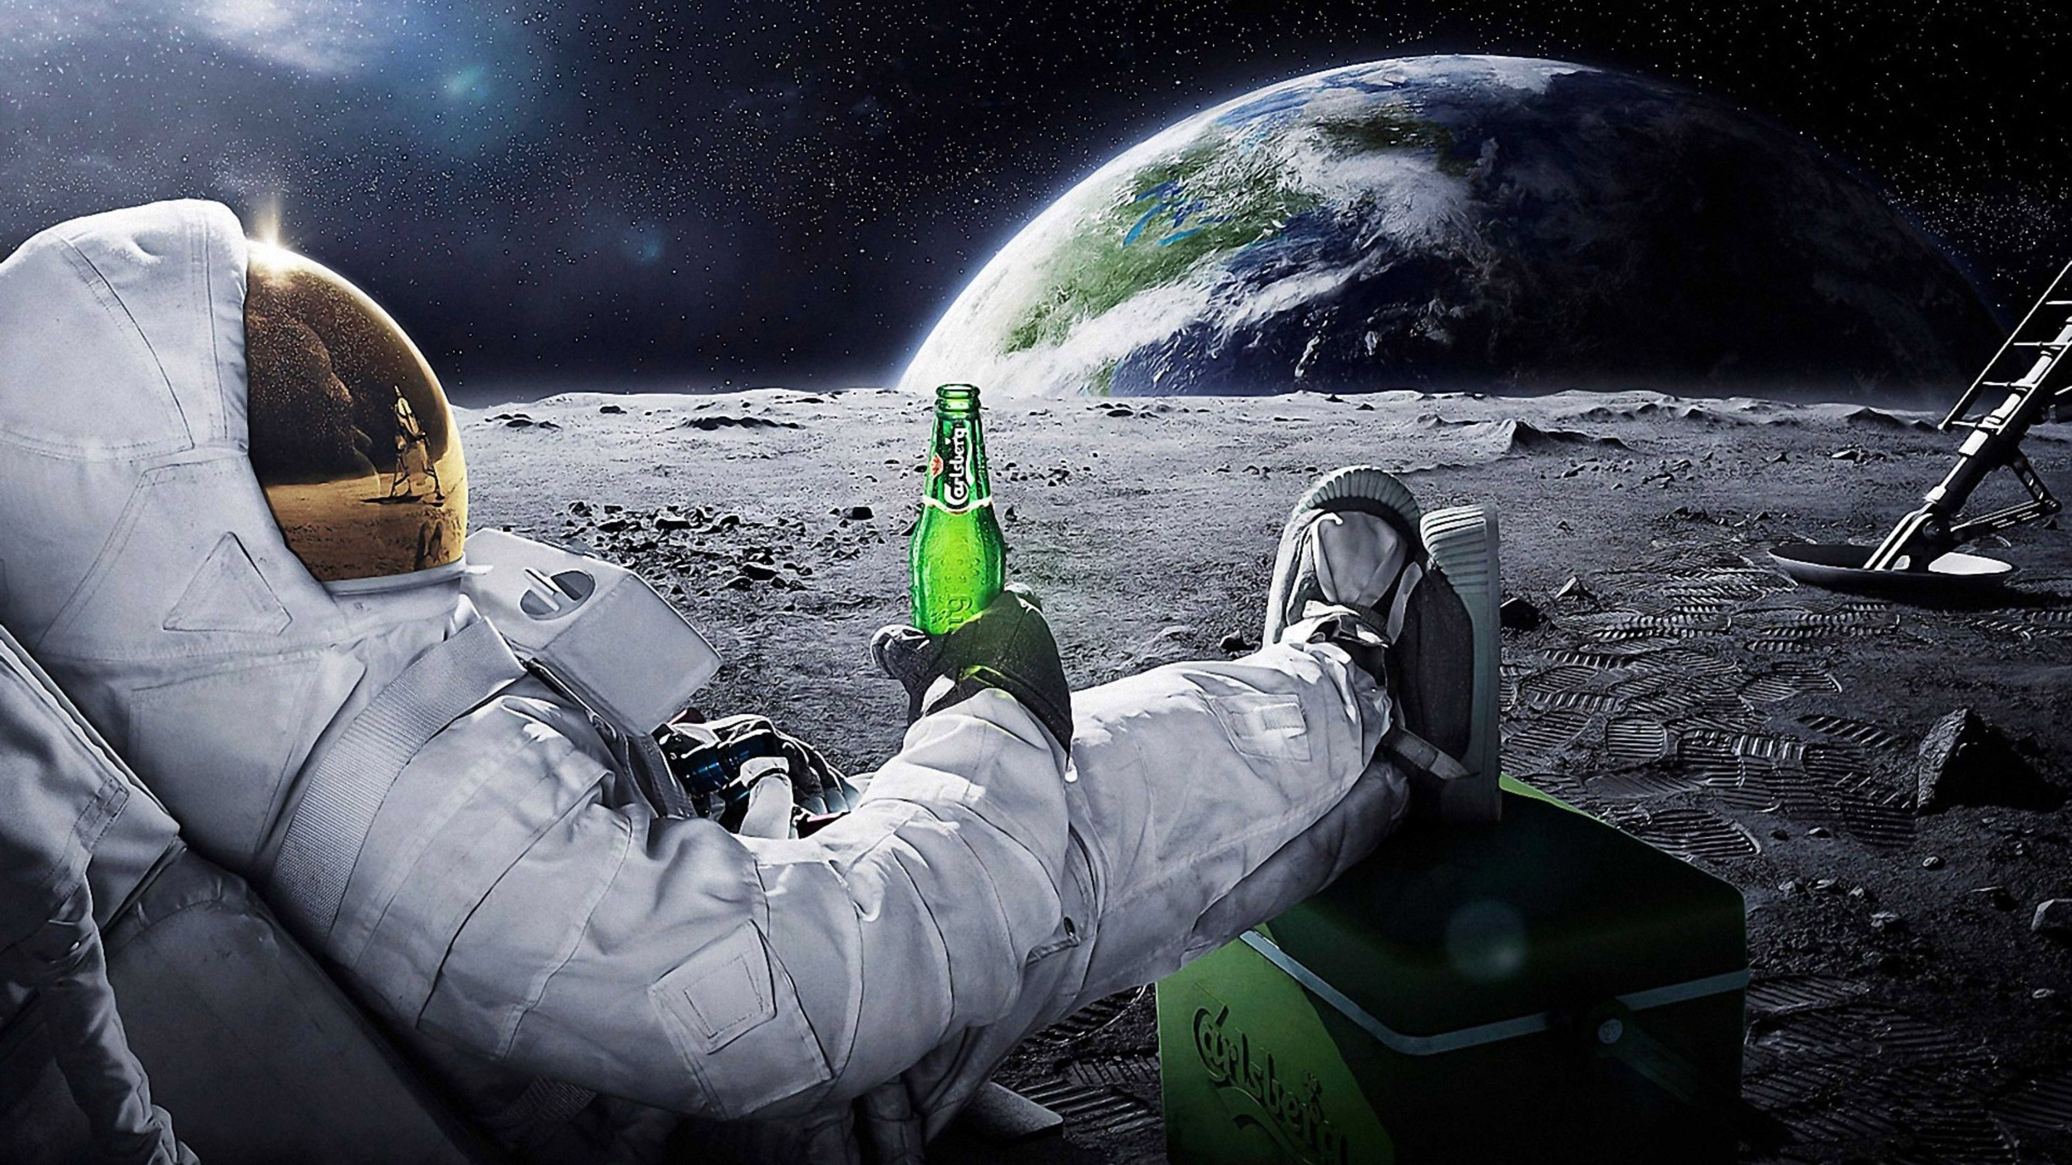
After knowing Lahore Astro-nomical Society

Slide 7
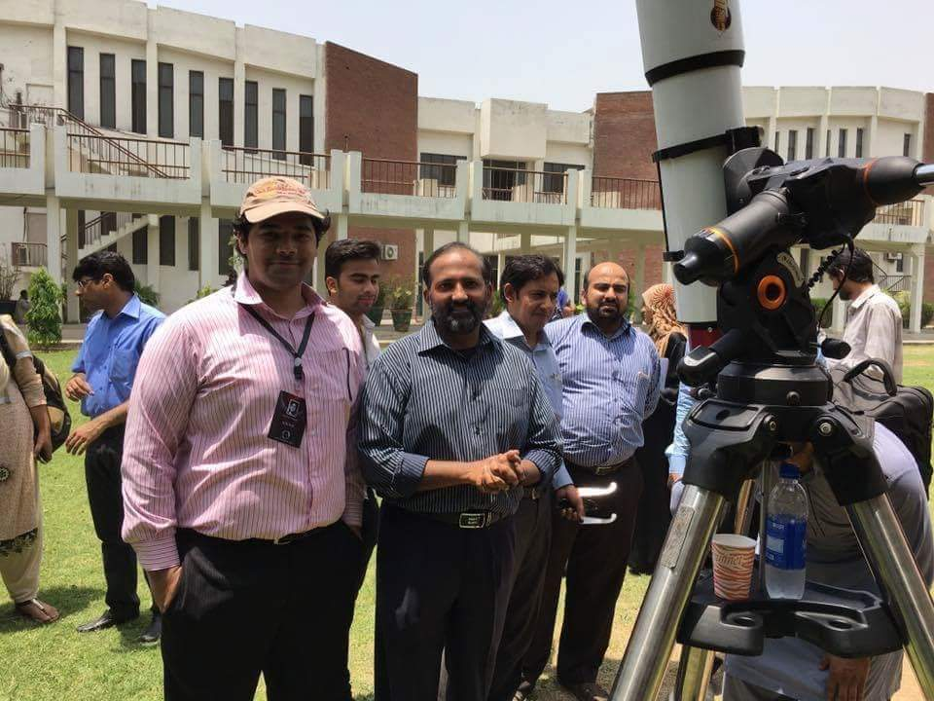

Slide 8
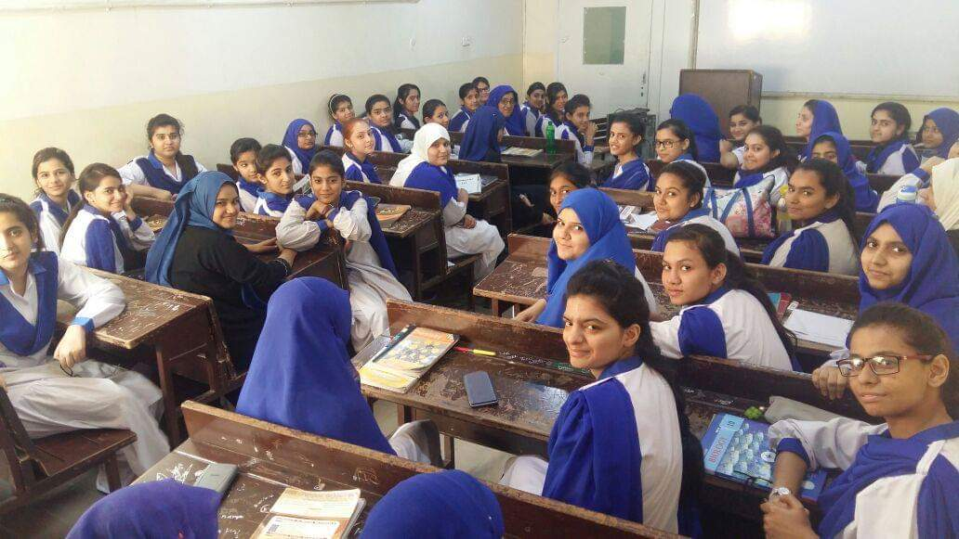

Slide 9
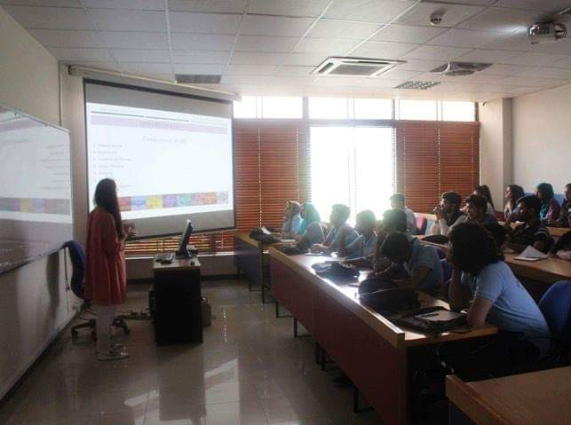
Institute of Space Technology
Could not find passionate people

Slide 10
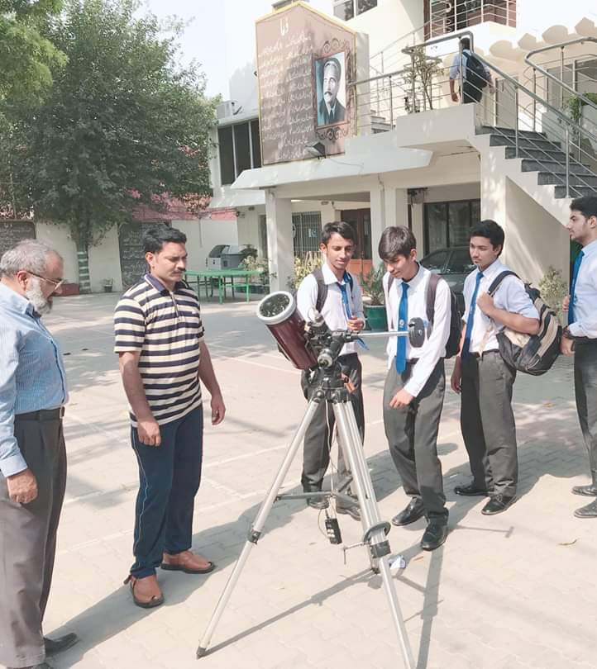
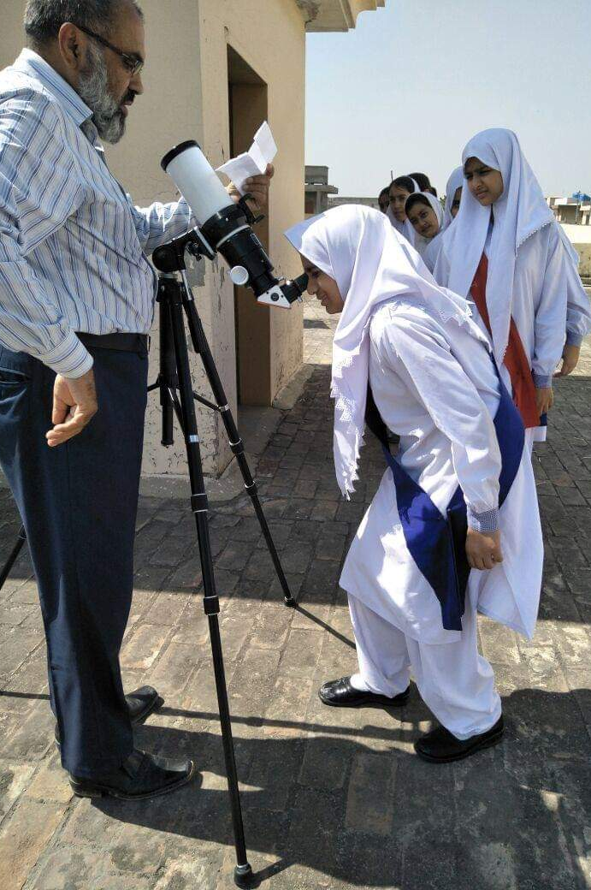

Slide 11
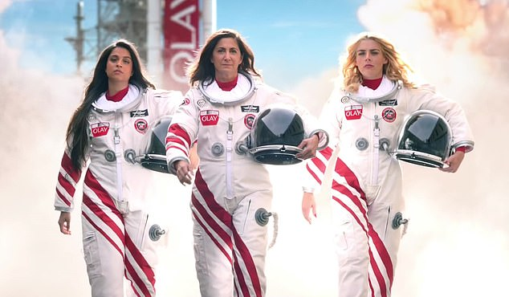
Astronaut Nicole Stott
Astronaut Artist
Sending Artwork in Space
Excitement
Disappointment

Slide 12
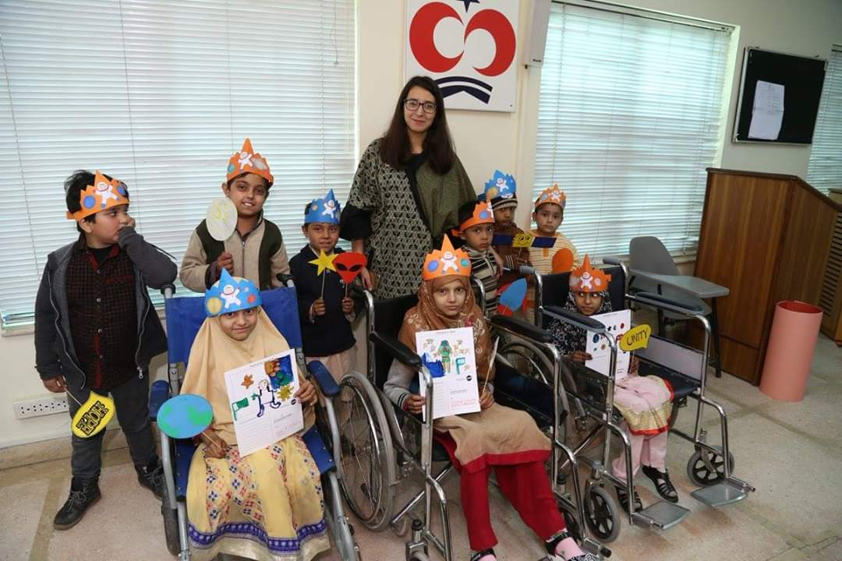
From
Lahore to
International
Space
Station

Slide 13
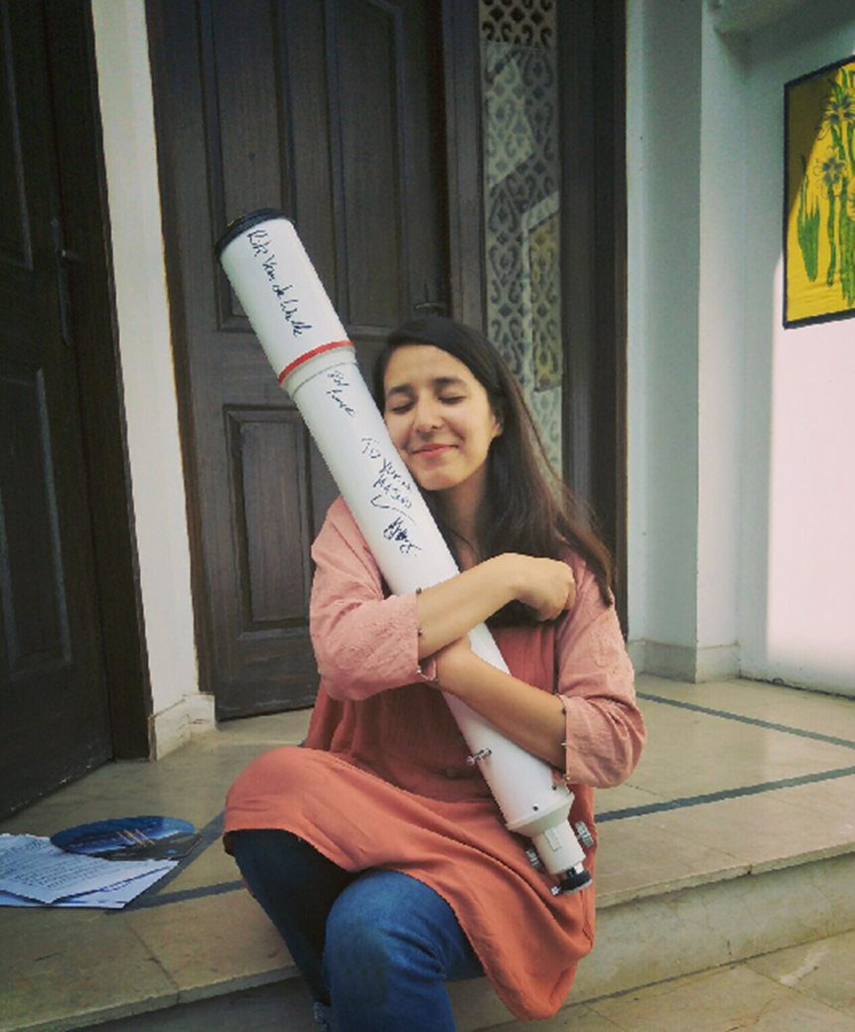
A young terrorist with her AK-47

Slide 14
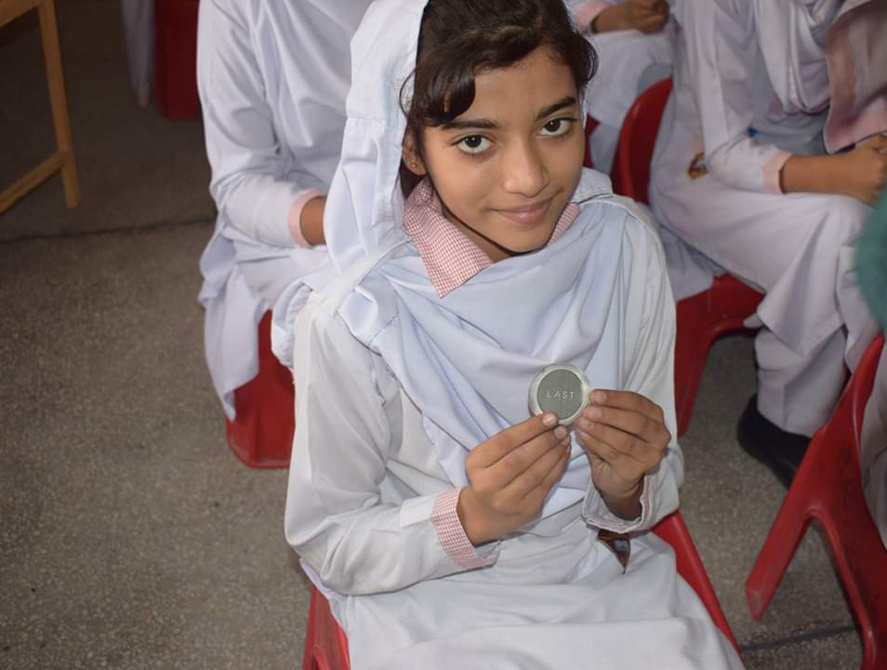
Getting space goodies from facebook friends.
Printing stickers.

Slide 15
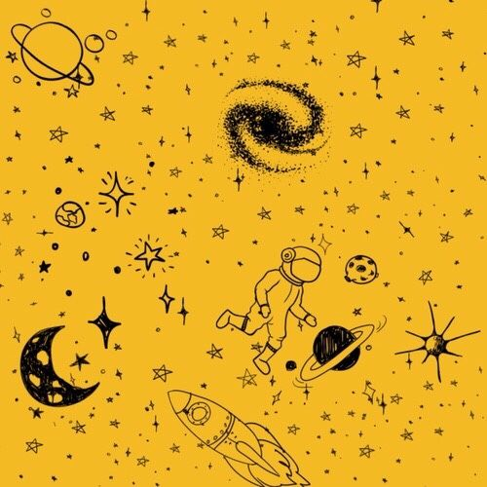
My father and mentors made me realise that
FREE IS FOR GRANTED.
I NEED SUSTAINABILITY.
MAKE PASSION, YOUR PROFESSION.

Slide 16
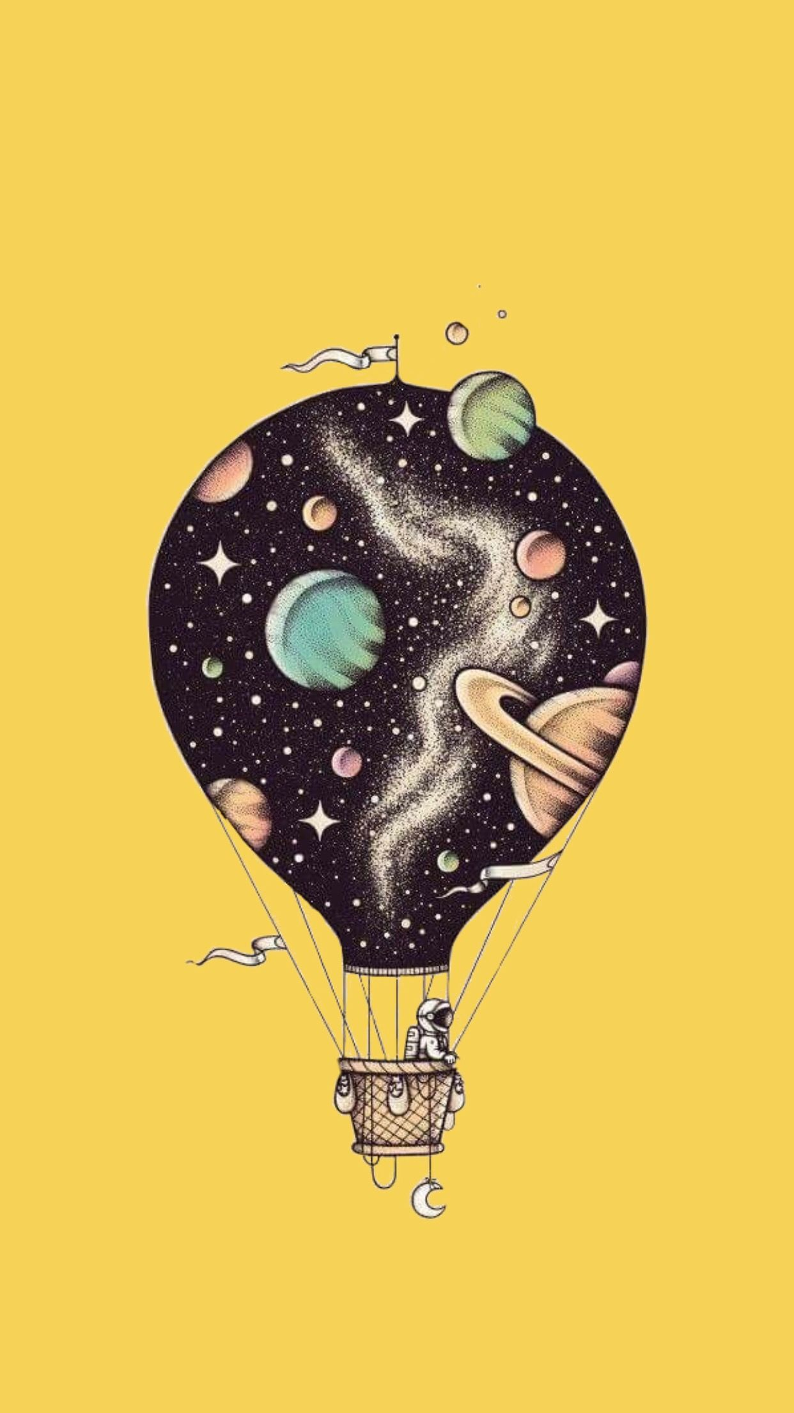
Modern Problems Require Modern Solutions

Slide 18
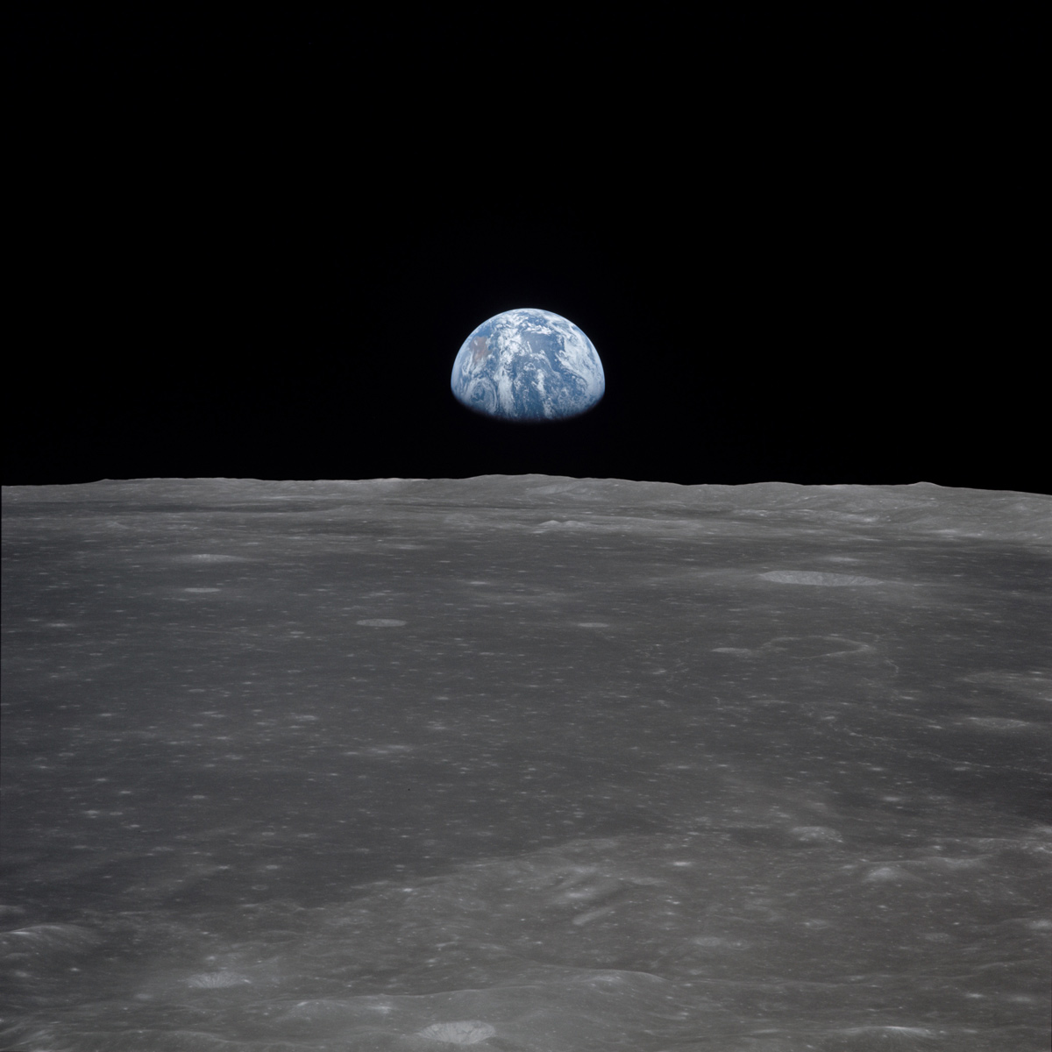
Come back home before it gets dark..

Slide 19
One – woman army
Content
Social Media
Materials
& people making fun!

Slide 20
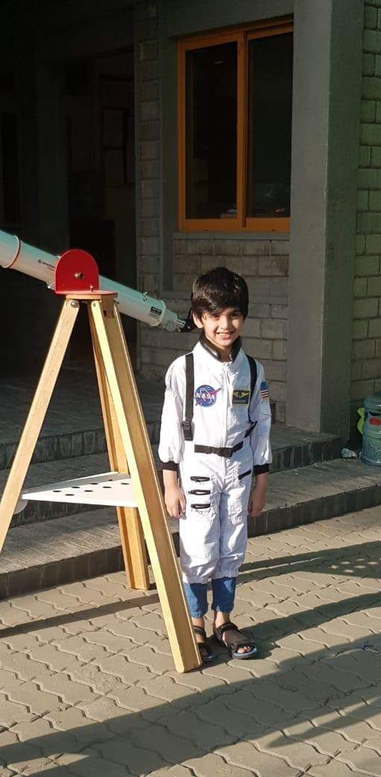
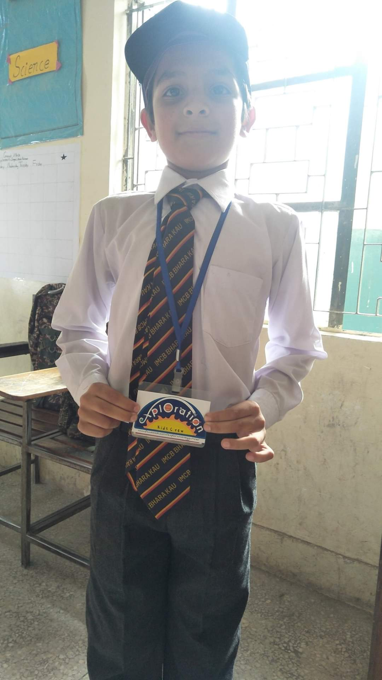
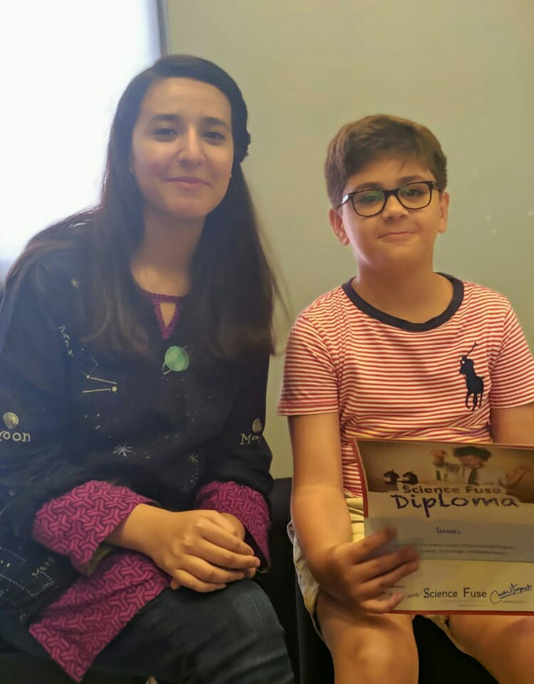

Slide 21
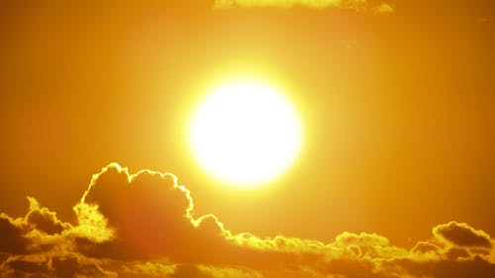
SHUKRIYAA!!

Slide 23
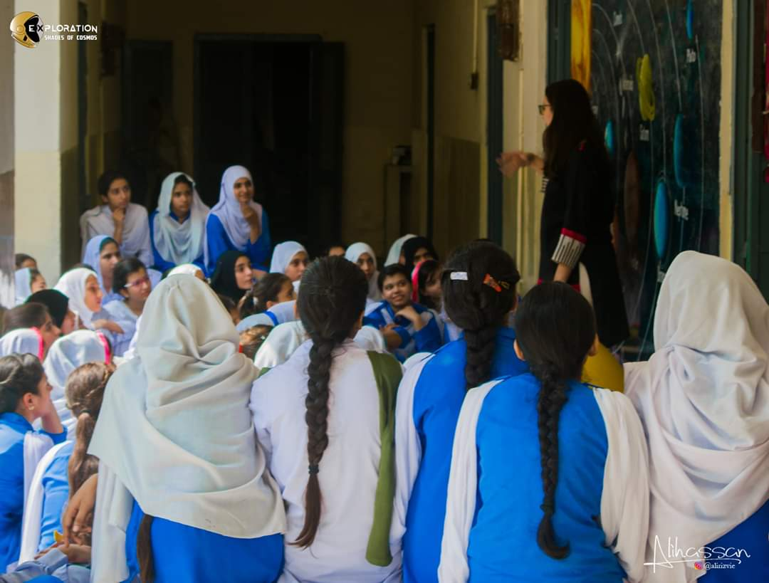
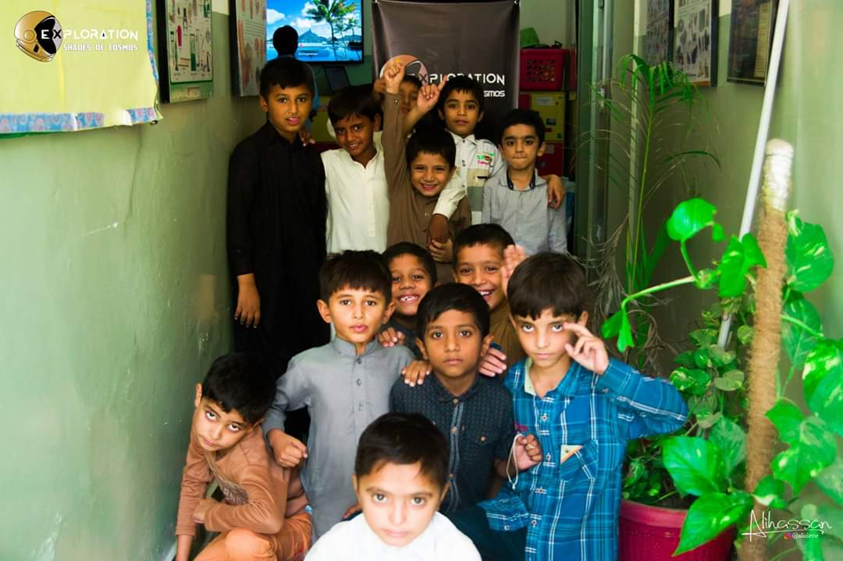
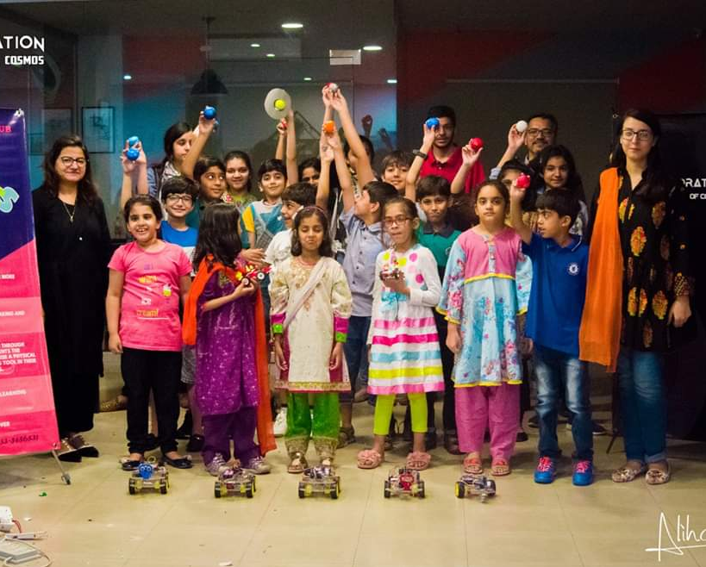
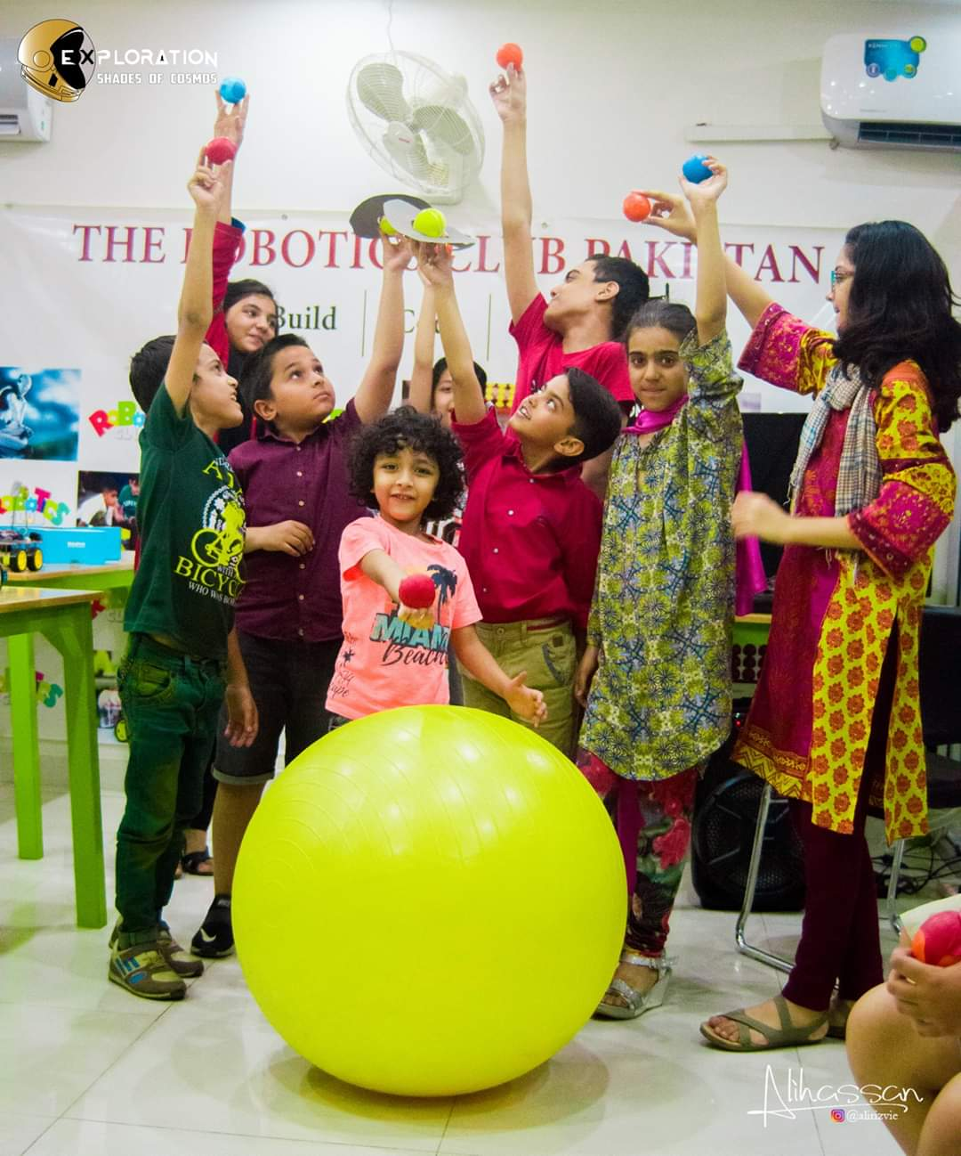
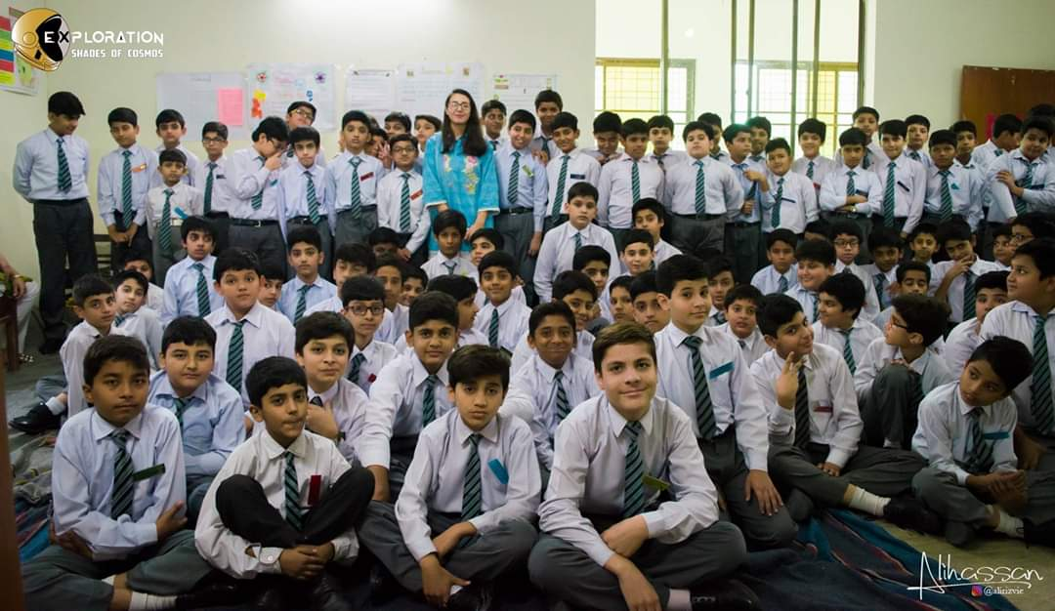

Slide 24
DONOT exploit others.
Learn professional ethics.
Collaborate, donot compete.

Slide 26
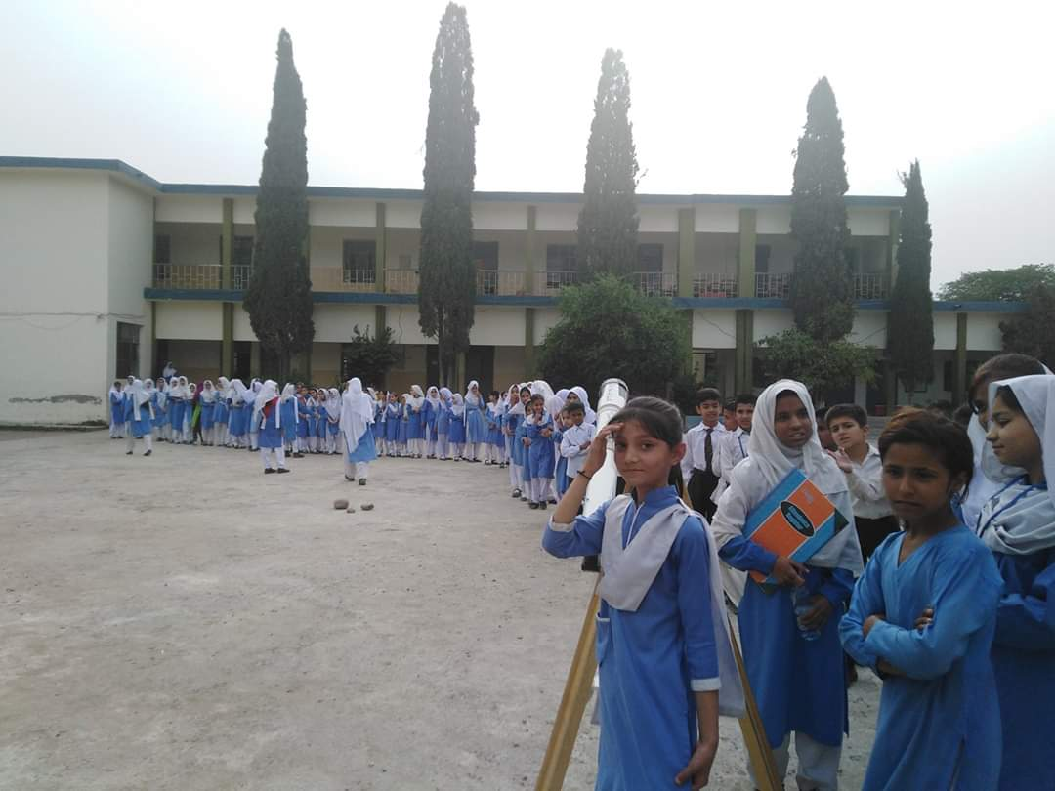
One telescope
is
Not
enough.

Slide 27
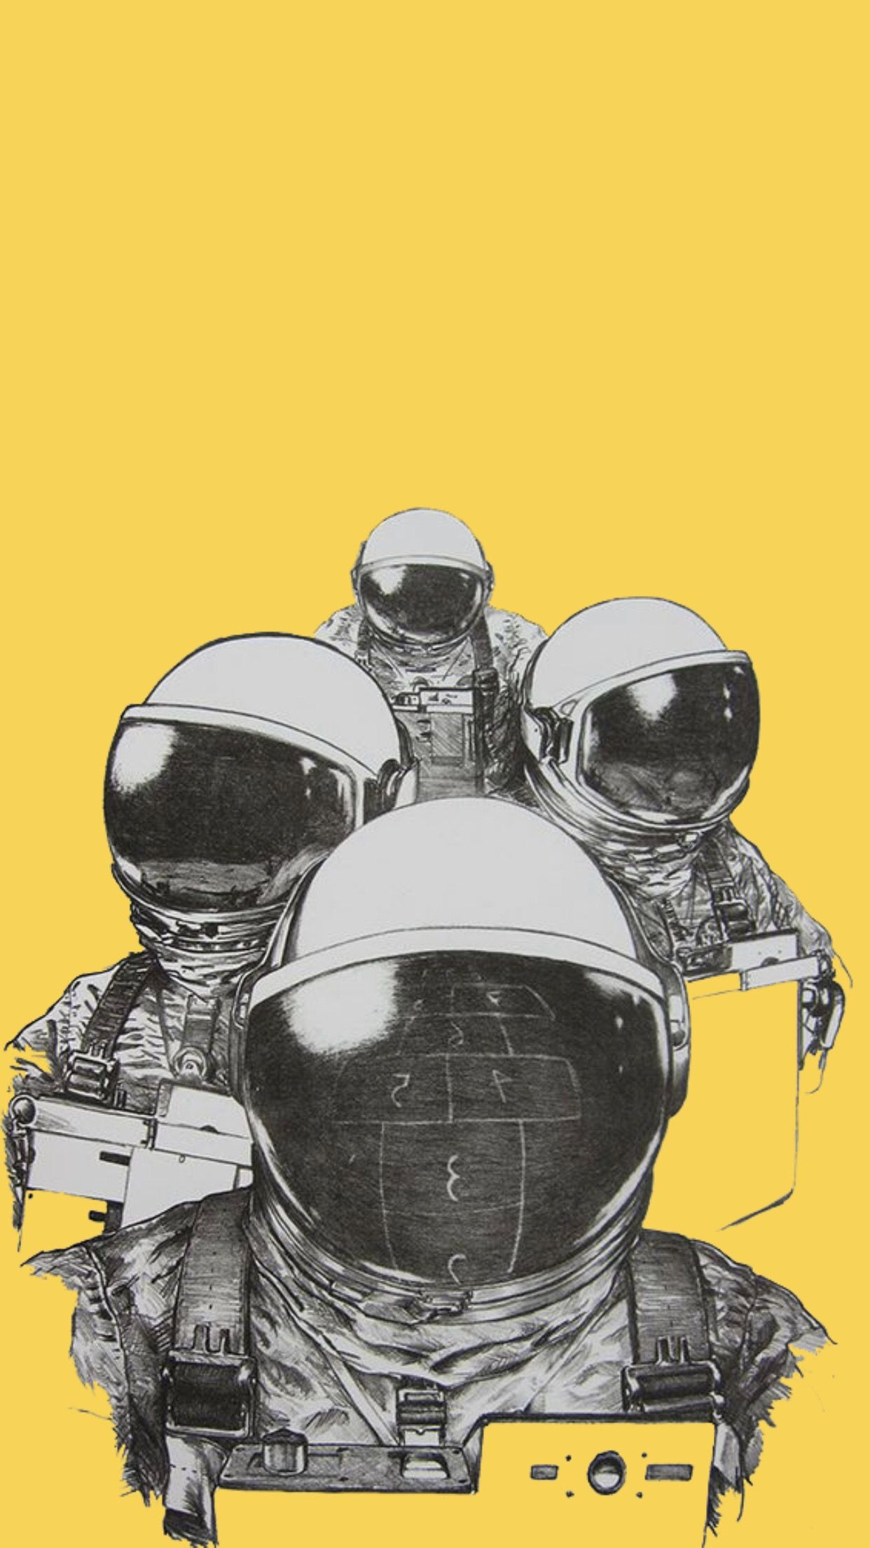
More ventures, more awareness
Make it viral/trend

Slide 28
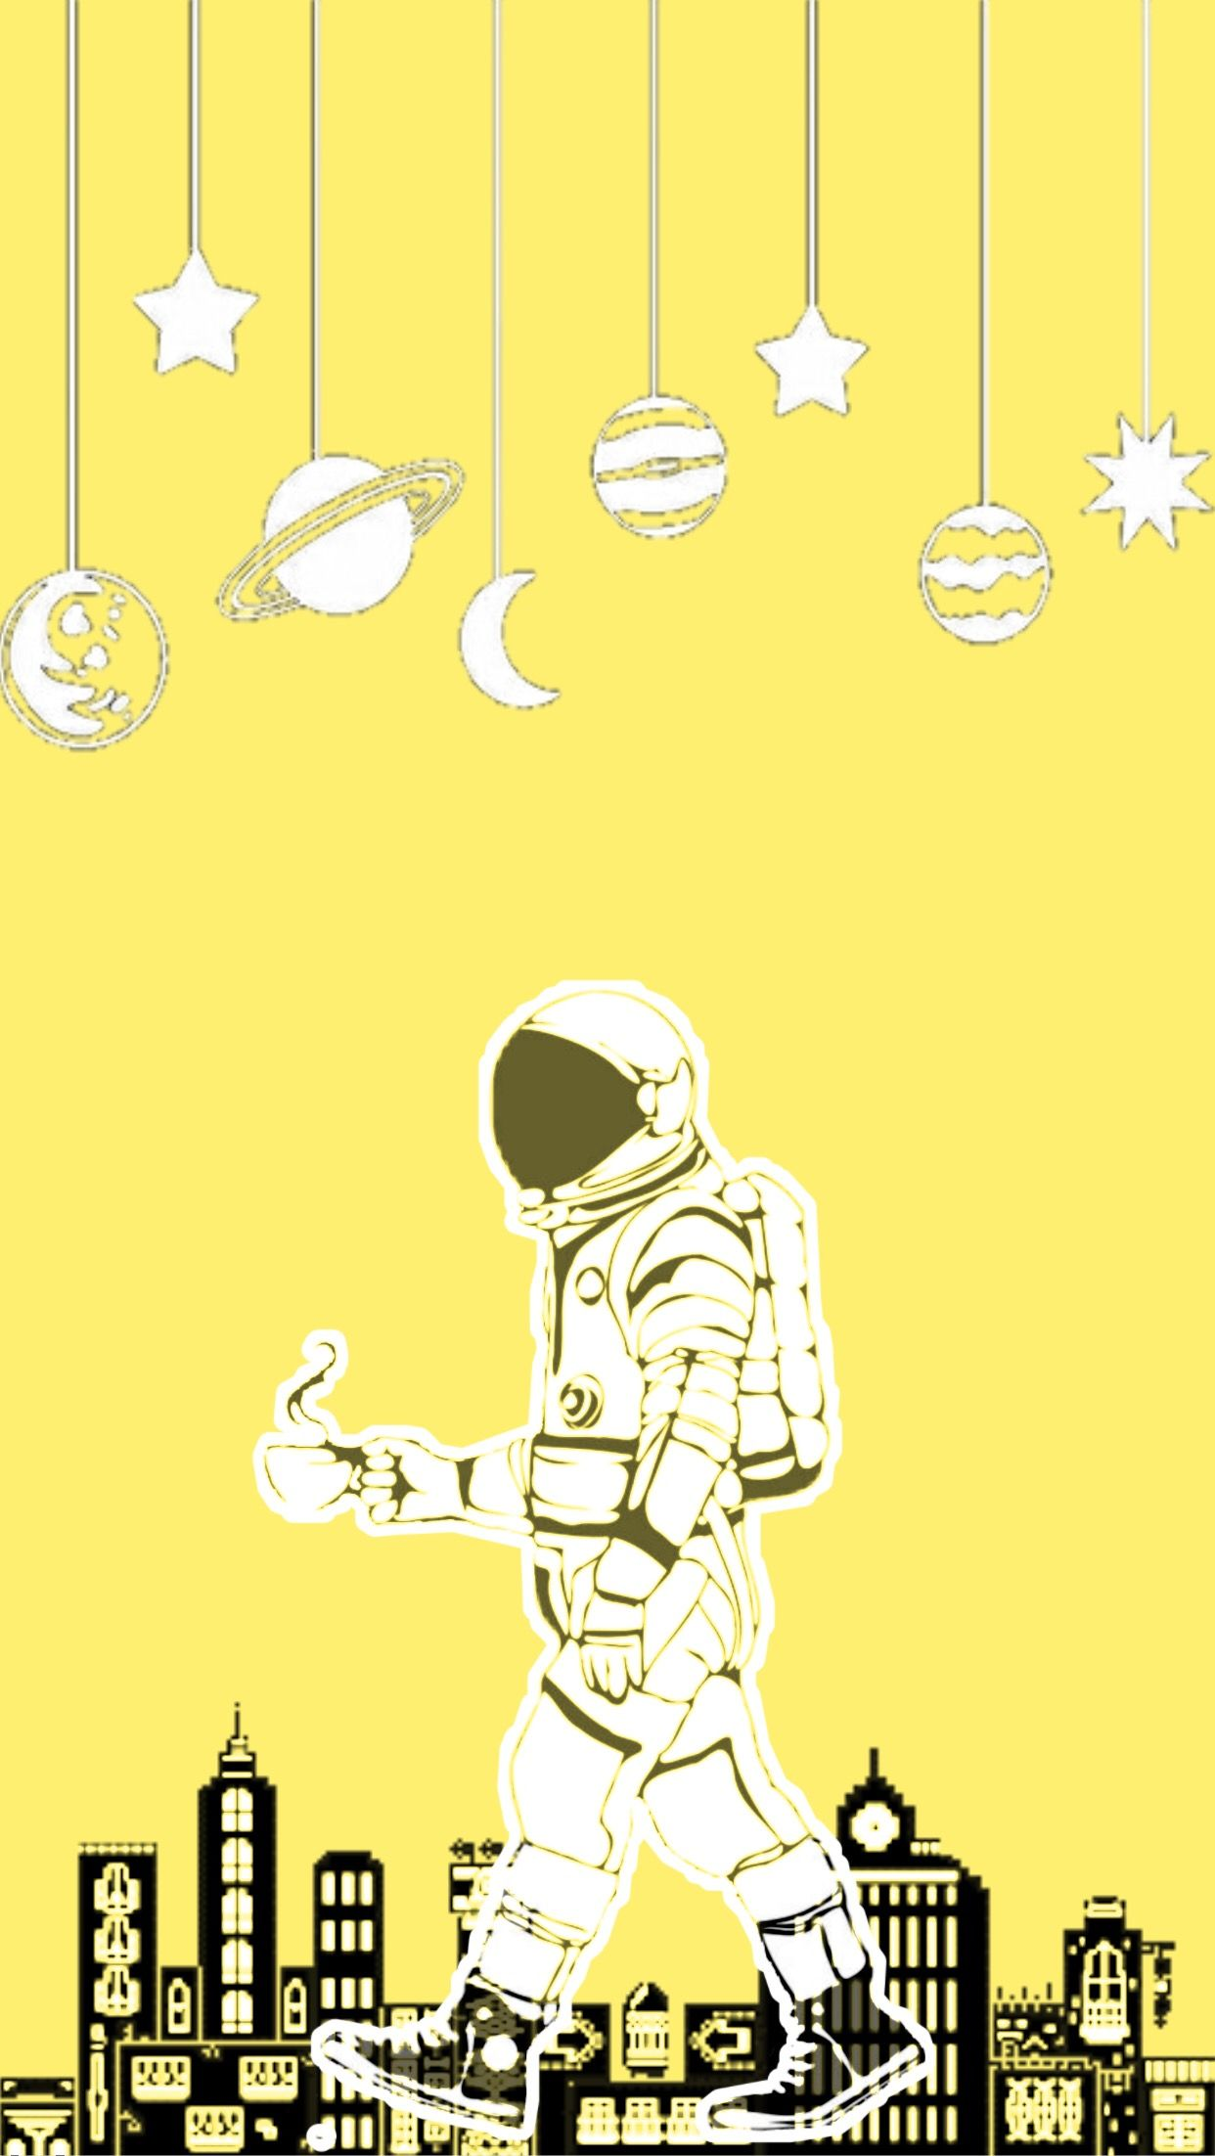
From
Donot detrack our students
To
We would love to have you at our school.

Slide 29
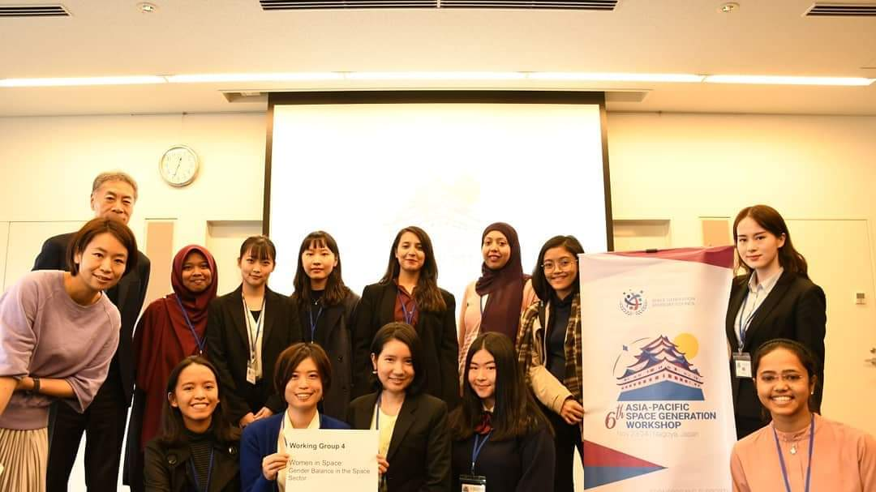

Slide 30
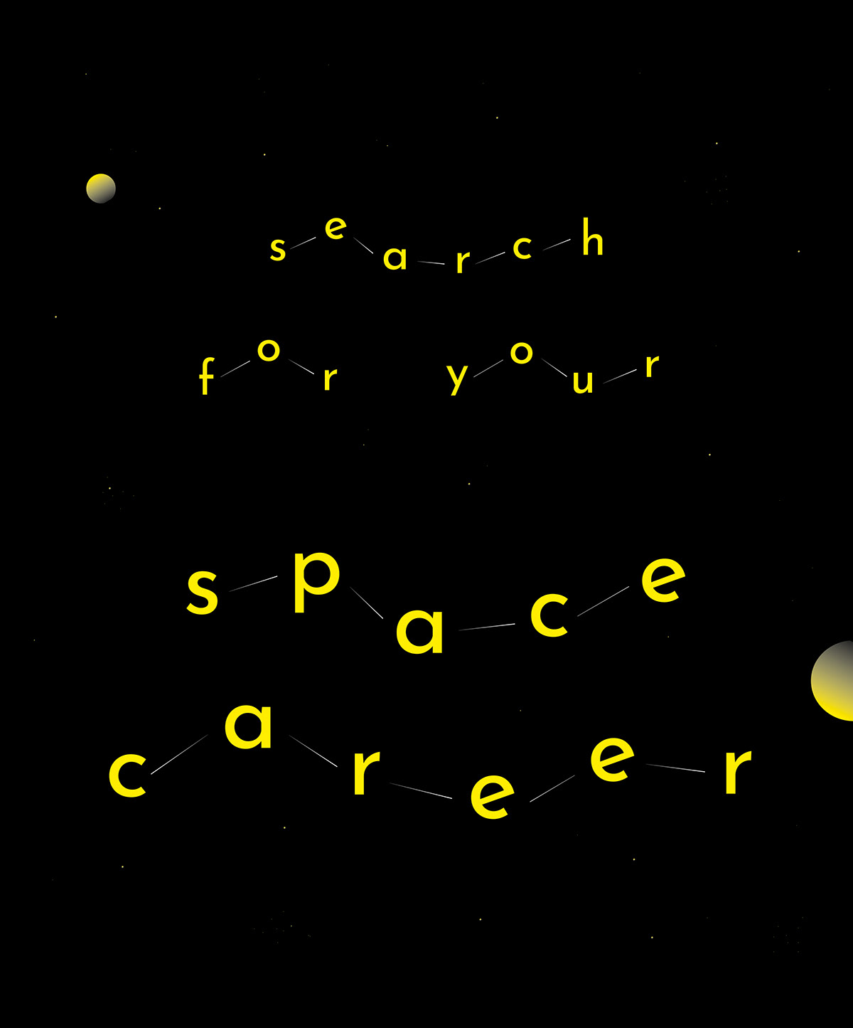

Slide 31
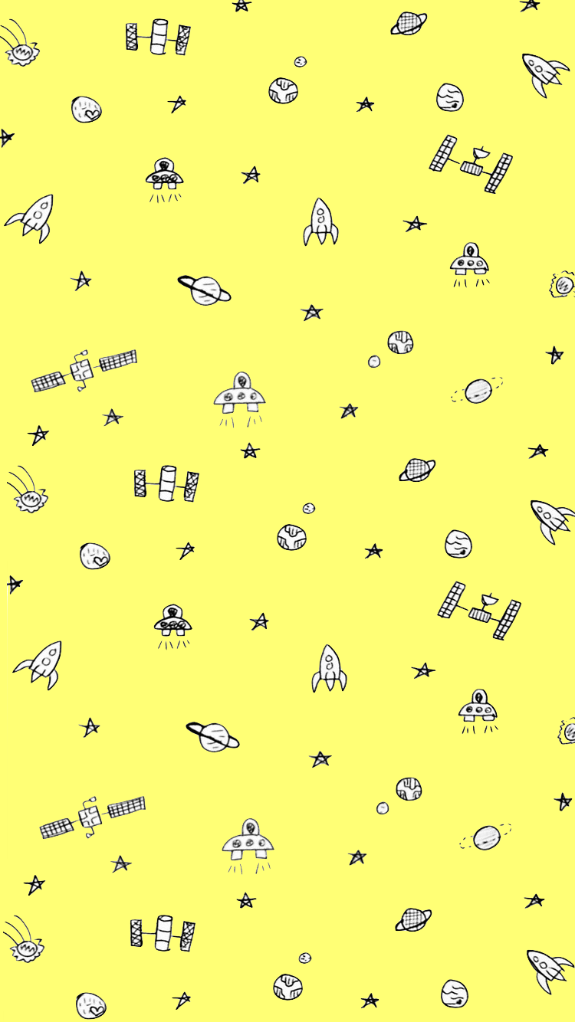
Make your mother/father, your best friend.
Do not let your dreams die.
Use internet correctly, you will find opportunities.
Never give up!

Slide 32
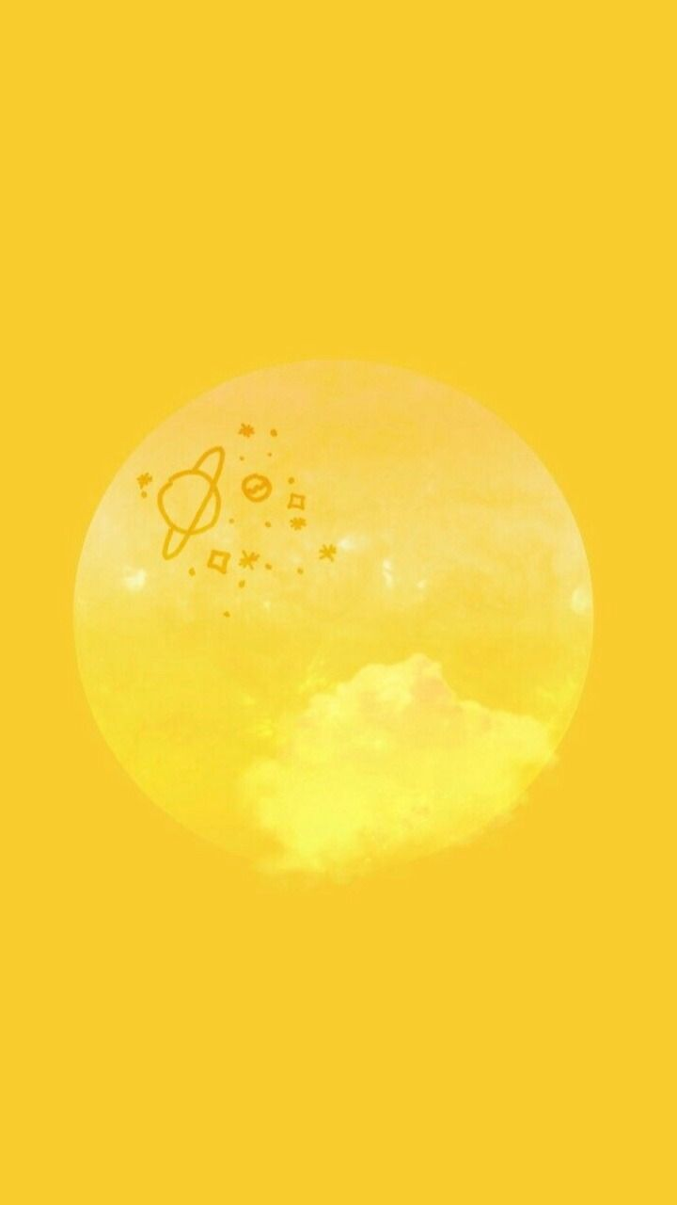
Work hard in Silence and let your success be your noise.
- Frank Ocean

Slide 33
Be the change you wish to see in the world.
-Gandhi

Slide 34
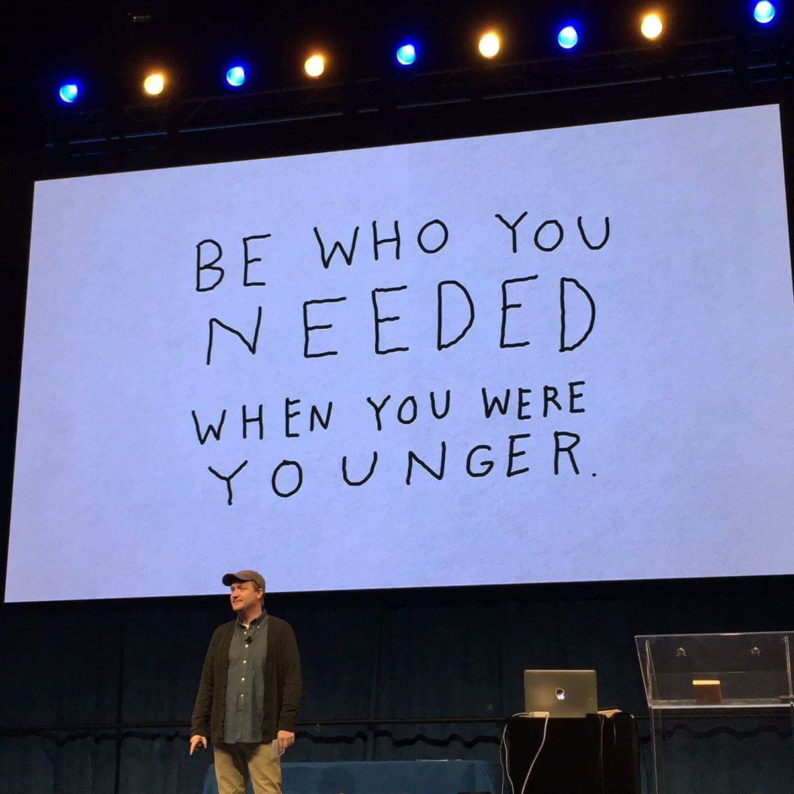

Slide 35
Current Situation:
- Working as a social entreprise.
-Charge free from private schools.
- work for free with public schools,
trusts and orphanages
Donations i.e. books/infographics/goodies etc
No Government help
No Astronauts yet. Need to bring someone on board to inspire young minds.
Always looking for educational material/content.
- Want to produce material locally to avoid shipment problems.

Slide 36
A Medical Lab Technologist who wants to recreate dinosaurs!

Slide 37
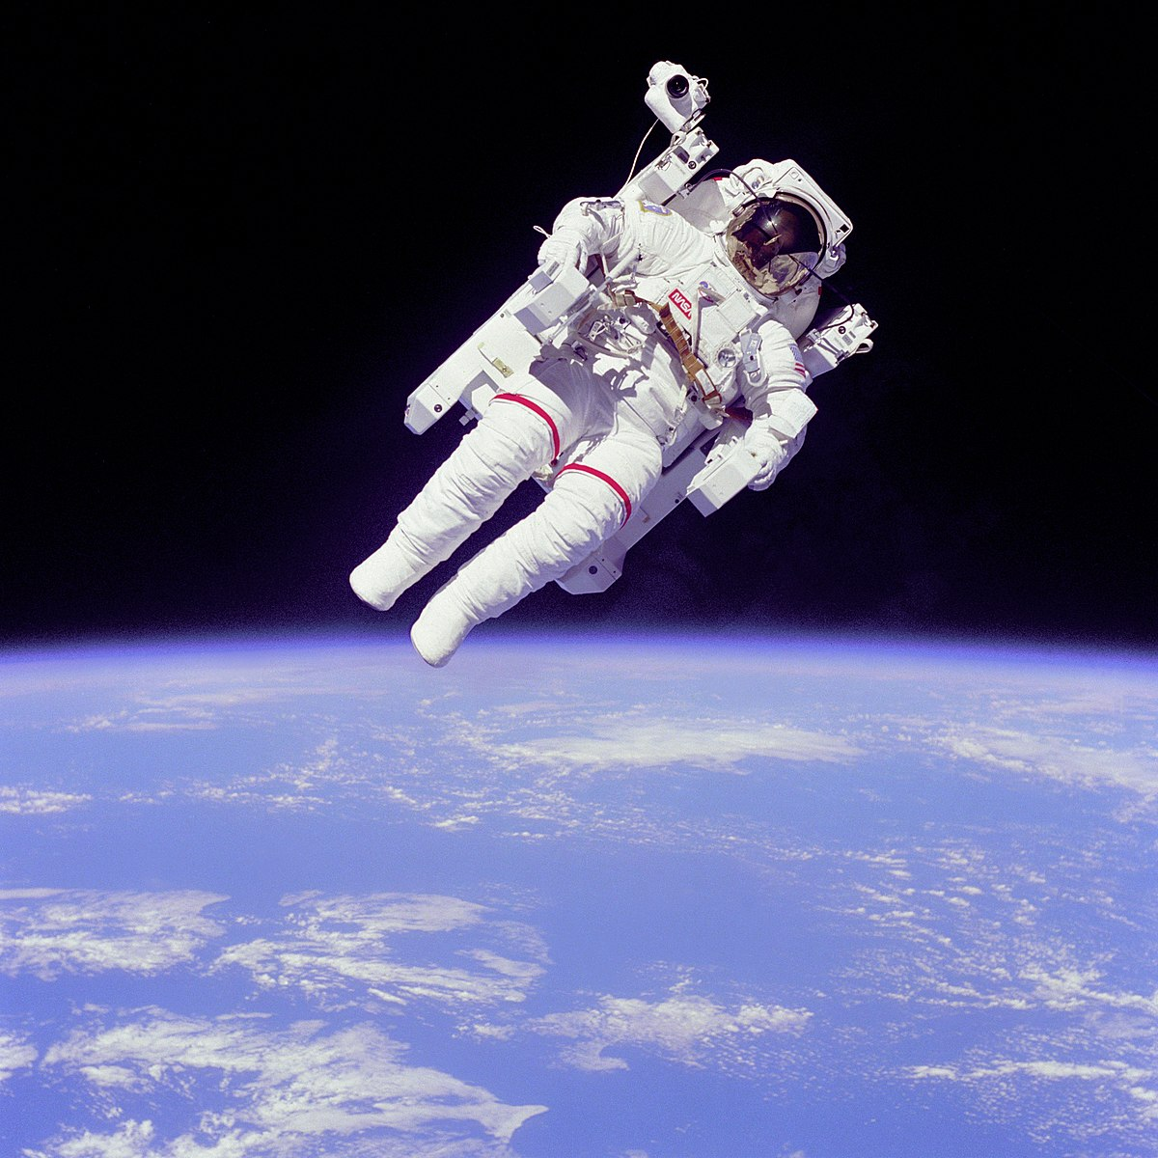
Thankyou

