Slide 1
NSS North Houston Space Society
July 11, 2020

Slide 2
Agenda
Agenda: 2:00 PM – Opening Remarks – Nathan Price
2:10 PM – Recent Space News – Greg Stanley
2:30 PM – Yumna Majeed
3:15 PM – Q&A
3:30 PM – Share your personal space experiences since the last meeting. Rocket Launches, Other Meetings, Research, etc.
4:00 PM – End of Meeting

Slide 3
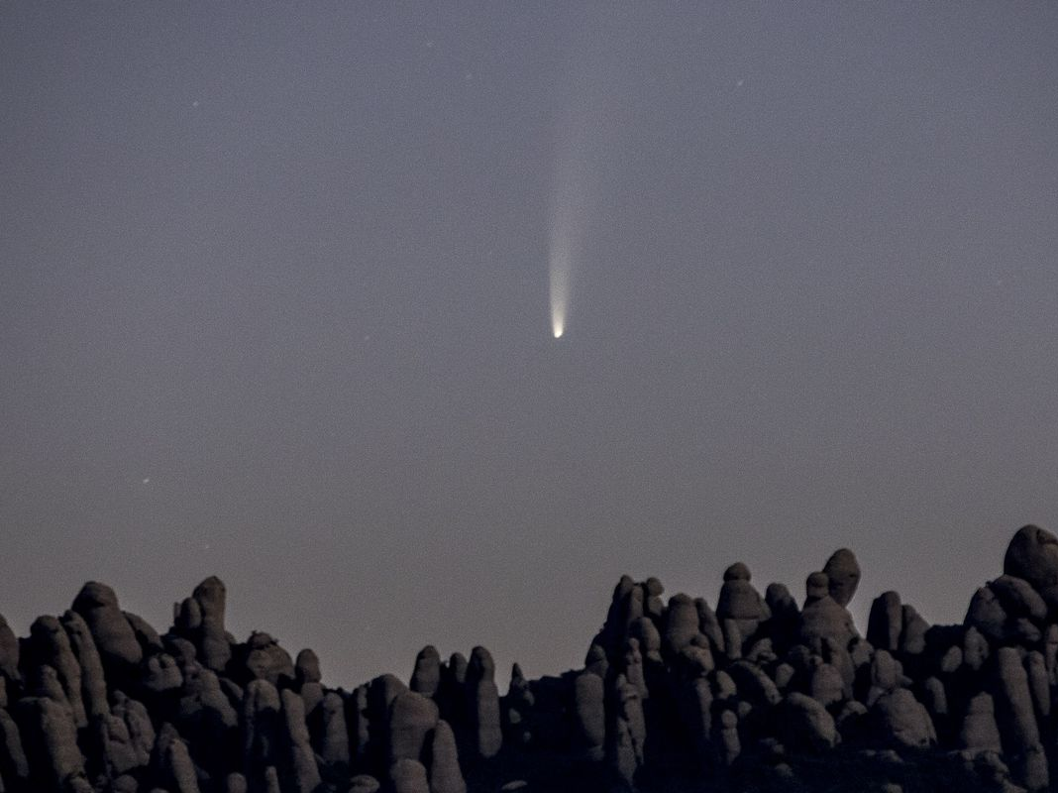
Comet Neowise

Slide 4
From the ISS

Slide 5
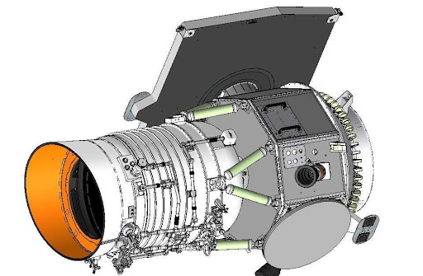
Comet C/2020 F3 NEOWISE
Discovered March 27, 2020
Named after the probe that discovered it, called NEOWISE, for Near-Earth Object Wide-field Infrared Survey Explorer
The mission consists of a spacecraft in orbit around Earth that’s tasked with cataloging as many asteroids near Earth as possible — especially any that might be potentially hazardous to our planet.

Slide 6
June 7, 2020 - Canada

Slide 7
June 8, 2020

Slide 8
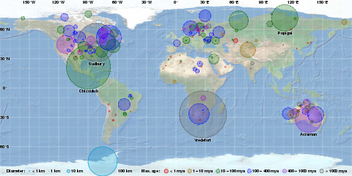

Slide 9
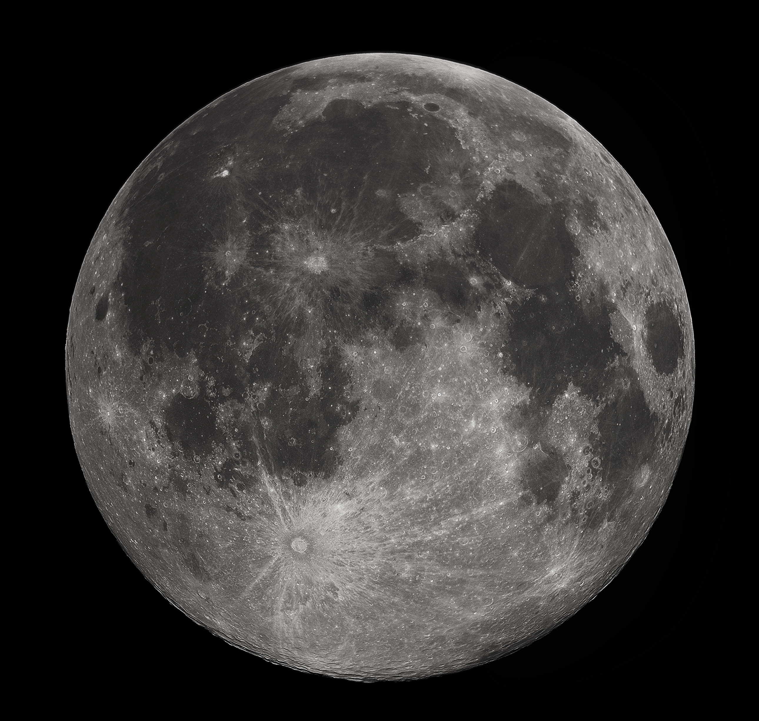

Slide 10
Making Certain Decisions in Uncertain Times

Slide 12
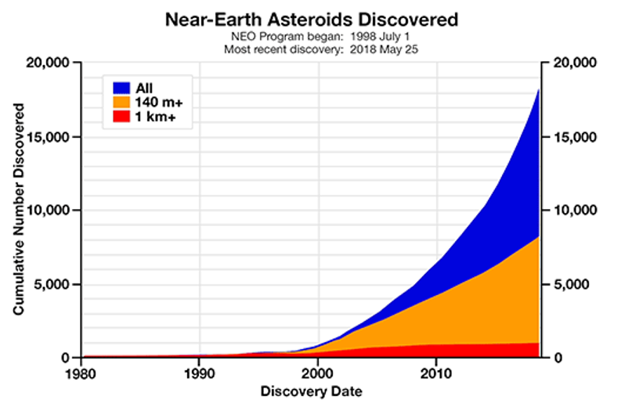

Slide 14
Symbol | Name | Selected applications
Sc | Scandium | Light aluminium-scandium alloys for aerospace components, additive in metal-halide lamps and mercury-vapor lamps,^{[8]} radioactive tracing agent in oil refineries
Y | Yttrium | Yttrium aluminium garnet (YAG) laser, yttrium vanadate (YVO₄) as host for europium in television red phosphor, YBCO high-temperature superconductors, yttria-stabilized zirconia (YSZ), yttrium iron garnet (YIG) microwave filters,^{[8]} energy-efficient light bulbs (part of triphosphor white phosphor coating in fluorescent tubes, CFLs and CCFLs, and yellow phosphor coating in white LEDs),^{[9]} spark plugs, gas mantles, additive to steel, cancer treatments
La | Lanthanum | High refractive index and alkali-resistant glass, flint, hydrogen storage, battery-electrodes, camera lenses, fluid catalytic cracking catalyst for oil refineries
Ce | Cerium | Chemical oxidizing agent, polishing powder, yellow colors in glass and ceramics, catalyst for self-cleaning ovens, fluid catalytic cracking catalyst for oil refineries, ferrocerium flints for lighters, robust intrinsically hydrophobic coatings for turbine blades.
Pr | Praseodymium | Rare-earth magnets, lasers, core material for carbon arc lighting, colorant in glasses and enamels, additive in didymium glass used in welding goggles,^{[8]} ferrocerium firesteel (flint) products.
Nd | Neodymium | Rare-earth magnets, lasers, violet colors in glass and ceramics, didymium glass, ceramic capacitors, electric motors of electric automobiles
Pm | Promethium | Nuclear batteries, luminous paint
Sm | Samarium | Rare-earth magnets, lasers, neutron capture, masers, control rods of nuclear reactors
Eu | Europium | Red and blue phosphors, lasers, mercury-vapor lamps, fluorescent lamps, NMR relaxation agent
Gd | Gadolinium | High refractive index glass or garnets, lasers, X-ray tubes, computer memories, neutron capture, MRI contrast agent, NMR relaxation agent, magnetostrictive alloys such as Galfenol, steel additive
Tb | Terbium | Additive in Neodymium based magnets, green phosphors, lasers, fluorescent lamps (as part of the white triband phosphor coating), magnetostrictive alloys such as terfenol-D, naval sonar systems, stabilizer of fuel cells
Dy | Dysprosium | Additive in Neodymium based magnets, lasers, magnetostrictive alloys such as terfenol-D, hard disk drives
Ho | Holmium | Lasers, wavelength calibration standards for optical spectrophotometers, magnets
Er | Erbium | Infrared lasers, vanadium steel, fiber-optic technology
Tm | Thulium | Portable X-ray machines, metal-halide lamps, lasers
Yb | Ytterbium | Infrared lasers, chemical reducing agent, decoy flares, stainless steel, stress gauges, nuclear medicine, monitoring earthquakes
Lu | Lutetium | Positron emission tomography – PET scan detectors, high-refractive-index glass, lutetium tantalate hosts for phosphors, catalyst used in refineries, LED light bulb

Slide 15
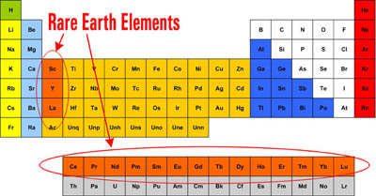
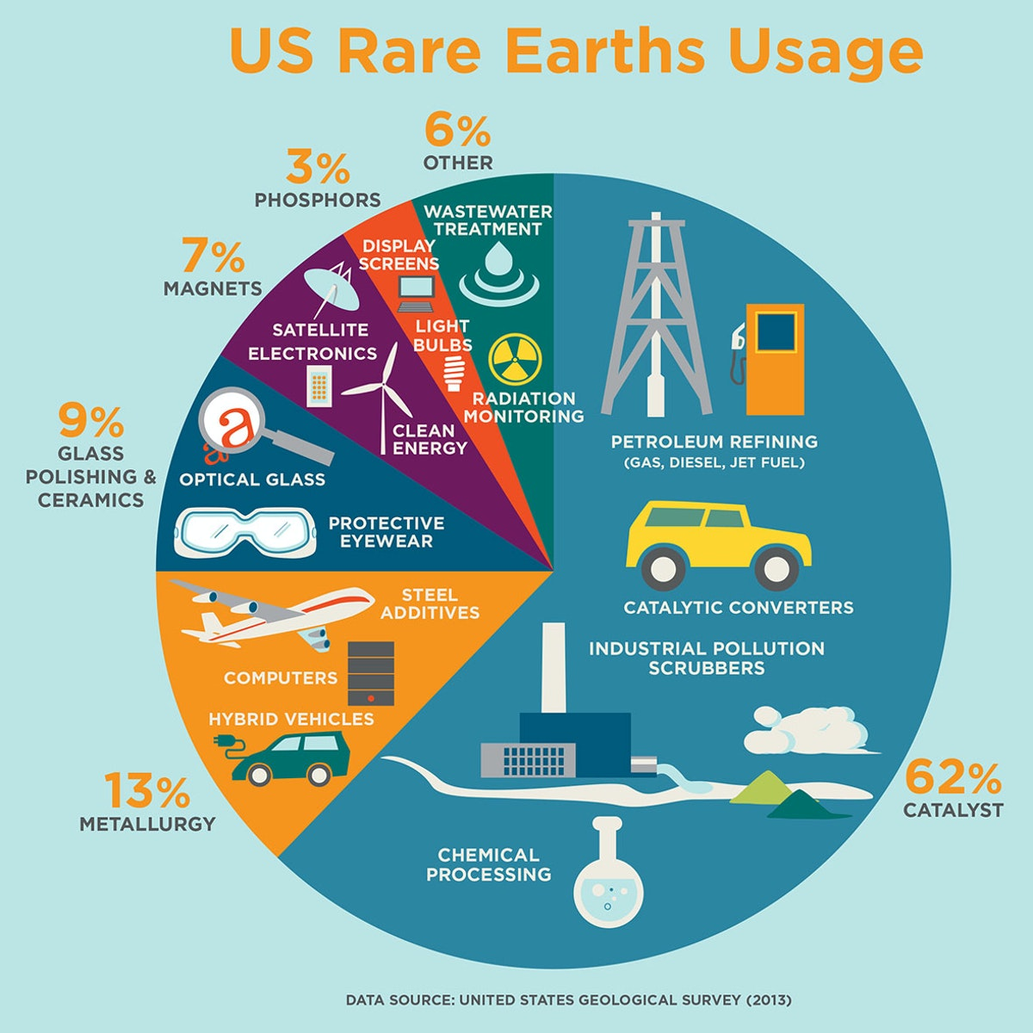
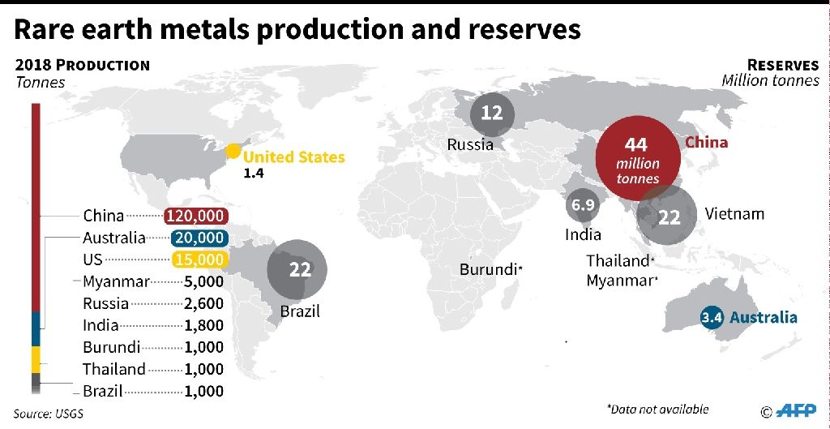

Slide 16
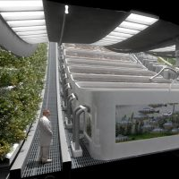
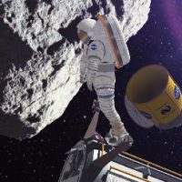
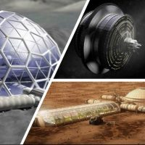
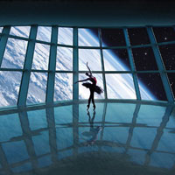
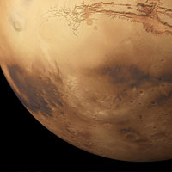
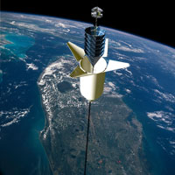
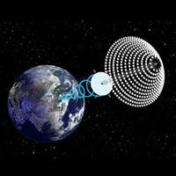
National Space Society Vision
People living and working in thriving communities beyond the Earth, and the use of the vast resources of space for the dramatic betterment of humanity.

Slide 17
Do you share this vision?

Slide 18
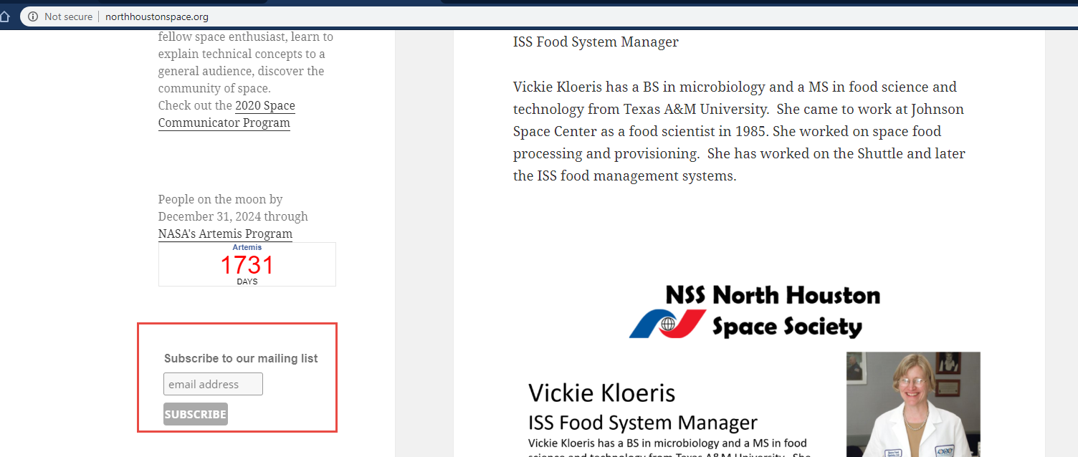
Join the NSS North Houston Space Society Mailing list
Visit http://NorthHoustonSpace.org
Scribe from left side bar

Slide 19
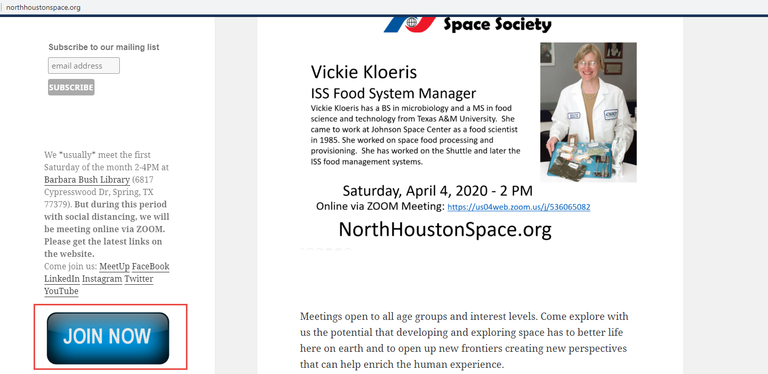
Join the National Space Society
Visit http://NorthHoustonSpace.org
Click on “Join Now” to go to the National Space Society’s website

Slide 20
Meeting IS being RECORDED
This meeting is being recorded and will be posted on YouTube, NorthHoustonSpace.org, Facebook, etc.

Slide 21
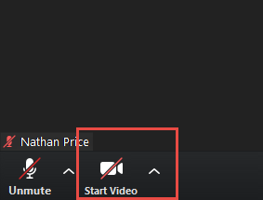
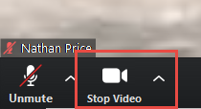
How to use ZOOM - Video & Mute & Chat
Video is turned off by default. Turn it on when you are ready:

Slide 22
Space News

Slide 23
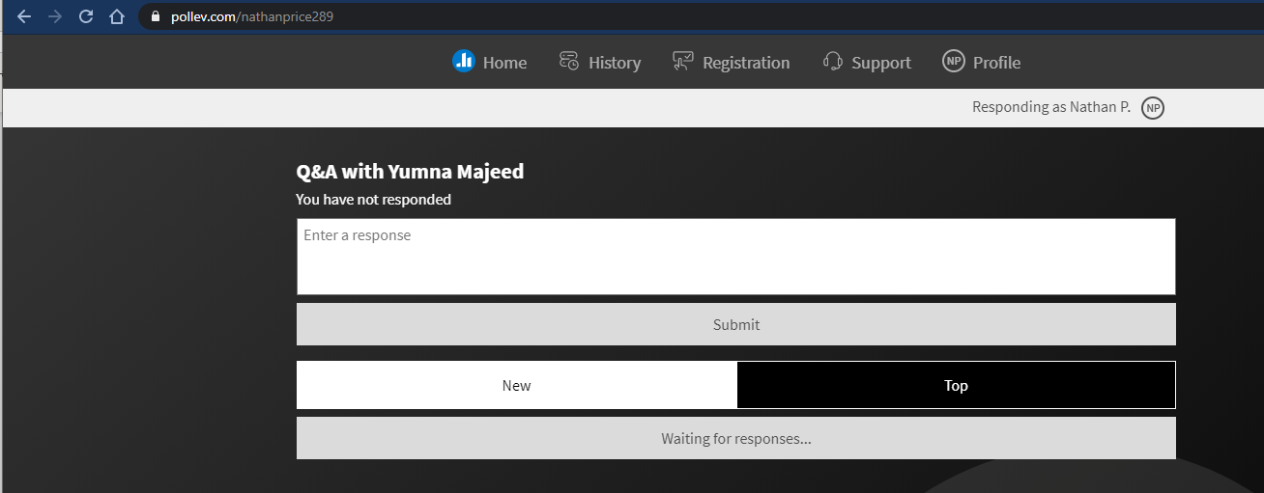
Q&A
https://pollev.com/nathanprice289

Slide 24
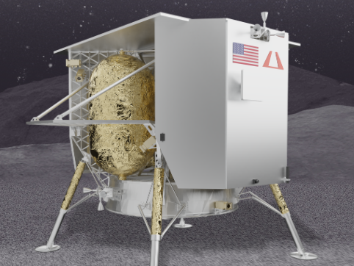
Next Meeting: Saturday, August 1, 2020
Jennifer W. Lopez
Director of Business Development Astrobotic Technology, Inc., Astrobotic has been commissioned by NASA to be the first U.S. mission to land on the Moon since the Apollo era. Astrobotic’s inaugural flight will carry more than 22 unique payloads from 6 nations and will be the first commercial planetary mission to land on the lunar surface in 2021.
Jennifer also supports lunar payload development as part of NASA’s Artemis Human Landing System in collaboration with prime contractor Dynetics, which aims to send the first woman and the next
man to the Moon by 2024.

Slide 25
Other Space Events (Online)
Sunday, July 12, 2020 – 3:30 PM – 6PM NSS of North Texas (in Dallas) Monthly meeting: July 2020 Meeting - Mars Exploration: Past, Present, & Future
Tuesday, July 14, 2020 – 10PM - ONLINE: Live Deep Sky Tour from McDonald Observatory

