Slide 1
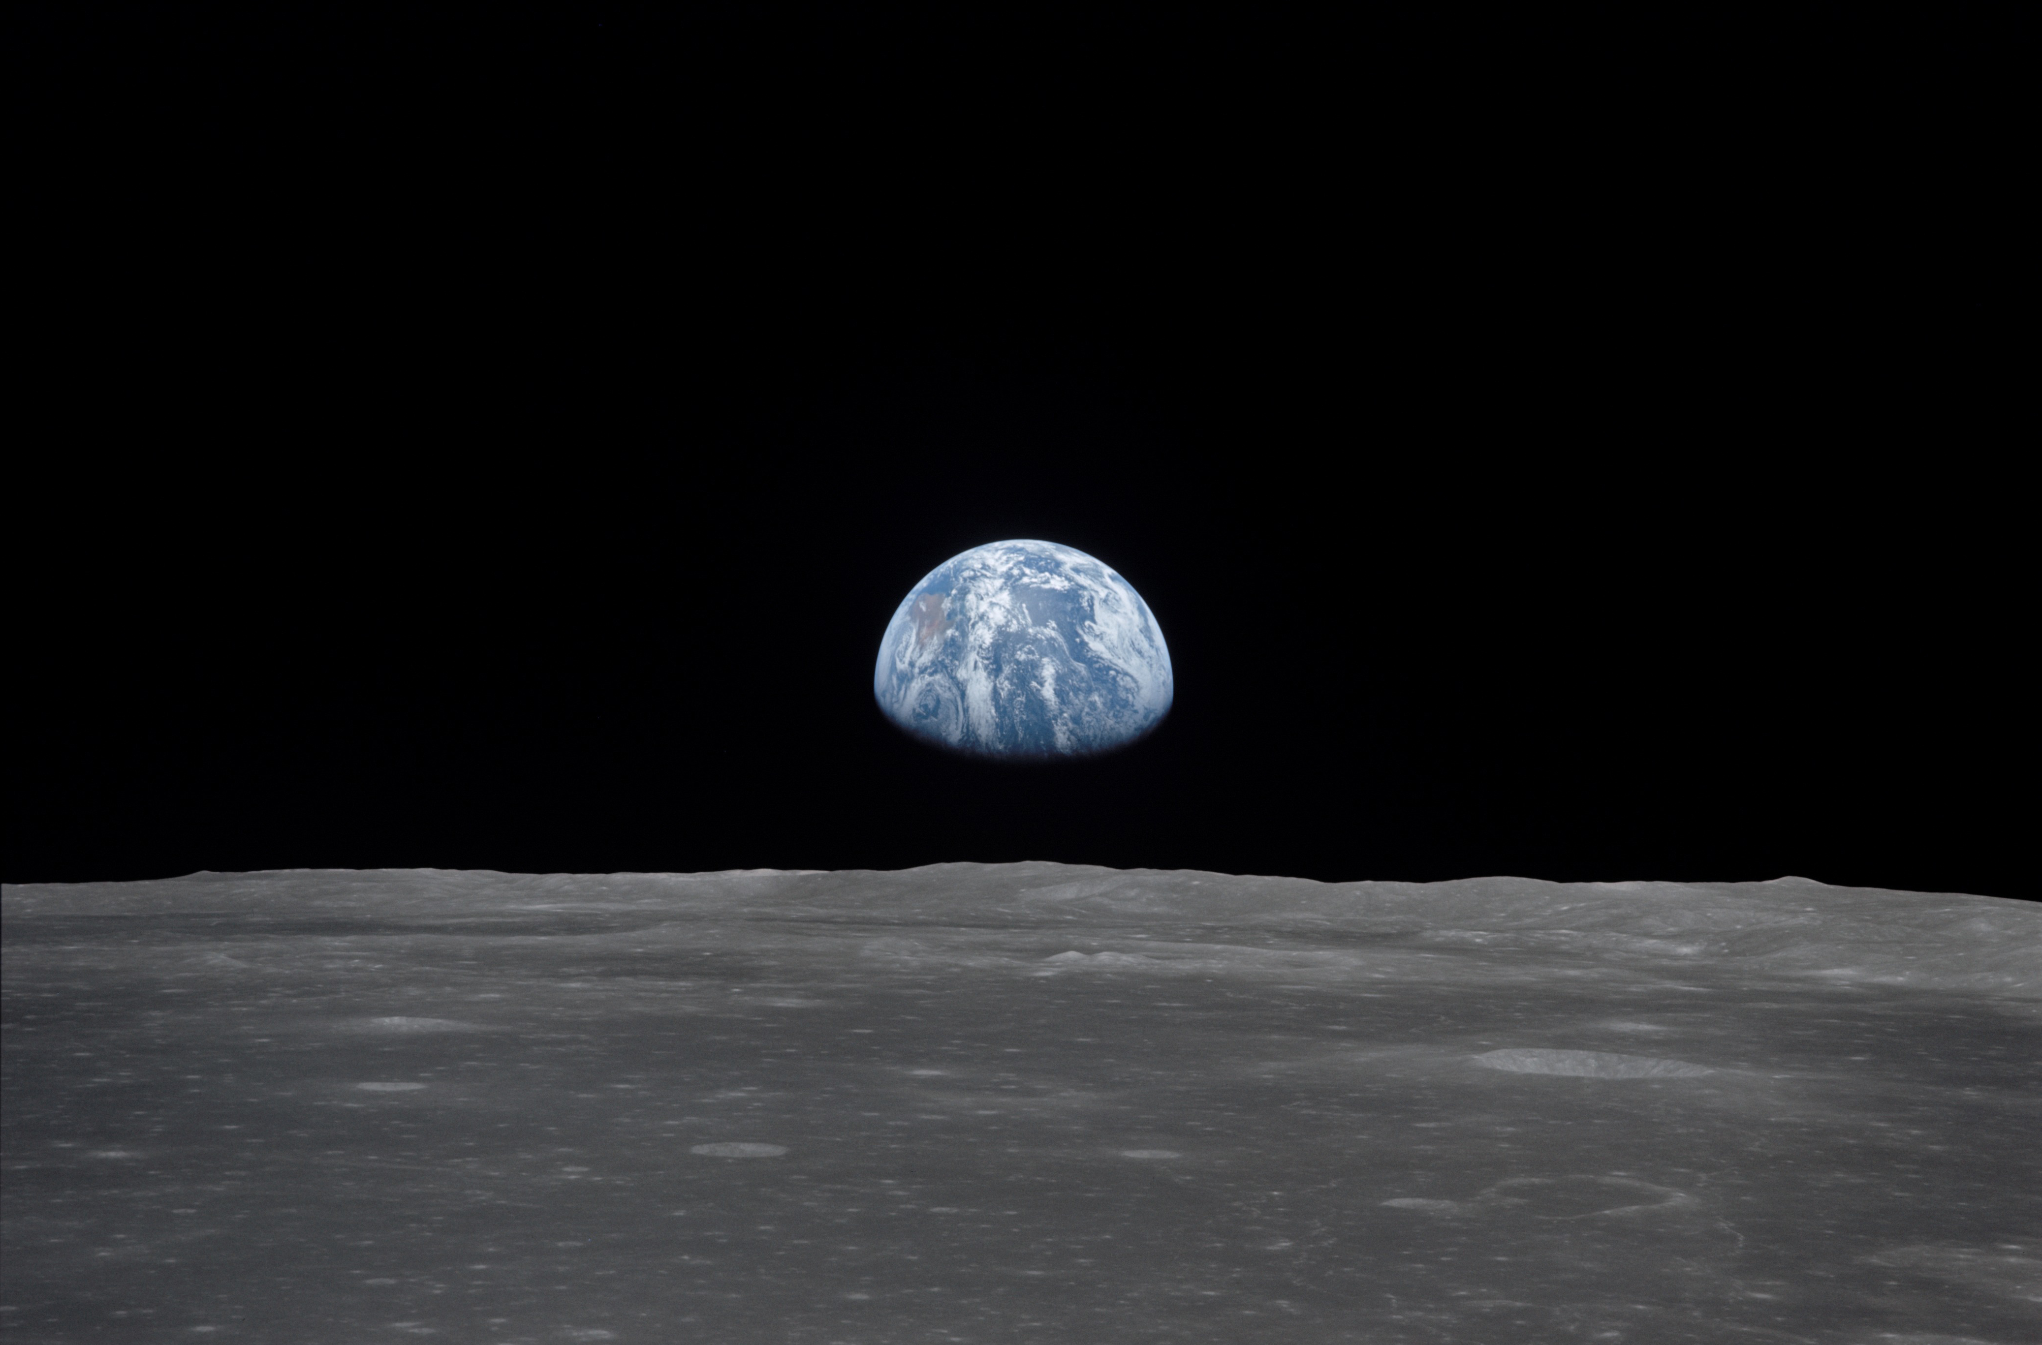
NSS North Houston Space Society Space News
July 11, 2020
Greg Stanley

Slide 2
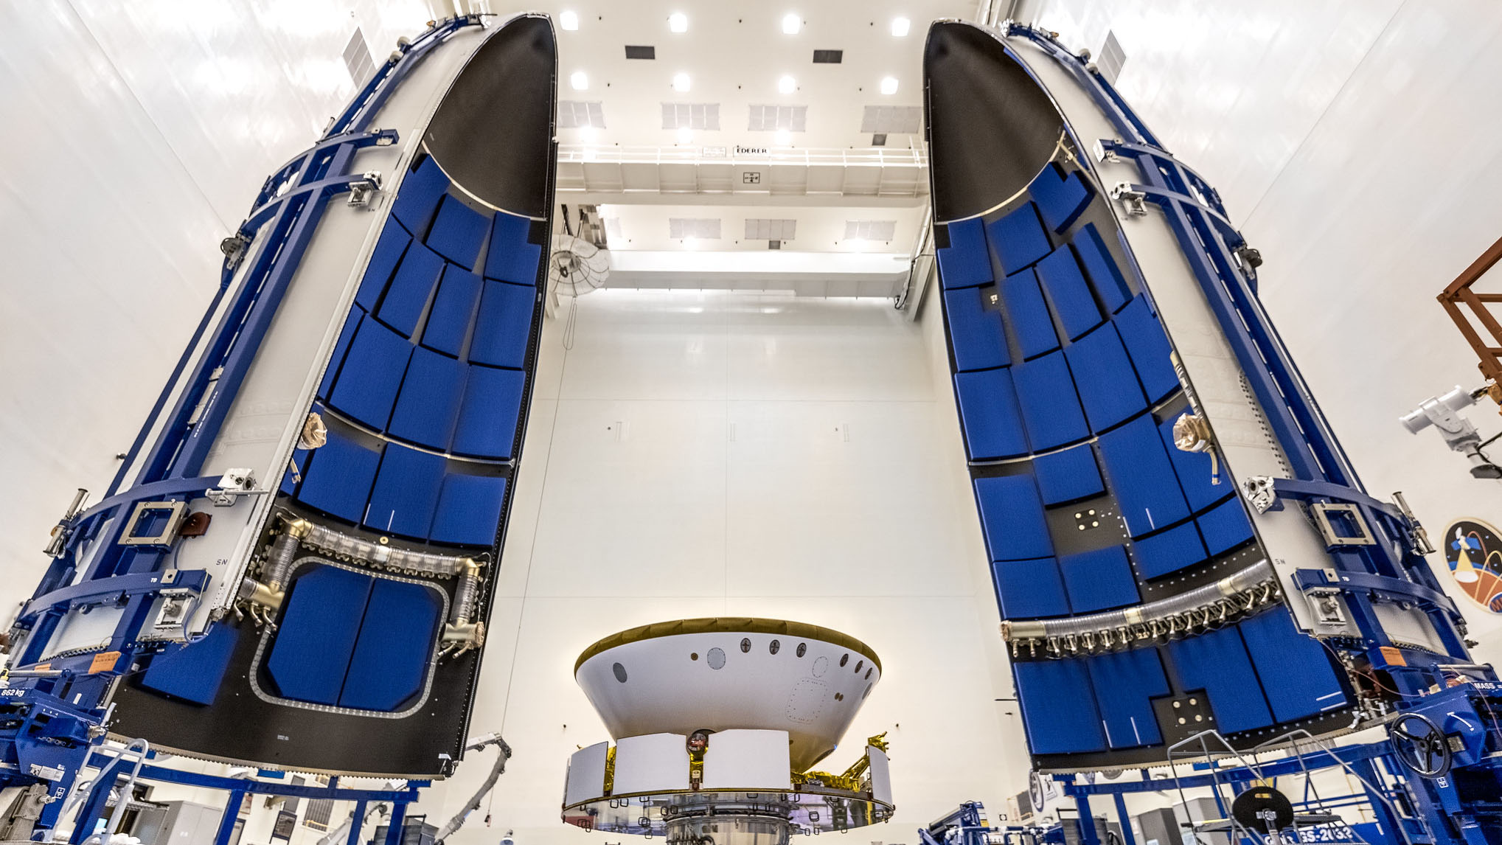
NASA Mars 2020 Perseverance rover delayed
Delayed until at least July 30 due to liquid O₂ level sensing problems
Launch windows: planets align best every 26 months
If delayed past summer, will have to wait until Autumn, 2022
Ancient life search
Sample return (2031)
Weather, monitoring
Test O₂ generation
Helicopter on Mars!
Rover before encapsulation
in Atlas V fairing
Credit: NASA/Christian Mangano

Slide 3
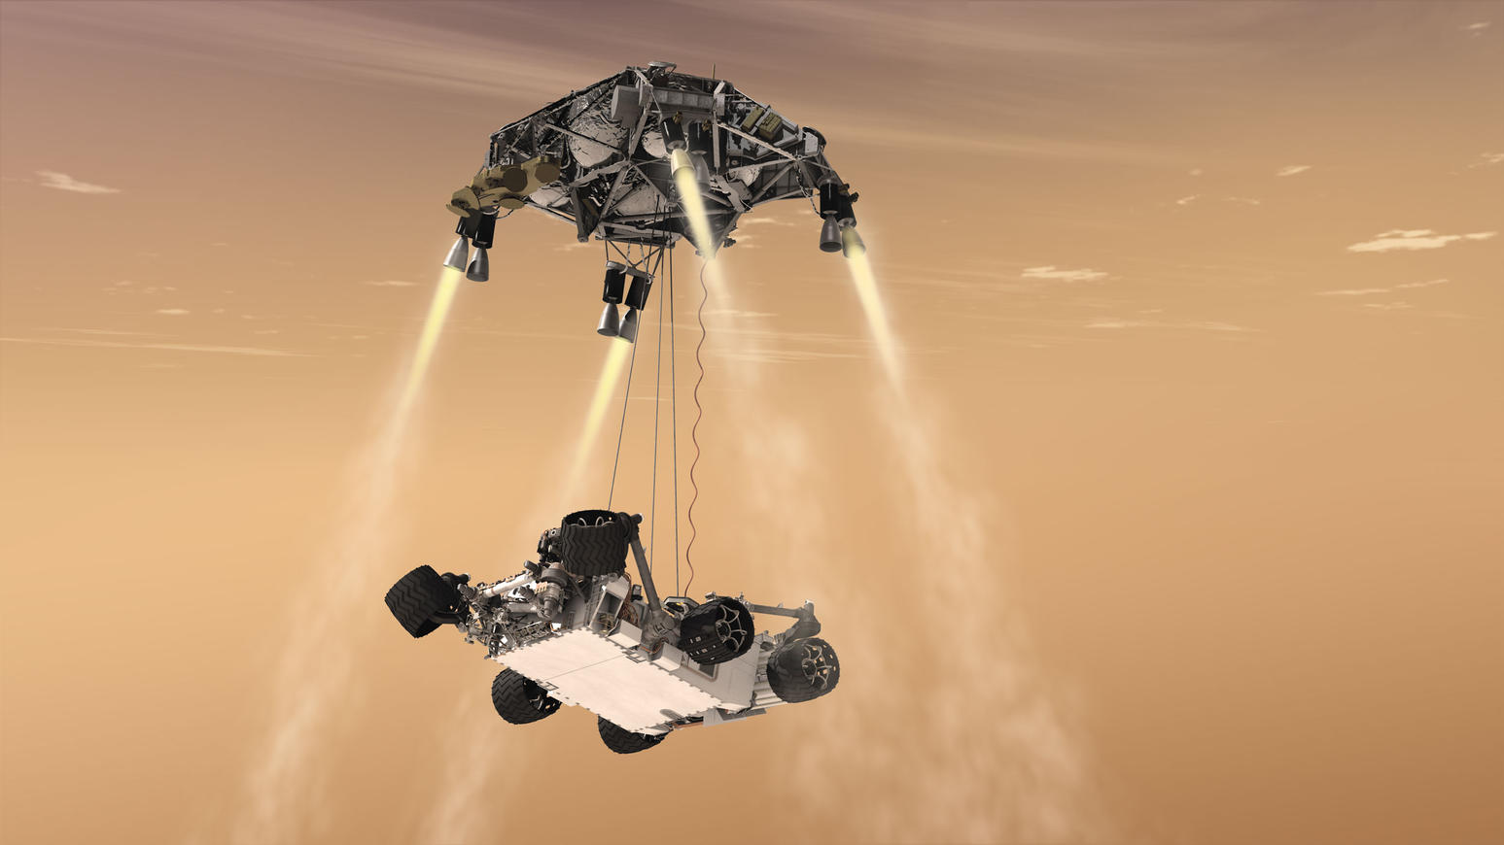
Perseverance Mars rover
Landing after a 314 million mile trip, Feb 18, 2021
Image: NASA

Slide 4
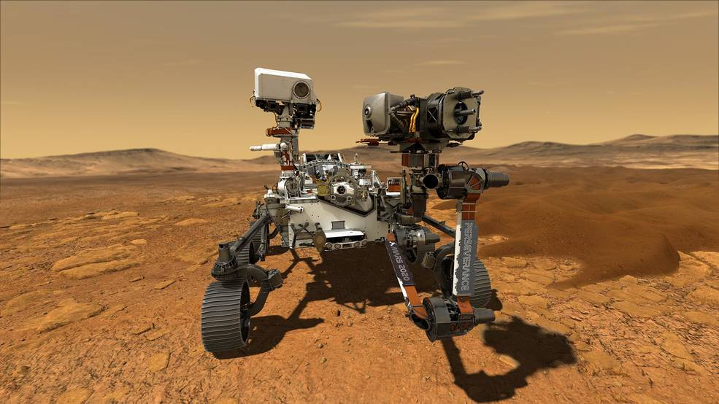
Perseverance Mars rover
Image: NASA

Slide 5
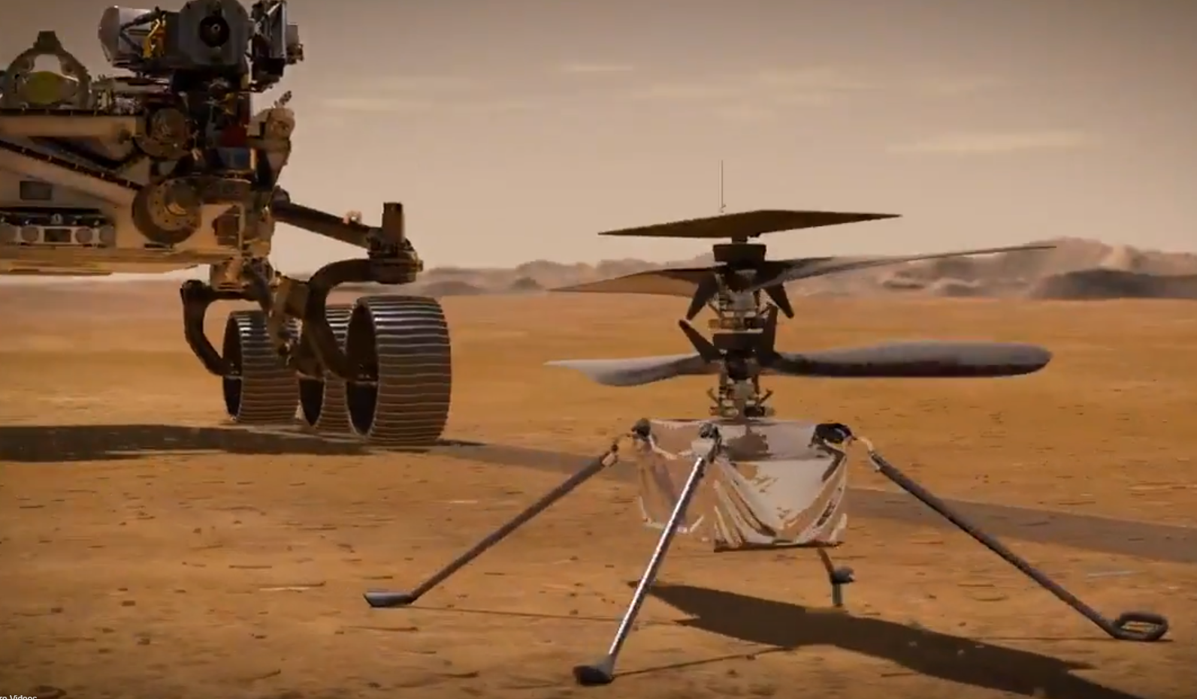
Helicopter on Mars: Ingenuity
4 lbs, 30 day design life, solar cell powered
Perseverance Rover
Ingenuity helicopter
Image: Space.com

Slide 6
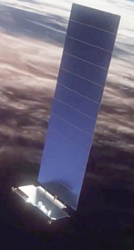
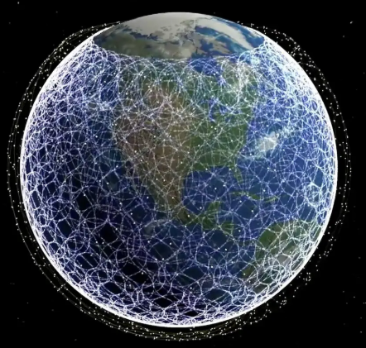
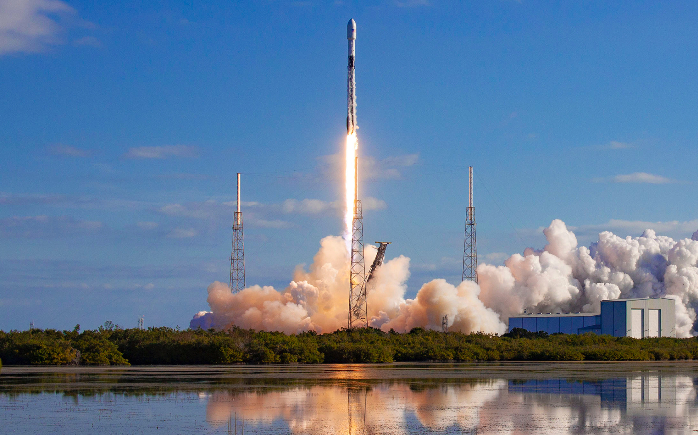
Another SpaceX Starlink launch
9th launch of Starlink satellites for internet service (58 this time)
Also included 3 SkySat Earth-imaging satellites
(first ride share, but there will be more)
Sign up for beta testing announcements at the Starlink web site
12,000+ satellites goal
Currently: 540
In the SpaceX spirit of reusability, this picture was re-used from last month
Credit: SpaceX

Slide 7
Space business news
Bankrupt OneWeb being recapitalized with $1 billion from British government and Indian telecom company Bharti Global
Pending approval from U.S. bankruptcy court
Had already launched 74 of planned 650 satellites for internet service
Higher altitude than Starlink (1200 km.)
Now filed FCC proposal for 48,000 !! more satellites
Adding GPS-like capabilities
Astronomers even more concerned than with Starlink- visible all night in summer
Amazon Web Services established a space-focused business unit
Had already been offering ground station services for satellite operators
Going beyond just “cloud” services!

Slide 8
Spaceship Neptune: To the stratosphere in a balloon
8 Passengers and pilot climb to 100,000 feet in a hydrogen-filled balloon, for $125,000 (half of Virgin Galactic flight cost)
Launch from Kennedy Space Center, no space suits required, testing next year
6 hour round trip (plus returning from splashdown in Atlantic or Gulf)
Not really “space” (generally accepted as 62 miles), but you will see the curvature of the earth, huge view, black sky, 2 hrs. at peak altitude
By Space Perspective, started by Taber MacCallum & Jane Poynter (Biosphere 2, Paragon Space Development, World View)
Includes a bar and airline-style toilet
Poynter: “It will have the best view of any loo in the world”

Slide 9
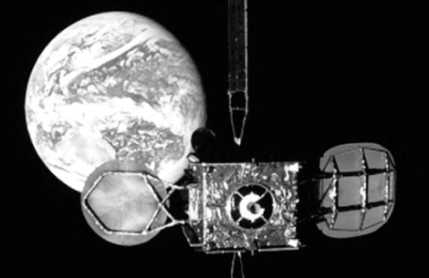
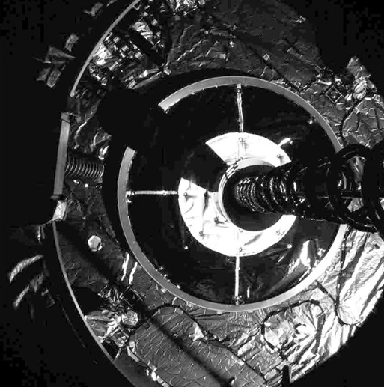
Zombie satellites return from the graveyard*
Geosynchronous satellites should climb up >300 km up to a graveyard orbit at the end of their 15 year design life, to avoid collisions
IADC guideline (Inter-Agency Space Debris Coordination Committee)
Satellites usually still function – they’re just running out of maneuvering fuel
283 are in the graveyard
Of 915 objects within 200 km of GEO, 365 are defunct – didn’t follow guidelines
Solution from NASA/Northrop Grumman: MEV (Mission Extension Vehicle)
Captures the satellite and maneuvers it back to GEO
MEV-1 captured Intelsat satellite IS-901 in April, moved back into service
Will hold for 5 years, then move it back to the graveyard, move to a new customer
MEV-2 will launch this summer, reaching another Intelsat satellite in Jan, 2021
Northrup Grumman: “The era of the space garbage truck is coming”
80 meters from docking: Capturing during final docking:
* Title stolen from IEEE Spectrum
Images: Northrup Grumman

Slide 10
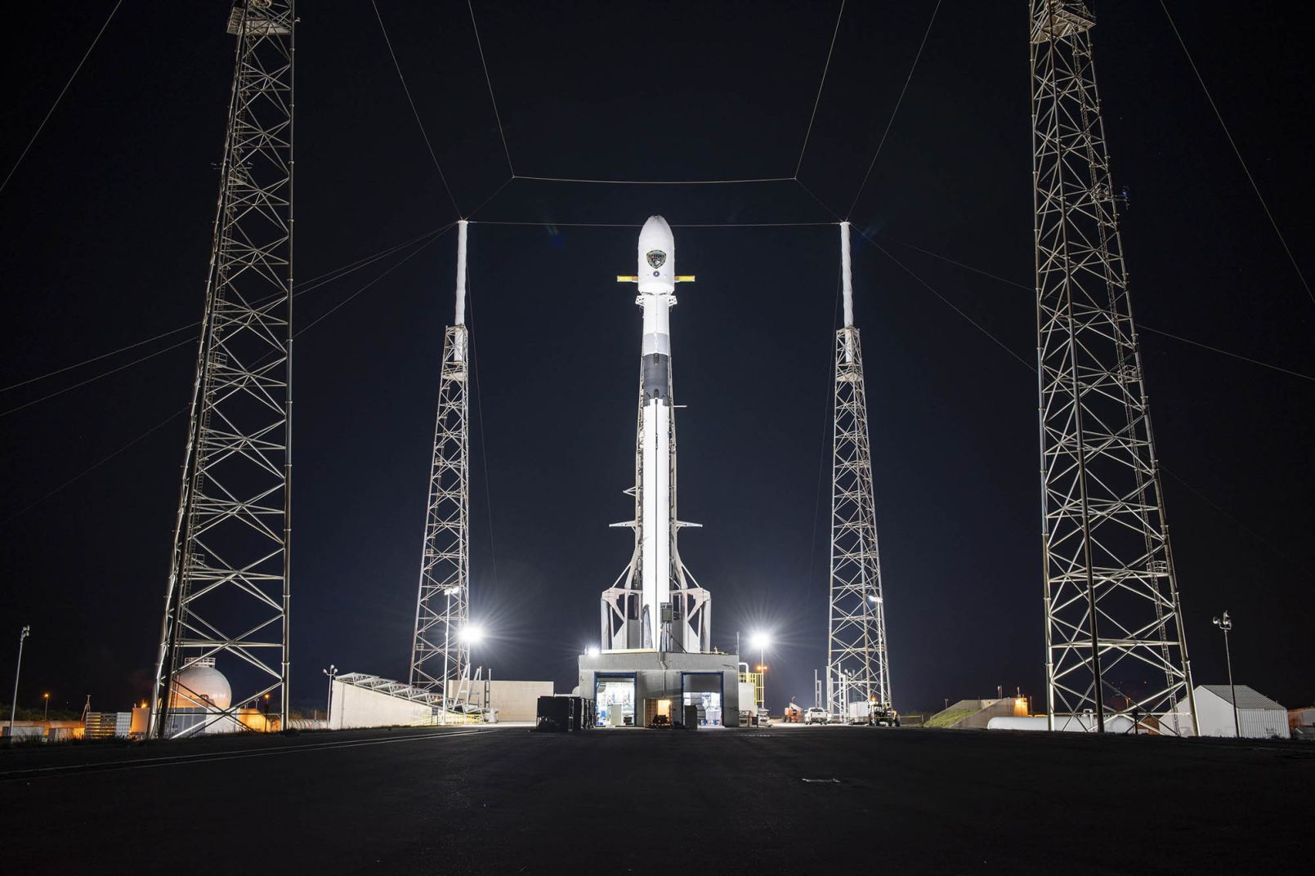
Other space news
SpaceX launched 3rd of next-generation GPS satellites for U.S. Space Force, previously delayed due to COVID-19
NASA announces “Lunar Loo Challenge”
$35,000 prize for best lunar lander toilet design, closes Aug 17
Work in moon gravity and in orbit
(See TheVerge.com, or Google it)
Space settlement takes more than rocket science!

Slide 11
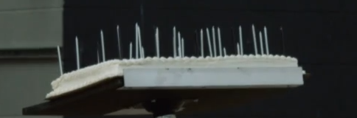
Unimportant space news
NASA-developed perfume “Eau de Space” may now be marketed
Developed 10 years ago, used for training
Only experienced when re-entering spacecraft after a spacewalk
Smells like gunpowder or burned cookies
Over $300,000 raised via Kickstarter
Birthday party for founder of Firefly Aerospace (Austin), Max Polyakov
A technical discussion arose about the optimal way to light 43 candles on the birthday cake …

Slide 12
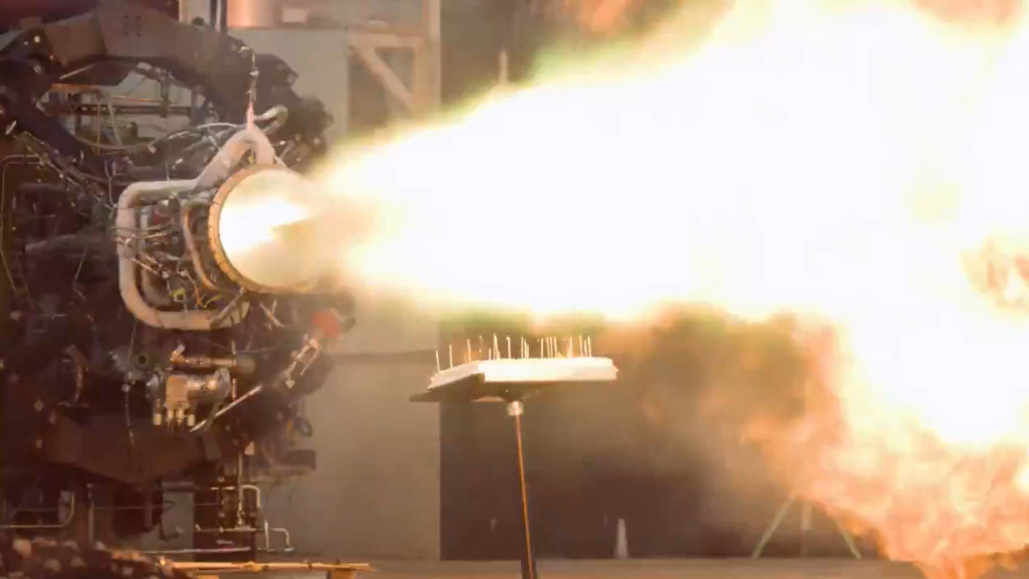
Unimportant space news, continued
Firefly Aerospace finds a new use for their rocket engine
Image: Firefly Aerospace – video at space.com

Slide 13
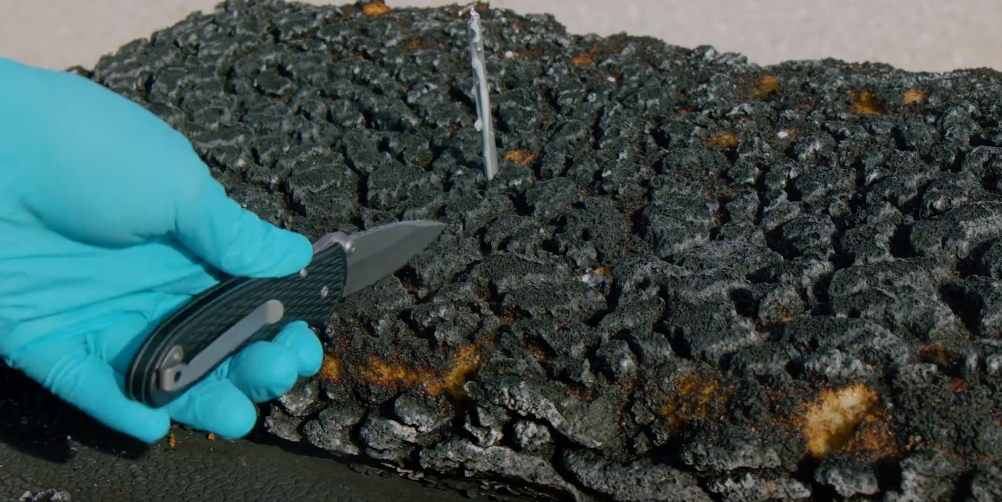
Unimportant space news, continued
Rocket science & engineering isn’t the solution for everything …
Define “optimum” carefully when dealing with scientists and engineers …
Image: Firefly Aerospace – video at space.com

Slide 14
How many launches since the last meeting?
Yes, this includes failed launches

Slide 15
Launches Since Last Meeting (June 6, 2020)
July 11 – Falcon 9 – MAYBE – 10th batch (57) Starlink satellites, 2 BlackSky earth-imaging satellites *
July 10– KZ-11 (new Chinese rocket)– FAIL *
(could send 3300 pounds to LEO or 220 pounds to Medium Earth Orbit)
July 9 – Long March 3D – APSTAR-6D communications satellite to GEO
July 4 – Electron (Rocket Lab, NZ) – (7 CubeSats) FAIL (second stage) *
June 30 – Falcon 9– 3rd of new generation GPS satellites *
June 22 – Long March 3B – Nav satellite (GEO - geostationary orbit) *
June 17 – Long March 2D – Earth observation satellite, others
June 13 – Falcon 9 – 9th batch, (58) Starlink satellites, also 3 SkySat earth-imaging satellites *
June 13 – Electron (Rocket Lab, NZ) – US spy satellite, CubeSats for Boston University, NASA, Australia *
June 10 – Long March 2C – ocean observation satellite
* Launches previously delayed, many due to COVID-19
https://spaceflightnow.com/launch-log/

Slide 16
Featured Speaker: Yumna Majeed
Student of Medical Lab Technology at Allama Iqbal Medical College
Aspiring astronaut
Promoting astronomy and space technology in Pakistan since 2016
Founded “Exploration”, a space education based social enterprise in Pakistan
“As a school kid I was told space has no scope in Pakistan. So I decided to create it.”
TOPIC:

