Slide 1
Brynlee Wright
Personal Space

Slide 2
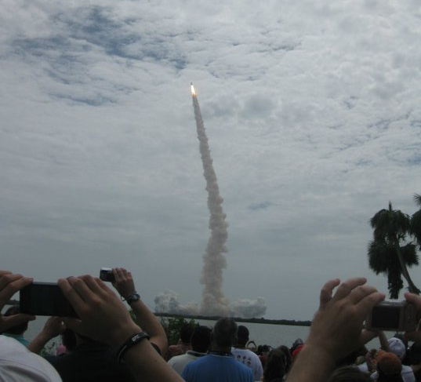
Atlantis Shuttle Launch
July 8, 2011

Slide 3
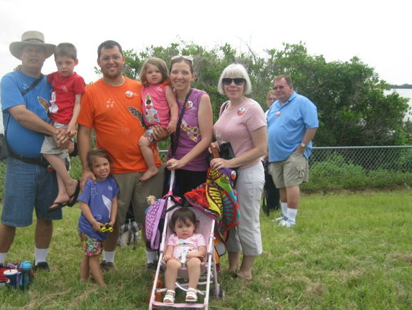
ME!

Slide 4
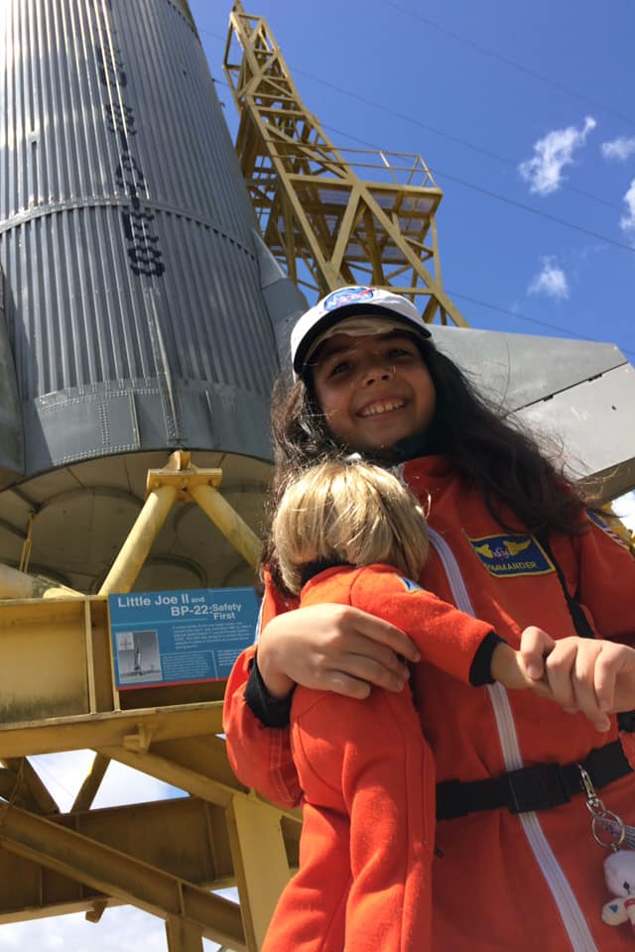
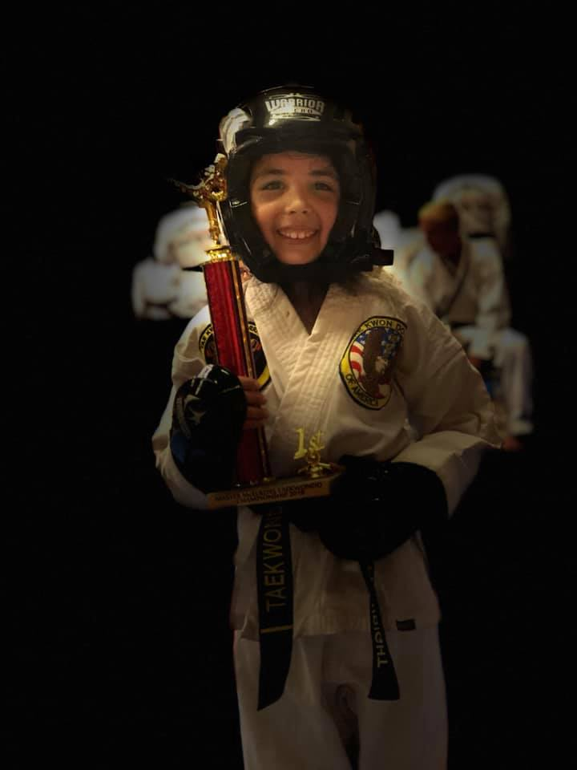
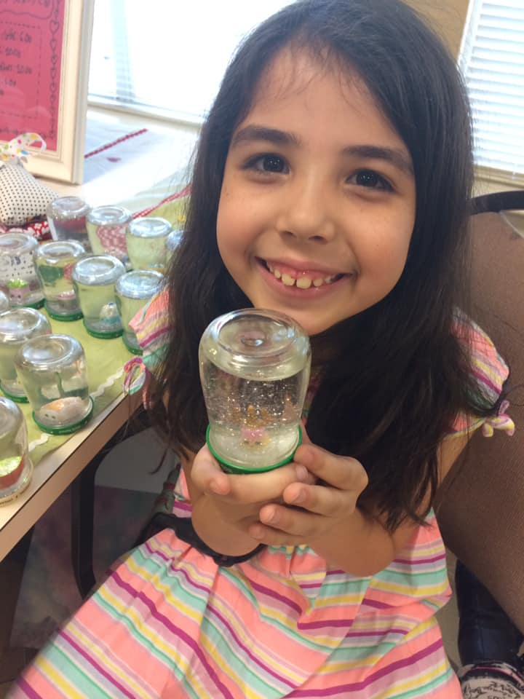

Slide 5
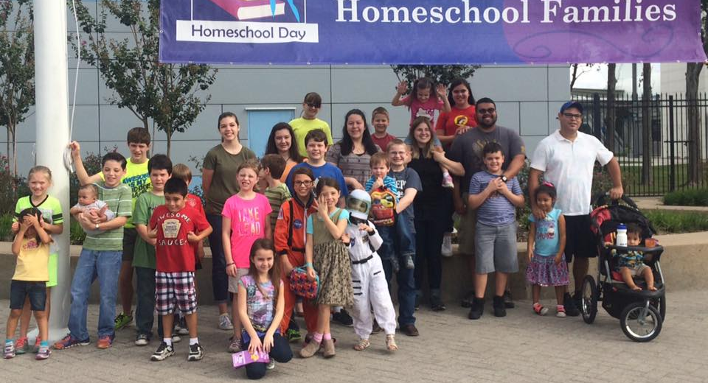
Homeschool Day
Space Center Houston
ME!

Slide 6
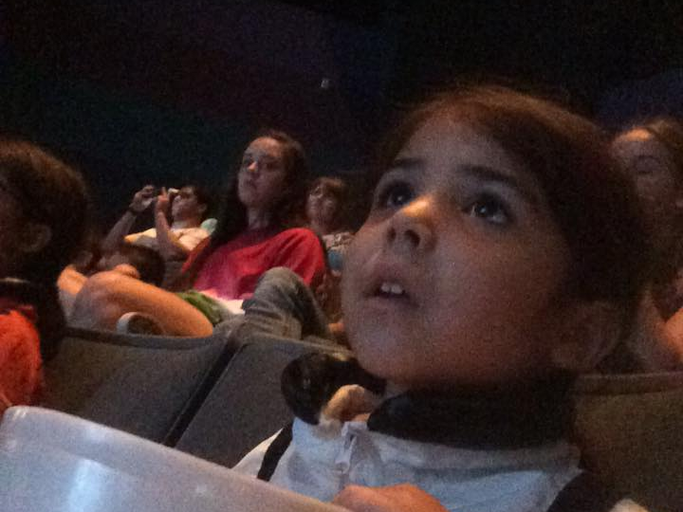

Slide 7
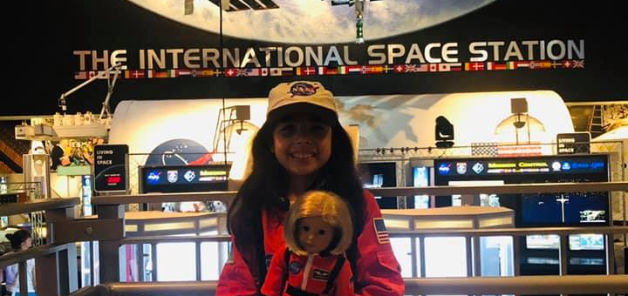
MY SPACE TRAINING

Slide 8
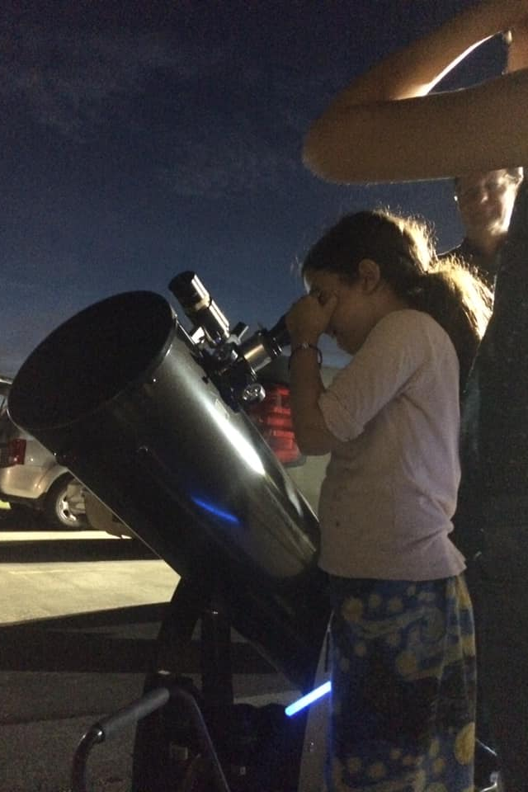
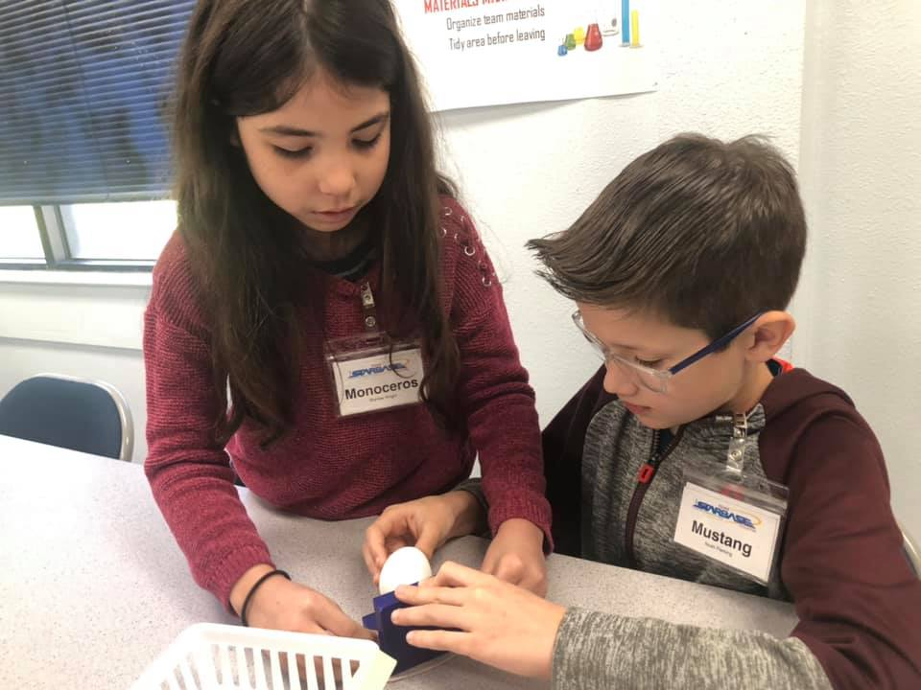
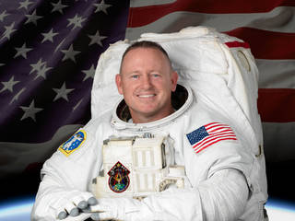

Slide 9
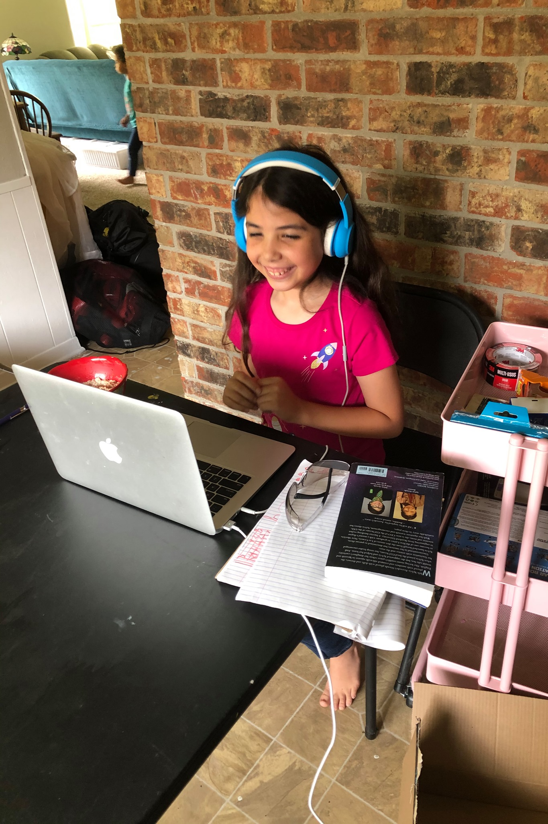
SPONSORED BY NASA & SAN JACINTO COLLEGE AEROSPACE PROGRAM
STEM SPACE CAMP

Slide 10
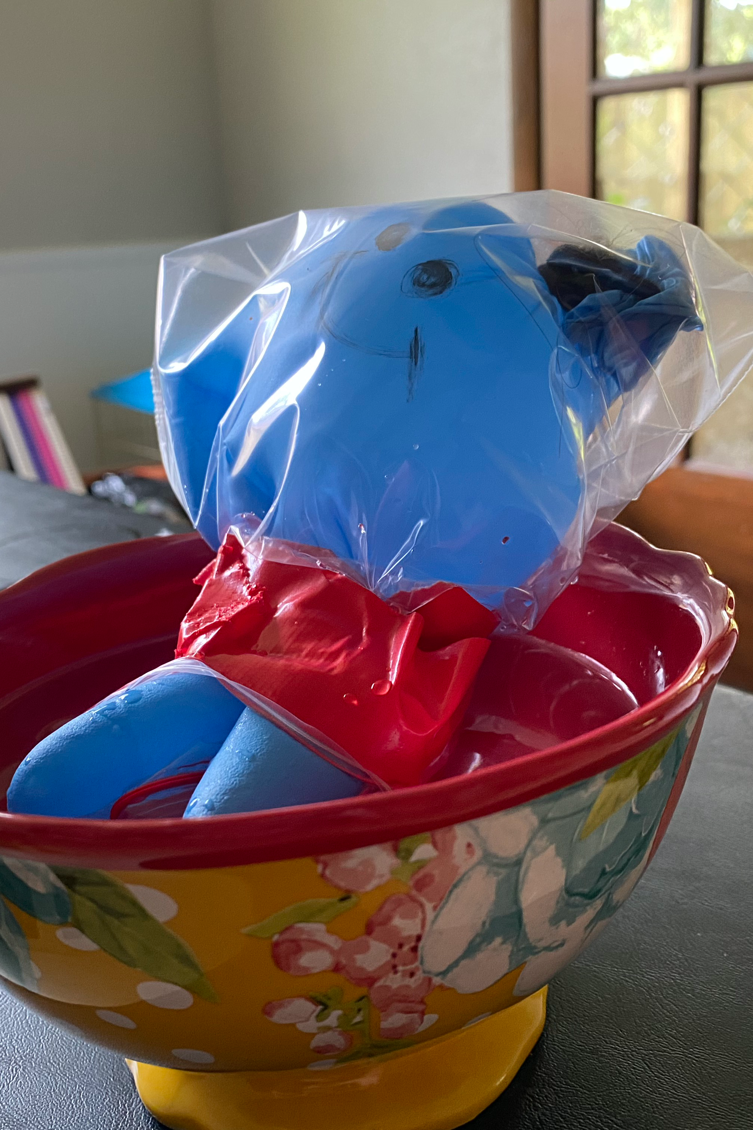
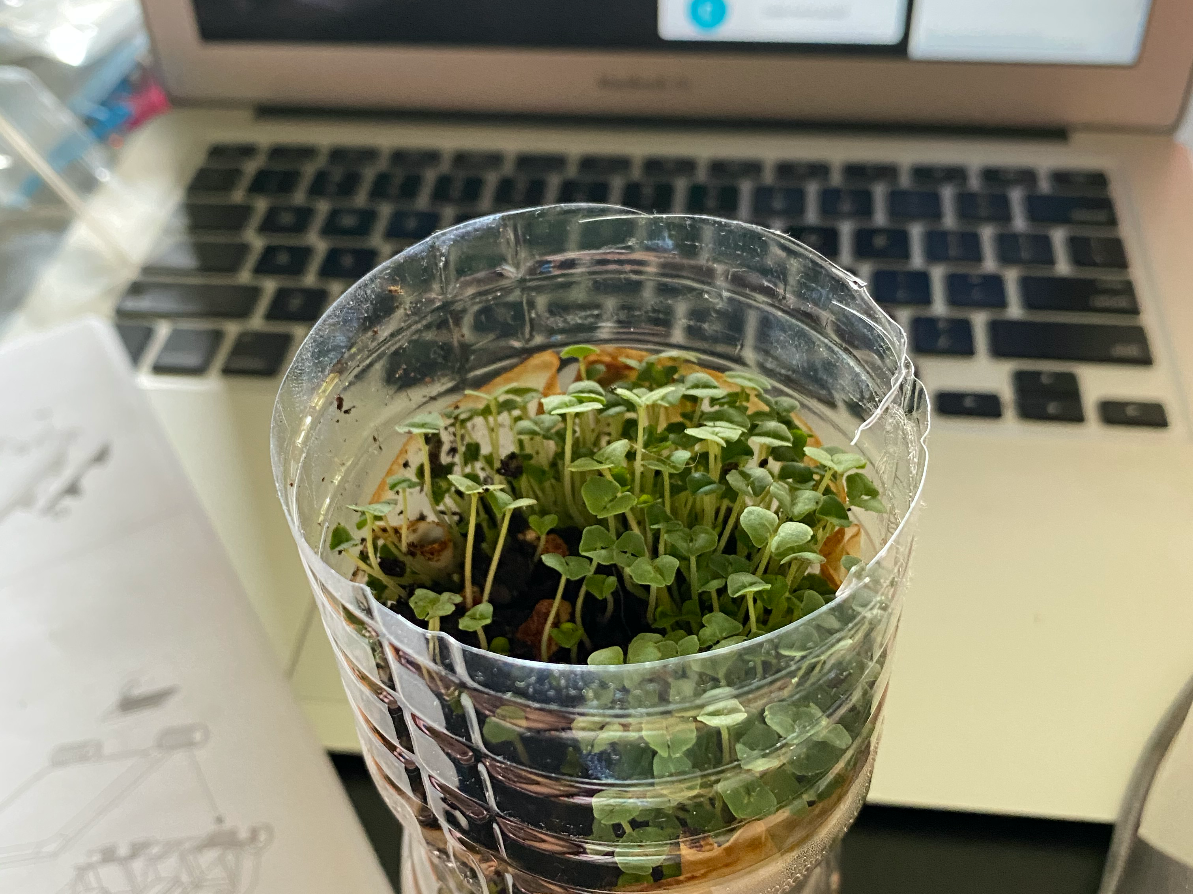
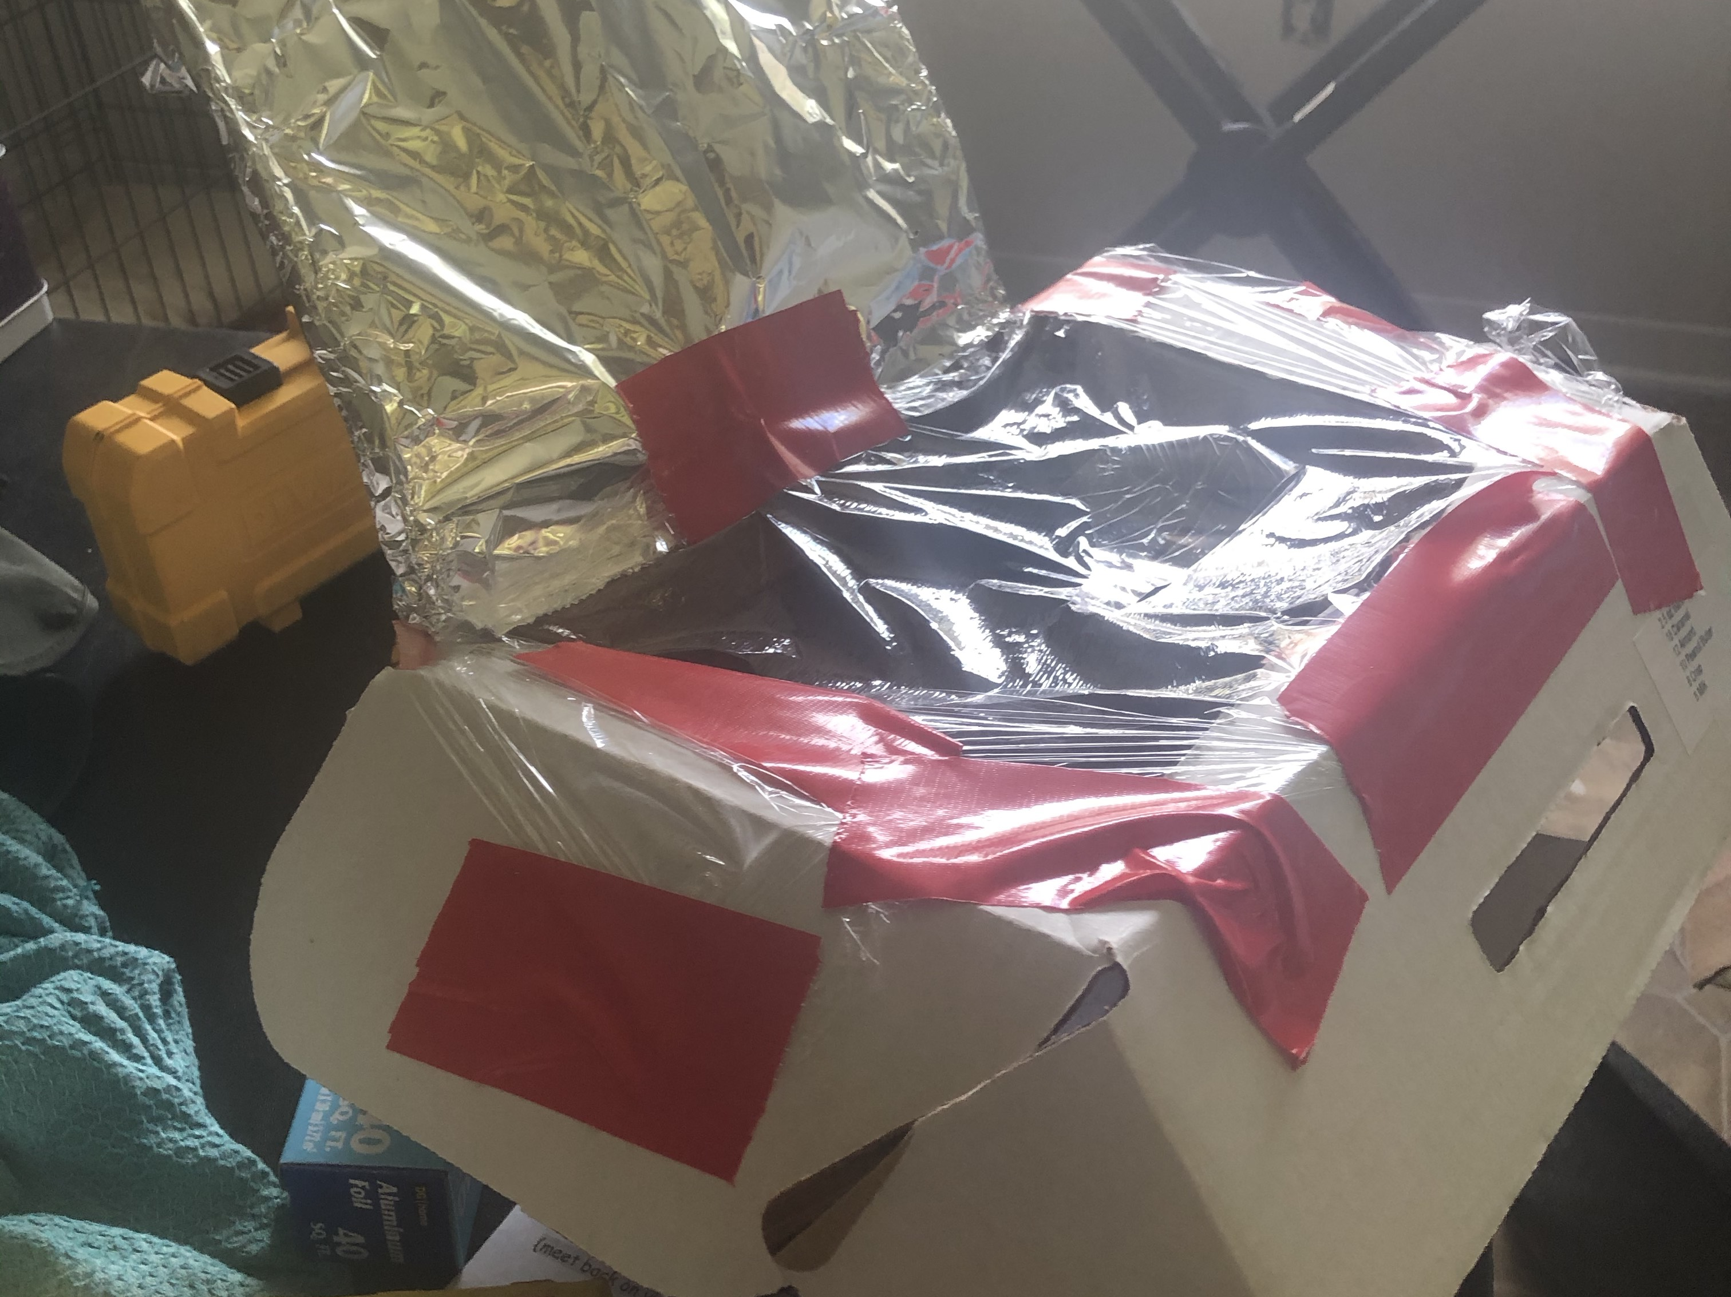

Slide 11

SPACE CAMP HUNTSVILLE, AL
GOAL #1

Slide 12
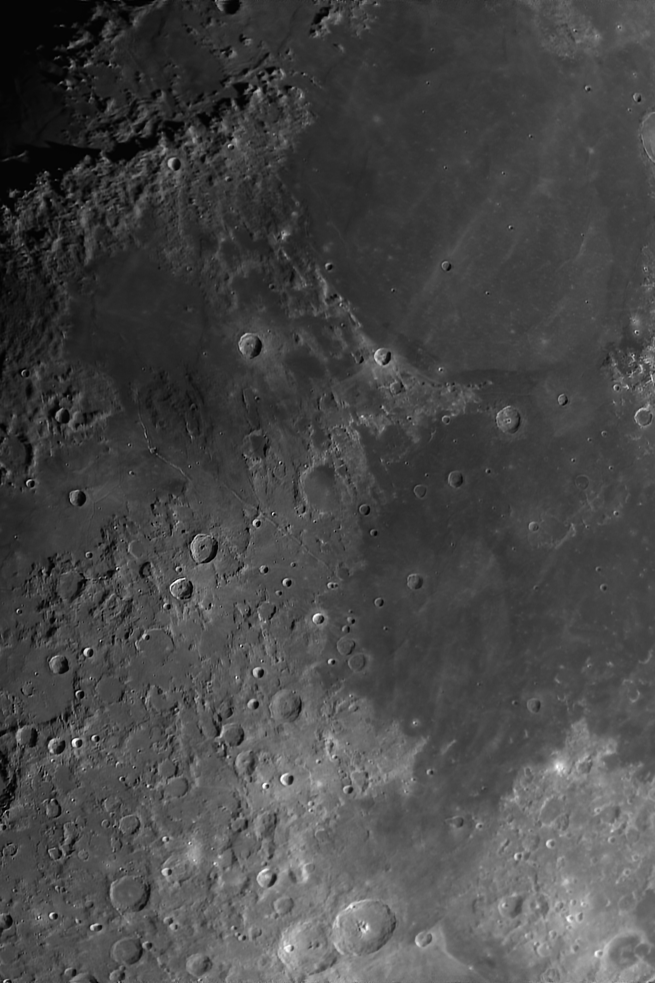
DANCE ON THE MOON…
OR MARS
GOAL #2

Slide 13
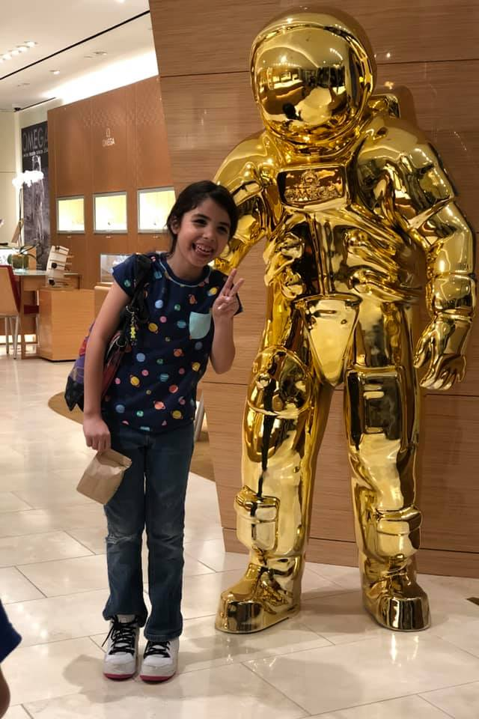
#BRYNLEENAUT
THANKS FOR LISTENING

