Slide 1
NSS North Houston Space Society
June 6, 2020

Slide 2
Agenda
2:00 PM – Opening Remarks – Nathan Price
2:10 PM – Recent Space News – Greg Stanley
2:30 PM – Tracking Satellites – Charles Phillips
3:15 PM – Q&A
3:30 PM – Where were you for the Historic SpaceX DM-2 Launch… Come prepared to share your experience. Some of our members went to Florida to see it.
4:00 PM – End of Meeting

Slide 3
Two Questions
Where are we?
When are we?

Slide 6
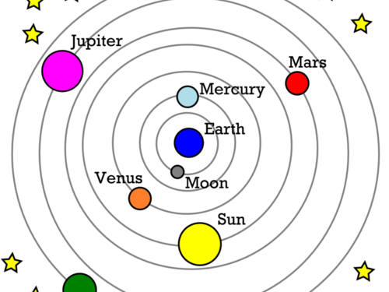

Slide 7
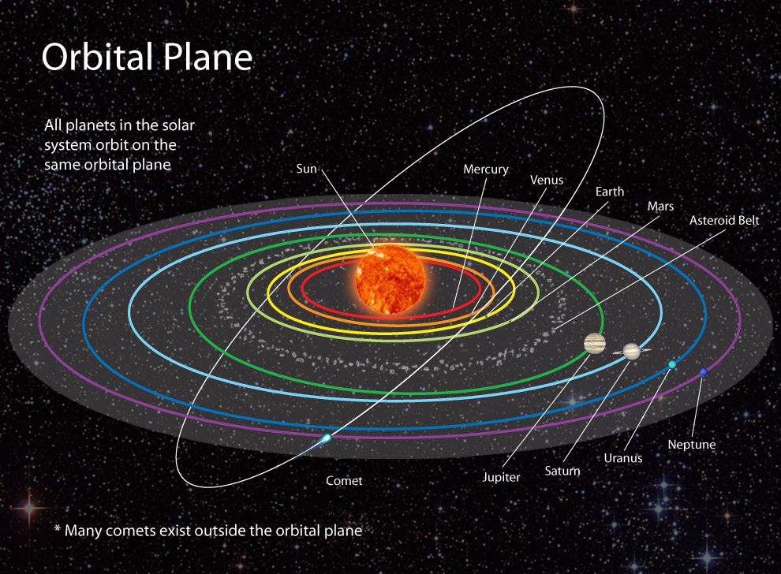

Slide 8
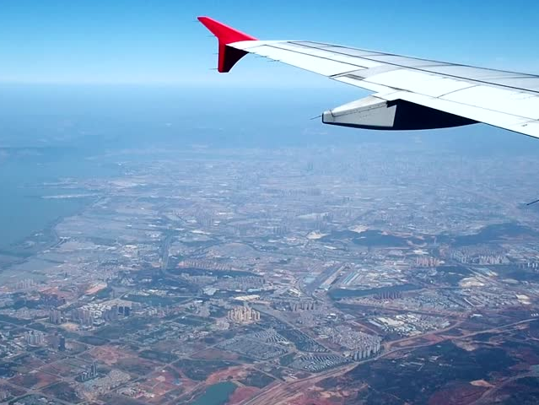

Slide 9
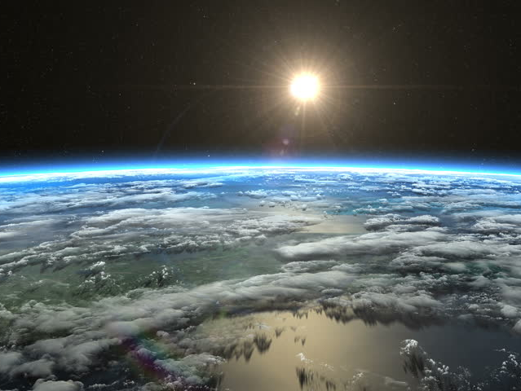

Slide 10
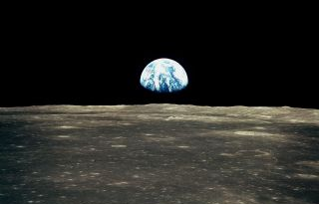

Slide 11
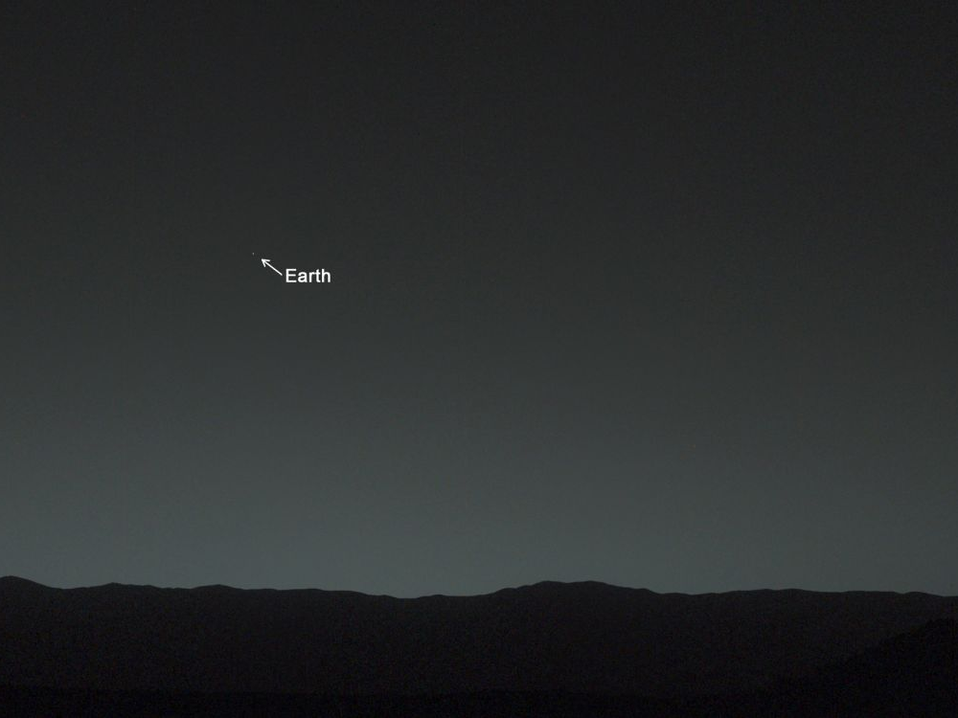

Slide 12
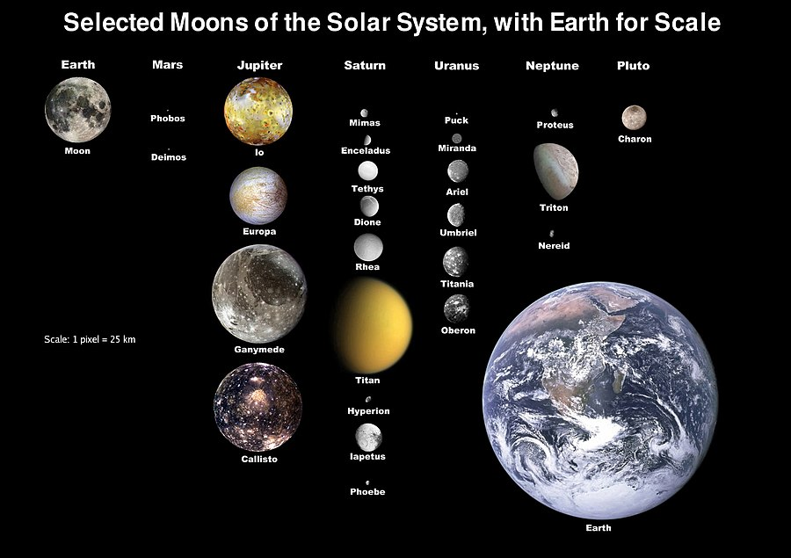

Slide 13
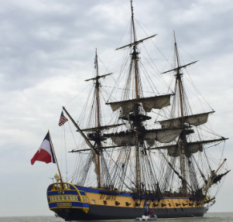
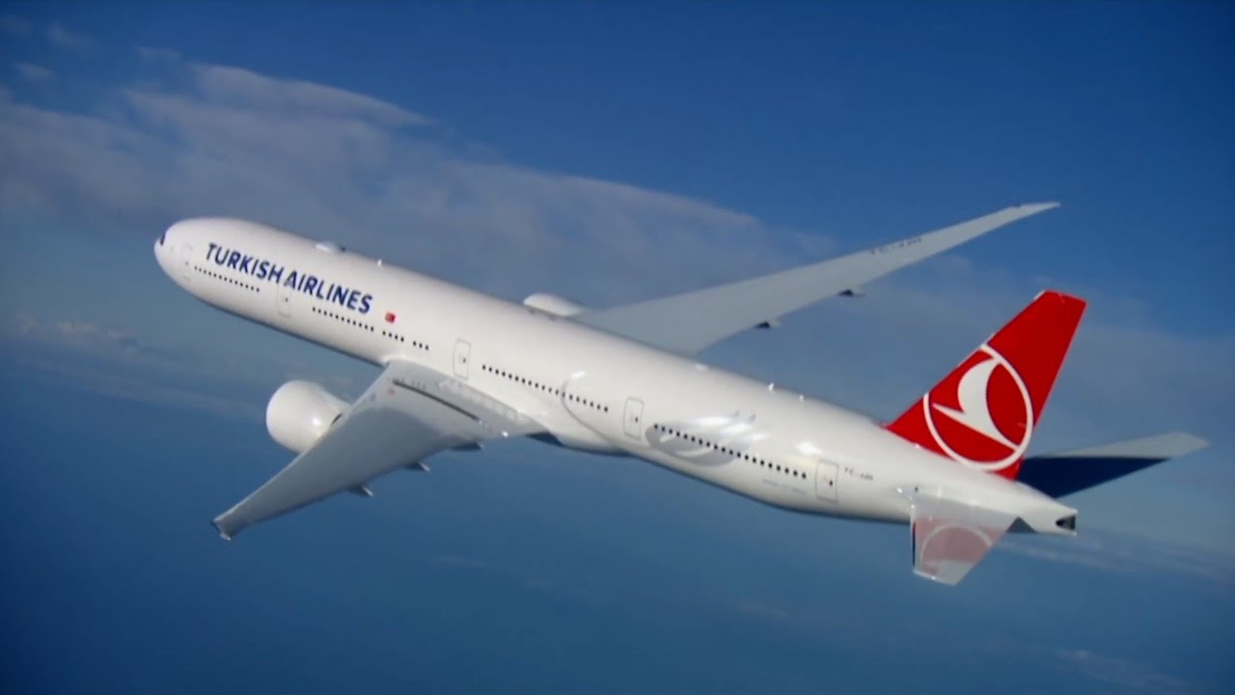
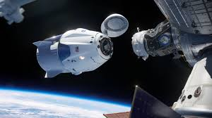

Slide 14
SpaceX Starship
Most powerful rocket ever built (carry 100 people)
Cheapest per launch (100% reusable)
High flight rate (3x per day)
Mass produced (2x week)
Versatile (point to point earth travel, earth orbit, lunar orbit, lunar surface, mars, other places)
Real (prototypes built in Boca Chica, TX, expect to have flight tests this year)

Slide 15
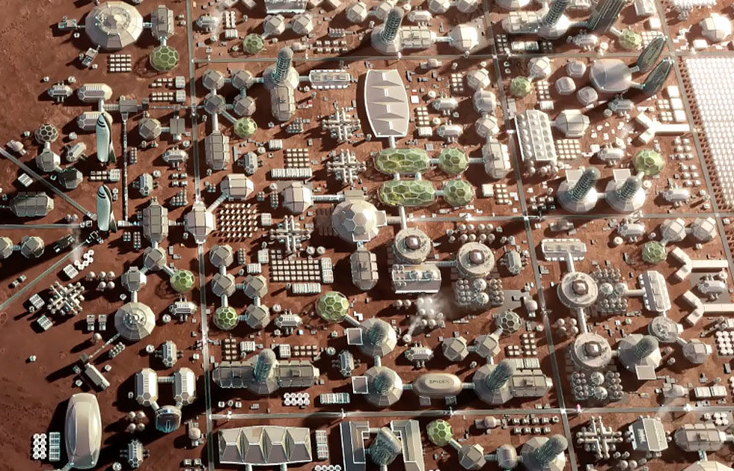
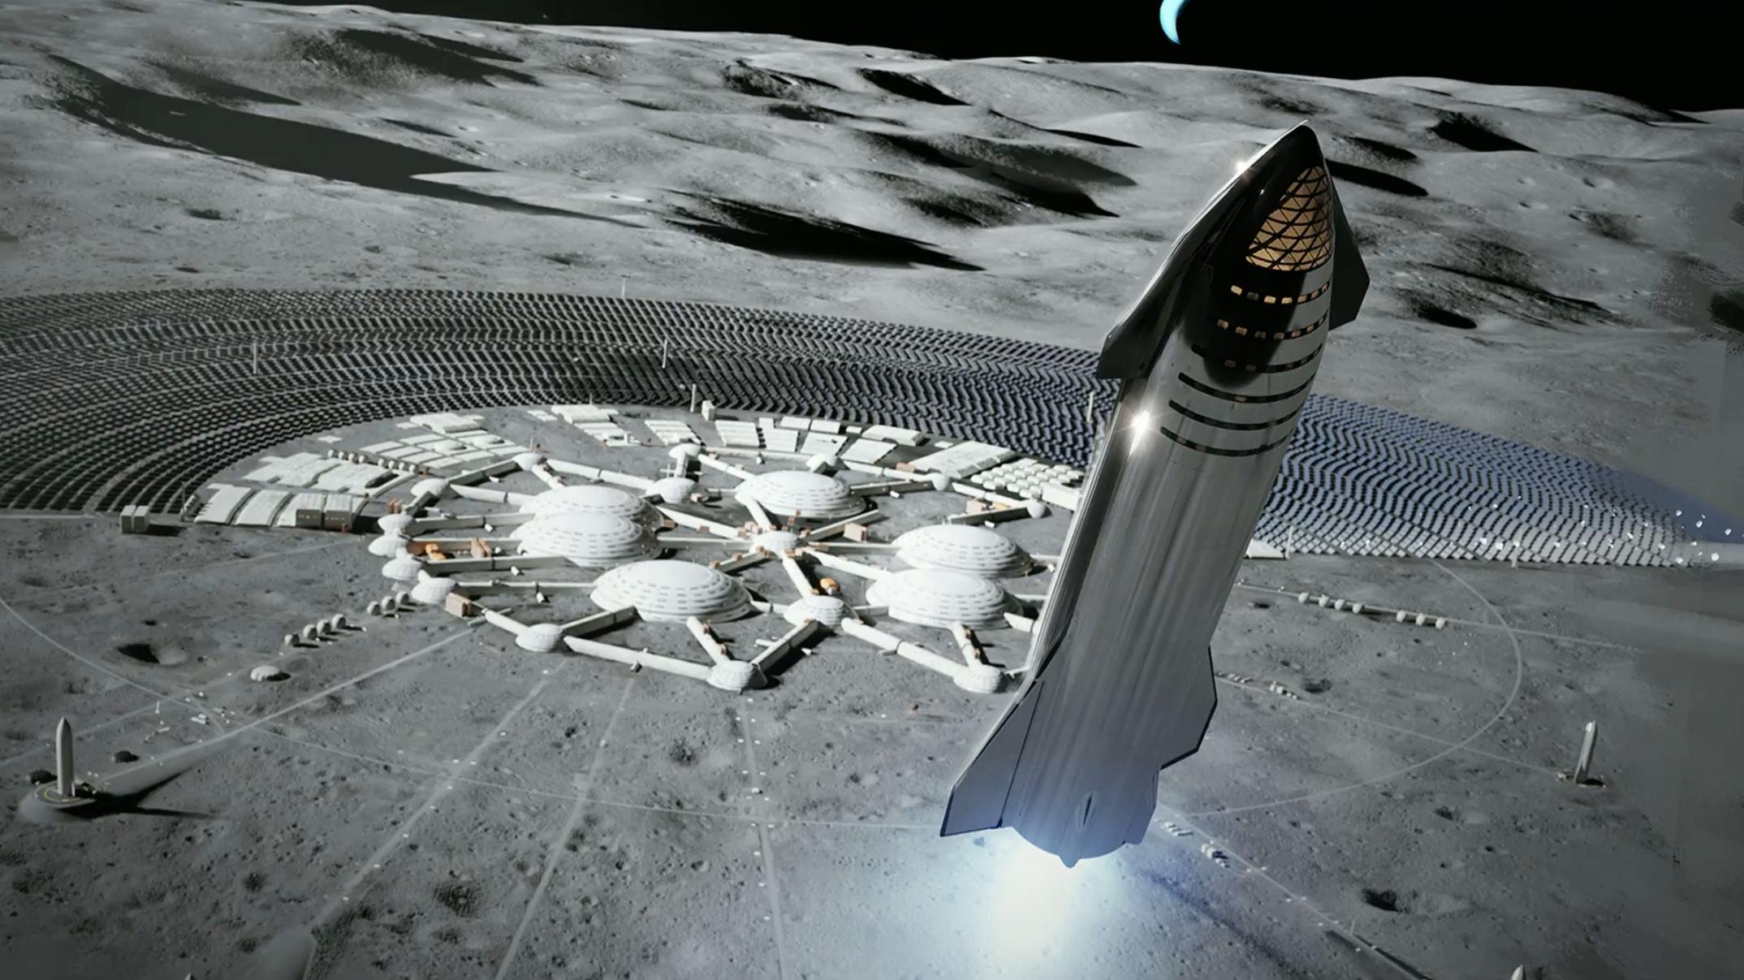
SpaceX StarShip

Slide 16
The Opportunities Will Be Huge
Discovery
Inspiration
Investment
Career

Slide 17
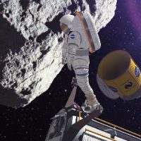
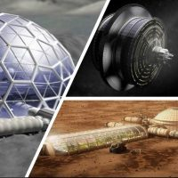
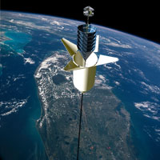
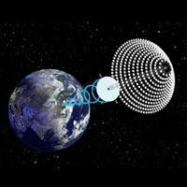
National Space Society Vision
People living and working in thriving communities beyond the Earth, and the use of the vast resources of space for the dramatic betterment of humanity.

Slide 18
Do you share this vision?

Slide 19
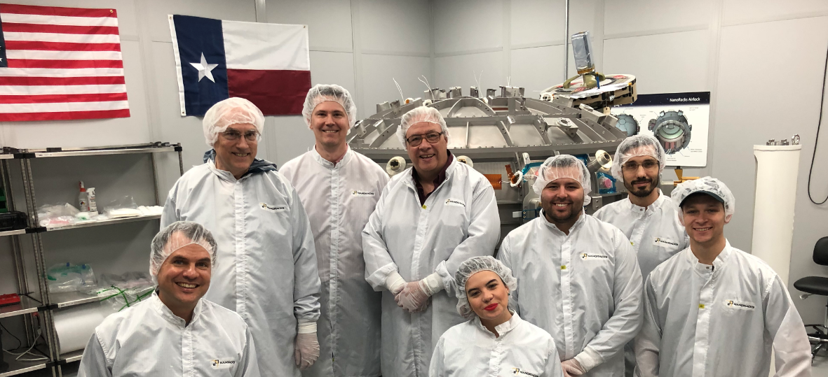
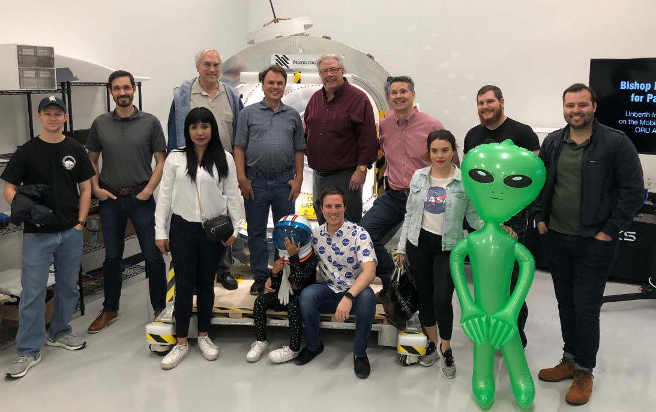
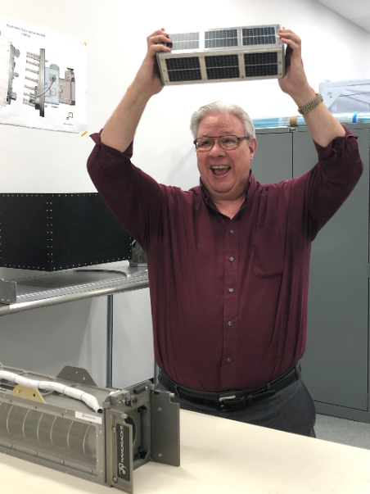
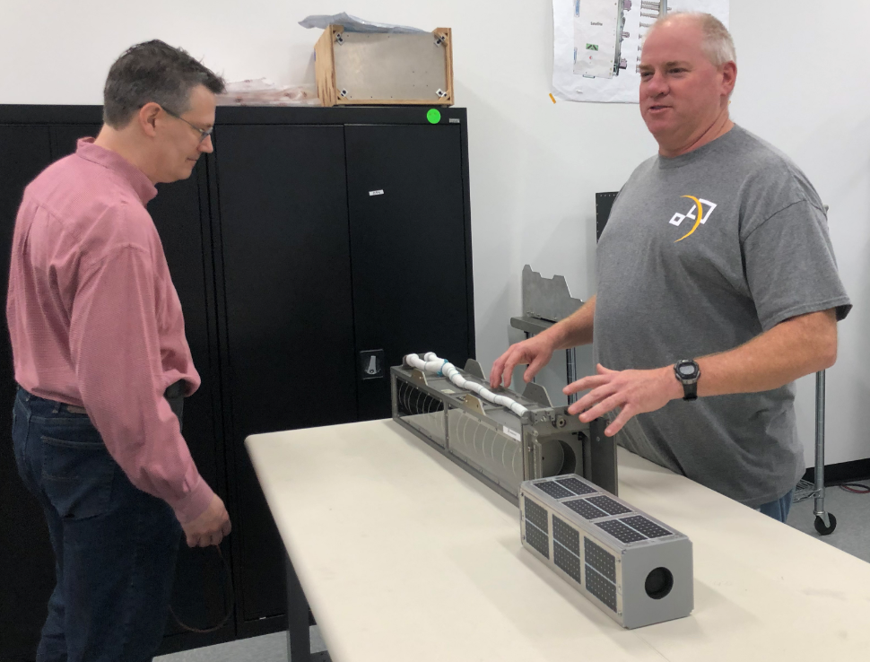

Slide 20
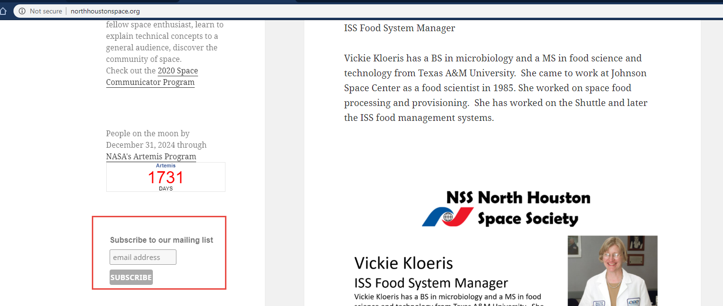
Join the NSS North Houston Space Society Mailing list
Visit http://NorthHoustonSpace.org
Scribe from left side bar

Slide 21
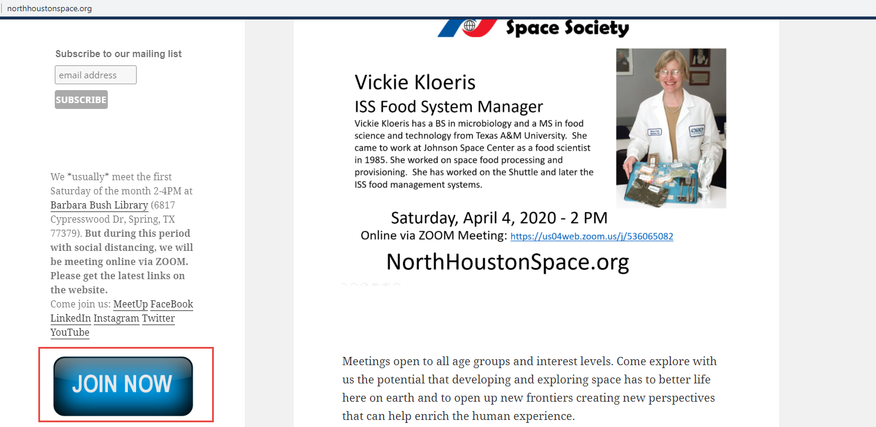
Join the National Space Society
Visit http://NorthHoustonSpace.org
Click on “Join Now” to go to the National Space Society’s website

Slide 22
Meeting IS being RECORDED
This meeting is being recorded and will be posted on YouTube, NorthHoustonSpace.org, Facebook, etc.

Slide 23
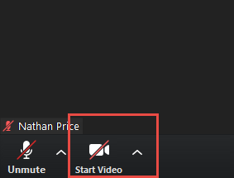
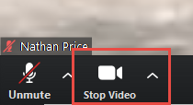
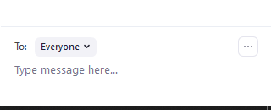
How to use ZOOM - Video & Mute & Chat
Video is turned off by default. Turn it on when you are ready:

Slide 24
Space News

Slide 25
Mark Guillette (NASA/JPL Ambassador)
Mark Guillette (NASA/JPL Ambassador) will be hosting more of his YouTube Live videos related to NASA. He currently has scheduled the following -
What's Up at NASA? Thursday, June 25th from 2-3pm Central time
and
Is There Life Beyond Earth? Tuesday, July 28th from 6:30-7:30pm Central time
They are available at those times on his YouTube channel - www.youtube.com/mjguillette and here is a link to his bio page - https://solarsystem.nasa.gov/ambassadors/1885/

Slide 26
Where were you for the DM-2 Launch?

