Slide 1
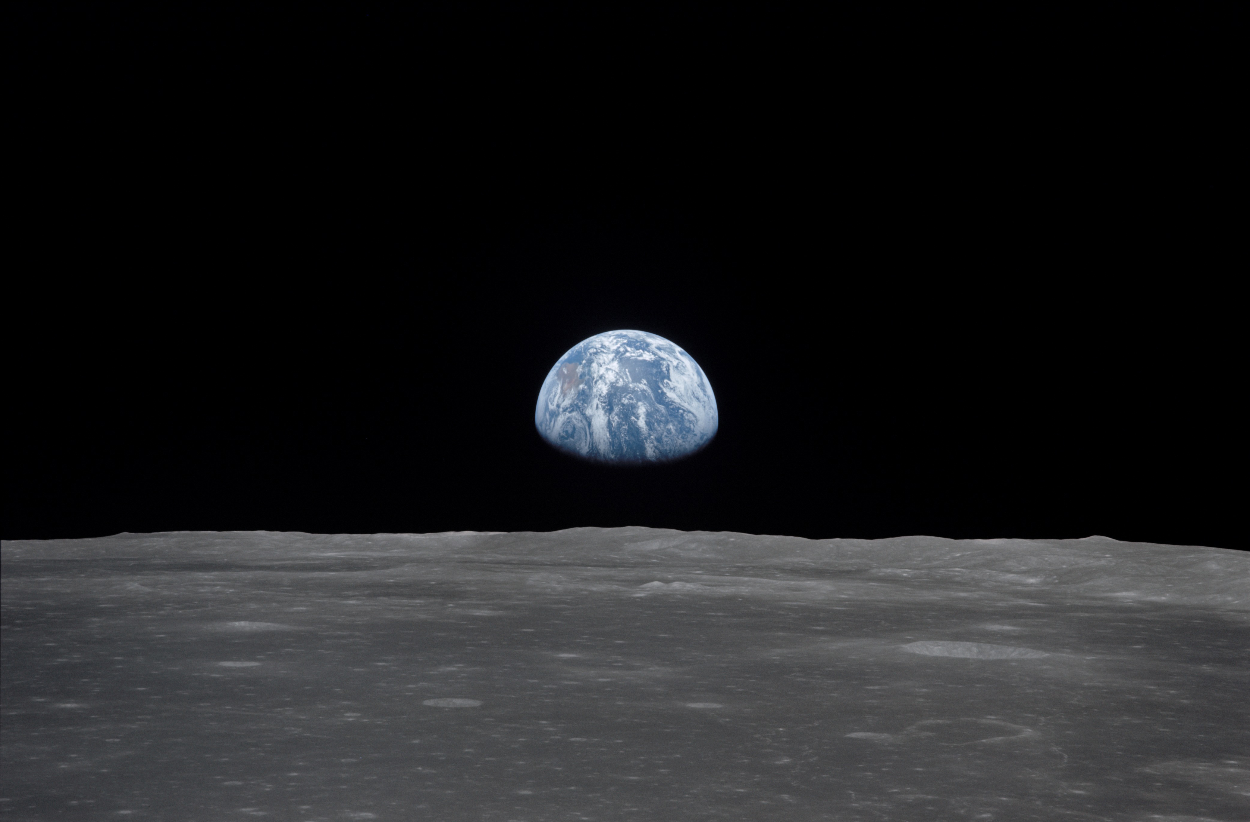
NSS North Houston Space Society Space News
June 6, 2020
Greg Stanley

Slide 2
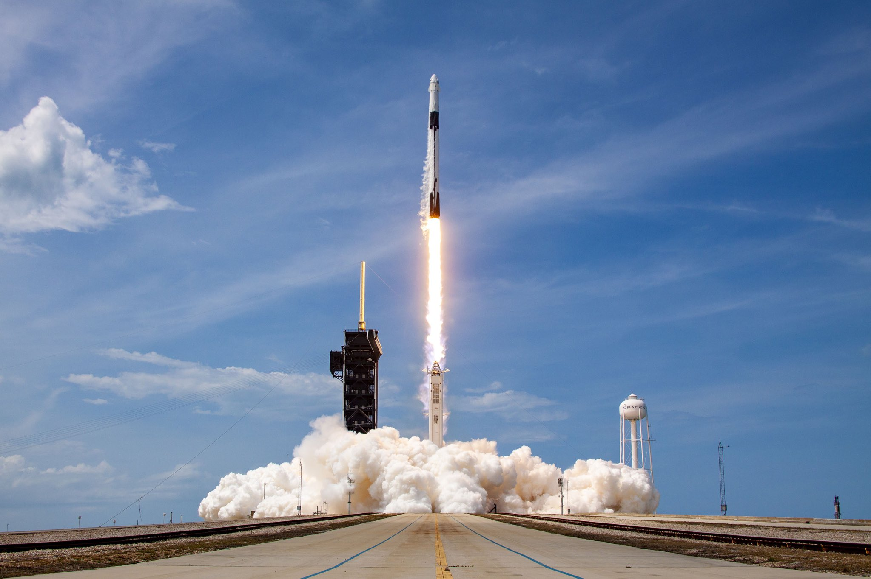
Historic launch to ISS on a SpaceX Falcon 9/Crew Dragon
First crew launch to the ISS (space station) from the U.S. since 2011
Crew of 2 American astronauts:
Robert Behnken & Douglas Hurley
12 minutes to initial orbit
19 hours total launch to dock
Fully automated docking
1st stage landed on ship, returned
Crew Dragon will eventually return with crew, splashing down in Atlantic
Astronaut Chris Cassidy:
“New car smell”
First astronauts launched in a commercially-made spacecraft
Costs per seat:
Boeing (future): $90 million
Russia: $86 million
SpaceX: $55 million
Musk:
“The trampoline works”
Credit: SpaceX

Slide 3
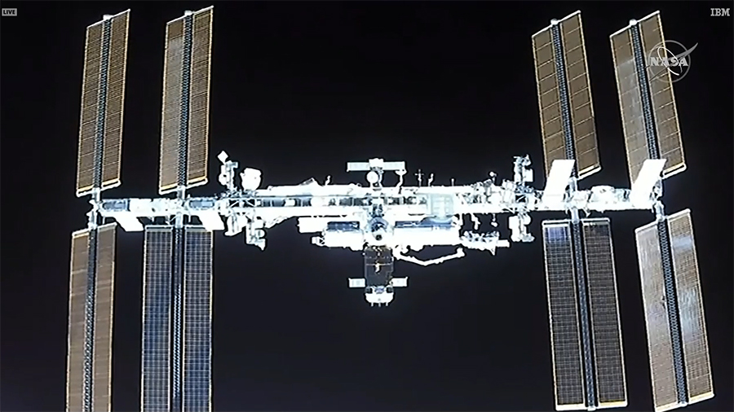
View of ISS from Dragon capsule at 150 meters
(This is actual, but there is a docking simulator at the SpaceX site)
Credit: SpaceX

Slide 4
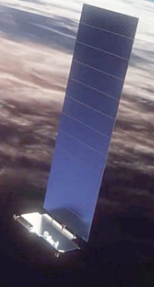
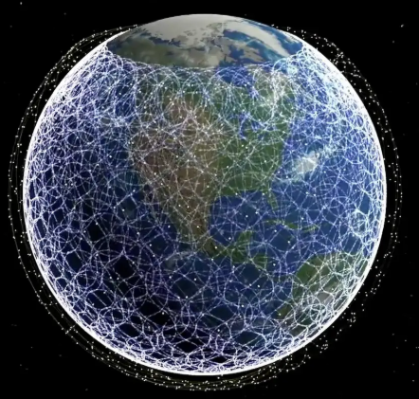
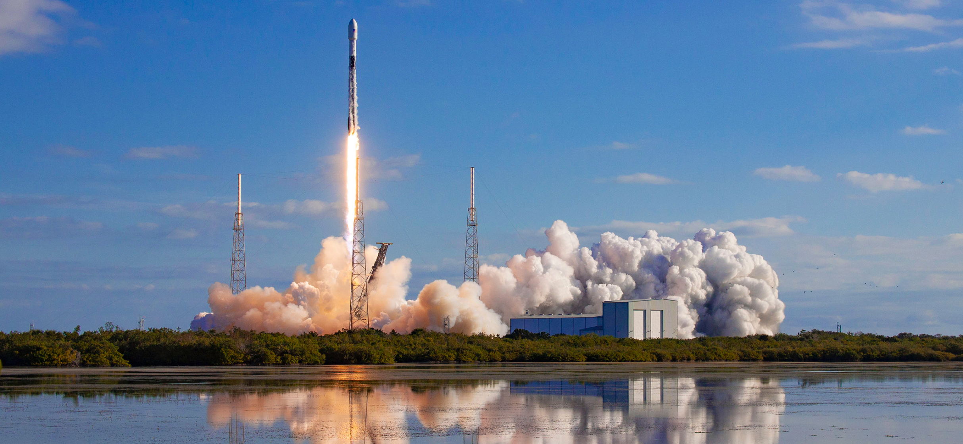
Another SpaceX Starlink launch
8th launch of 60 Starlink satellites for internet service, now totaling 482
Serious re-usability: first stage now flown 5 times, returned
(total recovered: 50)
Testing new sunshade to address astronomers’ concerns about brightness
12,000+ satellites goal
Credit: SpaceX

Slide 5
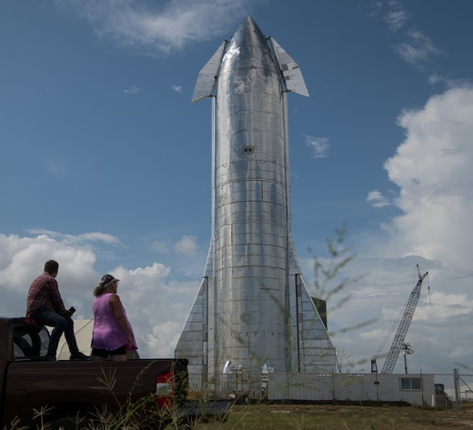
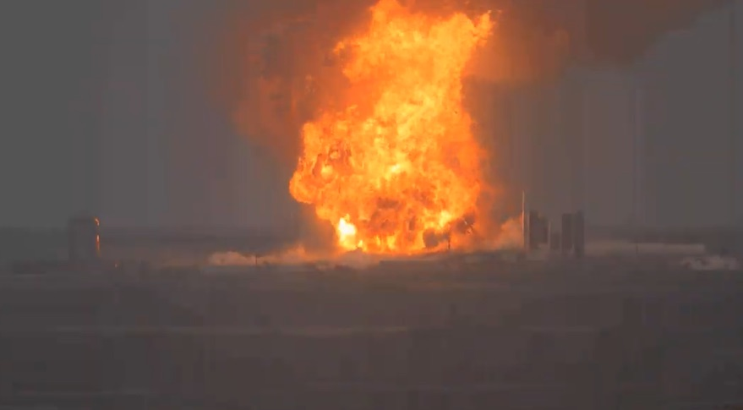
SpaceX Starship SN4 prototype explodes May 29 in Boca Chica, TX
Full sized (400 feet) prototype, not the 60 foot “Starhopper”
Explosion 2 minutes after successful static-fire test
No injuries with this “RUD” = “Rapid Unscheduled Disassembly”
Some external estimates suggest prototypes cost $10 million
Next step in a few weeks would have been a 500 foot “hop”
4th Starship prototype destroyed in testing in 6 months
Problem may have been due to propellant quick disconnect system
Credit: Getty Images
Credit: YouTube Space Padre Island

Slide 6
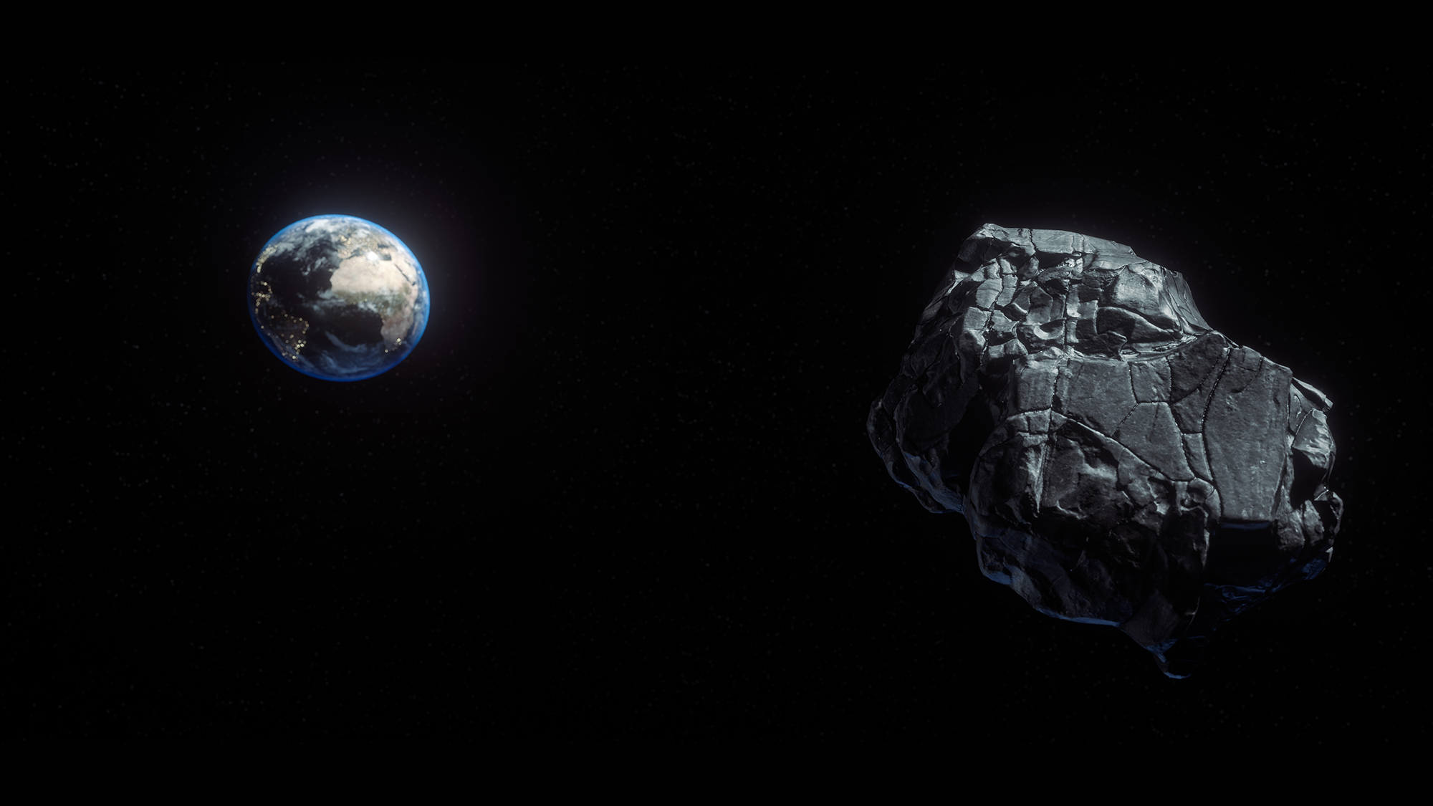
A stadium-sized asteroid near miss on June 5
Diameter 820 – 1870 feet (12x larger than one hitting Russia in 2013)
Closest distance: 13.25 x distance of Earth to the Moon
Hard to spot: dimmer than Pluto
(A public service reminder that space defense will be needed, someday)
Artist’s conception. Credit: Shutterstock, via space.com

Slide 7
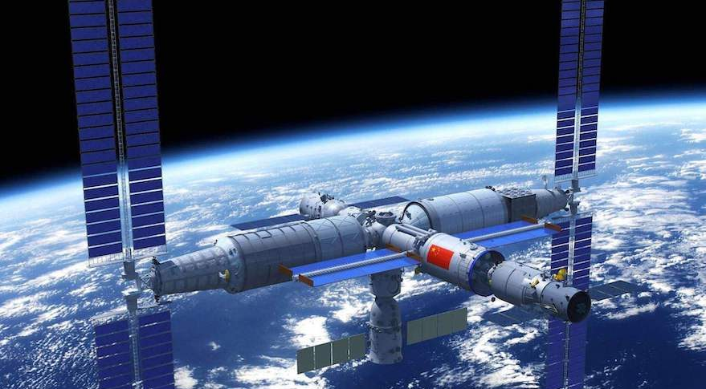
China intensifying space station development
Announced 11 missions to build it in 2 years, starting next year
Holds 3 astronauts, but expandable
66 metric tons
340-450 km orbit
Co-orbiting space telescope, resolution like Hubble, but 300 times greater field angle
Credit: CMSA, via spacenews.com

Slide 8
Other space news
Doug Loverro resigns from NASA after 6 months as chief of human spaceflight
Cited some “mistake” he made in procurement for HLS (Human Landing System, part of Artemis program to go back to the moon)
No one is commenting, but timing follows an audit
Unclear what this means for NASA or Artemis program
Another object bigger than Pluto found orbiting our sun, 3x farther than Pluto from our sun
Rocket Lab resuming launches in New Zealand in June, after COVID-19 delays

Slide 9
How many launches since the last meeting?
Yes, this includes failed launches

Slide 10
Launches Since Last Meeting (May 2, 2020)
June 3 – Falcon 9 – SpaceX 8th batch of 60 Starlink communications satellites
May 31 – Long March 2D – Gaofen Earth observation satellite and a microsatellite for ship & aircraft tracking
May 30 – Falcon 9 – Crew Dragon, 2 astronauts to space station
May 29 – Long March 11 – unknown experimental satellites
May 25 – LauncherOne (Virgin) – orbital test flight – FAILED
May 22 – Soyuz – Military satellite
May 20 – H-2B – Delivering cargo to space station
May 17 – Atlas 5 – Orbital Test Vehicle (spaceplane)
May 11 – Kuaizhou 1A – communications satellite
May 5 – Long March 5B – test flight for crew capsule (unpiloted)
https://spaceflightnow.com/launch-log/

Slide 11
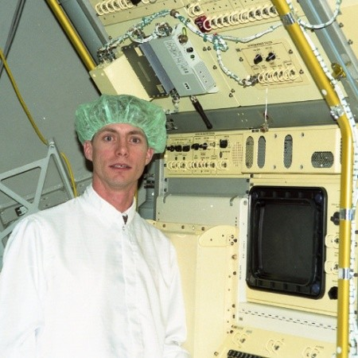
Featured Speaker: Charles Phillips
CEO, Spaceflight Research LLC (Houston)
Space station, space shuttle work at SAIC, Barrios Technology, Lockheed Martin
Flight controller, Johnson Space Center
Orbital analyst for USAF, tracking satellites at NORAD (Cheyenne Mountain, also Alaska)
TOPIC: How you can track satellites (and why)

