Slide 1
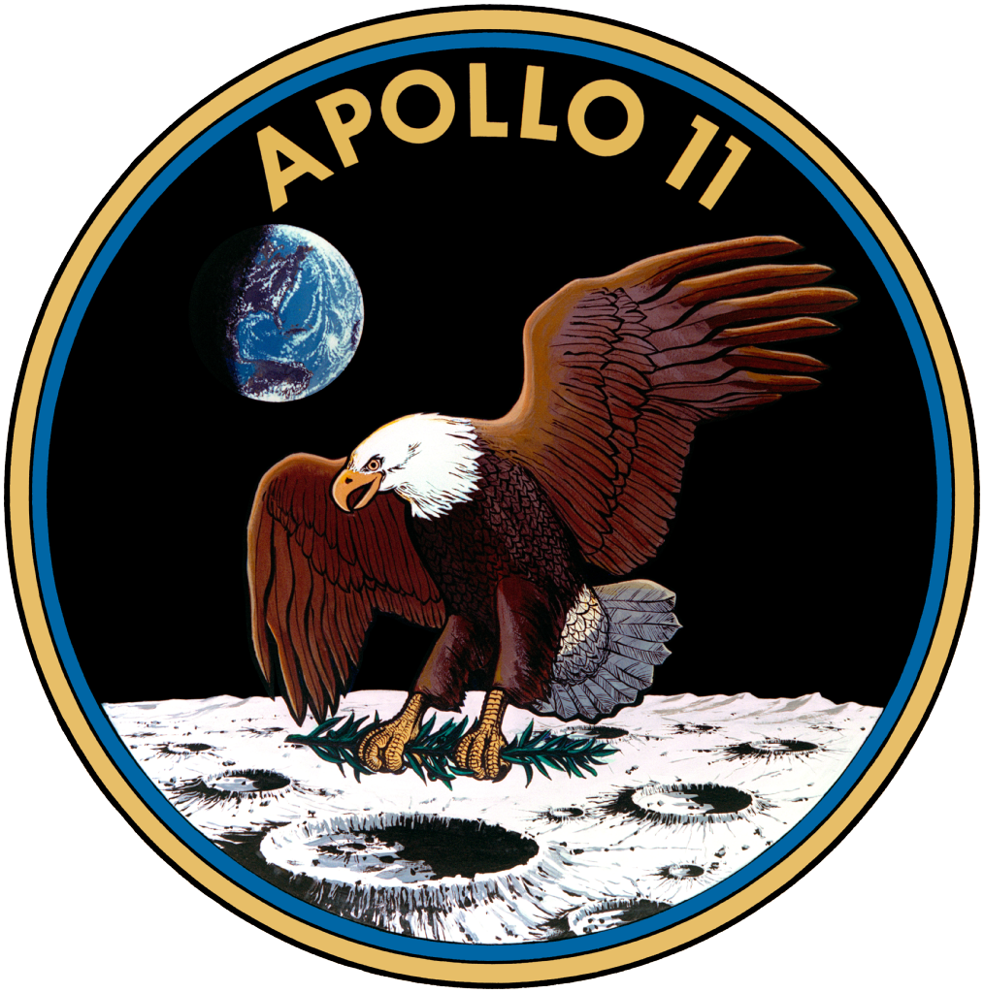
Some Fun Tidbits About Project Apollo
Lee Hutchinson
Senior Technology Editor
lee@arstechnica.com
Notes:
Hi everyone! My name is Lee Hutchinson, and I worked in the industry for about nine years, from just out of college in 2001 through mid-2010, supporting the shuttle and station programs at Boeing's clear lake campus.
A couple of years after leaving Boeing I wound up in my current job at Ars Technica, which is a science and technology news publication owned by Conde Nast. In that role I've been lucky enough to have had the opportunity to do a lot of research and writing about Apollo, which is kind of my passion subject.
There are a ton of lesser-known happenings that went on during the program that space fanatics like us might be familiar with, but that don’t really register with the general public. In this presentation, I’ve pulled together a few mid-to-deep-level explanations behind some of project Apollo’s quirks and features—and also some details on a few incidents that, had they gone a different way, could have derailed the Apollo program entirely.

Slide 2
When we left Earth…
Fifty years ago, 24 people voyaged beyond low Earth orbit and crossed the gulf to the Moon.
12 of them set foot on the lunar surface.
It remains the only time in the history of humanity that we have traveled more than a few hundred miles from the Earth.
Notes:
First, a bit of historical context. There were a total of nine Apollo missions that left earth orbit and flew to the moon, each carrying three astronauts. And out of the humans who went, three of those astronauts were lucky enough to make the trip twice on two different missions (Jim Lovell on Apollos 8 & 13, John Young on Apollos 10 & 16, and Gene Cernan on Apollos 10 and 17).

Slide 3
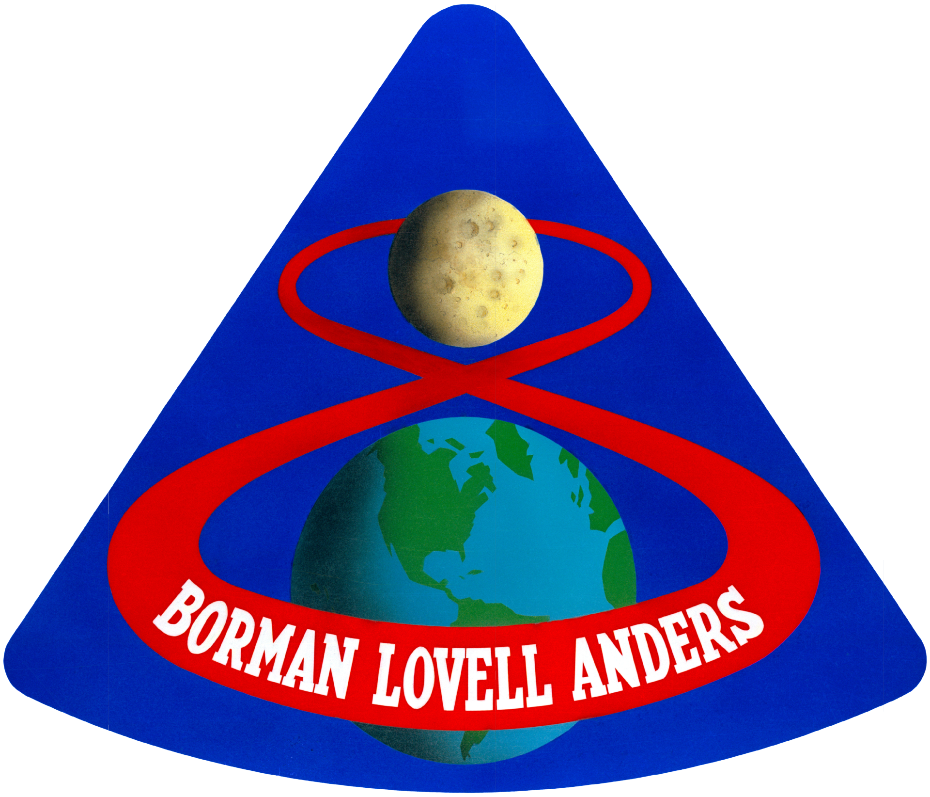
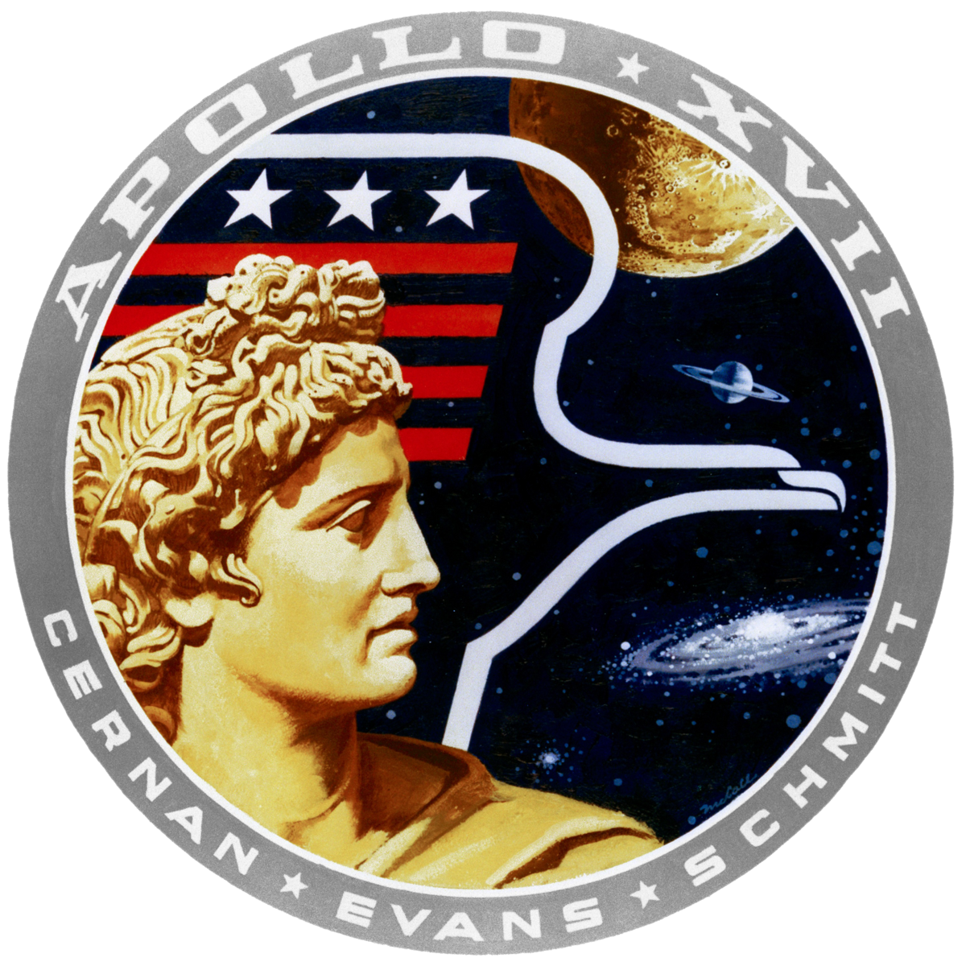
We retained the operational capability to put humans on the Moon for just four years.
Apollo 8
Liftoff: December 21, 1968
Apollo 17
Splashdown: December 19, 1972
Notes:
And in spite of how grand Apollo seems, the actual flights took place across a remarkably short period of time.

Slide 4
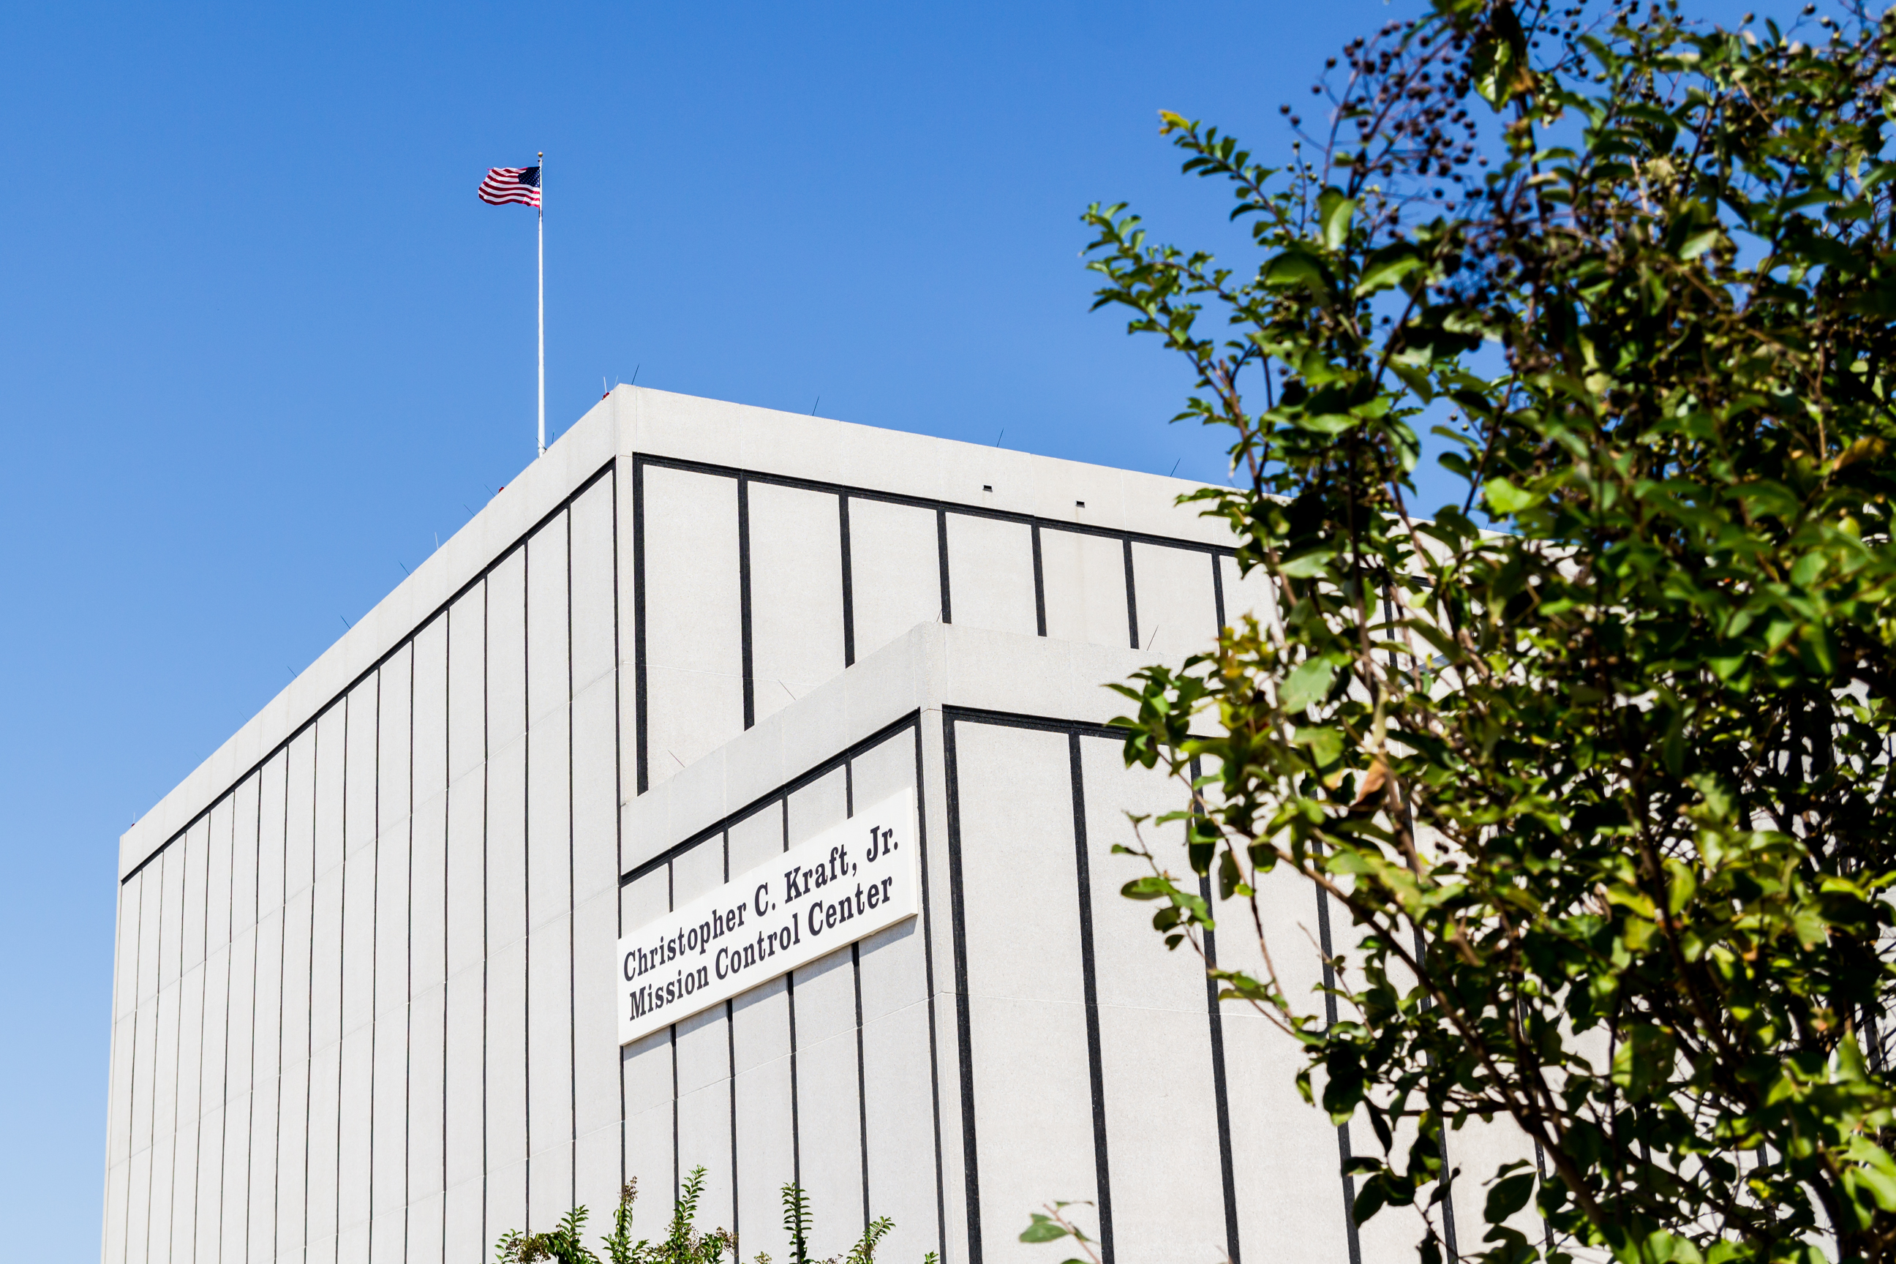
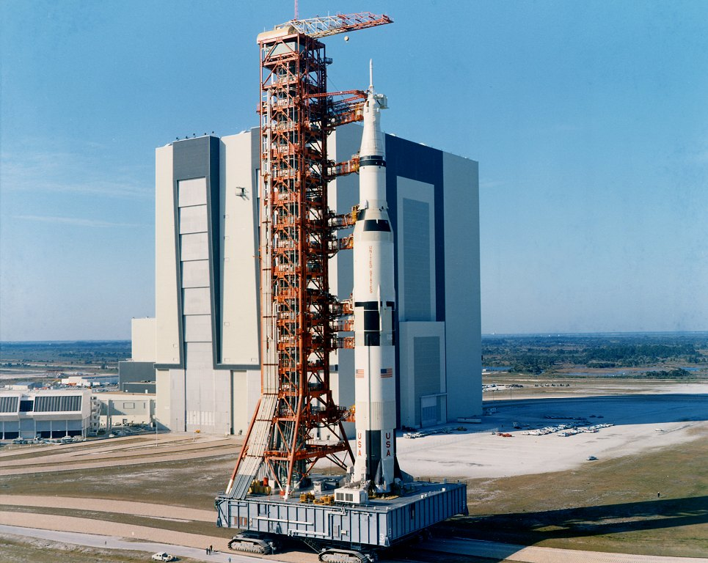
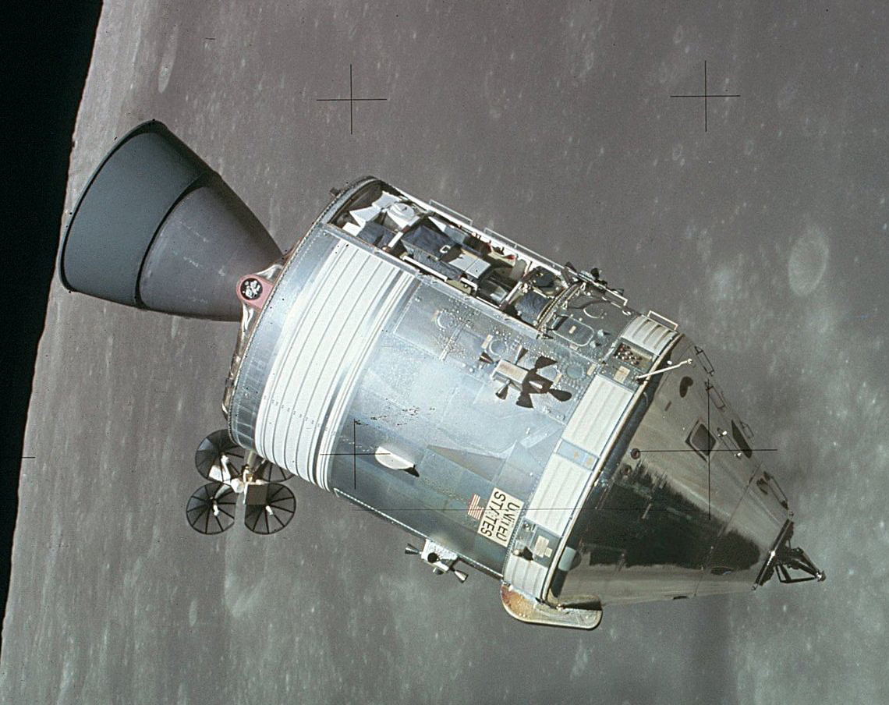
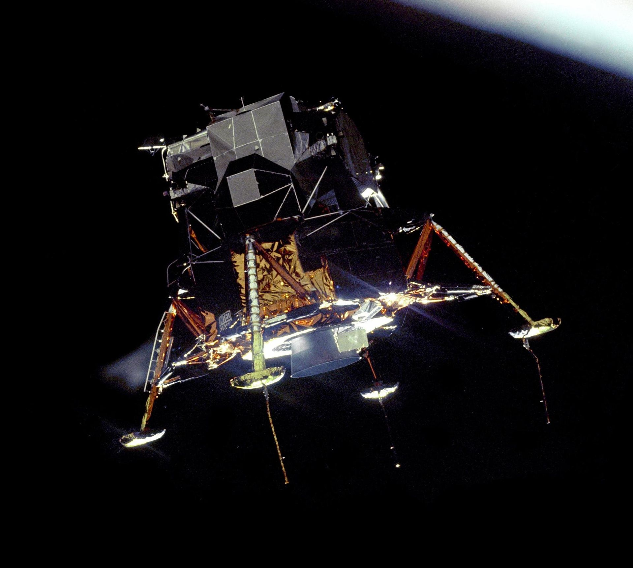
How did we do it?
Notes:
Rather than get bogged down in a discussion about the political realities of Apollo and that kind of stuff, we’re going to keep this discussion centered around technology—facilities, hardware, and software. Specifically, I’m going to focus up on three areas of interest—the ground, the rocket, and the two Apollo spacecraft. The idea here, especially with the spacecraft talk, is to illuminate a bit about how complex this machinery really was and why we were able to do what we did, even with technology that appears hopelessly, insanely primitive by 2020 standards.

Slide 5
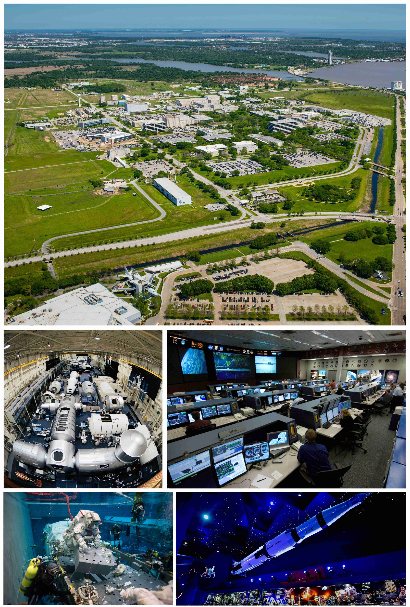
Controlling the Missions from Mission Control
Johnson Space Center
Originally the Manned Spacecraft Center
Location of “Mission Control”
Deeded to the .gov by Rice University (which got the land from the Humble Oil Co)
Houston was chosen due to political wrangling first and foremost
Geographic separation of national strategic assets played a secondary role
Notes:
So we’re gonna start with mission control, which is located at the Johnson Space Center down in clear lake. JSC was originally named the Manned Spacecraft Center or MSC, and its presence in Texas is kind of an oddity. After Sputnik in 1957, the government turned to a small academically-focused organization called the National Advisory Council on Aeronautics to research human space flight options. N.A.C.A. was headquartered in Virginia, and the original Space Task Group was primarily made up of folks who came from or lived in the northeast. Things really got going in 1958, when N.A.C.A. was dissolved and re-chartered as a full fledged government agency you might have heard of, called NASA. Over the course of the next few years, as what would become Project Mercury unfolded, a lot of horse-trading went on about where to build the enormous permanent facilities that NASA would need to do more than launch tiny little 1-person spacecraft. There were dozens of proposed sites for NASA centers, and the proposed Houston site was no one’s first choice, especially not the Space Task Group folks in Virginia, but it came down to old fashioned politics—and here I’ll quote A&M historian Henry C. Dethloff: “Although the Houston site neatly fit the criteria required for the new center, Texas undoubtedly exerted an enormous political influence on such a decision. Lyndon B. Johnson was Vice President and head of the Space Council, [Texas 8th District rep] Albert Thomas headed the House Appropriations Committee, [Texas 22nd District rep] Bob Casey and [Texas 6th District rep] Olin E. Teague were members of the House Committee on Science and Astronautics, and Teague headed the Subcommittee on Manned Space Flight. Finally, [Texas 4th District rep] Sam Rayburn was Speaker of the House of Representatives.” — also geographic separation

Slide 6
“Mission Control” has gone by many formal names. During the Apollo days, there were two flight control rooms: “MOCR1” and “MOCR2.” Almost all Apollo missions were flown out of MOCR2, on the third floor of Building 30.
Notes:
“Mission control” in general refers to the building where the mission control rooms are—the actual control rooms go by various names.

Slide 7
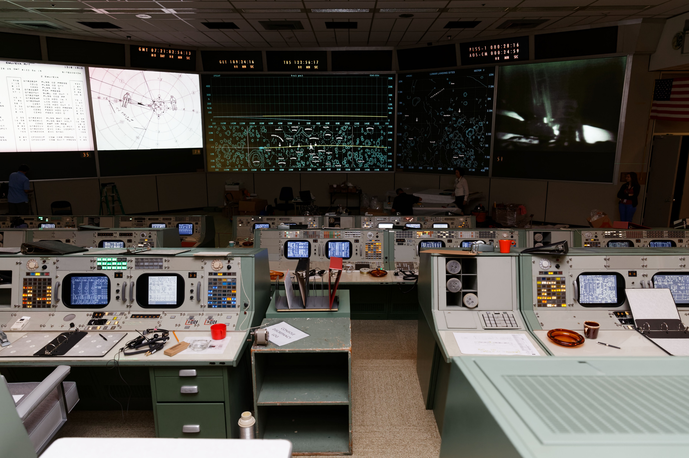
For Apollo, the MOCR was arranged in a theater-style layout with four tiers of consoles facing five large displays at the front of the room.
Notes:
“Mission control” in general refers to the building where the mission control rooms are—the actual control rooms go by various names.

Slide 8
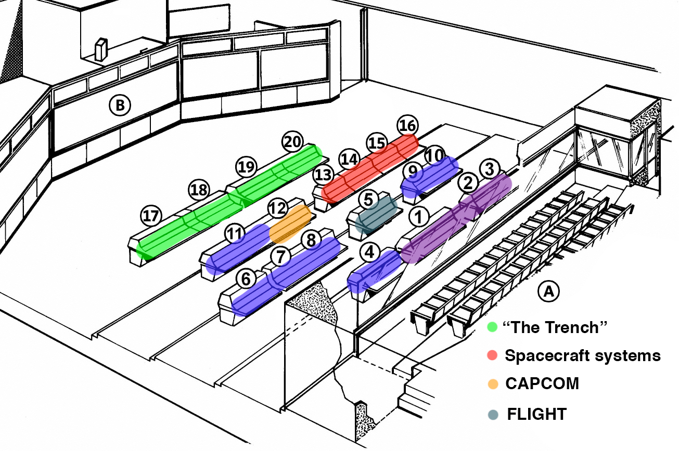
Notes:
There are two chunks of consoles that were particularly important—the front row in green, and the second row in red. The green front row, called “the trench” for various reasons, was concerned with the launch, guidance, and return of the Apollo spacecraft. The right part of the second row, in red, were referred to as the “systems guys.” Their collective role was to monitor all of the things on the spacecraft that the astronauts didn’t have time to monitor, and that was most of the systems. Other important bits are position 12, CAPCOM, who was the only person normally allowed to actually speak on the radio to the astronauts, and position 5, the flight director who oversaw the entire mission. The other positions are support positions (recovery, surgeon, etc) and the back row in purple was reserved for high-up NASA management. The primary role of mission control during a mission was essentially to keep track of things. Keep track of where the spacecraft was and where it was going, to keep a constantly updated set of instructions ready to go in case the mission needed to be aborted at any moment, where the mission was on the timeline, what activities were coming up, whether something was taking too long, and most importantly, the health of the spacecraft itself. Because— (next slide)
BOOSTER - RETRO - FDO - GUIDO
SURGEON - CAPCOM - EECOM - GNC - TELMU - CONTROL
INCO - O&P - AFD - FLIGHT - FAO - NETWORK
PAO - DFO - HQ - DOD

Slide 9
The three astronauts on an Apollo spacecraft were incapable of monitoring all of the capsule’s systems. There was simply too much to keep track of.
All these switches weren’t even remotely enough to address all the spacecraft’s functionality.
Notes:
The apollo spacecraft was the most complex vehicle ever designed by humans up to that point (and the LM comes a close second). It was massively complex and had a tremendous number of interlinked systems. The decision was made, then, to chop up the workload. Astronauts would focus on astronaut-appropriate tasks, like flying, rendezvousing, docking, landing, and running experiments. They had some amount of control over their environmental and comms systems, and they could do all of their guidance and navigation independent of the ground if necessary. But their primary job was flying, landing on the moon, taking off from the moon, and keeping the science experiments and other mission tasks happening on the timeline.

Slide 10
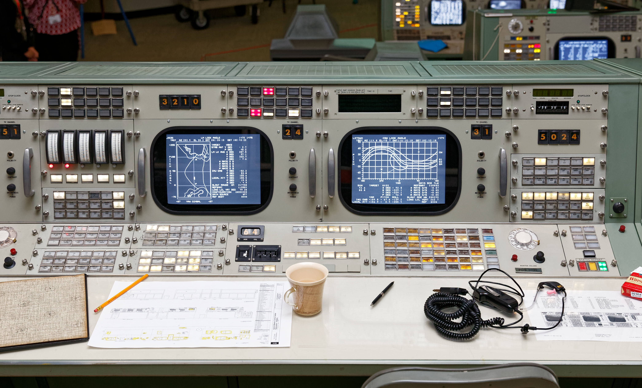
Therefore, the primary job of Mission Control was to keep watch over all the things the astronauts couldn’t. Each controller in turn had their own dedicated support staff to put more eyes on problems.

Slide 11
Notes:
So the watchers are the red consoles, the systems guys. Positions 13 and 14 (EECOM and GNC) watched over the CM, and 15 and 16 (TELMU - telemetry, electrical, and EVA mobility unit - and CONTROL) watched over the LM. The consoles in green, on the other hand—the trench—monitored the Saturn V rocket during launch (the BOOSTER “super console,” which had extra people at it during launch), and then kept track of where the spacecraft was and where it was going (FDO and GUIDO), as well as continually computing up-to-the-minute options to abort whatever was happening and return to earth (RETRO).
BOOSTER - RETRO - FDO - GUIDO
SURGEON - CAPCOM - EECOM - GNC - TELMU - CONTROL
INCO - O&P - AFD - FLIGHT - FAO - NETWORK
PAO - DFO - HQ - DOD

Slide 12
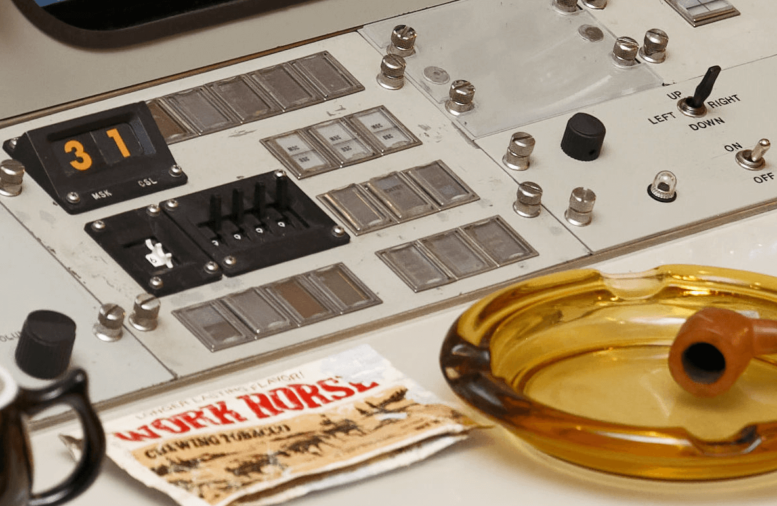
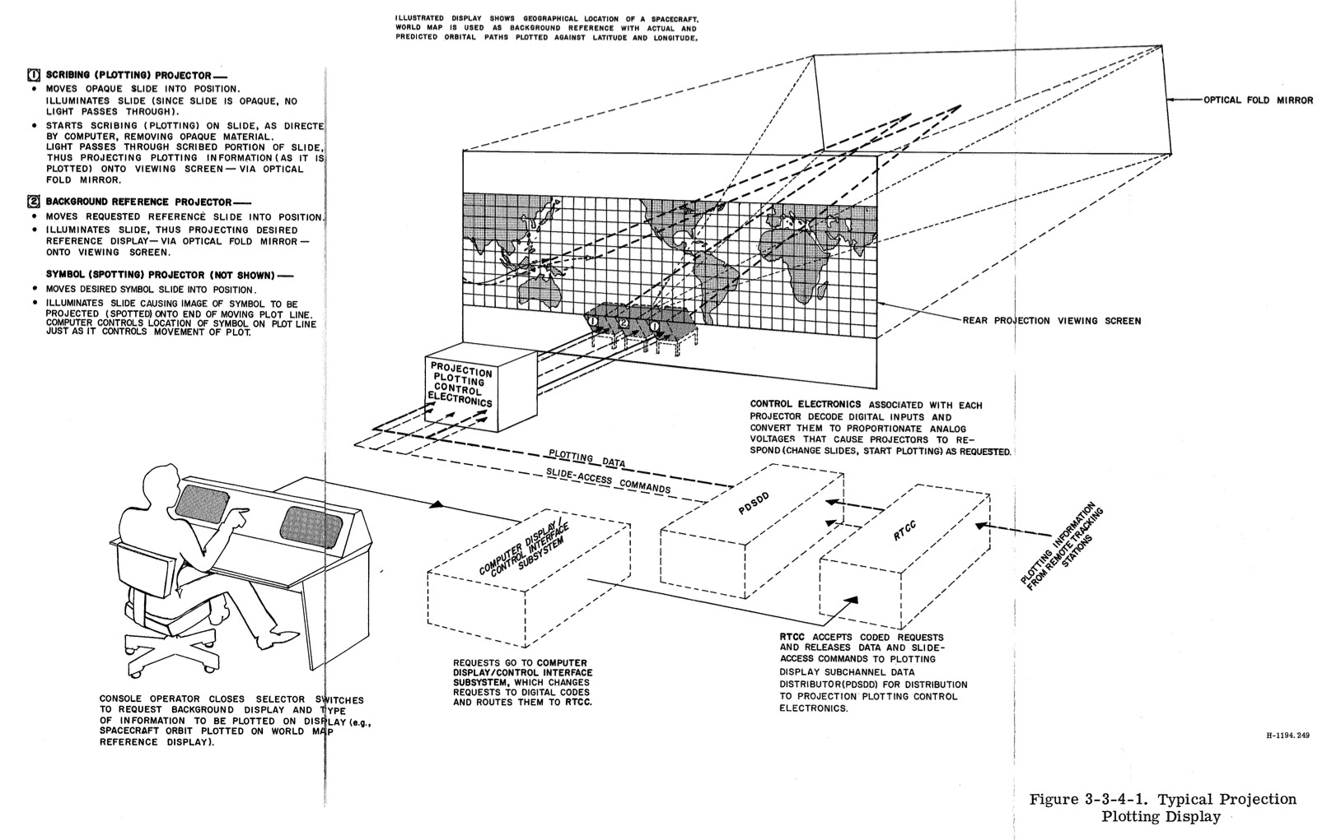
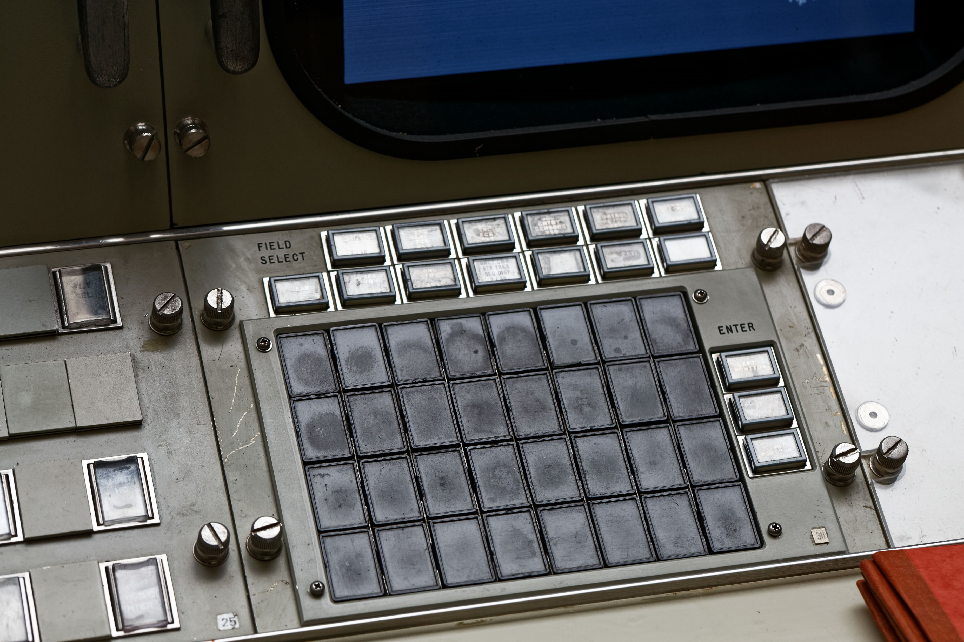
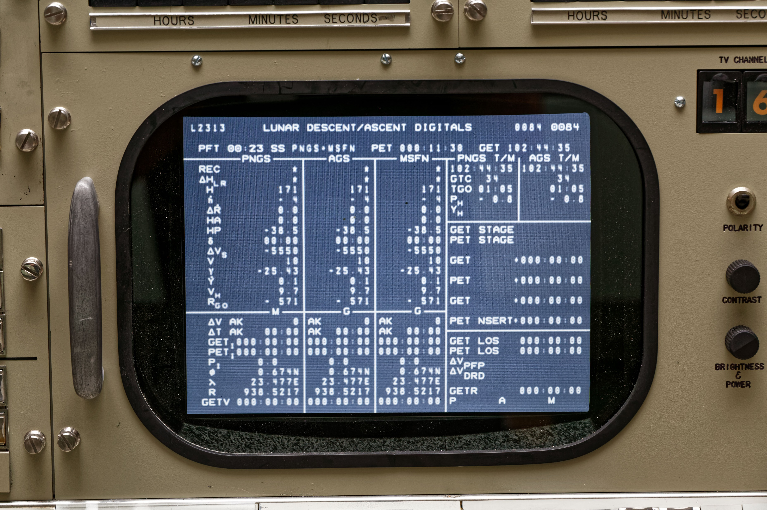
And those screens were more analog than you might believe…
Notes:
(explanation re: how displays were generated)
First explain channels — then explain generation
Source: https://www.hq.nasa.gov/alsj/MCCFamManual.pdf
“Mission Control Center Familiarization Manual”, NASA publication PHO-FAM001 (about 211MB)
Controllers selected what display they wanted by selecting a “channel,” exactly like changing the channel on a TV. Each “page” of information that a controller might want to look at was assigned to a TV channel, (there was a list of displays and their channels that was drawn up before each mission and shown on the up-front displays like a TV guide—want your ECS cryo tab screen? It’s on channel 21. The EECOM might have channel 21 up most of the time, but any controller that needed to also check that same display could simply change the channel on one of their screens to channel 21.). You see the IEE projection display at upper right in the photo, labeled “TV CHANNEL” showing the number “16”? That’s the current channel.
Every position had a “display request keyboard” - the thing at lower left - and a “manual select keyboard” - the thing at upper left. The Display Request Keyboard had four rows of eight buttons and each button could be configured to call up a certain channel. This was how controllers bookmarked the channels they most often needed to see, and switched between them. If a controller needed to look at a channel not preconfigured on their request keyboard, they’d use the manual select keyboard - it has some little dials for selecting the channel you want.
Okay, here’s the best part. The displays themselves aren’t rasterized images like we’d have today. Instead, on the first floor of the MCC was a room with dozens of CRT screens. The screens were connected to the IBM System/360 mainframes in the RTCC, and each CRT displayed the raw numbers that were used for that particular information channel. Each CRT had a camera pointed at it, filming the screen. Nearby was an enormous bank of slides—like, polaroid-type slides—and each slide had the non-numerical portions of the displays etched into them. Things like the column headings, solid lines for separating sections, most of the labeling, and any maps or graphical elements. The slides were projected via a system of lenses into the cameras pointing at the screens, and the resulting optical composite image was shown on controllers’ screens. So controllers on their screens were literally looking at an image of a TV screen of bare numbers with a formatting slide optically interposed between the camera and the screen.

Slide 13
When things go wrong…
The key to Mission Control and the Apollo flights all working so well was simple: intensive training
Controllers and astronauts spent hundreds of hours working through simulated missions, fixing simulated problems
The best controllers could eventually identify individual transistor failures by looking at patterns of trouble behavior
They got so good that they could even handle the most unexpected of issues…like the launch of Apollo 12
Notes:
Play video after this - dropbox

Slide 14
From the Earth to the Moon clip, Apollo 12 launch
https://www.youtube.com/watch?v=SSN4MIsP_90
Notes:
This is a four-minute clip from the HBO miniseries From the Earth to the Moon, which is basically Band of Brothers in space. If you’ve not seen it, it’s very much worth picking up. This clip is a pretty faithful recreation of the near-disaster that happened during the launch of Apollo 12, and the dialog is almost all verbatim from the air-to-ground loop (though John Aaron is a lot talkier here than he was in the real event). Let’s watch, and we’ll be back in four minutes!

Slide 15
“NCE to auxiliary? What the hell is that?”
“SCE” is the CM’s Signal Conditioning Equipment
Responsible for translating raw sense voltage outputs from cockpit instrumentation into the right format for transmission to the ground as telemetry
Lightning strike disrupted spacecraft’s AC power busses and drastically lowered power to the SCE, causing the telemetry feeds to look like garbage
“SCE AUX” switch put SCE in low-power mode, enabled it to run on reduced power
MOCR was then able to see telemetry feeds again, advise spacecraft on WTF to do next
Notes:
So what the hell happened? The spacecraft was literally struck by lightning, twice, and the surge tripped breakers on the spacecraft and disconnected a whole buttload of systems from the spacecraft’s main electrical busses. The fix was to set SCE to Aux, but what does that mean? (read chart) John Aaron—the controller who made the SCE call—was the best EECOM in the directorate. To hear the tale told by Sy Liebergot, one of Aaron’s EECOM peers, Aaron’s ability to recall tiny wiring and circuit diagrams was unparalleled, and when A12’s feeds went online, he stared at his console in silence for several seconds and then simply announced the fix over the loop. He later said he recognized the pattern of garbage on his screen from an exercise months before where a low voltage condition was being simulated. He was able to mentally look up that information under the stress of a launch and do it in seconds—and his quick thinking saved the mission.

Slide 16
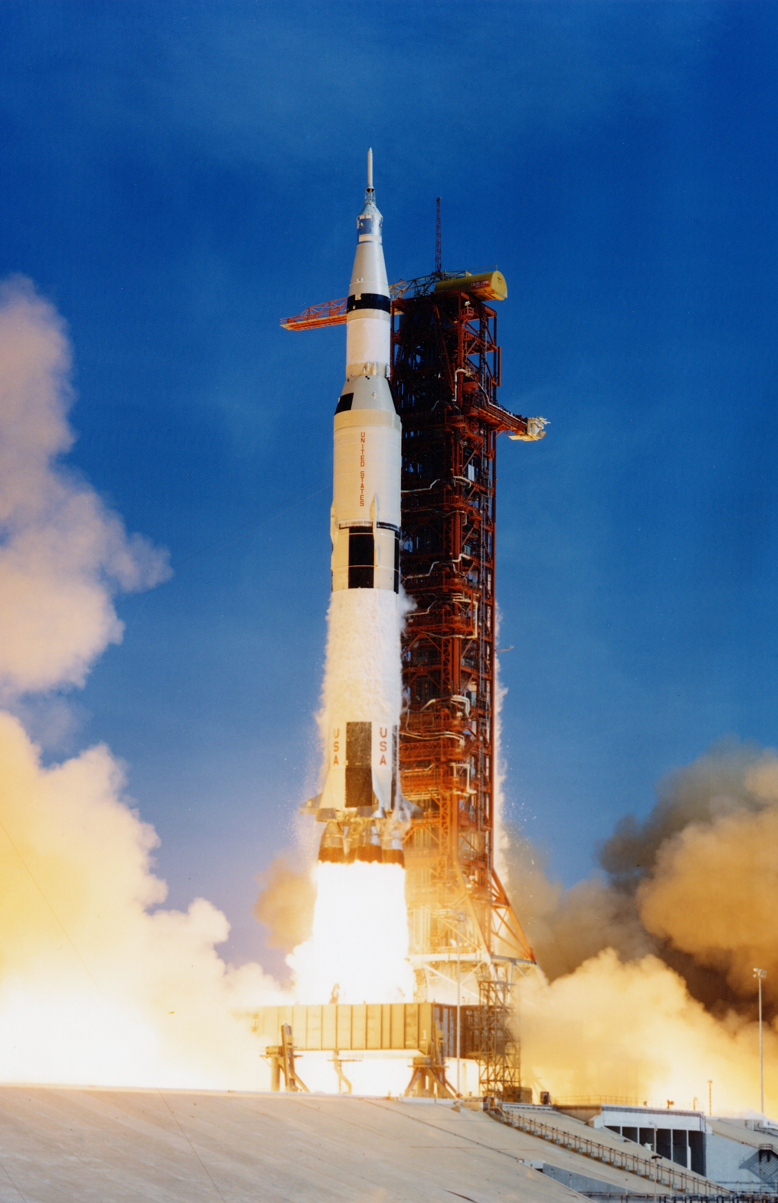
The Saturn V
Largest successfully flown rocket ever built by humans
Notes:
So speaking of launches, let’s talk — just briefly! — about the launch vehicle. Every component of Apollo was critical to success, but it doesn’t get much more critical than the rocket itself, because without the Saturn V, we’d never have gotten to the moon.

Slide 17
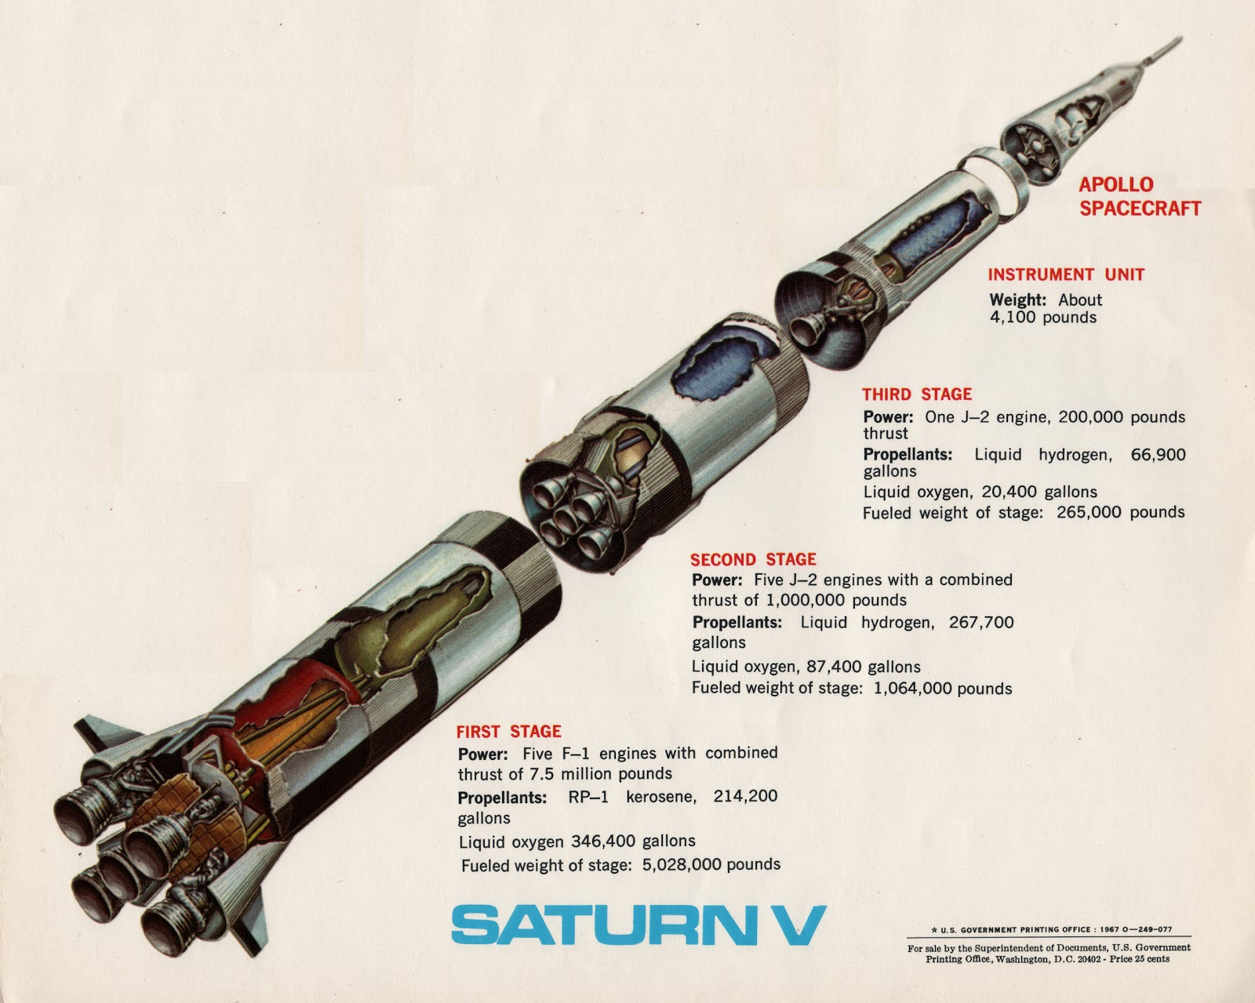
Three stages to the Moon
Notes:
3 stage rocket - each stage had a different function. Stage 1 - thick part of atmosphere. Stage 2 - workhorse stage, delta V, most improvements. Stage 3 - multipurpose. final kick into orbit, and also cruise to the moon.

Slide 18
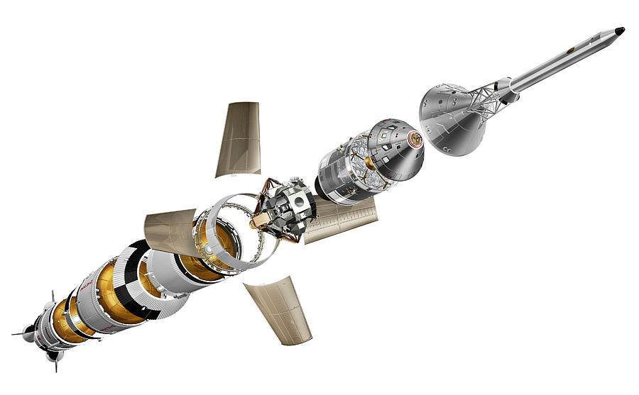
Exploded view: S-IC, interstage, S-II, interstage, S-IVB, IU, SLA (opened), LM, SM, CM, BPC, LES
Notes:
S-IC: the designation for the Saturn V’s first stage, manufactured by Boeing (more info)
Interstage: the load-bearing component that connects each stage together
S-II: the designation for the Saturn V’s second stage, manufactured by North American Aviation (more info)
S-IVB: the designation for the Saturn V’s third stage, manufactured by Douglas Aircraft Corp (more info)
IU: the Instrumentation Unit, where the rocket’s independent guidance and computers were located (more info)
SLA: Spacecraft/Lunar Module adapter (more info)
LM: Apollo Lunar Module (pronounced “lem”) (more info)
SM: Apollo Service Module (more info)
CM: Apollo Command Module (more info)
BCP: Boost Protective Cover (more info)
LES: Launch Escape System (more info)

Slide 19
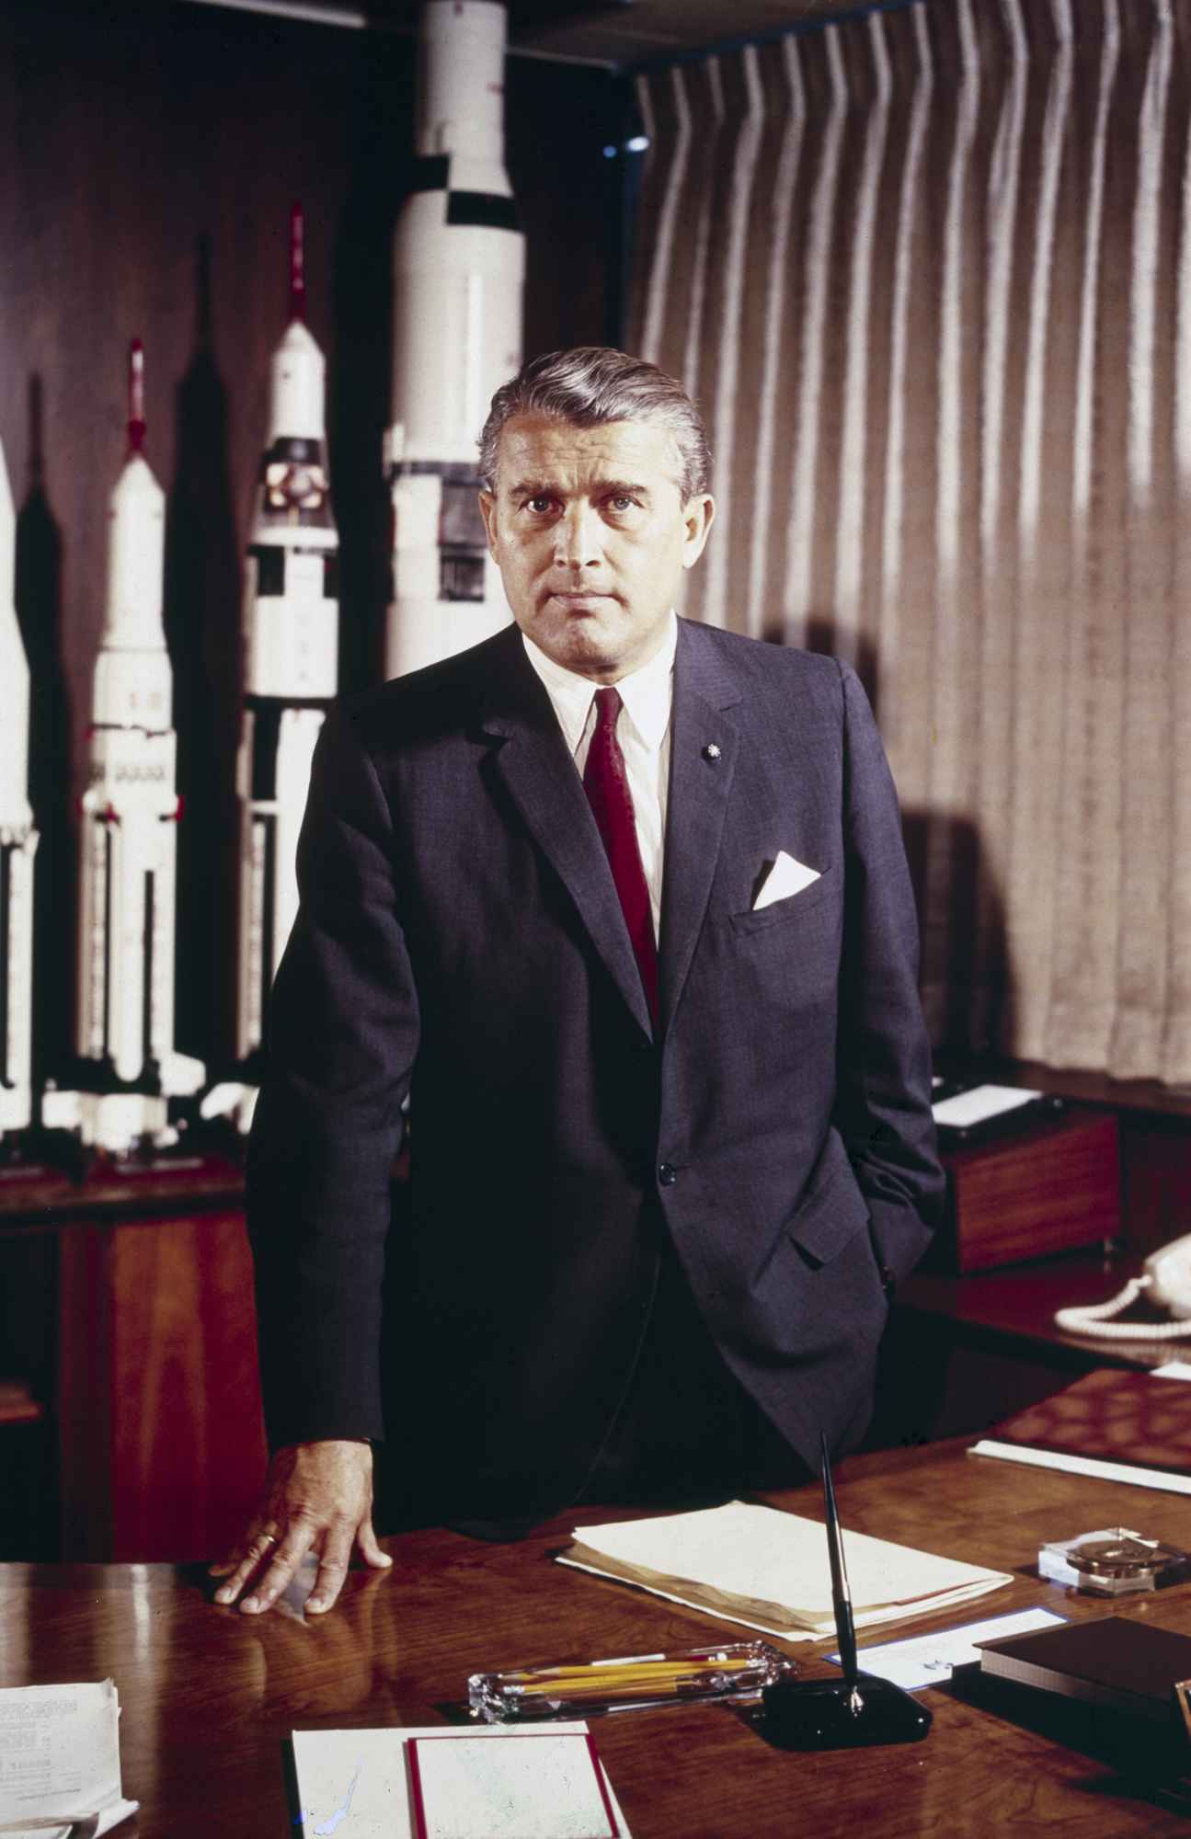
“Our Germans are better than their Germans!” —The Right Stuff
Wernher von Braun in his office at the Marshall Space Flight Center in Huntsville, AL
Notes:
(Quote source: https://www.youtube.com/watch?v=rYco0UsWhLc)
The Saturn V was the magnum opus of Wernher von Braun, the foremost rocket scientist of Hitler’s Reich. I say that not to be inflammatory, but because it’s impossible to put von Braun in context without acknowledging that he was a member of the Nazi party—likely out of necessity in order to be able to hold the position of power he had over rocket design. von Braun had dreamed since he was a boy of flying rockets to the moon and to Mars, and had designed Germany’s V1 and V2 rockets. He was smuggled out of Germany after the end of WW2 in a joint CIA/OSS operation called “Operation Paperclip,” which is absolutely worth reading about, and sent to live in Huntsville with his team, working on human space flight concepts first for the Air Force and then for NASA. Freed from the constraints of making war machines, he and his team of expatriated German rocket scientists designed the Saturn series of rockets for NASA. With typical teutonic engineering conservatism, the design for the Saturn was over-engineered to the point that after the first few flights, the safety margins were scaled back from “insane” to “huge” and the rocket was able to be upscaled to carry greater weight with minimum design changes. von Braun’s design was so good that no Saturn V ever suffered more than a minor mishap during flight, and many of von Braun’s “over-engineered” decision—like giving the Saturn V its own independent guidance, in case it were ever to be flown with cargo instead of a spacecraft—paid dividends. Without that separate guidance, Apollo 12 would have been an immediate abort when lightning struck.
Quoting Cox & Murray:
The joke that made the rounds of NASA was that the Saturn V had a reliability rating of .9999. In the story, a group from headquarters goes down to Marshall and asks Wernher von Braun how reliable the Saturn is going to be. Von Braun turns to four of his lieutenants and asks, "Is there any reason why it won't work?" to which they answer: "Nein." "Nein." "Nein." "Nein." Von Braun then says to the men from headquarters, "Gentlemen, I have a reliability of four nines."

Slide 20
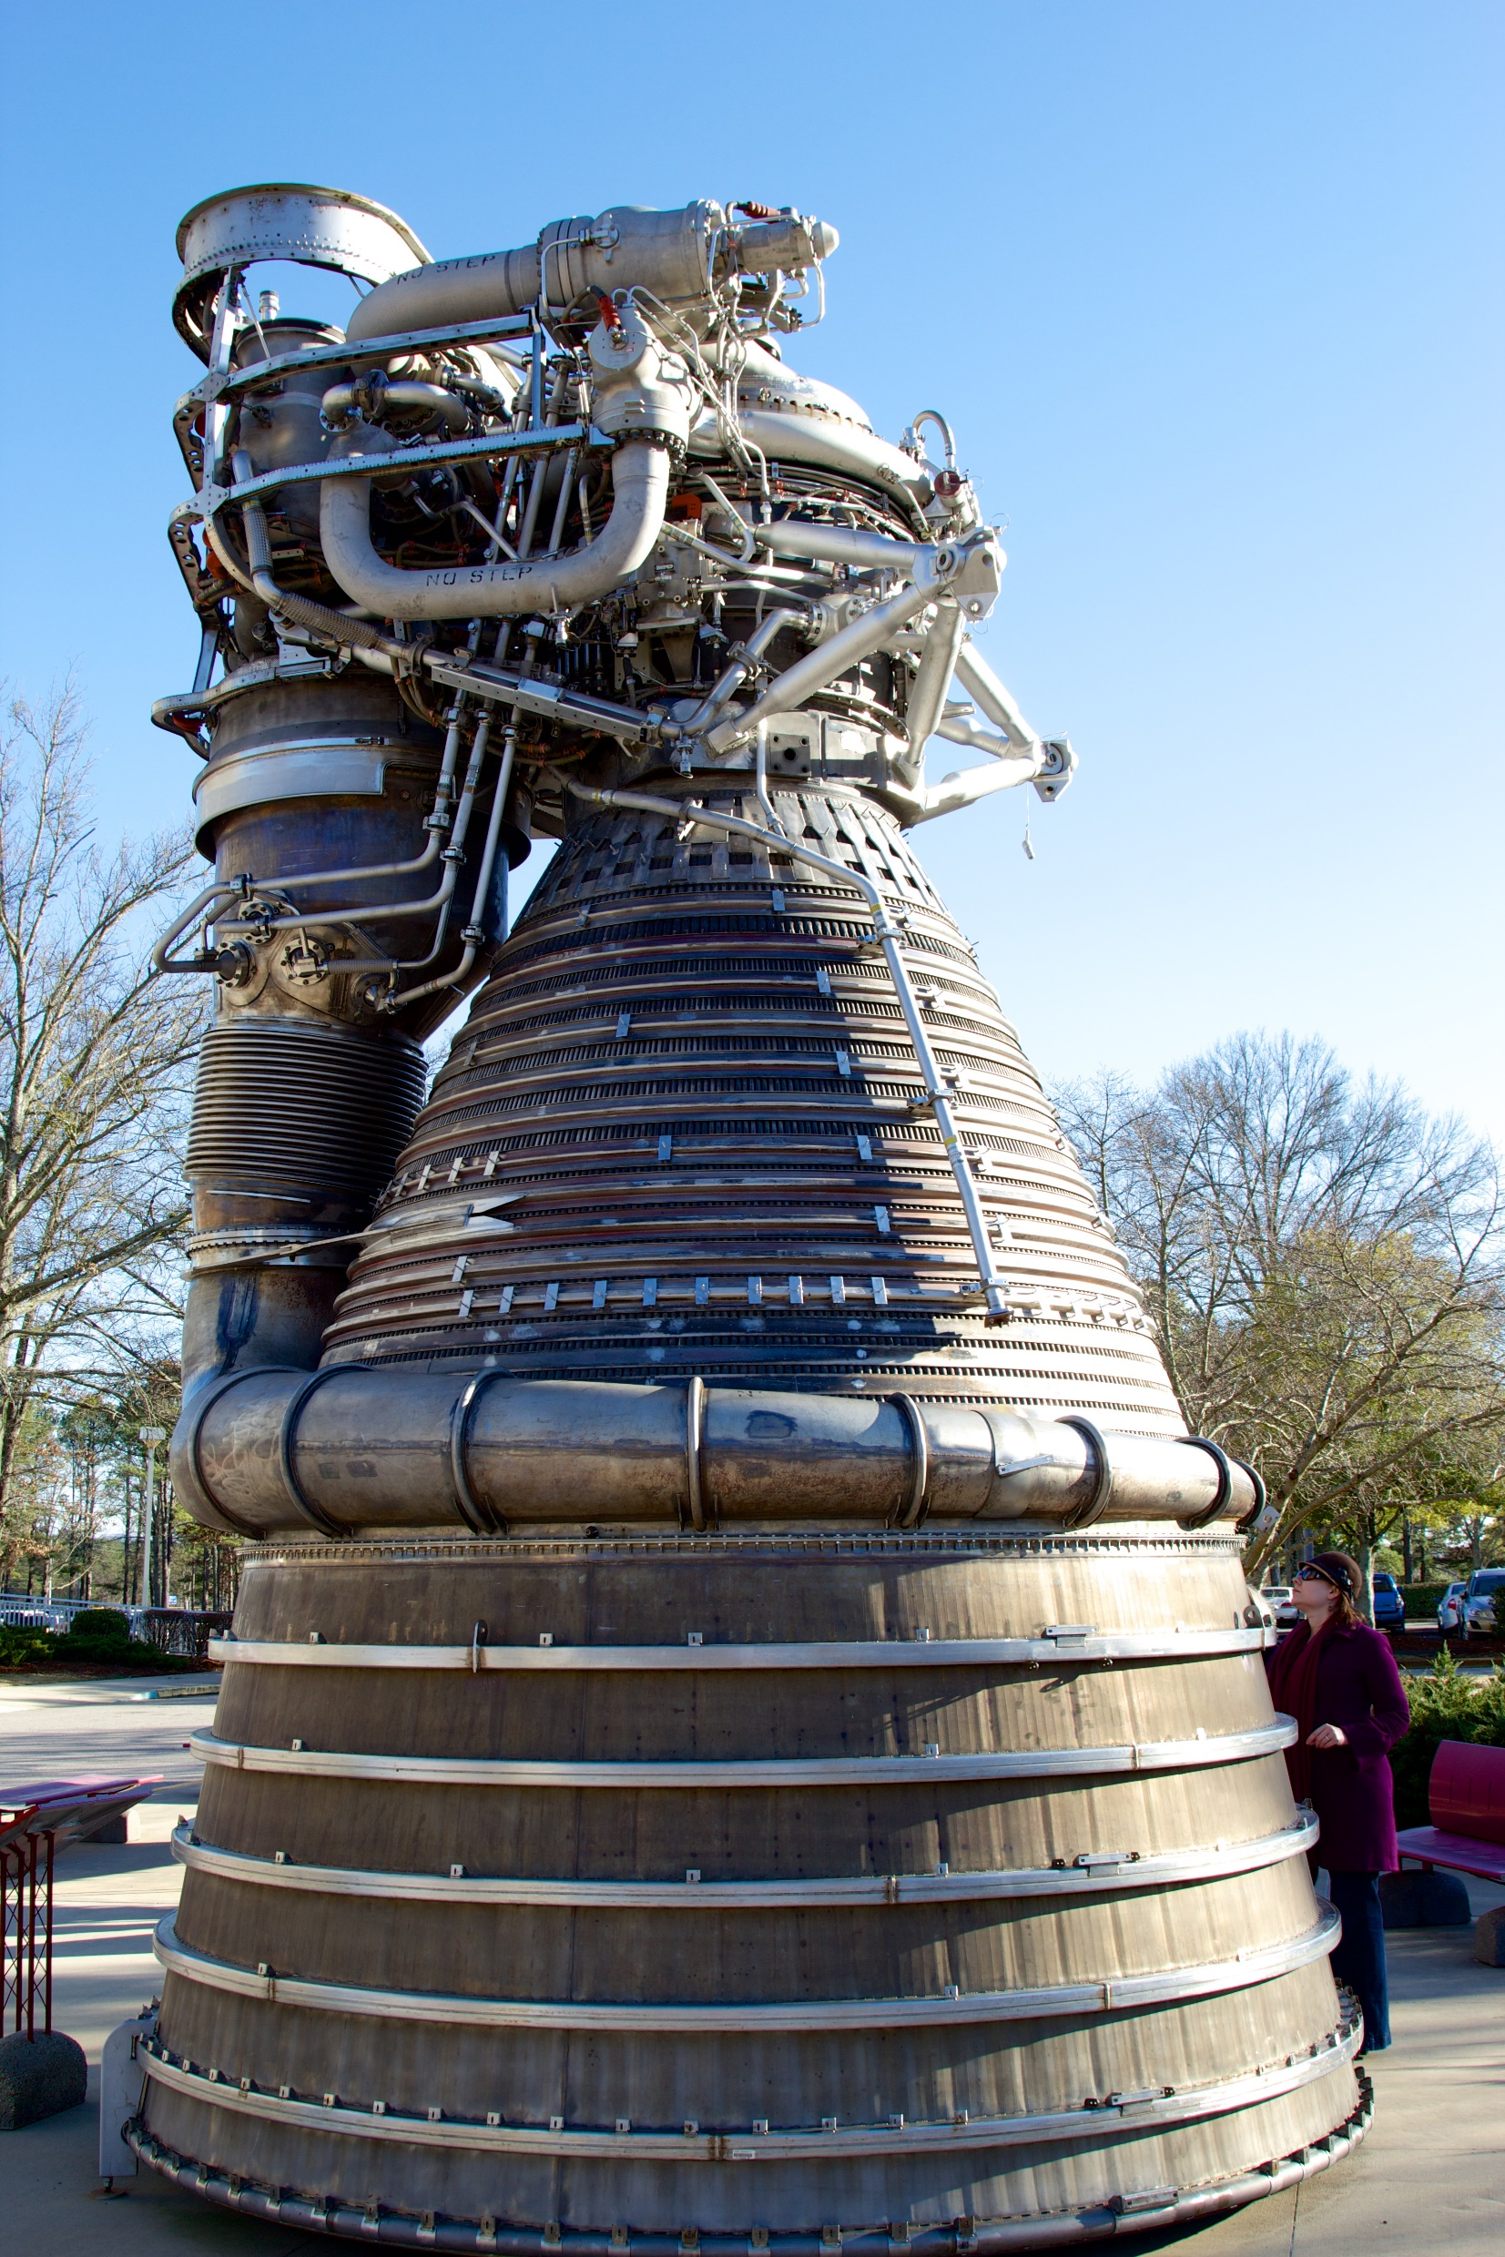
Monstrous thrust
A single Rocketdyne F-1 engine with my wife at right for scale. The F-1 is the largest single chamber liquid fueled engine ever successfully fired. The first stage of the Saturn V used five of these engines.
Notes:
The most interesting (and visually imposing!) part of the Saturn V is the first stage, and the most ridiculous part of the first stage are the massive F-1 engines. There are five of them, and the numbers behind them are staggering.
Image source is a long piece I wrote on reviving the F-1 for present-day testing: https://arstechnica.com/science/2013/04/how-nasa-brought-the-monstrous-f-1-moon-rocket-back-to-life/

Slide 21
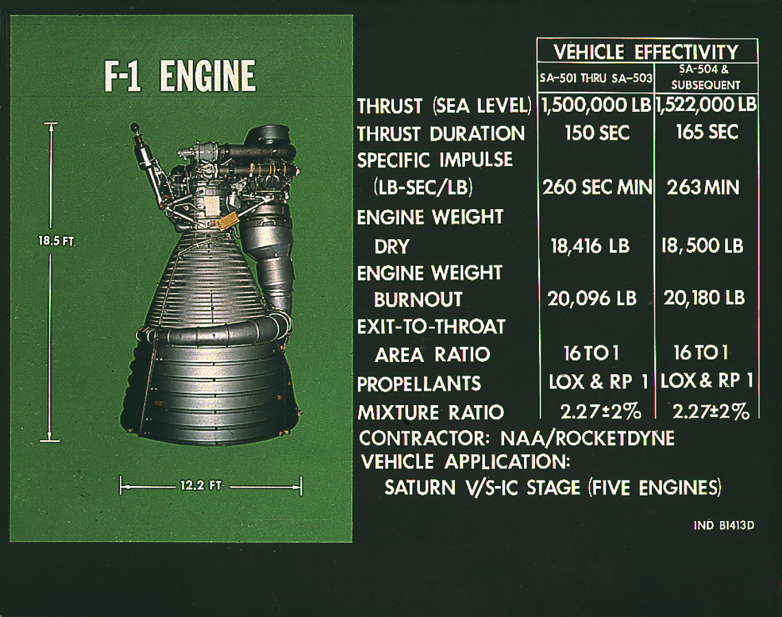
Almost twenty feet tall and twelve feet wide, the F-1 produced 1.5 million lbs of thrust and burned 1 ton of RP-1 kerosene and 2 tons of liquid oxygen per second.
And the Saturn V’s first stage had five of them.

Slide 22
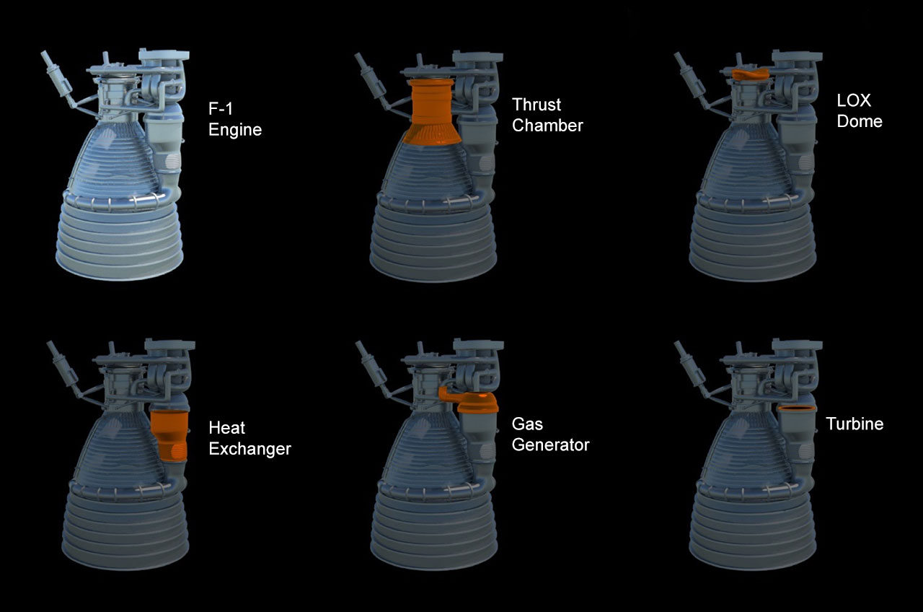
The F-1 is a “gas generator cycle” engine.
This means it uses the thrust from a small piggyback rocket motor (the “gas generator”) to turn the turbopumps to move fuel and oxidizer from the tanks to the thrust chamber.
Notes:
How a gas generator cycle rocket motor works (and some info on other types of rocket engine cycles): https://www.youtube.com/watch?v=jheMusS0JwA
A “gas generator” type of engine uses the thrust output of a smaller rocket engine—the gas generator, located above the thrust chamber—to turn the pumps that draw fuel and oxidizer out of the tank and into the thrust chamber. Think of blowing on a pinwheel to make it spin—except the rocket thrust from the gas generator is doing the blowing and the pinwheel is a giant turbopump.

Slide 23
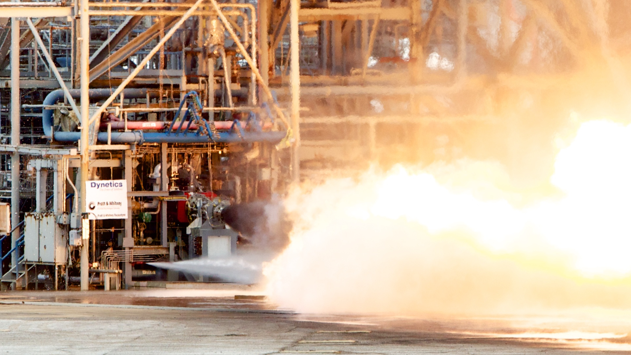
The gas generator itself develops more thrust than an F-16 at full afterburner. That power is used to turn the LOX and RP-1 turbopump, which puts out about 55,000 shaft horsepower.
Notes:
This is a photo I took in 2012 at Marshall, when NASA decided to pull an F-1 gas generator off of an F-1 in storage and do some test firings to collect data on how the old engines functioned.
Source: https://arstechnica.com/science/2013/04/how-nasa-brought-the-monstrous-f-1-moon-rocket-back-to-life/

Slide 24
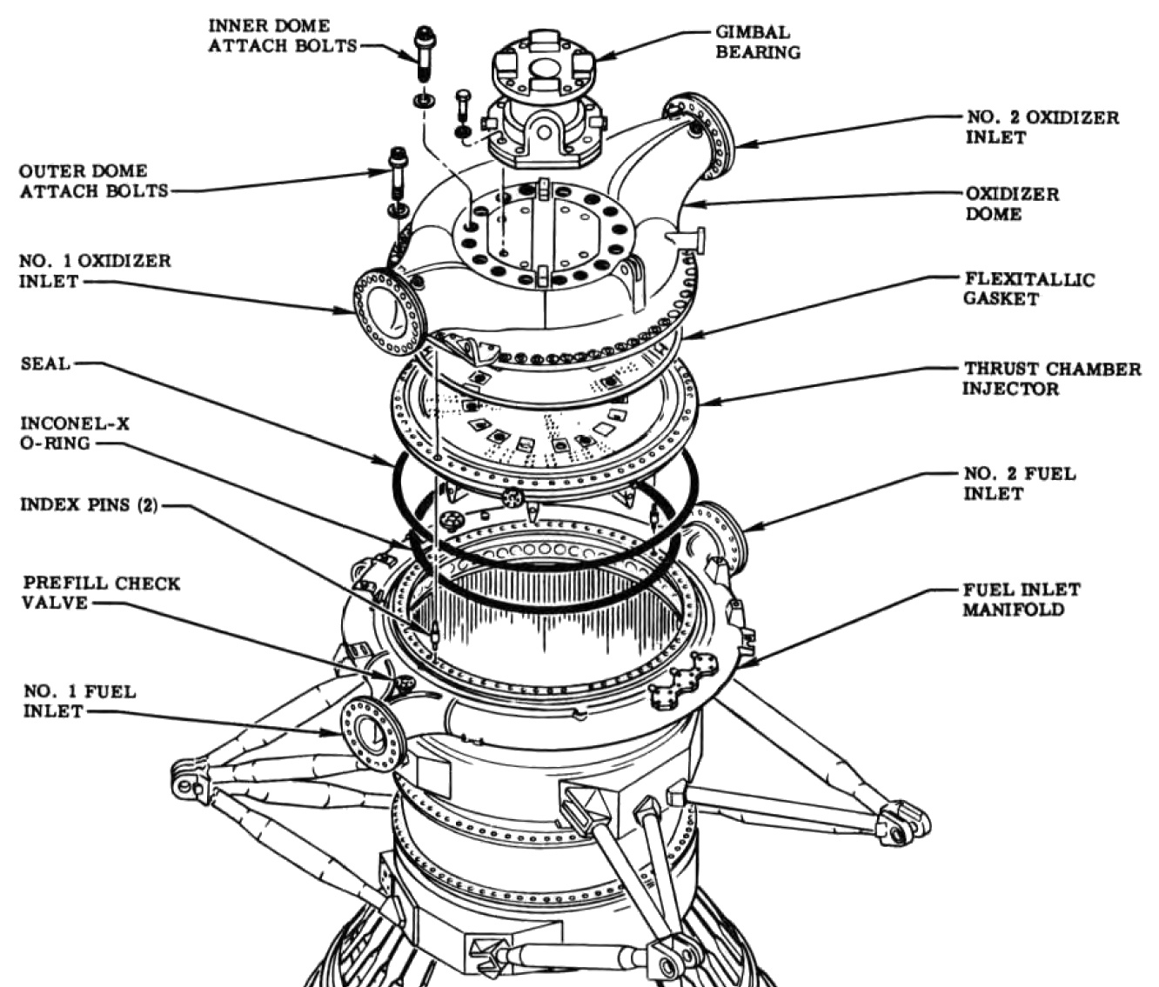
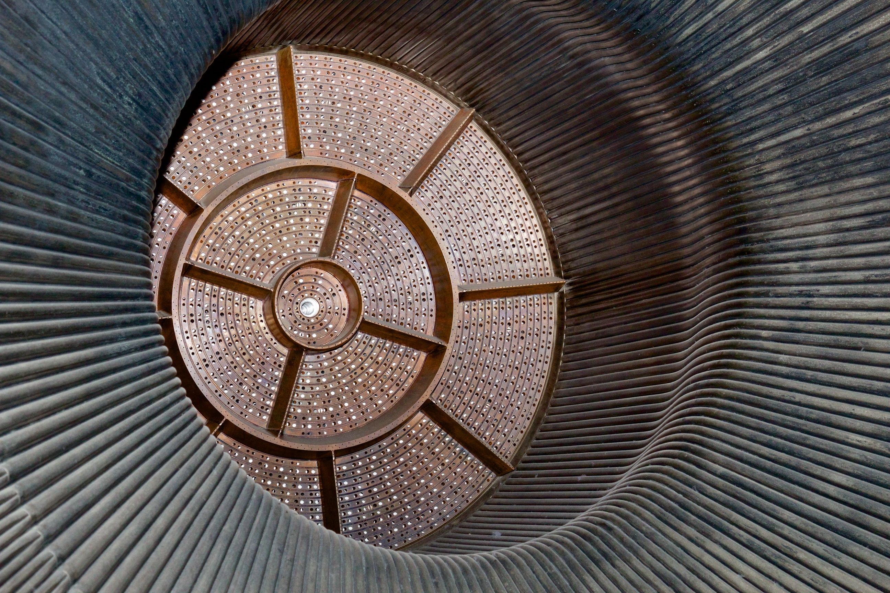
That power is used to shove three tons of propellent through a copper and steel sandwich called the “injector plate.” The plate was drilled with over a thousand holes arranged in concentric rings. The holes delivered precisely-aimed atomized streams of LOX and RP-1 into the combustion chamber.
Notes:
injector — 44” wide
More info:
http://heroicrelics.org/info/f-1/f-1-injector.html

Slide 25
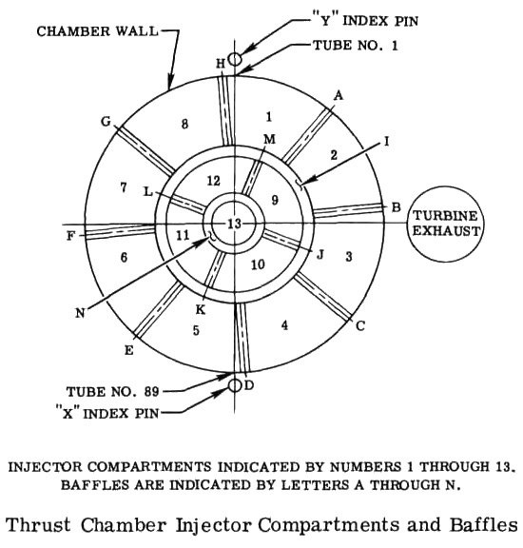
What’s up with those baffles?
They keep the engine from exploding!
Notes:
Story re: baffle design and layout
More info: http://heroicrelics.org/info/f-1/f-1-injector-baffles.html
First-hand account of injector design process by some of the folks who worked on it:
https://www.youtube.com/watch?v=o39UlJlMce8#t=9m34s (skip to 9m 34s if the link doesn’t automatically start there)
During its development, the F1 suffered from a problem called “combustion instability.” This is a not-uncommon problem on rocket engines, but the F1’s instability was very challenging to fix because the engine was so damn big—it was, and remains, the biggest single-chambered liquid fueled rocket engine that humans have ever built. The burning plume of propellent in the combustion chamber oscillates thousands of times per second, and with the F1, that oscillation had a tendency to very rapidly go from smooth rotation to wobbling craziness. And that’s a LOT of mass to wobble—remember, you’re spraying three tons of propellant into the combustion chamber every second, and that three tons of propellent is combusting and rotating thousands of times per second. When it goes unstable and wobbles, the engine more or less instantly explodes.
So F1s wouldn’t stop blowing up on the test stand, and engineers had to fix it. Now today, we’d build a 3d model of the engine in Catia or some other CAD system and we’d simply simulate it—we’d find the problem, fix it in the computer, simulate it to make sure it was fixed, and then build the real thing. But in the 1960s this wasn’t an option, so they had to begin physically iterating—build an engine with a proposed fix, run it to see if it blew up, and if it did, build another one.
The baffle arrangement shown above was the design that the engineers eventually iterated to. This specific arrangement of baffles proved good enough to damp down combustion instability for several minutes of firing—considerably longer than an F1 would have to operate in flight. In fact, it was so stable with this arrangement of baffles that the engineering team would insert a black powder charge up into the running engine and set it off, and the engine would recover from the explosion in less than a second.
One final interesting tidbit—it’s not clear whether or not there’s an even more optimal baffle layout. This design is simply the last one they iterated to because it was good enough, and they were out of time—the combustion instability issue had taken years to solve and there just wasn’t any more time to work on it, so this is what they flew with.

Slide 26
And that gas generator? You have to do something with its exhaust…

Slide 27
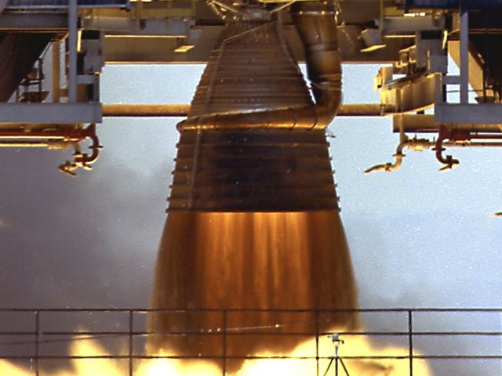
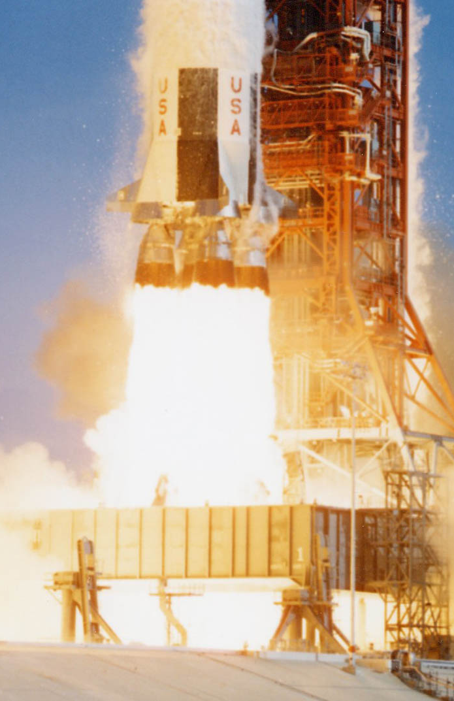
After the gas generator’s exhaust has done its job, the plume is funneled through the finger-like manifold that wraps around the engine bell and then vented across the walls of the lower rocket nozzle, cooling it.
The exhaust is fuel-rich and takes a few seconds to completely ignite, thus providing the F-1’s visually distinct dark thrust column.

Slide 28
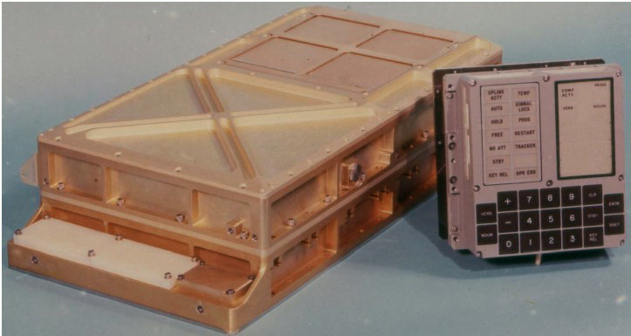
The Apollo Guidance Computer
Less powerful than a pocket calculator?
Well…sort of.
Notes:
Let’s talk computers — space computers. So you’ve probably heard the old bit about how we flew to the moon on less power than a digital watch or whatever, and that’s…kind of sort of true, but it’s also a gross mischaracterization of what “computing power” means in different contexts.

Slide 29
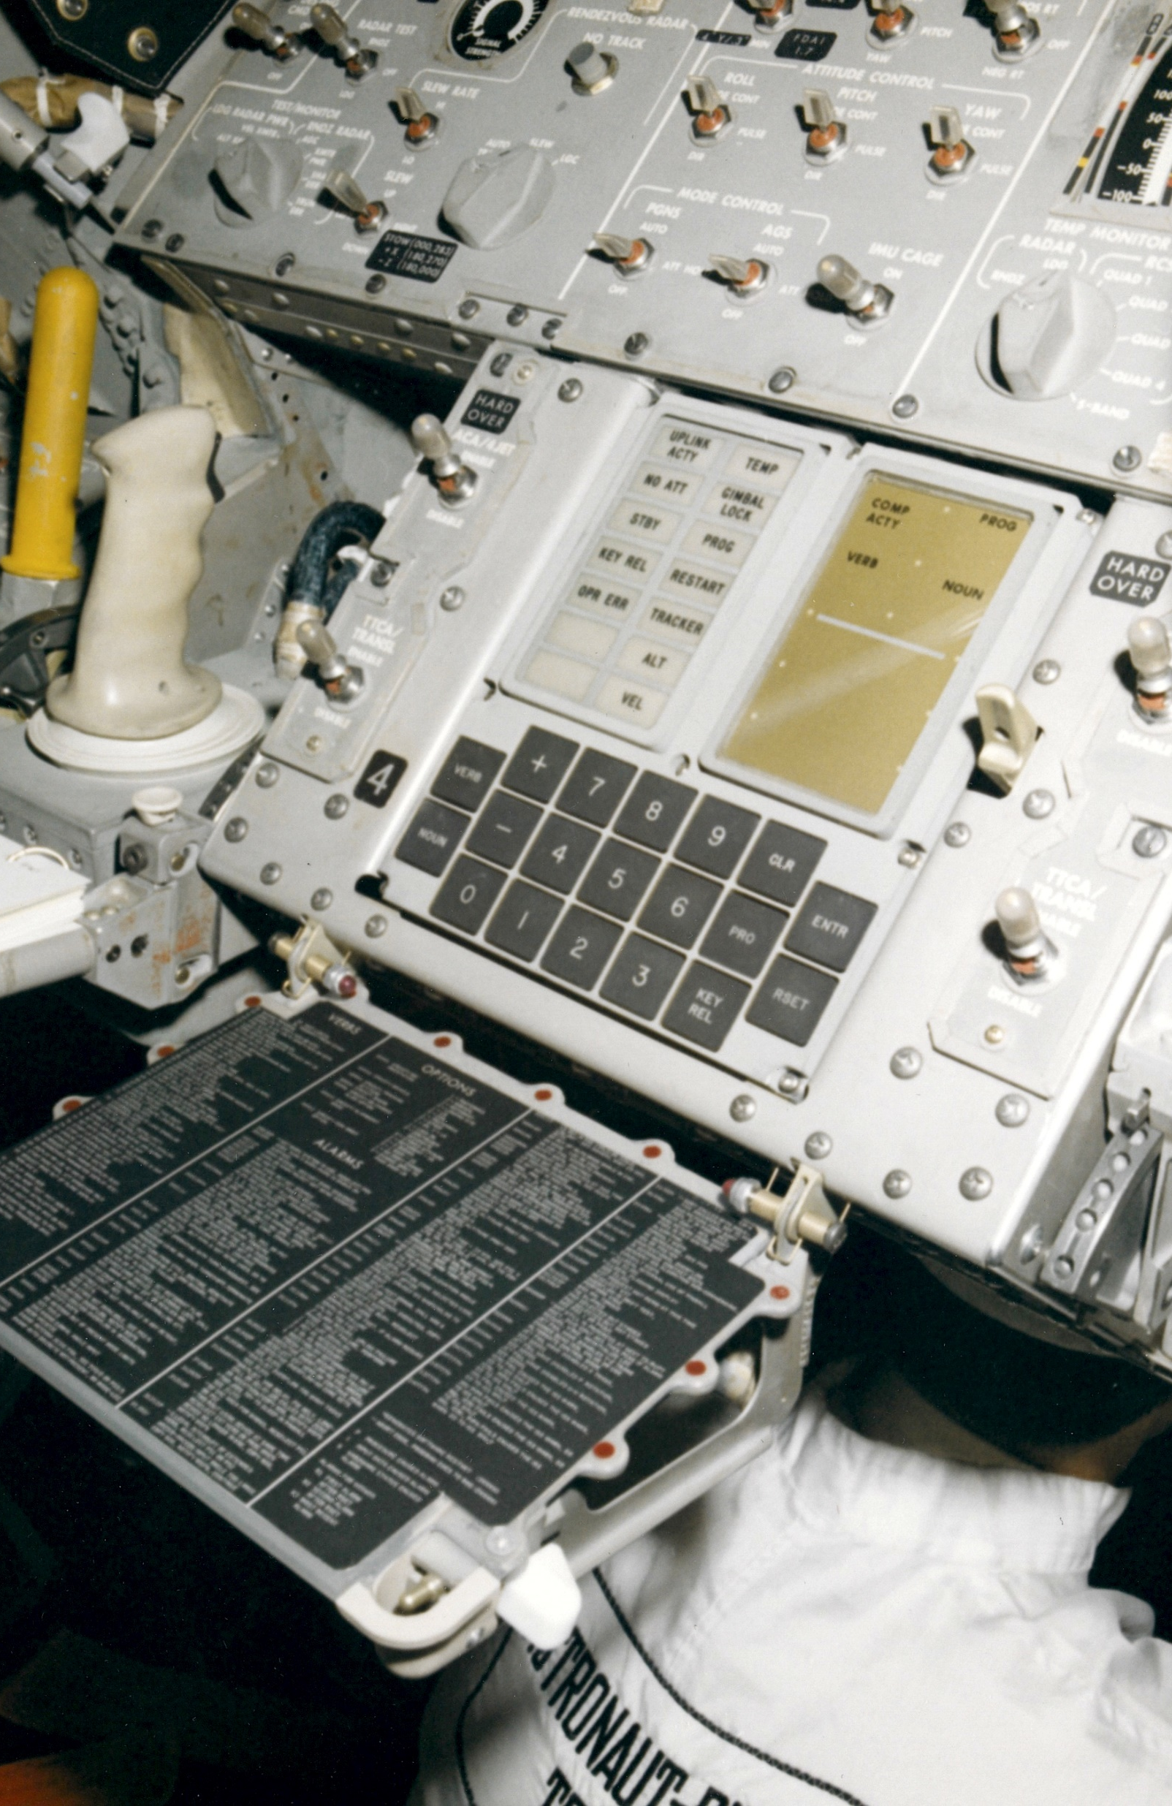
The AGC was the capstone of 1960s engineering achievement
The MIT-designed software it ran was literally revolutionary
The AGC effectively invented the entire field of real-time computing
Not so much a computer as a sophisticated embedded controller with purpose-built peripherals

Slide 30
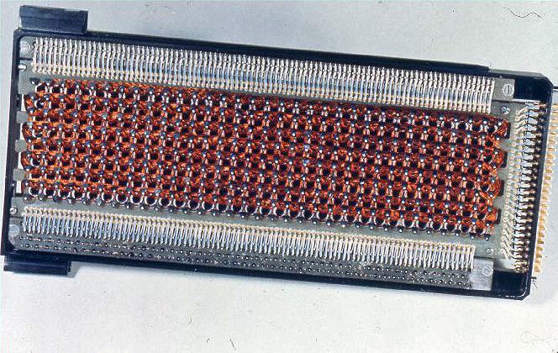
The AGC’s hardware was based on core-rope memory, with all the airspace in the the core-rope modules filled with epoxy
Complex and difficult to manufacture, but impervious to radiation effects, shock, G-loading, and pretty much everything else.
Notes:
A great documentary on the subject: https://www.youtube.com/watch?v=xQ1O0XR_cA0

Slide 31
Block II AGC internals
16-bit datawords (15 bit wordlength + 1 bit parity)
2k-words RAM, 36k-words core rope ROM
4x 16-bit registers for general computing
2.048 MHz crystal clock for timing reference (but actual cycle time was 960ms, sort of)
Notes:
Sounds primitive, but specs don’t tell the whole tale.

Slide 32
Split-brained
The AGC had a simple RTOS called the Executive that was responsible for batch job scheduling using primitive cooperative multitasking
Also had a sophisticated interpreter (called “Interpreter”) that ran a “virtual machine” in software
The Interpreter enabled the AGC to do complex math operations in software (including vector math and transcendental functions) that it couldn’t do in hardware
Notes:
(read slide first) None of this sounds outlandish in 2020, until you realize that the software designers were making all of this up as they went along. They invented the concept of a real-time operating system without google or any existing best practice guidelines—they were CREATING the best-practice guidelines that we use today. It’s all well and good to implement emulation in software to do math you can’t in hardware today—it’s another thing entirely to INVENT the idea of doing that and then DO IT SUCCESSFULLY, for the very first time, without a blueprint.

Slide 33
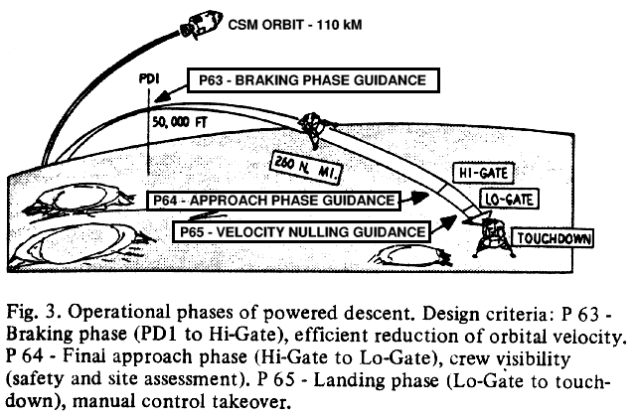
How well did it work?
Well enough to save the Apollo 11 landing.
Notes:
Setting the stage real quick—this is how you land on the moon. There’s no air, so you can’t use wings or parachutes—you have to use rockets. This is why the Apollo landing process was called “powered descent”—they had to ride their own rocket’s thrust down from orbit to the surface. Powered Descent was a complex and involved procedure, endlessly simulated by controllers and astronauts. There were tons of moving parts, and if anything went wrong, the only way to abort was to smack the “ABORT STAGE” button in the cockpit, which would blow the spacecraft in half, jettison the descent stage, and light the ascent engine. The astronauts would then have to locate and rendezvous with the command module for rescue. Powered descent was just about the worst possible time for something to go wrong, and so, of course, for the first lunar landing, that’s exactly when things went very wrong. I’m going to play you this clip from First Man, which dramatizes things a bit but which gets across both the seriousness of the situation and also the ridiculously FAST pace at which mission control resolved the problem.
This clip is five minutes long, but the important part is the first 90 seconds when the crazy alarms start going off.

Slide 34
First Man landing clip:
https://www.youtube.com/watch?v=TrvXqosqkls
Notes:
[Seriously, this movie is so damn good. The filmmakers demonstrate both a tremendous respect for the source material, and also an almost uncanny attention to detail and accuracy. There are a few dramatic liberties taken to make things a bit more watchable and movie-like—a lot of space flight is just flat-out boring when things are going right—but the movie succeeds brilliantly in giving audiences a realistic look at not just the technology that got us to the moon, but at the people who flew there. And the quiet scenes Armstrong and his wife make a powerful counterpoint to the major action pieces. If you’re a fan of human space flight and you haven’t seen it, stop what you’re doing and watch it.]

Slide 35
1201? 1202? WTF?
The timeline is compressed and amped up with dramatic music, but that’s pretty much how it went
What were these alarms?
1201 & 1202 are “executive overflow” alarms—the LM AGC was warning that it had run out of temporary storage space
AGC program flow was carefully and painstakingly arranged so that this occurrence should have been impossible—the alarms were there for debugging and were NEVER expected to happen in flight
Notes:
For a more in-depth explanation of the next few slides, please see the article I wrote on the 1201/1202 alarms a few years ago:
https://arstechnica.com/science/2015/07/no-a-checklist-error-did-not-almost-derail-the-first-moon-landing/
Or, if you really want to go down the rabbit hole, read Don Eyles even-more-in-depth explanation (which I used as the primary source for my article):
https://www.doneyles.com/LM/Tales.html
Eyles also has a book, which is a great time capsule of his work on the program as an MIT grad student in the 1960s. (In it I learned two major things: first, just how groundbreaking the AGC software was; and second, everybody at MIT writing the code was super-duper stoned for basically the whole program)

Slide 36
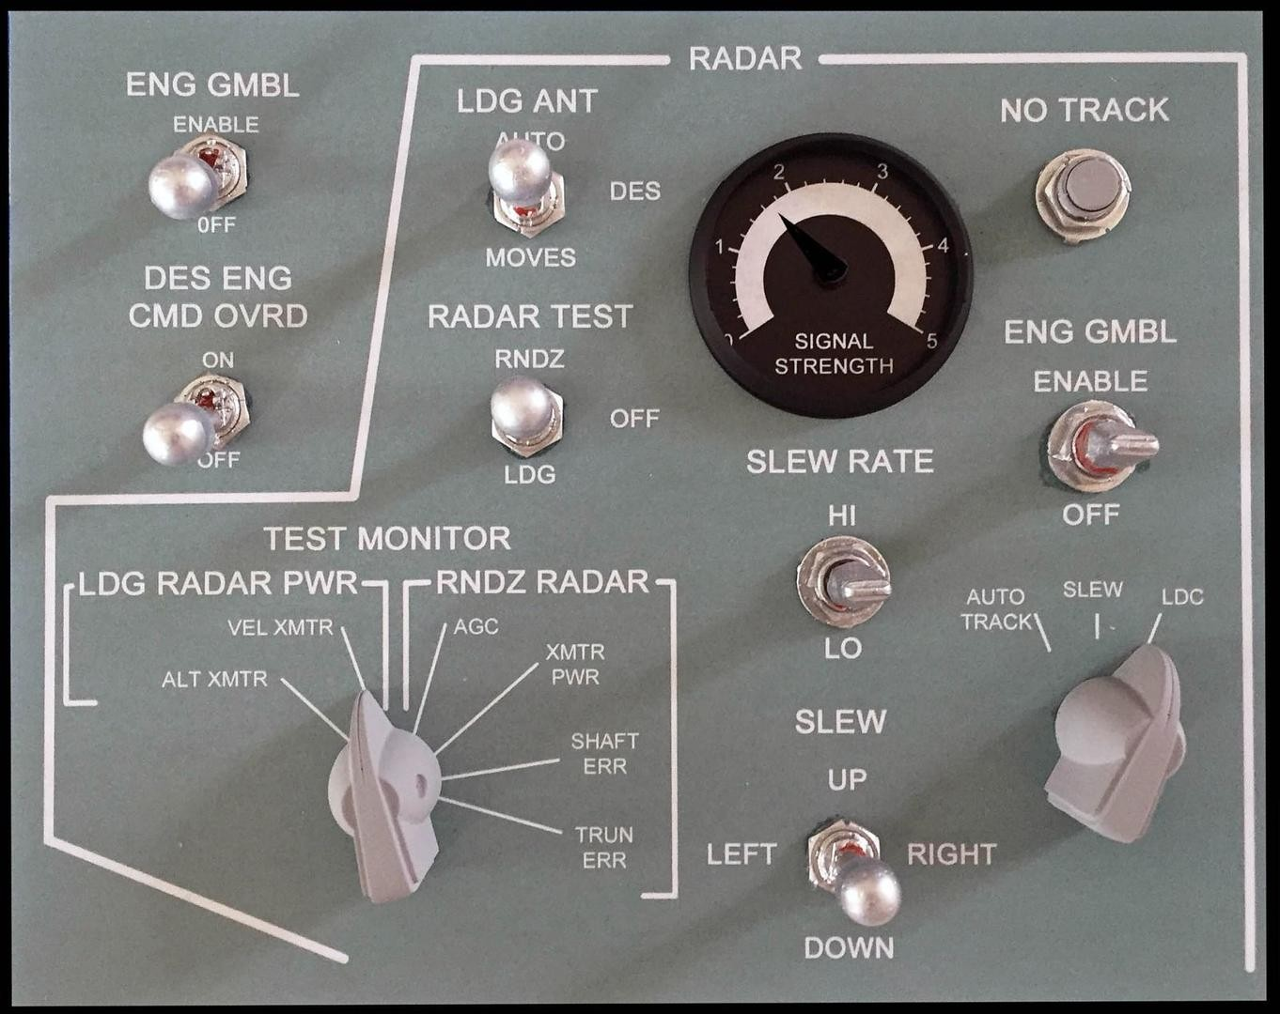
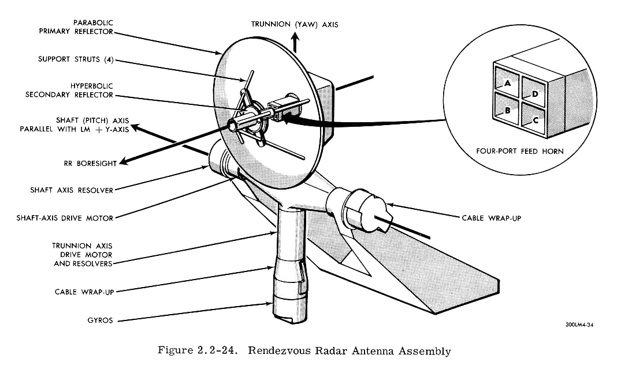
The alarms are commonly chalked up as the result of a “checklist error,” but this is not correct. The alarms stemmed from a design documentation error.
Before Powered Descent, Aldrin switched the LM’s rendezvous radar on to its “SLEW” mode, which energized the rendezvous radar.
This was done to give the crew one less thing to worry about if an abort were necessary (the rendezvous radar would be used to find the Command Module).

Slide 37
This gets a little complex, but stick with me.
The LM AGC connected to a piece of equipment called the ATCA (Attitude, Translation, and Control Assy), which provided the electrical interface for the AGC to steer the rendezvous radar’s hardware.
Similarly, the LM AGC connected to two devices called CDUs (Coupling Data Units) which allowed the AGC to read the position of the rendezvous radar’s dish.
The CDU read from the radar to the AGC, the ATCA sent commands from the AGC to the radar.

Slide 38
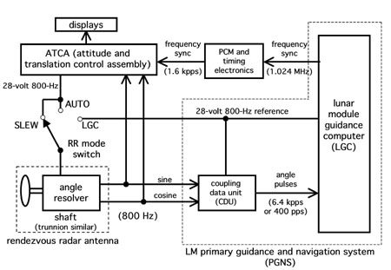
The ATCA was powered by 800Hz, 28-volt AC
CDUs had a separate 800Hz 28-volt AC synchronizing current.
In order for everything to work normally, all of these 800Hz 28VAC feeds were supposed to be both frequency locked and also phase-synchronized.
…but due to a documentation oversight, the system was built without electrical phase synchronization.
Notes:
The AGC was a digital device, but most of the LM’s hardware was thoroughly analog. The ACTA and CDUs were both fed by separate 800Hz, 28 Volt AC currents, which they used for both power and timing reference.
(Again, if you want a more thorough explanation, this is presented much more in-depth on AGC programmer Don Eyles’ site)

Slide 39
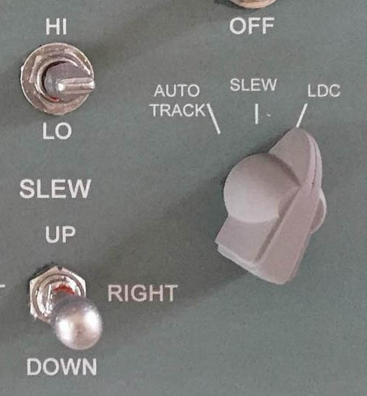
Rather than being phase-synced by design, the power to the ACTA and CDUs could be in phase or out of phase randomly, depending on the exact moment the rendezvous radar was activated by the crew.
The equipment expected all of its components to be in phase, and when they weren’t…weird stuff happened.

Slide 40
120x Alarms: Cause & Effect
The out-of-phase condition caused the CDUs and the ACTA to see each other’s signals as garbage instead of as valid radar dish position data
The CDUs began to frantically try to fix things by sending “MOVE THE DISH” signals to the guidance computer, as fast as it could generate them
This resulted in 12,800 unplanned spurious hardware signals per second slamming into the computer

Slide 41
120x Alarms: Cause & Effect
Handling those commands requires some amount of computing power
The 12,800 unplanned radar commands per second sucked up about 15% of the computer’s processing time and broke the carefully-planned program flow in the guidance computer
The computer was no longer able to service its joblist within its 960ms cycle time
Temp storage areas normally emptied and available at the end of each 960ms cycle weren’t being emptied because the jobs were lagging due to the extra 15% load

Slide 42
120x Alarms: Cause & Effect
And here’s where the genius of the AGC’s design shone.
When the overflow occurred, the computer displayed the “help, my temp storage is full” error code — 1201 (“EXECUTIVE OVERFLOW: NO CORE SETS”)
But rather than hanging or crashing, the computer automatically executed its BAILOUT restart routine
BAILOUT simply flushed the temp areas and restarted the current job list — the spacecraft retained its guidance data and the flight continued uninterrupted
Notes:
Here we get to see exactly how well planned the guidance computer’s design was. Even though these kinds of alarms should have been impossible, the scientists and grad students at MIT who designed the software had built in the capacity for the computer to execute a soft-restart of itself, where it simply dumped all its work and started over on its tasklist. Because the overflow wasn’t large, it took anywhere between several seconds and several minutes for it to recur. After a couple of occurrences, MCC figured out that the problem had to do with the radar and told the spacecraft that they’d monitor stuff and to not worry about it.

Slide 43
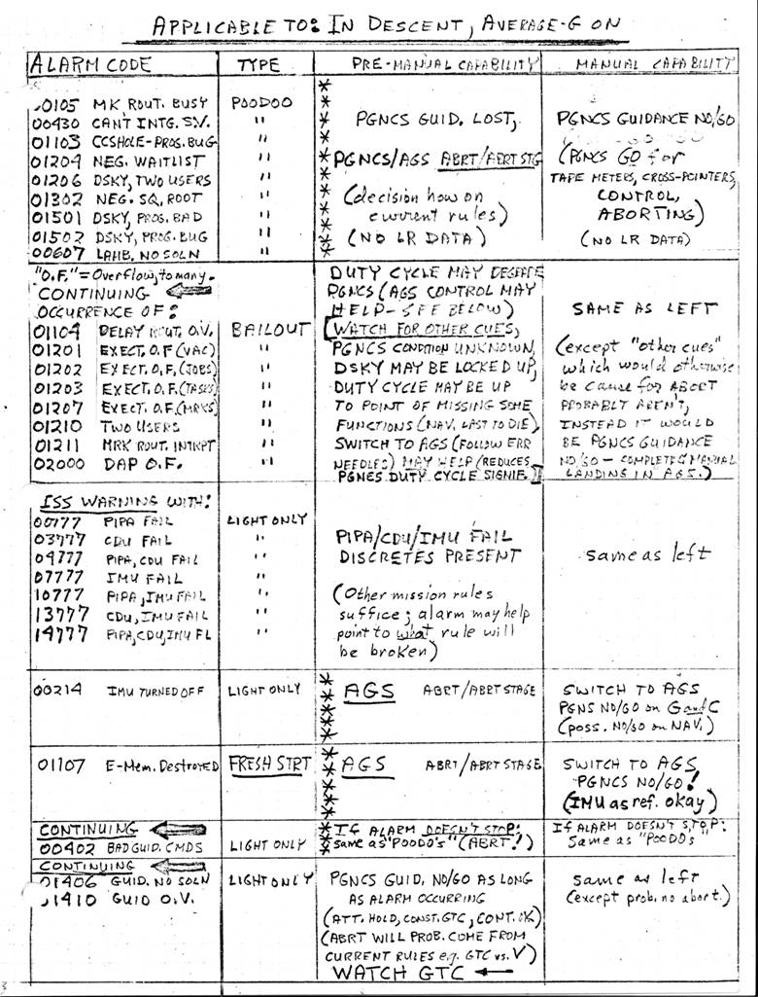
How’d they know so quick?
During previous sims, controllers had been too quick to call an abort in response to computer trouble
Flight director Kranz instructed GUIDO backroom controller Jack Garman to memorize every single computer error in case this happened during a mission
So he did—and then it happened during a mission
For his quick thinking, controllers began calling Garman as “GAR-FLASH”

Slide 44
Optional fun activity: the actual sync’d mission audio
https://www.firstmenonthemoon.com/
(If you guys want to experience how this went down in real-time!)

Slide 45
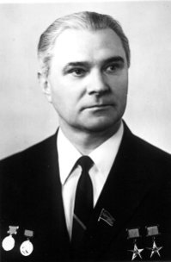
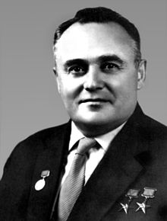
Lastly: What about the USSR?
The Soviet space program was locked in a push-pull war between two chief designers,Valentin Petrovich Glushko (left) and Sergei Pavlovich Korolev (right). It was a bitter and acrimonious rivalry that effectively destroyed any chance the USSR had to mount an effective response to Project Apollo.
Notes:
capitalist approach vs. communist approach

Slide 46
Why were they fighting?
Korolev favored rocket designs
powered by cryogenic propellants…
…while Glushko preferred designs
powered by hypergolic propellants.
Both have advantages and disadvantages.
Notes:
Cryogenic propellants are things like liquid hydrogen and liquid oxygen. They are very cold and difficult to store and transport because they must be kept at hundreds of degrees below zero and they’re constantly trying to boil off. You cannot leave a cryogenically fueled rocket sitting on the pad for very long or its fuel will evaporate. Hypergols, otoh, are easily storable and don’t require massive insulation; they can be left in a rocket for days (or more), doing away with having to fuel and de-fuel a rocket multiple times. On the other hand, the chemicals we use as hypergolic propellants are MURDEROUSLY TOXIC and HIDEOUSLY CORROSIVE. They are incredibly dangerous in the short term and if they don’t kill you in minutes, they’ll give you cancer later. A rocket burning H2+O2 produces steam and water vapor; a rocket burning DNT+Hydrazine produces cancersmoke. Spilling cryogenic fuels is a pain in the ass to clean up; spilling hypergols is a legit evacuate-the-surrounding-area-immediately emergency.

Slide 47
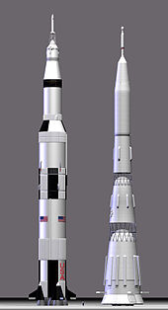
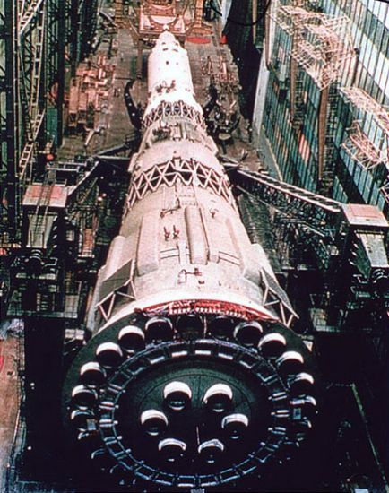
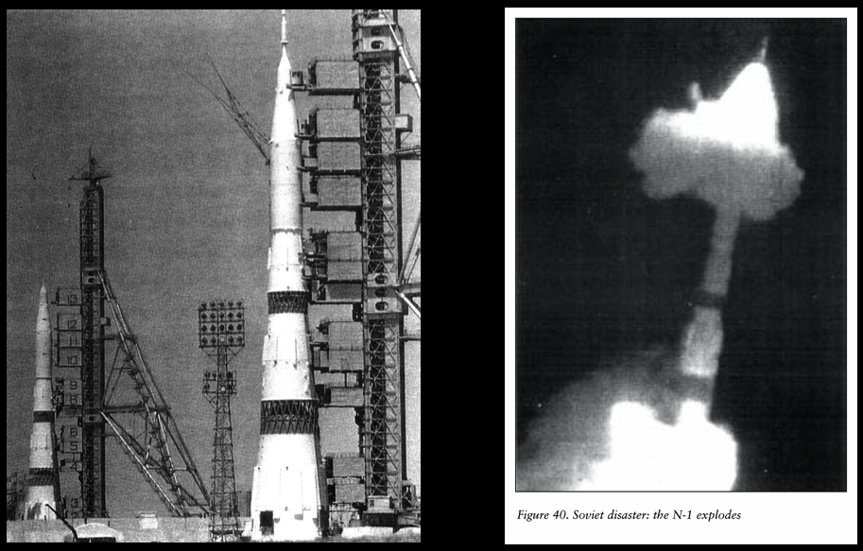
The USSR’s big candle
The Soviet “Moon rocket” (repurposed from Korolev’s initial design study for sending humans to Venus) was an enormous beast called the “N1,” and it was even more powerful than the Saturn V.
It had four launches between 1969 and 1972 and all four ended in failure. The N1 was Korolev’s grandest design, and after Korolev’s death, Glushko forced the rocket’s cancellation.
There is every indication that the rocket’s fifth flight would have been a success.
Notes:
We out-spent them. It was yet another area where Apollo was a strategic victory against the USSR.
This wikipedia article is a good jumping-off point if you want to fall down the Soviet space rabbit hole and spend a few hours reading about stuff.

Slide 48
Do you want to know more?
Apollo: The Race to the Moon, by Charles Murray & Catherine Bly Cox
A Man on the Moon, by Andrew Chaikin
How Apollo Flew to the Moon, by David Woods
Flight: My Life in Mission Control, by Chris Kraft
The Apollo Guidance Computer: Architecture & Operation, by Frank O’Brein
Chariots for Apollo: A History of Manned Lunar Spacecraft, by Brooks, Grimwood, & Swenson
Challenge to Apollo: The Soviet Union and the Space Race, by Asif Siddiqi (see presenter notes for link)
Ракеты и люди (“Rakety i Lyudi,” or “Rockets and People”), by Boris Evseyevich Chertok (see presenter notes for link)
Notes:
Siddiqi’s work is available in two volumes from Amazon (part one, part two) or as a pair of PDFs for free from NASA (part one, part two).
Chertok’s work is available as a four-volume set from Amazon (here) for free from NASA (here).

Slide 49
“If we die, we want people to accept it. We are in a risky business, and we hope that if anything happens to us, it will not delay the program. The conquest of space is worth the risk of life. Our God-given curiosity will force us to go there ourselves because in the final analysis, only man can fully evaluate the Moon in terms understandable to other men.”
–Gus Grissom

