Slide 1
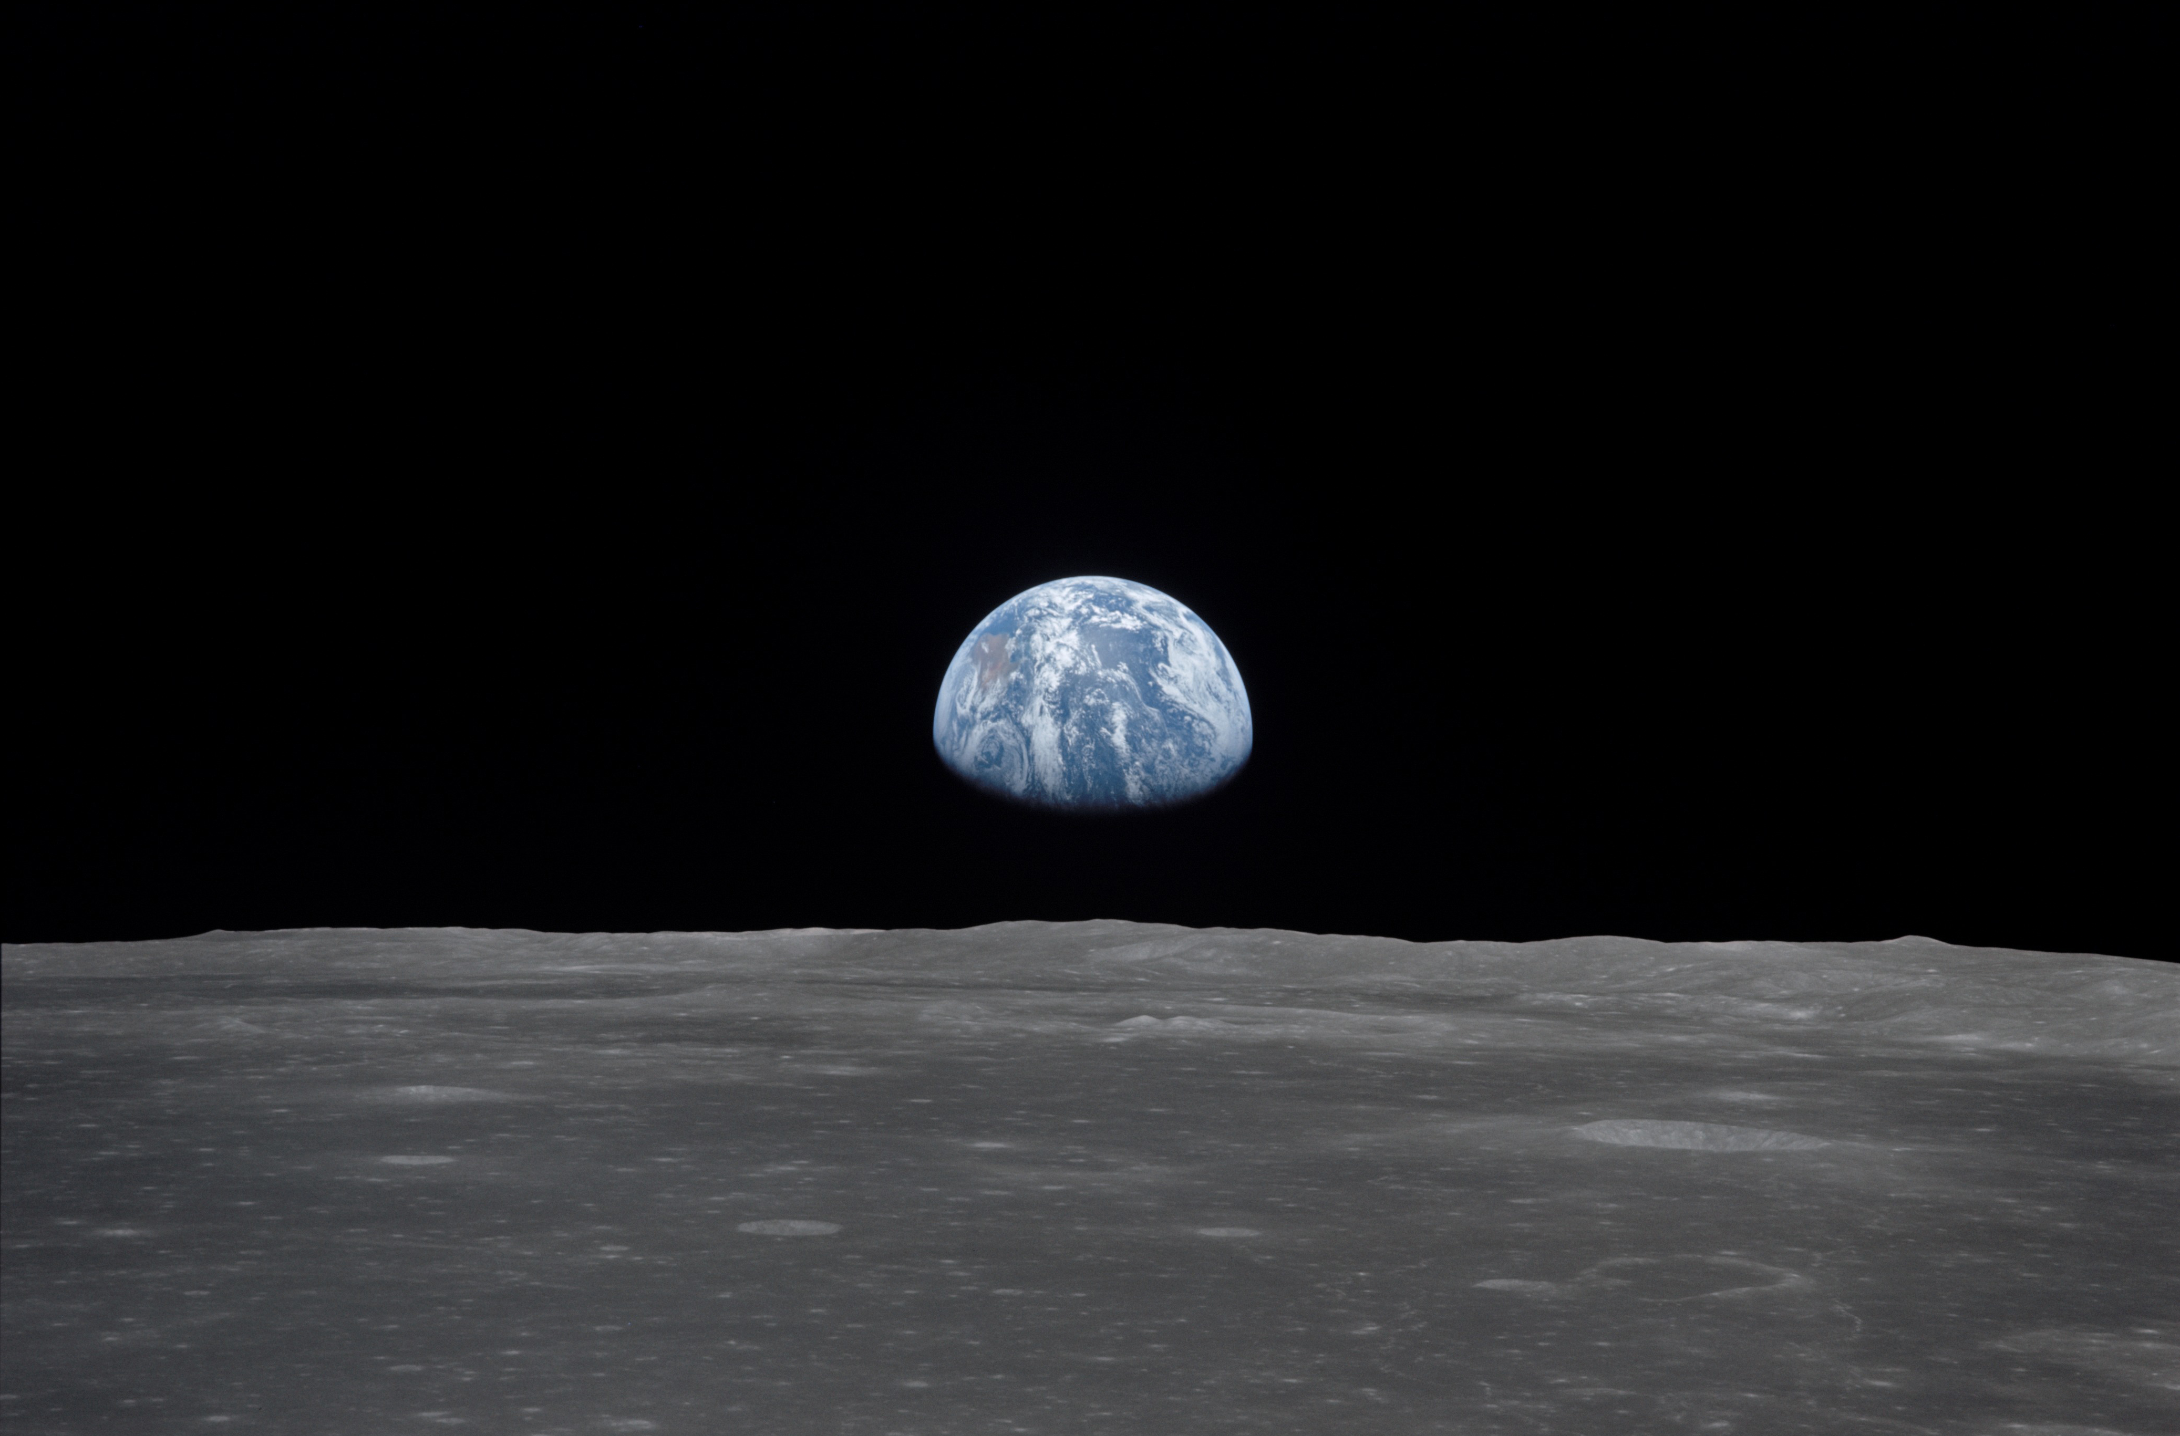
NSS North Houston Space Society Space News
May 2, 2020
Greg Stanley

Slide 2
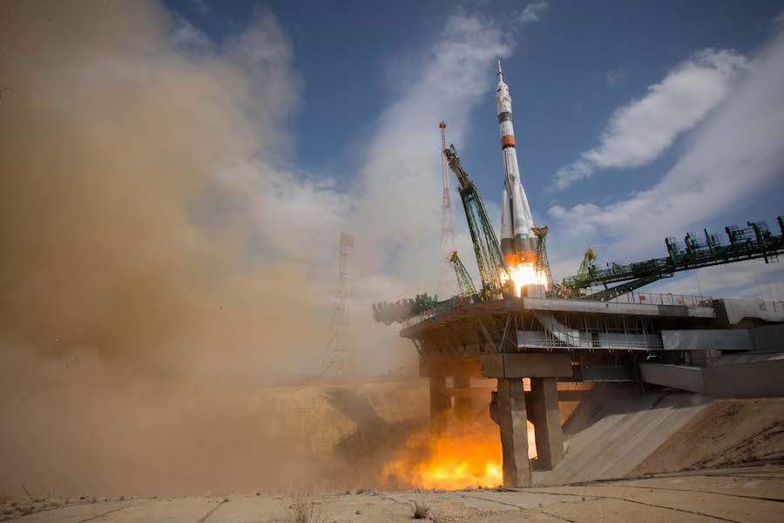
International Space Station (ISS)
Crew of 3 (1 American, 2 Russians) launch from Kazakhstan …
… Hopefully the end of an era, as US crewed launches should begin soon

Slide 3
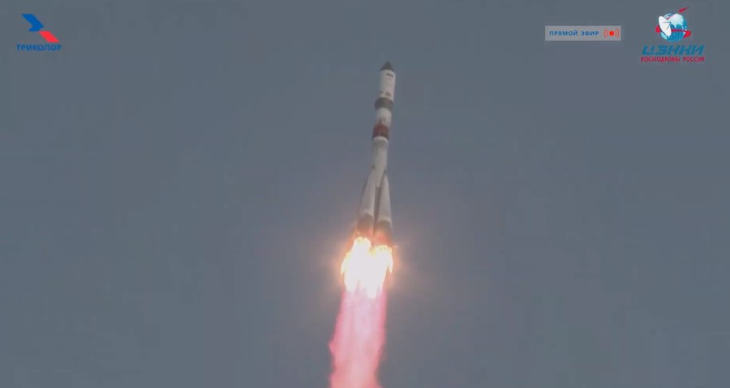
International Space Station (ISS)
Crew of 3 (2 Americans, 1 Russian) return to Kazakhstan in a Soyuz capsule
Cargo launch (Soyuz)

Slide 4
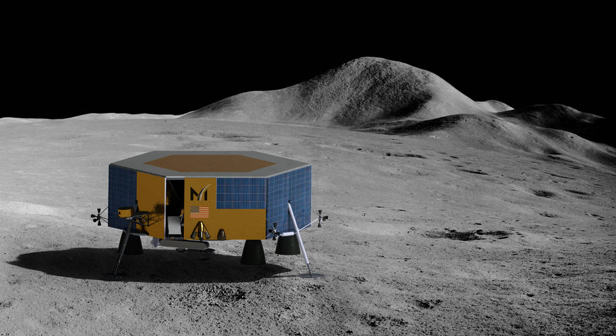
NASA Contracts Masten Space Systems for robotic lunar landing in 2022
$76 M to deliver 9 science and technology instruments to the moon’s south pole in late 2022 (including a rover, and a robotic arm)
Fourth company receiving task orders through NASA’s Commercial Lunar Payload Services (CLPS)
First mission to softly land at a lunar pole
Payload of 80 kg
Hundreds of additional kgs available for Masten to sell to others
Launcher not yet announced

Slide 5
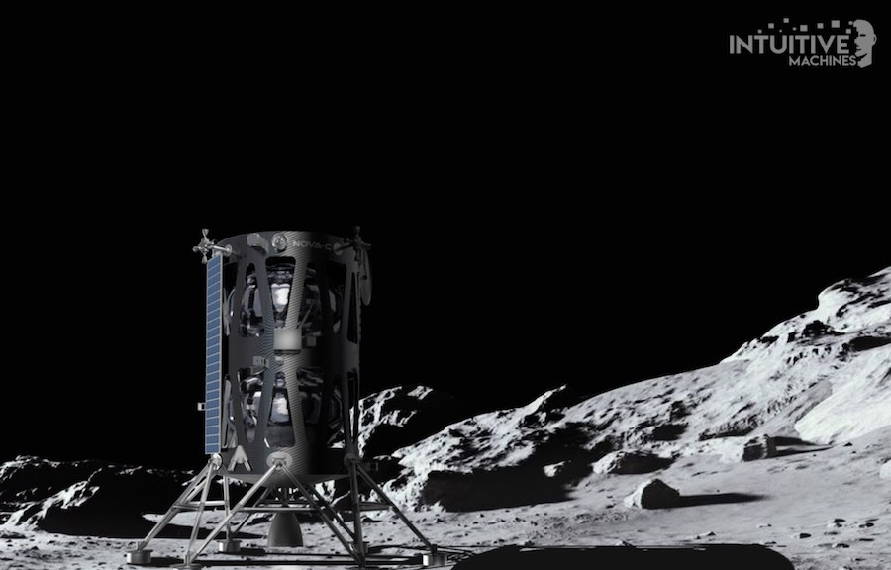
Intuitive Machines (Houston) announces Oct. 2021 moon launch date and landing site
NASA contracted $77 M for a robotic lander to deliver 9 science instruments to the moon in Oct. 2021
Task order through NASA’s Commercial Lunar Payload Services (CLPS)
Landing near a deep, narrow valley, likely a collapsed volcanic lava tube (not near a pole)
To launch on a SpaceX Falcon 9 rocket
100 kg payload

Slide 6
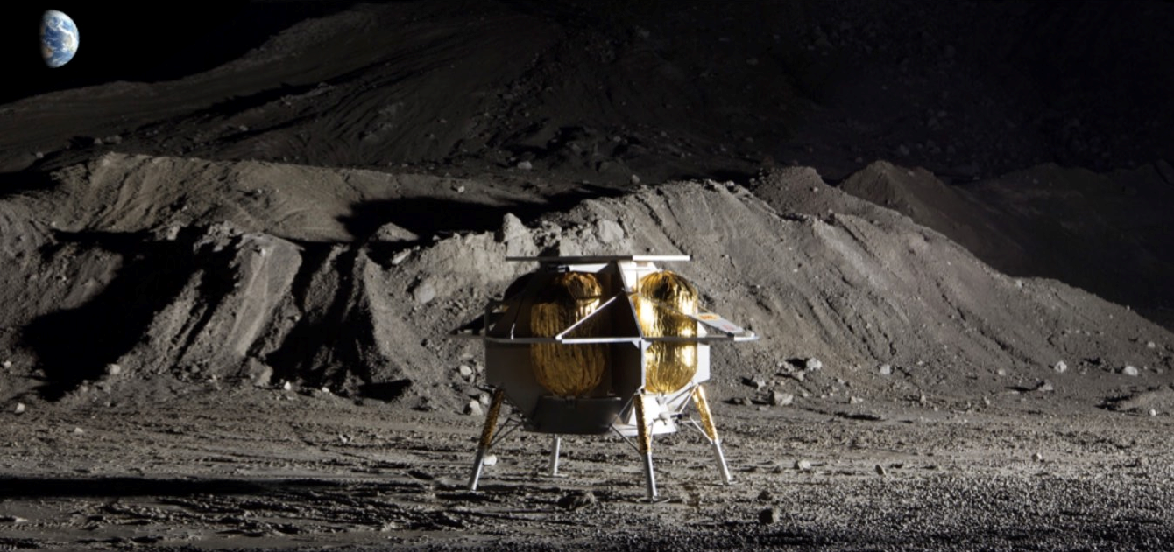
Astrobotic (Pittsburgh) is the other company with a lunar landing in 2021
NASA contract: $79.5 M for a robotic lander to deliver payloads to the moon in Oct. 2021
Task order through NASA’s Commercial Lunar Payload Services (CLPS)
90 kg payload
Commercially available rate: $1.2M / kg

Slide 7
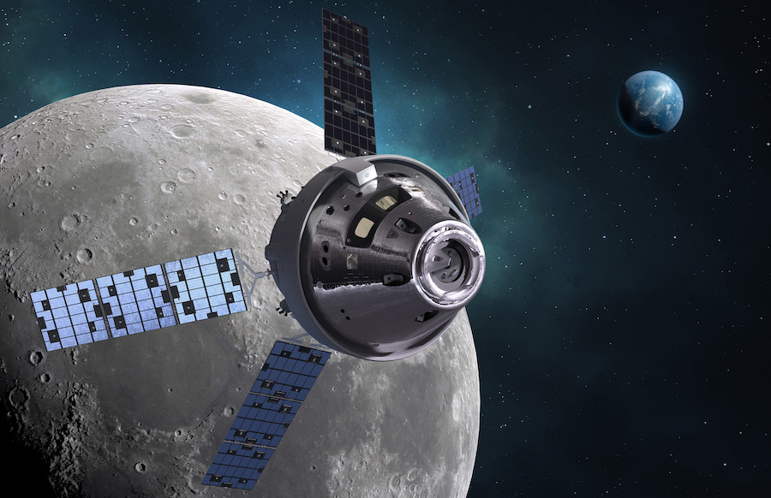
NASA $1B Phase 1 funding for lunar “Human Landing System” (HLS)
NASA selects companies to develop crewed lunar landers
Part of overall Artemis program to get back to the moon
Phase 1: 10 months, nearly $1B
All phases cost $18.4 B through end of 2024
Each contractor must provide private funding for design & development
Orion spacecraft. Credit: Lockheed Martin

Slide 8
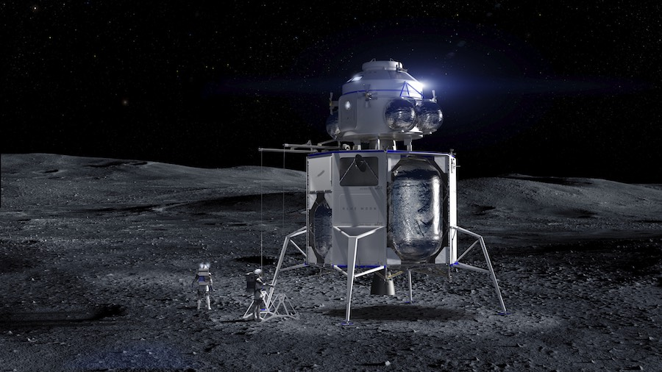
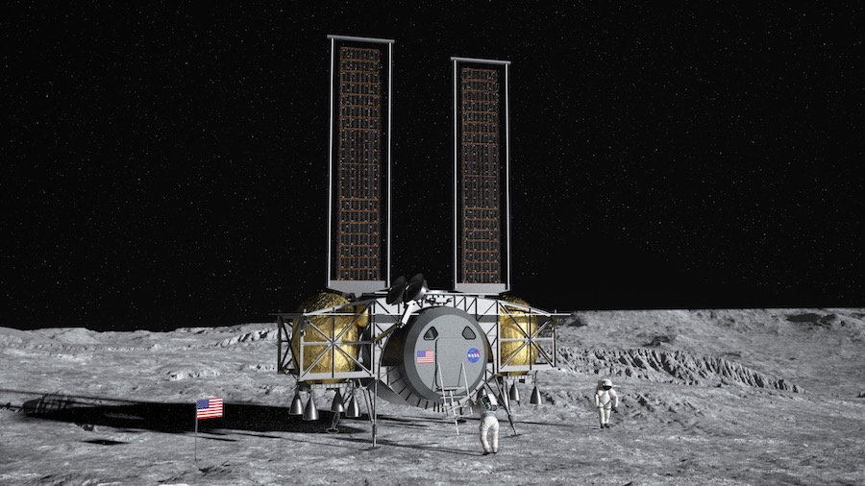
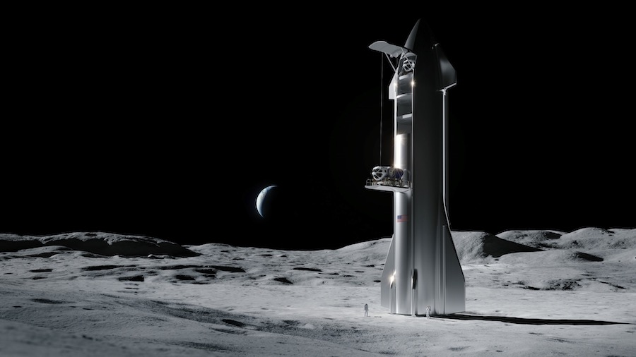
3 Companies in NASA Phase 1 funding for lunar “Human Landing System” (HLS)
Blue Origin (partnered with Lockheed Martin & Northrop Grumman) $579 M
SpaceX $135 M
Dynetics (partnered with Sierra Nevada Corp.) $253 M

Slide 9
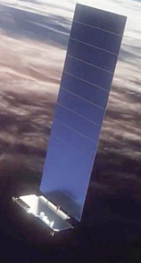
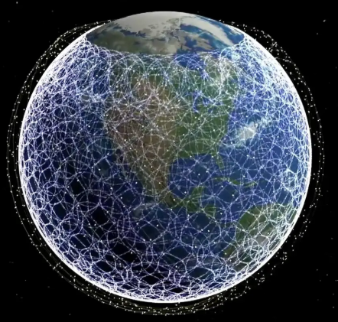
SpaceX/Starlink update
Now launched 420 satellites
Astronomers are worried about brightness and number of satellites
Solutions now being implemented
Adding a light-blocking panel of radio-transparent foam
Changing orientation during initial orbit-raising and final orbits

Slide 10
How many launches since the last meeting?
Yes, this includes failed launches

Slide 11
Launches Since Last Meeting (Apr. 4, 2020)
Apr. 24/25 – Soyuz – Cargo to ISS
Apr. 22 – Falcon 9 – SpaceX 7th batch of 60 Starlink communications satellites
Apr. 22 – Qased (Iranian)– Noor military satellite
Apr. 9 – Long March 3B – Palapa N1 communication satellite (Indonesian) - FAILED
Apr. 9 – Soyuz – Crew to ISS. Capsule also an escape pod for 6 months
https://spaceflightnow.com/launch-log/

Slide 12
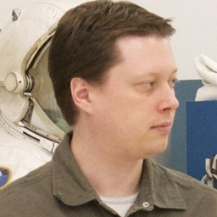
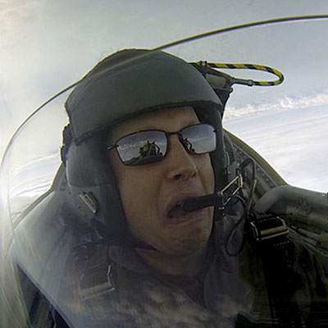
Featured Speaker: Lee Hutchinson
Senior Technology Editor, Ars Technica
Oversees story development for gadget, automotive, IT, and video sections of Ars Technica
Writes about manned space flight, gaming
Extensive background in enterprise storage and security
Decade at Boeing as an enterprise architect, then EMC and Symantec

