Slide 1
NSS North Houston Space Society
April 2020

Slide 2
Agenda
2:00 Opening Comments – Nathan Price
2:10 Recent Space News Greg Stanley
2:20 Guest Speaker: Vickie Kloeris - ISS Food System Manager
3:00 Q&A and Open Discussion

Slide 3
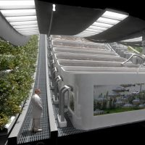
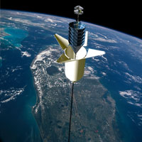
National Space Society Vision
People living and working in thriving communities beyond the Earth, and the use of the vast resources of space for the dramatic betterment of humanity.

Slide 4
Do you share this vision?

Slide 5
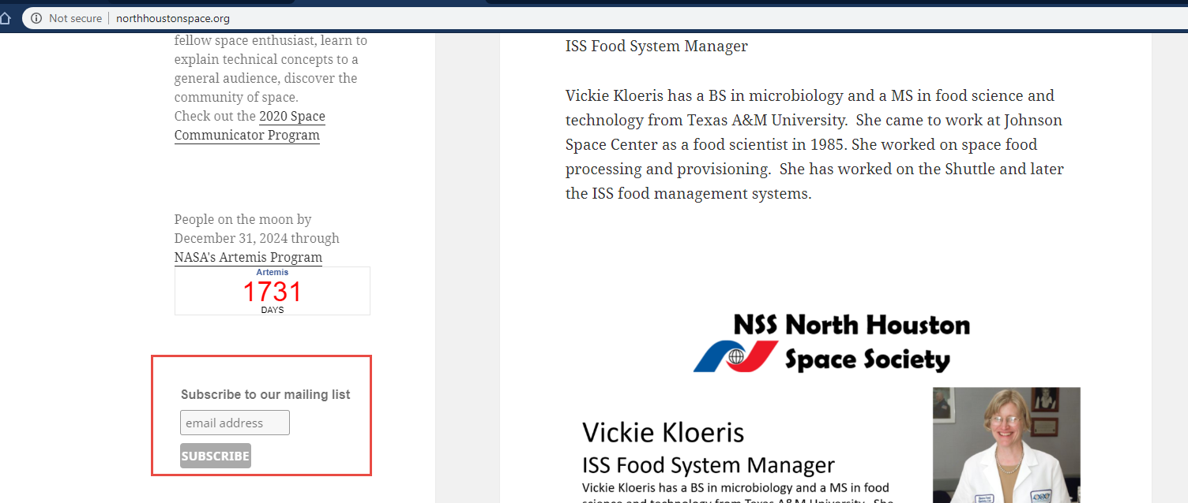
Join the NSS North Houston Space Society Mailing list
Visit http://NorthHoustonSpace.org
Scribe from left side bar

Slide 6
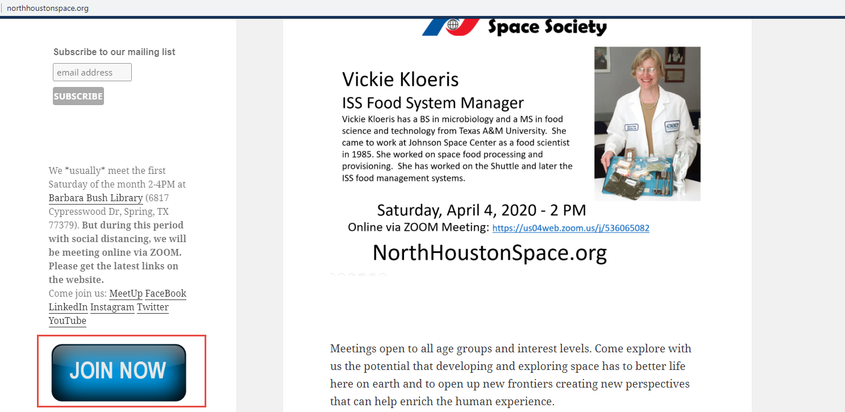
Join the National Space Society
Visit http://NorthHoustonSpace.org
Click on “Join Now” to go to the National Space Society’s website

Slide 7
Meeting IS being RECORDED
This meeting is being recorded and will be posted on YouTube, NorthHoustonSpace.org, Facebook, etc.

Slide 8
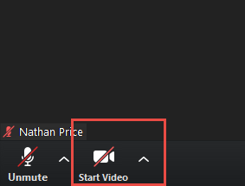
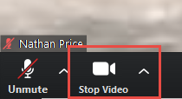
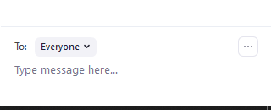
How to use ZOOM - Video & Mute & Chat
Video is turned off by default. Turn it on when you are ready:

