Slide 1
NSS North Houston Space Society
April 4, 2020

Slide 2
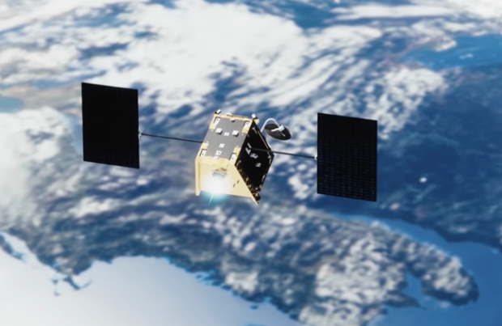
Space-related news - OneWeb
(Satellite-based internet, competing with SpaceX Starlink, Telesat –June 2019 meeting)
OneWeb launched batch of 34 satellites, now at 74 of planned constellation of 650 satellites

Slide 3
Space-related news - OneWeb
(Satellite-based internet, competing with SpaceX Starlink, Telesat –June 2019 meeting)
OneWeb launched batch of 34 satellites, now at 74 of planned constellation of 650 satellites (March 21st)
OneWeb filed for bankruptcy, like so many previously … Iridium, Orbcomm, Globalstar, Teledesic, Skybridge (March 27th)
Blaming COVID-19 for delays in financing (need another $7.5 Billion)
… and you thought you could avoid virus talk here!
Probably doomed anyway
Higher cost launch & groundstation cost vs. Starlink, no deep pockets like Amazon’s Project Kuiper, no ongoing operations like Iridium, Orbcomm and Globalstar
Major backer Softbank has other cash flow problems
But, like Iridium, Orbcomm, & Globalstar, may re-emerge, or at least assets will probably get bought and used
Elon Musk: "Guess how many constellations didn’t go bankrupt? ... Zero. It’d be a big step to have more than zero in the not-bankrupt category.”

Slide 4
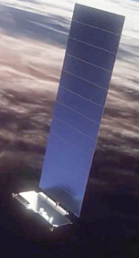
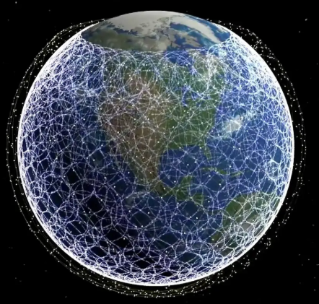
Space-related news – SpaceX/Starlink
Received FCC license for up to 1 million (customer) data terminals
They’re not pizza-box shaped, they’re a
…”THIN FLAT ROUND UFO ON A STICK”*
Motors self-adjust for optimal angle
Instructions*
Plug in socket
Point at sky
Works in either order. No training required.
* Direct quotes from Elon Musk

Slide 5
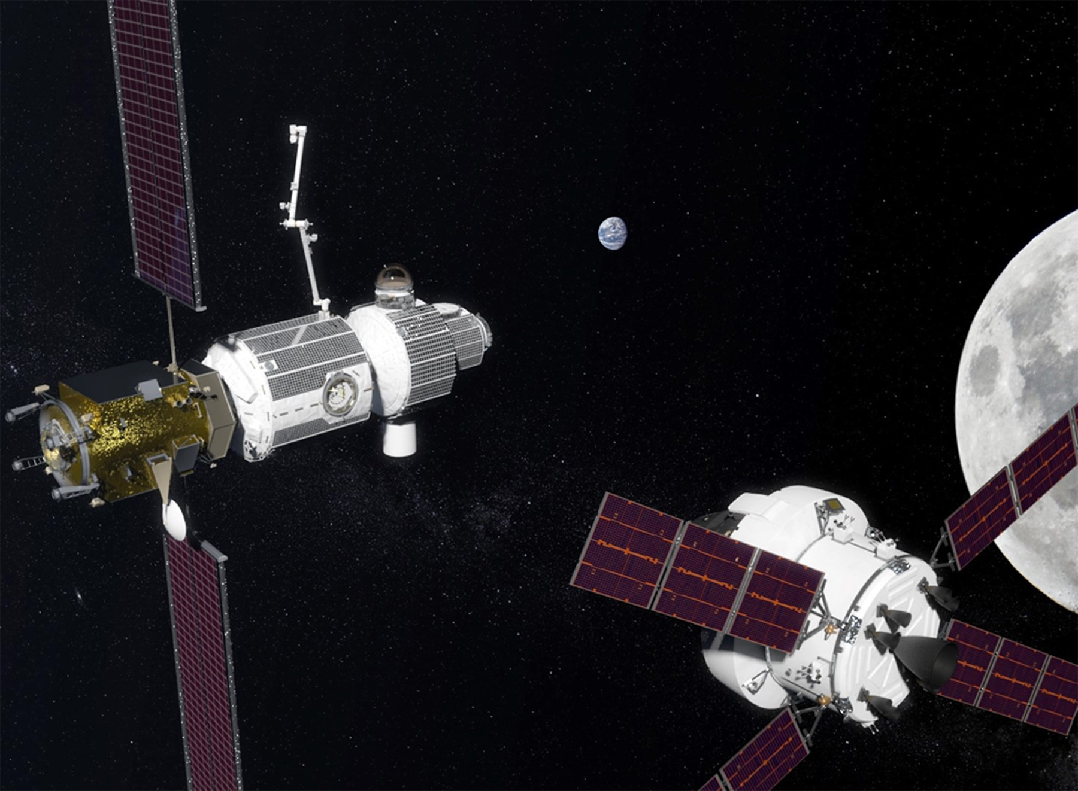
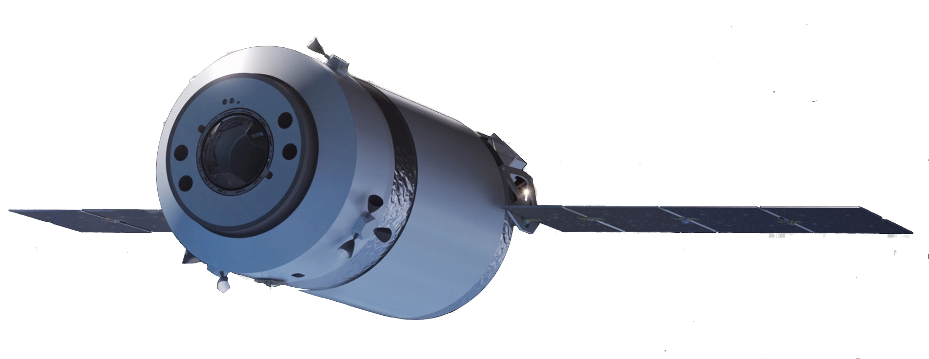
Space-related news – SpaceX
NASA selected SpaceX to provide transportation service to the Lunar Gateway for Artemis
SpaceX revealed new Dragon XL cargo spacecraft, variant of Dragon
BUT: Gateway is “removed from critical path” for 2024 lunar landing. Will it ever get built?

Slide 6
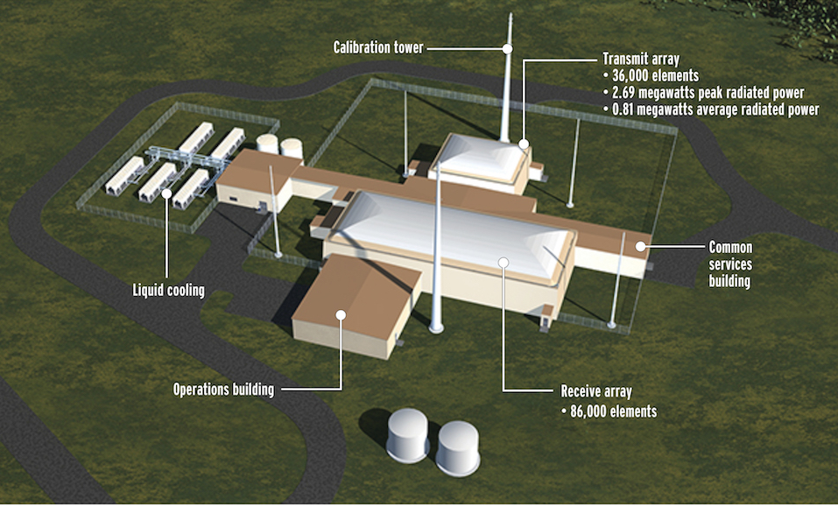
Space-related news – “Space Fence”
$1.5 Billion “Space Fence” U.S. radar in Marshall Islands completed
For tracking satellites and space debris
Can detect a marble in low Earth orbit

Slide 7
Space-related news - COVID-19 impact
OneWeb bankruptcy
ESA (European Space Agency) delaying 4 launches
Rocket Lab (New Zealand) postpones launch
Bigelow Aerospace laid off ALL its employees. Future unclear.
Investors pulling back on small companies is a concern
Example: Leo Aerospace (balloon-borne small launch vehicles) “going into hibernation”
Delays in SLS testing, James Webb Space Telescope, …
Conference cancellations, almost everyone working at home, etc.
We started videoconference meetings!

Slide 8
How many launches since the last meeting?

Slide 9
Launches Since Last Meeting (Mar. 7, 2020) https://spaceflightnow.com/launch-log/
Mar. 26,2020 - Atlas 5 - U.S. Military communications satellite
Mar. 23/24, 2020 – Long March 2C – 3 Chinese military surveillance satellites
Mar. 21, 2020 – Soyuz – 34 OneWeb satellites
Mar. 18, 2020 - Falcon 9 – 60 SpaceX Starlink satellites
Mar. 16, 2020 – Soyuz – Russian navigation satellite
Mar. 16, 2020 – Long March 7A (Failed) – Chinese classified satellite
Mar. 9, 2020 – Long March 3B – Chinese navigation satellite
Mar. 6/7, 2020 – Falcon 9 – SpaceX cargo to ISS

Slide 10
Featured Speaker: Vickie Kloeris
34 years as NASA manager of space food systems for ISS (International Space Station) and Shuttle (recently retired)
Author or coauthor of numerous publications
Awards
NASA Distinguished Service Medal (NASA’s highest award) (2019)
NASA Exceptional Service Medal (twice)
Johnson Space Center Director’s Commendation Award
Outstanding Alumni Award, College of Agriculture & Life Sciences, Texas A&M (2017)
Institute of Food Technologists (IFT) – Certified Food Scientist
In 3rd year of 3-year term on IFT Board of Directors
President Elect, 3 year term as President starting Sept, 2020
Education
B.S. Microbiology; minor in Chemistry from Texas A&M
M.S. in Food Science and Technology from Texas A&M

