Slide 1
Community Space
BY: Adam Hawkins

Slide 2
Overview:
There are many ways to get involved with the community in the world of space. Today I will discuss three different opportunities (one is open to everyone, one is open to students in community college system, and one is open to students in an undergrad environment).
Mars Desert Research Station (MDRS), Utah Location – The Mars Society
NASA Community College Aerospace Scholar Program
NASA Lucy Student Pipeline Accelerator and Competency Enabler (L’SPACE) Virtual Academy

Slide 3
MDRS – The Mars Society
There are a few ways you can get involved with MDRS
Before season and post season volunteering to prep/cleanup for other seasons
Volunteer to be Capcoms during “missions”
Be a part of the astronomy team
Be a part of the web development team
Be a participant in field season on site (this method has a cost associated with it)
https://mdrs.marssociety.org/call-for-volunteers/

Slide 4
MDRS – The Mars Society – Apply to Field Season
Two ways to register
Individually with chance of being paired with a team or fill in for a dropped spot
Register a full crew at once
Cost
Profession Fees - $1000/wk or $2000 for standard two week rotation
Student Fees - $750/wk or $1250 for standard two week rotation
Roles: Executive Officer, Health and Safety Officer, Crew Engineer, Greenhab officer, Crew Scientist, Crew Astronomer, Crew Artist, and Crew Journalist. Minimum of 6 people on a crew.
https://mdrs.marssociety.org/apply-to-field-season/

Slide 5
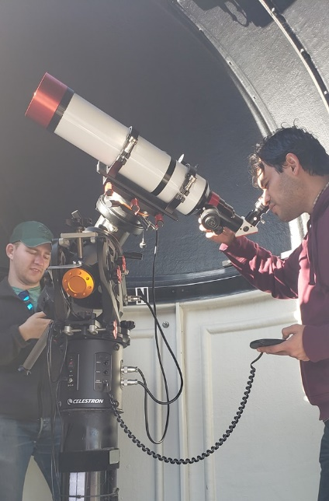
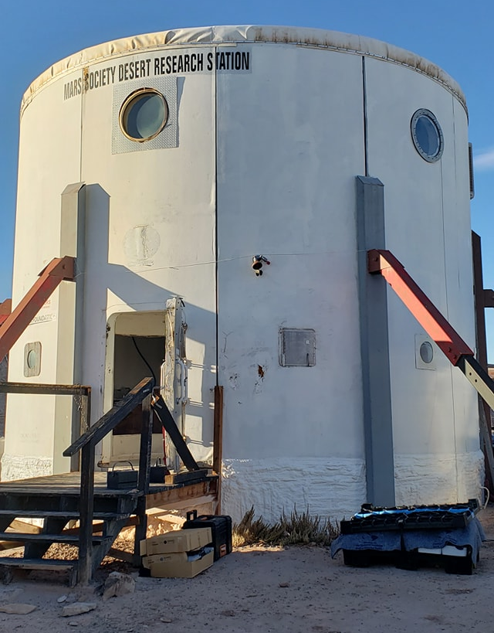
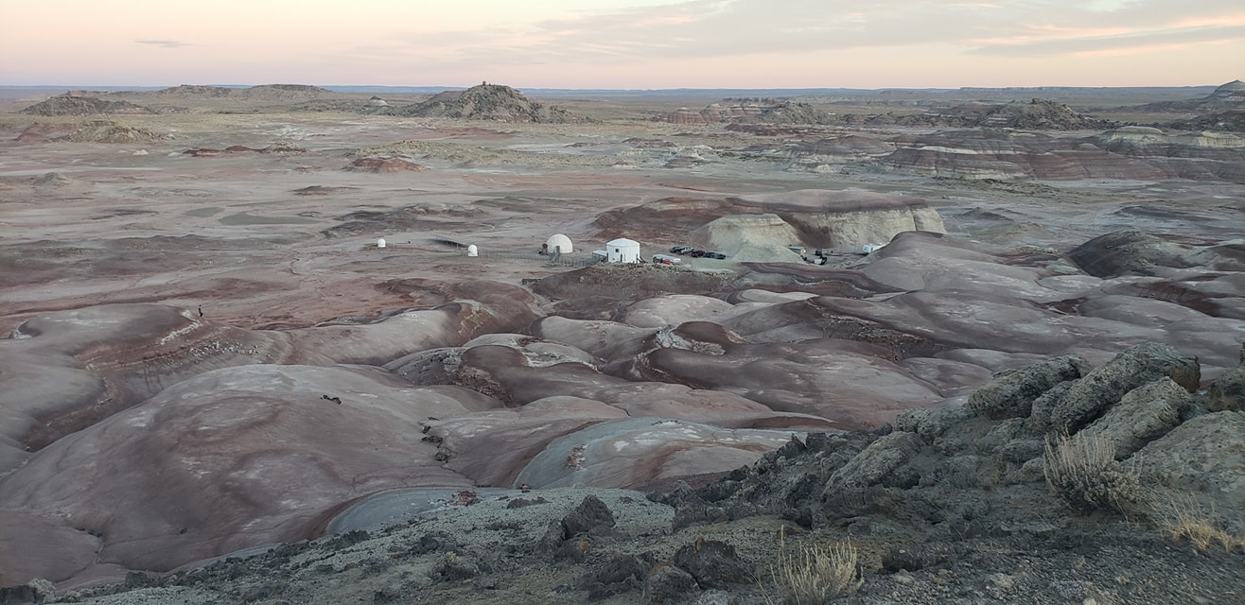
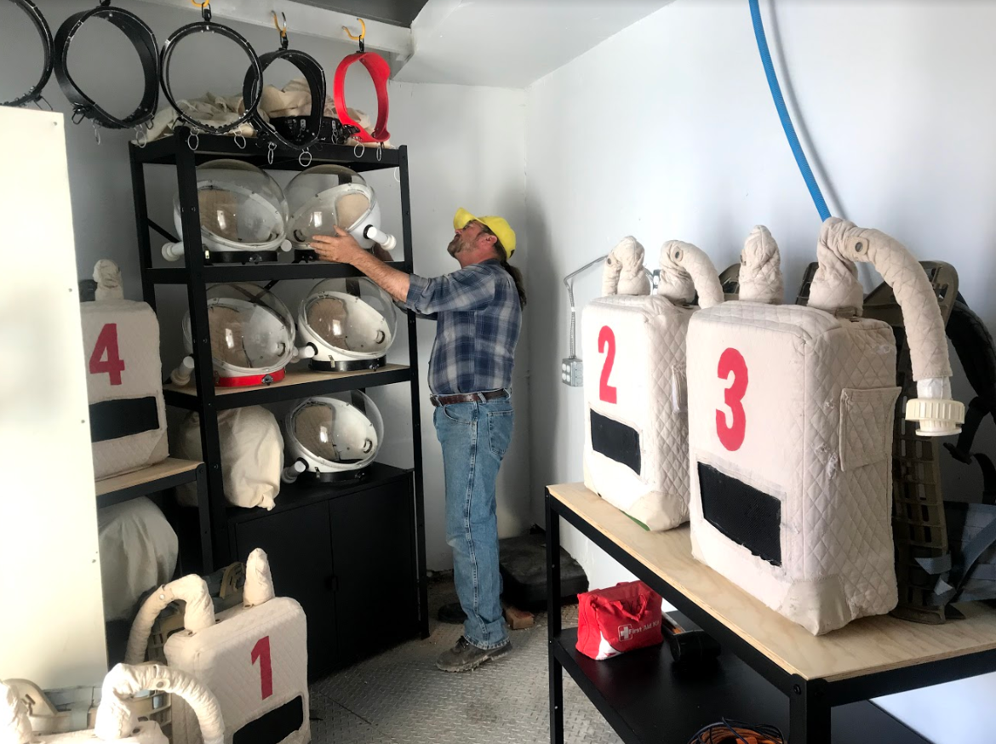
My Involvement (MDRS):
Mars Desert Research Station (MDRS) Habitation Remodel
Worked with a volunteer crew and Mars Society to get MDRS up to date for the 2019/2020 season
Built Habitat Furniture
Prepared Surrounding Areas
Setup Green Hab unit

Slide 6
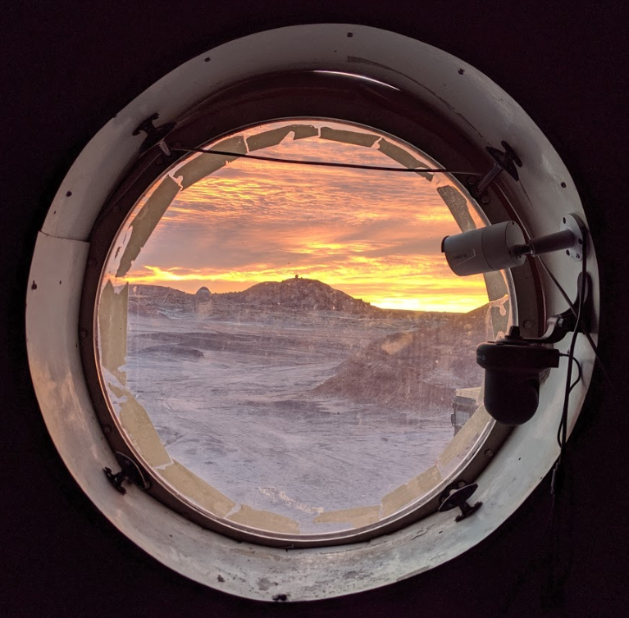
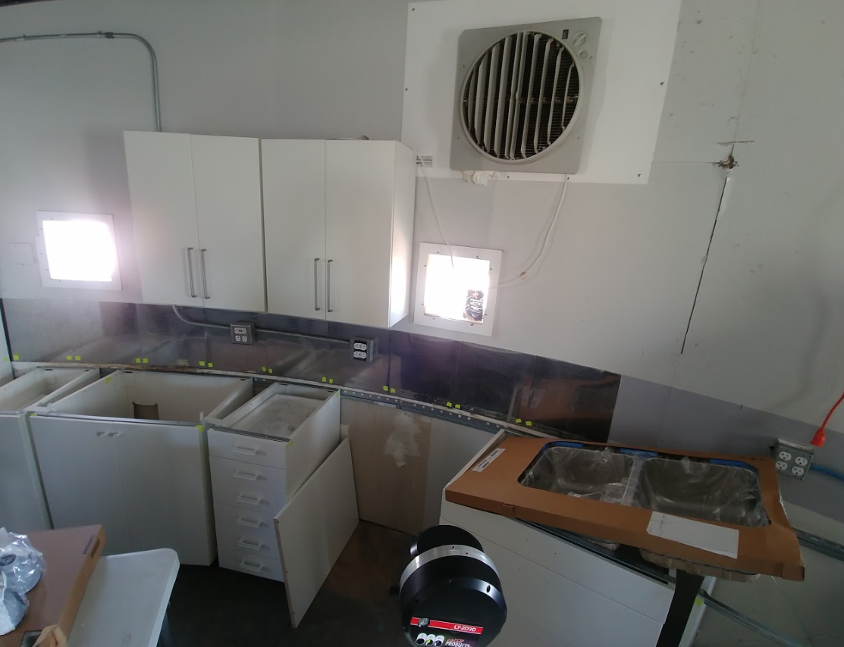
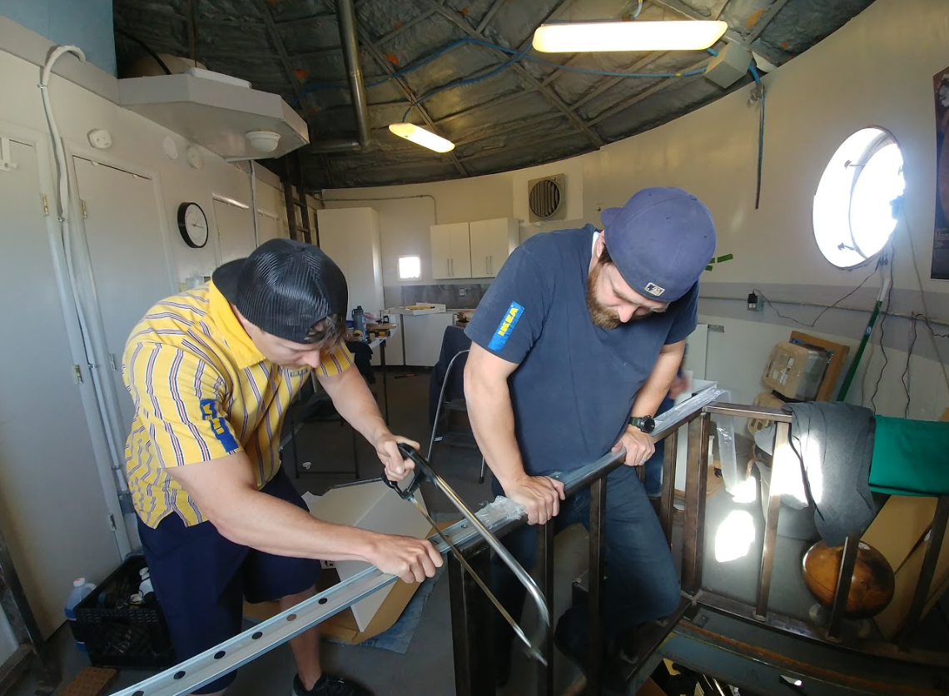
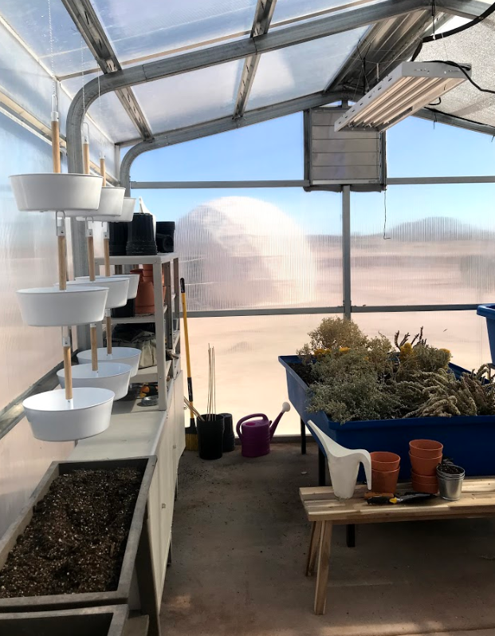
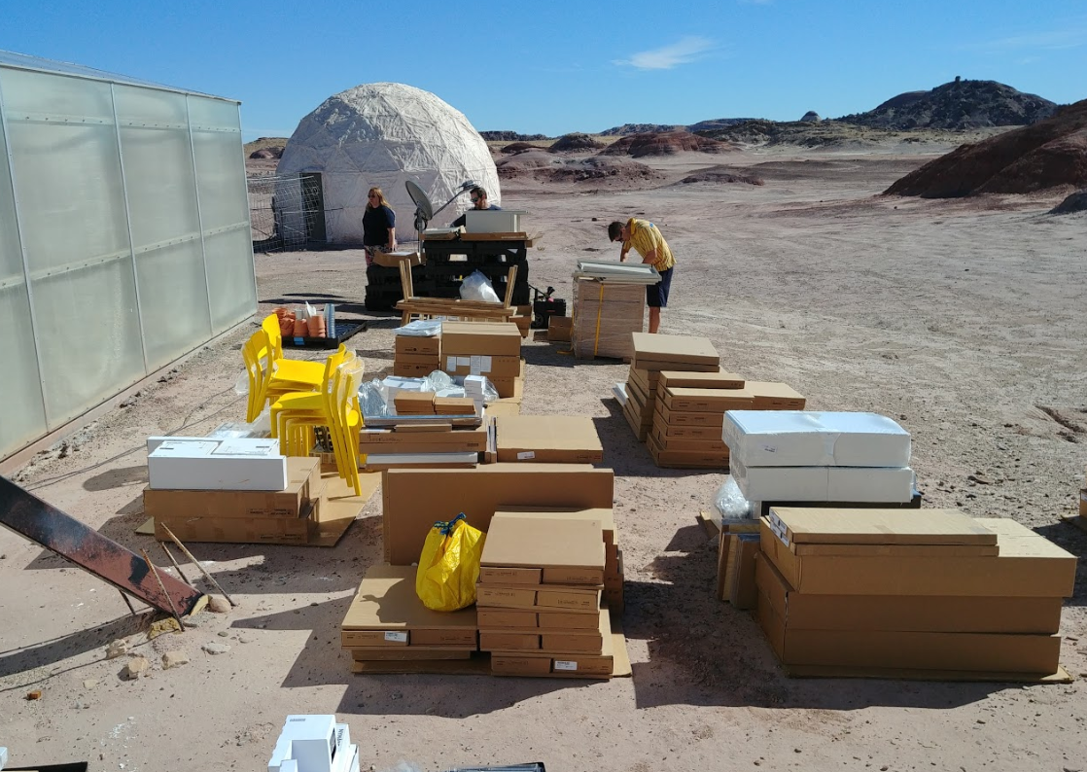
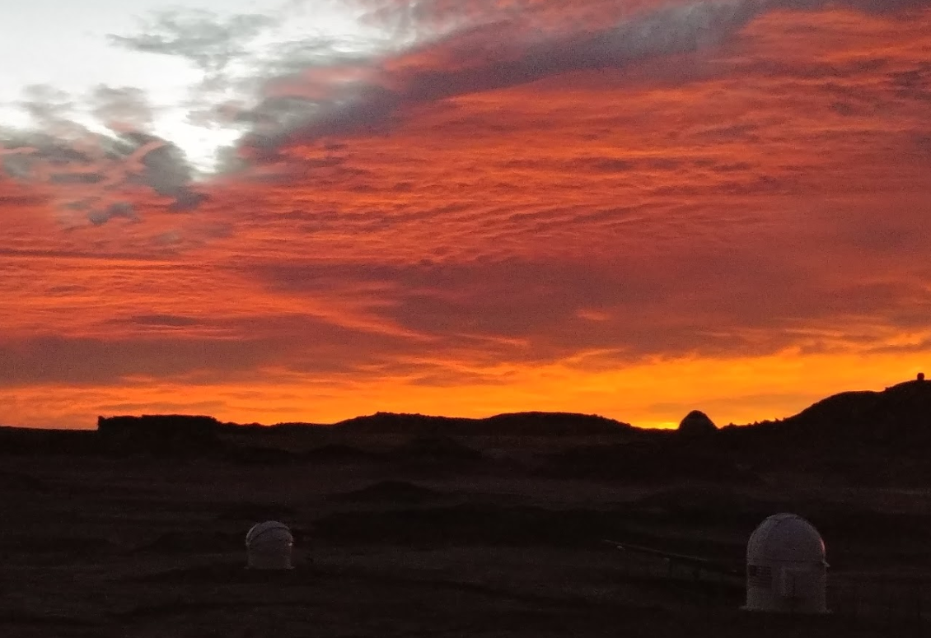
My Involvement (MDRS) More Pictures:

Slide 7
NCAS – NASA Community College Aerospace Scholar
NASA gives community college STEM students an authentic NASA experience and encourages them to finish a 2-year degree or transfer to a 4-year university to pursue a NASA-related field or career.
https://nas.okstate.edu/ncas/
This program has two parts associated with it:
Part 1 – 5 Week online class where you complete 6 modules and write a 10-page research paper or do a project.
Part 2 – If you successfully complete part 1 with high merit, you are invited for an onsite portion where you visit a NASA center for a week, view the facility, meet NASA employees, and compete in a ROVER competition.

Slide 8
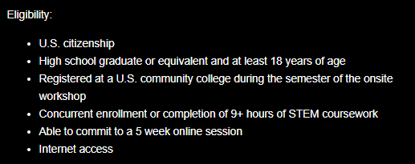
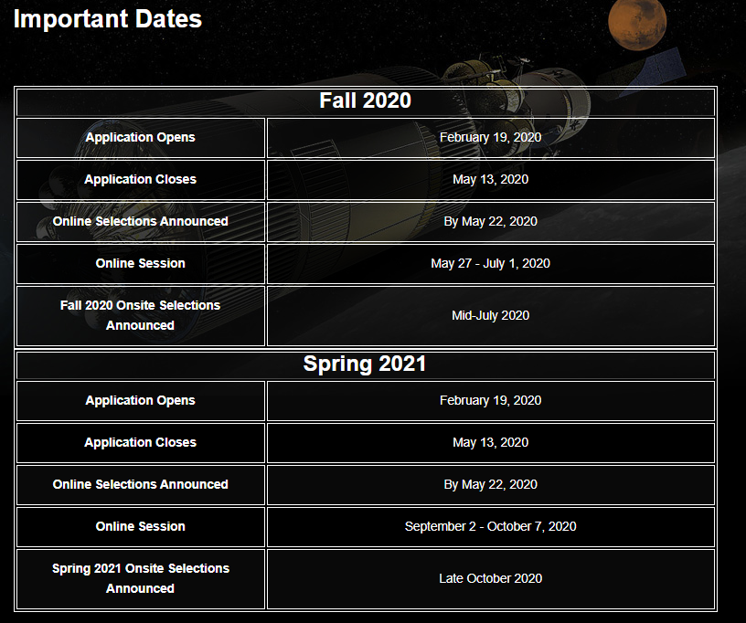
NCAS – NASA Community College Aerospace Scholar – Eligibility and Important Dates

Slide 9
My NCAS experience:
The six modules we had to complete include (note this varies each session):
The past and Present Exploration of Mars
The Human Exploration of Mars
The international Space station
Earth: Your Home, Our Mission
Solar System and Beyond
Exploring Flight and NASAs impact on aviation
Successfully completed online class with 98/100 which included 6 module exams and a 10-page research paper with NASA employee mentor covering inflatable habitats and importance of CO2 Scrubbing/Recycling
Invited to On-site portion at Stennis Space Center on July 13-17, 2020. (possible follow up to share this experience)
The three possible project/research paper selections include:
10-page paper on In-situ Resource Utilization (ISRU) Capabilities
10-page paper on Habitation System Concept Studies
Mars Rover design Project inclusive of CAD modelling

Slide 10
NASA Lucy Student Pipeline Accelerator and Competency Enabler (L’SPACE) Academy
L’Space has two separate academies that undergraduate students can select from and be chosen to participate in:
Mission Concept Academy
Receive Mission development skills training each week from NASA scientists and engineers and collaborate with other students to design a mission-related team project.
NASA Proposal Writing and Evaluation Experience Academy
Learn To Effectively Write a concept proposal that turns innovative ideas into a reality. Gain experience in the process of writing, reviewing, and scoring proposals through the lens of a NASA reviewer.
https://www.lspace.asu.edu/

Slide 11
(L’SPACE) Academy – Requirements/Eligibility
Must be Enrolled in a undergraduate STEM program (Freshman-Senior level accepted)
Must be able to commit to a 12-week program with 1.5 hours/week online sessions and at least 4 hours per week working on team project.
Program is opened for Spring, Summer, and Fall semesters and the current registration deadline for summer is May 3, 2020.
Application includes:
Personal information
School information
Short response over academic background
Small essay on important experience or events that led you to where you are
Short response on educational goals
Short response on career goals

Slide 12
NASA Lucy Student Pipeline Accelerator and Competency Enabler (L’SPACE) Academy
Upon successful completion of a project, students qualify for special internship positions which help support NASAs Lucy Mission and these positions are only available for LSPACE alumni.
NASA Goddard Space Flight Center
Kint X
Southwest Research Institute
Lockheed Martin
Arizona State University Research
L’SPACE alumni will also receive VIP access to the Lucy Mission launch in October 21, 2021.

Slide 13
My L’SPACE experience (Ongoing until end April)
I am working with a group of 11 students across the Southeast part of US.
Your team’s task will be to design a small mission concept that will help to scientifically characterize the polar water ice on Earth’s Moon. As missions are planned for the sustained human exploration of the Moon, there will be a need to know with more certainty the chemical and physical aspects of the water ice deposits. This L’SPACE Academy’s concept will be considered an In Situ Resource Utilization (ISRU) mission.
Mission Constraints:
Mass Constraint: 10 kg maximum
Volume Constraint: Spacecraft/lander must fit into a space no larger than a 60cm cube.
Budget Cap: $35M maximum

Slide 14
My L’SPACE experience (Ongoing until end April)
Things we must complete:
How Spacecraft will land/descend
Communication btw Spacecraft and Communication satellite
Chose a viable site which might be composed of lunar water ice – (Our team chose Shackleton Crater)
Create a detailed budget including material cost, employee cost, travel cost, mission cost, etc.
Create a detailed schedule which shows all tasks required from Preliminary design phase → detailed design phase → manufacturing/testing → operations → science analysis of data.
Develop CAD 3d model with detailed dimensions and material weight/cost
Select Instrumentation in order to complete prospecting lunar water ice/regolith composition.
Perform a Hazard Identification analysis and risk mitigation

Slide 15
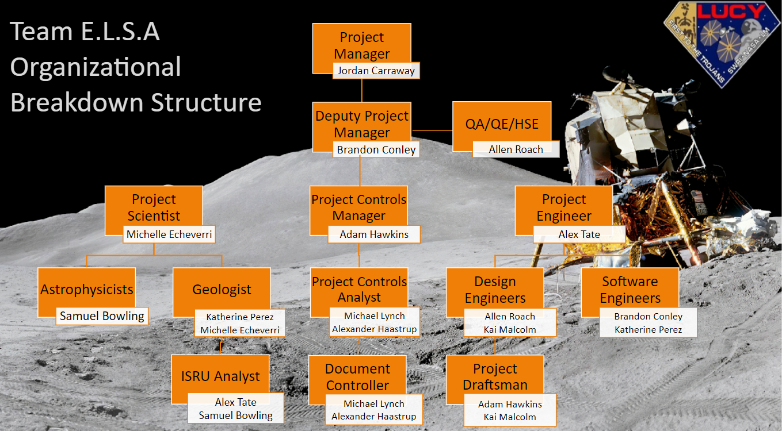
My L’SPACE experience – Team and Roles
E.L.S.A stands for
Elemental
Lunar
Surface
Analysis

