Slide 1
Interest in Space
BY: Adam Hawkins

Slide 2
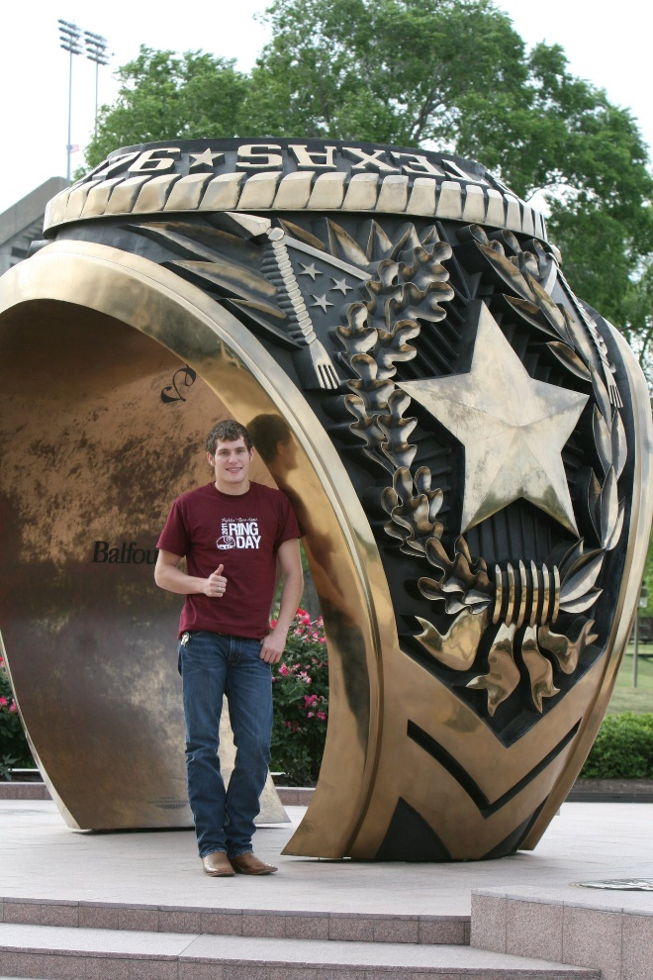
About Me - Education
Education:
Texas A&M University (2008-2012) – BS Civil Engineering (Dual Emphasis Structural Engineering and Construction Management), Business Minor, Project Management Certificate
University of Alabama (2019-2022 Expected) – BS Mechanical Engineering
Planned: University of Houston (2023-2027) – MS Aerospace Engineering (Structures and Materials) and MS Space Architecture

Slide 3
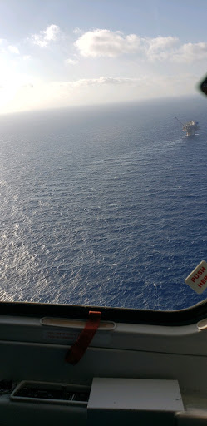
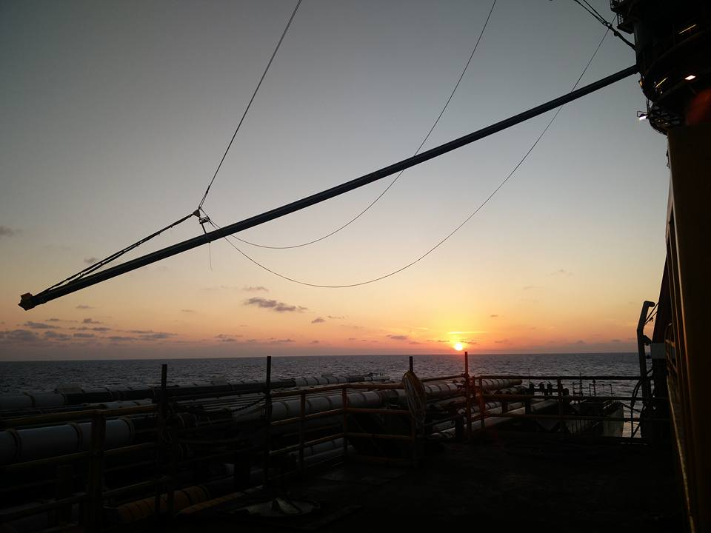
About Me - Career
Career:
Licensed Civil/Structural Professional Engineer
8 years experience working in Oil and Gas
7 years Offshore Oil & Gas
1 year Onshore Oil & Gas
Over 500 days in field on Offshore Facilities (GoM), Fabrication Yards, Oil & Gas Processing Facilities
Engineering Experience: Structural, Construction, Mechanical, Marine, Civil, Project, and Field Engineering
Business Experience: Project Management, Construction Management, Procurement, Logistics, and Asset Management

Slide 4
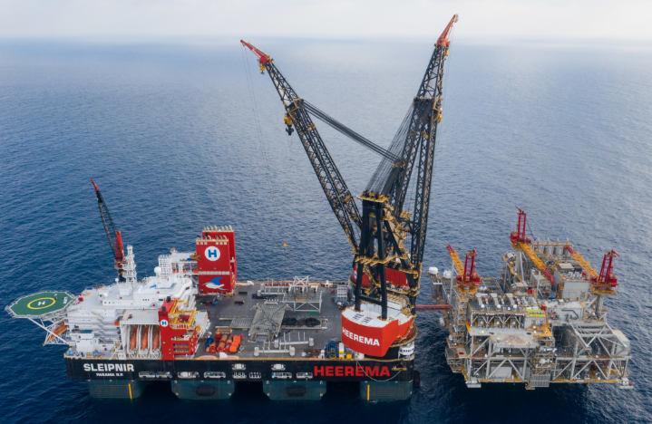
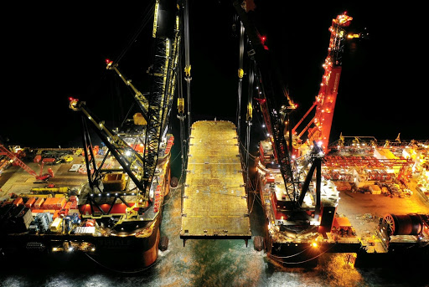
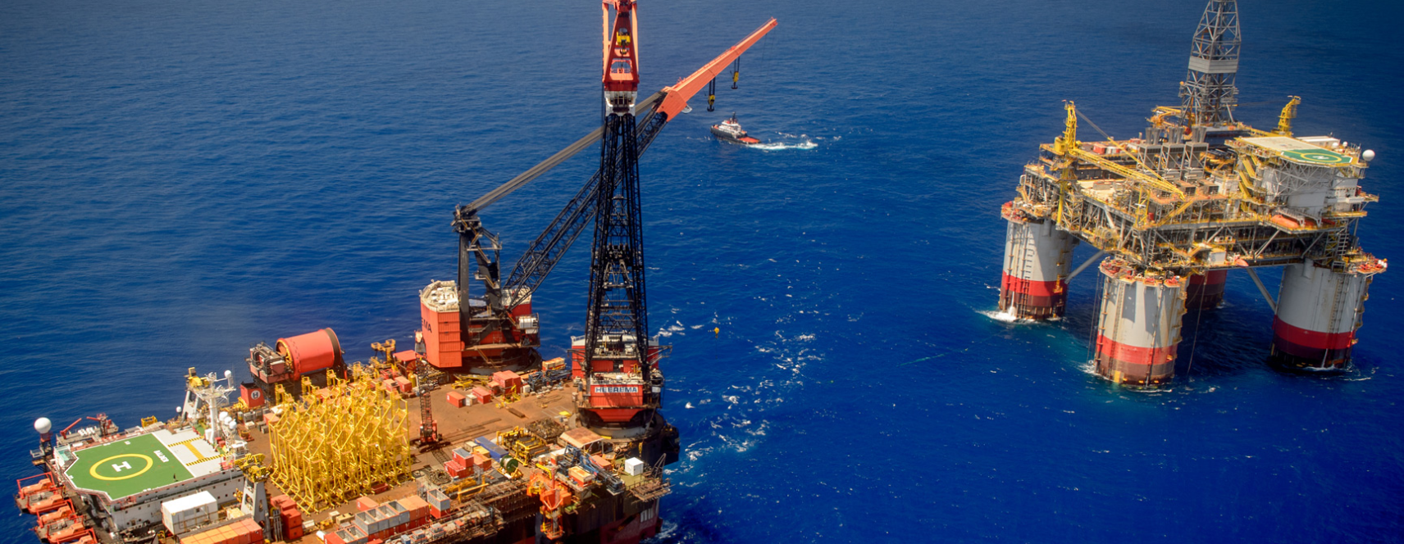
Career – Notable Projects
World Record Crane Vessel Lift (15,300 Metric Tons) →
Performed Lift Plan/Design and Misc. Engineering Calculations
First Ever Quad Crane Lift Offshore – Concept Proven 2019
Largest TLP Platform Installed in World →

Slide 5
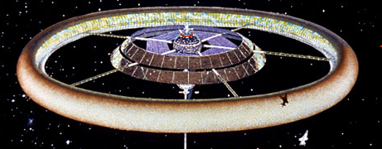
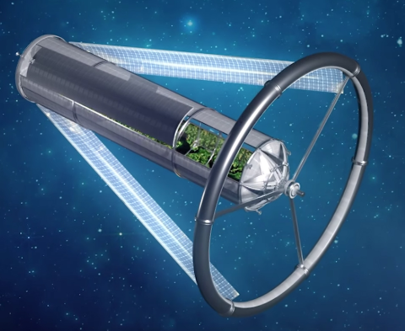
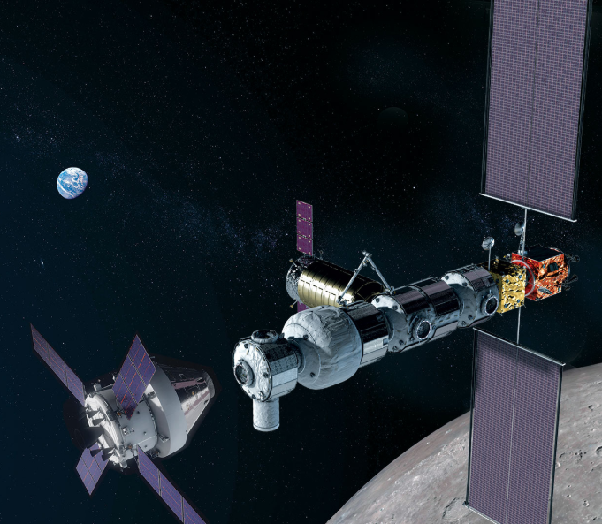
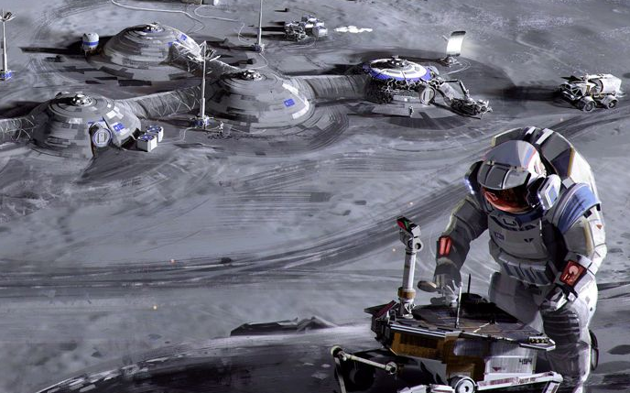
Space Interest
My passion lies in working on structures and materials in harsh/complex environments.
Goal: To create a meaningful impact in the development of Astronautical Structures extending past LEO in one of the following areas: O’Neill Cylinders, Stanford Torus, Gateways, Lunar/Planetary Settlements, Asteroid Mining, and Space Manufacturing.
Stanford Torus
O’Neill Cylinder
Lunar Settlement
Lunar Gateway

Slide 6
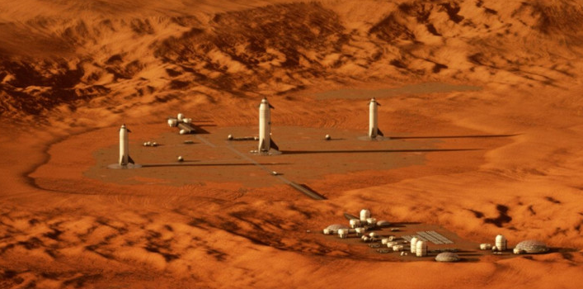
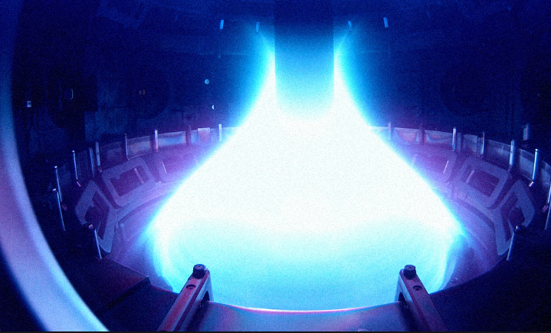
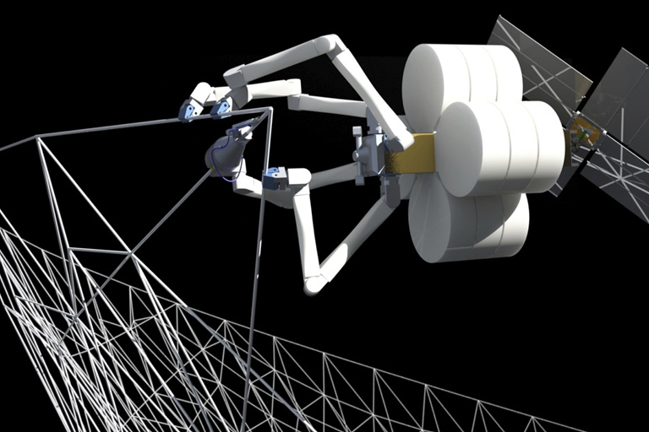
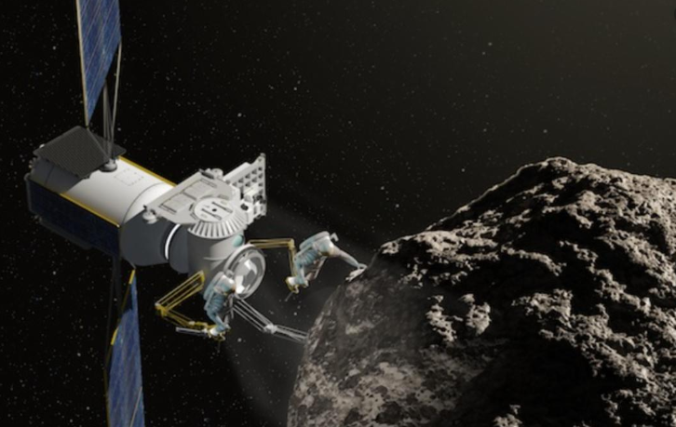
Why Space?
Work in Harsh/Complex Environments
The need to innovate ideas/solutions
Quick Engineering Turnaround when things go wrong
To do what no one has done before
To help better humanity
Mars Settlement
Fusion Energy/Reactor
Space Manufacturing
Asteroid Mining

Slide 7
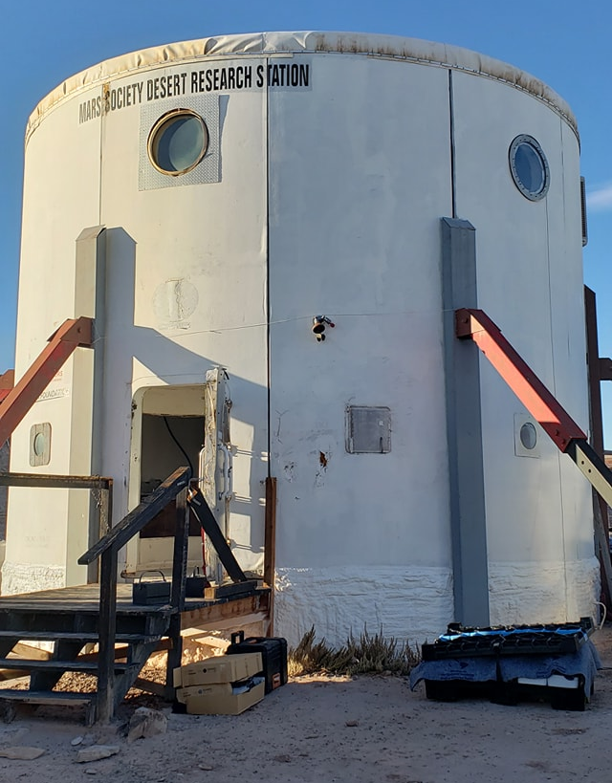
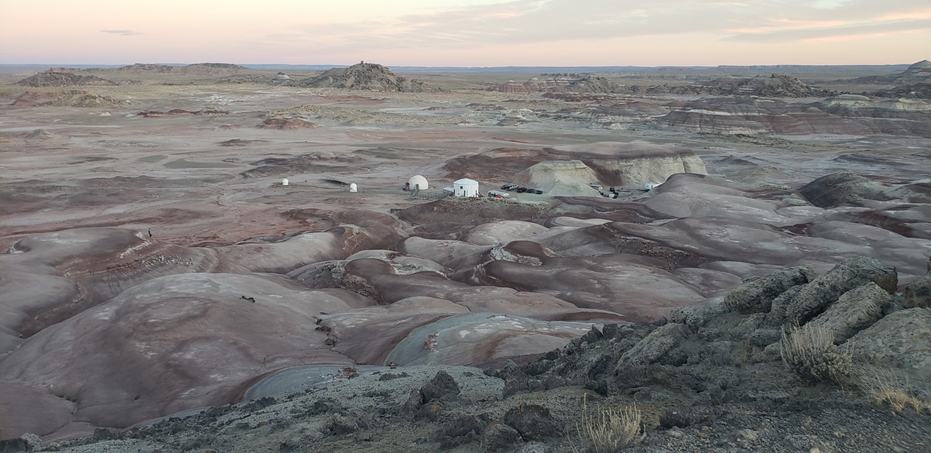
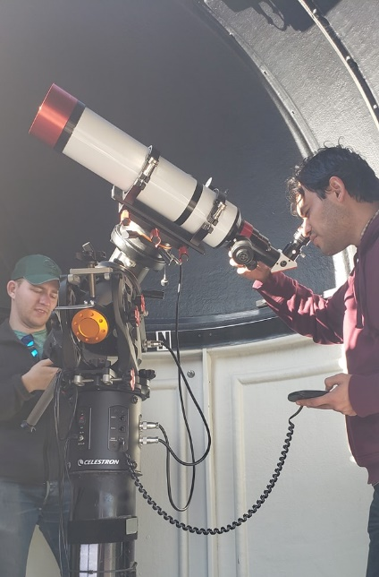
My Involvement:
NASA Aerospace Scholar (NCAS) Participant
Successfully completed online class which included 6 module exams and a 10-page research paper with NASA employee mentor
Invited to On-site portion of program to which includes being at NASA for a week alongside other Scholars and NASA Employees
Mars Desert Research Station (MDRS) Habitation Remodel
Worked with a volunteer crew and Mars Society to get MDRS up to date for the 2019/2020 season
Built Habitat Furniture
Prepared Surrounding Areas
Setup Green Hab unit

Slide 8
What’s Next for me?
Spring/Summer 2020 – NASA L’Space Academy
12 Week Volunteer program working with other students to complete a Project with NASA Mentors
Not yet accepted into program
Summer/Fall 2020 Work on Engineering Design Project utilizing CAD and Finite Element Analysis to build Portfolio
Spring/Summer 2021 – Attempt to get an internship with Space X, Blue Origin, NASA or into Matthew Isakowitz Fellowship Program

