Slide 1
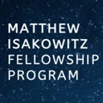
Inspiring the Next Generation of Commercial Spaceflight Leaders
North Houston Space Society Info Session
November 2, 2019

Slide 2
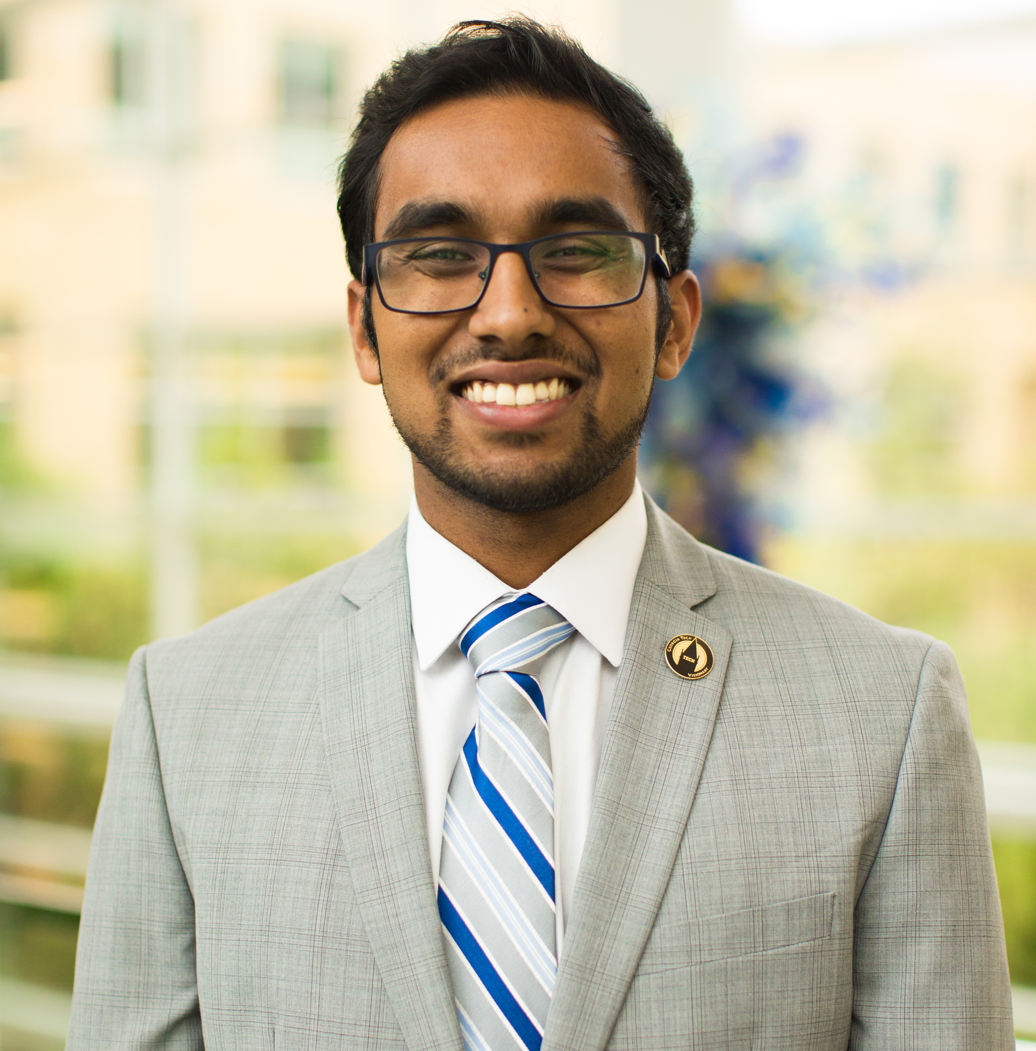
About Me
2nd Year MS Aero/Astro at Stanford
B.S. Aerospace Eng. from Georgia Tech
Space-related clubs: Stanford Aerospace Business Club, SEDS@GT, SEDS-USA, Space Frontier Foundation
Internships: Aerospace Corporation, OneWeb, JPL, Lockheed Martin
Hobbies/Interests: Urban dance, Vinyl collection, Podcasts
Notes:
Commercial space is broadly defined as activities in entrepreneurship, intrapreneurship, and innovation that will enable new or dramatically improved products or services that do not depend solely on government cost-plus contracting to prove viable. In its most aspiring terms, commercial space promises to alter the space industry through new business models that will open up the space frontier.

Slide 3
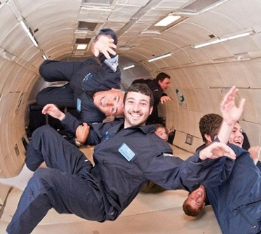
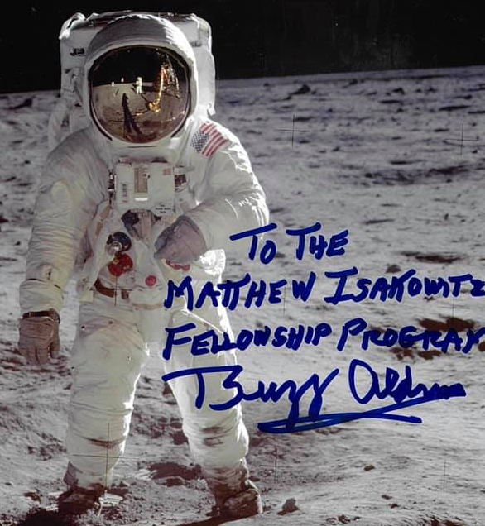
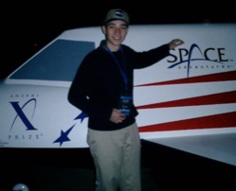
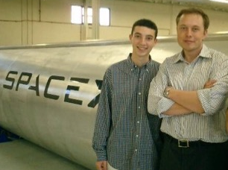
Who Inspired the Program?
The Program was created in memory of Matthew Isakowitz (1987–2017)
— an engineer, entrepreneur, and extraordinary individual whose
passion for commercial space exploration led to great strides in
the industry and inspired all who knew him.
The Program seeks to instill that same enthusiasm into the next generation of commercial spaceflight leaders by providing impactful career training to those who embody Matthew's drive for exploring our universe to help better humankind.
Notes:
Matthew Isakowitz was an extraordinary young man whose passion for opening the commercial space frontier was only matched by his kindness and generosity to those around him.
Despite leaving us far too soon, Matthew’s contributions left an outsized impact on the space community. Finding inspiration in Carl Sagan’s words, “Somewhere, something incredible is waiting to be known,”
Matthew began exercising his passion in high school by serving on the XPRIZE Foundation during the flight of SpaceShipOne, the first privately piloted spacecraft.
In college, Matthew worked on NASA’s New Horizons mission to Pluto at the Applied Physics Lab,
human space travel at Space Adventures,
and the Dragon capsule at SpaceX.
Matthew’s career took flight as Associate Director of the Commercial Spaceflight Federation, which contributed to the transformation of commercial space pioneers—such as Elon Musk’s SpaceX, Jeff Bezos’ Blue Origin, and Richard Branson’s Virgin Galactic—into the notable players they are today.
Afterwards, Matthew continued to push humanity’s frontiers as an entrepreneur and engineer at Planetary Resources and Astranis.
Matthew was granted early acceptance to Phi Beta Kappa Academic Honor Society and graduated summa cum laude with a degree in Mechanical and Aerospace Engineering at Princeton University. He also earned a Masters Degree in International Science and Technology Policy from George Washington University.
Matthew was a warm, compassionate, and generous person, who loved life to the fullest and whose enthusiasm for commercial space exploration inspired everyone who knew him.

Slide 4
In the Words of Those Who Knew Matthew...
“Matthew reminds me of myself. Someone who, early in their life, identified space as their primary passion. Someone who was always asking how we can do more, go faster. It was because of Matthew and his passion that the XPRIZE actually got the attention of NASA, a sequence of events that led to the creation of NASA’s Centennial Challenges. Rather than choose the traditional path, Matthew lived the space entrepreneur’s dream, a path that would ultimately bring him back into my life where he interned at both Space Adventures and Planetary Resources. It would be an honor and pleasure for me to host young space entrepreneurs with Matthew’s level of passion and dedication.”
-- Peter Diamandis, Founder of the X-Prize (an MIFP Host Company!)

Slide 5
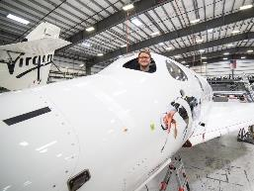
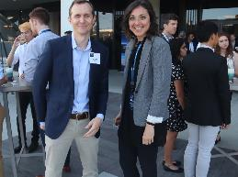
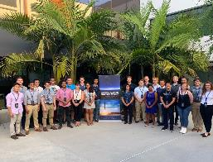
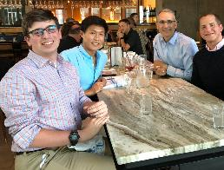
What is the Matthew Isakowitz Fellowship Program?
The Fellowship is designed to inspire and grow
the next generation of young men and women to be the
future innovators, entrepreneurs, and leaders of the commercial space industry.
Internship
Mentorship
Summit
Networking
Notes:
INTERNSHIP-- Paid summer internship at leading commercial space companies
MENTORSHIP-- Paired with an experienced and notable space industry leader, plus a Fellow alum as a Buddy.
SUMMIT-- Bring together Fellows at end of summer in LA to network with one another, get behind-the-scenes tours of companies and learn about the latest developments in commercial spaceflight from top innovators in the field
NETWORK-- Fellows are among an elite group of alumni to continue to network with this program, Fellow peers, mentors, and future Fellows, on the path to becoming space icons.

Slide 6
Eligibility for the
Matthew Isakowitz Fellowship Program?
Current college junior, college senior, or graduate student who intends to pursue a full-time career in the commercial spaceflight industry.
Has earned an engineering or science degree, or is working towards one at the time the Fellowship begins.
Has a diversity in experience and academic interests such as in engineering, science, management, business, and other related fields that can be related to commercial space.
Is a U.S. citizen or U.S. permanent resident (green card holder) due to export control regulations at the host companies.
Notes:
Commercial space is broadly defined as activities in entrepreneurship, intrapreneurship, and innovation that will enable new or dramatically improved products or services that do not depend solely on government cost-plus contracting to prove viable. In its most aspiring terms, commercial space promises to alter the space industry through new business models that will open up the space frontier.

Slide 7
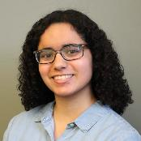
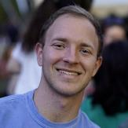
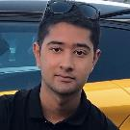
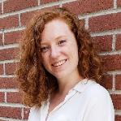
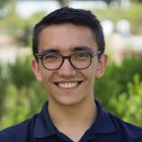
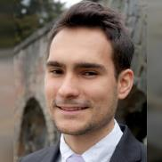
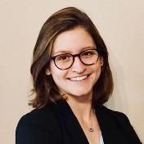
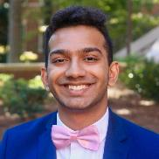
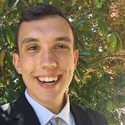
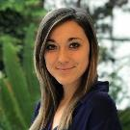
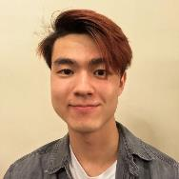
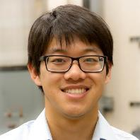
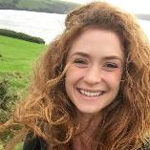
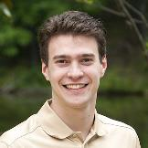
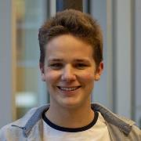
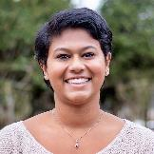
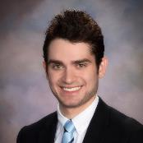
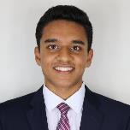
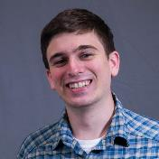
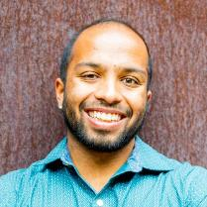
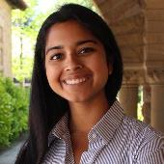
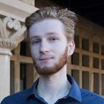
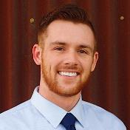
2019 Fellows
Notes:
2019 Fellows Info
6 PhD, 7 Masters
Previous work: 13 NASA, (7 JPL, 4 Langley), 8 SpaceX
7 rocketry clubs
PASSION
Offers for full-time employment from host company: Parker Buntin (VO) and Maya Naphade (VG)

Slide 8
Host Companies

Slide 9
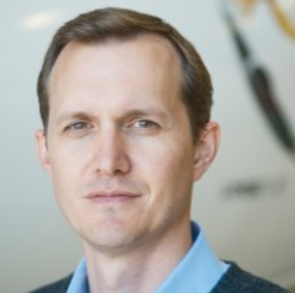
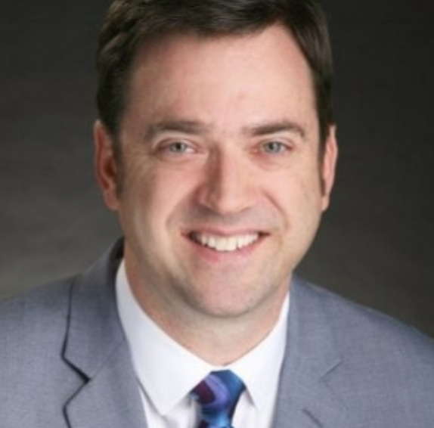
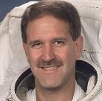
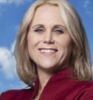
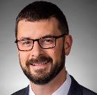
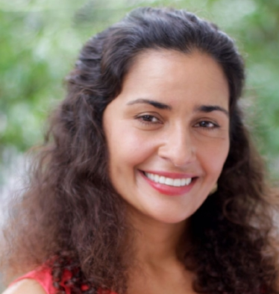
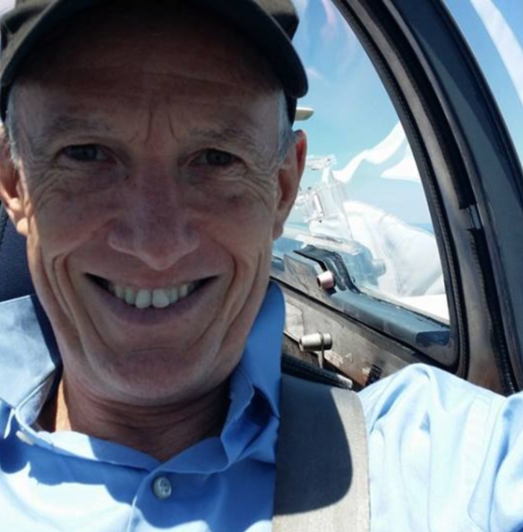
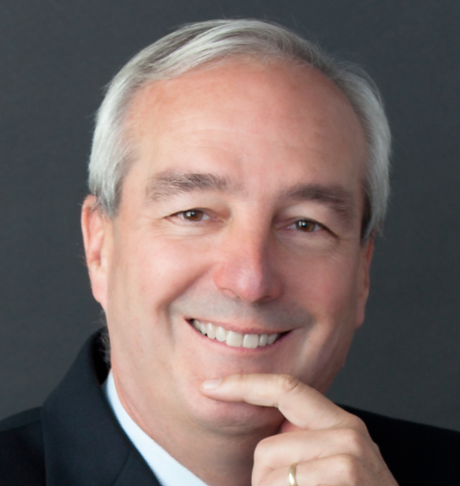
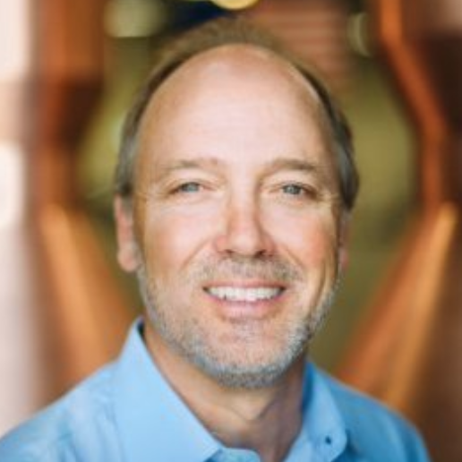
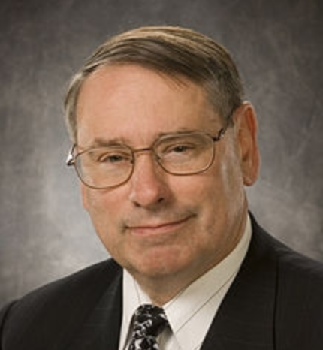
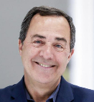
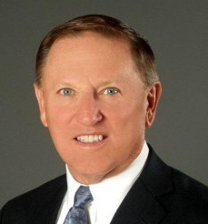
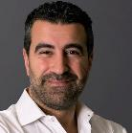
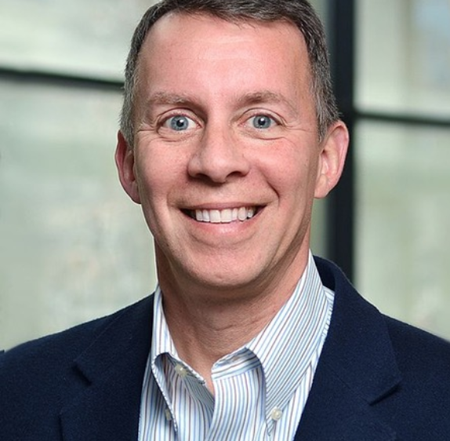
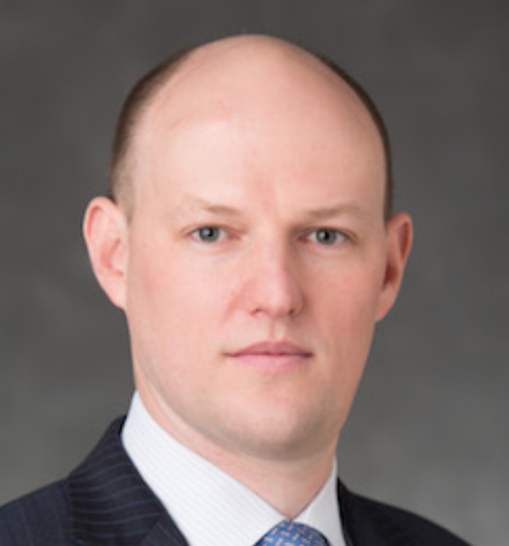
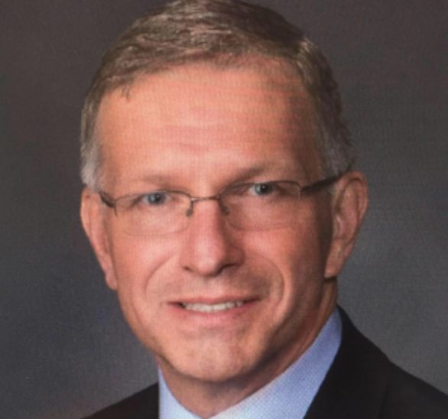
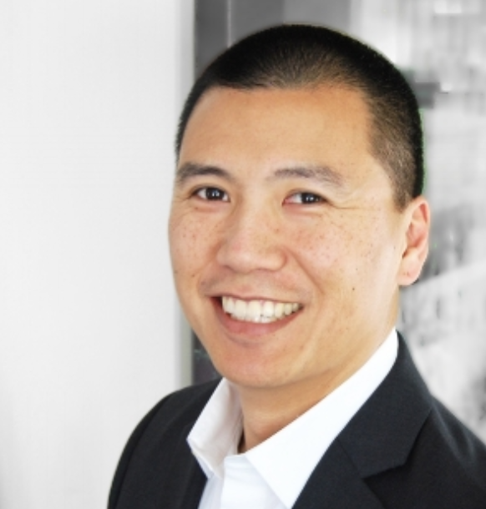
Executive Mentors
George Whitesides
Virgin Galactic and TSC
CEO
Brett Alexander
Blue Origin
VP
John Grunsfeld
Astronaut
Suzi McBride
Iridium
COO
Barry Matsumori
BridgeComm
CEO
Joe Landon
Lockheed Martin
VP
Anita Sengupta
ASX
VP
Lee Rosen
SpaceX
VP
Alan Weston LTA
CEO
Ray Rothrock
Venture Capitalist
Tim Buzza
Relativity Space
Distinguished Engineer
Pete Worden
Breakthrough Prize
Chairman
Pam Melroy
Astronaut
John Gedmark
Astranis
Co-Founder/CEO
Mandy Vaughn
VOX Space
President
Mark Sirangelo
Entrepreneur
Stu Witt
Space Exec
Bulent Altan
Global Space Ventures
Co-Founder
Bobby Braun
CU-Boulder
Dean of Engineering
Kacy Gerst DARPA
Chief of Commercial Strategy
Phil Ingle
Morgan Stanley
Managing Director
Chris Moran
Lockheed Ventures
Executive Director
Randy Villahermosa
Aerospace
Executive Director, Innovation
Jeffrey Manber
Nanoracks
CEO
Karina Drees
Mojave Spaceport
CEO

Slide 10
Summit
“Very impressed with the extraordinary individuals selected for the Matthew Isakowitz Fellowship Program. It’s a quality program with an inspirational legacy—connecting fellows in the exciting field of commercial spaceflight.”
-- Buzz Aldrin, Apollo 11 Astronaut
Elon Musk
Buzz Aldrin
Notes:
The summer culminates in a summit that brings together the current class of Matthew Isakowitz Fellows in a memorable and celebratory event in Los Angeles.
This summit allows the Fellows to network with one another, while also getting behind-the-scenes tours of companies and learning more about the latest developments in commercial spaceflight from top innovators in the field.

Slide 11
Networking
Notes:
Upon completing the summer internship, the Fellows remain among an elite group of alumni who have the opportunity to continue to network with this program, their Fellow peers, assigned mentors, and future Fellows, on the path to becoming future space icons.

Slide 12
2018 Fellow Alums-
Where are They Now?
Eva Abramson
ABL Space Systems
Previously: UCLA
Sam Albert
Colorado-Boulder (MS)
Previously: Purdue (MS)
Yash Chandramouli
Stanford (MS)
Previously: Georgia Tech (BS)
Shayna Hume
Colorado-Boulder (PhD) Previously: U of Miami (BS)
Dylan Dickstein
UCLA (PhD)
Sydney Dolan
MIT (PhD)
Previously: Purdue (MS)
Max Goldberg
Strike Force
and Wisconsin-Madison (BS)
Henry Ha
Princeton (BS)
Padraig Lysandrou
Colorado-Boulder (MS)
Previously: Cornell (BS)
Josh Etkind
Tufts (MS)
Leon Kim
JPL
and Columbia (BS)
Brian Hardy
Illinois (MS)
Calvin Lin
Stanford (MS)
Previously: Stanford (MS)
Dylan Cohen
House Comm.-Science, Space, Tech.
Previously: MIT (MS)
Hailee Hettrick
MIT (PhD) Previously: MIT (MS)
Axel Garcia Burgos
MIT (PhD)
Golda Nguyen
MIT (MS)
Previously: Georgia Tech (BS)
Todd Sheerin
Aerospace Corp
Previously: MIT (PhD)
Alex St. Clair
Colorado-Boulder (MS)
Jeremy Stroming
MIT (MS)
Previously MIT (BS)
Ian Vorbach
U Penn (MBA)
Previously Stanford (MS)
Adam Zachar
Accion Systems
Previously: U Penn (MS)
Chloe Downs
Georgia Tech (PhD)
Daniel Dyck
Blue Origin
Previously: Embry Riddle (BS)
Notes:
Most alum continued on to grad school/advance degrees
Others are working in the space industry, many through their MIFP host company or connections made through MIFP:
Aerospace Corporation
Accion Systems
ABL Space Systems
House Committee on Science, Space and Technology
BlueOrigin

Slide 13
In the Words of a 2019 MIFP Fellow...
“The Matthew Isakowitz Fellowship has been one of the most phenomenal experiences of my life. It has been a summer of one extraordinary moment after the next... However, it was all the little things that really set this fellowship apart: sharing jokes on the bus with incredibly passionate people, meeting my heroes in the industry over lunches, stumbling into opportunities in casual conversations, and learning about all the ways one person's incredible love for space touched not only all of our lives, but also changed the course of the industry.”
--Anjali R., 2019 Fellow

Slide 14
Application Components
1) General Information
2) Resume, Transcript, and Two Recommendation Letters
3) Essays
All three portions of the application must be completed and submitted by 11:59 PST on Monday, December 2, 2019 to be considered for the Fellowship.
Notes:
Commercial space is broadly defined as activities in entrepreneurship, intrapreneurship, and innovation that will enable new or dramatically improved products or services that do not depend solely on government cost-plus contracting to prove viable. In its most aspiring terms, commercial space promises to alter the space industry through new business models that will open up the space frontier.

Slide 15
Essays
Prompt 1:
350 words or less
Describe and explain your ideal company and internship environment
Prompt 2:
350 words or less,
Choose between 3 prompts pertaining to your ideas and expectations for the future of commercial space
Prompt 3:
800 words or less.
Explain your passion for commercial space, your current/future role in it, and why you would be a strong fellowship candidate

Slide 16
My MIFP Experience
Host Company: OneWeb
Space Segment Intern
Transitioned into a year-long internship
Interacted with executives and leaders across the org
Summit:
Met with Gwynne Shotwell (CEO of SpaceX)
Toured SpaceX, Millenium Space Systems, Boeing, VO
Mentor: Randy Villahermosa – The Aerospace Corporation
Notes:
Commercial space is broadly defined as activities in entrepreneurship, intrapreneurship, and innovation that will enable new or dramatically improved products or services that do not depend solely on government cost-plus contracting to prove viable. In its most aspiring terms, commercial space promises to alter the space industry through new business models that will open up the space frontier.

Slide 17
Key Dates
Interviews
APPLICATION OPEN
Start Summer Internship
SEP 9 2019
DEC 2 2019
DEC 2019
JAN 31 2020
MAY/JUNE 2020
JULY 2020
Fellow selection & host company placements completed
MIFP Summit
APPLICATION DUE
Notes:
Looking for PASSION
APPLICATION PROCESS
Candidates have to complete only the single online application in order to be considered for positions at all of the host companies. The application consists of the following three parts (described in detail below):
1) General Information
2) Resume, Transcript, and Two Recommendation Letters
3) Essays
All three portions of the application must be completed and submitted by 11:59 PST on Monday, December 2, 2019 to be considered for the Fellowship.
Further details:
RESUME & TRANSCRIPT
Your résumé should be no more than two pages in length and include your current GPA. Your transcript can be unofficial, although official transcript is required upon selection into program.
RECOMMENDATION LETTERS
Two letters of recommendation must be submitted for your application to be complete. These can be sent directly to apply@matthewfellowship.org (by you or your recommender, with your name in the subject line) OR submitted by you as part of your electronic application (you will see an “Upload” option on the form). At least one of these letters must be from a faculty member at your university. Please encourage the authors of your letters of recommendation to address 1) how your coursework or work experience to date has related to commercial space, and 2) why you are a good candidate for this specific Fellowship program, given the eligibility criteria mentioned above.
ESSAYS
Three essay responses must be submitted:
In 350 words or less, what type of company and internship work assignment would you prefer and why?
Please answer ONE of the following essay questions in 350 words or less:
What will be the next giant leap in space technology from the private sector and why?
You are testifying before Congress for a hearing focused on the biggest barriers for the commercial space industry. What would be your opening remarks?
Elon Musk, in a discussion with our 2019 Fellows, stated that starting a company is like “eating glass and staring into the abyss.” Thankfully, you have the stomach for this kind of business. What start-up idea would drive you into starting a business and why?
In 800 words or less, please answer the following: Why are you excited and passionate about commercial space and your current or future role in it, and why are you a strong candidate for this Fellowship?
SELECTION PROCESS
All completed applications are reviewed by the Matthew Isakowitz Fellowship Selection Committee, with the most highly qualified candidates being selected for 30 minute video chat interviews to assess their passion.
Following this process, finalists are selected and offered to the host companies for consideration. Ultimately, each host company will select a Fellow from among the final applicant pool.
The Matthew Isakowitz Fellowship Program will then complete the placement by notifying each Fellow of their acceptance by January 31, 2020. Fellows begin their work term in May/June.

Slide 18
For more information visit: MatthewIsakowitzFellowship.org
@mattfellowship #mattfellowship

Slide 19
Ad Astra
MatthewIsakowitzFellowship.org

