Slide 1
NSS North Houston Space Society
October 2019

Slide 2
Agenda
2:00 Room available. Get set up
2:05 Introduction/Recent Space News – Nathan Price
2:20 Importance of Space Architecture and the Mars Analog Habitat – Anastasia Prosina
3:10 What it is like to be Weightless – Mallesh Maharana – Winner of 2018 Space Vacation Contest
3:30 Closing Comments & Drawing – Nathan Price
3:45 Open Discussion & Socializing
4:00 End of Meeting

Slide 3
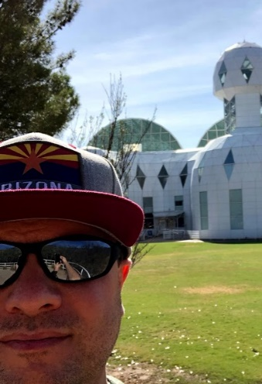
Nathan Price
(nathan.price@gmail.com – 832-620-6385)
NSS North Houston Space Society President and Founder. Nathan works for a software company but has a lifelong passion for space exploration. He has attended space conferences including the International Astronautical Congress (IAC), New Worlds Conference (in Austin, TX), and International Space Development Conference (ISDC). He has experienced weightlessness on a ZERO-G flight. He dreams of the day that humanity branches out into the stars.

Slide 4
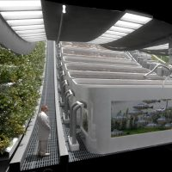
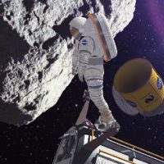
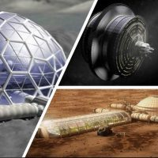
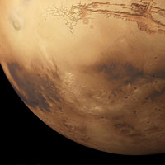
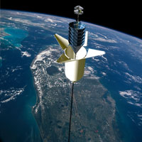
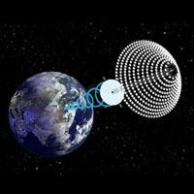
National Space Society Vision
People living and working in thriving communities beyond the Earth, and the use of the vast resources of space for the dramatic betterment of humanity.

Slide 5
How many launches where there since the last meeting?

Slide 6
Events Since Last Meeting - Launches
7 Rocket Launches Since Last Meeting (https://spaceflightnow.com/launch-log/):
Sept. 11 - Long March 4B • Ziyuan 1-2D - h observation satellite, the Ice Pathfinder microsatellite for polar ice observations, and the Taurus 1 CubeSat to test solar sail technology.
Sept. 19 - Long March 11 • Zhuhai 1 Group 3 - A Chinese Long March 11 rocket launched a third group of five Zhuhai 1 remote sensing satellites for a commercial constellation of Earth-imaging craft for Zhuhai Orbita Aerospace Science and Technology Co.
Sept. 22, 2019Long March 3B • Beidou - A Chinese Long March 3B rocket and Yuanzheng upper stage launched two satellites into Medium Earth Orbit for the Beidou navigation constellation
Sept. 24, 2019H-2B • HTV 8 - A Japanese H-2B rocket launched the eighth H-2 Transfer Vehicle. The HTV serves as an automated cargo vehicle to deliver equipment and supplies to the International Space Station. Delayed from July. Scrubbed by a launch pad fire on Sept. 10. Delayed from Sept. 23.
Sept. 24, 2019 - Long March 2D • Yunhai 1-02 - A Chinese Long March 2D rocket launched the Yunhai 1-02 environmental monitoring satellite
Sept. 25, 2019 - Soyuz • ISS 61S - A Russian government Soyuz rocket launched the crewed Soyuz MS-15 spacecraft to the International Space Station with members of the next Expedition crew. The capsule will remain at the station for about six months, providing an escape pod for the residents. The rocket flew in the Soyuz-FG configuration.
Sept. 26, 2019 - Soyuz • EKS 3 - A Russian government Soyuz rocket launched the EKS 3 early warning satellite for the Russian military. The EKS, or Tundra, satellites fly in highly elliptical tundra orbits. The rocket flew in the Soyuz-2.1b configuration with a Fregat upper stage.

Slide 7
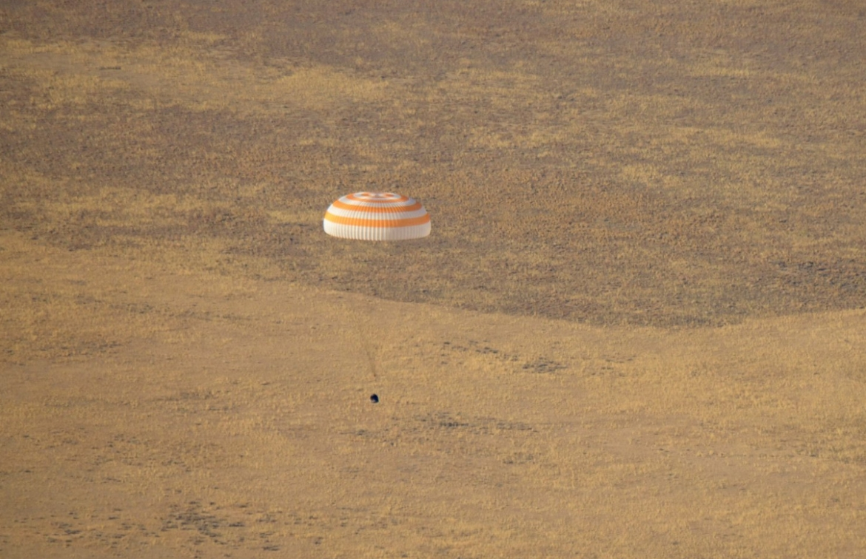
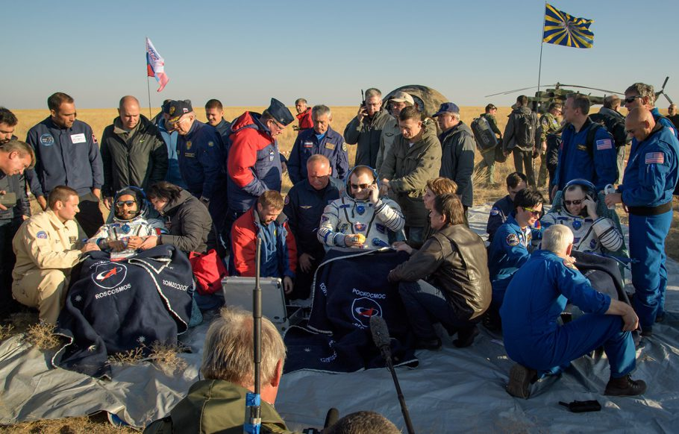
October 3, 2019 - NASA astronaut Nick Hague, Russian cosmonaut Alexey Ovchinin and United Arab Emirates space agency astronaut Hazza AlMansoori return safely to earth in a Russian Soyuz MS-12 capsule from the International Space Stations (ISS).

Slide 8
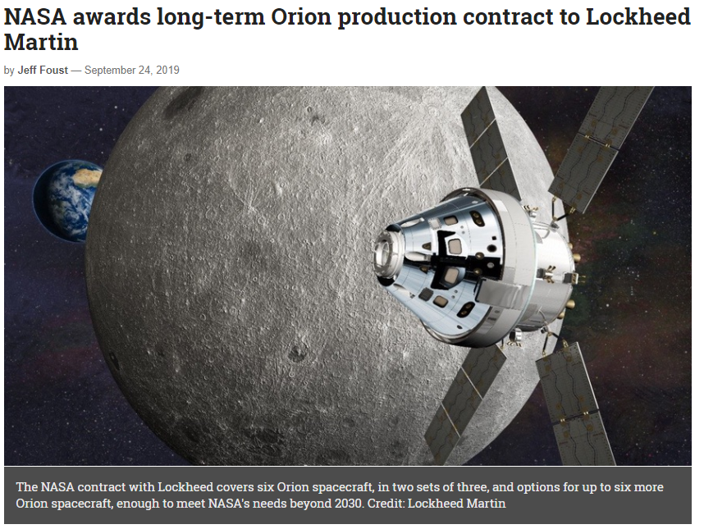
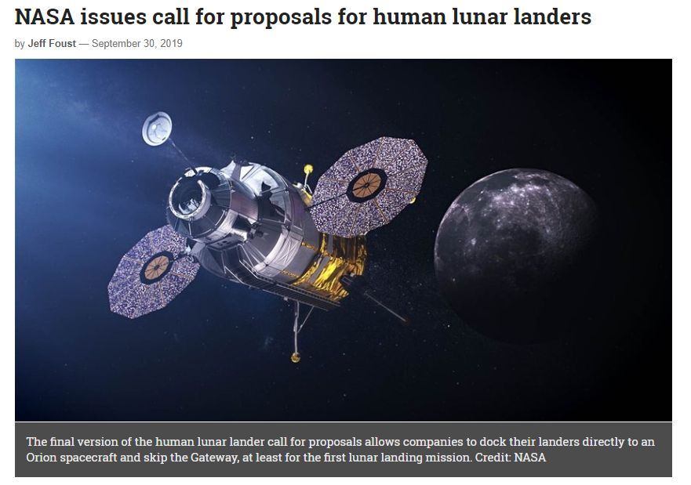
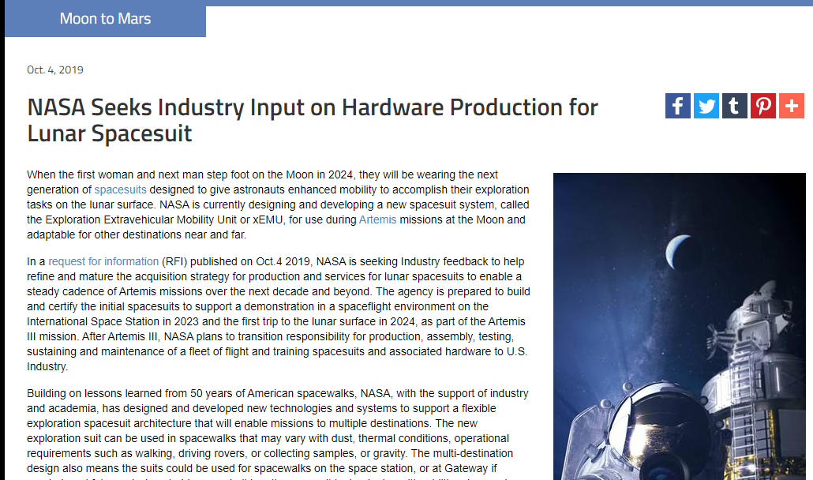
Events Since Last Meeting - Artemis
NASA Continues to make progress with the Artemis Program – First Woman and Next Man to land on the moon in 2024

Slide 9
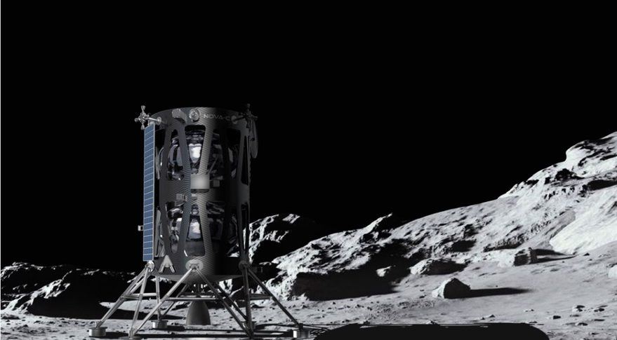
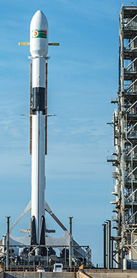
Intuitive Machines announced it would launch it’s Nova-C lander on a SpaceX Flacon 9 Rocket in 2021 which will carry 100 kilograms to the surface of the moon.
Intuitive Machines is one of 9 companies in NASA’s Commercial Lunar Payload Services (CLPS) program.
Intuitive Machines is one of two companies under a NASA task order to deliver experiments to the surface of the moon.

Slide 10
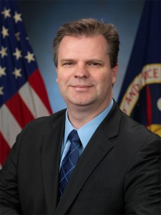
Trent Martin
VP of Aerospace Services – Intuitive Machines
Intuitive Machines is one of only two companies currently tasked by NASA to land payloads onto the surface of the moon. Mr. Martin is responsible for managing this and all other aerospace engineering services and products provided by Intuitive Machines. Mr. Martin previously served as Assistant Directory of Advanced Development Projects at NASA JSC.
Come learn about the work that Intuitive Machines is doing to get us back to the moon and about Mr. Martin’s career in aerospace.
Saturday, December 14, 2019 - 2 PM
NorthHoustonSpace.org
Barbara Bush Library
6817 Cypresswood Dr.
Spring, TX 77379

Slide 11
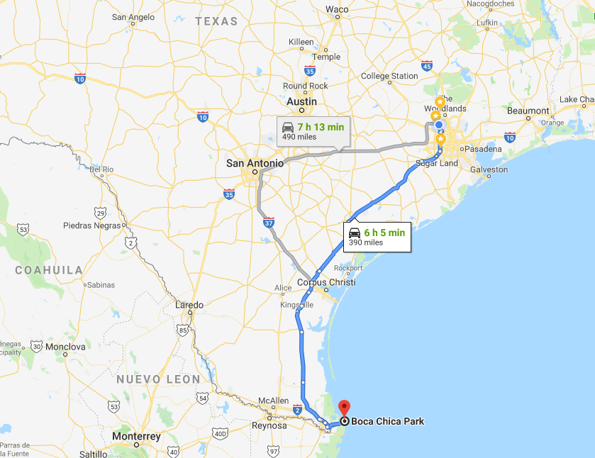
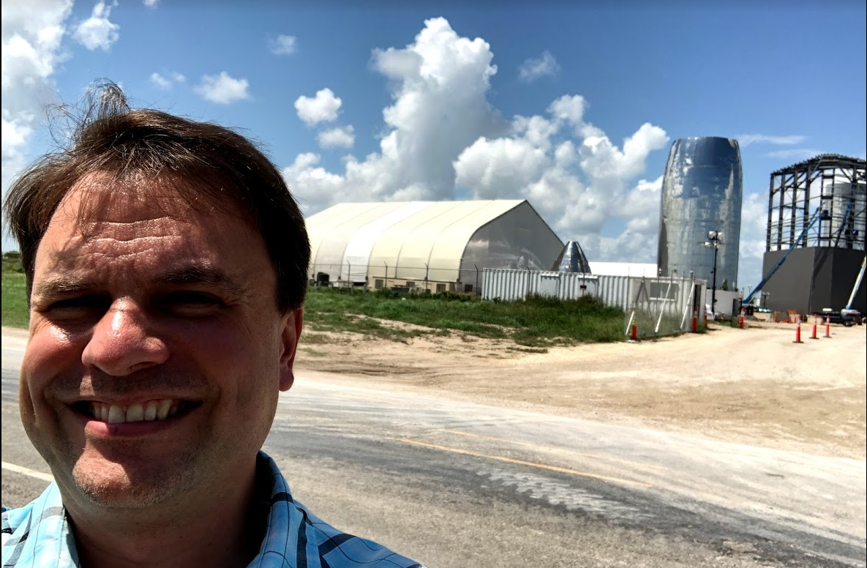
SpaceX StarShip Update – Sept. 28, 2019 in Boca Chica, TX
September 13, 2019

Slide 12
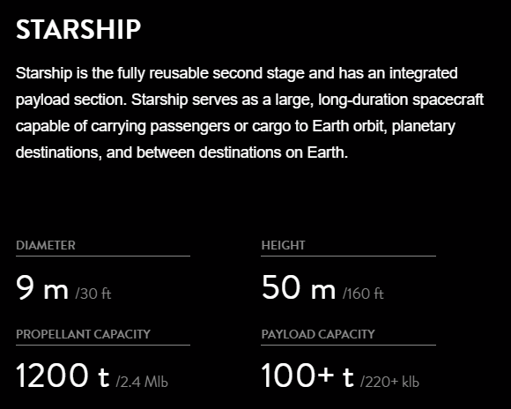

Slide 13
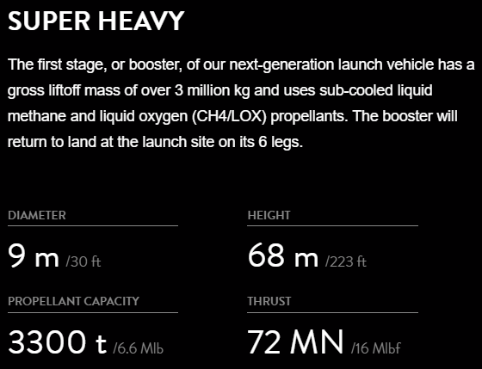

Slide 14
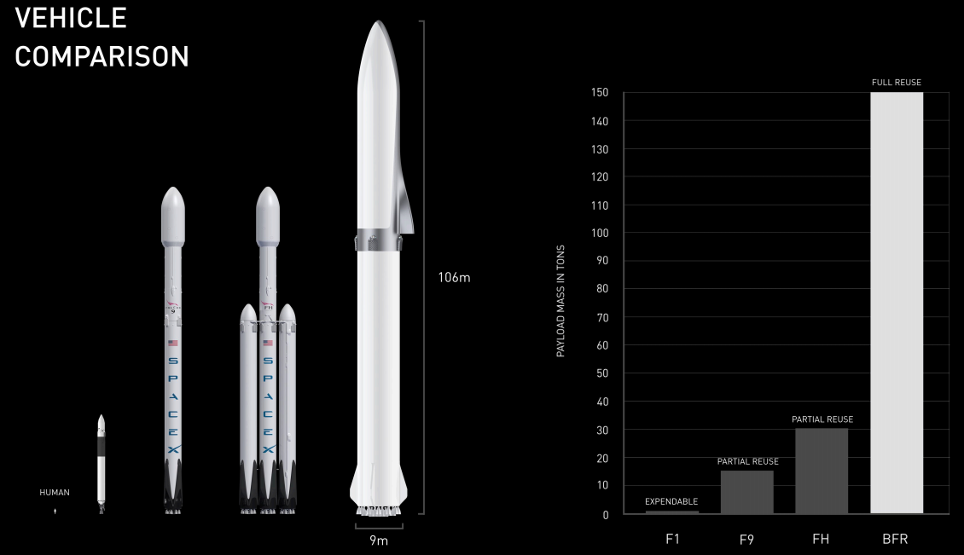

Slide 15
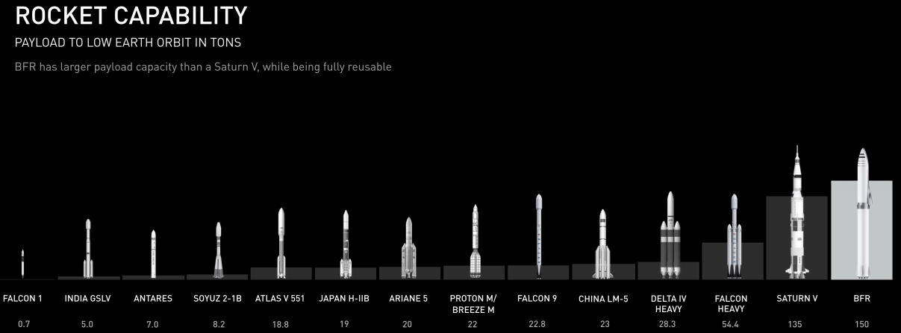

Slide 16
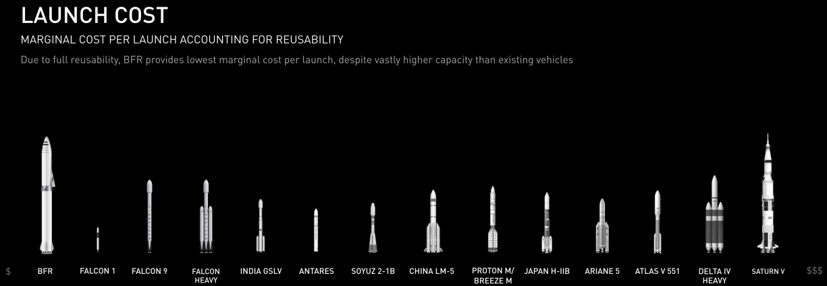

Slide 17
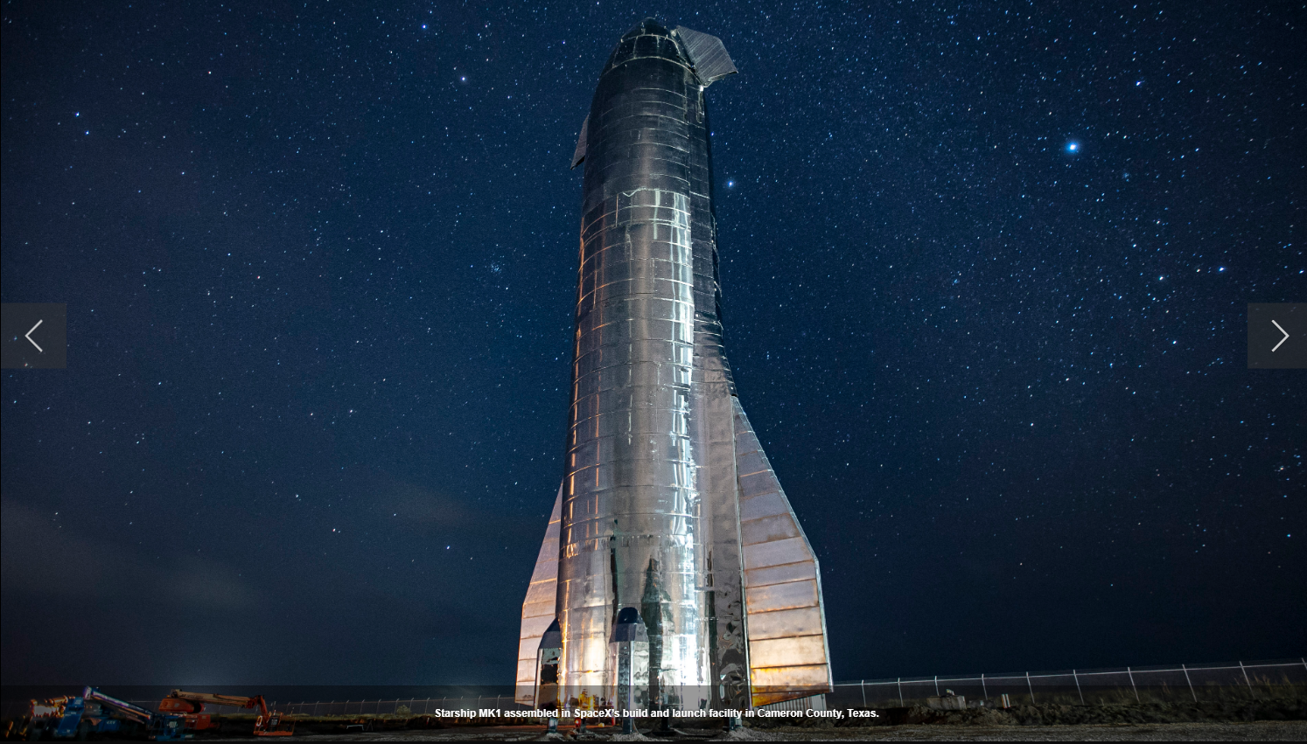
SpaceX Starship mk1 Boca Chica, TX

Slide 18
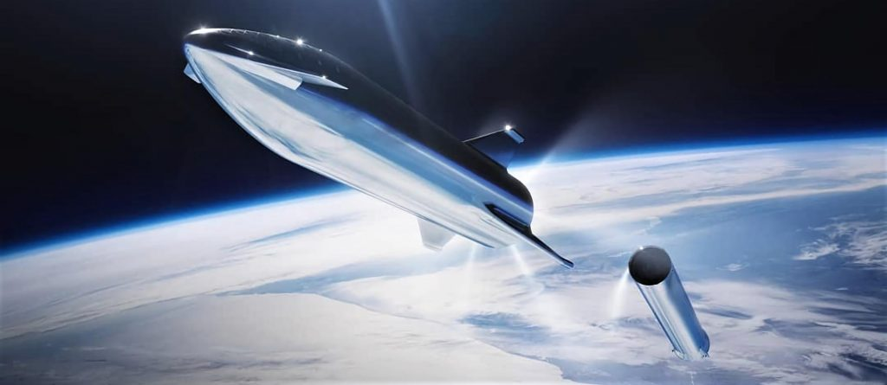
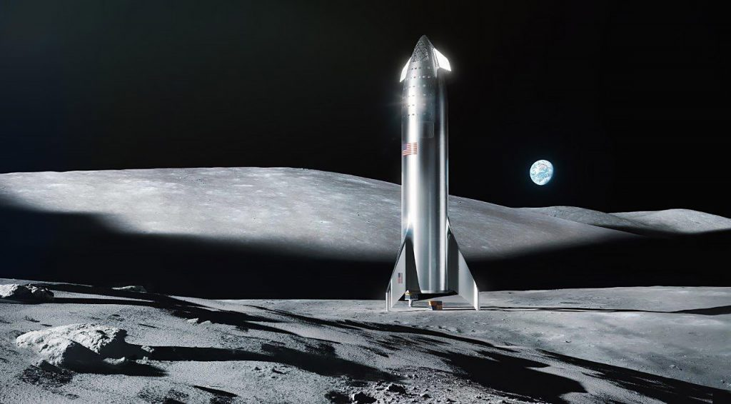
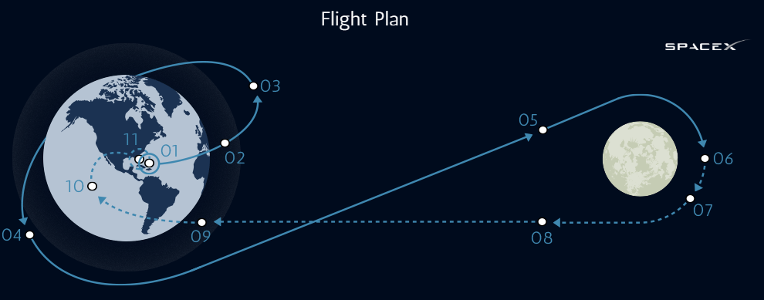
SpaceX Starship 100% Reusable Lowest cost of Launch of any Spacecraft
Orbital Test Flights as early as 2020
Unmanned Commercial Flights as early as 2021
Plans to send a group of artists around the moon in 2023 – http://DearMoon.earth
Also can provide Earth to Earth transport allowing for you to go from Houston to Mumbai in about 30 minutes.

Slide 19
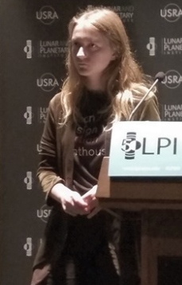
Anastasia Prosina
Master student of Sasakawa International Center for Space Architecture, University of Houston, will give a talk on why space architecture is a critical point in any space mission. She will cover projects she has been involved in, in particular, a Mars Analog Habitat commissioned by Mars Society.

Slide 21
2018 Space Vacation Idea Contest
Greater Houston Area
High School Student

Slide 22
Step 1: Think of a Space Vacation
Needs to be possible in the next 50 years

Slide 23
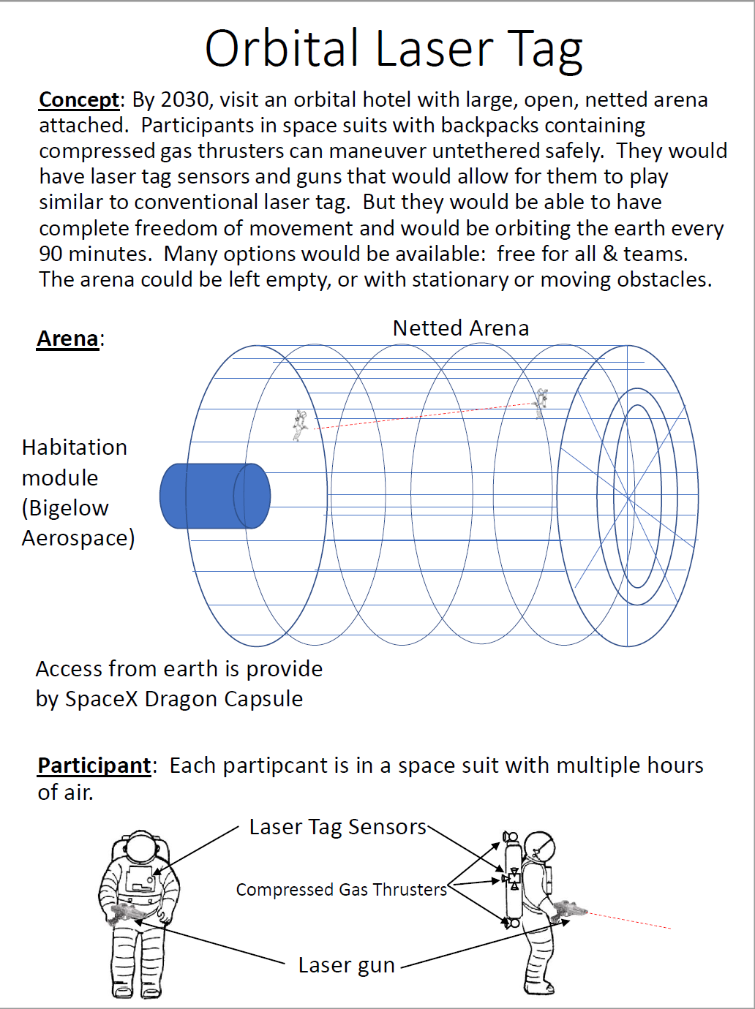
Step 2: Write a Page Explaining the Space Vacation
EXAMPLE
Create a one page summary of the idea.
How does it work?
What technologies do you need?

Slide 24
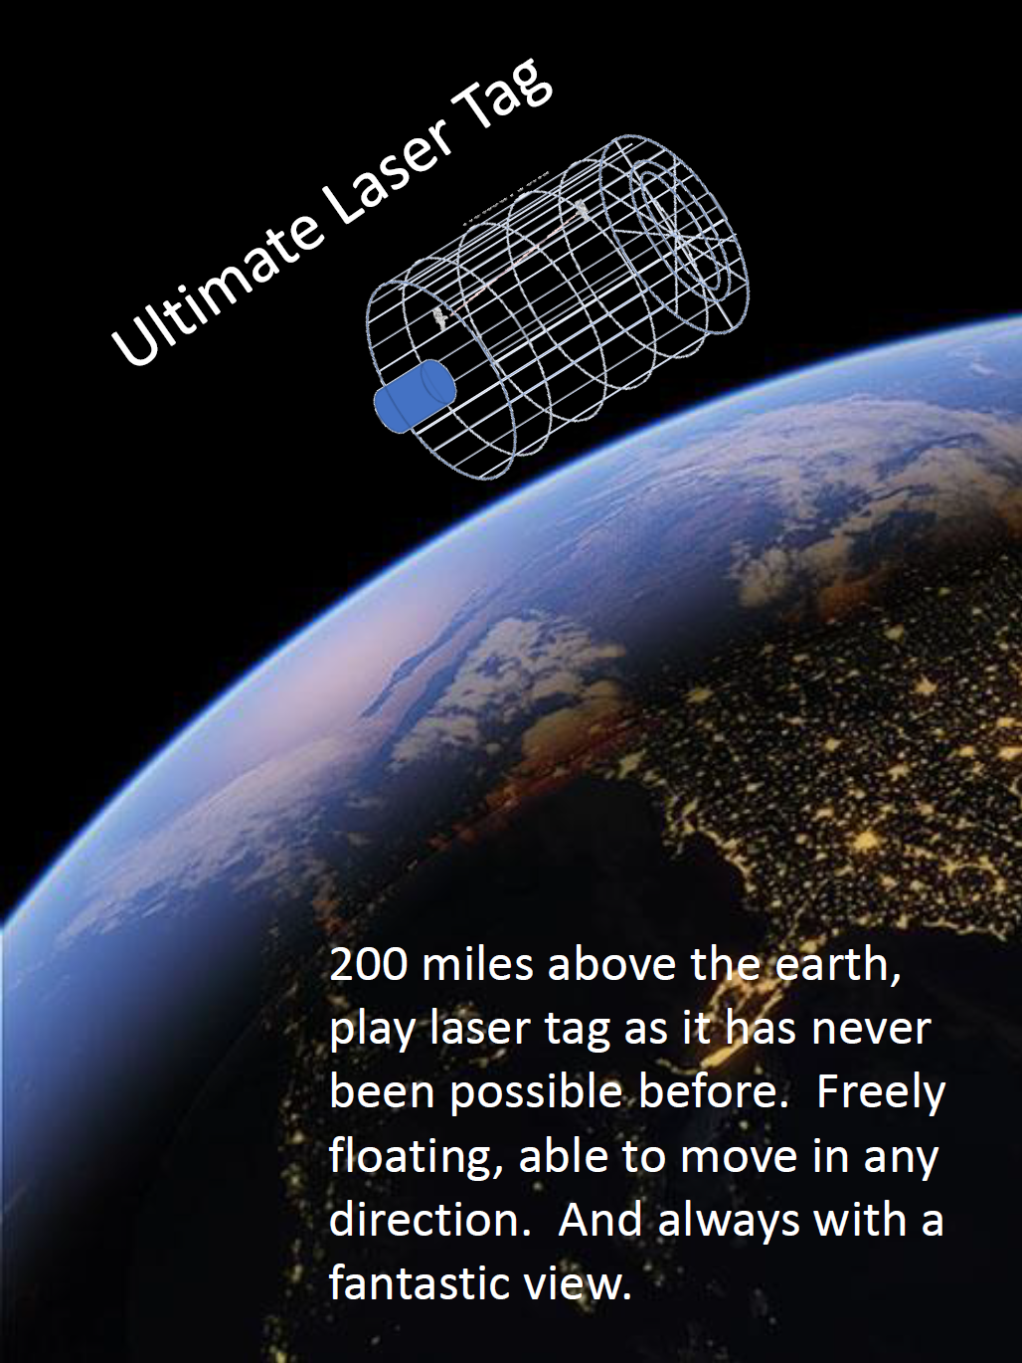
Step 3: Create a Flyer Advertising the Vacation to Future Tourists
EXAMPLE
Imagine you now have to create a one page advertisement for a magazine.
How would you present the idea so that future space tourists would want to go.

Slide 25
Step 4: Submit Your Entry
Go to
http://www.HighSchoolAstronaut.org
Due by July 31^{st,} 2018
(Judging Criteria: Creativity, Realism, Clarity, General Appeal)
ZERO-G Experience®
September 22, 2018
Nathan.Price@HighSchoolAstronaut.org

Slide 26
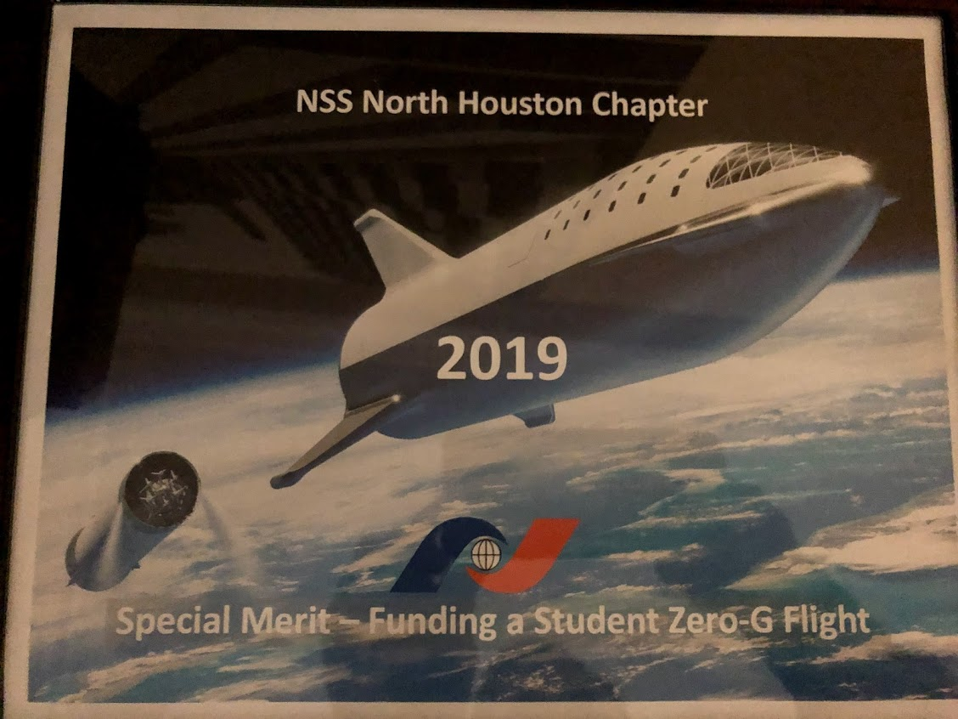

Slide 27
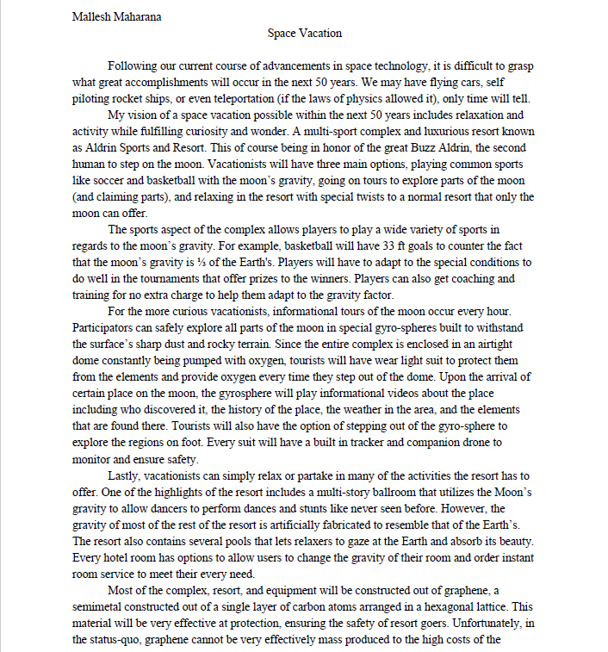

Slide 28
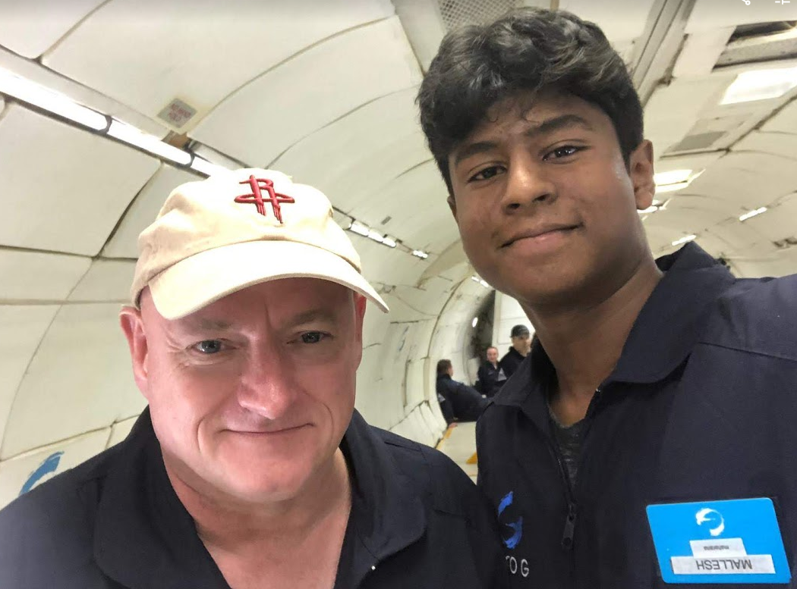
Mallesh Maharana
As the winner of the 2018 Space Vacation Contest, he was able to experience weightlessness on a ZERO-G flight. (Scott Kelly also was on that flight)

Slide 29
Thank you!!

Slide 30
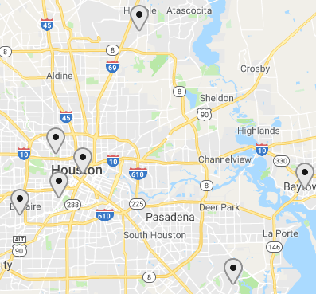
https://moon.nasa.gov/observe
October 5, 2019

Slide 31
World Space Week, October 4-10 annually, is the largest space event on Earth.
“The Moon: Gateway to the Stars.”
“The General Assembly declares 4 to 10 October World Space Week to celebrate each year at the international level the contributions of space science and technology to the betterment of the human condition”
UN General Assembly resolution, 6 December 1999
https://www.WorldSpaceWeek.org/

Slide 32
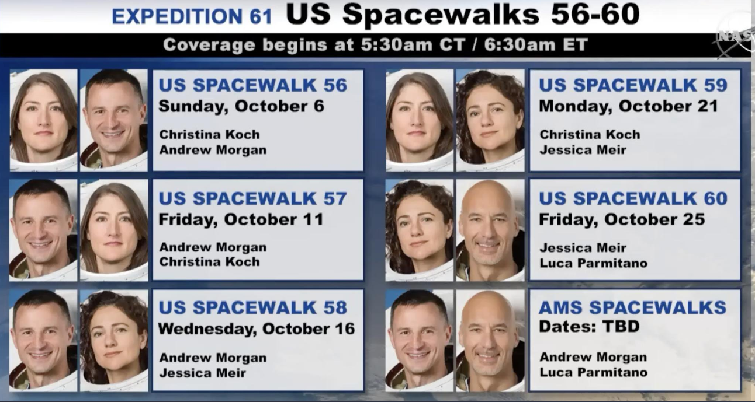
NASA is planning for five spacewalks in October.

Slide 33
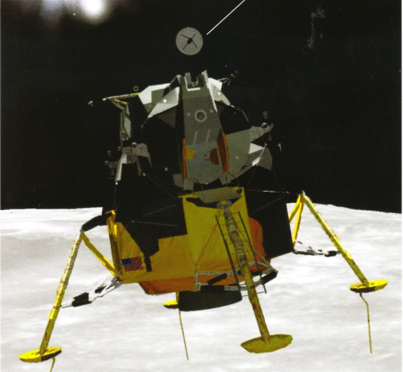
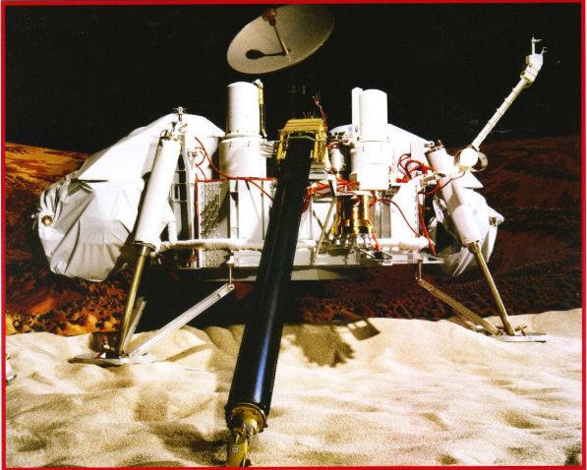
Featured Speaker: Tom Rowan
Mechanical Engineer
Tom Rowan designed the actuator for the radar disc on the Lunar Lander used on Apollo 11 which landed Buzz Aldrin and Neil Armstrong on the moon on July 24, 1969. He also invented the hermetically sealed DC motors that were used by the NASA Viking Lander on Mars in 1976. And he has over 50 years of engineering experience.
Featured Speaker: Yash Chandramouli – 2018 Matthew Isakowitz Fellow
MS/PhD student studying Aeronautics and Astronautics at Stanford University. His research interests include spacecraft formation-flying, reinforcement learning, and spacecraft pose estimation from images.
The Matthew Isakowitz Fellowship Program made an immense impact on his life and career path and he is excited to talk about his experience!
Saturday, November 2, 2019 - 2 PM
Barbara Bush Library
6817 Cypresswood Dr.
Spring, TX 77379
NorthHoustonSpace.org

Slide 34
Upcoming Events
Saturday
Nov 2, 2019
2 PM
Barbara Bush Library
Monthly Meeting
http://NorthHoustonSpace.org

Slide 35
