Slide 1
NSS North Houston Space Society
July 2019

Slide 2
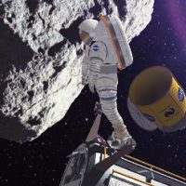
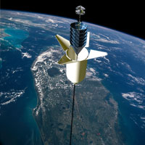
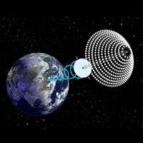
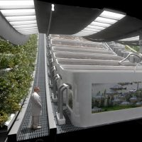
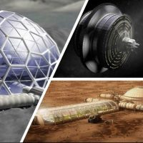
National Space Society (NSS) Vision
People living and working in thriving communities beyond the Earth, and the use of the vast resources of space for the dramatic betterment of humanity.

Slide 3
Agenda
3:00 Room available. Get set up
3:15 Introduction
3:20 Recent space-related news
3:30 Summary of International Space Development Conference (ISDC) 2018 – Arlington, VA
4:00 Brief summary of upcoming NSS-NH meetings and other events
4:15 Open discussion
4:45 Start clearing room of our materials (but don’t stop talking!)
5:00 Library Closes

Slide 4
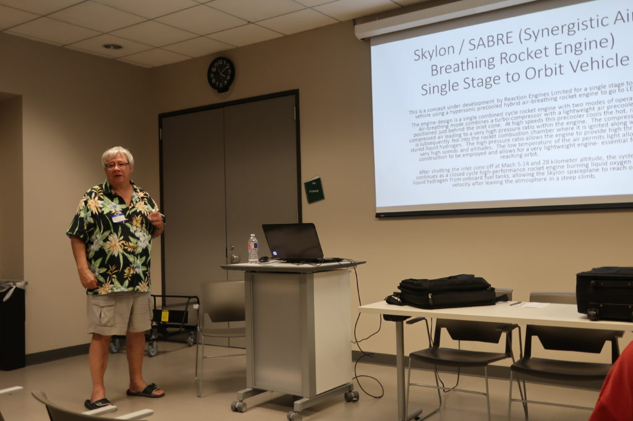
Our Last Meeting – June 1
Greg Stanley – SpaceX’s StarLink
Doug Hall – Skylon/SABRE
Check out their presentations at http://NorthHoustonSpace.org

Slide 5
Thank You!

Slide 6
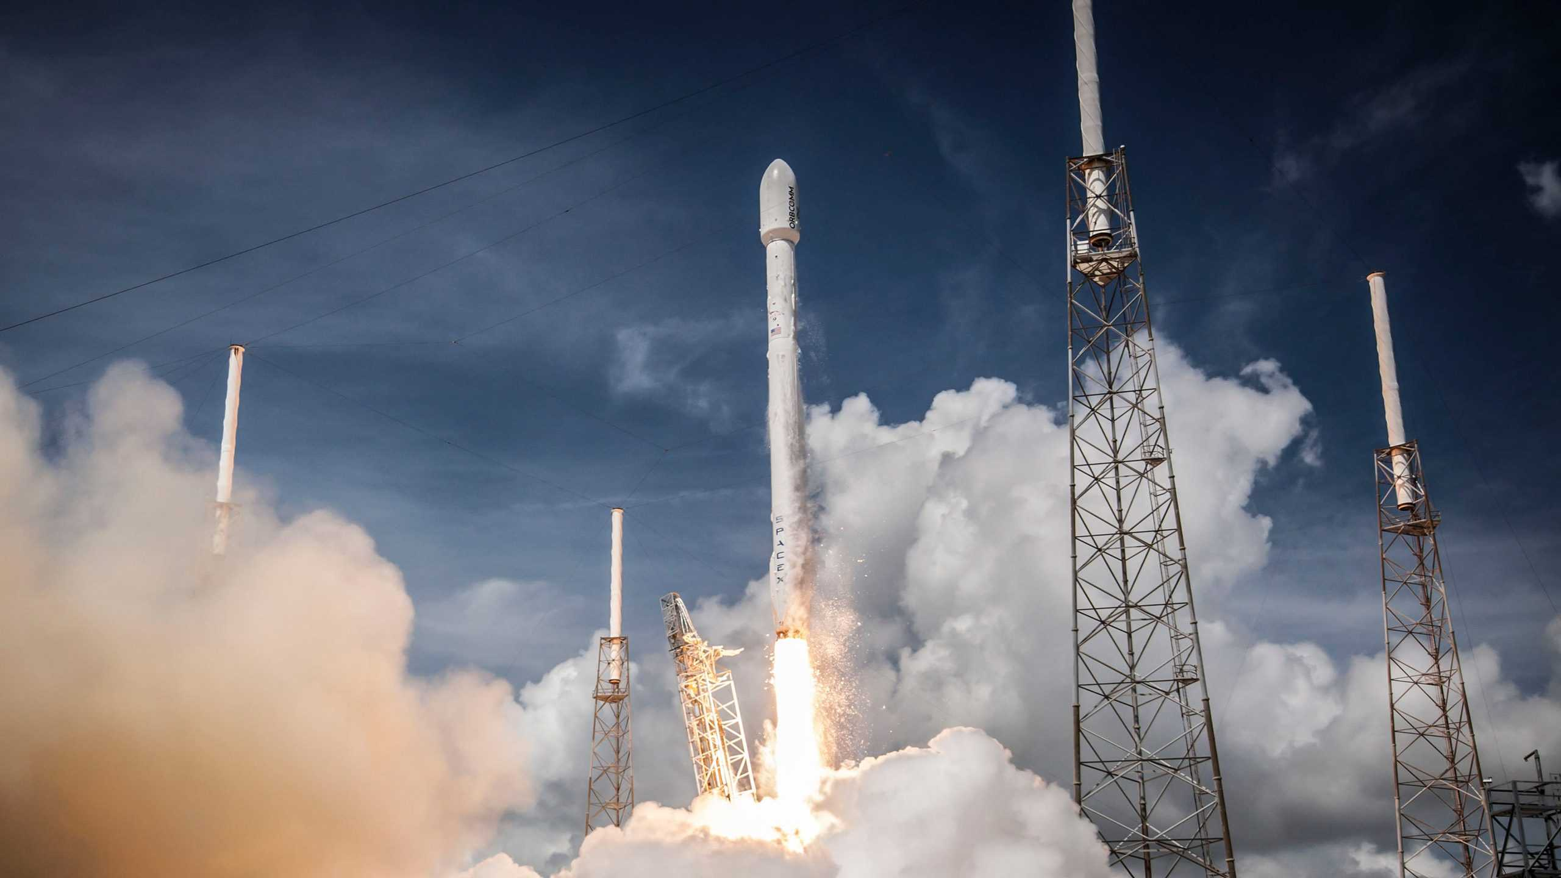
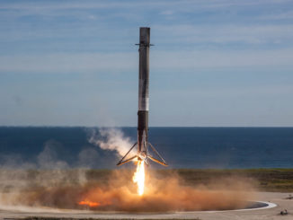
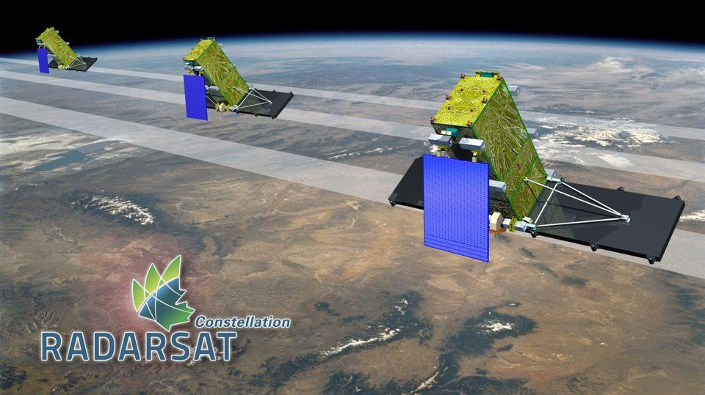
SpaceX Falcon 9 Launch – June 12
The RADARSAT Constellation Mission (RCM) is Canada’s newest generation of radar Earth Observation (EO) satellites that will contribute to a better understanding of Canada’s land and natural resources.
The RCM will capture images of the earth’s water, land, ice and atmosphere during the day and night and in all types of weather, including heavy cloud cover, smoke and haze.
Maritime surveillance: Ice monitoring, ship detection, oil pollution monitoring and marine wind measurement.
Disaster management: Mitigation, warning, response and recovery for earthquakes, floods, landslides, volcanoes, and windstorms.
Ecosystem monitoring: Forestry, agriculture, protected areas, wildlife habitat, wetlands, and coasts.

Slide 7
Recent space-related news
June 20 – Blue Origin perform first test of BE-7 lunar lander engine

Slide 8
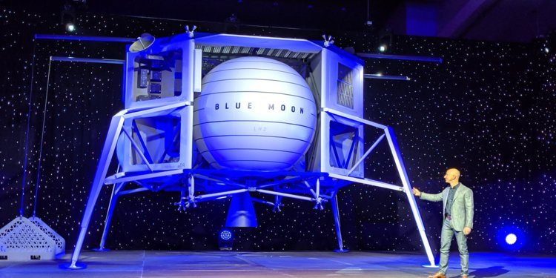
Recent space-related news Blue Origin announces the Blue Moon lunar lander
Proposed for returning Americans to the moon by 2024

Slide 9
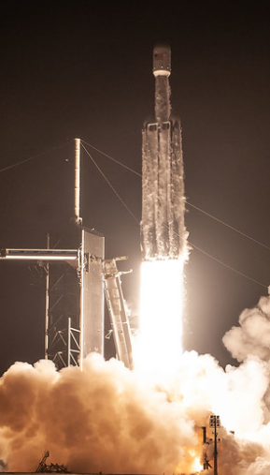
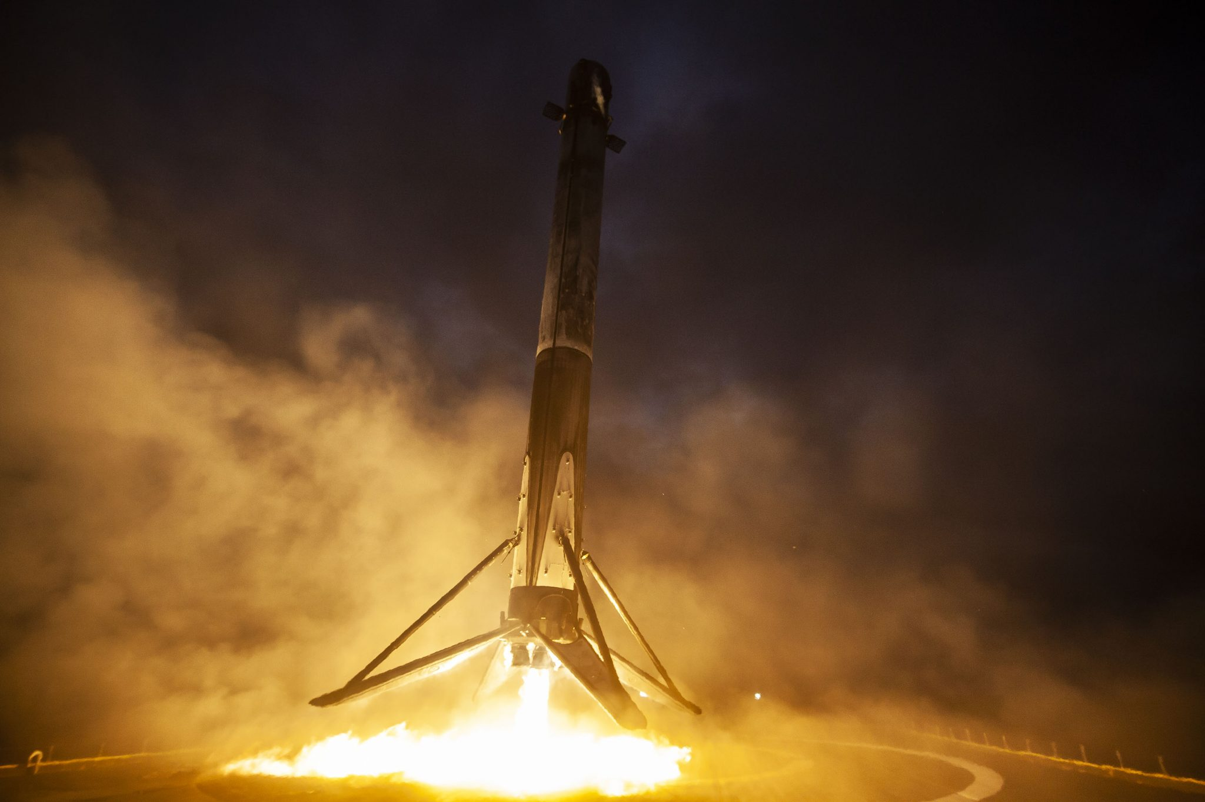
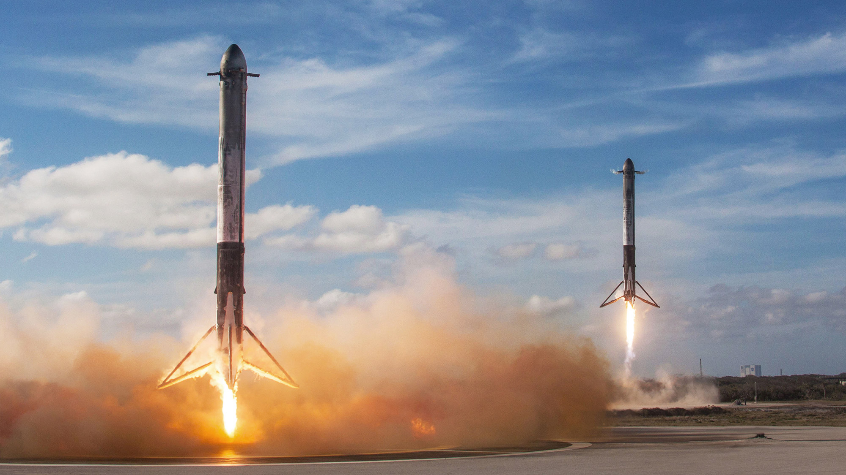
June 25 – Falcon Heavy – STP-2

Slide 10
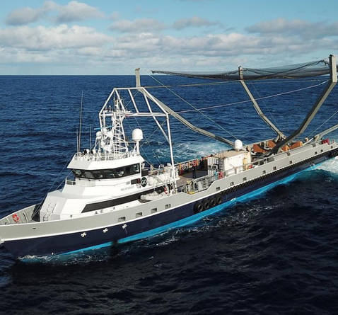
June 25 – Falcon Heavy – STP -2 – Also caught a fairing

Slide 12
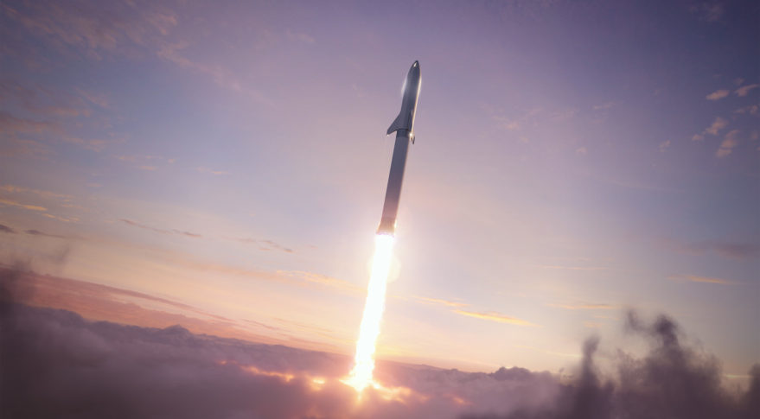
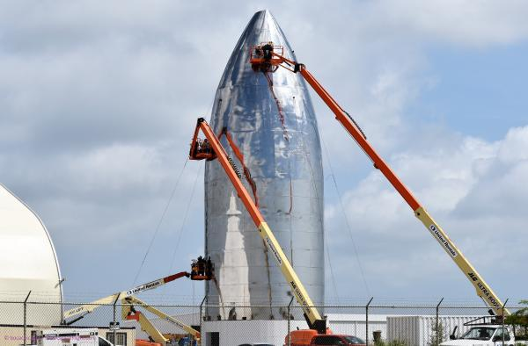
June 28: SpaceX targets 2021 commercial Starship launch
Two competing build sites: Boca Chica, TX and Florida
Suborbital “hopper” Tests planned for 2019
Orbital tests planned for 2020
Under contract by Yusaku Maezawa to fly himself and a group of artists around the moon in 2023 (http://DearMoon.earth)
StarShip will be 100% reusable (inspect, fuel, re-fly) which will make it the lowest cost to operate rocket
Most capable rocket ever built. Plans to transport 100 people into orbit at a time. Can go to moon and to Mars.

Slide 13
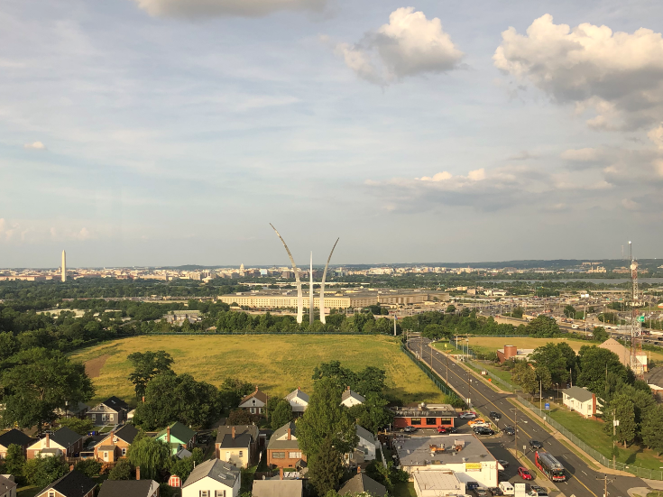

Slide 14
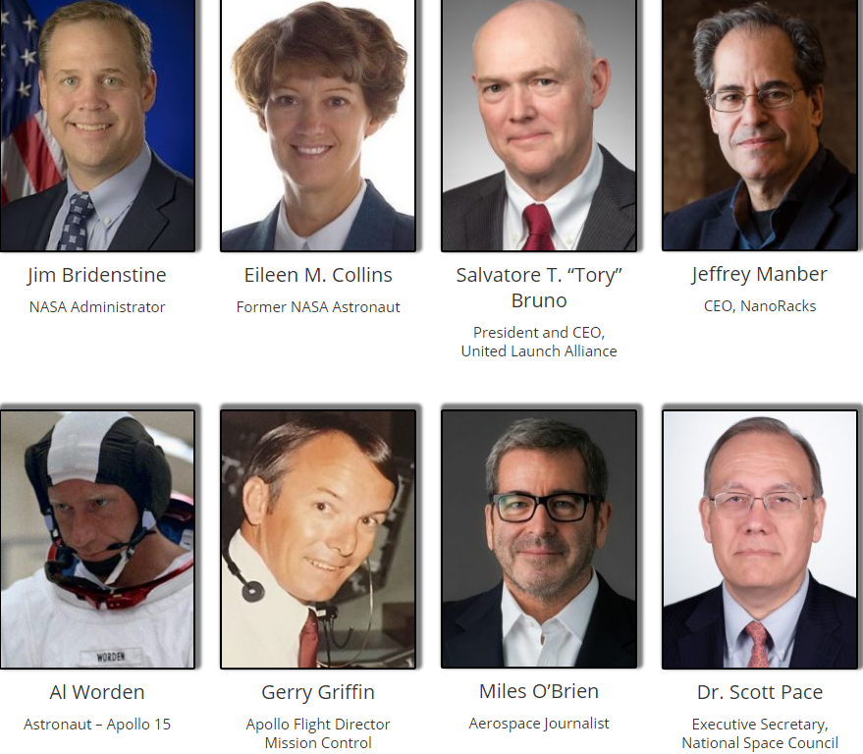

Slide 15
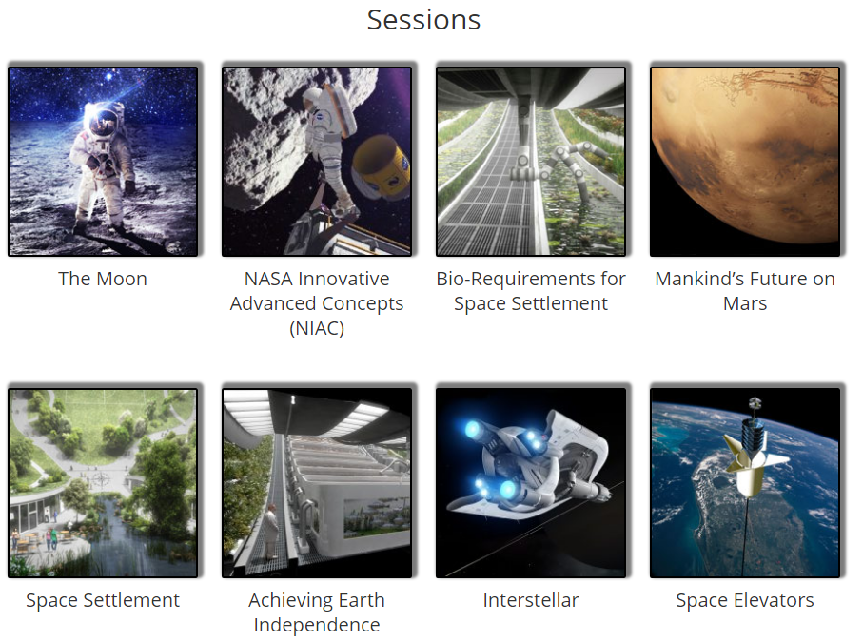

Slide 16
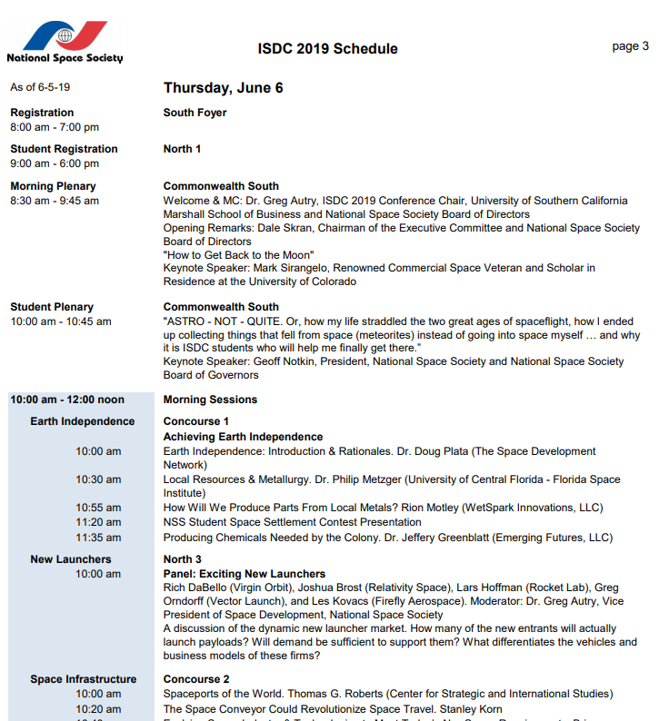

Slide 17
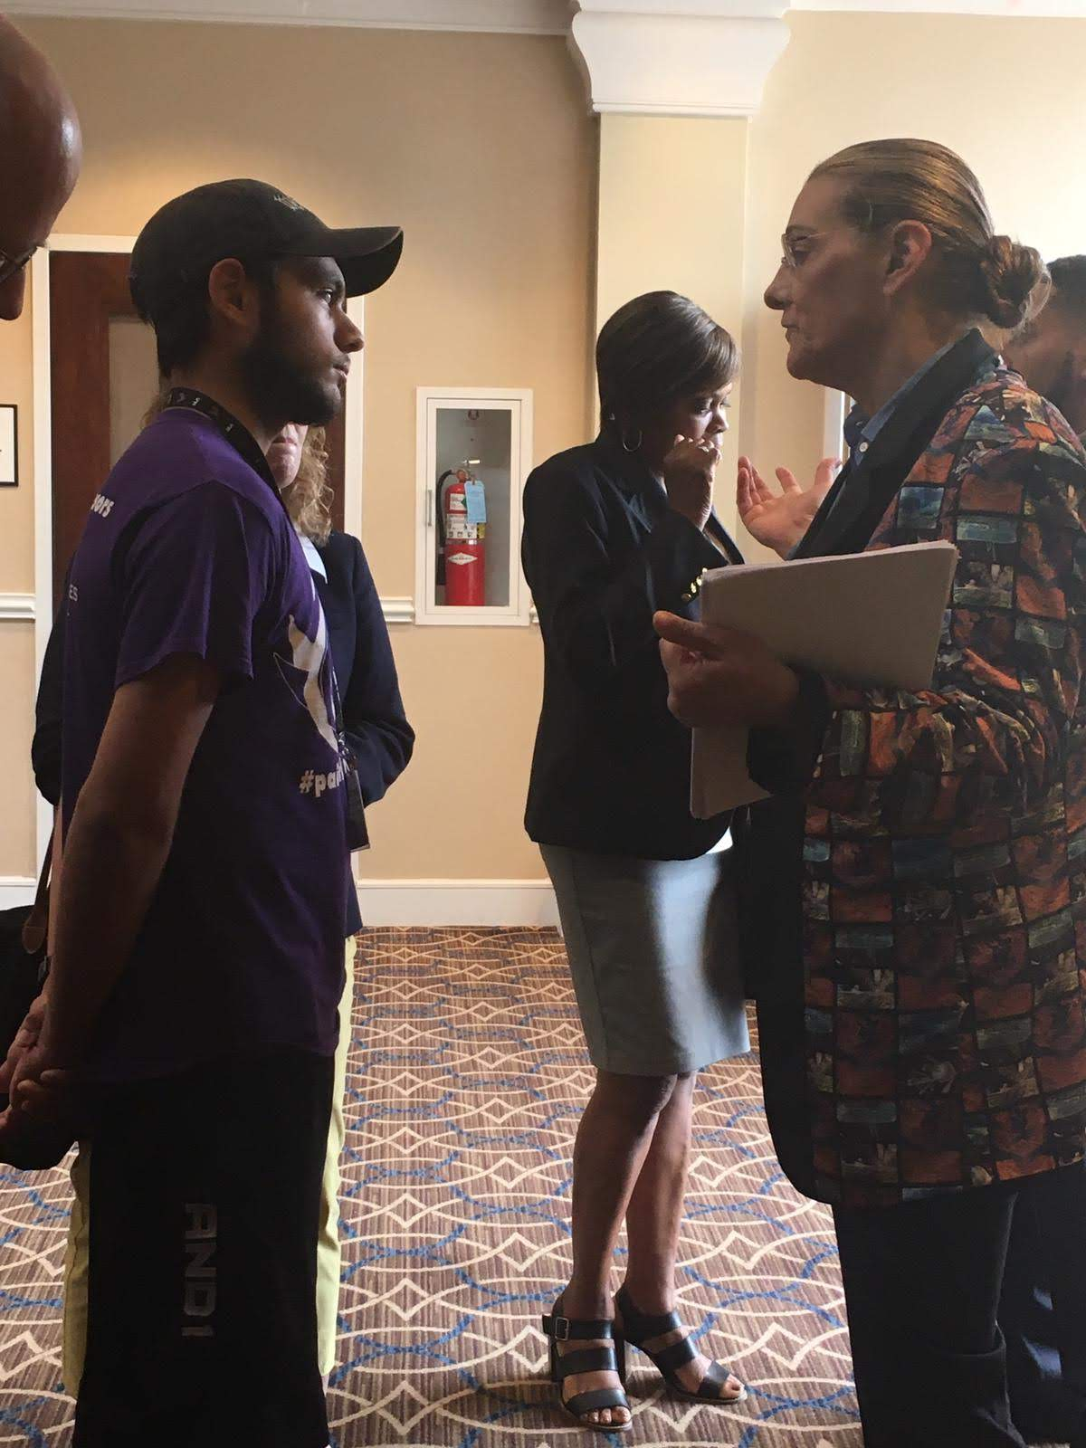
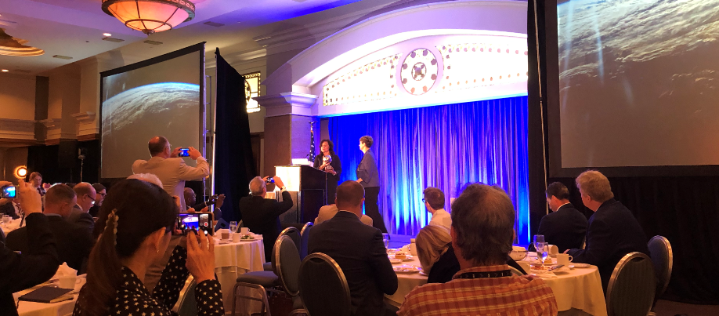
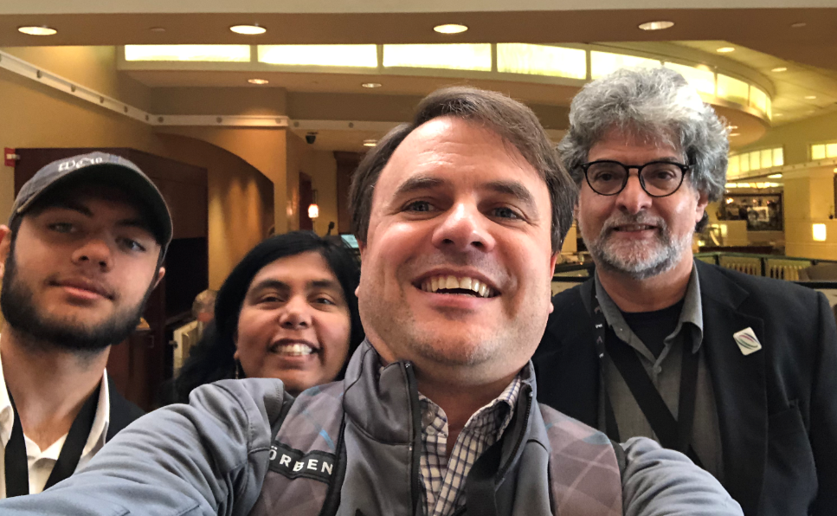
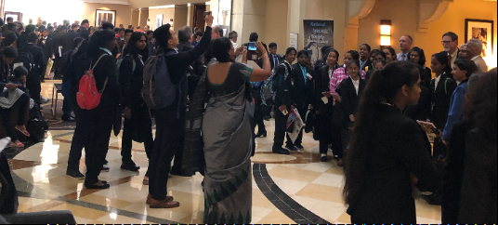

Slide 18
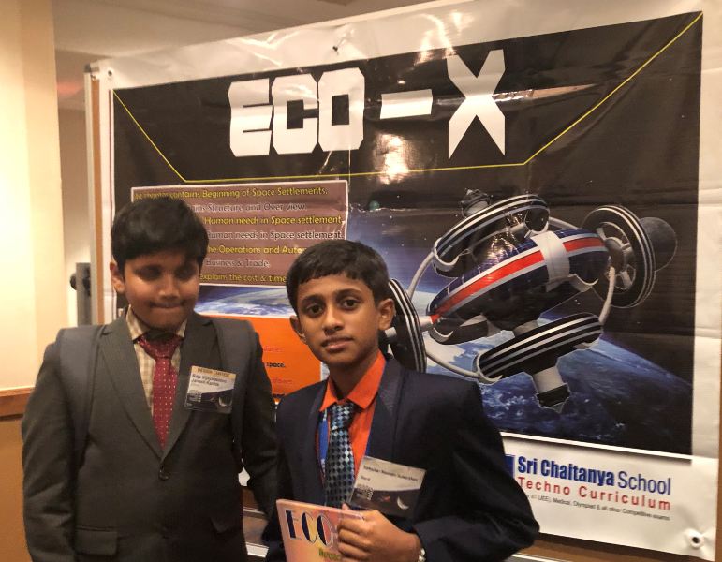

Slide 19
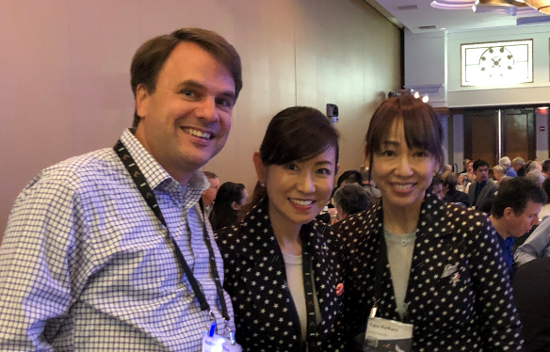
Yuko Kirhara
CEO & CTO
Chieko Takahashi
CEO & COO
Astrax – Flight Attendant Training for Space Tourism
3 Month Training Program (~$30k)

Slide 20
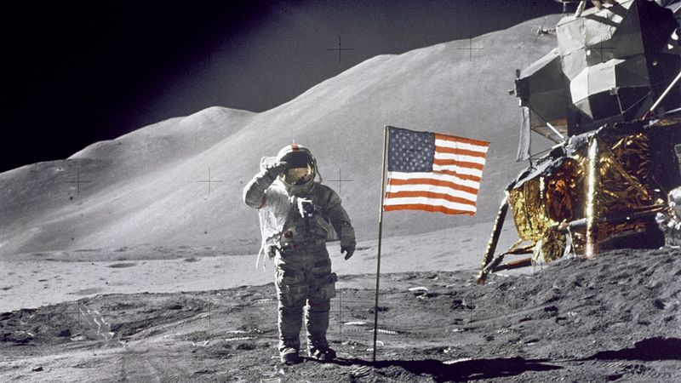
Back to the Moon to Stay
July 20, 2019 will mark the 50th anniversary of Neil Armstrong and Buzz Aldrin setting foot on the moon back in 1969 as part of the Apollo program.

Slide 21
Apollo 17 – Lift off from the Moon December 14, 1972

Slide 23
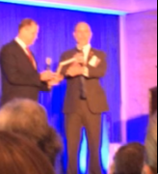
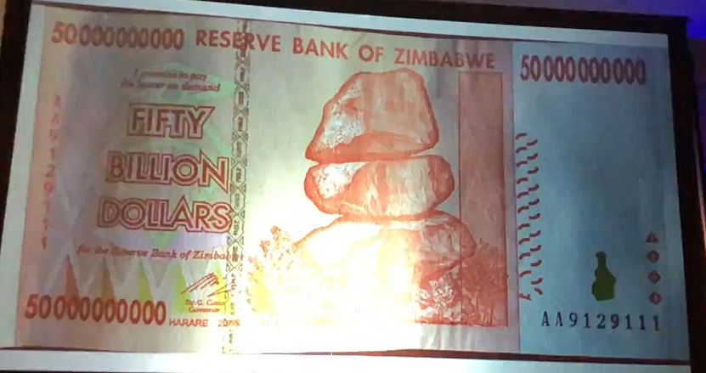
Jim Bridenstine, NASA Administrator

Slide 24
Why Go Back?
Utilize the resources of the moon
Testbed of systems and techniques to go further
Unknown unknowns

Slide 26
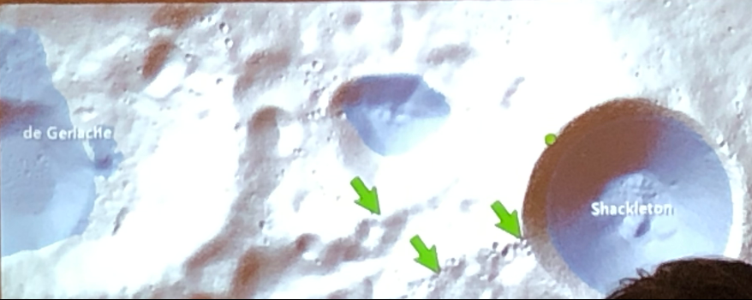
The Moon has WATER

Slide 27
Artemis – The Return to the Moon in 2024
Things will be different this time:
Focus on buying services instead of building hardware
International Partnerships
Go Sustainably (focus on using the resources of the moon)

Slide 28
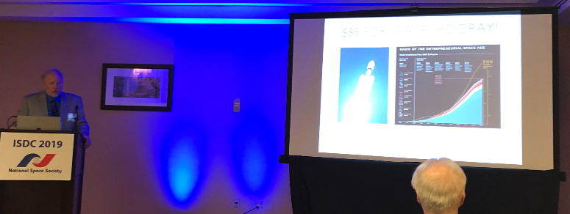
Making Space Part of the Economy
The "Space-Scalable Strategy: How to Profitably Invest in the New Space Economy Without Being a Self-made Billionaire. Thomas Andrew Olson (The Center for Space Commerce & Finance)

Slide 29
Many Over Lapping Areas of Terrestrial and Space Business Opportunities
Remote Medicine
Food Growing
Water Purification/recycling
Radiation protection
Communications

Slide 30
Meagan Crawford – The State of NewSpace: Thousands of Companies, Trillions in Opportunity

Slide 31
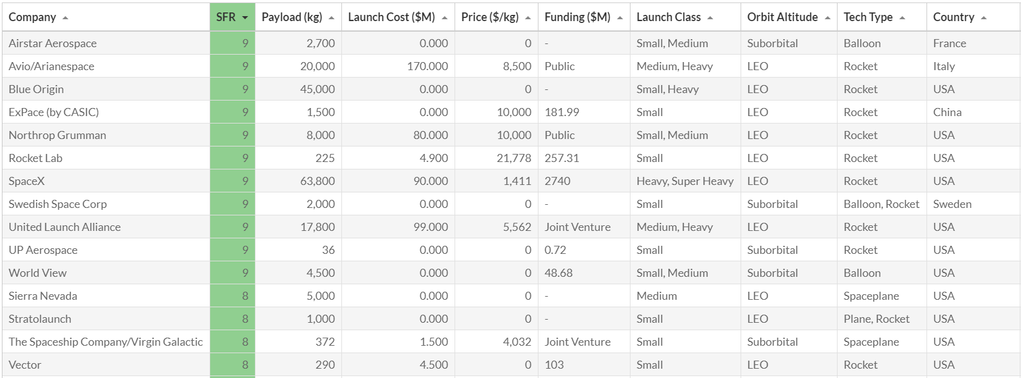

Slide 32
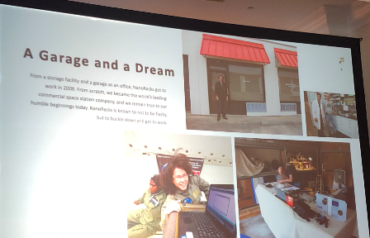
Jeffrey Manber, CEO, NanoRacks
10yrs – private ownership on the ISS
Previous endeavor: MirCorp (20 yrs ago)

Slide 34
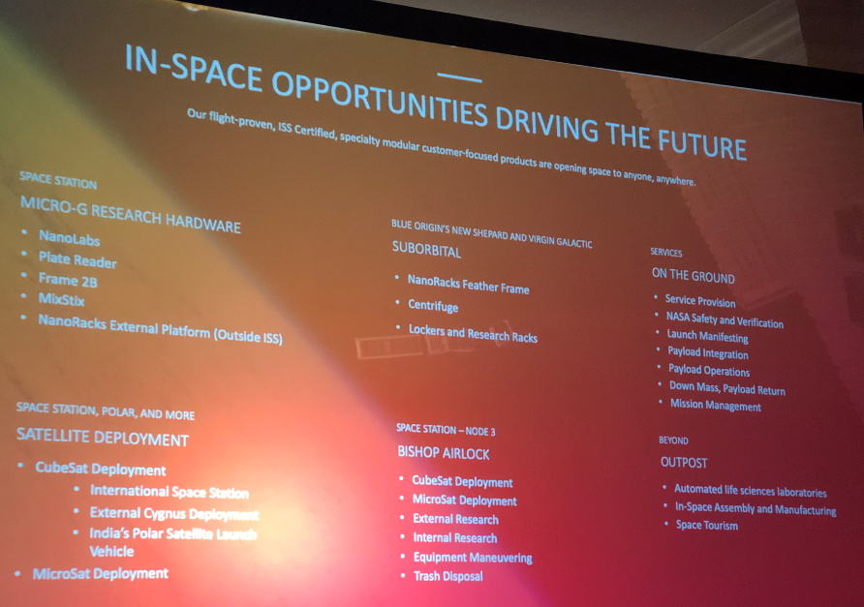

Slide 36
Just on more thing…

Slide 37
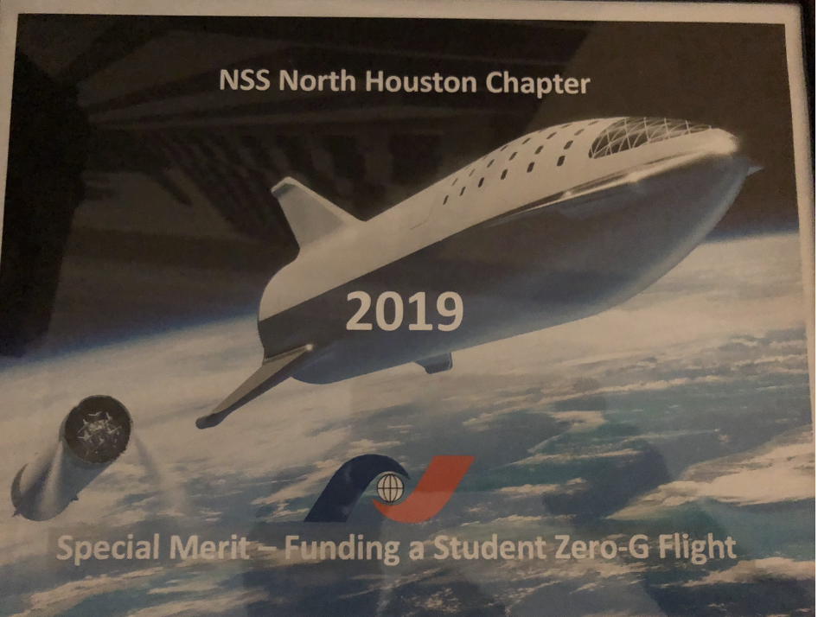

Slide 38
Save the date

Slide 39
Space Events around Houston
Chasing the Moon Movie Screening at Space Center Houston | Tuesday, July 16 | FREE – Space Center. 7pm.
Space on Screen & Dinner: Armstrong Movie Screening at Space Center Houston | Thursday, July 18 –Tickets start at $24.95. 6pm.
Apollo 11 50th Anniversary Celebration at Kemah Boardwalk | Friday, July 19 | FREE – 5pm to 11pm.
Mixers & Elixirs at the Houston Museum of Natural Science | Friday, July 19. 7pm to 10pm.
Apollo 11 50th Live at Space Center Houston | Saturday, July 20 Tickets start at $49.95. The opening ceremony kicks off at 9:15am; outdoor festival begins at 8pm.
Star Wars Meet-and-Greet & Moon Landing Screening at Children’s Museum of Houston | Saturday, July 20 – 10am to 4pm.
A Giant Leap: 50th Anniversary of the Moon Landing at Discovery Green | Saturday, July 20 | FREE – 6pm to 10pm.
Grand Tour of the Moon by David Kring & WindSync Concert at Houston Museum of Natural Science | Saturday, July 20 –7pm.
Apollo 50 ft. Mothership: Tribute to Led Zeppelin & Eclipse: Tribute to Journey | Saturday, July 20 – Tickets start at $15. 7pm.
Movie Nite on The Strand: First Man Movie Screening at Saengerfest Park | Saturday, July 20 | FREE – 8pm.
Apollo 11 Mission Splashdown Party at Space Center Houston | Wednesday, July 24 – 6pm to 10pm.

Slide 40
Anima Sabale
August NSS-NH meeting:
Orion Spacecraft Simulations Lab Manager
Johnson Space Center (Jacobs)
Aerospace and Software Engineer for NASA while pursuing childhood aspirations to become an Astronaut. Citizen Scientist-Astronaut Candidate during off-work hours, participating in research missions, including analog missions at NASA HERA and Mars Desert Research Station.
Barbara Bush Library, Aug 3, 2019 3:00 PM

Slide 41
Open Discussion

Slide 42
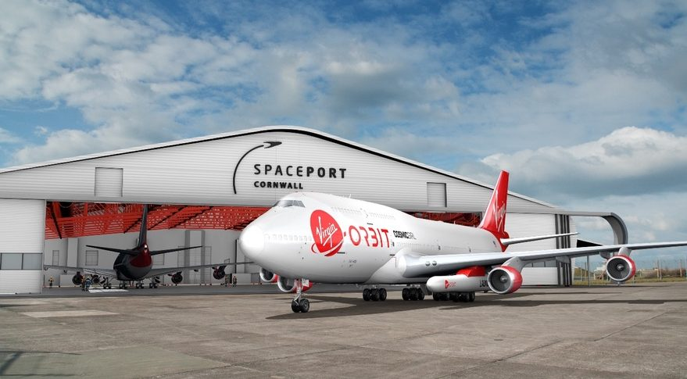
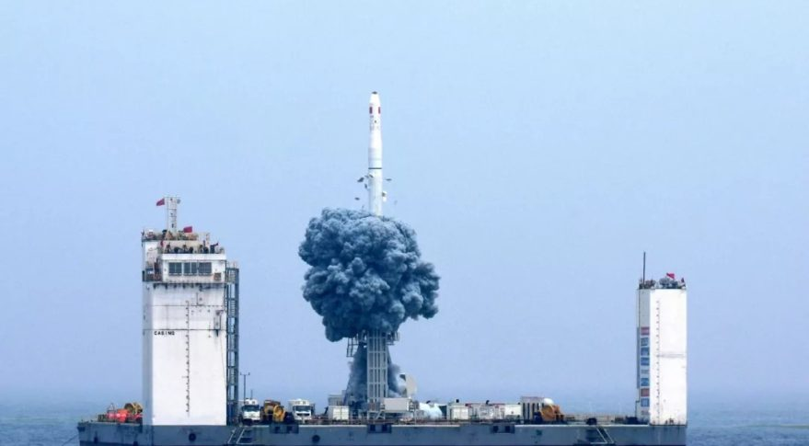
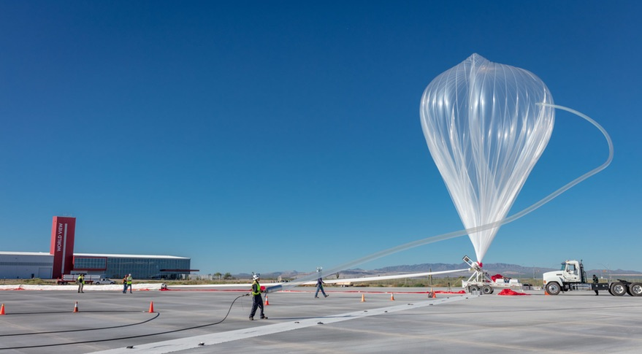
Recent space-related news
June 4 – UK Space Agency announced plans create SpacePort for Virigin Orbit
June 5 – China conducts first sea launch
June 5 – World View announced the successful completion of their longest stratospheric balloon flight

Slide 43
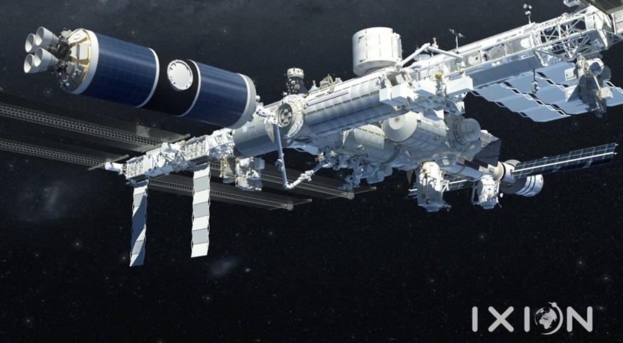
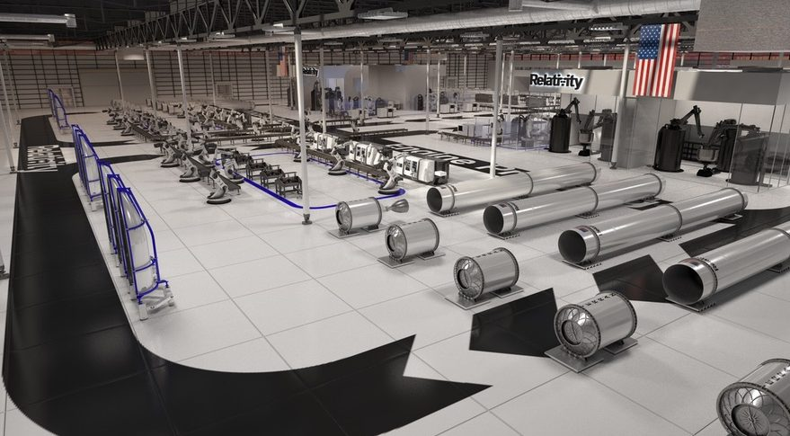
Recent space-related news
June 7 – NASA Releases ISS Commercialization Plan
June 7 – Bigelow Aerospace announces that it has made “significant deposits” for 4 dedicated SpaceX Crew Dragon Missions. Company plans to charge $52 million per seat
June 8 – Trump on Twitter:
“For all of the money we are spending, NASA should NOT be talking about going to the Moon – We did that 50 years ago.”
June 11 – Relativity announced it would build a factory at NASA’s Stennis Space Center

Slide 44
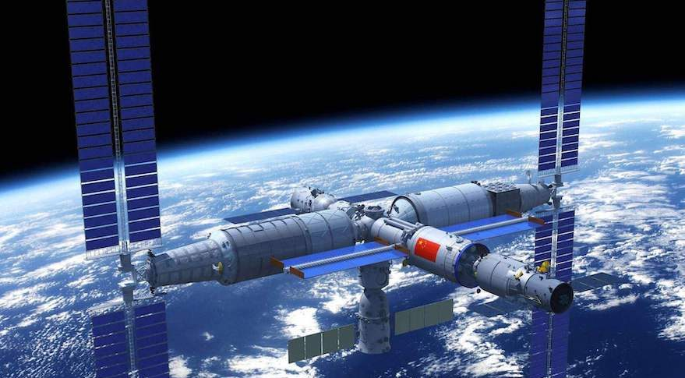
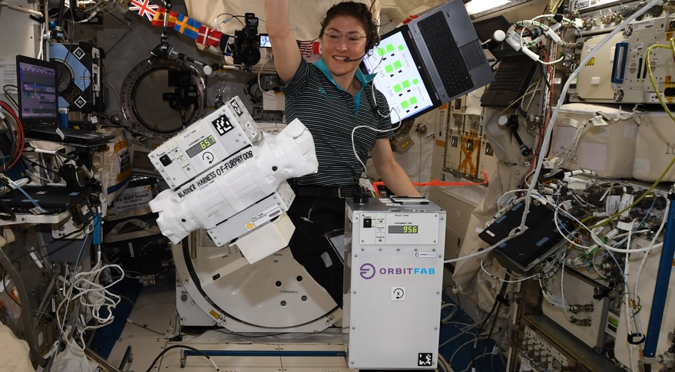
Recent space-related news
June 13 – China announces that 6 international experiments have been selected to fly on its future space station
June 14 – NASA Administrator Jim Bridenstine estimated that it would cost $20 to $30 Billion additional over the next 5 years to achieve the Artemis Program
June 18 – Orbit Fab demonstrates satellite refueling technology on ISS

