Slide 1
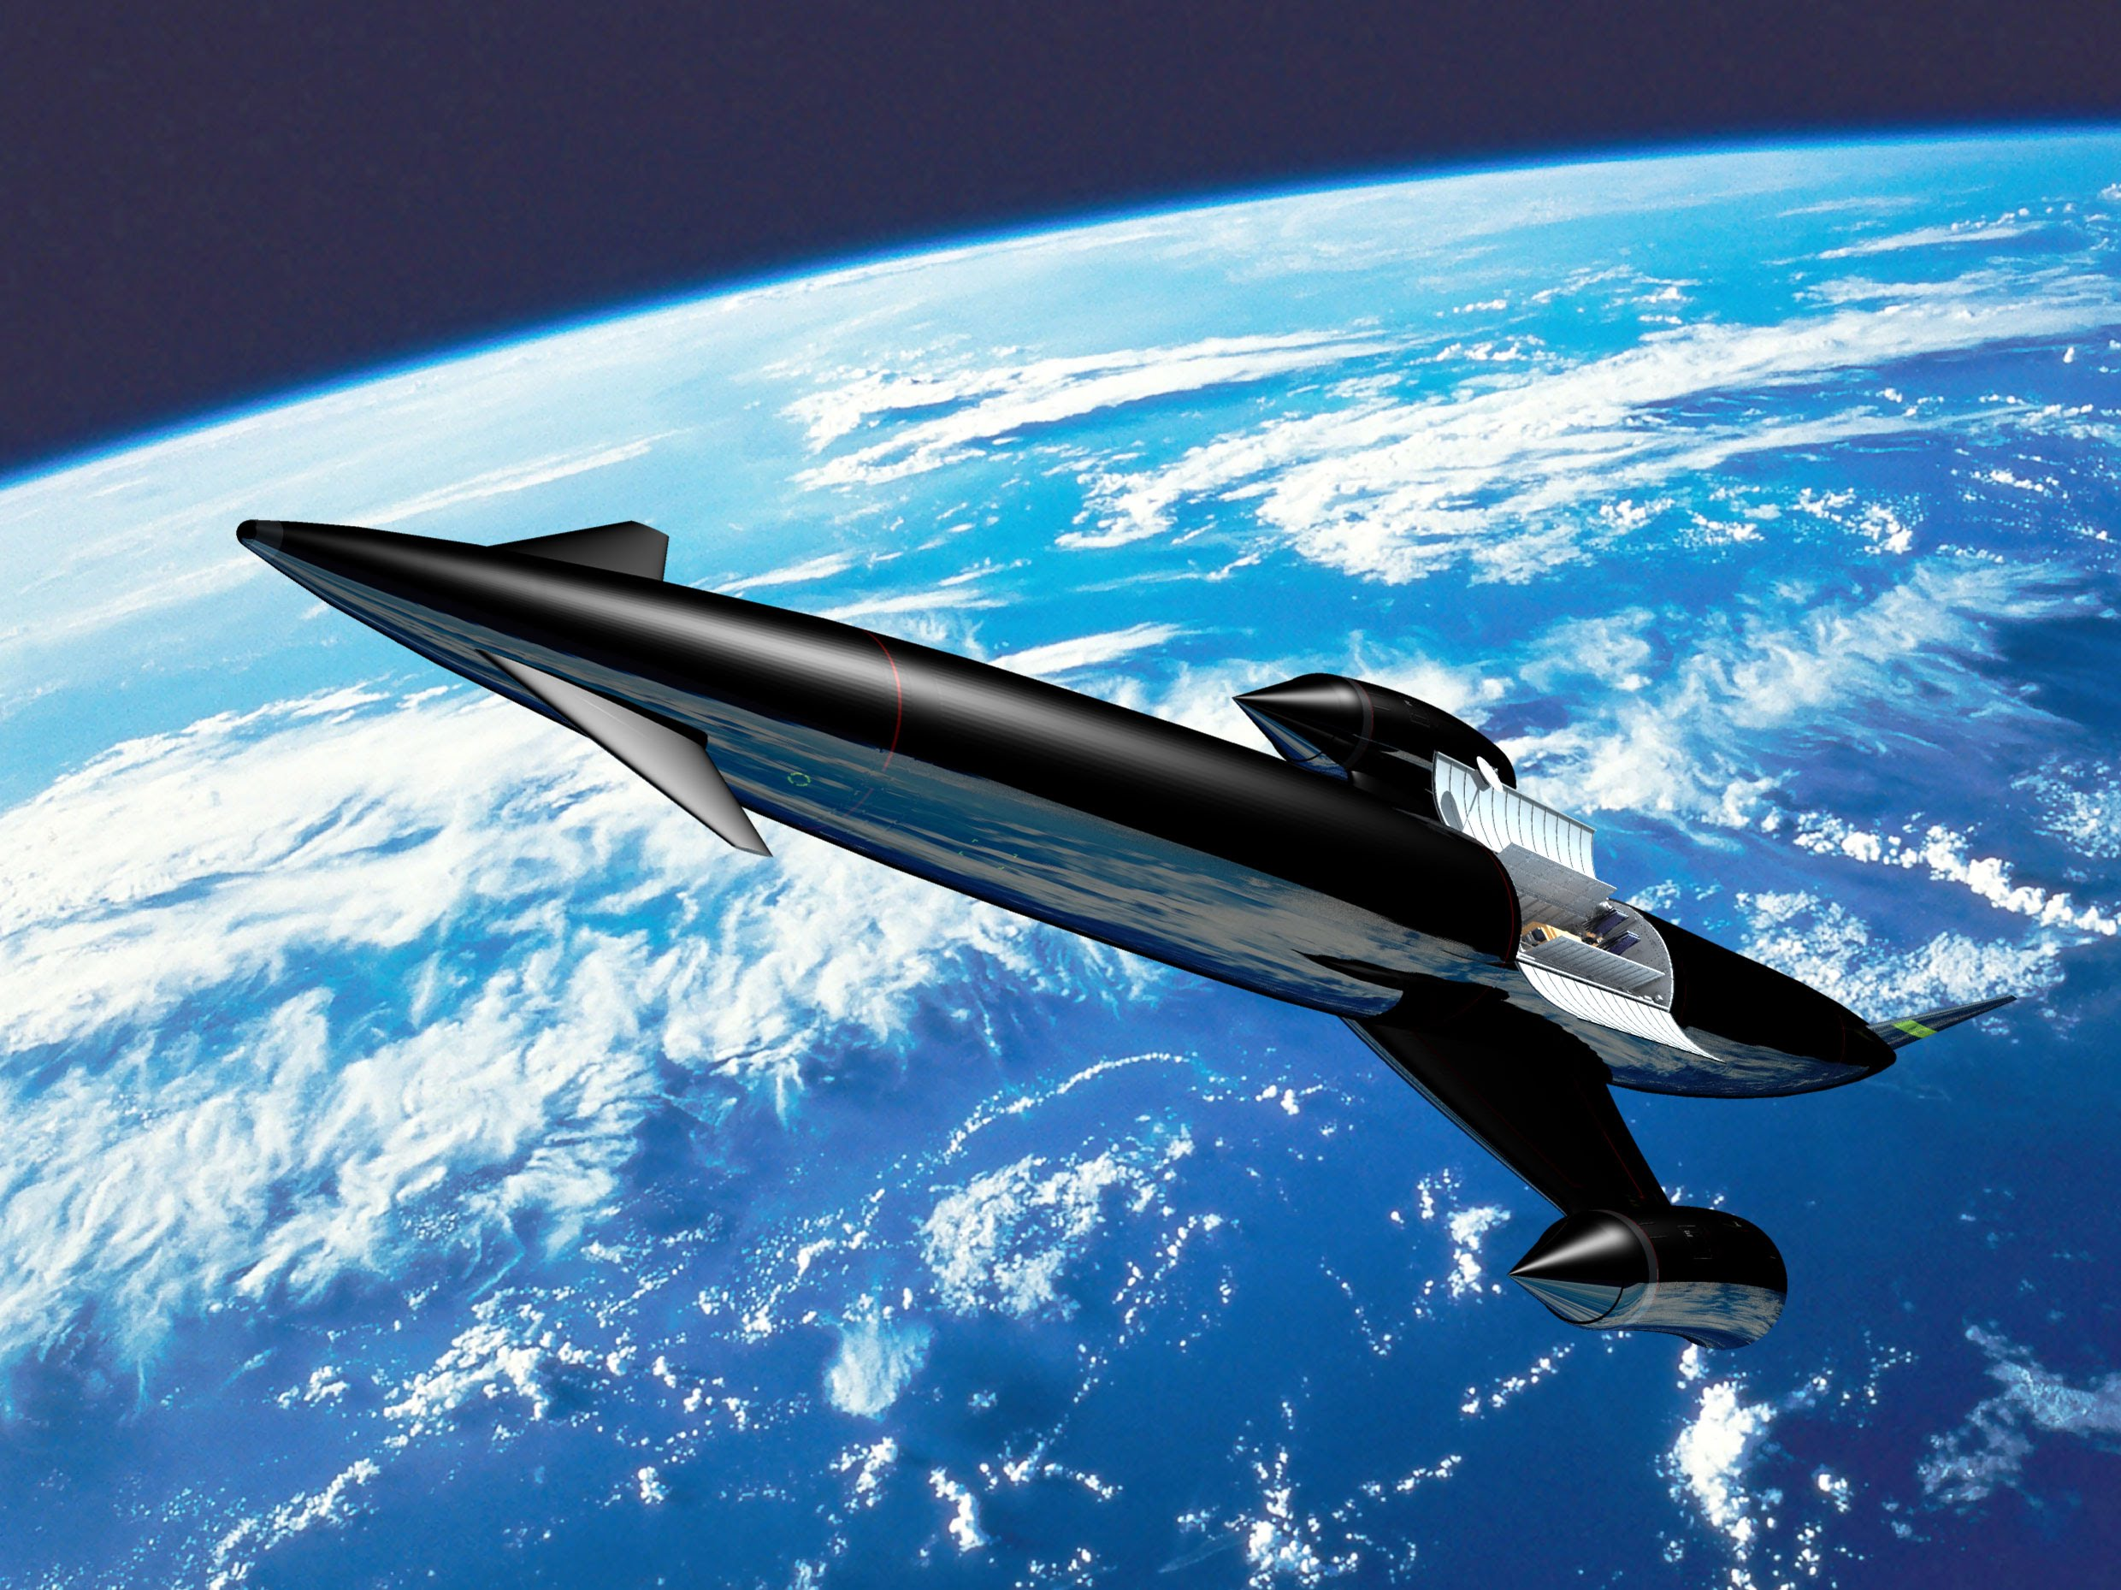
SKYLON and
SABRE

Slide 2
Skylon / SABRE (Synergistic Air Breathing Rocket Engine)
Single Stage to Orbit Vehicle
This is a concept under development by Reaction Engines Limited for a single stage to orbit vehicle using a hypersonic precooled hybrid air-breathing rocket engine to go to LEO.
The engine design is a single combined cycle rocket engine with two modes of operation. Air-breathing mode combines a turbo-compressor with a lightweight air precooler positioned just behind the inlet cone. At high speeds this precooler cools the hot, ram-compressed air leading to a very high pressure ratio within the engine. The compressed air is subsequently fed into the rocket combustion chamber where it is ignited along with stored liquid hydrogen. The high pressure ratio allows the engine to provide high thrust at very high speeds and altitudes. The low temperature of the air permits light alloy construction to be employed and allows for a very lightweight engine- essential for reaching orbit.
After shutting the inlet cone off at Mach 5.14 and 28 kilometer altitude, the system continues as a closed cycle high-performance rocket engine burning liquid oxygen and liquid hydrogen from onboard fuel tanks, allowing the Skylon spaceplane to reach orbital velocity after leaving the atmosphere in a steep climb.

Slide 3
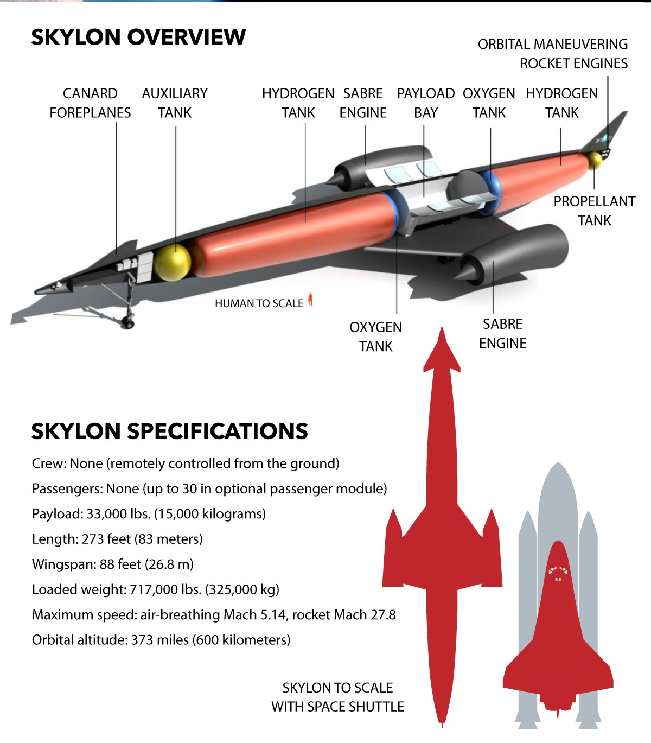
For scale, note the small human figure under the center fuel tank.
REL proposes two orbital versions: a cargo carrier, and a passenger carrier.
The EC is designing an aircraft version, Lapcat, that will fly from London to Sydney in 4.5 hours (currently a 22 hour trip).

Slide 4
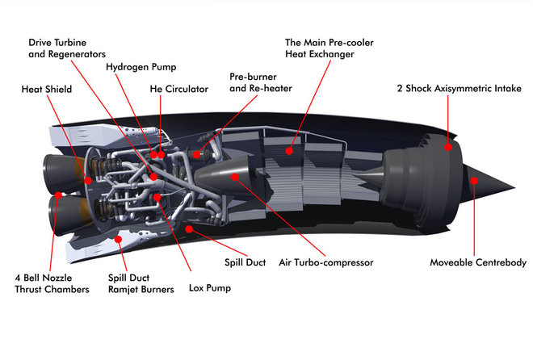
It’s so cool
The key to the engine is a proprietary heat exchanger capable of taking a core of ram heated inlet air at 1000C (1800F) and cooling it to -150C (-238F) in 1/100th of a second.
Most of the non-core air passes directly through a ring of bypass ramjets.
The cooled core air is fed to four high pressure combined cycle rocket engine combustion chambers.
Thrust (V) = 660,000 lbs Thrust (SL) = 440,000 lbs
Isp (V) = 460 sec (SSME engines) Isp(SL) = 3600 sec (x 7.8!)
Breakthrough was thinwall 3D printed tubes 1/32” ID
Why is the engine curved? The answer is: the air intake on the front of the nacelle needs to point directly into the incoming airflow whereas SKYLON's wings and body need to fly with an angle of incidence to create lift, so the intake points down by 7 degrees to account for this.

Slide 5
Technical history supporting the concept
Liquid Air Cycle Engine (LACE) built by General Dynamics in the 1960s as part of USAF aerospaceplane efforts. Limited potential.
Alan Bond at Rolls-Royce invented the “43rd option” in mid 80s called RB545 Swallow, promptly classified by UK gov’t as Top Secret. UK funded for 6 years as HOTOL, a Brit Space Shuttle.
UK stopped funding in 1989, Bond et.al. formed Reaction Engines Limited, developed offshoot SABRE to get around Official Secrets Act.
IN 2016, the SABRE project received 60M Lbs Sterling from UK govt and from ESA for a demonstrator engine involving full-cycle.

Slide 6
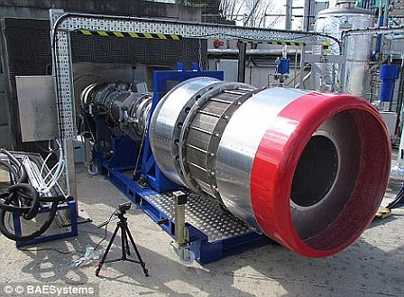
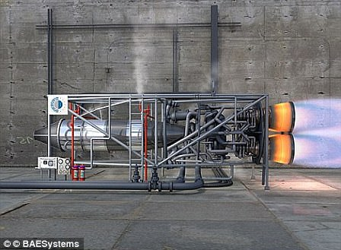
Real hardware being tested

Slide 7
Hardware Development Schedule
Nov 2012 -REL successfully concluded tests that proved the cooling technology worked. ESA evaluated HTX design and test results and agreed to provide funding.
June 2013 -UK gov’t provided 60M Lbs to begin full-scale prototype of SABRE engine for 2014-2016 period, with ESA providing 7M Lbs more. Total cost of test full-scale test rig is estimated at 200M Lbs.
June 2015 -Partnered with ANP to make and test aerodynamics of advanced nozzles, and also 3D-printed propellant injection system.
April 2015 -Passed a US AFRL feasibility study, for TSTO use.
August 2015 –European Commission approved more funding 50M Lbs.
October 2015 – BAE Systems agreed to buy 20% stake in company for 20.6M Lbs.
2016 – RE CEO announces with present funding, a ¼ scale engine will be built
May 2917 – Groundbreaking for construction of SABRE TF1 engine test facility, to activate in 2020.

Slide 8
Other design innovations and secrets
Proprietary lightweight alloy (probably Be) for HTX
Previous designs routed hydrogen fuel as coolant through HTX, hydrogen embrittlement issues. Helium coolant loop now inserted between H2 cold reservoir and hot HTX tubes. No more H2 embrittlement in precooler.
Engine combustion chambers are cooled by liquid O2, not H2, nor He.
Ice-prevention system was a closely guarded secret, but REL disclosed methanol-injection 3D-printed de-icer in 2016 patents, since they now had partner companies.
Expansion-deflection nozzle tests (STERN) successful, nozzle adjusts to maintain thrust efficiency as altitude increases
Sept 2017 – US DARPA contracted with REL to build parallel HT airflow test facility in Watkins, Colorado to test HTX. Tests start in 2018, running HTX at 1800F (Mach 5).

Slide 9
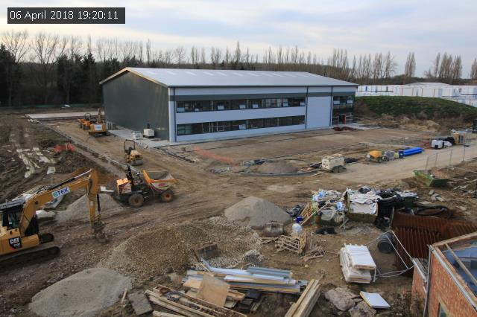

TF1 Test Facility UK at left TF2 Test Facility US at right

Slide 10
A key element of the revolutionary SABRE™ air-breathing rocket engine successfully passes the first phase of high-temperature testing. Precooler technology will enable a wide variety of high-speed flight and advanced propulsion systems.
Reaction Engines’ precooler heat exchanger successfully achieved all test objectives in the first phase of high-temperature testing designed to directly replicate supersonic flight conditions and future tests are planned at even higher temperatures. The precooler is a key element of Reaction Engines’ revolutionary SABRE engine and is a potential enabling technology for advanced propulsion systems and other commercial applications.

Slide 11
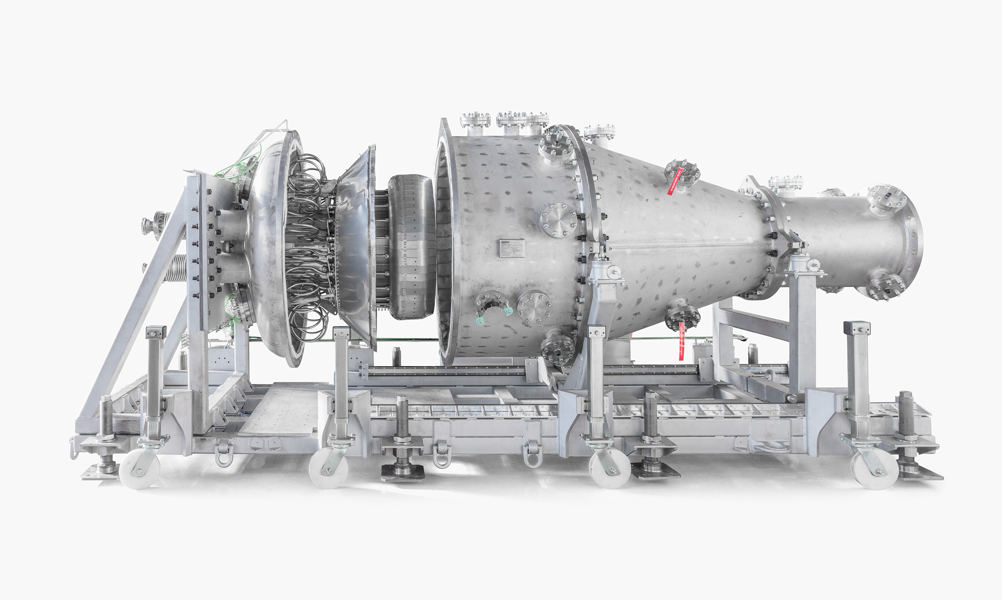

Slide 12
The ground-based tests saw Reaction Engines’ unique precooler successfully quench the 420°C (~788°F) intake airflow in less than 1/20th of a second. The intake temperature replicates thermal conditions corresponding to Mach 3.3 flight, or over three times the speed of sound. Mach 3.3 matches the speed record of the SR-71 Blackbird aircraft, the world’s fastest jet-engine powered aircraft produced to date and is over 50% faster than the cruising speed of Concorde.
In the recent tests, the compact precooler achieved all test objectives and achieved 1.5 MW of heat transfer, the equivalent to the energy demand of 1,000 homes; successfully cooling incoming air from a temperature at which hot steel starts to glow. The tests are the first phase in an extensive test programme which will see the precooler test article (HTX) exposed to high-temperature airflow conditions in excess of the 1,000°C (~1800°F) expected during Mach 5 hypersonic flight.
The tests produced a large volume of detailed high-quality test data under unusual conditions. The test facility is uniquely set up to allow this type of information to be recorded. Word of the flawless test has prompted several companies, both in and outside of aerospace, to contact REL about use of the new facility for other products.

Slide 13
The significant testing milestone occurred at Reaction Engines’ recently commissioned TF2 test facility located at the Colorado Air and Space Port, US. The TF2 test facility has been constructed by Reaction Engines to undertake ground based ‘hot’ testing of its precooler technology. The technology has already passed an extensive range of tests in the UK where its performance was fully validated at ambient air temperatures.
Commenting, Mark Thomas, Chief Executive, Reaction Engines, said:
“This is a hugely significant milestone which has seen Reaction Engines’ proprietary precooler technology achieve unparalleled heat transfer performance. The HTX test article met all test objectives and the successful initial tests highlight how our precooler delivers world-leading heat transfer capabilities at low weight and compact size. This provides an important validation of our heat exchanger and thermal management technology portfolio which has application across emerging areas such as very high-speed flight, hybrid electric aviation and integrated vehicle thermal management.”
To replicate the conditions the precooler will experience at hypersonic speeds, the TF2 test facility uses a General Electric J79 turbojet engine formerly used in a McDonnell Douglas F-4 Phantom aircraft to provide high-temperature airflow. Engineers at Reaction Engines’ Culham headquarters constructed the HTX precooler test article and after initial testing it was shipped to Colorado at the end of 2018, and ‘hot’ tests commenced in early March 2019.

