Slide 1
NSS North Houston Space Society
June 2019

Slide 2
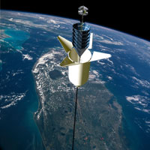
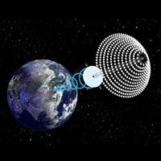
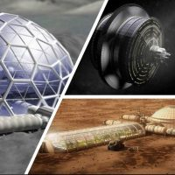
National Space Society (NSS) Vision
People living and working in thriving communities beyond the Earth, and the use of the vast resources of space for the dramatic betterment of humanity.

Slide 3
Agenda
3:00 Room available. Get set up
3:15 Introduction
3:20 Recent space-related news
3:30 Talk on StarLink and other communication satellites by Greg Stanley
4:05 Short talk on Skylon/SABRE by Doug Hall
4:20 Brief summary of upcoming NSS-NH meetings and other events
4:30 Open discussion
4:45 Start clearing room of our materials (but don’t stop talking!)
5:00 Library Closes

Slide 4
Recent space-related news
SpaceX launches first 60 satellites for StarLink internet service
(covered in talk later)
Artemis Moon Initiative
New name for NASA going to the moon: Artemis project
(Named after Greek moon goddess)
New goals include landing near the lunar south pole by 2024
Proposed budget increase of $1.6 Billion (total NASA up 5% to $22.6 billion)
For lunar lander, precursor capabilities on the lunar surface.
Money taken from student Pell grant program, which will be controversial
Critics say it’s not enough of an increase to matter
But Congress gets a say. Who knows what will happen?
NASA chooses Maxar (formerly SSL) to develop, build, launch the Power and Propulsion module for the Lunar Gateway

Slide 5
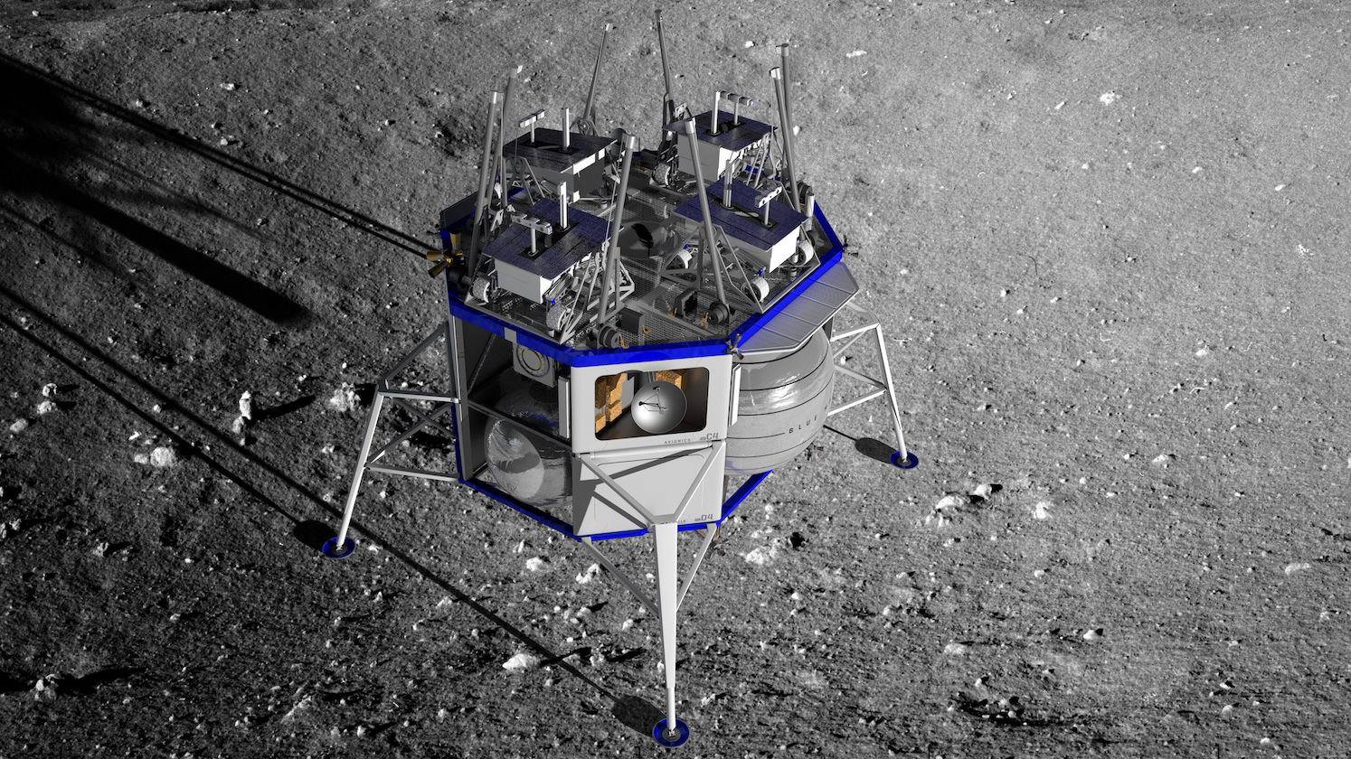
Recent space-related news Blue Origin announces the Blue Moon lunar lander
Proposed for returning Americans to the moon by 2024

Slide 6
Other news???

Slide 7
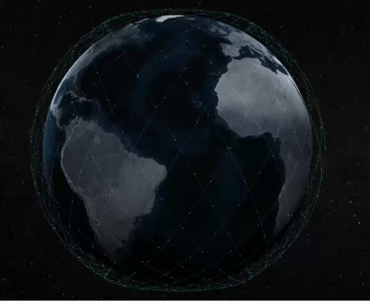
Presentation: SpaceX’s StarLink and other satellite-based internet services
Greg Stanley
June 1, 2019

Slide 8
StarLink (service of SpaceX)
SpaceX StarLink will be a worldwide internet service based on up to 12,000 Low Earth Orbit (LEO) satellites
Comparison: about 5000 total satellites in orbit now
Iridium on steroids (launched in 1997, 66 satellites in LEO, mainly voice)
Goal: low cost, easy to install, low-latency broadband worldwide
To fixed locations, not phones like Iridium
End user terminals targeted to cost $200 (flat, pizza-box sized, omnidirectional), but not demonstrated yet
Requested license for 1,000,000 fixed locations in Feb, 2019
Goal: major funding for Mars plans , dwarfing current SpaceX
Some milestones
Two experimental satellites launched Feb, 2018
First buildout launch of 60 satellites on May 23, 2019

Slide 9
StarLink: Much bigger than SpaceX launch business
Hoping for $30 billion revenue, $15 billion profit by 2025
Comparisons
Expected SpaceX launch business in 2025: $3 - $5 billion (Musk)
Musk says that’s probably a peak, so other business is needed
2018 SpaceX total revenue: $2 billion
Iridium yearly revenue: $538 million, with 1 million subscribers
Total world internet connectivity revenue: $1 trillion (Musk)
Decade-long investment: $10 billion
SpaceX raising funding for StarLink: $1 billion already in 2019
One key to expansion into space is developing business in space – this is a reminder that much current space business is based on satellite communications of all types

Slide 10
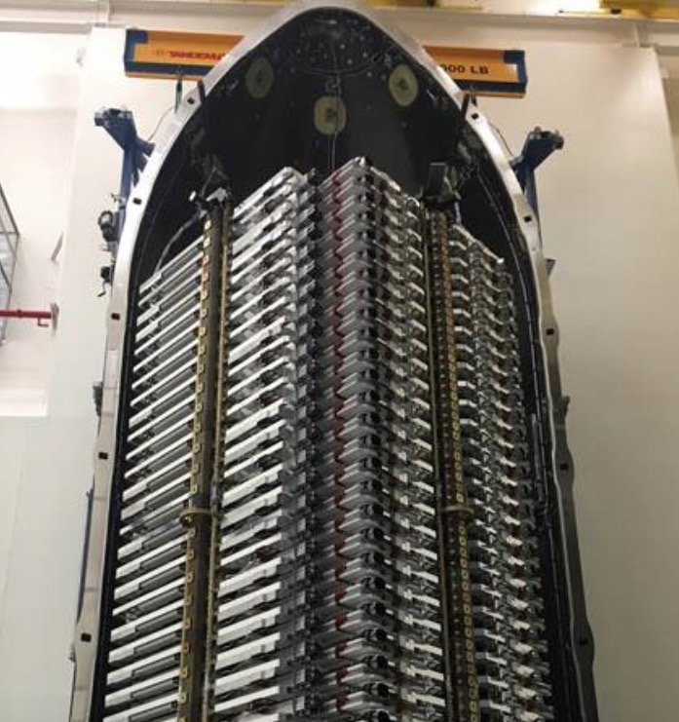
First StarLink buildout launch -- 60 satellites
Successful launch from Cape Canaveral May 23, 2019
Heaviest mission to date for SpaceX & Falcon 9: 13.6 metric tons
The first stage was re-used from two previous launches
First stage landed on the “droneship” in the Atlantic
Reusability is real!
60 Satellites in one launch to one low earth orbit (LEO)
500 lbs each, initial altitude of 250 miles (400 kilometers)
Ion thrusters (Krypton) will lift to higher, different orbits at 340 miles (550 kilometers) (in progress)
All 60 satellites deployed their solar arrays, generated power, and communicated with ground stations

Slide 11
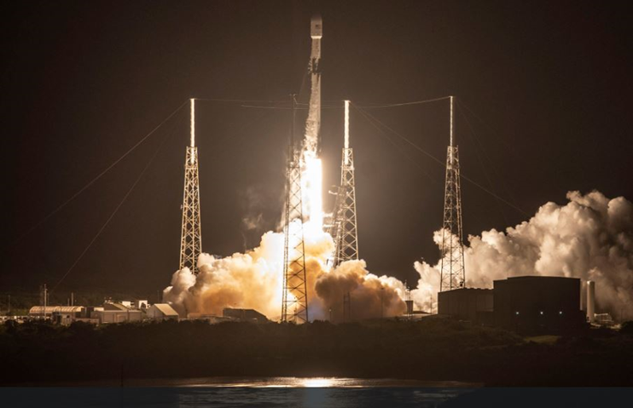
The StarLink launch May 23

Slide 12
The 60 satellites stacked before deployment

Slide 13
StarLink Launch
Part of the train of Starlink satellites passing over Leiden, the Netherlands, about 22.5 hours after launch
(Marco Langbroek, Leiden, the Netherlands)

Slide 14
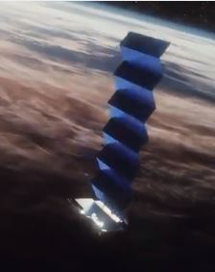
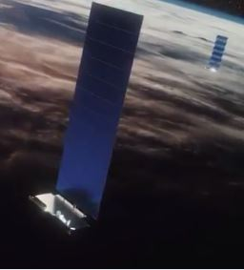
The StarLink satellites
Mass produced for lower cost
Flat, stackable for packing many in one launch
Think of them as a flying wireless “base station” and router
Optical inter-satellite links
2-way communications: ground to satellite (…to satellite…) to ground
Other capabilities
Satellites track stars, orbiting debris; some autonomous collision avoidance
Unfolding single solar array

Slide 15
Visualizing a (generic) LEO satellite constellation
Image: https://www.bcsatellite.net/blog/leo-update-the-big-three-which-is-best/

Slide 16
The StarLink constellation
Size requirements for the satellite constellation (Musk) :
400 to go online, possibly in 2020
800 satellites for “significant operational capacity”
1000 satellites for economic viability
Full system: 11,927 satellites in 3 orbital shells, in 3 phases:
1584 at 340 miles (550 km) (Typical Low Earth Orbit – LEO)
2825 at 710 miles (1150 km) (maybe complete in 2024)
7518 at 210 miles (340 km) – VLEO: Very LEO! Short orbital lifetimes.
Combined mass: 10 times that of the International Space Station
Expecting 6 launches in 2019
Satellite life: 5-6 years, requiring ongoing replacements

Slide 17
StarLink
(Mouse over the image and start the video)

Slide 18
StarLink
(Mouse over the image and start the video)

Slide 19
Some satellite constellation design choices
Orbits heights (VLEO, LEO, MEO, Geosynchronous)
Affects power requirements, latency, number of required satellites because of area “seen” by a satellite, difficulty in aiming antennas, orbit lifetime
Orbits angle of inclination (angle deviation from equator)
Affects coverage, polar orbits providing fullest coverage
Orbits circular or elliptical
(Almost all constellations use circular orbits)
Satellite as repeater (“bent pipe”) or as router with satellite interconnections to pass communications between satellites

Slide 20
Satellite orbit types by angle of inclination
Orbits angle of inclination (0 deg = equatorial, 90 deg = polar)
StarLink phase I: 32 orbital planes (?), inclined at 53 deg
Image: https://www.bcsatellite.net/blog/leo-update-the-big-three-which-is-best/

Slide 21
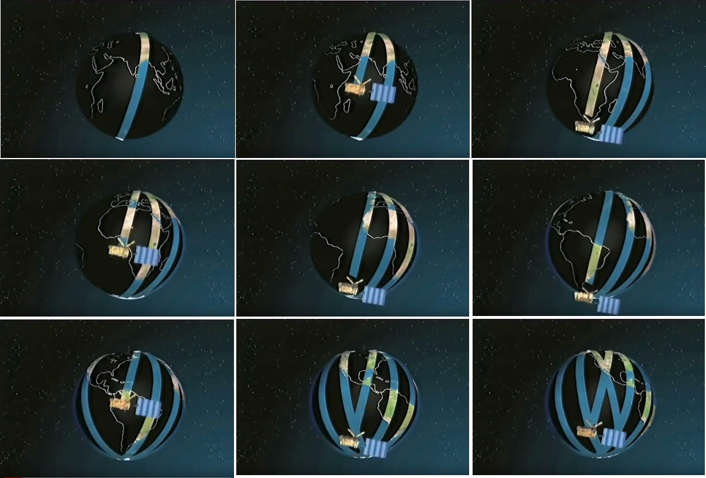
Example: Polar orbit around rotating earth
https://www.youtube.com/watch?v=y_jM_BxQGvE

Slide 22
Satellite as repeater (“bent pipe”)
Satellite as repeater (“bent pipe”)
Satellite simply retransmits what’s sent to it
Communications path: user to satellite to ground station
Ground station could be another user (e.g., broadcast use), but usually linked to the terrestrial phone network for 2-way internet communication
Might re-send up to another satellite if two are in view of the ground station
Simple, but requires many ground stations because communications requires satellite in view of both user and ground station
Examples: all (?) geosynchronous satellites, OneWeb

Slide 23
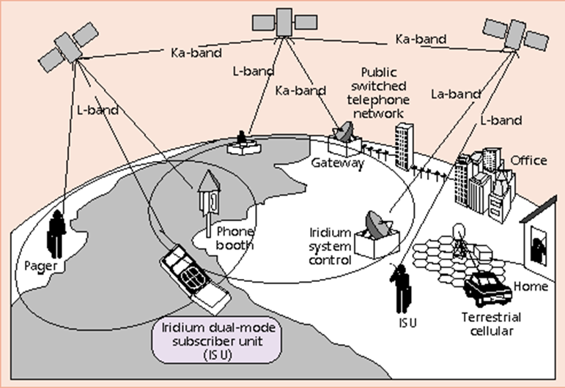
Satellite with inter-satellite links (“flying router”)
Satellites can communicate with each other, as well as ground
Inter-satellite links pass communications without needing ground stations
More complex, requiring routing tables to direct packets
Examples: StarLink, Iridium, Telesat

Slide 24
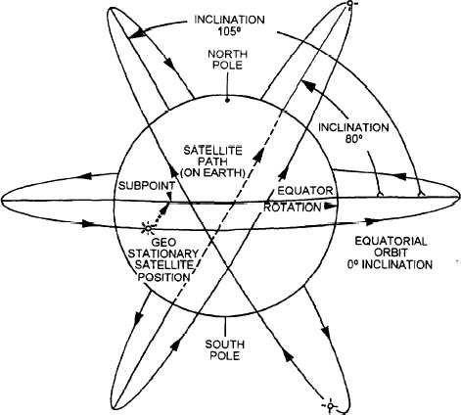
Technical challenges: LEO satellites fly fast, break communications links
LEO satellite overhead is only visible to a ground user ̴̴7 minutes, so “handoffs” of users from one satellite to the next must be fast
Communications links include satellite-satellite links to reach different locations, and account for earth’s rotation even for one user
Easy to constantly link satellites ahead & behind in the same orbital plane
Satellites in different orbits make & break links frequently
Changing the routing tables for each satellite (flying router) rapidly was a challenge for just 66 Iridium satellites, for operation and diagnostics
Image: https://www.bcsatellite.net/blog/leo-update-the-big-three-which-is-best/

Slide 25
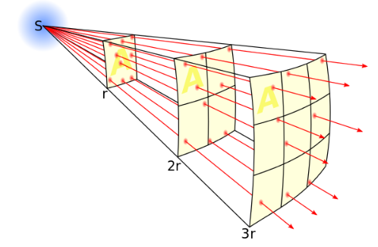
Technical challenges: Power and the inverse square law
Without directional antennas, needed transmission power goes up as the square of the distance
compare cell phones 4 mile distance to base station vs. 400 miles to space
100 times the distance means 10,000 times the power needed
Geosynchronous satellites at 22,236 miles: (22,236/4)² = 30,902,481
Lowest orbit possible is favored, but too low and…
the orbit decays quickly due to air friction
Low altitude means higher speed, so handoffs and antenna aiming must be faster
Satellite sees a smaller part of the globe, so more are needed
Phased array/beam forming technologies help address power requirements, and “point” radio waves without moving parts
Image: Borb, from Wikipedia

Slide 26
Technical challenges: Communications latency (time delay)
Communications latency (time delays) proportional to distance
(Not just speed of light – there’s delays from computer processing as well)
Latency is shortest at lowest orbits
Geosynchronous satellites (22,236 miles): theory 477 ms, practice 600 ms
LEO satellites: 25 – 35 ms, comparable to existing cable & fiber
Geosynchronous satellites are fine for broadcasting TV, etc., but poor for interactive communications due to latency and transmitting power from the ground
There are acknowledgements, etc., built into internet protocols
Lowest orbit possible is favored

Slide 27
Risks: What could possibly go wrong?
Economic risks:
Large upfront investment and time before revenue starts
Competition from other satellite players, and land-based services like 5G
Astronomers and others worried about interference
Others worried about debris falling to earth
Not everything will burn up upon de-orbiting a satellite
NASA standard: less than 1 in 10,000 chance of parts hurting or killing someone (any one of the 7.5 billion people on earth)
SpaceX says several kilograms of each StarLink satellite could hit surface
Iron thruster components, stainless steel reaction wheels, silicon carbide mirrors
Chances 1 in 18,200 of hurting or killing someone from one satellite
But, in steady operation, eventually there’s over 1000 satellites falling/year
Result using NASA software: kill or injure someone every 6 six years (a calculation done for an IEEE Spectrum article)
Spectrum fights: Some 5G cell signals will use same V band as StarLink phase 3

Slide 28
Some existing satellite constellations
O3b
Name stands for “Other 3 billion” (where broadband isn’t available)
A Medium Earth Orbit (MEO) constellation, currently at 20 satellites at 5,009 miles (8,062 km)
Medium latency
Launches started in 2013, most recent in April, 2019
At least 7 more to be launched in 2021
Aimed at commercial users that can afford end user station, e.g., cruise liners
Orbcomm
Several generations of LEO satellites since 1995, currently about 50
Mostly orbiting at 750 km, 45 or 52 degree inclination
1.9 million subscribers in 2017
“Bent pipe” system – satellites as repeaters, requiring ground stations
Commercial focus (machine to machine), mobile transmitters to ground-based terminals
Doesn’t seem to be expanding the constellation
Iridium

Slide 29
A sobering comparison: Iridium history
Iridium $5 billion constellation of 66 satellites was the first LEO-based communication service (1997)
1,412 pound satellites in orbits at 483 miles, taking 100 minutes to orbit
6 polar orbital planes of 11 satellites each, providing 100% earth coverage
“Flying router” model with inter-satellite links
1999 bankruptcy: underestimated the rapid growth of terrestrial cell phone network as much cheaper competition, with less clunky handsets
BUT…
Iridium re-emerged after bankruptcy, now has 1 million subscribers
Saved by military interest: used in Iraq, Afghanistan, …
Deal of the century: new investors bought for 0.5 cents on the dollar
Relegated to stable niche market for remote places
Military, ships, offshore rigs, polar regions, adventurers, drug lords, CIA, whale tracking, Tsunami warning buoys, airplane transponders, … )
Could a similar result happen to StarLink in competition with terrestrial 5G service?
5G probably cheaper in city, suburbs?
Initial 5G applications are to fixed locations, just like StarLink

Slide 30
Upcoming StarLink competition
OneWeb
640 LEO satellites at 1,200 km (requesting FCC approval for 1,980 satellites) \
Satellites weigh 319 lbs (145 kg)
“Bent pipe” architecture: no satellite interlinks, requires many ground stations
Starting launches in 2019, first one with 10 satellites
Backed by Airbus, Intelsat, Coca-Cola, private investors
Japan’s Softbank will soon add $1 billion investment
Telesat (Canada)
(Already operating 17 geosynchronous satellites)
292 LEO satellites in 1,000 and 1,250 km polar and inclined orbits
Possible future scaling to 512 satellites
“Flying routers” communicate with each other
Launched one LEO satellite in 2018, with global service targeted for 2022
Marketing for commercial use, not consumer use (electronically-steerable antennas still unaffordable for home users)
Hongyan (China)
300 LEO satellites
60 satellites in orbit around, 2023, full system by 2025

Slide 31
Potential additional StarLink competition
LeoSat (Luxembourg)
108 LEO satellites at 1,400 km with intersatellite links
Commmercial focus, not consumer
Kepler (Canada)
140 LEO satellites
Two satellites launched, now in pilot trials
Expect to deploy during 2022/2023
Boeing
1,396-2,956 LEO satellites at 1,200 km, same as OneWeb
Applied for spectrum, not actually moving forward
Amazon’s Kuiper Systems, part of Amazon Web Services
Filed with ITU for spectrum rights for 3,236 LEO satellites in 3 layers
Not part of Blue Origin, but obviously will want to use Blue Origin
Iridium?
Not viewed as competition
Iridium focused on voice and direct communication with handsets
But, original Iridium plans did include broadband internet. Might they revive that?
Iridium is SpaceX’s largest commercial customer – launched its entire new generation constellation

Slide 32
Other LEO satellite constellations: A story of bankruptcies & niche markets
GlobalStar, re-emerged from bankruptcy in 2004 as a going concern
24 LEO satellites, 1500 lbs each, covering 80% of earth (orbital inclination of 52 degrees rules out polar regions)
Phone and low speed data (9600 bits/sec)
“Bent pipe” communication path: users to satellite to ground station linked to traditional cellular networks to complete the calls
So, requires satellite view of one of 24 gateway ground stations – rules out much of Africa, South Asia, mid-ocean regions
Mainly a niche market for remote areas, but near ground stations
Additional niche markets in tracking trucks, etc.
Teledesic (broadband internet service)
Planned 840 LEO satellites
Backed by Microsoft, Bill Gates, A Saudi prince, Craig McCaw
Abandoned in 2002
SkyBridge (Alcatel’s satellite internet) bankrupt in 2000

Slide 33
End of StarLink presentation
Greg Stanley
June 1, 2019

Slide 34
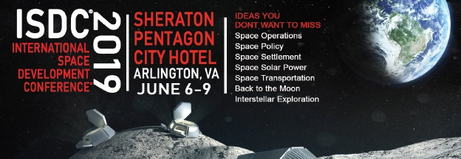
Report on ISDC (and discussion)
July NSS-NH meeting:
”…focus on returning humans to the Moon…this time to stay.”
By Nathan Price, NSS-NH President, and attendee
Barbara Bush Library July 6, 2019 3:00 PM

Slide 35
Anima Sabale
August NSS-NH meeting:
Orion Spacecraft Simulations Lab Manager
Johnson Space Center (Jacobs)
Aerospace and Software Engineer for NASA while pursuing childhood aspirations to become an Astronaut. Citizen Scientist-Astronaut Candidate during off-work hours, participating in research missions, including analog missions at NASA HERA and Mars Desert Research Station.
Barbara Bush Library, Aug 3, 2019 3:00 PM

Slide 36
Other Events at the Barbara Bush Library
Saturday Shorts with CineSpace
CineSpace is a short film competition, a collaboration between NASA and the Houston Cinema Arts Society
Creators must include NASA footage ( see cinespace.org )
See short film finalists from previous years
It’s not too late to win the $26,000 prize for 2019! (closes July 15)
6/22/2019, 2:00 PM, Barbara Bush Library, Earl Elliott Room (Foyer)
Moon Men & Rock Stars: True Tales of Apollo Astronauts and Planetary Scientists.
Judy Allton: storyteller, also curator of solar wind collectors for JSC at NASA, and previously worked with Apollo lunar soil cores
Includes updates on Apollo samples soon to be opened and analyzed for the first time since collection 50 years ago.
Includes a tale “The Astronaut and the Emperor”.
All teens and adults welcome
6/14/2019, 4:30 PM, Barbara Bush Library, Earl Elliott Room (Foyer)

Slide 37
Open Discussion

Slide 38
Has anyone read this?

