Slide 1
Why Space?

Slide 2
Better Vision

Slide 3
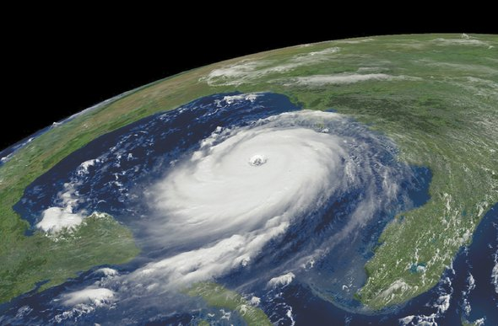
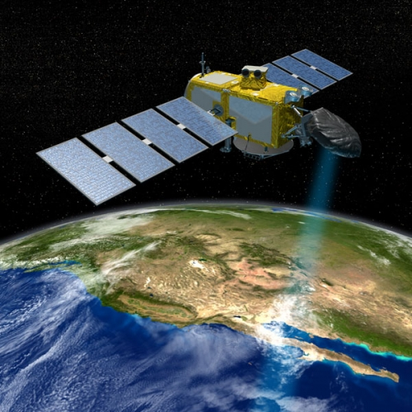
Weather Prediction

Slide 4
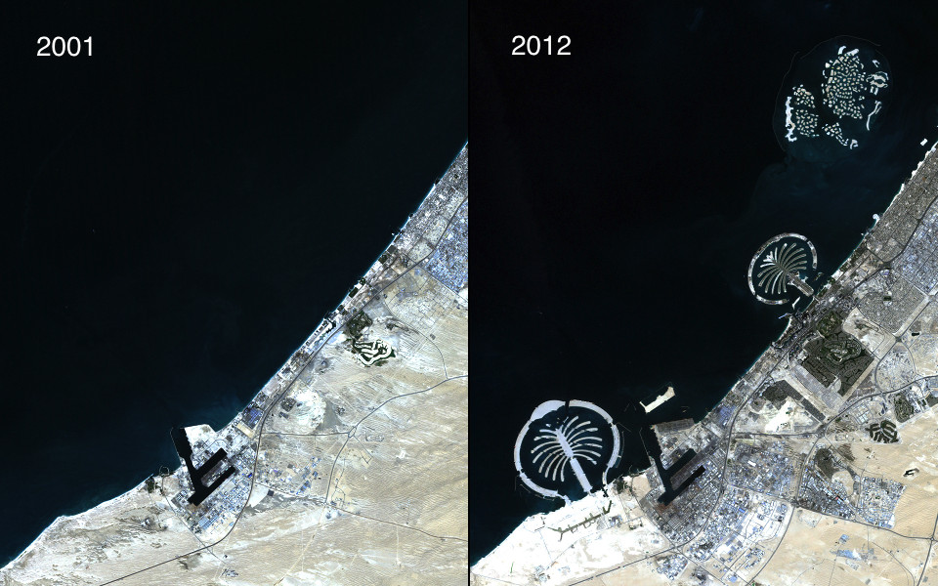
Earth Observation
Dubai

Slide 5
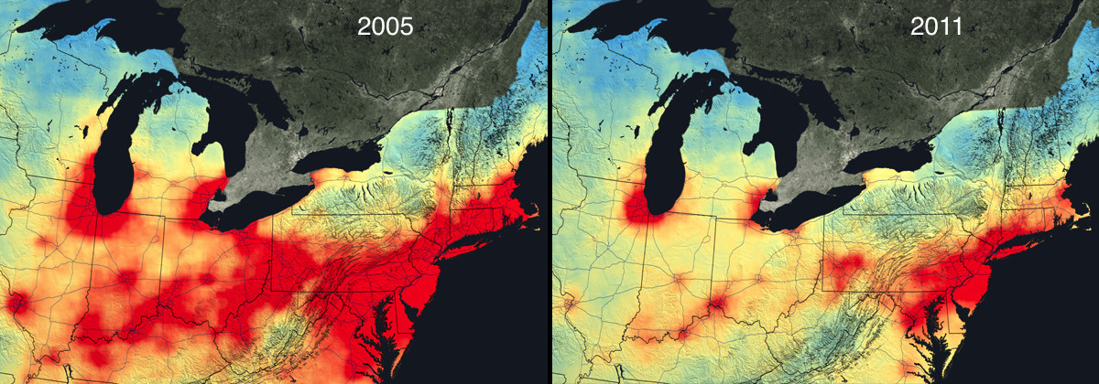
Nitrogen dioxide in 2005 and 2011 from low (blue) to high (red)

Slide 6
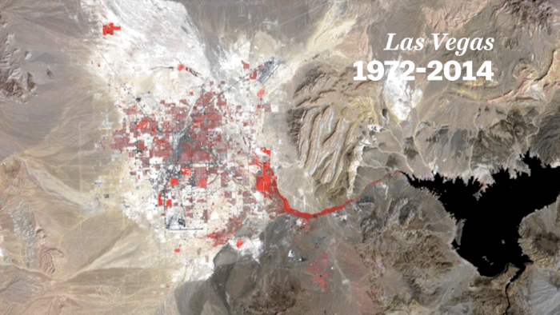
Las Vegas (1972-2014)

Slide 7
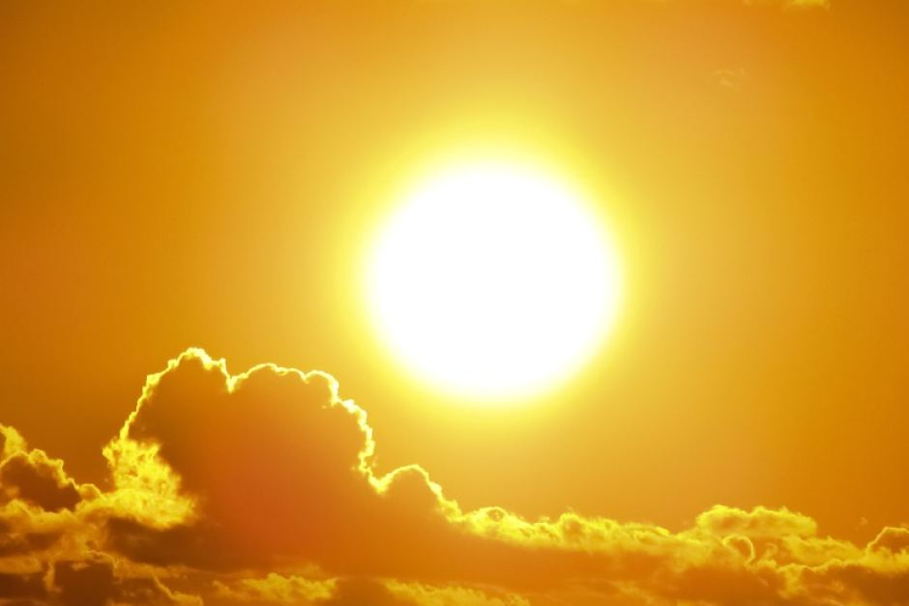
Sun Weather

Slide 8
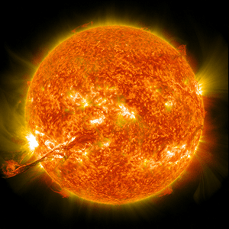
Sun Weather

Slide 10
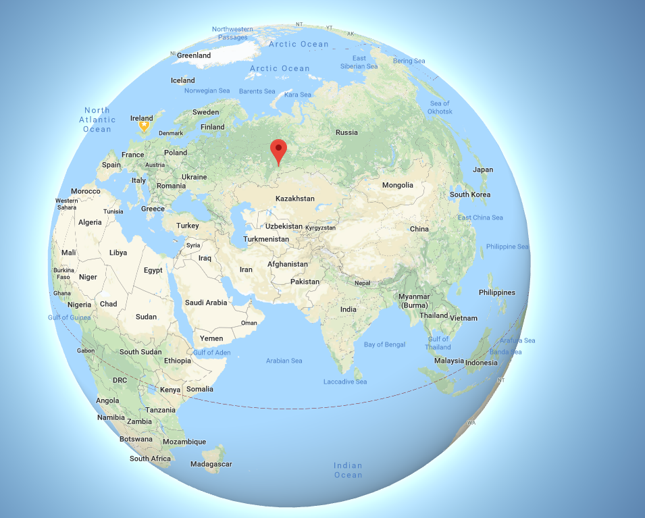
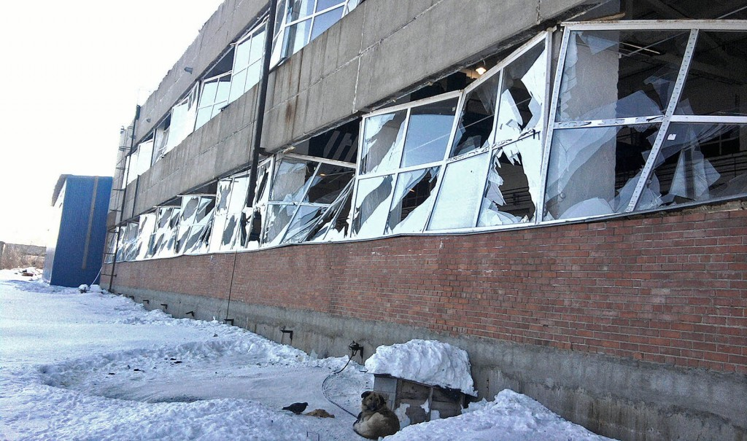
Feb. 15, 2013 – Chelyabinsk, Russia
Nearly 1,200 people were reported injured by the shock wave from the explosion, estimated to be as strong as 20 Hiroshima atomic bombs.
66 ft asteroid travelling at 40,000 mph

Slide 11
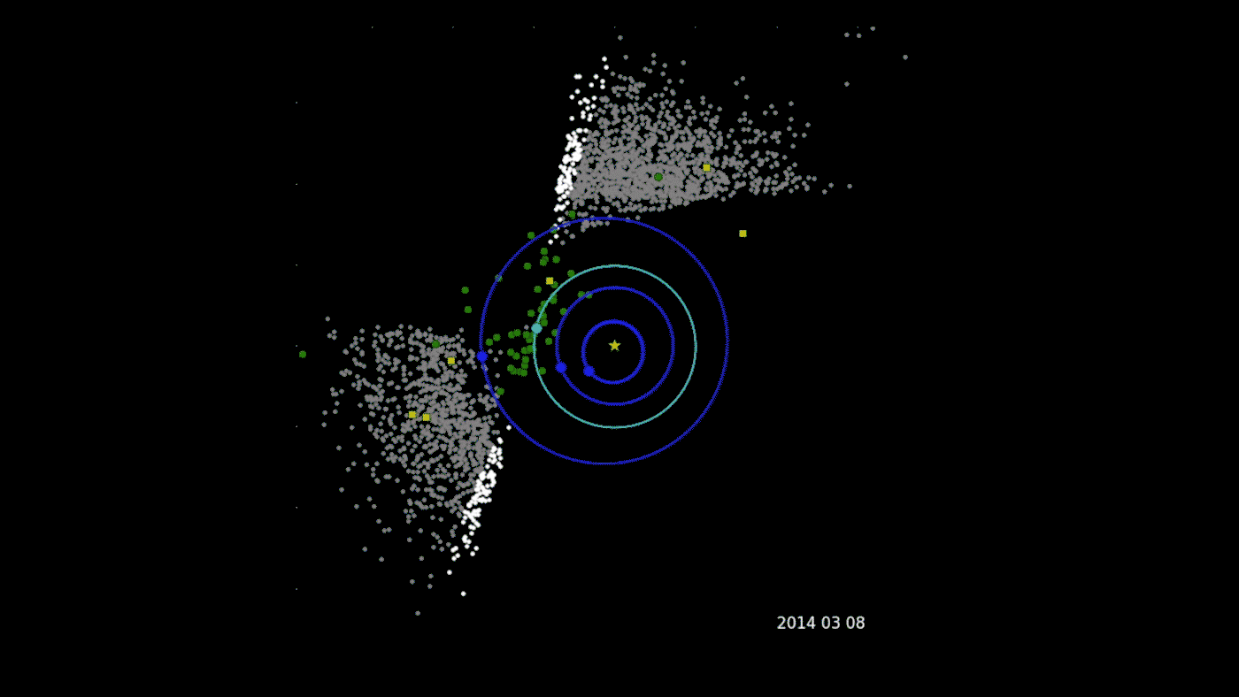
NASA's Near-Earth Object Wide-field Survey Explorer (NEOWISE)

Slide 12
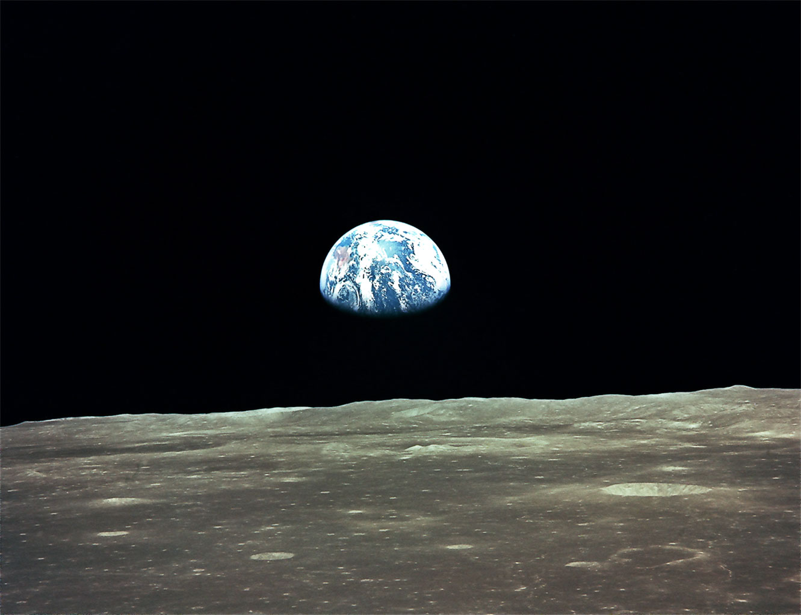

Slide 13
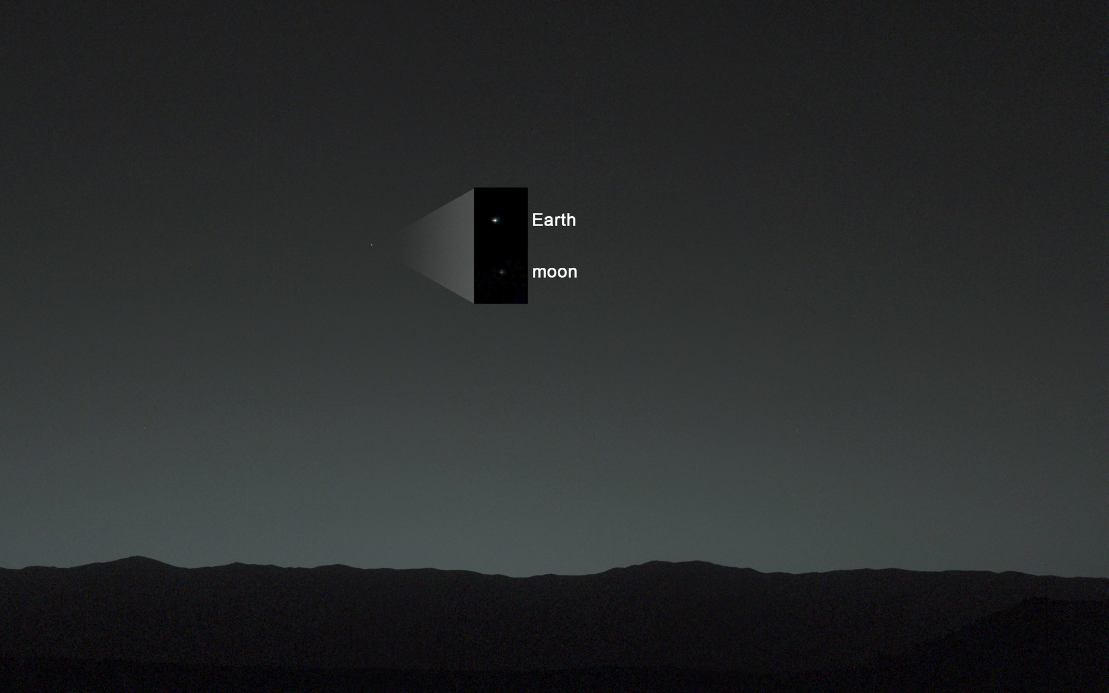
View of Earth from Mars Curiosity Rover

Slide 14
National Space Society (NSS) Vision
People living and working in thriving communities beyond the Earth, and the use of the vast resources of space for the dramatic betterment of humanity.

Slide 15
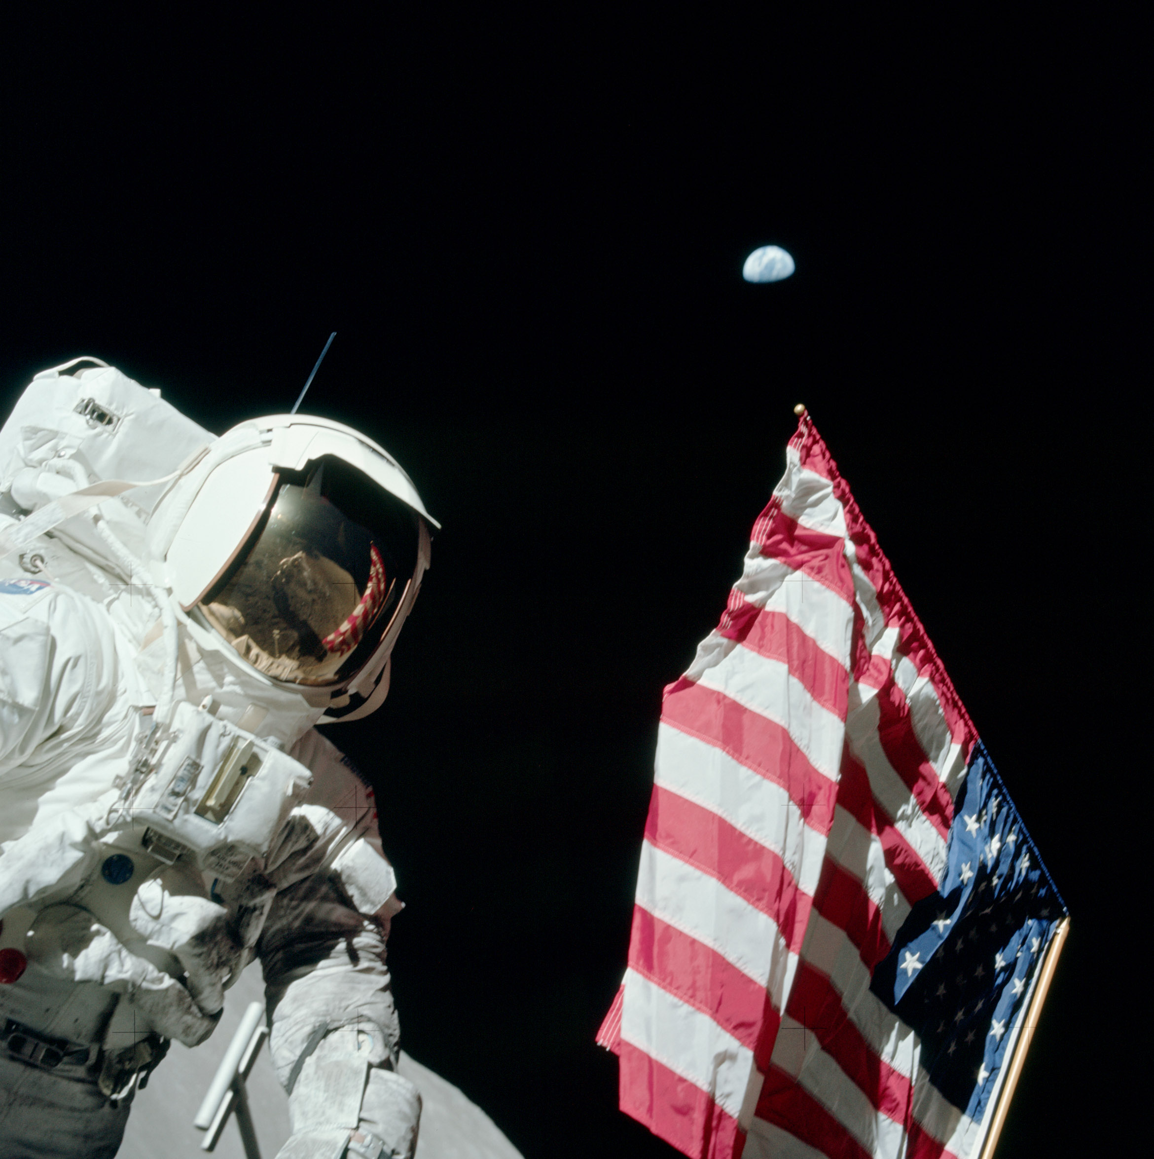
December 12, 1972
Apollo 17
Harrison Schmitt
Photographed by
Eugene Cernan

