Slide 1
A Life with NASA since the Apollo Moon Landings
Herb Baker
Former Manager, Operations Support Office
NASA/Johnson Space Center

Slide 2
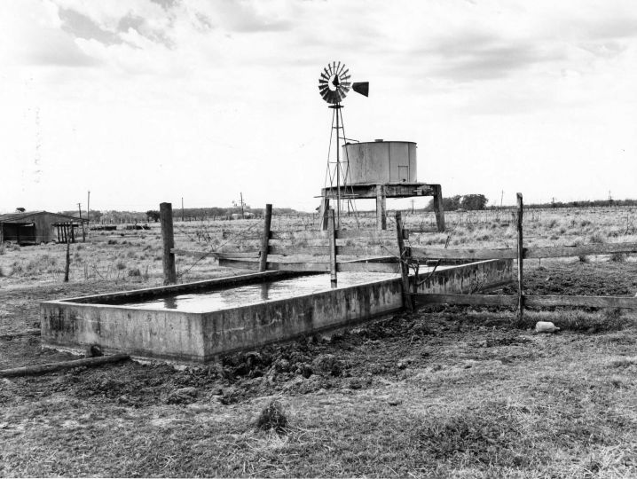
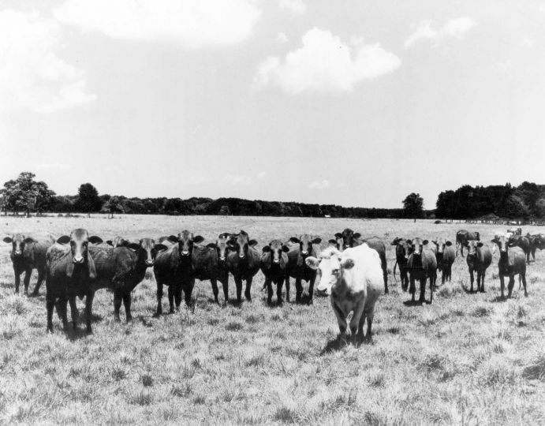
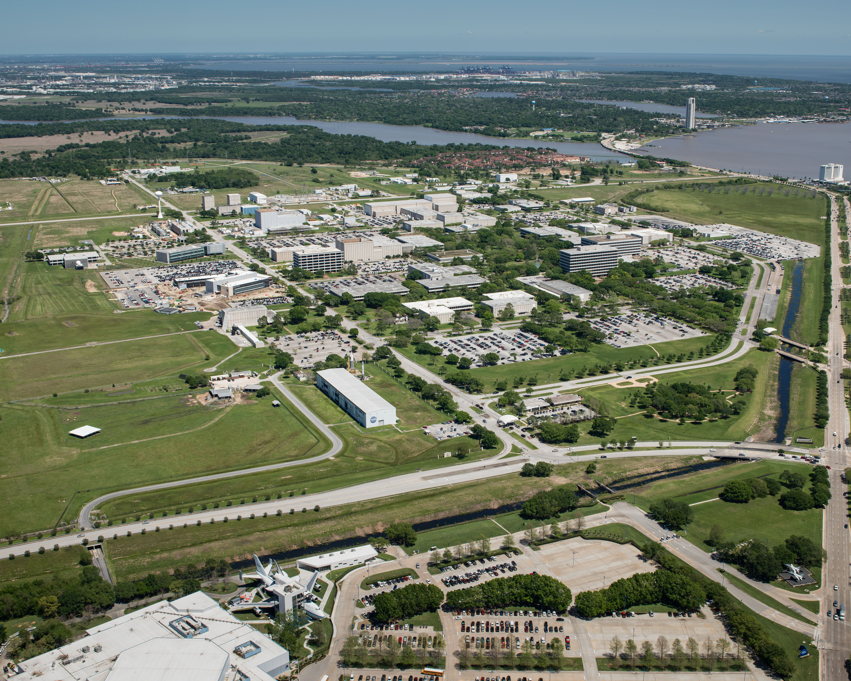
The Johnson Space Center site was a cow pasture when my family moved to League City in 1960. The Manned Spacecraft Center was built here in 1962/63.
Aerial view of JSC Today

Slide 3
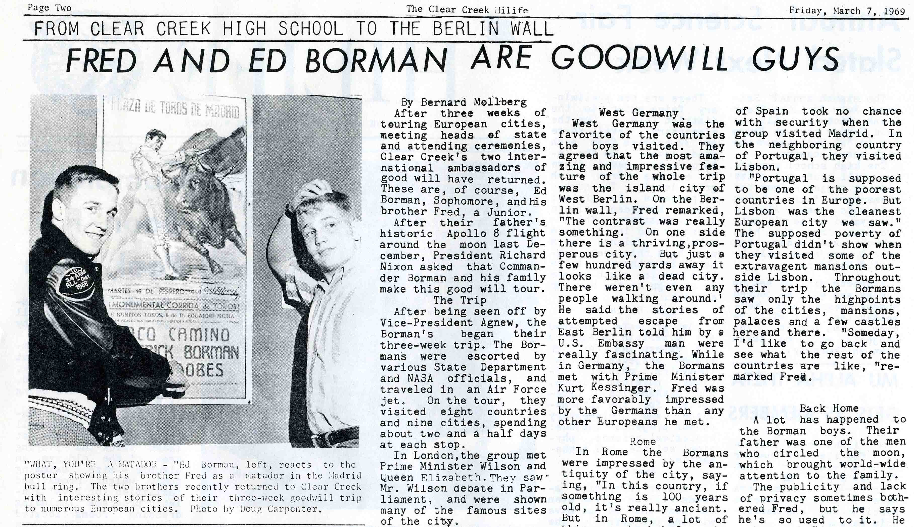
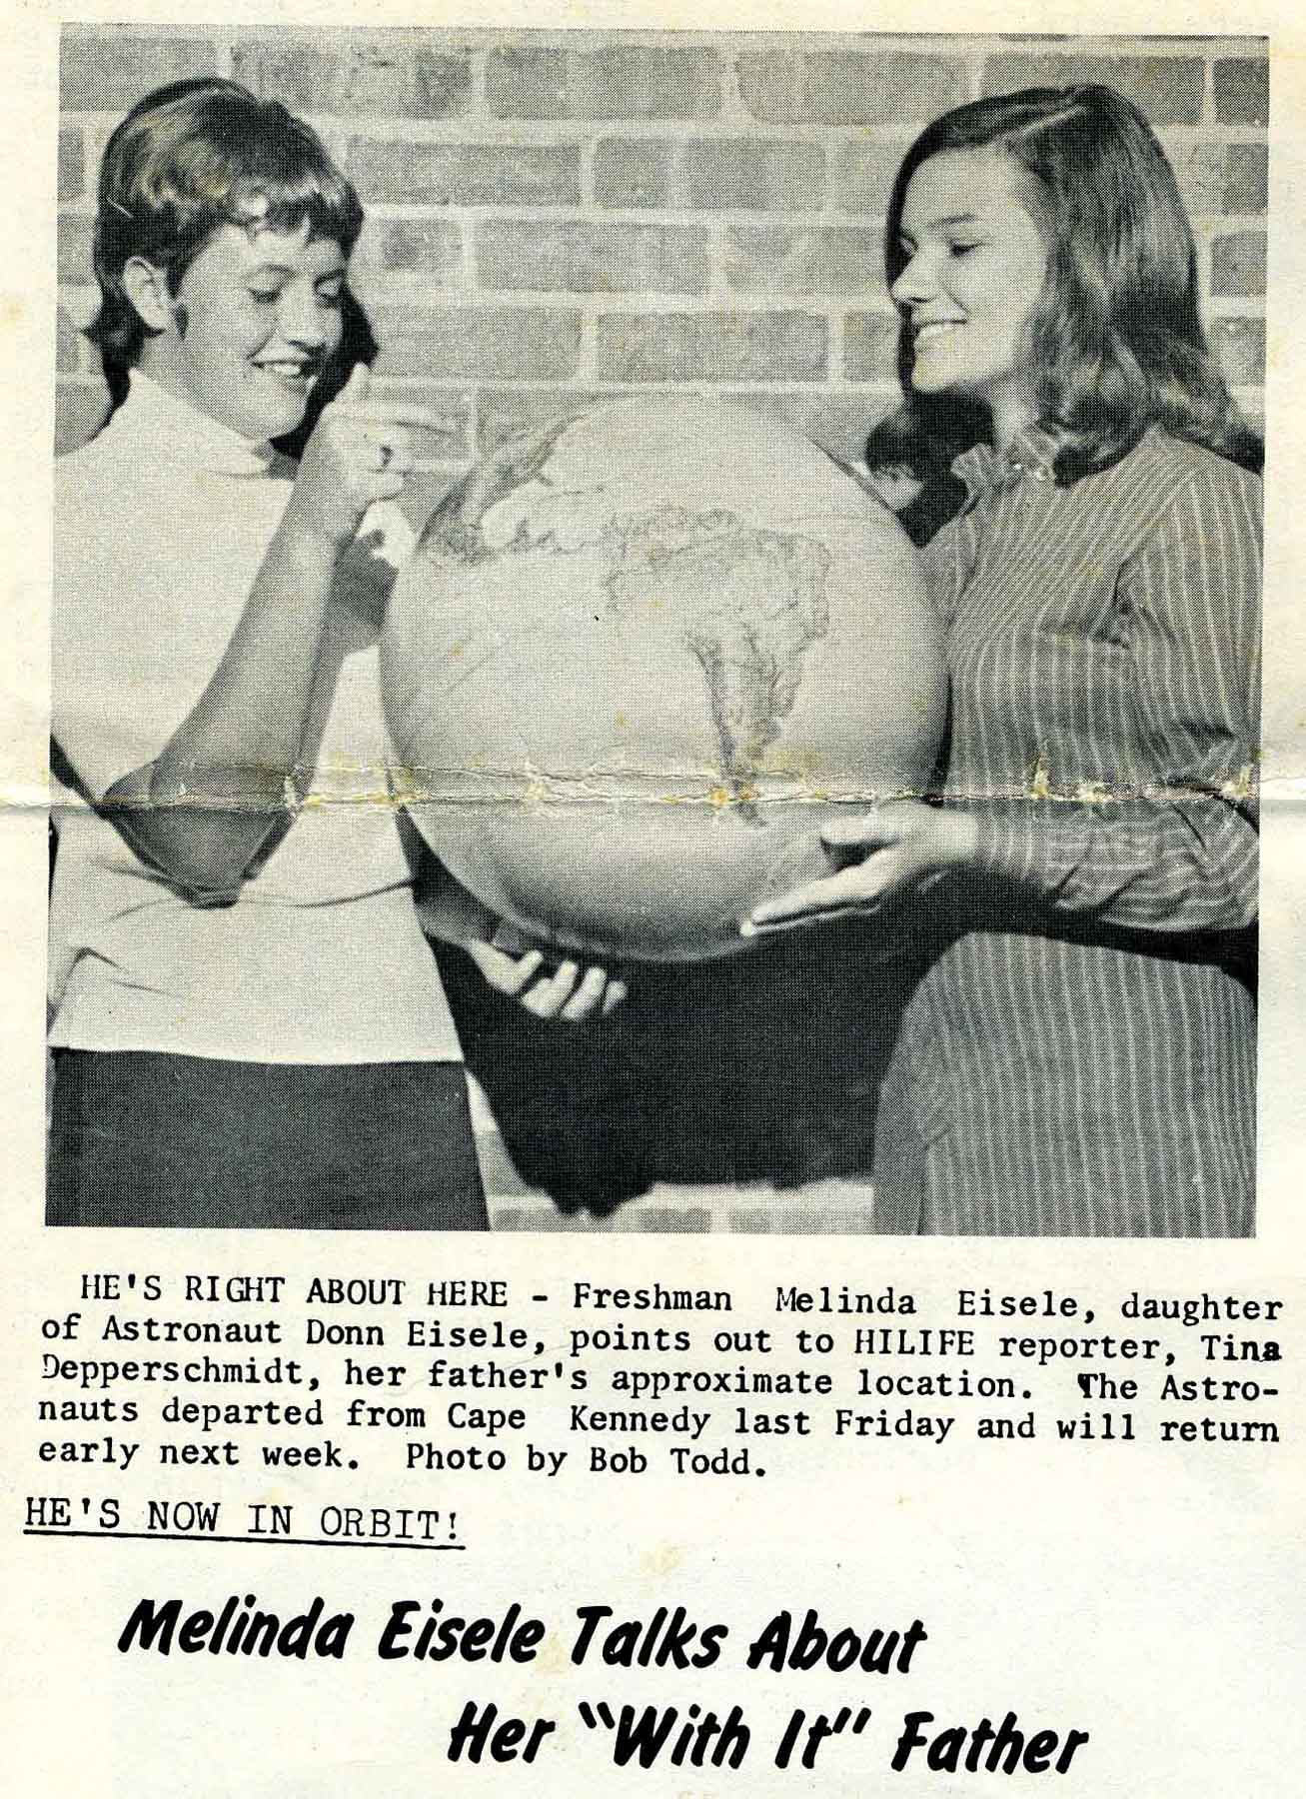
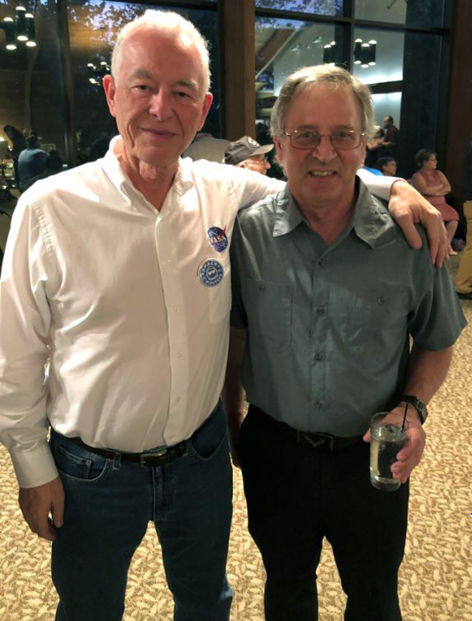
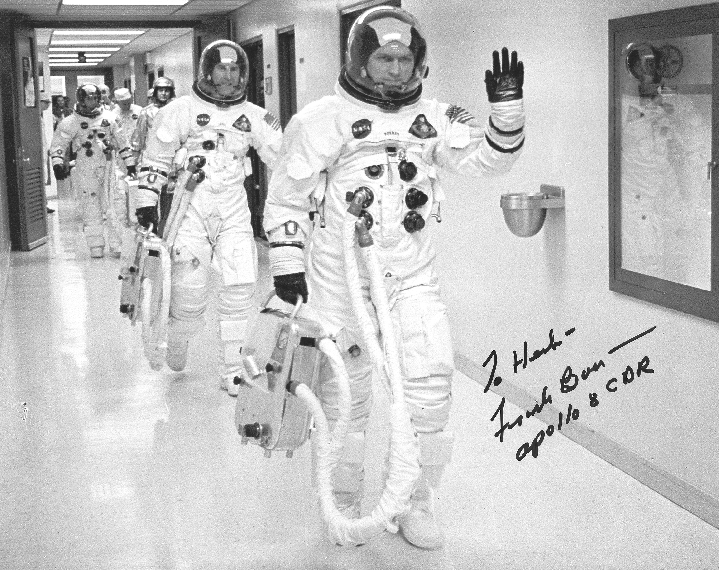
When I started intermediate school in ‘64, the Apollo astronaut’s kids were my classmates
With Mark Grissom in 2018
Frank Borman’s sons
Donn Eisele’s (Apollo 7) daughter

Slide 4
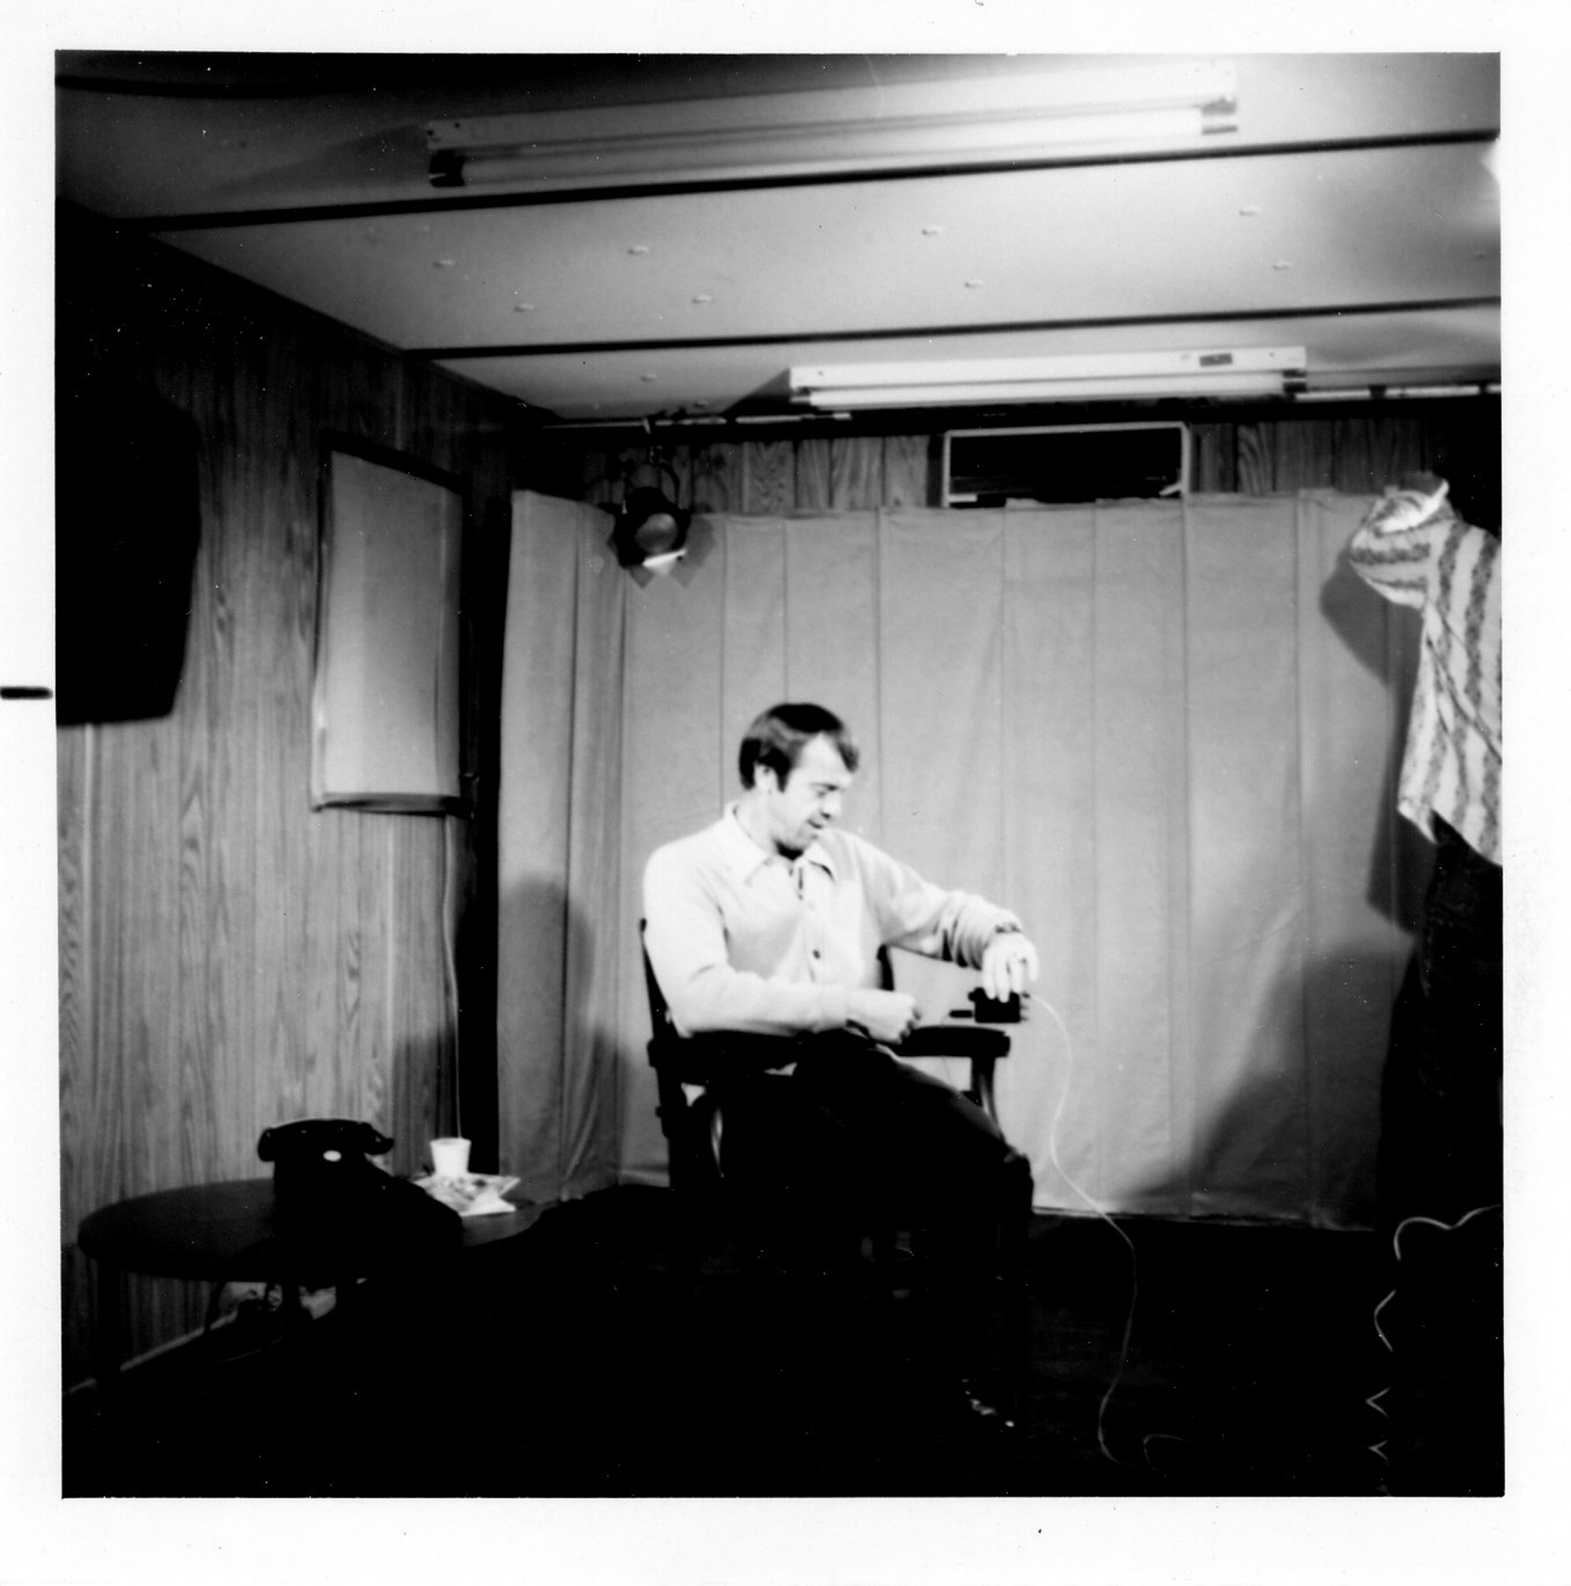
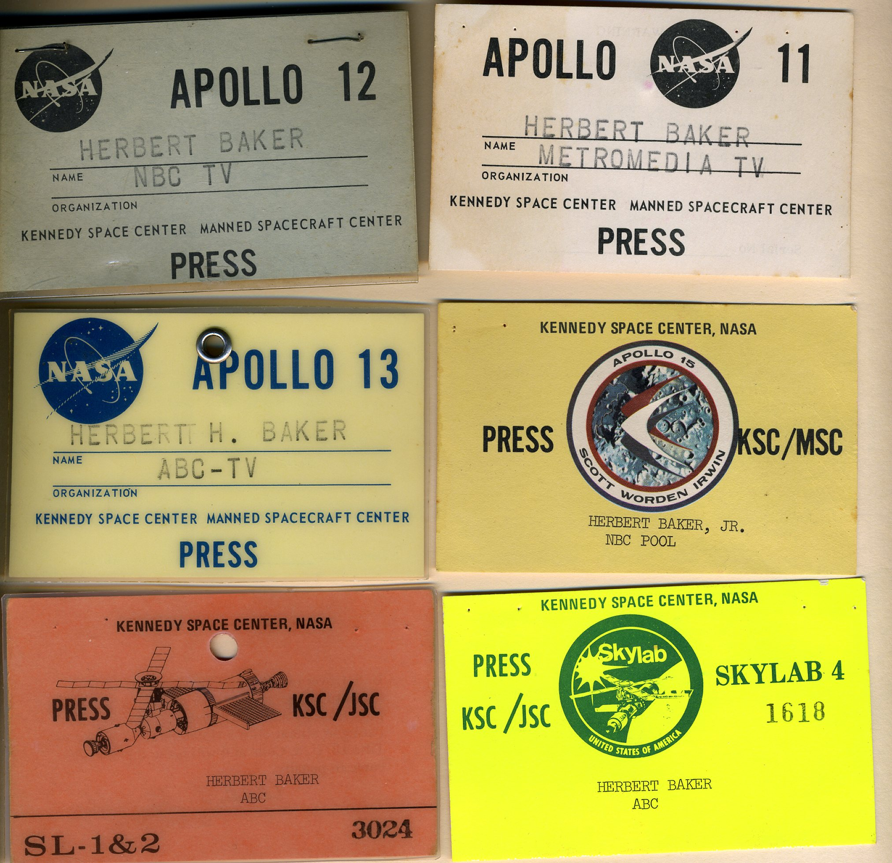
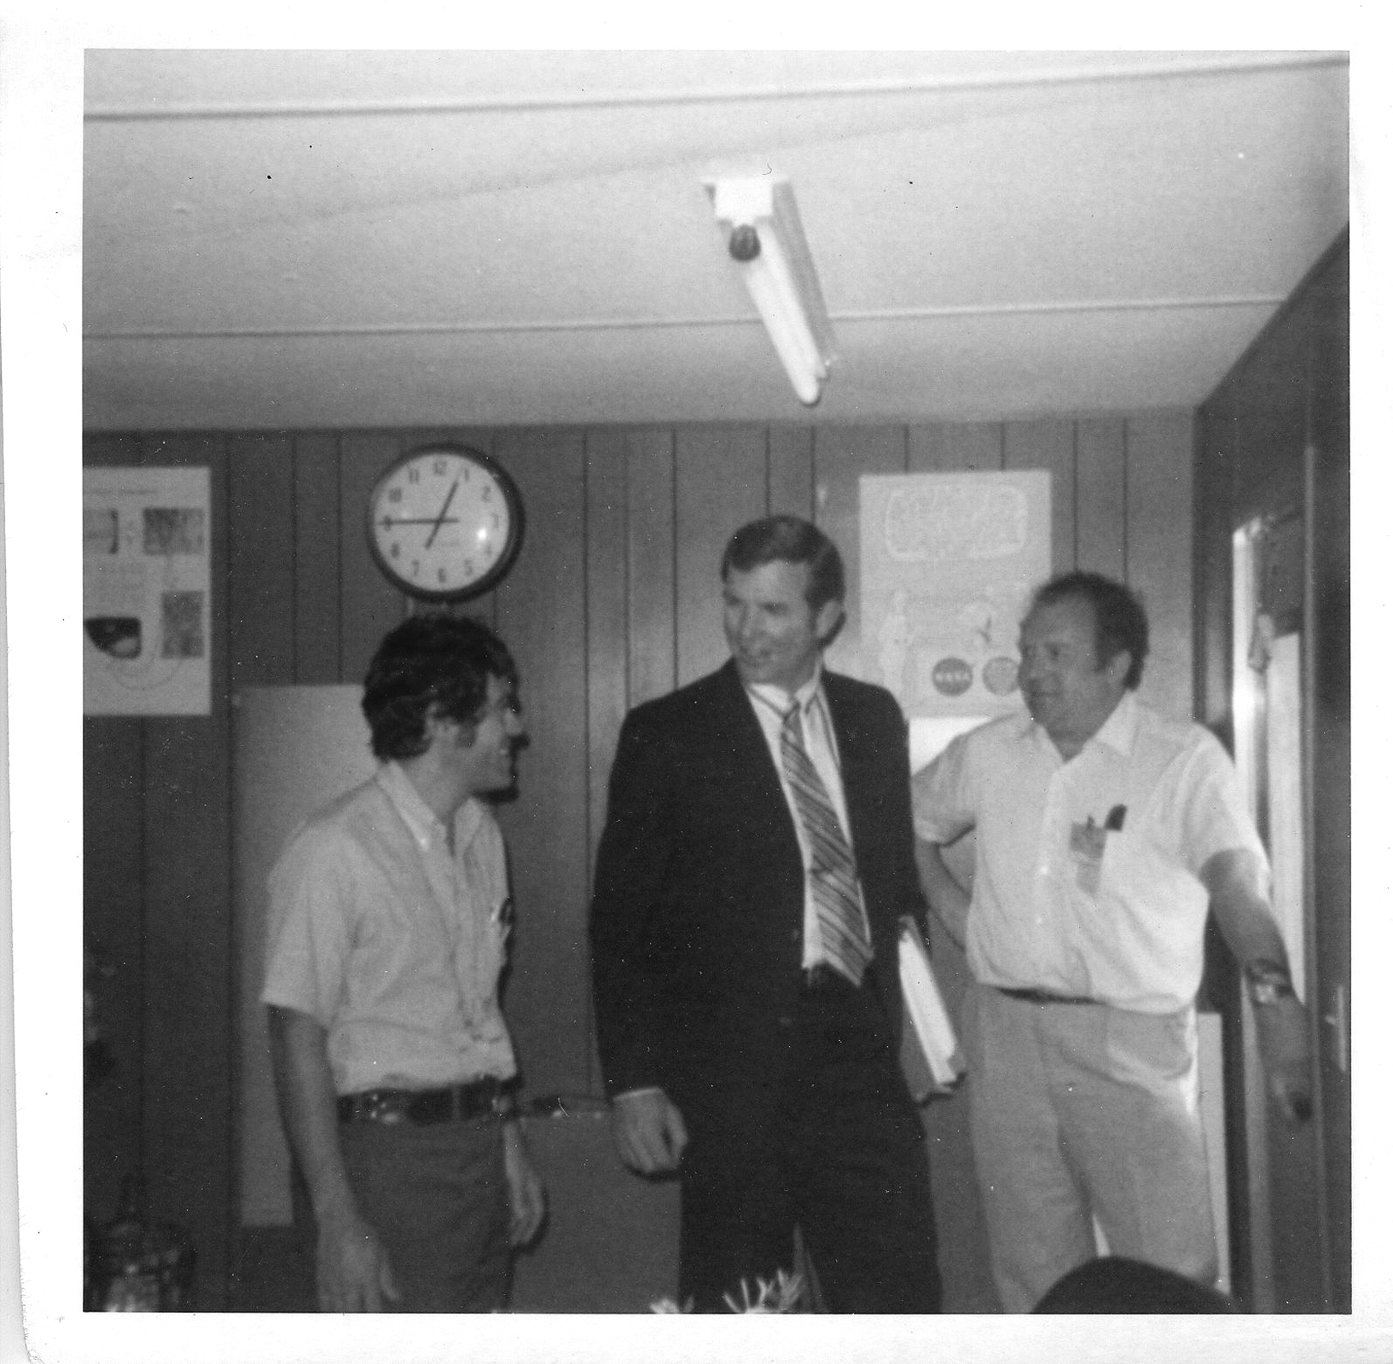
I worked for TV networks covering NASA missions in high school/college.
Hanging out with moonwalkers Alan Shepard (Apollo 14) and Dave Scott (Apollo 15)

Slide 5
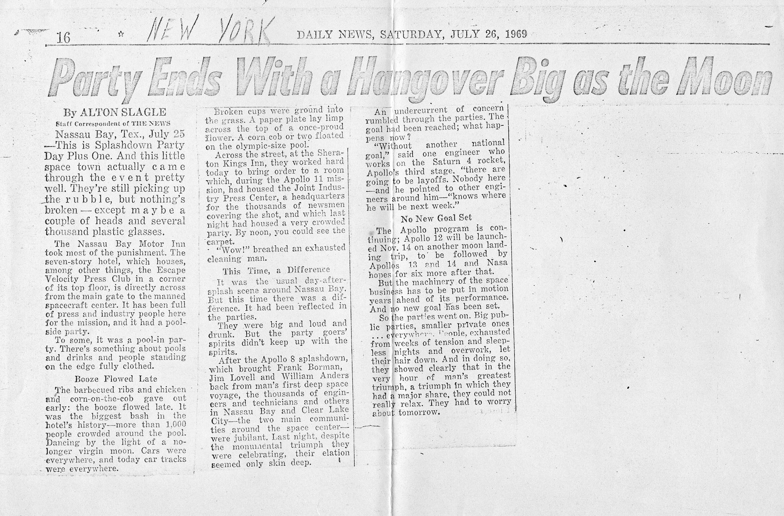
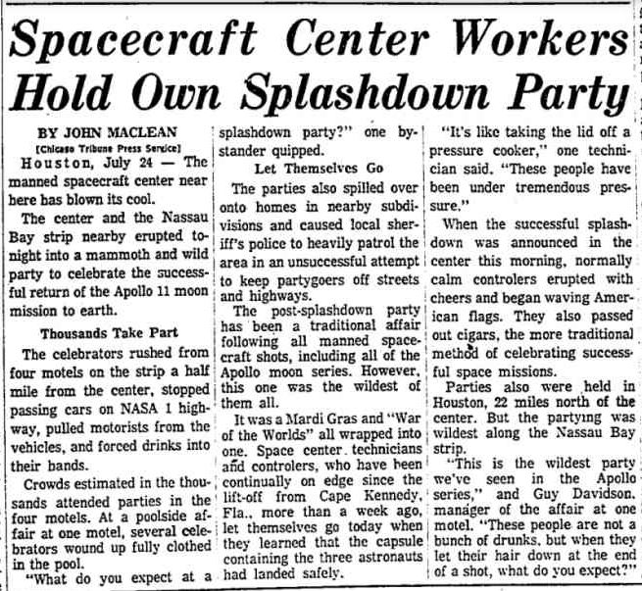
Apollo 11 Splashdown Party
New York Daily News
Chicago Tribune
“It was a Mardi Gras and ‘War of the Worlds’ all wrapped into one.”
“Several celebrators wound up fully clothed in the pool.”
“Celebrators stopped passing cars on NASA 1 and forced drinks into their hands.”
“More than 1000 people crowded around the pool, dancing by the light of a no longer virgin moon.”
“This is the wildest party we’ve seen in the Apollo series.”

Slide 6
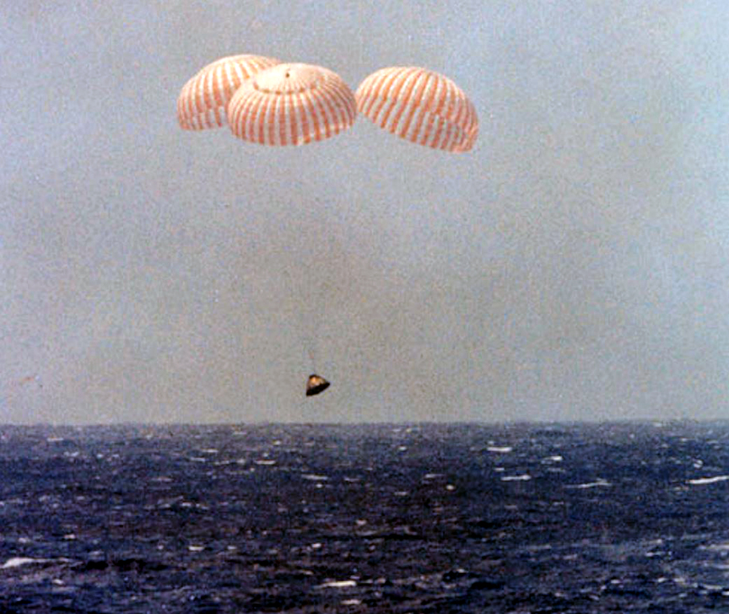
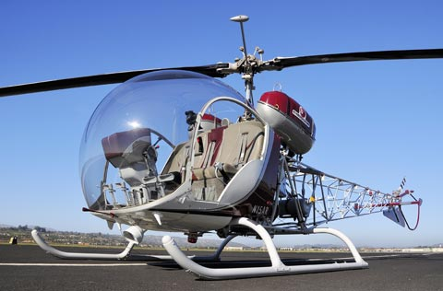
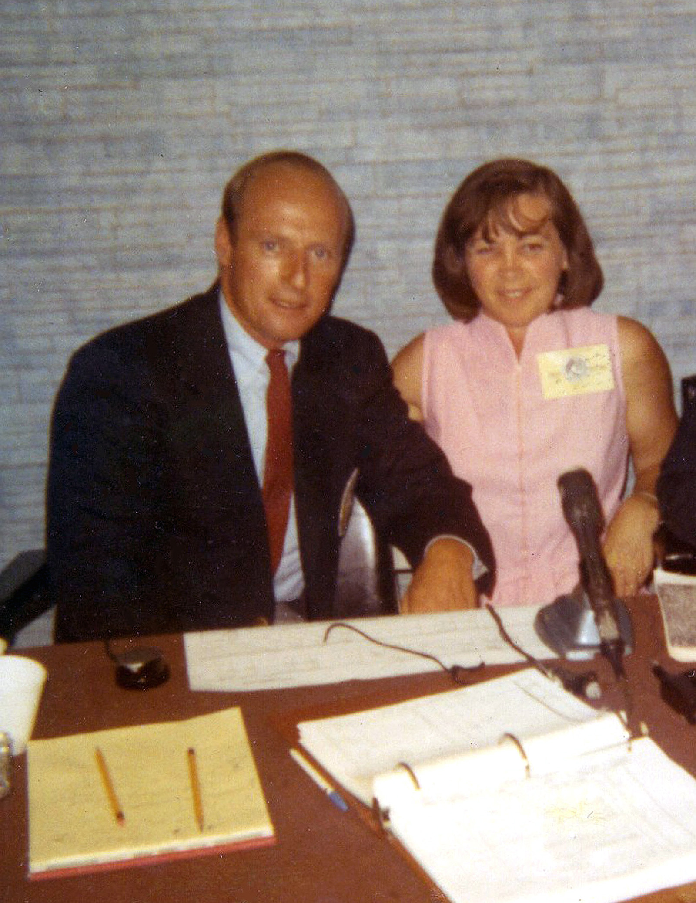
Apollo 12 (Conrad, Gordon, & Bean) splashdown in the South Pacific on Nov. 24, 1969
My ride to TV station downtown to deliver film
Apollo 12 Commander Pete Conrad and Mom

Slide 7
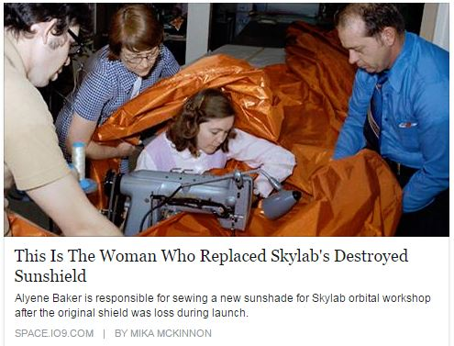
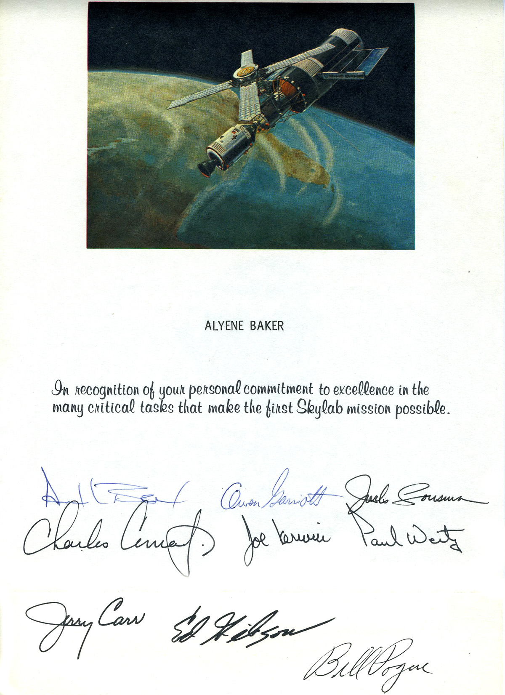
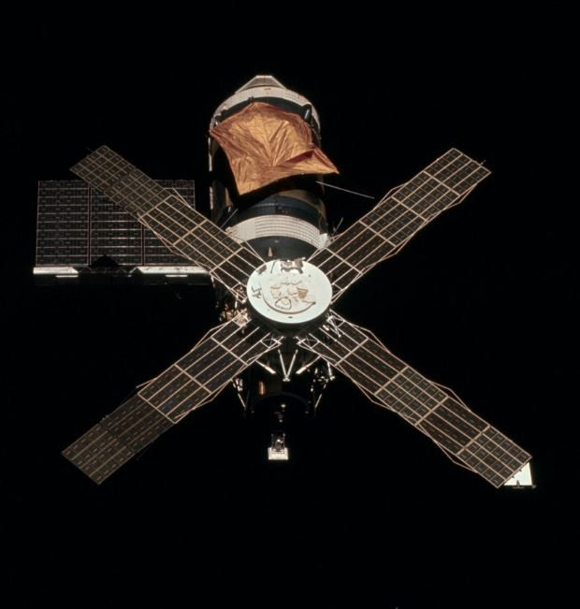
Mom helped make the parasol that served as a replacement heat shield for Skylab.

Slide 8
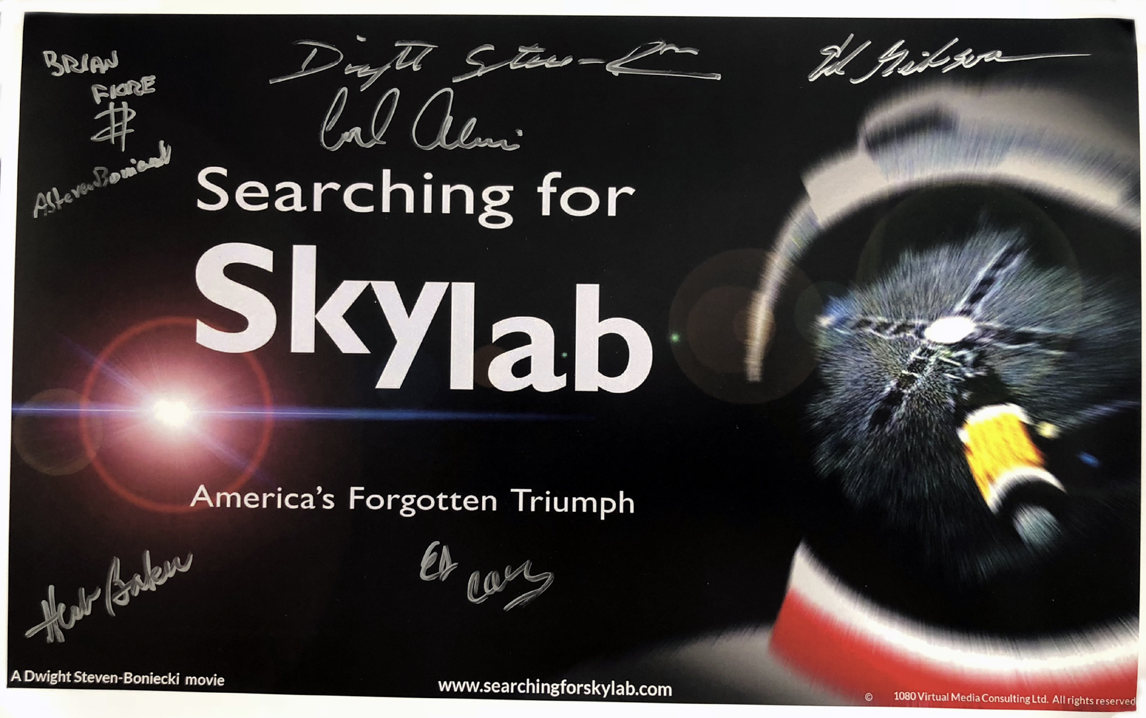
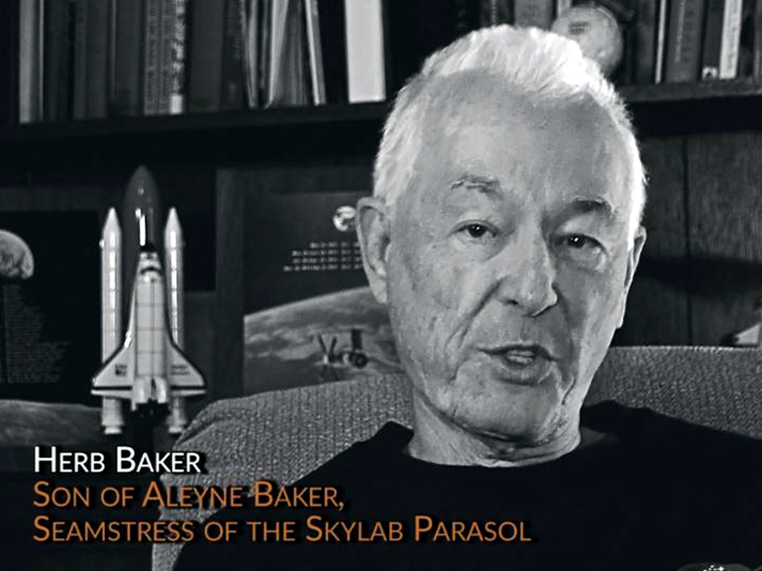
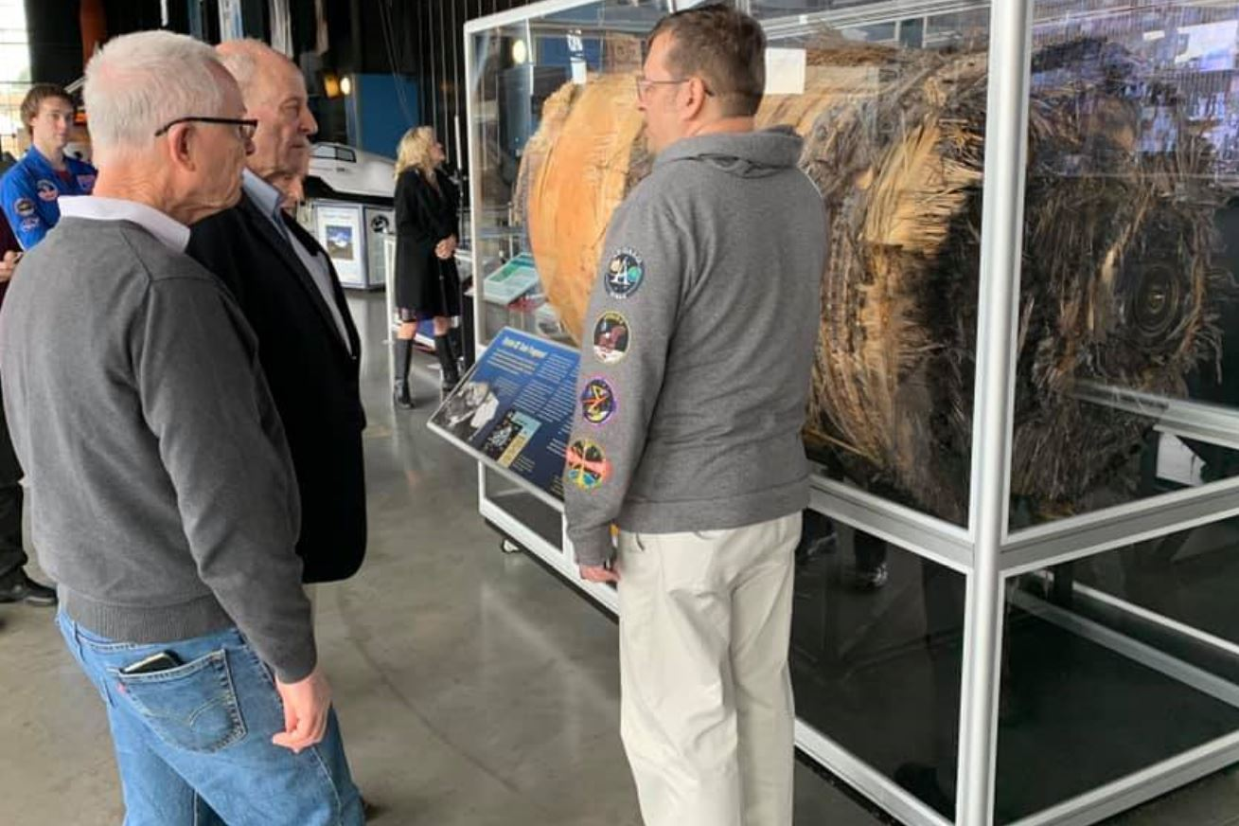
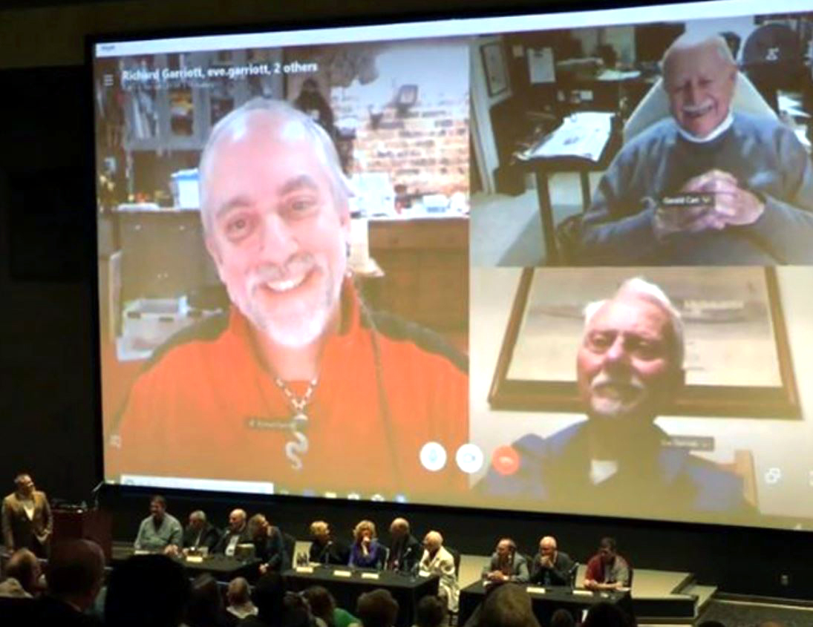
“Searching for Skylab” official poster. Movie premiered at US Rocket & Space Center in Feb. 2019
Screenshot from the movie
With Jack Lousma & Skylab O2 tank at Space/Rocket Center for the premiere
Panel after movie with Jerry Carr & Richard & Owen Garriott

Slide 9
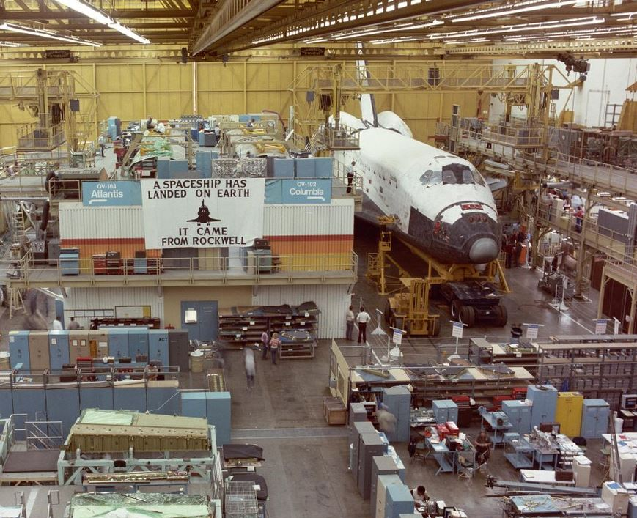
Started job at NASA in 1975.
Starting in 1979, I worked on NASA team that bought Shuttle Orbiter vehicles from Rockwell. They were built in Palmdale, CA. Each Orbiter vehicle cost about $1.5B-$2B to build.

Slide 10
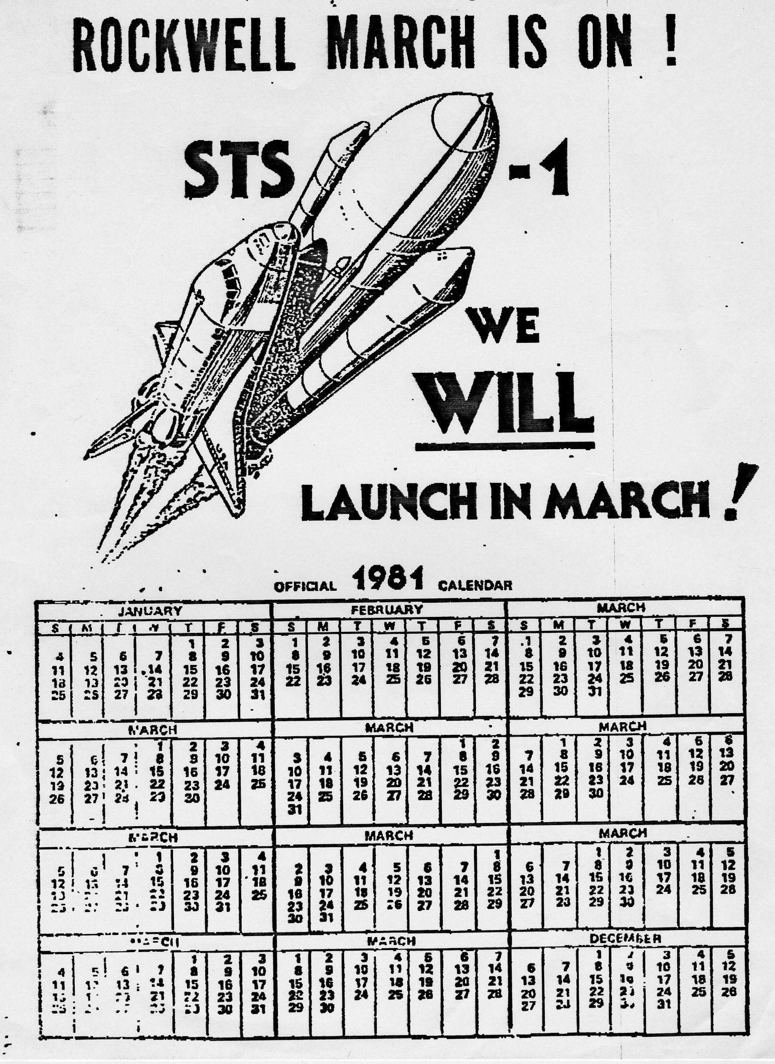
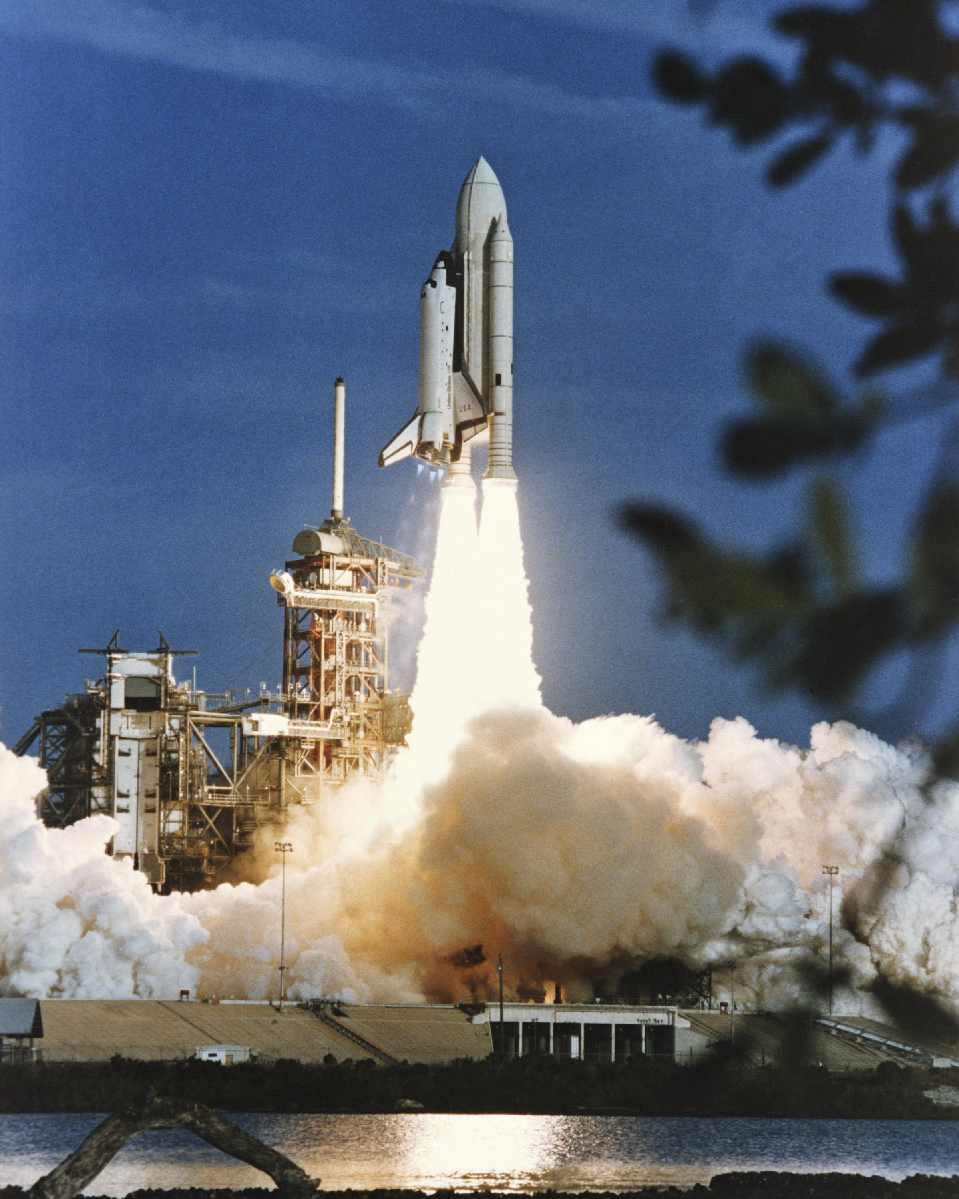
We didn’t make it in March after all! (STS-1 launched April 12, 1981)

Slide 11
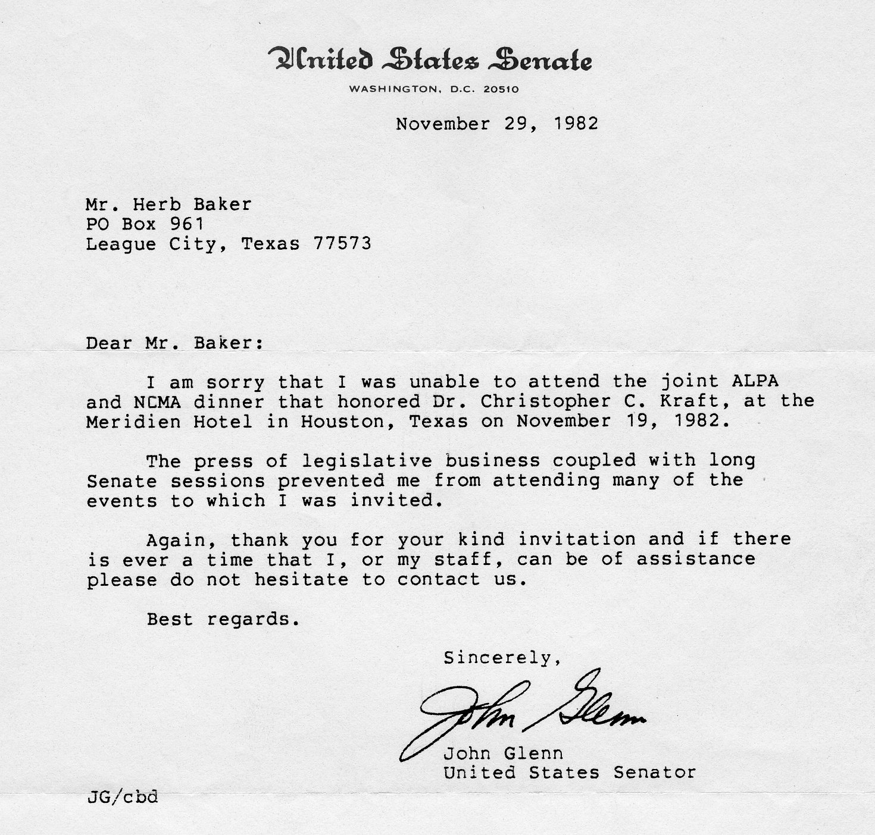
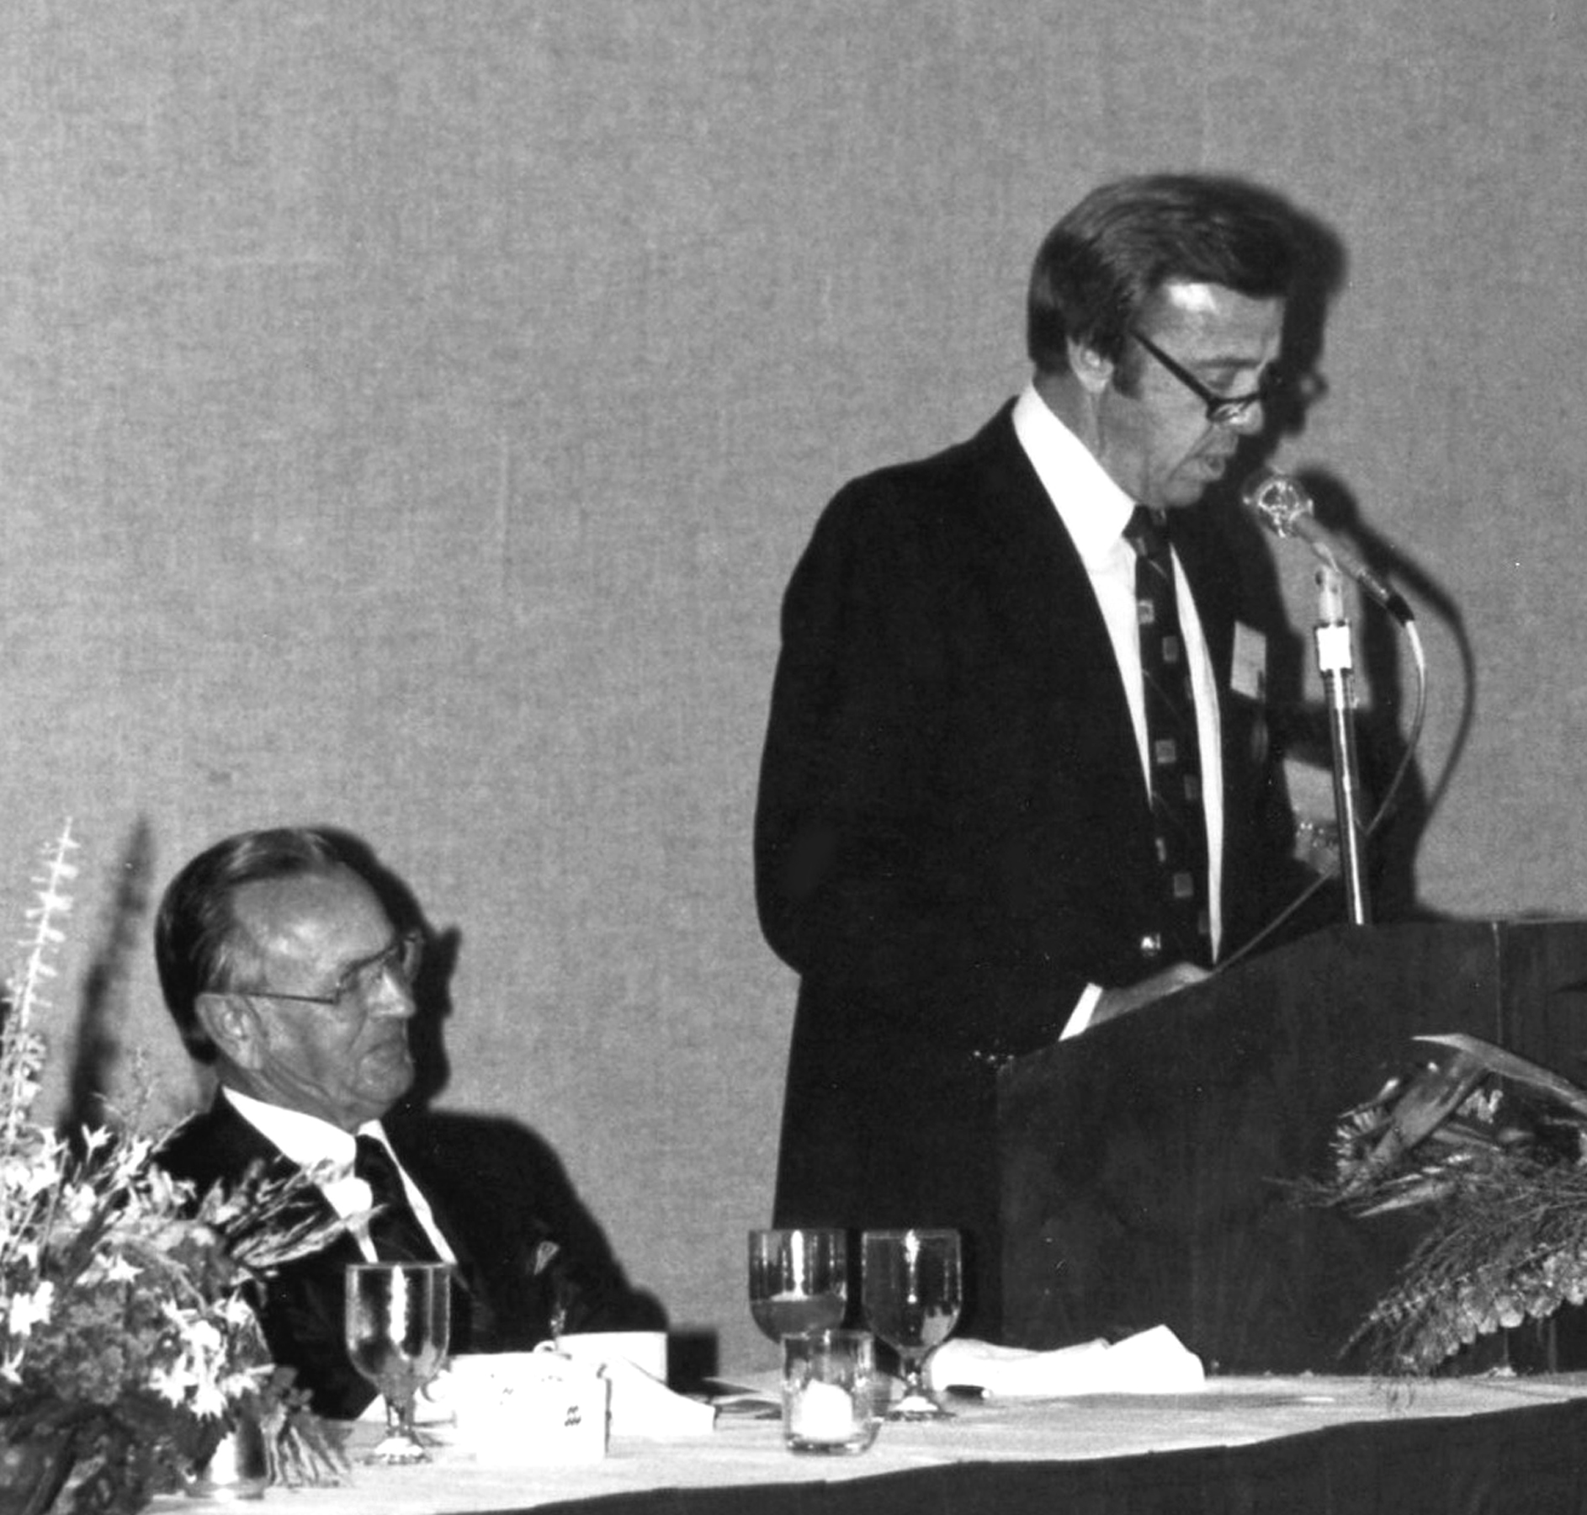
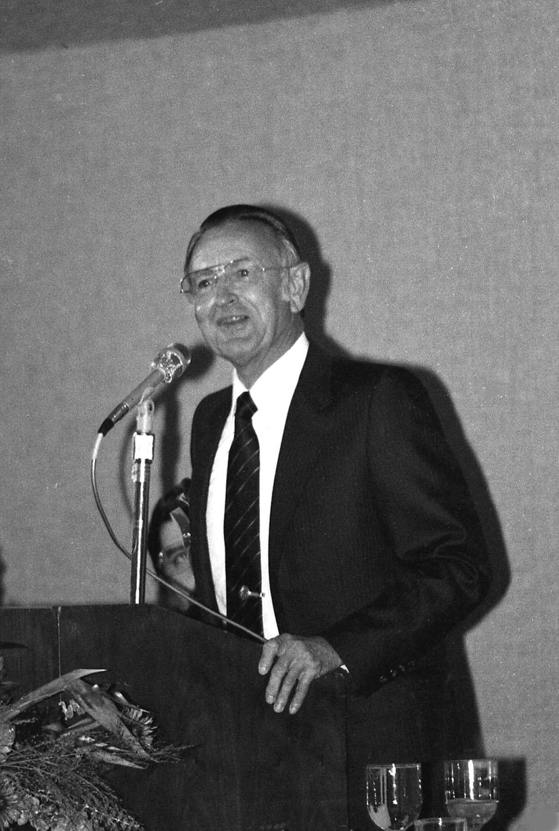
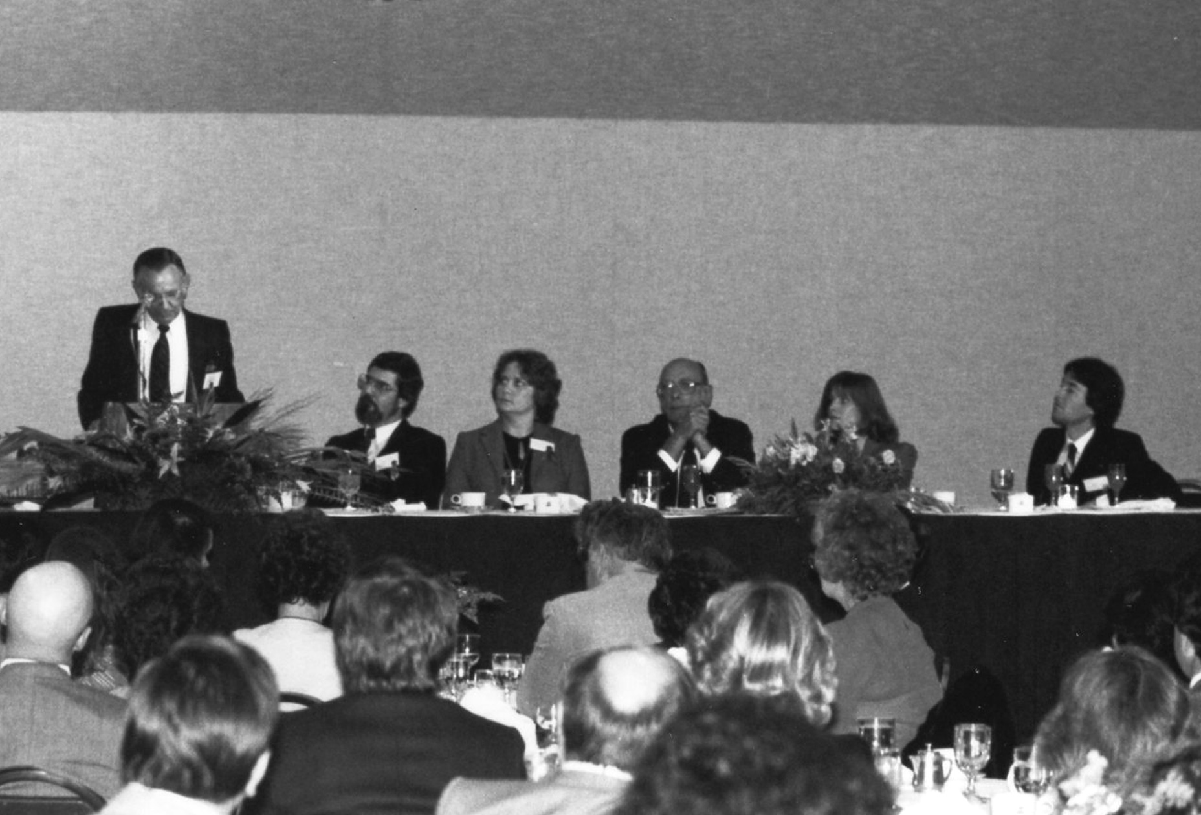
Arranged for Alan Shepard to present the Distinguished Public Servant Award to Chris Kraft in 1982.

Slide 12
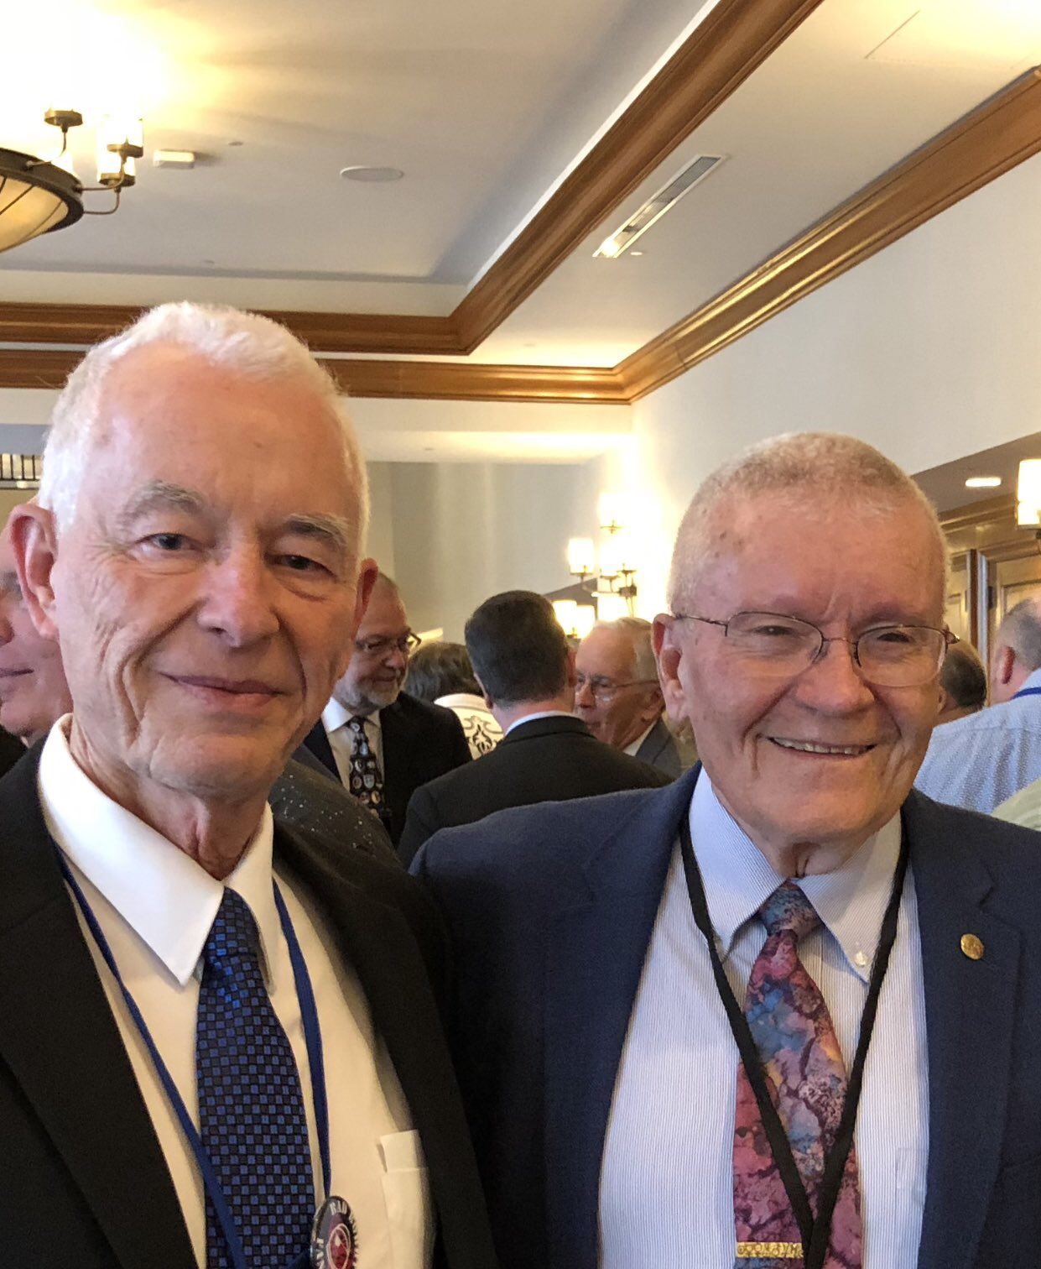
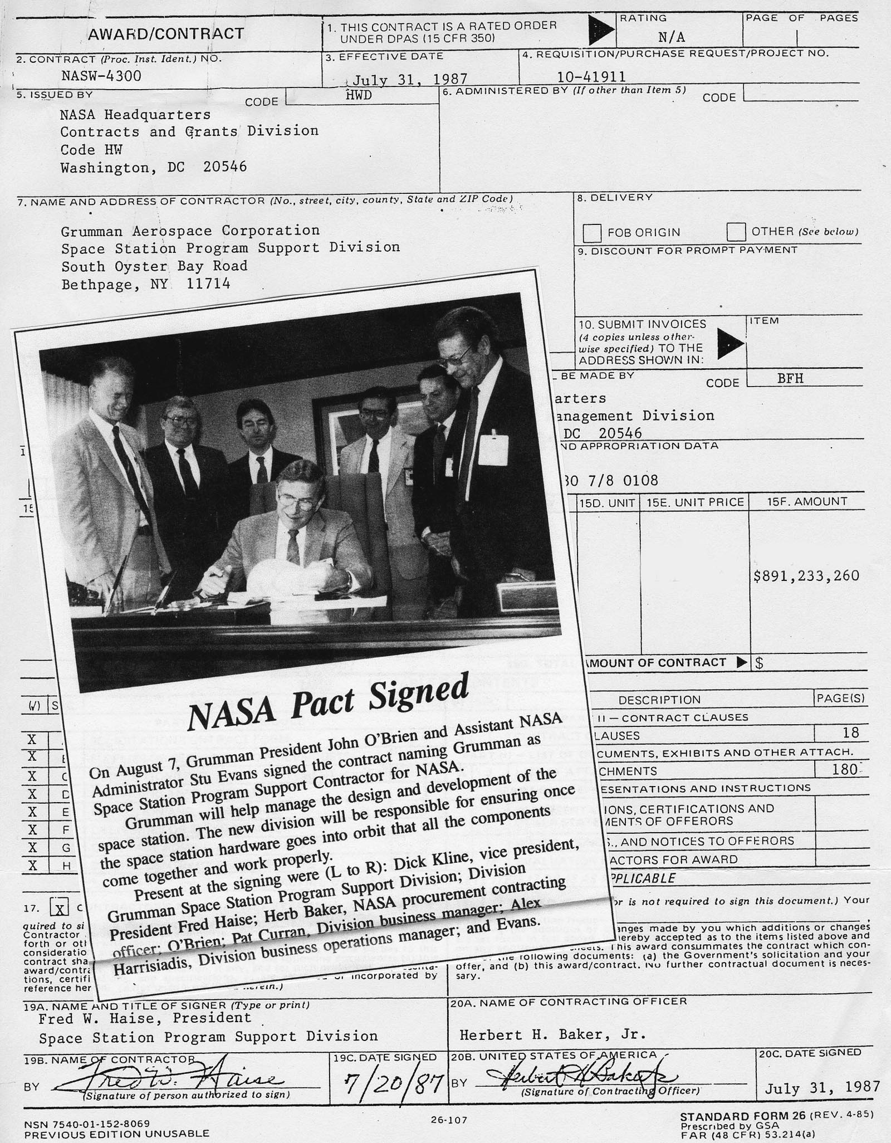
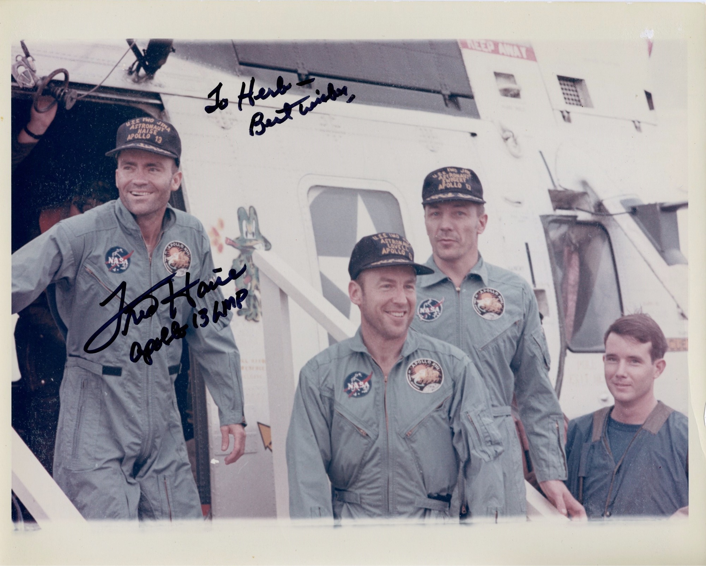
Worked with Apollo 13 astronaut Fred Haise on Space Station project in 1987 after he had retired from NASA

Slide 13
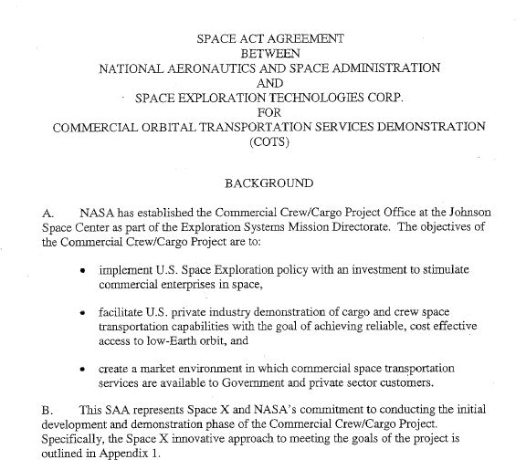
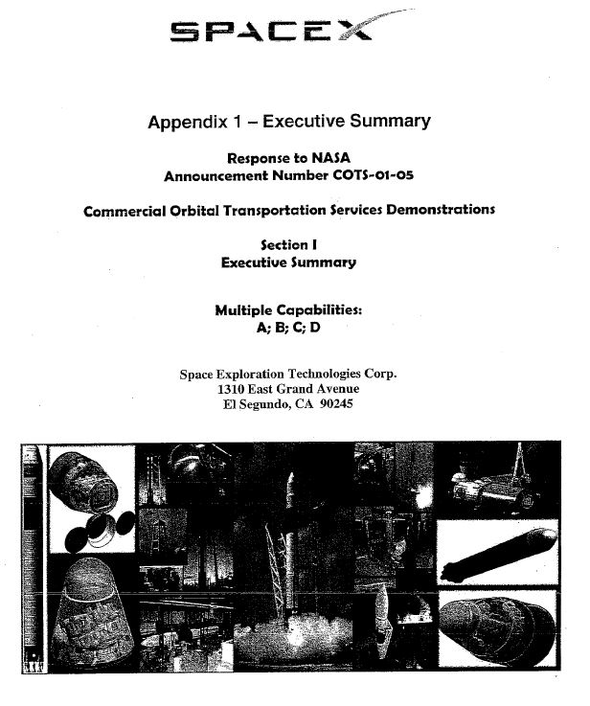
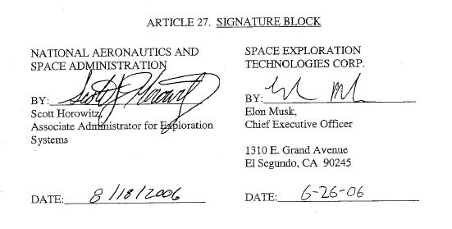
Commercial Orbital Transportation Services (COTS) – To stimulate commercial enterprises in space
2 Space Act Agreements awarded in August, 2006 - SpaceX ($250M) & Rocketplane Kistler ($207M)

Slide 14
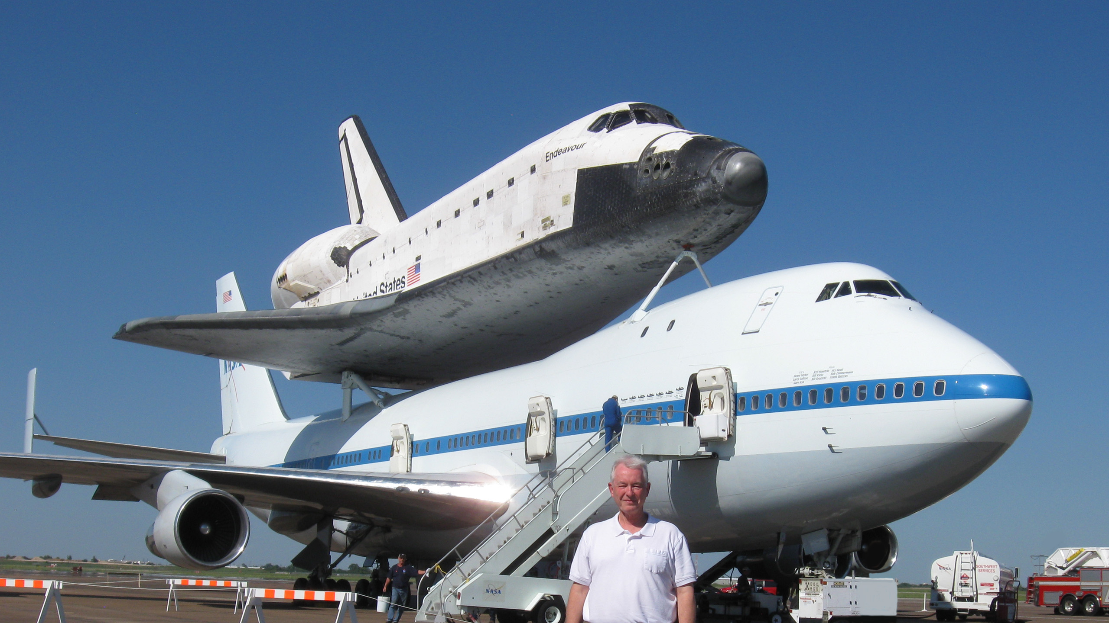
Shuttle Endeavour stopover in Houston in 2012

Slide 15
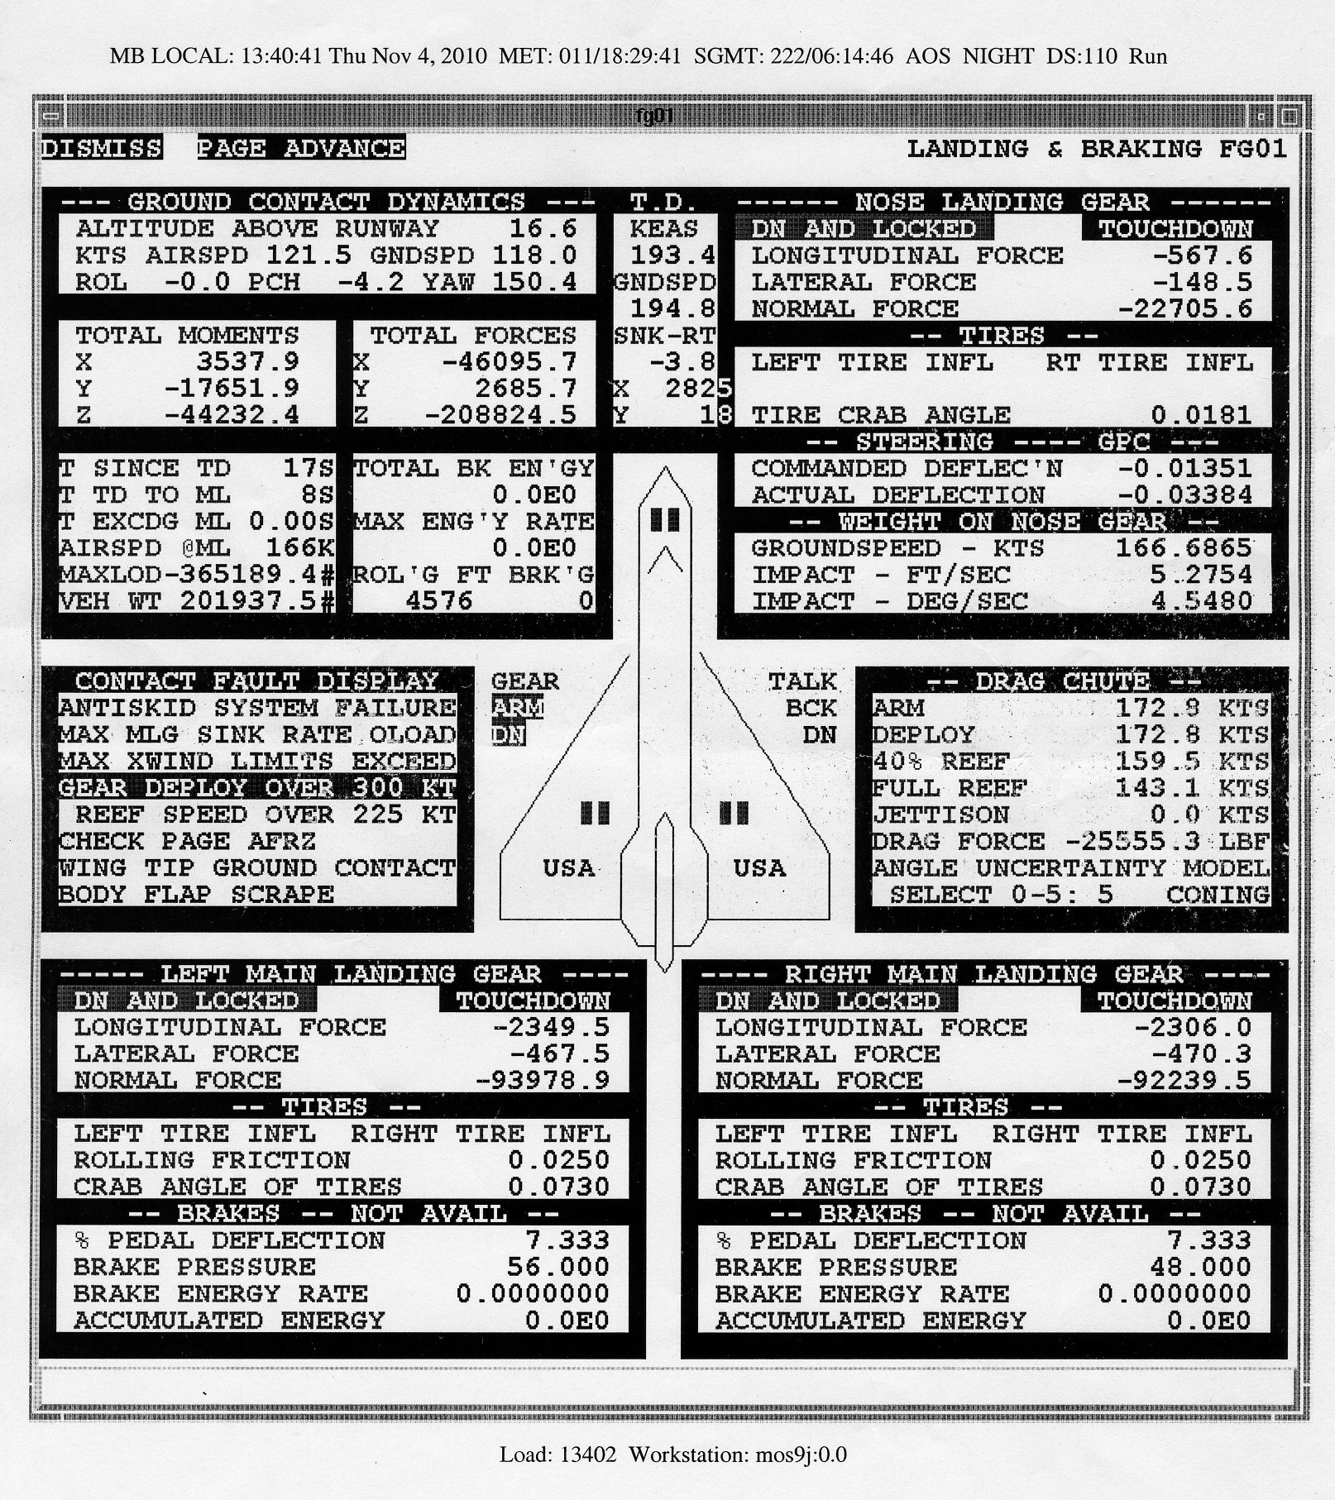
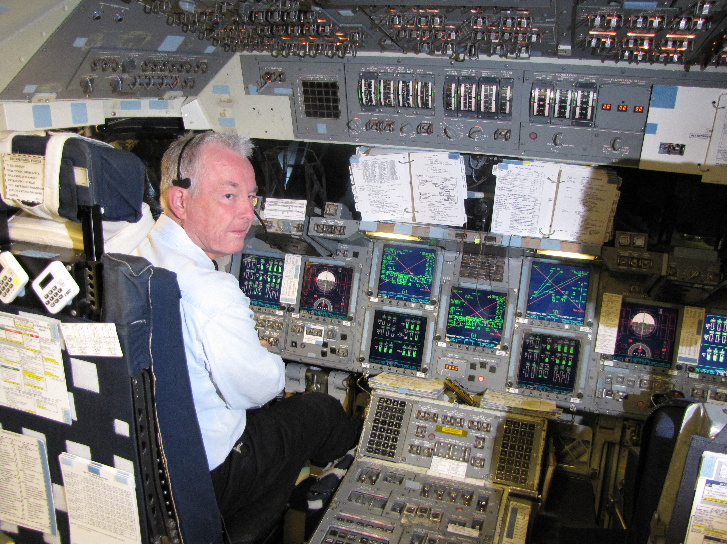
Flew the Shuttle Mission Simulator that all of the Shuttle Pilots trained in

Slide 16
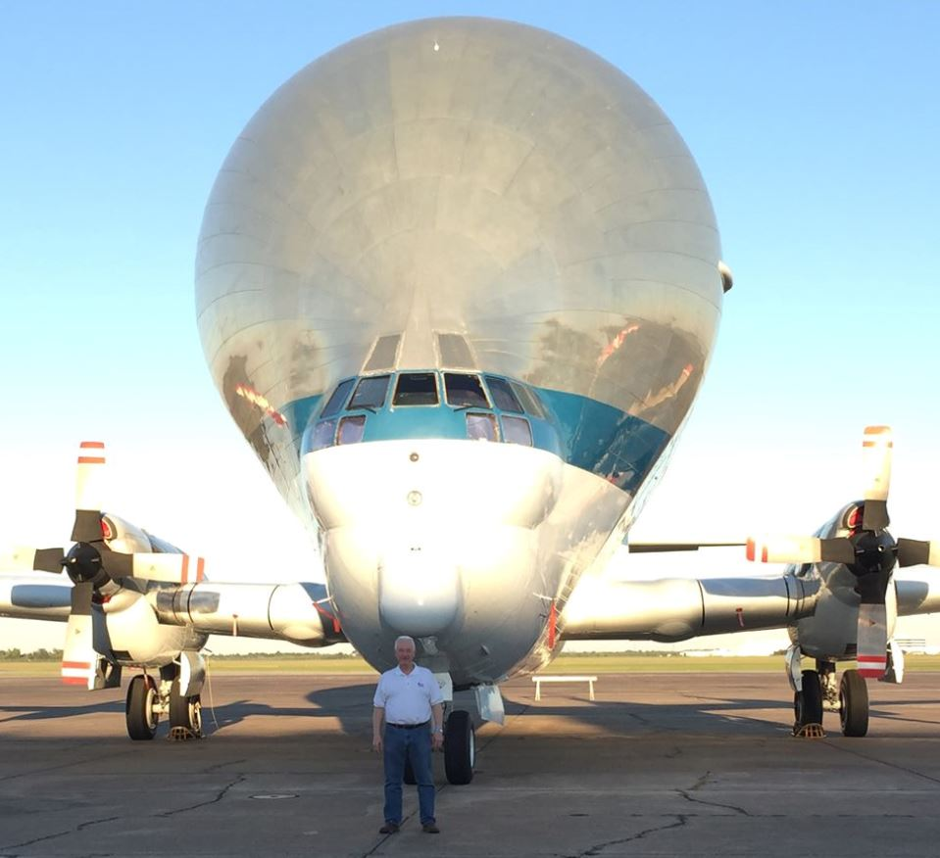
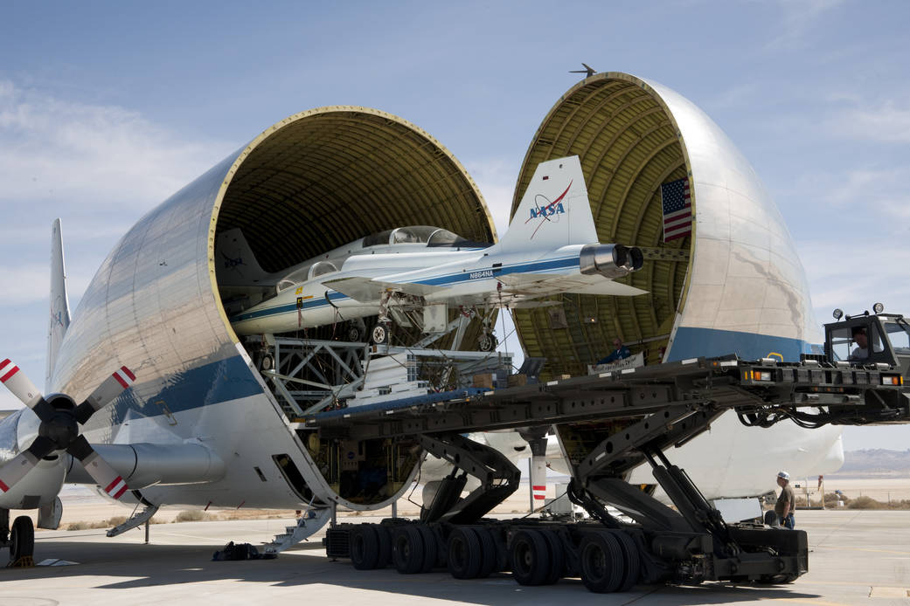
I worked on a 3-way barter with ESA & Airbus for the Super Guppy in 1997. NASA gave ESA 450kg of Shuttle upmass on future flights, ESA gave cash to Airbus & Airbus gave NASA the Super Guppy – needed to transport ISS modules to KSCfor launch to the ISS.

Slide 17
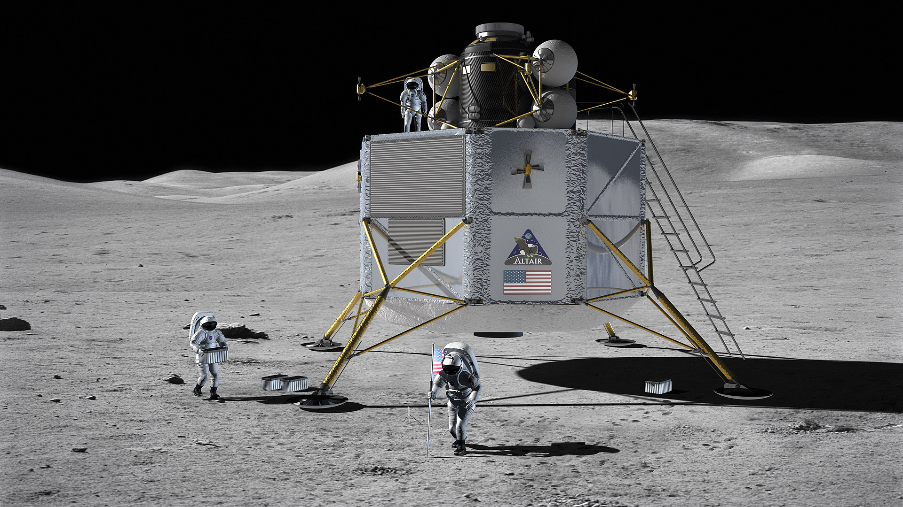
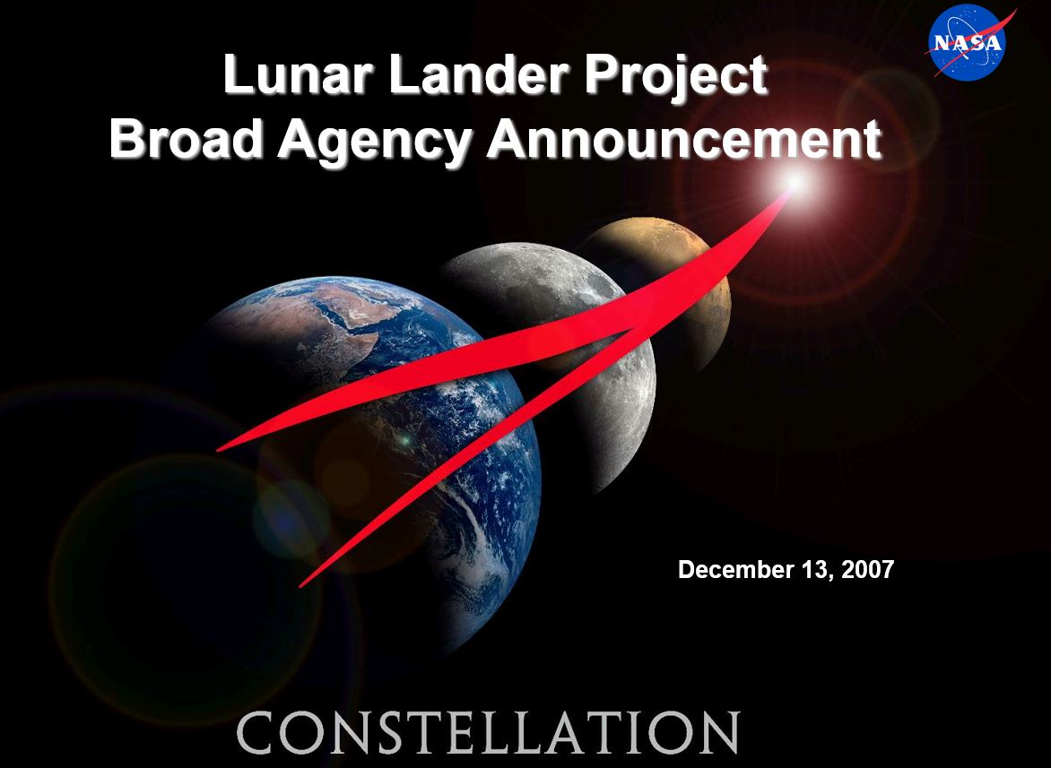
Constellation Program
2005-2009: Complete ISS; Return to Moon by 2020; crewed flight to Mars
Multi-Purpose Crew Vehicle = Orion
Ares I and Ares V = Space Launch System
Altair Lunar Lander = canceled
Early artist’s rendering of Altair
Requested input/ideas from industry

Slide 18
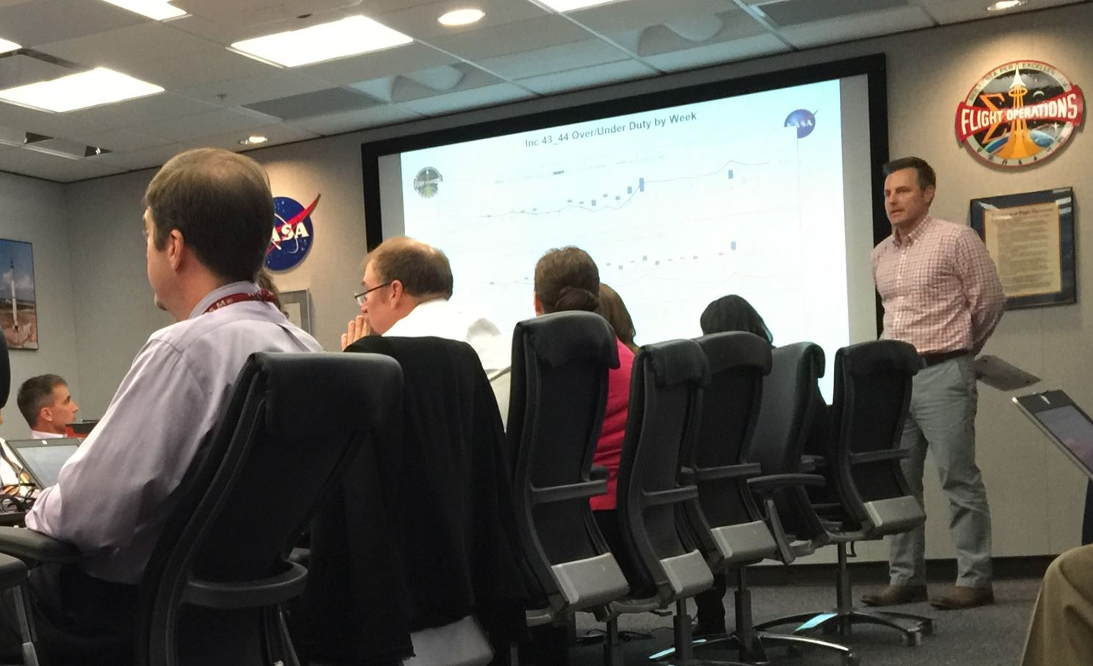
Monday morning Flight Operations Staff Meeting. Astronaut duty hours are tracked closely to avoid overworking them

Slide 19
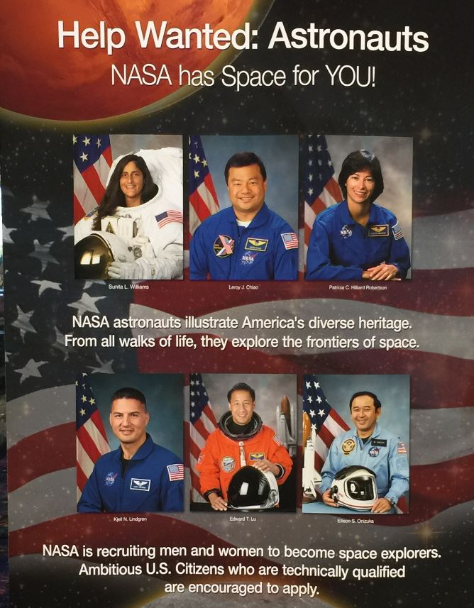
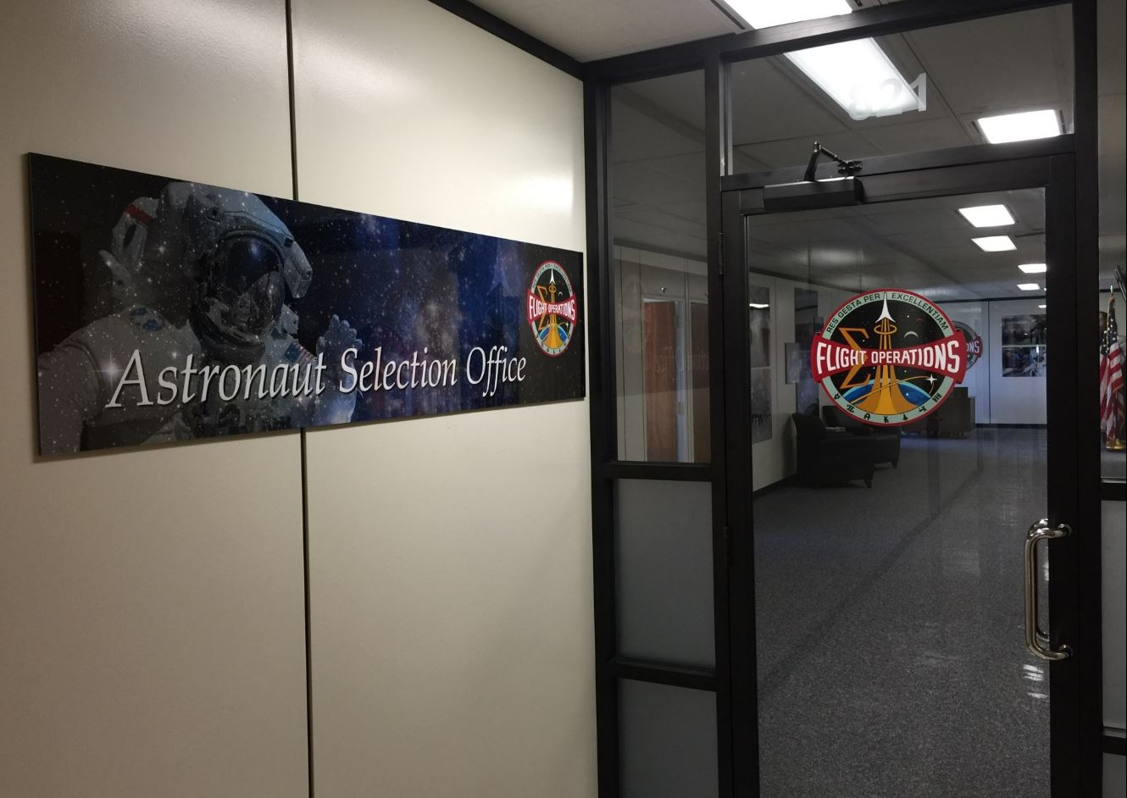
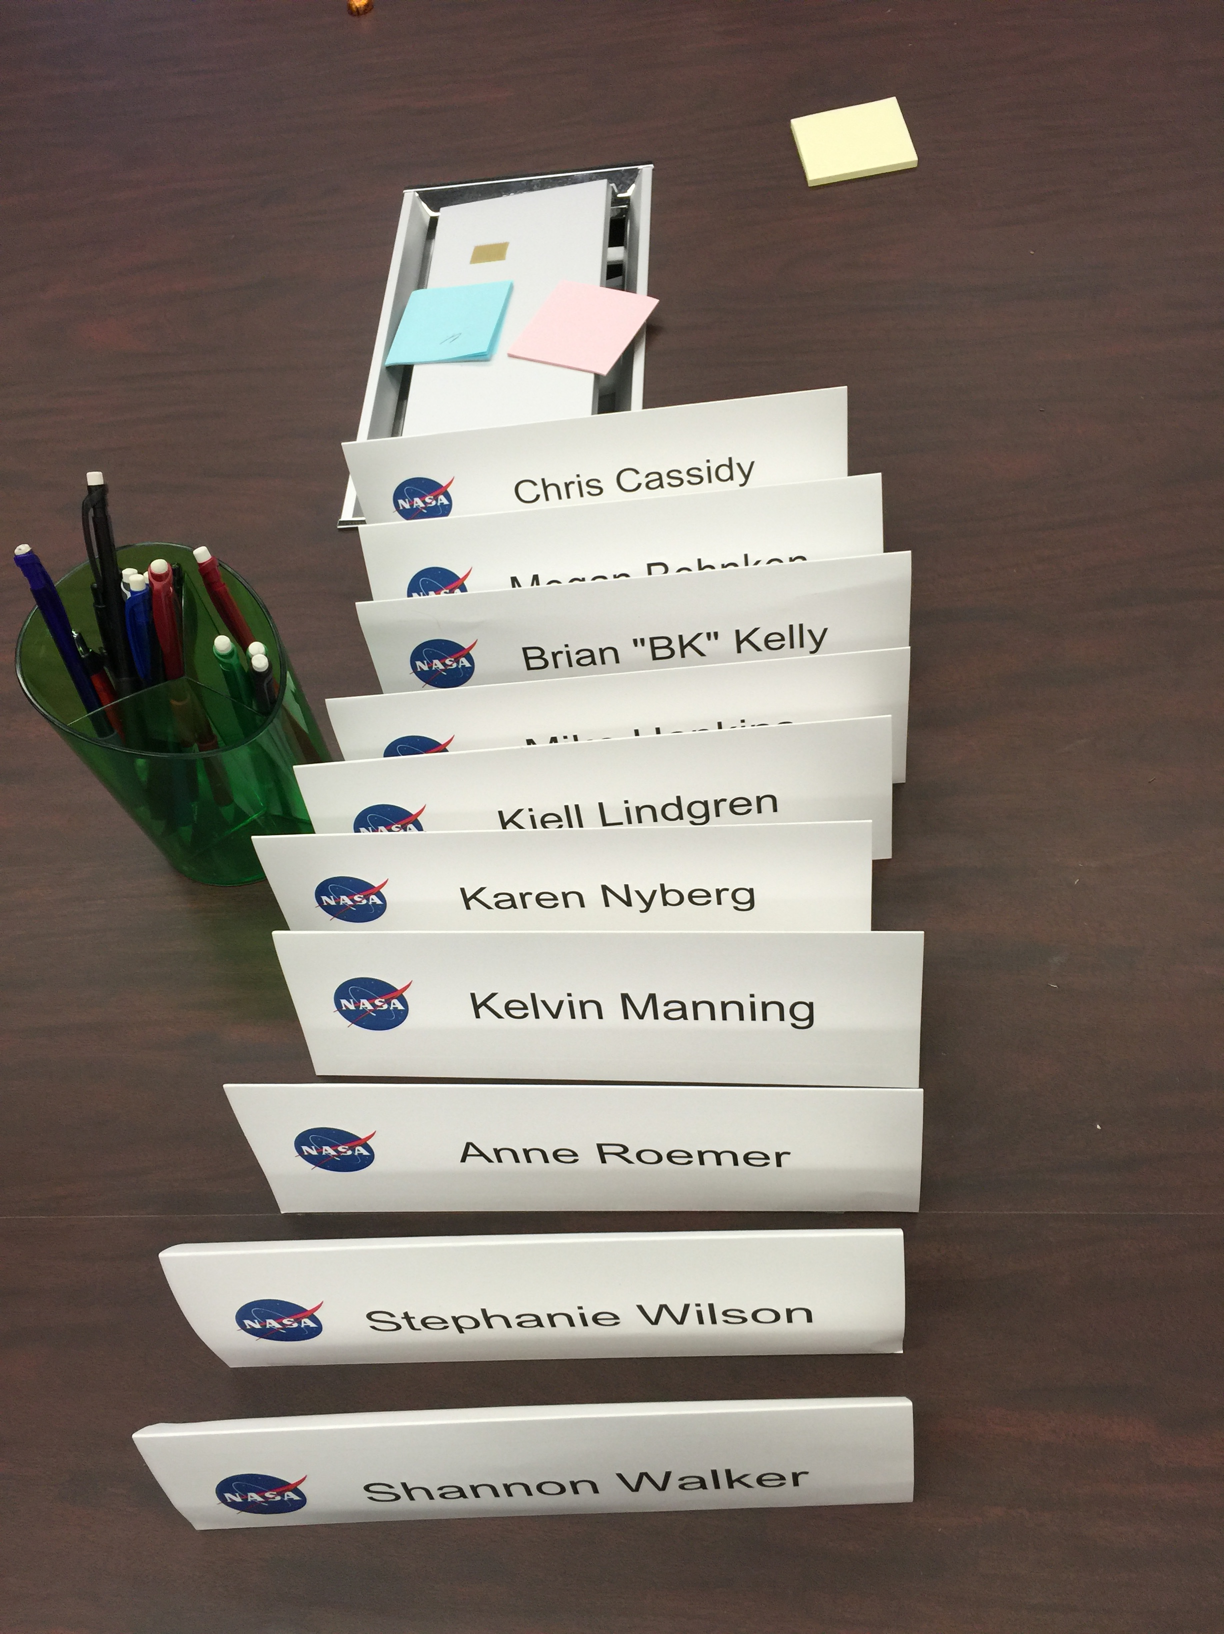
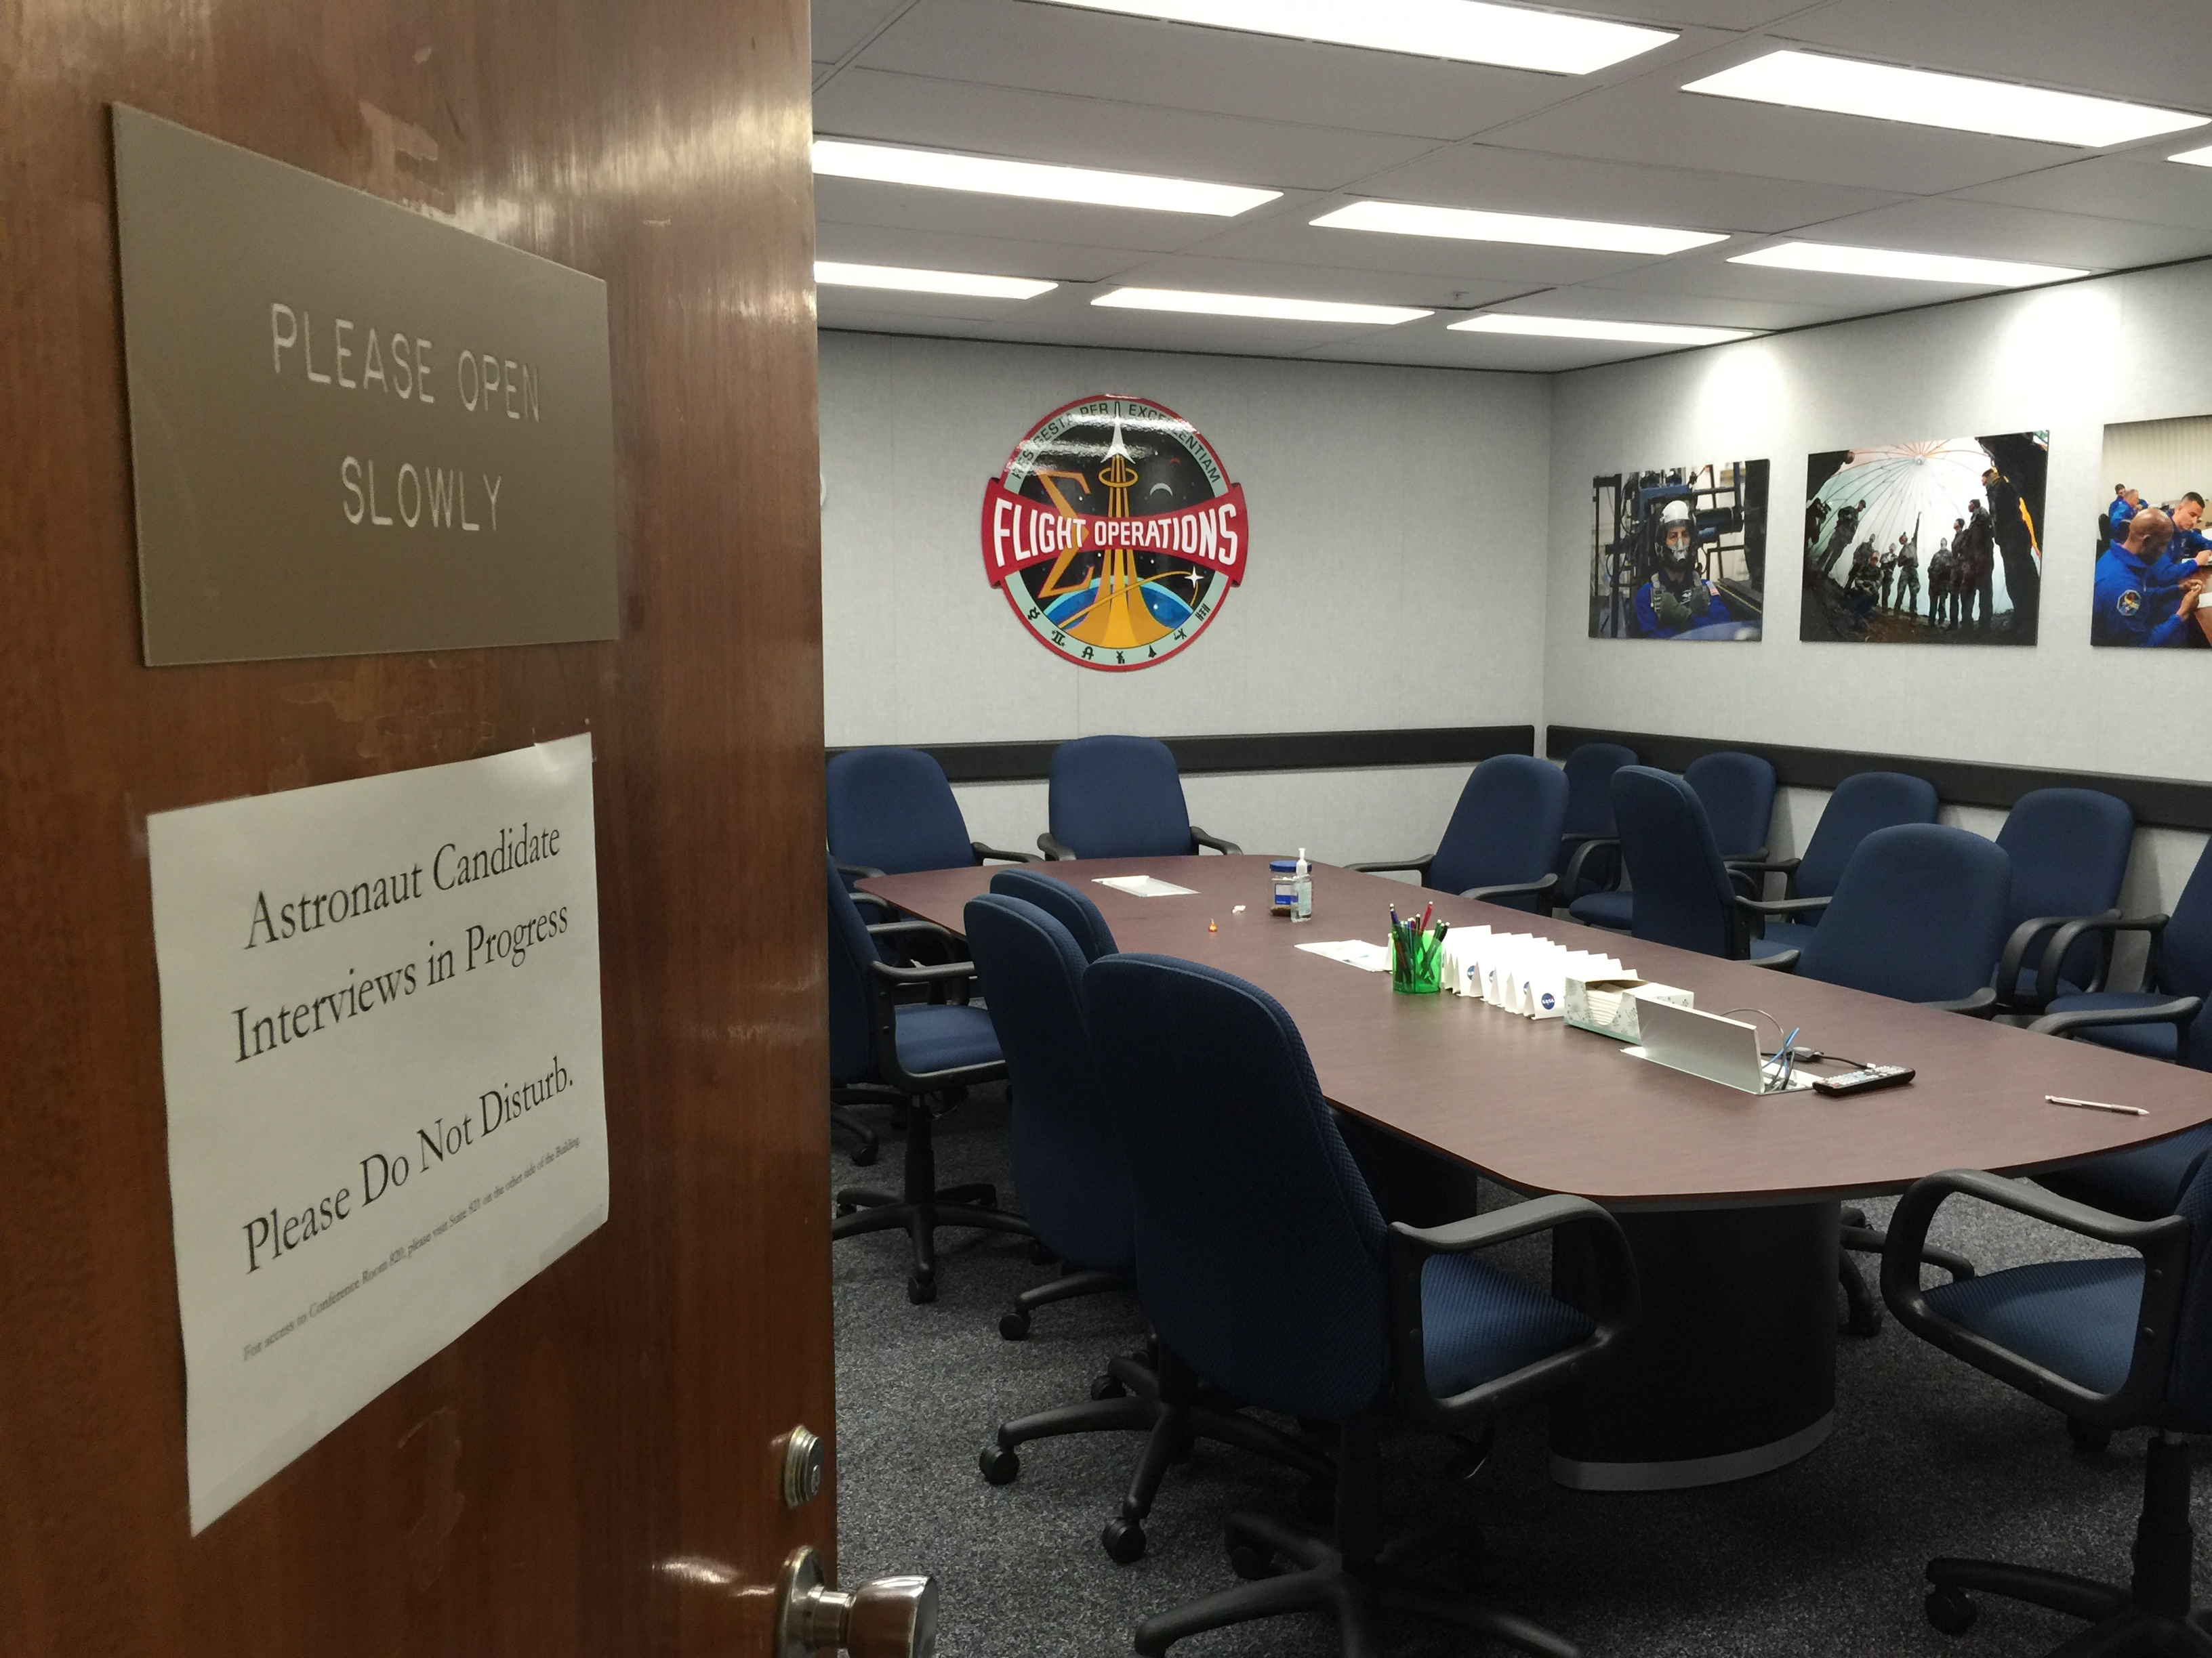
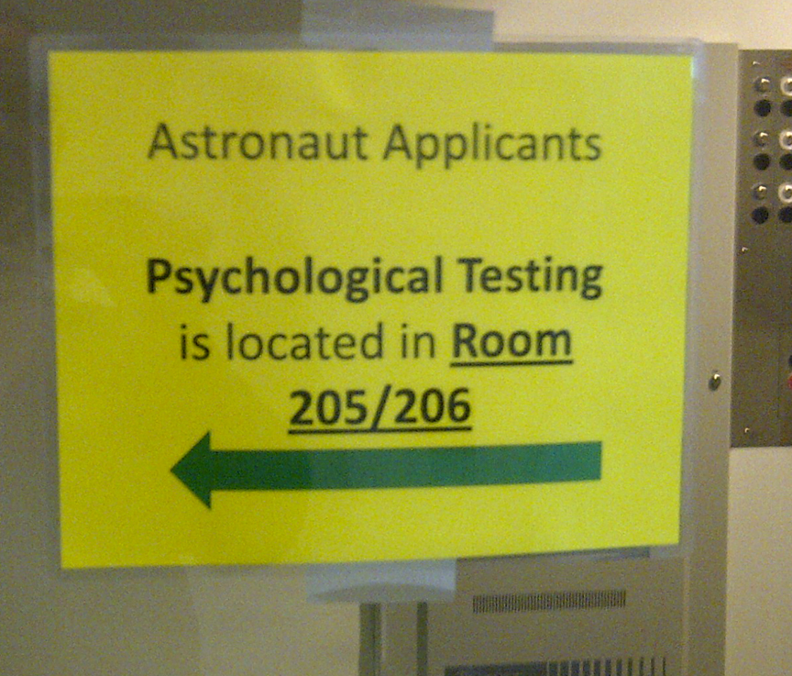
Recent (2017) Astronaut Selection Process – 18,300 applicants / 12 AsCans Selected

Slide 20
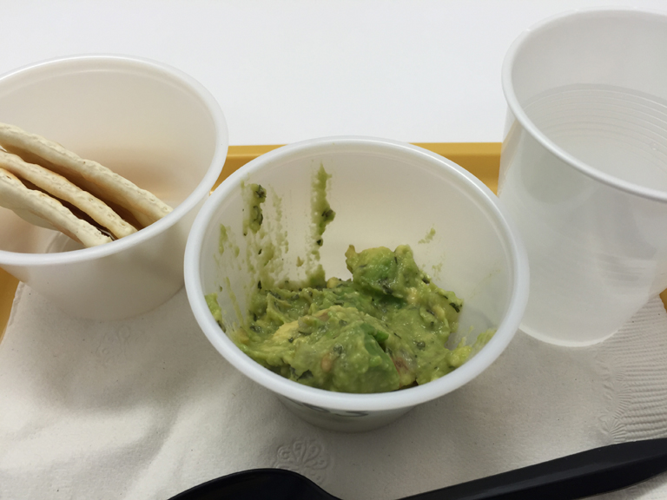
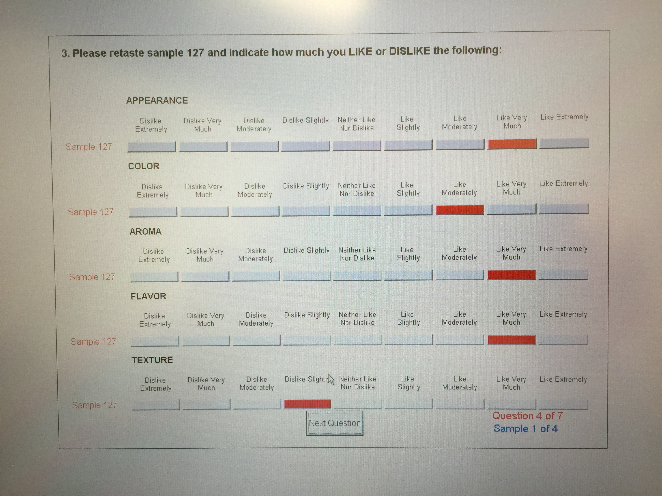
Space Food Testing

Slide 21
Gave many tours of Mockup Facility, Mission Control, & Neutral Buoyancy Lab

Slide 22
Toured the Lunar Sample Laboratory
“Lunar Trash Only”

Slide 23
I was responsible for acquiring the Gulfstream-V aircraft for direct return of astronauts from Kazakhstan. Randy Bresnik shown returning after Expedition 52/53 in December 2017.

Slide 24
NASA Social – Feb. 2017

Slide 25
Gemini/Apollo/ASTP Astronaut Tom Stafford
Charles Schulz family at JSC/Mission Control
Apollo 10 LM=Snoopy / CM=Charlie Brown
Gene Cernan & Jamye Flowers – May 1969

Slide 26
Astronaut Memorial Tree Grove at JSC
Pete Conrad quote: “If you can’t be good, be colorful.”

Slide 27
Who’s my favorite astronaut? Ellen Ochoa

Slide 28
Women of NASA Lego set
Maia Weinstock & Ellen Ochoa
Maia Weinstock, Margaret Hamilton, & Nancy Grace Roman at Launch Party

