Slide 1
COMPARING ORBITS FOR THE LUNAR GATEWAY
Dr. Greg Stanley-January 5, 2019

Slide 2
Mission goals for cis-lunar orbits (orbits near the moon)
Support potential lunar surface activities (as yet undefined)
Proving ground: short term human habitat in orbit in a place more dangerous than the LEO (Low Earth Orbit) of ISS
(distance, radiation, etc.)
A “parking place” for supplies and people on the way to/from the moon or Mars
Use SLS/Orion

Slide 3
Criteria for choosing orbits
Access from earth within constraints of SLS two-stage rocket / Orion capsule maneuvering
ΔV < 1250 m/s
Life support: time < 21 days
Support for potential lunar surface activities
Station-keeping propellant for multi-year operation
Minimizing or eliminating communication interruptions by line-of-sight to earth
Thermal considerations: re-radiating direct and reflected sun with fixed radiators
Other operational considerations (eclipses, aborts)

Slide 4
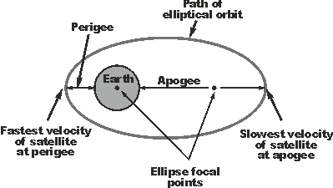
orbits around a single large mass: Kepler’s laws
(Empirically observed by Kepler, 1609-1619, derived later by Newton)
All (periodic) orbits are ellipsoidal
(Circular orbit is a special case of ellipsoidal)
Within an orbit, the satellite goes faster nearer the large mass)
(Constant angular momentum and energy, shifting potential and kinetic energy)
Smaller orbits have shorter the orbital period
(More speed to overcome higher gravitational pull, and path is shorter as well)
Terminology:
Orbital plane: the geometric plane containing the orbit
Diagram: https://www.radio-electronics.com/info/satellite/satellite-orbits/elliptical-satellite-orbit.php

Slide 5
But that nice ellipse is idealized…
Other objects exert gravitational pull
At least a 3-body problem: earth, moon, satellite (plus sun)
Assumes even distribution within the large mass
Uneven mass concentrations perturb the orbits –especially on the moon, with no plate tectonics to homogenize things
Proven that most low lunar orbits are unstable because of this -- only a few safe “frozen” orbits have been calculated
Caused unexpectedly early crash of several moon probes
Assumes large mass is much heavier than the satellite
(OK for satellite case, not perfect for earth/moon case)
Neglects long term effects from atmospheric drag in LEO case, radiation pressure, etc.
Neglects relativity/bending of space by big objects
(A factor in Mercury’s orbit, but not for cis-Lunar analysis)

Slide 6
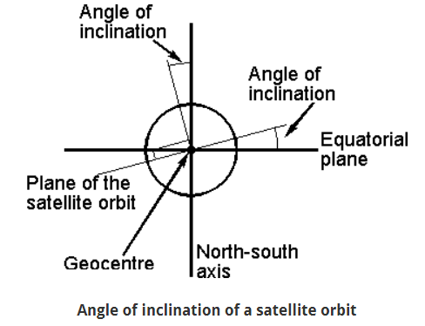
terminology: angle of inclination
For cis-lunar orbits: angle between an object’s orbital plane and the earth/moon orbital plane as the reference plane
Diagram: https://www.radio-electronics.com/info/satellite/satellite-orbits/elliptical-satellite-orbit.php

Slide 7
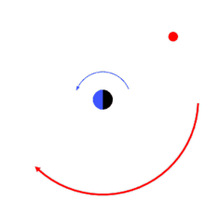
Prograde & retrogRade orbits
Prograde: satellite rotates in same direction as the central mass
(Angle of inclination between 0 and 90 degrees)
Retrograde: satellite rotates in the opposite direction as the central mass
(Angle of inclination between 90 and 180 degrees)
Diagram: https://en.wikipedia.org/wiki/Retrograde_and_prograde_motion

Slide 8
Polar orbits
Polar orbits pass over or near both poles
Angle of inclination near 90 degrees (say 70 to 110)
More expensive to get to polar orbit than others: no launch benefit from earth’s rotation
Useful for low orbits providing coverage of an entire planet or moon for observation, mapping, or landing & return
Because the planet is rotating underneath
Useful for a gateway, mapping, spy satellites, Iridium
Animation of a polar orbit:
https://www.youtube.com/watch?v=y_jM_BxQGvE

Slide 9
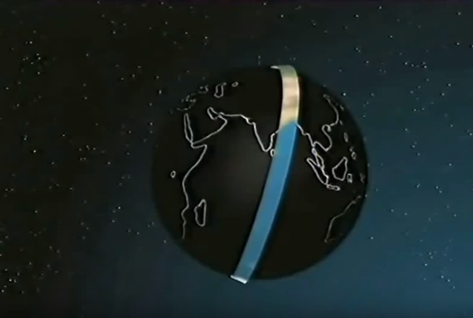
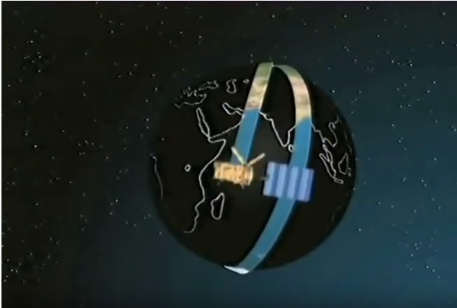
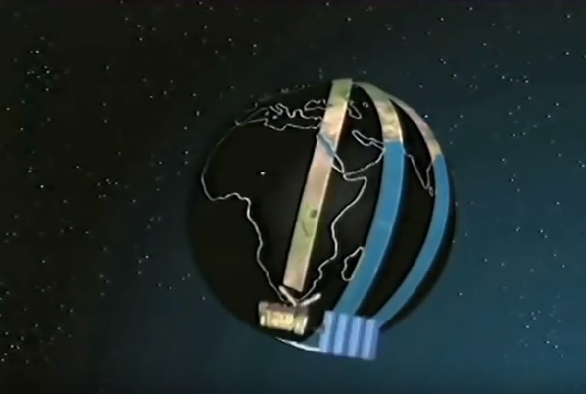
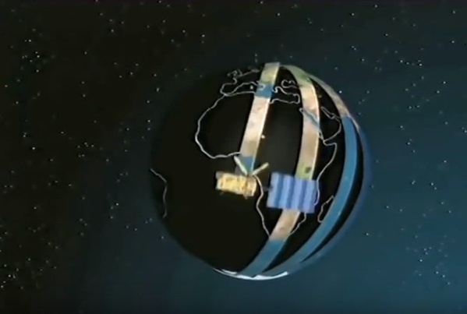
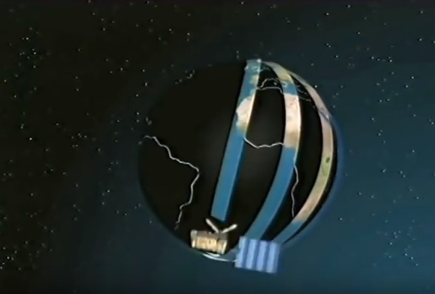
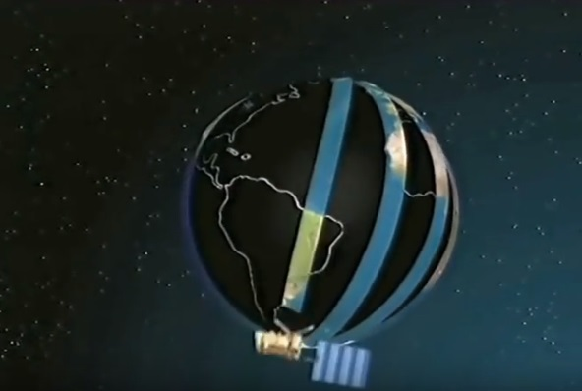
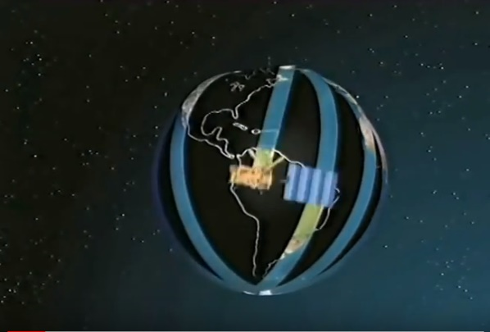
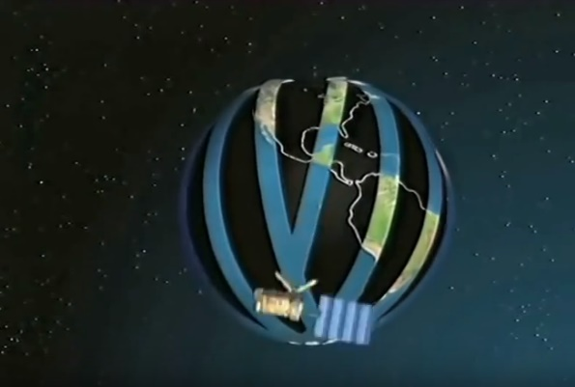
POLar orbit around rotating planet (earth)

Slide 10
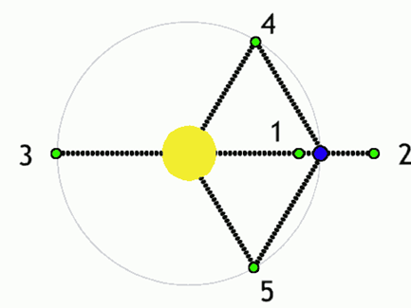
Lagrangian points (Libration points/L-points)
(Euler & Lagrange, circa 1772)
Points near two large bodies in orbit where a smaller object could maintain its position relative to the larger bodies
At these points, gravitational forces of the two large bodies balance along with centripetal force
5 points L₁, L₂, L₃, L₄, L₅ for any two large bodies
Sun-Earth
Earth-Moon

Slide 11
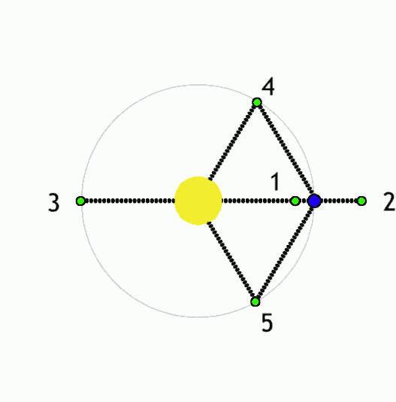
Lagrangian points (Libration points/L-points)
Diagram: https://en.wikipedia.org/wiki/Lagrangian_point

Slide 12
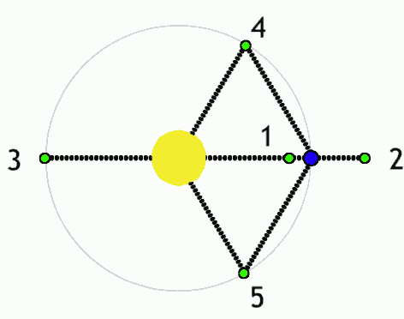
Lagrangian points (Libration points/L-points)
Example: L₁ point between earth and the moon
Closer to earth, you might expect a shorter orbital period than moon, but pull from moon reduces earth’s gravitational effect, so orbital period is the same as the moon
Orbits at L₁, L₂, L₃ positions are not stable
Example at Earth/moon L₁: Any perturbance that moves the object closer to earth (moon) increases earth’s (moon’s) pull, pulling object further to earth (moon).
Natural objects can’t accumulate there, unlike L₄/L₅
Station-keeping (propellant use) is required to maintain an orbit

Slide 13
halo orbits
(Invented in 1968, proposed for far side of moon
communications relay)
Halo orbit is an orbit near the L1, L2, or L3 Lagrange points
Halo orbits, like L₁,L₂, L₃ are also unstable
Station-keeping (propellant use) is required to maintain the orbit, although the amounts can be small
Used since 1978 because of direct communications path
Various solar observatories at Sun-Earth L₁
2018 Chinese communication relay satellite orbiting the Earth/Moon L₂ point, to support Chinese “direct to the far side of the moon” missions.

Slide 14
NEAR RECTILINEAR HALO ORBITS
A subset of halo orbits
Nearly perpendicular to the Earth-Moon orbital plane (polar)
Close approach to one of the lunar poles

Slide 15
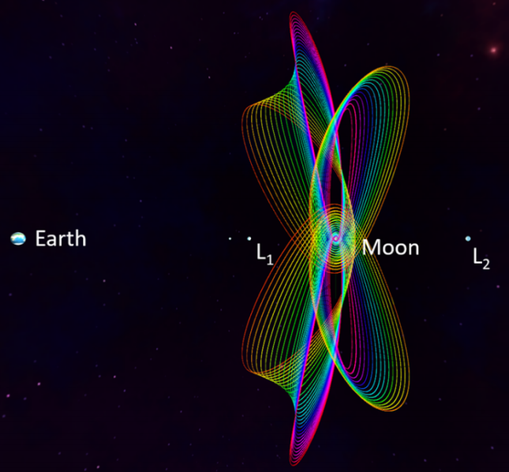
NEAR RECTILINEAR HALO ORBITS EXAMPLES
Diagram: https://ntrs.nasa.gov/archive/nasa/casi.ntrs.nasa.gov/20170001347.pdf

Slide 16
NEAR RECTILINEAR HALO ORBITS properties
Nearly stable, leading to modest station-keeping propellant use
For larger orbits (radius greater than moon radius), always has line of sight to earth for communications

Slide 17
Orbit design choices
Type of orbit
Circular, elliptical, Lagrangian points, Halo, Near-Rectilinear Halo, …
Some special sub-cases of orbits
“Frozen”, geosynchronous (orbit period matching planet rotation), …
Orbital parameters for the orbit type, e.g., …
Min/max distances, implying speed & period (orbital energy)
Angle of inclination (includes prograde/retrograde cases)

Slide 18
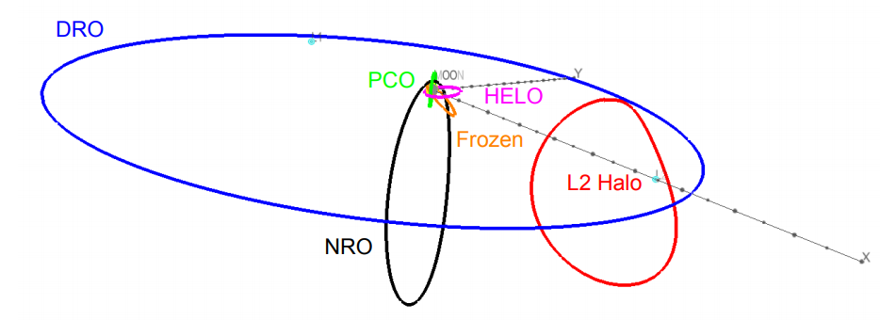
Potential orbits STUDIED
Whitley & Martinez, “Options for Staging Orbits in Cis-Lunar Space”, 2015
For reference:
Mean Earth-Moon distance is 384,400 km
Moon’s radius is 1,737.5 km

Slide 19
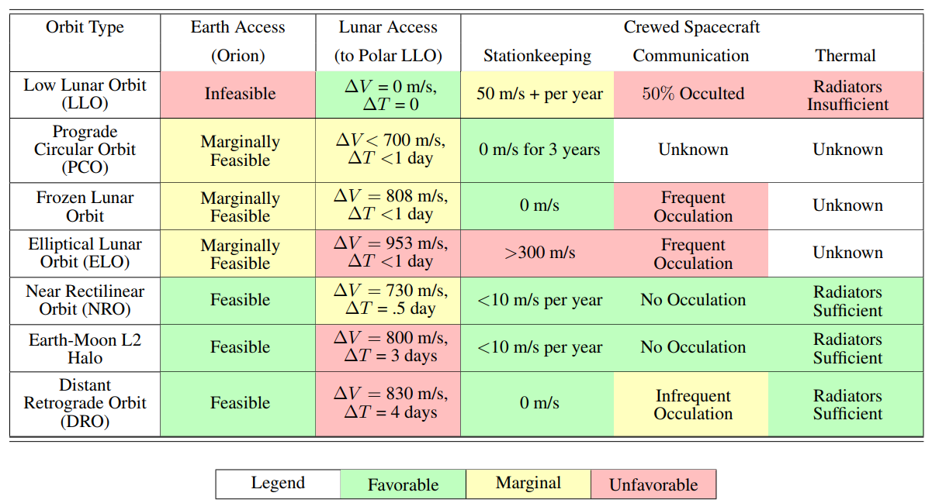
STAGING ORBIT SUMMARY
Whitley & Martinez, “Options for Staging Orbits in Cis-Lunar Space”, 2015

Slide 20
Conclusion: short version
Near Rectilinear Orbit (NRO) is favored

Slide 21
Conclusion: LONGER VERSION
Near Rectilinear Orbit (NRO) is favored

