Slide 1
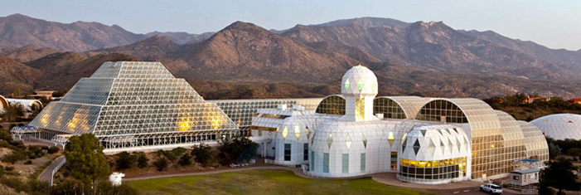
Biosphere 2 and CLOSED ECOLOGICAL SYSTEMs
SYSTEMS Biology for sustainable life outside earth
Dr. Greg Stanley – May 2018

Slide 2
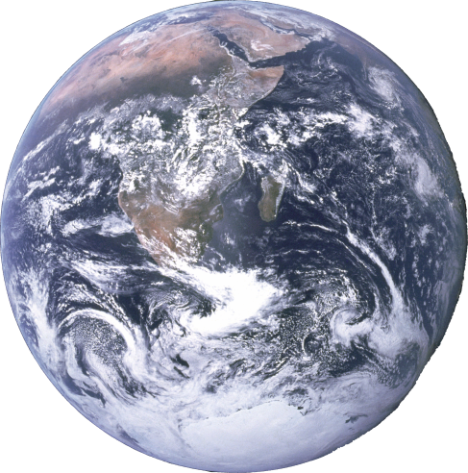
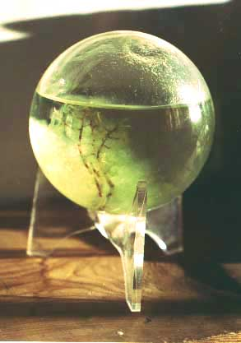
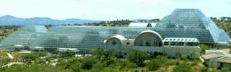
What is a biosphere
Worldwide sum of all ecosystems
Closed system materially (or almost)
Open system for energy and information
Includes atmosphere, geological processes
Largely self-regulating given energy input
1
2
“EcoSphere®”

Slide 3
Origins of the word “biosphere”
Geologist Eduard Suess, 1875
  No, not “that” Dr. Seuss!
  Word meant geology of the place that life dwells
  Also originator of “Gondwanaland” (old supercontinent)
Geochemist Vladimir Vernadsky added ecological and systems meaning in1926 book “The Biosphere”
  Life as a geological force
  Systems view: integrating geology, geochemistry, hydrology, meteorology, evolution, all life sciences

Slide 4
How small can a biosphere be?
Earth (Biosphere 1) works
  Extremely complex, with many species & interactions
  Many closed material cycles: water, carbon, nutrients, etc.
    Includes geological processes
  Roughly stable, but with adaptation
    Sun is 25% to 30% brighter than at start of life
    Survived ice ages, warm periods, meteor impacts, rise of photosynthesizing organisms, etc.
    Individual species arrive, 99% go extinct, but Biosphere survives
Can a smaller, simpler version of earth work?
  Research on closed ecological systems in 1968 at University of Hawaii – sealed up samples from beach and water
  Sealed “EcoSphere®“ novelty
    Small shrimp with “pond scum” (algae, bacteria), 2-10 years
How small could that get and still support people?

Slide 5
Why should we care?
Space settlements benefit by being as close to sustainable as possible
  Cost
  Risk of adequate resupply
  Expansion beyond our solar system will require long trips and bringing enough Earth with us
In the long run, Earth is toast (literally)
  Biosphere 1 will be incinerated by our expanding, dying sun
    (Even if we survive other potential catastrophes like asteroids, genetically-engineered plagues, etc.)
  We’re maybe a third to half of the way through the useful life of the earth – better get going!

Slide 6
Biosphere 2 bigger than a basketball, Smaller than earth
Biosphere 1 is earth
Unique biosphere experiment, intended as a prototype for sustainable space settlement
8 “biospherians” sealed in a 3.14 acre facility in 1991 for 2 years, with 3800 species
Was (and remains) worlds largest and longest running closed environment test
Facility still there as a research laboratory, open to the public (and the atmosphere --no longer sealed)
This talk is a retrospective on the experiment and the ideas behind it

Slide 7
Biosphere 2 structure overview
3.14 acres (plus basement)
40 acre site
  Support buildings, cooling towers
  Energy center with backup generators, boilers, water chillers
  Power failure: 20 minutes until plants damaged
91 foot maximum height at rainforest
7.2 million cu.ft.
Closed to material flow, open to energy and information (as would be a space or Mars colony)
  Low air leakage rate – about 10%/year
  Energy input: passive solar, and 5.7MW power plant
  Energy removal: cooling tower water and chilled water
  Special sealants for 6500 windows in space frame
  500 ton welded stainless steel liner underneath

Slide 8
Biosphere 2 organized as 7 connected “biomes”
5 Wilderness biomes
  Rainforest (Amazonian, with lowlands, 50 ft. mountain, and cloud forest with misters and condensers to generate rain)
  Savannah (from tropics to thorn scrub)
  Marsh (Fresh → Salt, mangroves, Everglades)
  Ocean (35 feet deep, 1 million gallons, with coral reef, waves, and tides)
  Fog Desert (Baja California – humid)
IAB (Intensive Agricultural Biome)
Human habitat
Other stuff
… “lungs”, and a basement, referred to as the “technosphere”

Slide 9
Biosphere 2: other features
Ponds, streams, waterfalls
Two “Lungs” (1 million cu.ft. each)
  Provide constant pressure slightly above atmospheric
  Avoid blowing out or imploding glass due to temperature changes (remember the ideal gas law!)
  Ensure leaks are outward, not inward (contaminate experiment)
  16-ton aluminum disk, 4 tons of synthetic rubber membrane
  Disk level indeed goes up and down during the day
Location: near Oracle, AZ, north of Tucson
  Elevation: 3820 ft. (So they get hot summers, snow)

Slide 10
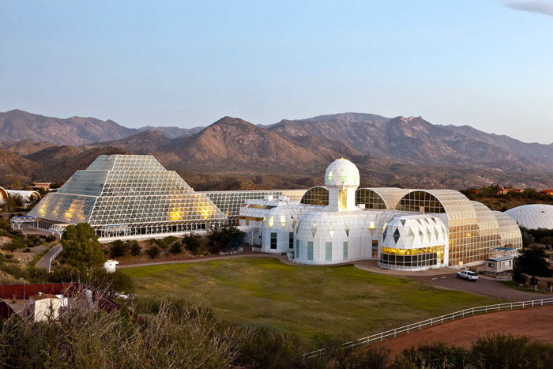

Slide 11
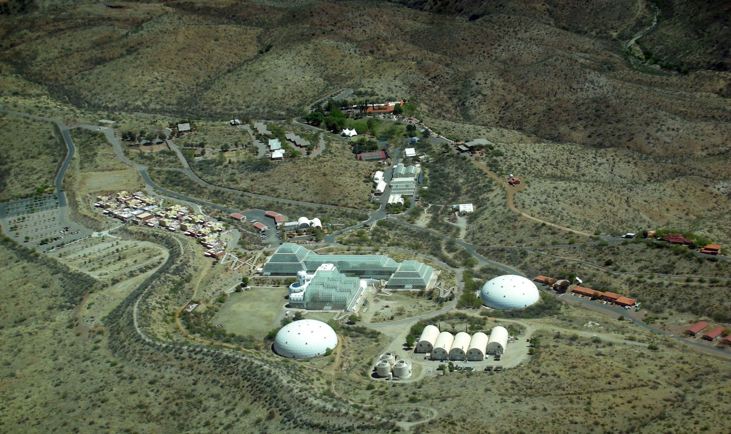
Site overview

Slide 12
Why put a greenhouse in the middle of the arizona desert?
Photosynthesis is key to maintaining O₂ & CO₂
Glass blocks ultraviolet light, part of “PAR” – Photosynthetically Active Radiation
  Glass and the space frame structure block about 50%
So, a lot of sunlight/clear sky is needed
  Want many days without clouds, rain, haze, smog
  Higher elevations of Arizona are perfect!
  Outweighs the additional costs of air conditioning (and some heating in winter)
At first, they didn’t consider artificial lights
  Despite the fact that on Mars there’s less sunlight, and you’d need to mostly be buried to avoid radiation anyway

Slide 13
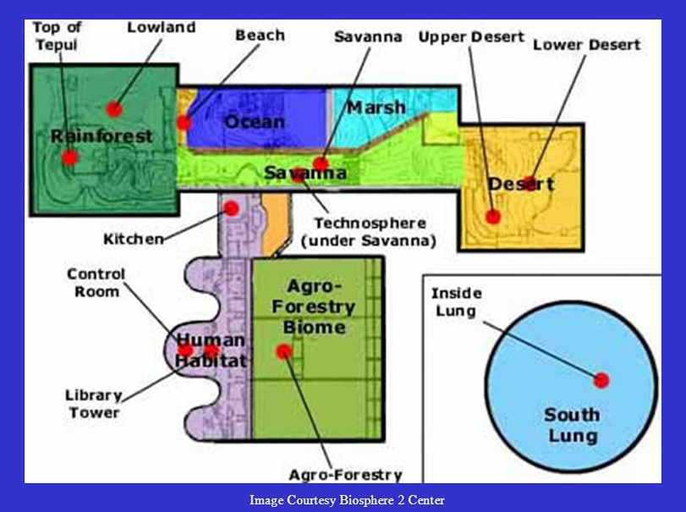
overview

Slide 14
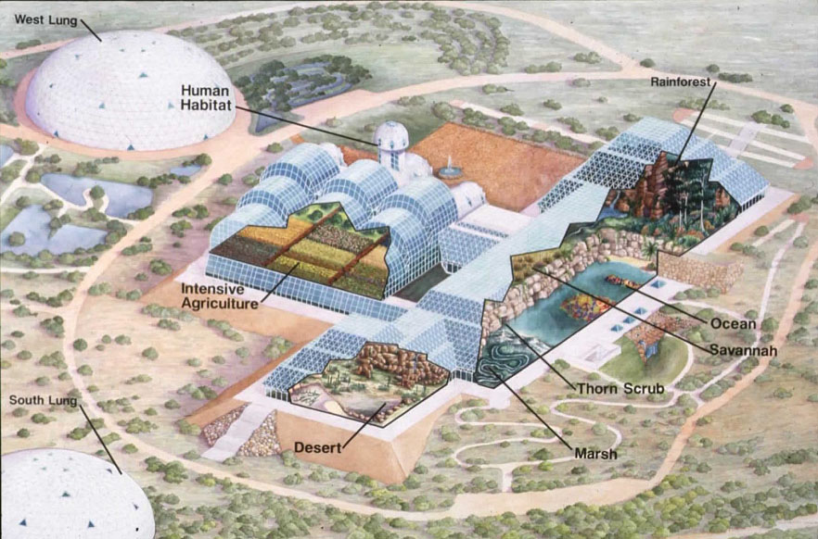
3D cutaway overview

Slide 15
“Technosphere” a.k.a infrastructure in basement
HVAC (Heating, Ventilating, Air Conditioning)
  26 AHUs (Air Handling Units) – 14 large, 12 smaller cooling-only
  Heating, cooling, condensing water for drinking and “rain”
  Peak air recirculation rate of 1 million cu.ft./min.
120 pumps, plumbing, wiring
Tanks for water storage
Crop storage
Machine shop
Algae-based nutrient removal system for ocean

Slide 16
The secret co₂ scrubber also in the basement
CO₂ scrubber secretly added very late in project
Submarine technology to remove CO₂
    Maybe the same regenerable metal oxide as in space shuttle?
    Intended for “emergency” use
Controversial
  Lead programmer quit on closure day
  PR disaster later when public found out
Many thought it violated spirit of the project
  Not sustainable
  In theory, was regenerable to recover the carbon, but who would want to do that?
I noticed it when sneaking in the day before closure

Slide 17
monitoring systems
2500 sensors and automated analyzers, plus manual lab
  Temperature, pressure, humidity, wind velocity, flow, water levels, fan status, pump status, power, PAR, etc.
  Chemical compounds: CO, CO₂, O₂, O₃, NO_{x}, N₂O, NH₃, H₂S, SO₂, CH4, total hydrocarbons, for air, potable water, other water, soil
15 internal and external networked computers
“Global Monitoring System”
  Computerized monitoring, analyzing, and storing data
  Automated and manual chemical analyzers for air & water
  Health of the computers and networks
  Comprehensive diagnostics postponed, never implemented

Slide 18
“Test module” built before full-sized biosphere 2
480 cubic meters (1/400) scale, about 20ft. X 20ft
At the time, the largest closed ecology ever built
Tested major systems
  Feasibility of closed system, ecology of recycling, treating waste in a marsh (water hyacinth, microbes)
  Soil bed reactors to remove trace impurities like methane
  Technical systems (HVAC, computer systems)
  Structure, sealants, stainless steel liner, lung
  Agriculture: sugar cane, sweet potatoes, rice paddies, tilapia
Closures with plants only up to 5 weeks
Three closures with one person, up to 3 weeks
Dynamic simulations (O₂, CO₂), parameter estimation

Slide 19
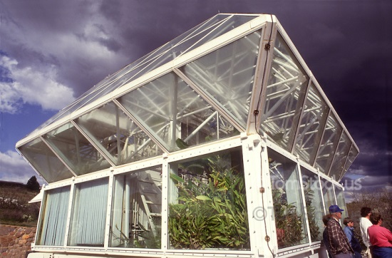
Test module
(Not visible to right: lung)

Slide 20
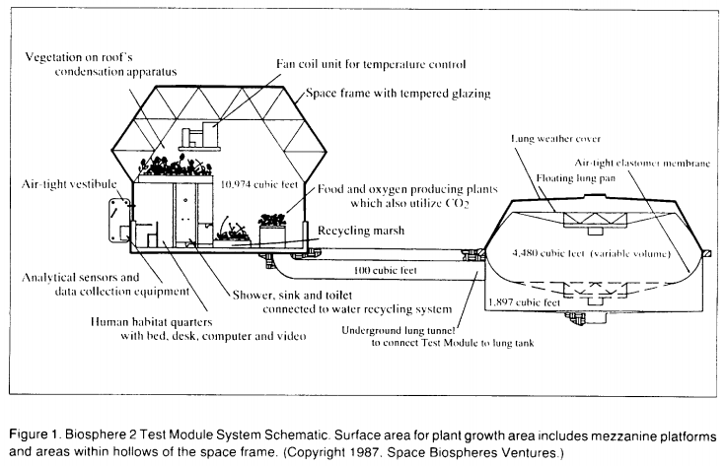
Test module

Slide 21
Some test module results
Tested and modified technology
  Leak rate of 24%/year
  Estimating parameters in dynamic simulation models
First facility to use biological means to simultaneously purify air (vs. catalytic burners), completely recycle water & human waste, remove toxic trace compounds
Some food grown
  Soil-based rather than hydroponic,
  Not enough area for sustaining long-term human habitation

Slide 22
Biosphere 2 project milestones through mission 1
Space Biospheres Ventures (SBV) started July 1984
  Owned by Decisions Investment (Ed Bass), initial $30M
Conference on vision and feasibility: Dec., 1984
  Signed up outside scientific advisory committee
Basic design & engineering done: 1986
Test module construction done: 1986
Test module closed experiments: 1986-1989
Construction start: Jan, 1987
Support buildings completed: Mar.,1989
Plants, animals, agriculture in place before closure
9 one-week test closures before Mission 1
Mission 1: closure (8 people): Sep. 1991 – Sep. 1993

Slide 23
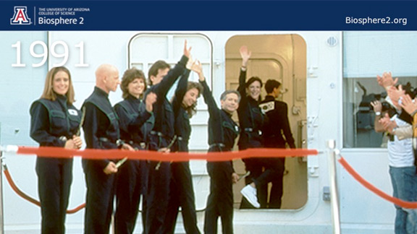
Mission 1 closure
Huge media event with an Indian chief, Buddhist monks, ceremonies, speeches
Mission 1 had major controversies, problems, but was completed and arguably a lot was learned.
Mission 2, on the other hand…

Slide 24
Biosphere 2 mission 2 ended in chaos
Mission 2 started March, 1994, intended 10 months
April 1994: dispute led to ousting of management
  Federal marshals and police arrived with restraining order, took over the site, stopped communications
  Ed Bass hired Steve Bannon (!) to run SBV
  Two members of first crew broke in, unsealed the airlock, broke some windows
  Team captain quit to join wife (the suspended SBV CEO)
Many in the Scientific Advisory Committee quit
June, 1994 SBV dissolved
September, 1994: Mission 2 ended prematurely
Scientific credibility at an all-time low at that point

Slide 25
After the mission 2 chaos
Columbia University ran it 1995 - 2003
  Biosphere 2 modified from closed system to open air flow
  No longer applicable for space habitats- focus on earth: e.g., CO₂ effects on plants & ocean acidification
Offered for sale in 2005 by Decisions Investments Corp (Ed Bass)
Sold briefly to a real estate development company in 2007, leading to fears of subsequent demolition
University of Arizona took over running it in 2007
University of Arizona assumed ownership in 2011
Various earth science & farming experiments ongoing
  None sealed, but large, nearly-isolated facility is unique

Slide 26
The money
Privately funded (Ed Bass – Texas billionaire)
SBV (Space Biospheres Ventures) set up as a for-profit corporation, initial $30M
  Expected to sell technology
  Tourism & education – ecology theme park
Up through first 2-year experiment, estimates of $150M - $200M
Rumored yearly cost to run: $25M, of which $16M are energy costs
  This is, after all, a greenhouse in the Arizona desert!
Unnamed source on Wikipedia put total cost at $200M by 2007

Slide 27
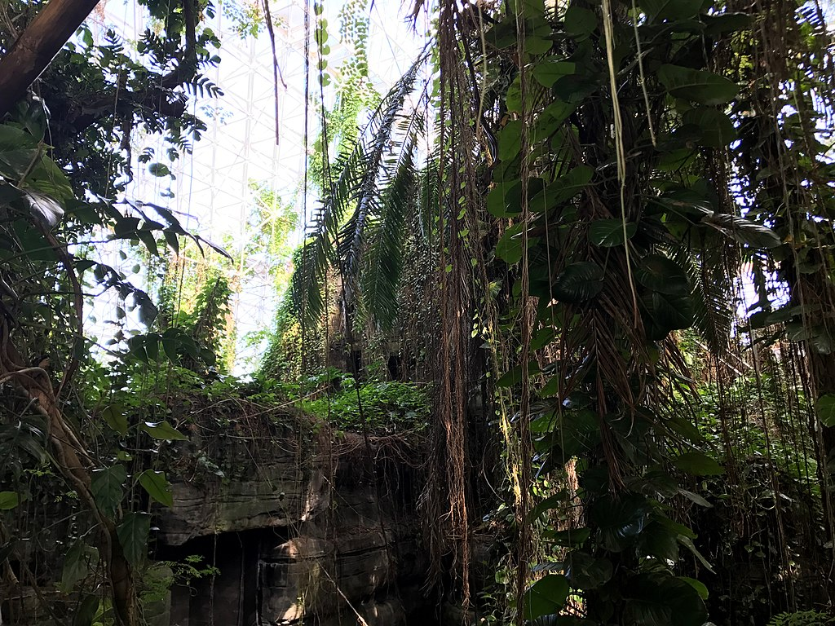
rainforest

Slide 28
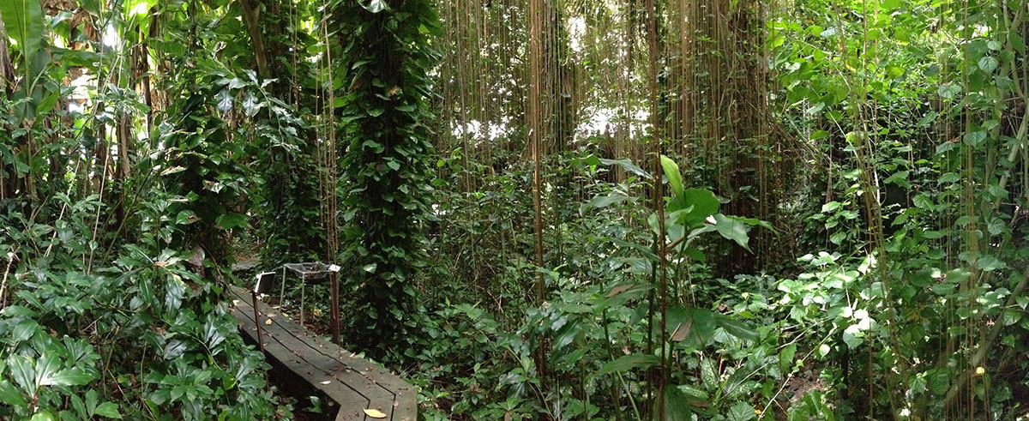
Rainforest lowlands

Slide 29
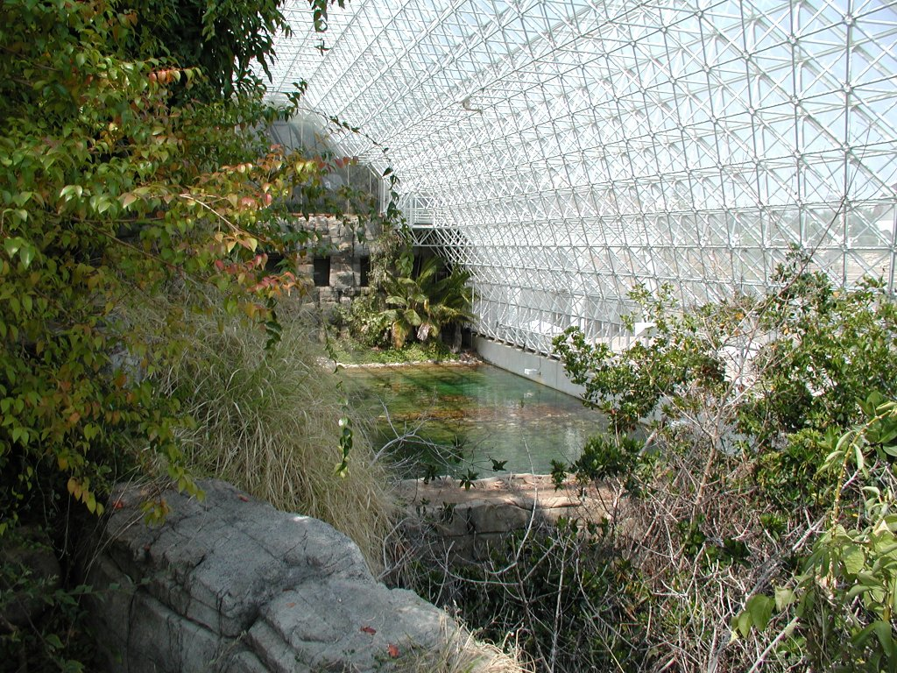
savannah towards rainforest, overlooking marsh, ocean

Slide 30
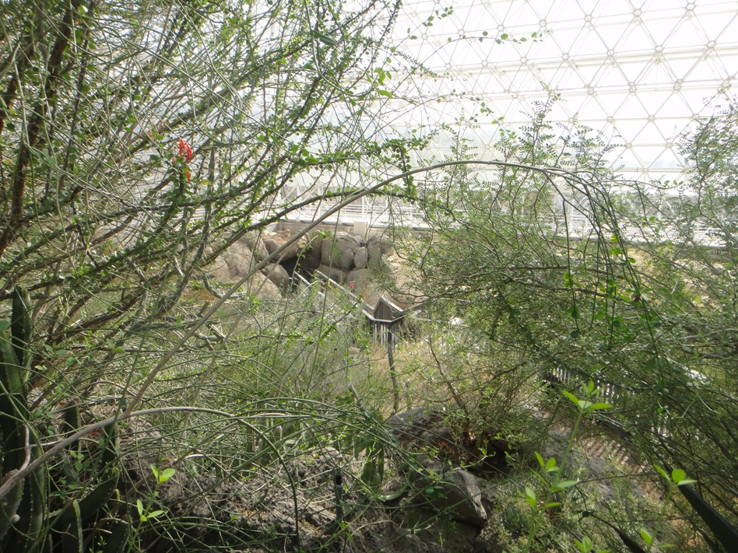
Savannah thorn scrub overlooking desert

Slide 31
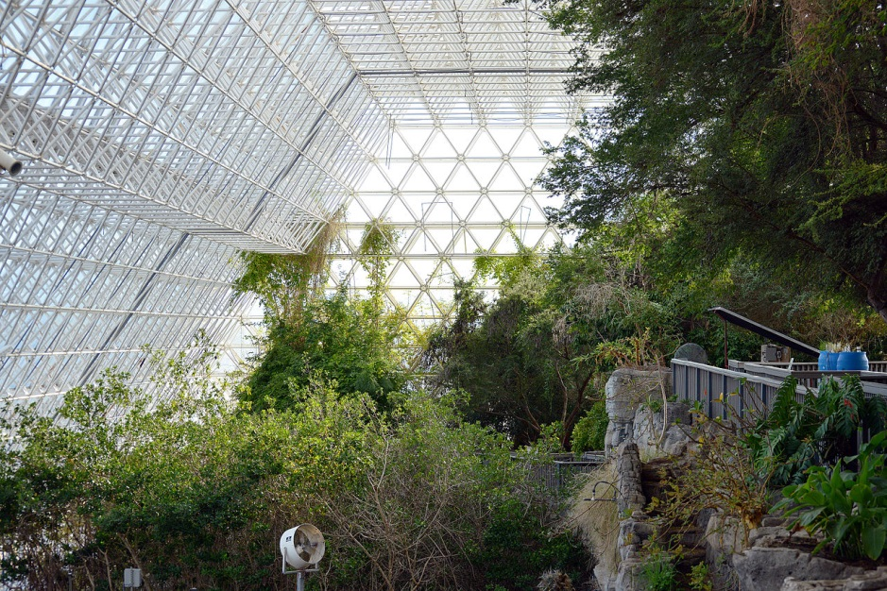
Marsh/savannah just above ocean edge

Slide 32
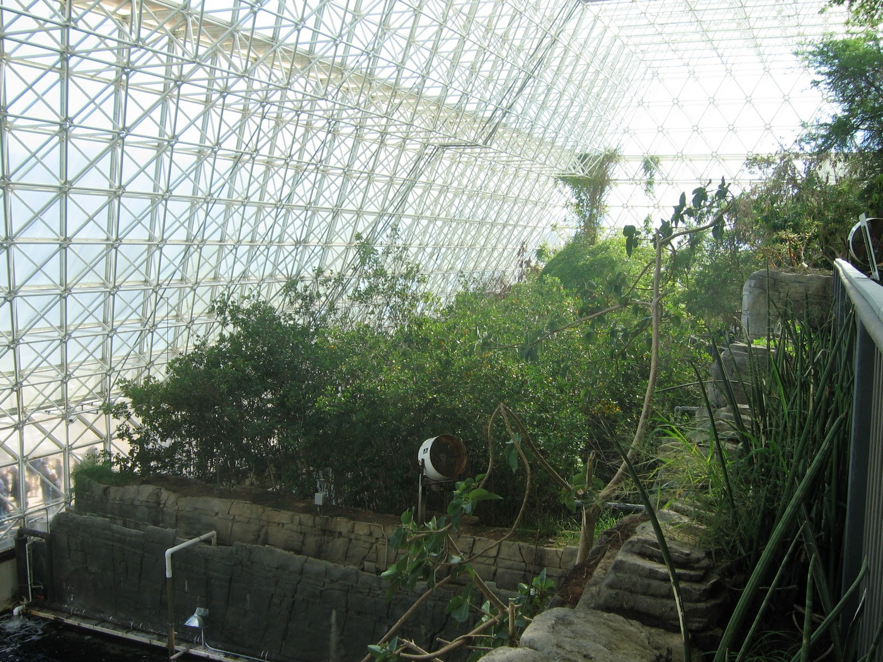
Mangrove Marsh, with terracing somewhat visible

Slide 33
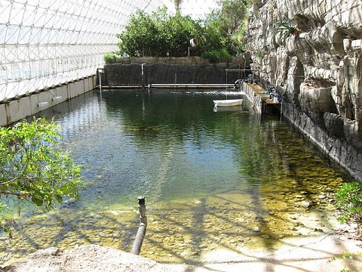
Ocean beach, view towards marsh and wave maker

Slide 34
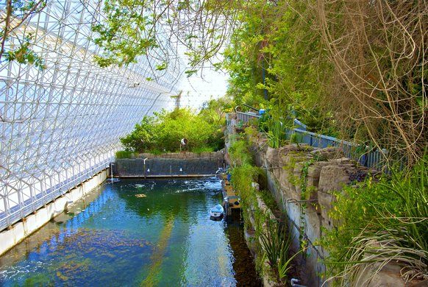
Ocean, view towards marsh and wave maker, savannah at right

Slide 35
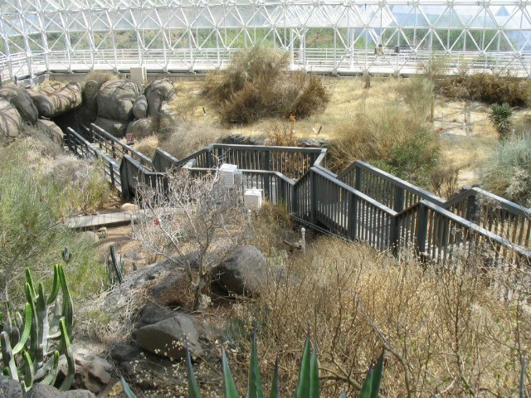
Fog desert

Slide 36
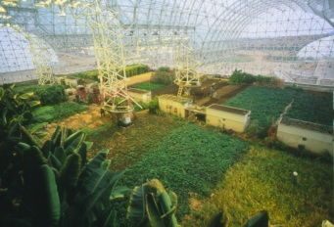
Intensive agricultural biome (IAB)

Slide 37
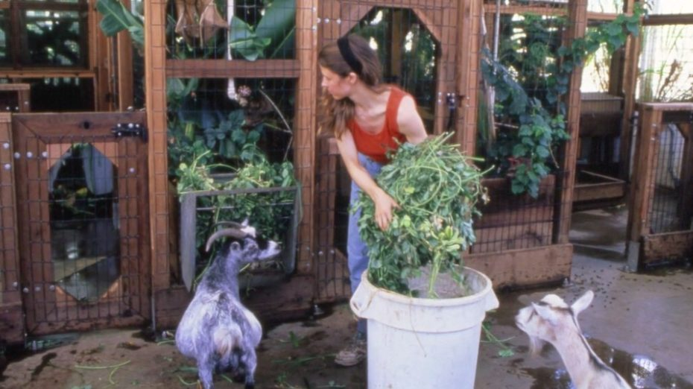
Pygmy goats in iab

Slide 38
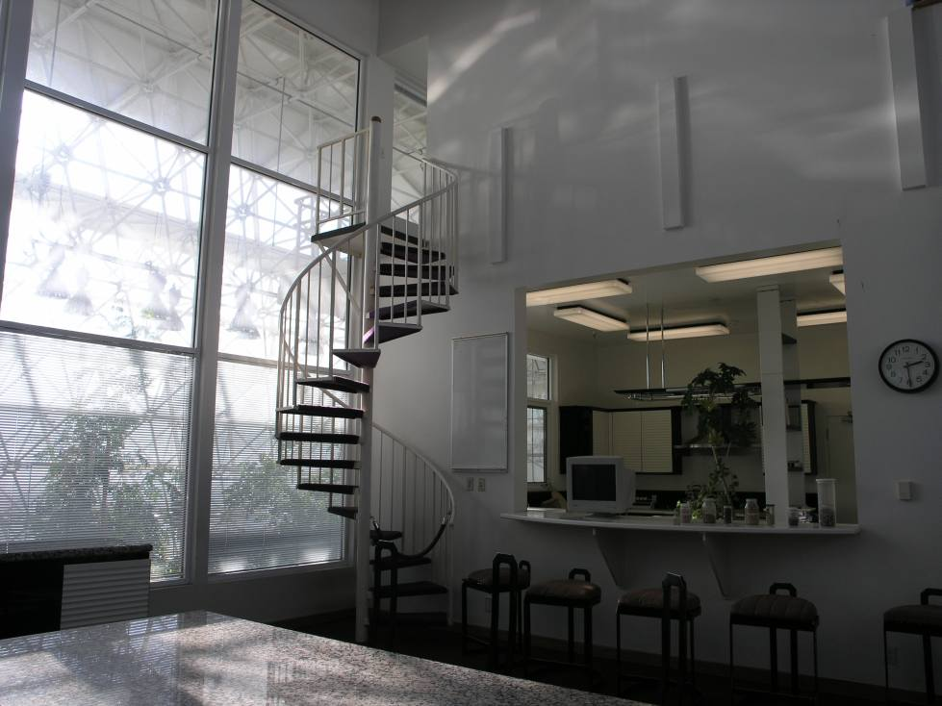
Human habitat (meeting room)

Slide 39
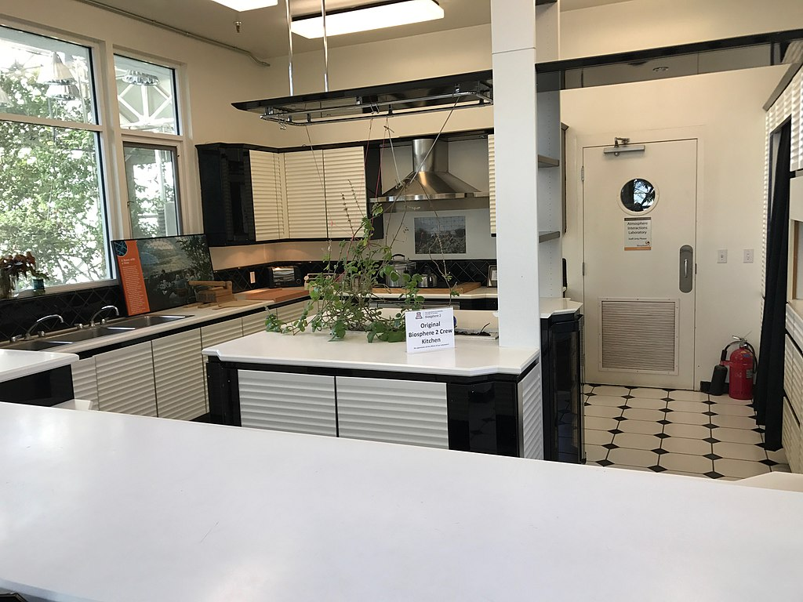
kitchen

Slide 40
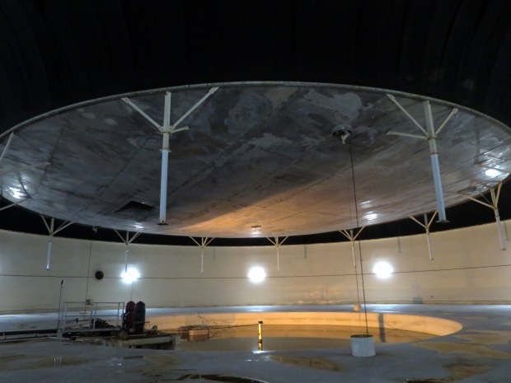
South Lung, inside view

Slide 41
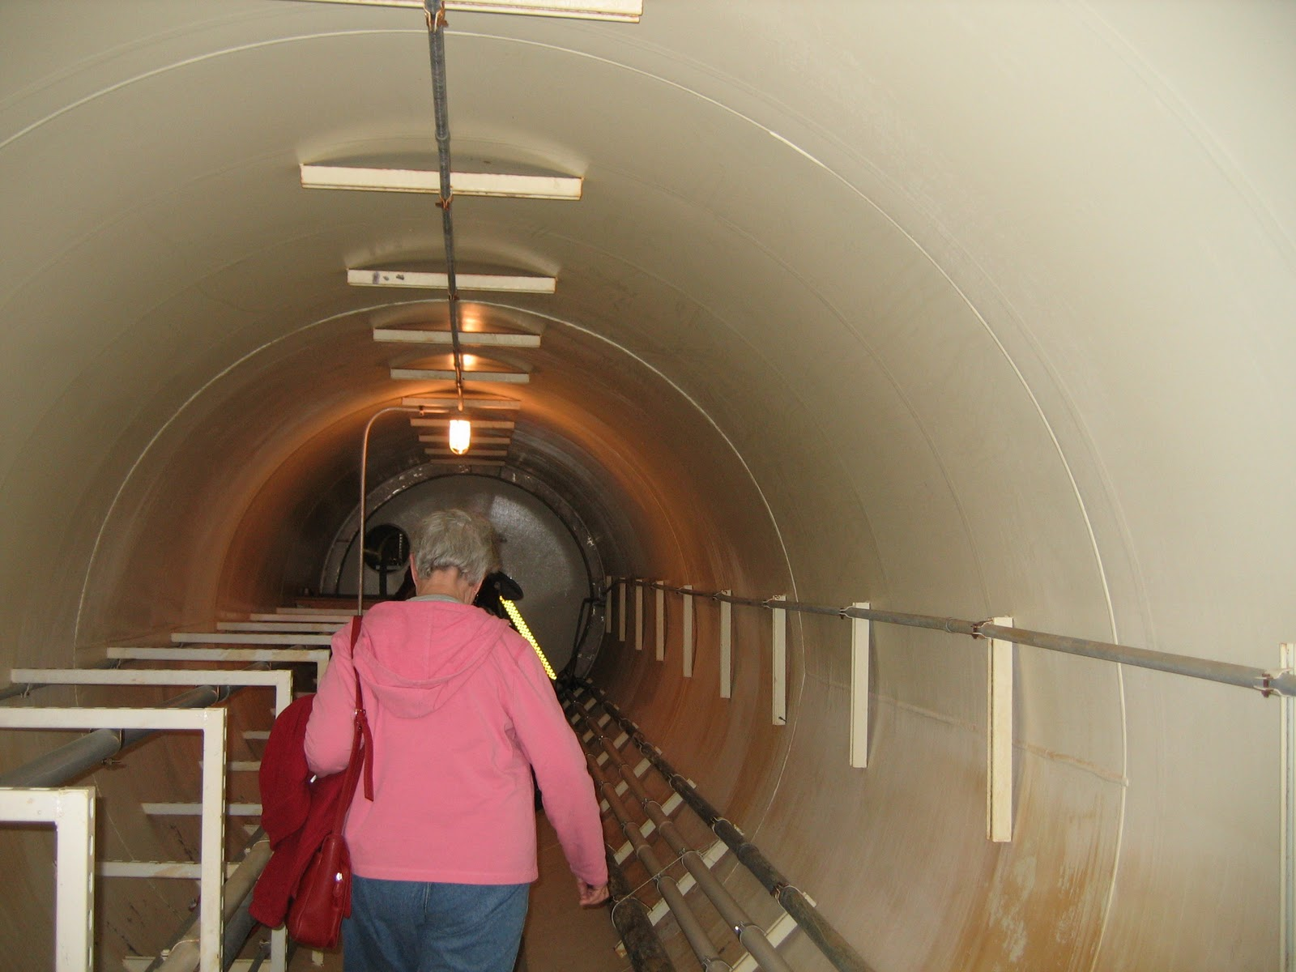
Tunnel between lung and main buildings

Slide 42
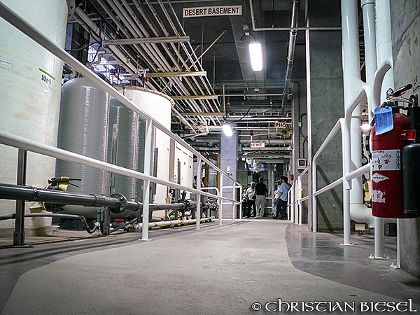
Technosphere (basement)

Slide 43
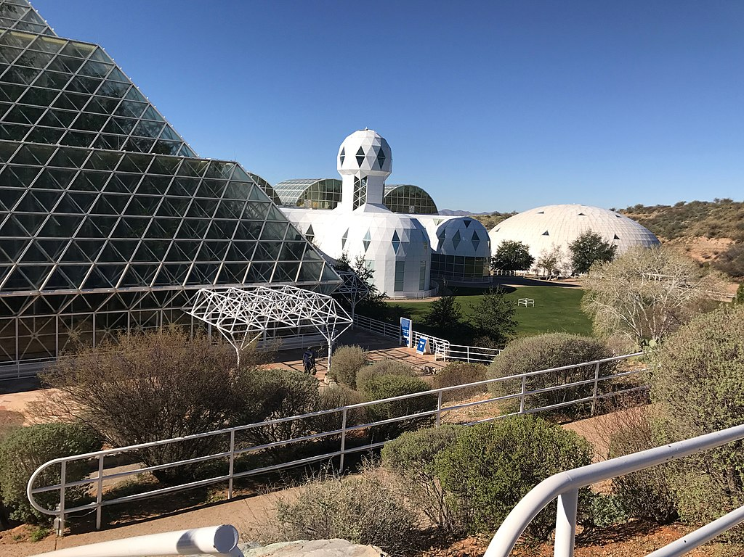
Outside rainforest, human habitat, lung

Slide 44
How do you Design a biosphere?
What were the goals?
What were the constraints?

Slide 45
Goals of biosphere 2
Demonstrate feasibility of long-term life in a sealed environment (plants, animals, 8 people)
  Self sufficiency in food production
  Complete material isolation: sustain air, soil, water, etc.
  Design as a miniature version of Earth (Biosphere I)
Develop technology usable in space or on Earth
  Recycling technologies such as soil-bed reactors, algal scrubbers, sewage treatment, …
  Self sufficiency in food production – highly productive agriculture
  Building techniques to minimize losses
Study human factors of small isolated workgroups
Tourism and education: an ecopark

Slide 46
Biosphere 2 as a research lab
Often likened to a “tool”, like a microscope
Also really an engineering prototype
“Just do it”
  Draw on available science and technology
  Set a timetable, do the best possible within that time
  Throw in as much of Earth as possible as insurance that something wouldn’t be missed, and hope it works
    and don’t forget the microbes
    (a leap of faith inspired by the “Gaia hypothesis”)
It’s still there, as a giant laboratory (although not doing closed system studies)

Slide 47
Vision: settle mars
Initial vision was for Mars colonization…
  Core group all wanted to go on a 1-way trip to Mars
… But also to better understanding earth ecology
  Lab for effects of global warming, higher CO₂ levels, faster recycling of materials
  Shifted over time more towards this -- maybe partly for PR and future funding, like NASA did?

Slide 48
DESIGN CONSTRAINTS - examples
Closed loop material cycles - EVERYTHING is recycled
  Food self sufficiency
  Breathable atmosphere
  Water: drinking, waste water, irrigation, “rain”, streams
  No toxic chemicals, including pesticides or herbicides
  Tightly sealed to minimize exchanges with Earth
  Positive pressure (slightly higher than outside atmospheric pressure)
    ensure any leaks are out of Biosphere 2, not into it
    avoid large pressure difference blowing out windows
Long-lasting
  2 years for first closure experiment
  Goal of operating multiple experiments over 100 years

Slide 49
Gaia hypothesis
A Biosphere might be self-regulating (controversial)
Doesn’t require any mystical belief – could be an emergent property of interactions among species
Some examples:
  Energy provided by the sun has increased 25%-30% since life started on earth, but temperatures have remained habitable
  Balances achieved in carbon and oxygen
  Predator/prey cycles
  An extremely simple example of how this could happen: Daisyworld simulation

Slide 50
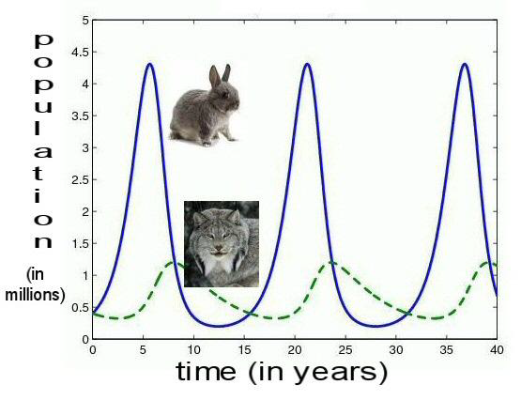
Predator/prey cycles
Hare and Lynx example
Biosphere 2 eliminated this for large animals
  Humans as “keystone predator”
  Too much risk of extinctions with small populations

Slide 51
Daisyworld
A simple mathematical model of a “toy world”
  Sun whose output is rising over time
  Only 2 species: black daisies and white daisies
Temperature regulation based on balance between black daisies and white daisies
  Black daisies
    absorb more light, warm the planet
    do better at low temperatures because they get warmer
    die off at higher temperature because they get too warm
  White daisies
    reflect more sun, cooling the planet
    do better at higher temperature because they stay cooler due to reflecting the sun

Slide 52
System stability for biospheres
Many definitions of stability for systems
  Bounded input, bounded output: allows cycles as long as they stay within bounds for given external disturbances
Complex web of species interactions dominates
  System behavior is determined by interactions, not just one species by itself
  Analogous example: understanding individual neurons provides almost no understanding of what the brain does
Different system behavior with each added species
  Case with no predators has very different cycles
    Too many hares, at risk of collapse in years of bad weather
    Diseases may limit populations
System stability improves with more species

Slide 53
Species packing
Too hard to accurately model and simulate complex systems like a biosphere.
  Accept that you’ll never know everything. Then what?
Biosphere 2 followed belief that having more species promotes system stability
  Possibly a general principle
Led Biosphere 2 to “species packing”
  If you don’t know exactly what you need, fill a big suitcase!
  Add many species, not knowing which ones will survive
  Expect the system to self-organize, with some extinctions
  Use some actual seawater, soil, etc. to ensure microbes
  Started with 3800 species

Slide 54
Examples of Some of the species placed in the wilderness biomes
Hummingbirds, bees, bats, moths, butterflies
Snakes, reptiles, turtles, 40 geckos, 50 toads
Ants, termites, cockroaches
Predators for mites, mealy bug, cockroaches, pillbugs
Oysters, crabs, coral
Agave, jojoba, rubber trees, mosses, ferns, trees producing gum and soaps.

Slide 55
Agriculture
(intensive agriculture biome)
18 plots, producing 3 crops per year
86 crops (including herbs)
  Beans, potatoes, peanuts for protein
  Oats, barley, rice, wheat, millet, sorghum, maize, soybeans
  Sweet potatoes, beets, taro, rape, mustard, safflower, tomatoes, cabbage, carrots, eggplant, peppers, leafy vegetables
  Bananas (in rainforest), papayas, pineapple, guava, apples, grapes, strawberries, oranges, sugar cane
Milk from African pygmy goats, eggs from 35 hens, limited meat, fish (tilapia grown in rice paddies)
3 pigs

Slide 56
Agriculture approach
Soil-based, not hydroponic
  Sustainable: no separate chemicals produced elsewhere
  Able to process human and animal waste, inedible parts of food
  Energy efficient, proven on earth
  Soil and marsh microbes capture toxic trace compounds
Integrated Pest Management
  Selection of pest-resistant crops
  Small plots with frequent replanting of different crops
  Variations in varieties of major crops
  Maintaining beneficial insects
  Manual control

Slide 57
Human habitat
Private apartment for each biospherian with upstairs and downstairs, shower & toilet (but no toilet paper)
Kitchen, meeting area, recreation facilities, exercise room, communications center
Lab space, medical clinic

Slide 58
So, what happened in mission 1?

Slide 59
Breaking the seal: The missing fingertip and the duffel bag
12 days into mission, Jane Poynter had a threshing machine accident, cutting off the tip of her finger
Evacuated for medical attention
Returned hours later with a duffel bag
  She claimed it only had spare parts and plans
PR disaster, media claiming experiment was compromised, bringing in food, letting in air
(The lead programmer had a $1000 bet with a biospherian that Biosphere 2 would be opened within 100 days)

Slide 60
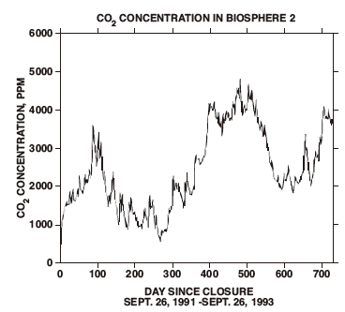
Co₂ was a huge concern before closure, and a major focus
CO₂ levels on earth 350 ppm then, 400 ppm now
CO₂ levels in Biosphere 2
  1000 ppm in summer
      14.5 daylight hours
  5000 ppm maximum in winter
      9.5 daylight hours
  600 ppm daily fluctuation
      Due to high ratio of biomass
      carbon to atmospheric carbon
      (2 orders of magnitude vs. earth)
CO₂ levels on Space shuttle: 5,000 ppm
CO₂ levels unhealthy at 10,000 ppm

Slide 61
Co₂ MANAGEMENT
Lowering temperatures at night (reducing plant respiration)
Suspending composting during low-light season
Activating and deactivating desert and savannah by controlling irrigation
Cutting, drying, storing biomass to sequester carbon
Planting fast-growing plants to increase photosynthesis
Some use of CO₂ scrubber in winter (100 ppm effect)
Could be considered successful, but a lot of work
Made harder by unusually-overcast winters, and starting with too much carbon (compounds) in the soil (more coming… )

Slide 62
The unexpected O₂ decline
Rapid, steady decline in O₂, without correlated CO₂ increase
  20.9% down to 14.5% after 16 months
  Equivalent to being at 13,400 ft.
  Unknown reason at the time, not seen in test module
  Led to fatigue, sleep apnea
2 unusually dark, overcast el-Nino winters weren’t the cause, but didn’t help
31,000 lbs liquid O₂ added, returning atmosphere to 19%: Jan, 1993
Another PR disaster!

Slide 63
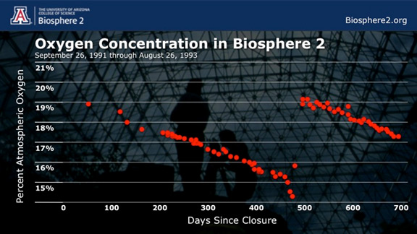
The O₂ decline: graph

Slide 64
the O₂ decline cause
Due to rich soil, fresh concrete
  Unusually rich soil (high in organics) placed in Biosphere 2
  Led to high O₂ consumption by soil microbes consuming it
  Resulting CO₂ wasn’t all absorbed by plants
  Resulting CO₂ absorbed as calcium carbonate on fresh concrete
For second mission, they coated concrete to avoid the first mission O₂ problem (and didn’t need O₂ injection)
  Soil didn’t stabilize until around 1998, long after missions

Slide 65
O₂ problem as a reminder of biology/geology interactions
On earth, calcium carbonate (limestone) was created by life (coral and marine shell), and the largest repository of carbon on earth (by far) is in rock
    Rock: 60,000,000 gigatons
    Kerogens (e.g., oil, also from life): 15,000,000
    Ocean: 38,400
    Biomass (living and dead): 2,000
    Atmosphere: 720
So, as on earth, carbon went into rock, unfortunately taking O₂ with it.

Slide 66
Agriculture results
Highly productive (claimed most efficient ever), but still not quite enough
81% of food was grown inside for Mission 1
  Remaining 19% from seed stock and food grown inside system prior to closure
  Low-calorie starvation diet
  Relied only on natural light (reduced by 50% by glass/space frame)
  Mission 2 achieved 100%, partly by adding artificial light (high-pressure sodium lamps)
Pigs and chickens took too much food, so were slaughtered and eaten

Slide 67
Diet
Low calorie nutrient dense diet advocated by Dr. Roy Walford (UCLA) in previous work on diet and aging
  He wrote the book and got to live the dream as a biospherian
Carefully tracked entire diet by computer
Lost 16% of their body weight in first year, stabilized and recovered some in second year
Overall health good, improved cholesterol, blood pressure
System supplied all vitamins except D

Slide 68
Species packing: survival results
Started with 3800 species.
  As expected, not all survived.
  Example: in the rainforest, 61% of 282 species of plants survived the 2 year experiment
  Plants were individually tagged and tracked
Proved self-organization and adaptation happens
  Explosion of ants, cockroaches, katydids
  Rainforest overgrown with morning glories, other invasives, requiring manual intervention
  Rainforest grew rapidly, doubling size
  Pollinating insects died, several bird species
  Desert Biome shifted considerably towards species adapted to humid conditions

Slide 69
Other sustainability results
Proved feasibility of a sustainable biosphere(more or less)
  Notable problems like O₂ were explained and preventable
  People came out alive and healthy after 2 years
    It wasn’t a given that this was possible before this
System removed harmful compounds without toxic buildup
  CO₂, NO_{x}, H2S, ethylene, CO, methane, Ozone
  Exception: N₂O, which is normally decomposed by radiation in the stratosphere
They were able to track and model elements in closed loop cycles
  Accelerated cycles vs. earth
Small closed systems are vulnerable

Slide 70
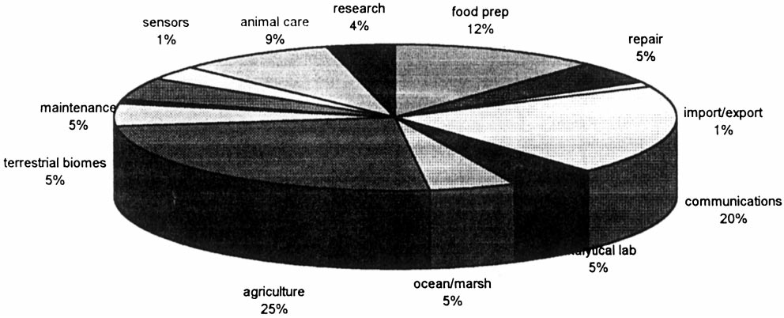
How did they spend their time inside biosphere 2?

Slide 71
Group dynamics
External relationships suffered
Halfway through first mission, group had split into 2 factions, barely on speaking terms
Power struggles outside on how to proceed were reflected inside
  Importance of maintaining closure vs other research
  Decisions on importing air or food
  “Holistic” view vs. “reductionist” view of science.
Made worse by effects of O₂ deprivation
  Equivalent to elevation of 13,400 ft.
  Fatigue, sleep apnea
Still worked together as a team to achieve their goals
2 team members got married right after exiting

Slide 72
were they a cult?
Well, maybe yes, to some extent…
  More so than, say, “Aggies”.
    Close-knit group for many years
    Based on shared ideology and vision of going to Mars
    Important roles closed to outsiders
    Closed meetings, lots of rumors about what went on
  John Allen, the leader, ran a commune in New Mexico (Synergia), and a theatre group (“Theatre of All Possibilities”)
    Accusations of psychological humiliation, corporal punishment
Accusations were somewhat overblown
  “doomsday cult”, “western civilization is over”, “just a failed theatre group”, etc.
Accusations definitely hurt their scientific credibility

Slide 73
MAYBE Yes, KIND OF, but…
Accusations of lack of scientific training were overblown
  There was expertise in their group, at least some with appropriate degrees
  They tapped and managed outside scientists, expertise as well.
While there was some weirdness, this was a serious project
That’s probably what it took to get this unusual project going

Slide 74
end
SYSTEMS Biology for sustainable life outside earth

Slide 75
Additional material
SYSTEMS Biology for sustainable life outside earth

Slide 76
CONTROL SYSTEMS
Control temperatures, humidities, wind velocities
Control via Air Handling Units (AHU’s)
  Flows of cooling tower water and chilled water
  Steam heating flow (heating, and reheat for humidity control)
  Throttling of inlet air flow to blowers
Challenges
  Wanted tight control – scientific experiment, not a house
  Significant variations in targets across biomes, heights
  Sun/shade variations inside
  Weather variations outside (sun/shade , day/night)
    All-glass, without shade, louvers, or tinting, for photosynthesis
    Cloud passing overhead caused noticeable changes
    Hot summer sun, winter snow
  Interactions between AHUs & biomes due to shared cooling water
  Interactions between biomes due to open air boundaries
  Need for condensation for potable water and utility water
  Sensor & valve reliability
  Graceful degradation with failures. Only some spare parts.

Slide 77
Control systems (continued)
Optimization goals: economics and constraints
  Humidity maximums, air velocity min & max
  Cooling tower water cheaper but less effective than chilled water
  Number of AHUs used and airflow at each
  Supervisory control for optimization, startup sequencing
Initial proposals used industrial-style controls
  Temperature to energy flow cascade controls (feedback)
  Feedforward for solar input energy and history, between biomes
Subcontractor never got sensors, valves, low-level controls to work very well
  Local builder with little understanding of control systems
  Abandoned tight control, optimization
  Ended up with a set of templates for targets for simple controllers for different conditions

Slide 78
early prototype top-level global monitoring system display

Slide 79
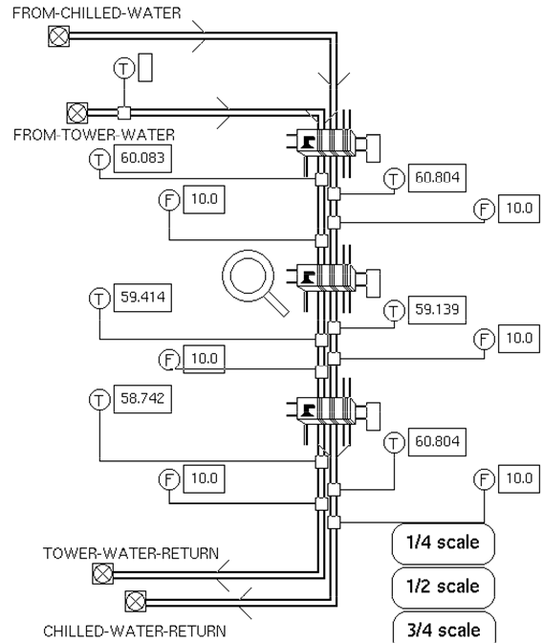
Example cooling subsystem

Slide 81
simulation for test module experiments
Biological system dynamic simulation
  Focus on O₂, CO₂, etc.
  Biological objects following Odum’s ecology textbooks
    “Primary producers” (plants)
    “Decomposers”, others
    Differential equations associated with each type of object
  Flows of material and energy as connections between the objects
  Parameter estimation to match test data to simulation
  Work mostly by University of Arizona

Slide 83
Examples of variables tracked during simulation

