Slide 1
Agenda
6:00 - Gathering/Opening Activity
6:15 - Yuri's Gagarin – First Man in Space
6:30 – Discussion/ Pizza
6:45 - Presentation on HOTOL/Skylon/ Sabre engine (Doug)
7:00 - Discussion
7:15 – International Space Development Conference (ISDC)
7:30 - Discussion
7:45 - Space Exploration Jeopardy – with prizes

Slide 2
Yuri Gagarin
Events before the first man in space
About the first man in space and his flight
Events after the first man in space

Slide 3
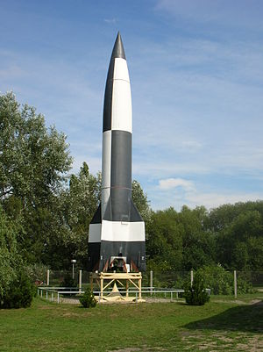
V-2 Rocket -
The V-2 was the world's first long-range guided ballistic missile.
The missile, powered by a liquid-propellant rocket engine, was developed during the Second World War in Germany as a "vengeance weapon", assigned to attack Allied cities as retaliation for the Allied bombings against German cities.
The V-2 rocket also became the first man-made object to travel into space by crossing the Kármán line with the vertical launch of MW 18014 on 20 June 1944.

Slide 4
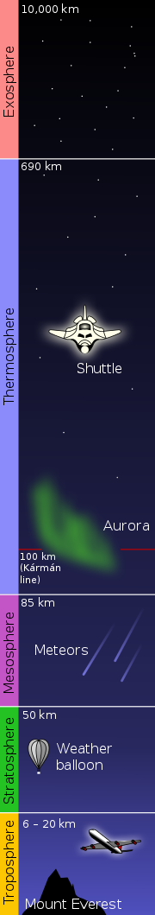
The Kármán line, or Karman line, lies at an altitude of 100 km (62 mi; 330,000 ft) above Earth's sea level and commonly represents the boundary between Earth's atmosphere and outer space.[2] This definition is accepted by the Fédération Aéronautique Internationale (FAI), which is an international standard-setting and record-keeping body for aeronautics and astronautics.
Karman line 100 km (62 mi; 330,000 ft) above Earth's sea level
Official division between atmosphere and Space

Slide 5
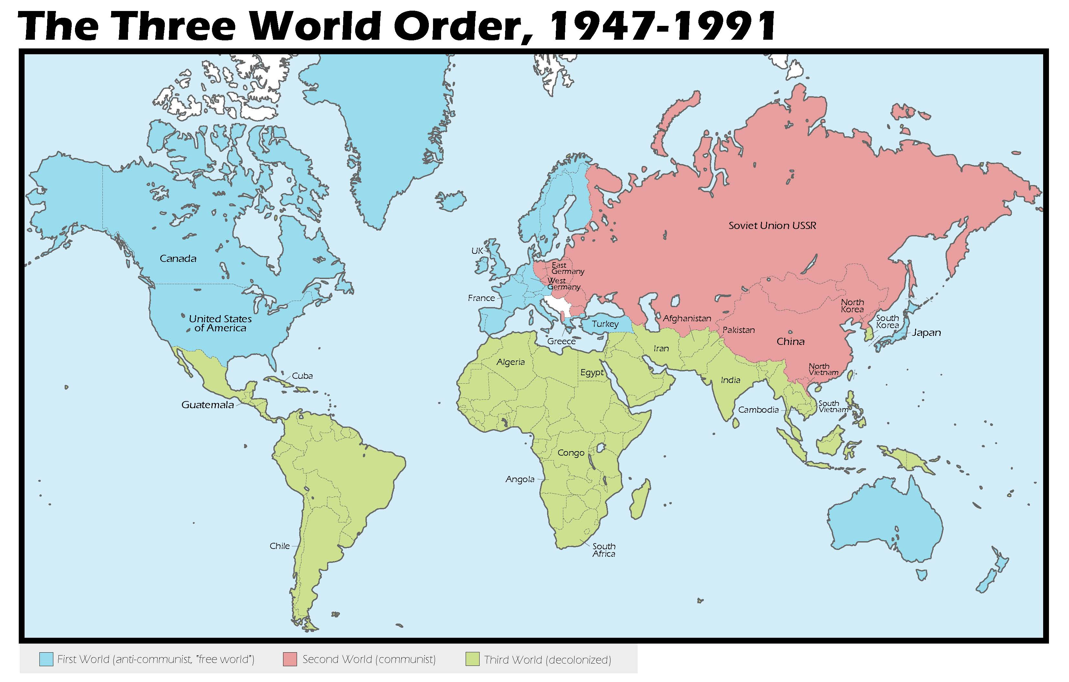

Slide 6


Slide 9
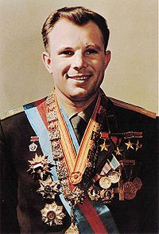
Biography: Yuri Gagarin, cosmonaut
Born: 9 March 1934
Birthplace: Klushino, Russia
Died: 27 March 1968 (airplane crash)
Best Known As: The first human in space
Presention created by: Vlad Florea

Slide 10
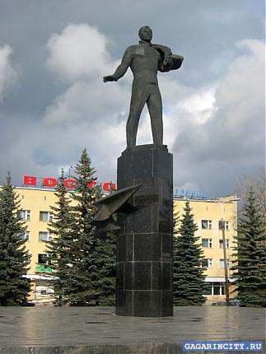
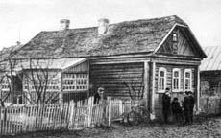
Early life
Yuri Gagarin was born in the village of Klushino near Gzhatsk (now in Smolensk Oblast, Russia), on 9 March 1934. The adjacent town of Gzhatsk was renamed Gagarin in 1968 in his honor. His parents, Alexei Ivanovich Gagarin and Anna Timofeyevna Gagarina, worked on a collective farm.

Slide 11

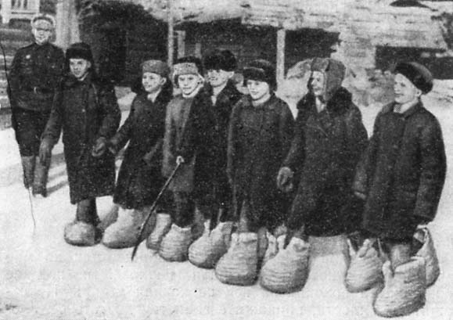
Early life
Like all people his age Gagarin had to undergo the ordeals of the war years. He was seven, when the Second World War broke out. The boy survived the Nazi invasion, the severe hardships of the war. The first planes he saw were war planes.

Slide 12
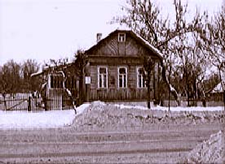
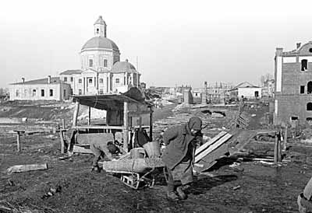
Early life
When the war ended the Gagarin family moved to Gzhatsk. Yuri attended an elementary school in this town.

Slide 13
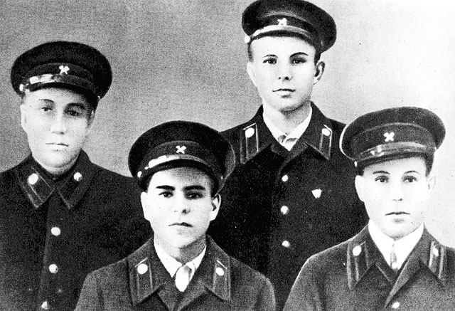
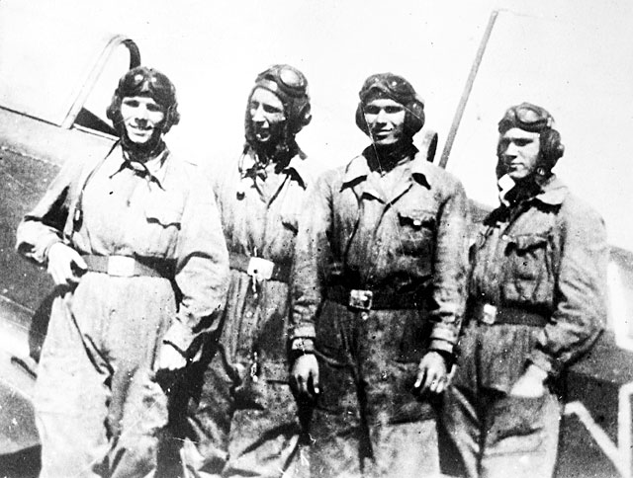
Early life
Gagarin briefly attended a trade school to learn foundry work in the Moscow satellite town of Lyubertsy, then entered a technical school. He joined the Saratov Flying Club in 1955 and learned to fly the Yak-18.

Slide 14
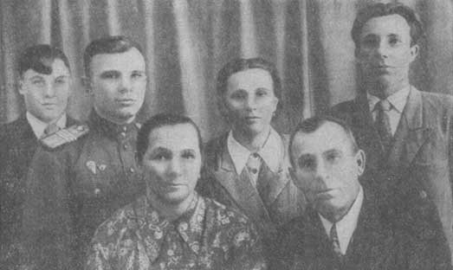
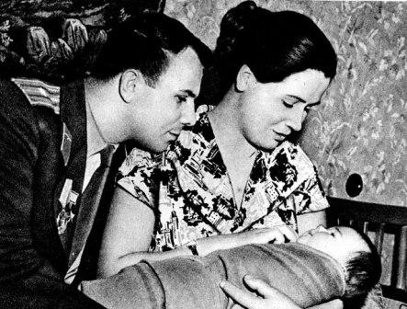
Early life
Later that year, he was drafted and sent to the Orenburg Flying School, where he trained in the MIG jet. Gagarin graduated November 7, 1957, four days after Sputnik 2 was launched. He married Valentina Goryacheva, a nursing student, the day he graduated.

Slide 15
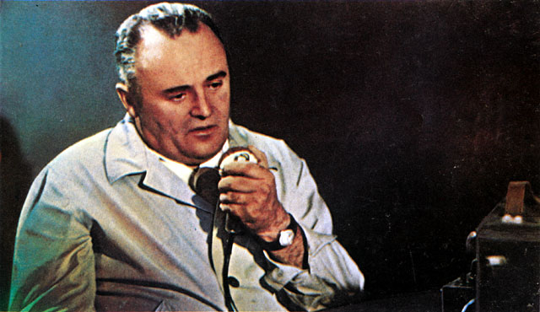
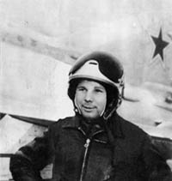
Career in the Soviet space program
Selection and training
Post-graduation, he was assigned to Luostari airbase in Murmansk Oblast, close to the Norwegian border, where terrible weather made flying risky. In 1958 space officials recruited air force pilots to train as cosmonauts.

Slide 16
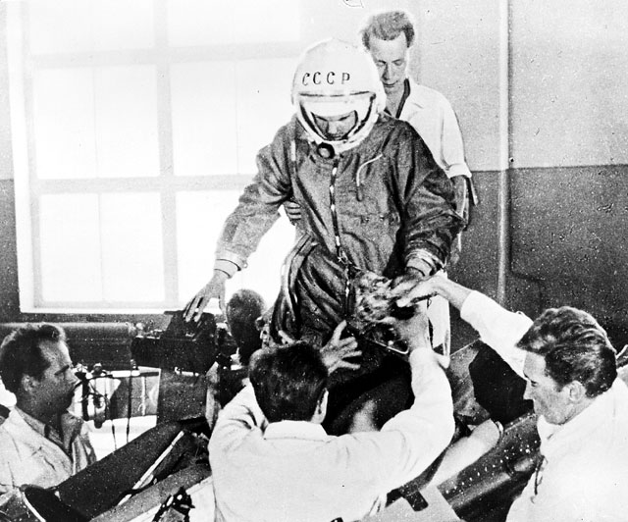
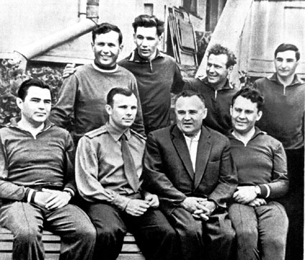
Career in the Soviet space program
Selection and training
Gagarin applied and was selected to train in the first group of sixty men. Only twelve men were taken for further training at Zvezdograd (Star City), a training field outside Moscow.

Slide 17
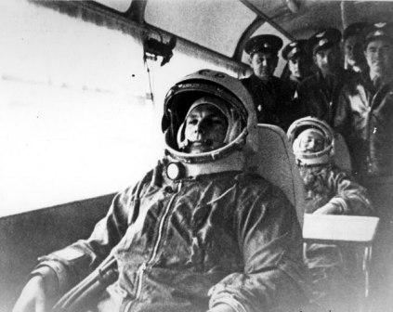
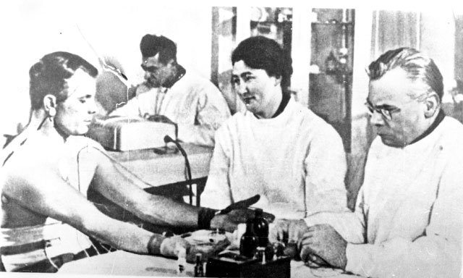
Career in the Soviet space program
Selection and training
Space officials closely observed the trainees. They finally selected Gagarin for the first spaceflight. Capable, strong, and even-tempered, Gagarin represented the ideal Soviet man, a peasant farmer who became a highly trained cosmonaut in a few short years.

Slide 18
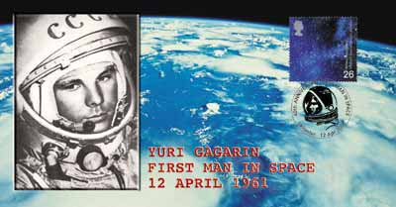
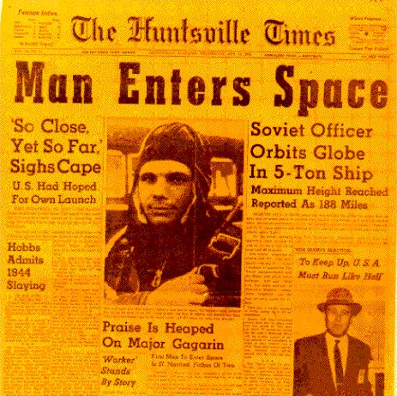
Career in the Soviet space program
Space flight
He was launched in Vostok 1 on the planned date, and during the crowded 1 hour 48 minutes of his single orbit of the earth he proved that man could survive in space and perform useful tasks. His mission ended at 10:55 A.M., when he landed safely in a field near Saratov

Slide 19
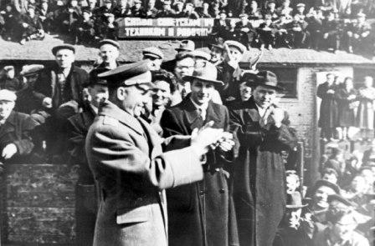
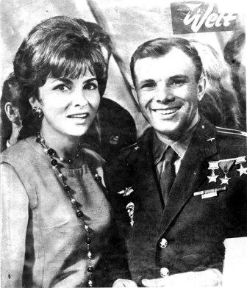
Career in the Soviet space program
Fame and later life
After the flight, Gagarin became a worldwide celebrity, touring widely with appearances in Italy, Great Britain, Germany, Canada, and Japan to promote the Soviet achievement.

Slide 20
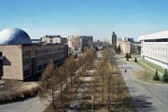
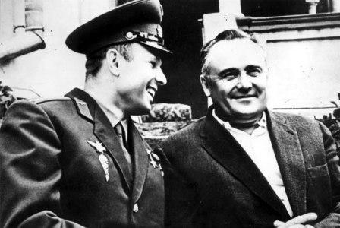
Career in the Soviet space program
Fame and later life
In 1962, he began serving as a deputy to the Supreme Soviet. He later returned to Star City, the cosmonaut facility, where he worked on designs for a reusable spacecraft. Gagarin worked on these designs in Star City for 7 years.

Slide 21
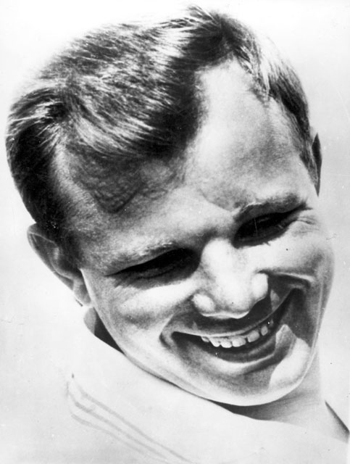
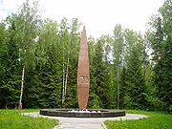
Death and legacy
On 27 March 1968, while on a routine training flight, he and flight instructor Vladimir Seryogin died in a MiG-15UTI crash near the town of Kirzhach. Gagarin and Seryogin were buried in the walls of the Kremlin on Red Square.

Slide 22
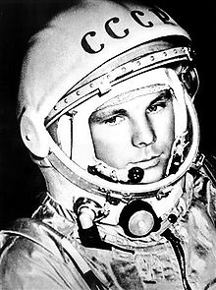
Death and legacy
American astronauts Neil Armstrong and Edwin Aldrin left one of Gagarin's medals on the moon as a tribute. The cosmonaut training center where he had first trained was named after him. A crater on the moon bears his name, as does Gagarin Square in Moscow with its soaring monument, along with a number of monuments and streets in cities throughout Russia. At Baikonur, a reproduction of his training room is traditionally visited by space crews before a launch. Russians celebrate Cosmonaut Day on April 12 every year in honor of Gagarin's historic flight.

Slide 26
Discussion/ Pizza

Slide 27
HOTOL/Skylon/ Sabre engine

Slide 28
Discussion

Slide 29
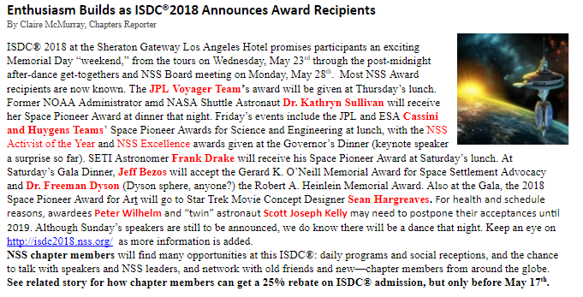

Slide 30
ISDC
http://ISDC2018.nss.org

