Slide 1
SKYLON and SABRE

Slide 2
Skylon / SABRE (Synergistic Air Breathing Rocket Engine) Single Stage to Orbit Vehicle
This is a concept under development by Reaction Engines Limited for a single stage to orbit vehicle using a hypersonic precooled hybrid air-breathing rocket engine to go to LEO.
The engine design is a single combined cycle rocket engine with two modes of operation. Air-breathing mode combines a turbo-compressor with a lightweight air precooler positioned just behind the inlet cone. At high speeds this precooler cools the hot, ram-compressed air leading to a very high pressure ratio within the engine. The compressed air is subsequently fed into the rocket combustion chamber where it is ignited along with stored liquid hydrogen. The high pressure ratio allows the engine to provide high thrust at very high speeds and altitudes. The low temperature of the air permits light alloy construction to be employed and allows for a very lightweight engine- essential for reaching orbit.
After shutting the inlet cone off at Mach 5.14 and 28 kilometer altitude, the system continues as a closed cycle high-performance rocket engine burning liquid oxygen and liquid hydrogen from onboard fuel tanks, allowing the Skylon spaceplane to reach orbital velocity after leaving the atmosphere in a steep climb.

Slide 3
For scale, note the small human figure under the center fuel tank. REL proposes two orbital versions: a cargo carrier, and a passenger carrier. The EC is designing an aircraft version, Lapcat, that will fly from London to Sydney in 4.5 hours (currently a 22 hour trip).

Slide 4
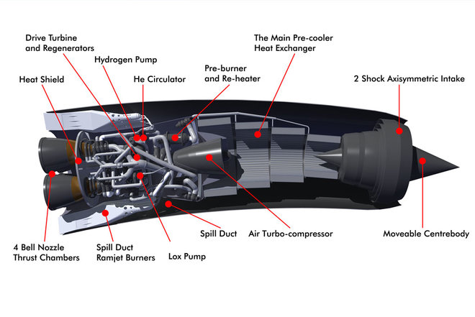
It’s so cool
The key to the engine is a proprietary heat exchanger capable of taking a core of ram heated inlet air at 1000C (1800F) and cooling it to -150C (-238F) in 1/100th of a second.
Most of the non-core air passes directly through a ring of bypass ramjets.
The cooled core air is fed to four high pressure combined cycle rocket engine combustion chambers.
Thrust (V) = 660,000 lbs Thrust (SL) = 440,000 lbs
Isp (V) = 460 sec (SSME engines) Isp(SL) = 3600 sec (x 7.8!)
Breakthrough was thinwall 3D printed tubes 1/32” ID
Why is the engine curved? The answer is: the air intake on the front of the nacelle needs to point directly into the incoming airflow whereas SKYLON's wings and body need to fly with an angle of incidence to create lift, so the intake points down by 7 degrees to account for this.

Slide 5
Technical history supporting the concept
Liquid Air Cycle Engine (LACE) built by General Dynamics in the 1960s as part of USAF aerospaceplane efforts. Limited potential.
Alan Bond at Rolls-Royce invented the “43rd option” in mid 80s called RB545 Swallow, promptly classified by UK gov’t as Top Secret. UK funded for 6 years as HOTOL, a Brit Space Shuttle.
UK stopped funding in 1989, Bond et.al. formed Reaction Engines Limited, developed offshoot SABRE to get around Official Secrets Act.
IN 2016, the SABRE project received 60M Lbs Sterling from UK govt and from ESA for a demonstrator engine involving full-cycle.

Slide 6
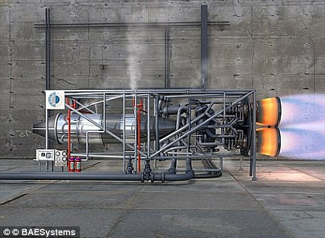
Real hardware being tested

Slide 7
Hardware Development Schedule
Nov 2012 -REL successfully concluded tests that proved the cooling technology worked. ESA evaluated HTX design and test results and agreed to provide funding.
June 2013 -UK gov’t provided 60M Lbs to begin full-scale prototype of SABRE engine for 2014-2016 period, with ESA providing 7M Lbs more. Total cost of test full-scale test rig is estimated at 200M Lbs.
June 2015 -Partnered with ANP to make and test aerodynamics of advanced nozzles, and also 3D-printed propellant injection system.
April 2015 -Passed a US AFRL feasibility study, for TSTO use.
August 2015 –European Commission approved more funding 50M Lbs.
October 2015 – BAE Systems agreed to buy 20% stake in company for 20.6M Lbs.
2016 – RE CEO announces with present funding, a ¼ scale engine will be built
May 2917 – Groundbreaking for construction of SABRE TF1 engine test facility, to activate in 2020.

Slide 8
Other design innovations and secrets
Proprietary lightweight alloy (probably Be) for HTX
Previous designs routed hydrogen fuel as coolant through HTX, hydrogen embrittlement issues. Helium coolant loop now inserted between H2 cold reservoir and hot HTX tubes. No more H2 embrittlement in precooler.
Engine combustion chambers are cooled by liquid O2, not H2, nor He.
Ice-prevention system was a closely guarded secret, but REL disclosed methanol-injection 3D-printed de-icer in 2016 patents, since they now had partner companies.
Expansion-deflection nozzle tests (STERN) successful, nozzle adjusts to maintain thrust efficiency as altitude increases
Sept 2017 – US DARPA contracted with REL to build parallel HT airflow test facility in Watkins, Colorado to test HTX. Tests start in 2018, running HTX at 1800F (Mach 5).

Slide 9
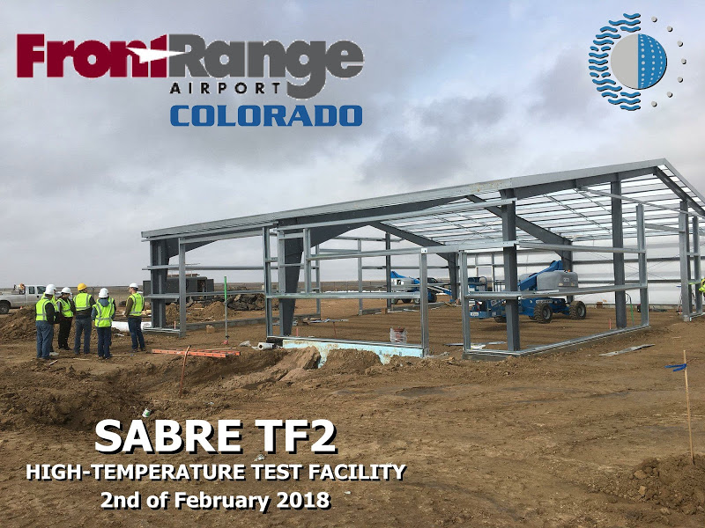
TF1 Test Facility UK at left TF2 Test Facility US at right

